Slide 1
Sneak Peek of iCEV 2023 with AES HealthCenter21
AES HealthCenter21 curriculum is now live on iCEV’s Platform.
In this session, you will learn about the AES to iCEV Transition
and how this impacts YOU, the health science educator.
You’ll see a demonstration of your switch to iCEV and leave with actionable tips to start the new school year.

Slide 2
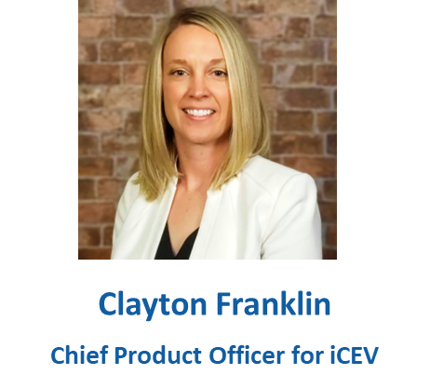
Welcome, THOA Educators!

Slide 3
Today’s Session
AES to iCEV Transition Overview
What’s included in the recent release?
Live Demonstration
Recommendations for Back-to-School 2023
What’s Next for Health Science (Closing Remarks)
Open Discussion and Q&A

Slide 4
AES to iCEV Transition Overview
October 2022
July 2023
Development Complete!
Development In-Progress:
Content Sectioning
Custom Exam Tool

Slide 5
What’s included in the recent release?
The Curriculum from AES HealthCenter21
Content Sectioning
Class Shell Migration
iCEV Platform Enhancements for All Teachers

Slide 6
Live Demonstration

Slide 7
Recommendations for Back to School ‘23
Save Time Planning – Migrate Your AES Classes
Start the year with the curriculum you’re the most accustomed to
Give Yourself Time to Learn a New System
Don’t psyche yourself out – it’s easy!
Block off the time you need to eliminate distractions
Attend iCEV Professional Development or schedule 1-on-1 training

Slide 8
Recommendations for Back to School ‘23
File Records for Any Returning Students
Decide what assignments completed in the past still count going forward
Export student progress, grades, and other reports from AES
Start Your Students on iCEV This School Year
Don’t have students working on assignments in two separate systems

Slide 9
Recommendations for Back to School ‘23
Explore Curriculum Gained
Projects and vocabulary handouts available to supplement what you already use
Video interviews with industry professionals
Skill demonstration videos
Don’t Rush!
It’s a marathon, not a sprint!
Mix in new assignments all year

Slide 10
Recommendations for Back to School ‘23
Use Your Whole Team!
Don’t Know? Ask Customer Support!
Schedule a 1-on-1 Training of iCEV’s system
Plan Ahead for Adjustments & Reflection
We can reflect and discuss lessons learned together in October!
Email: Corinne.Guinter@icevonline.com

Slide 11
What’s Next For Health Science?
Courses Added to iCEV from HealthCenter21
Anatomy and Physiology
Health Care Foundations
Health Career Readiness
Patient Care Technician
Nursing Assistant
Medical Assistant
Emergency Medical Responder
Emergency Medical Technician
All curriculum resources aligned with prominent certifications from NHA, AMCA, NOCTI and more!

Slide 12
What’s Next For Health Science?
1000+ Hours Added with Our New and Updated Health Science Courses
Anatomy & Physiology
Medical Microbiology
Pathophysiology
Medical Assistant
Medical Coding & Billing
Principles of Health Science
Health Science Theory – UPDATED
Medical Terminology – UPDATED
COMING SOON - Updated alignment resources for upcoming updates to NHA CCMA and CMAA.

Slide 13
Career and Technical Education Matters!
Educate
Serve
Inspire

Slide 14
Open Discussion and Q&A

