Slide 1
Investigating Innovative Methods To Combat Antibiotic Overuse
Miranda Rutledge, Mauro Avila, & Dr. LeRoy Marklund

Slide 2
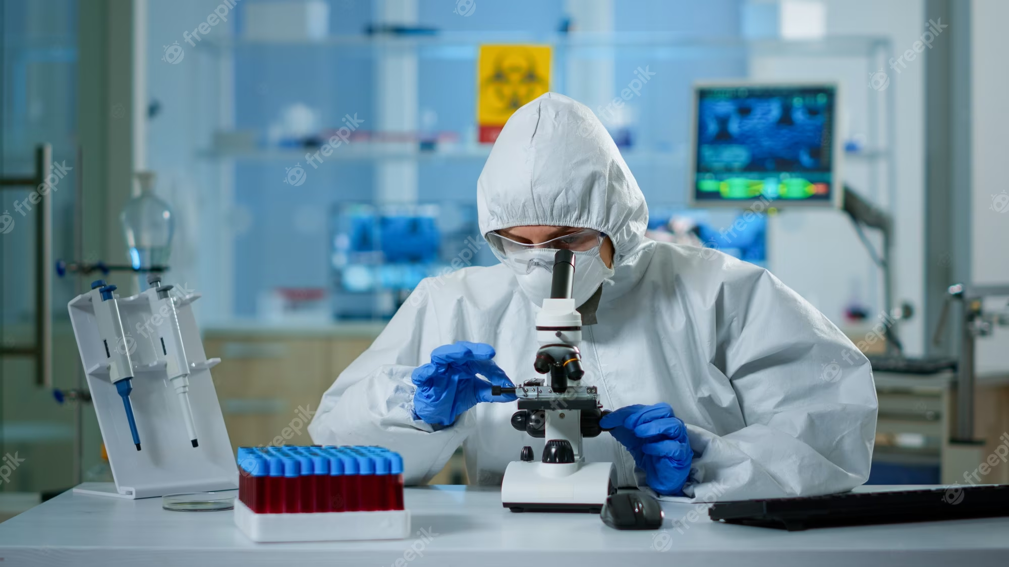
BACTERIA RELATED MORTALITY
In the past bacteria related mortalities were widespread as individuals had a limited understanding of how to combat various pathogens.
Bacteria related mortality rates have since declined due to the discovery and invention of antibiotics.
https://www.freepik.com/premium-photo/scientist-ppe-suit-making-adjustments-looking-through-laboratory-microscope-typing-pc-chemist-coverall-working-with-various-bacteria-tissue-blood-samples-antibiotics-research_17787047.htm
Rutledge
Notes:
Millions of people have died from

Slide 3
ANTIBIOTICS: REVOLUTIONIZING THE BATTLE AGAINST BACTERIA
The beginning of the antibiotic revolution was ushered by the discovery of penicillin by Sir Alexander Fleming in 1928
This discovery began the golden era of antibiotic discovery as this opened new avenues to combat various pathogens
Advancements have since slowed as no new classes of antibiotics have been discovered since 1970
As antibiotics became normalized and seemingly overused, the issue of antibiotic resistance began to arise as bacteria began to gain resistance to antibiotics that they were once sensitive to
Antibiotic resistance has been gained through mutation as bacteria begin to selectively develop defenses to combat antibiotics
Adedeji, W. A., 2016
Rutledge

Slide 4
CAUSES OF ANTIBIOTIC RESISTANCE
OVER PRESCRIBING ANTIBIOTICS
NOT TAKING MEDICATIONS AS PRESCRIBED
UNNECESSARY ANTIBIOTICS IN AGRICULTURE
Due to the overprescription of antibiotics when they are not necessary these bacteria are being exposed to antibiotics and learning to adapt in order to survive
Individuals that discontinue their antibiotics early are simply lowering their bodies defenses by killing off both weak bacteria while the strong continue to persist and multiply
A rise in antibiotic use in agriculture has contributed to antibiotic resistance as these animals are used for food and their manure is used as fertilizer subsequently contaminating crops
Centers for Disease Control and Prevention, 2021b
Rutledge

Slide 5
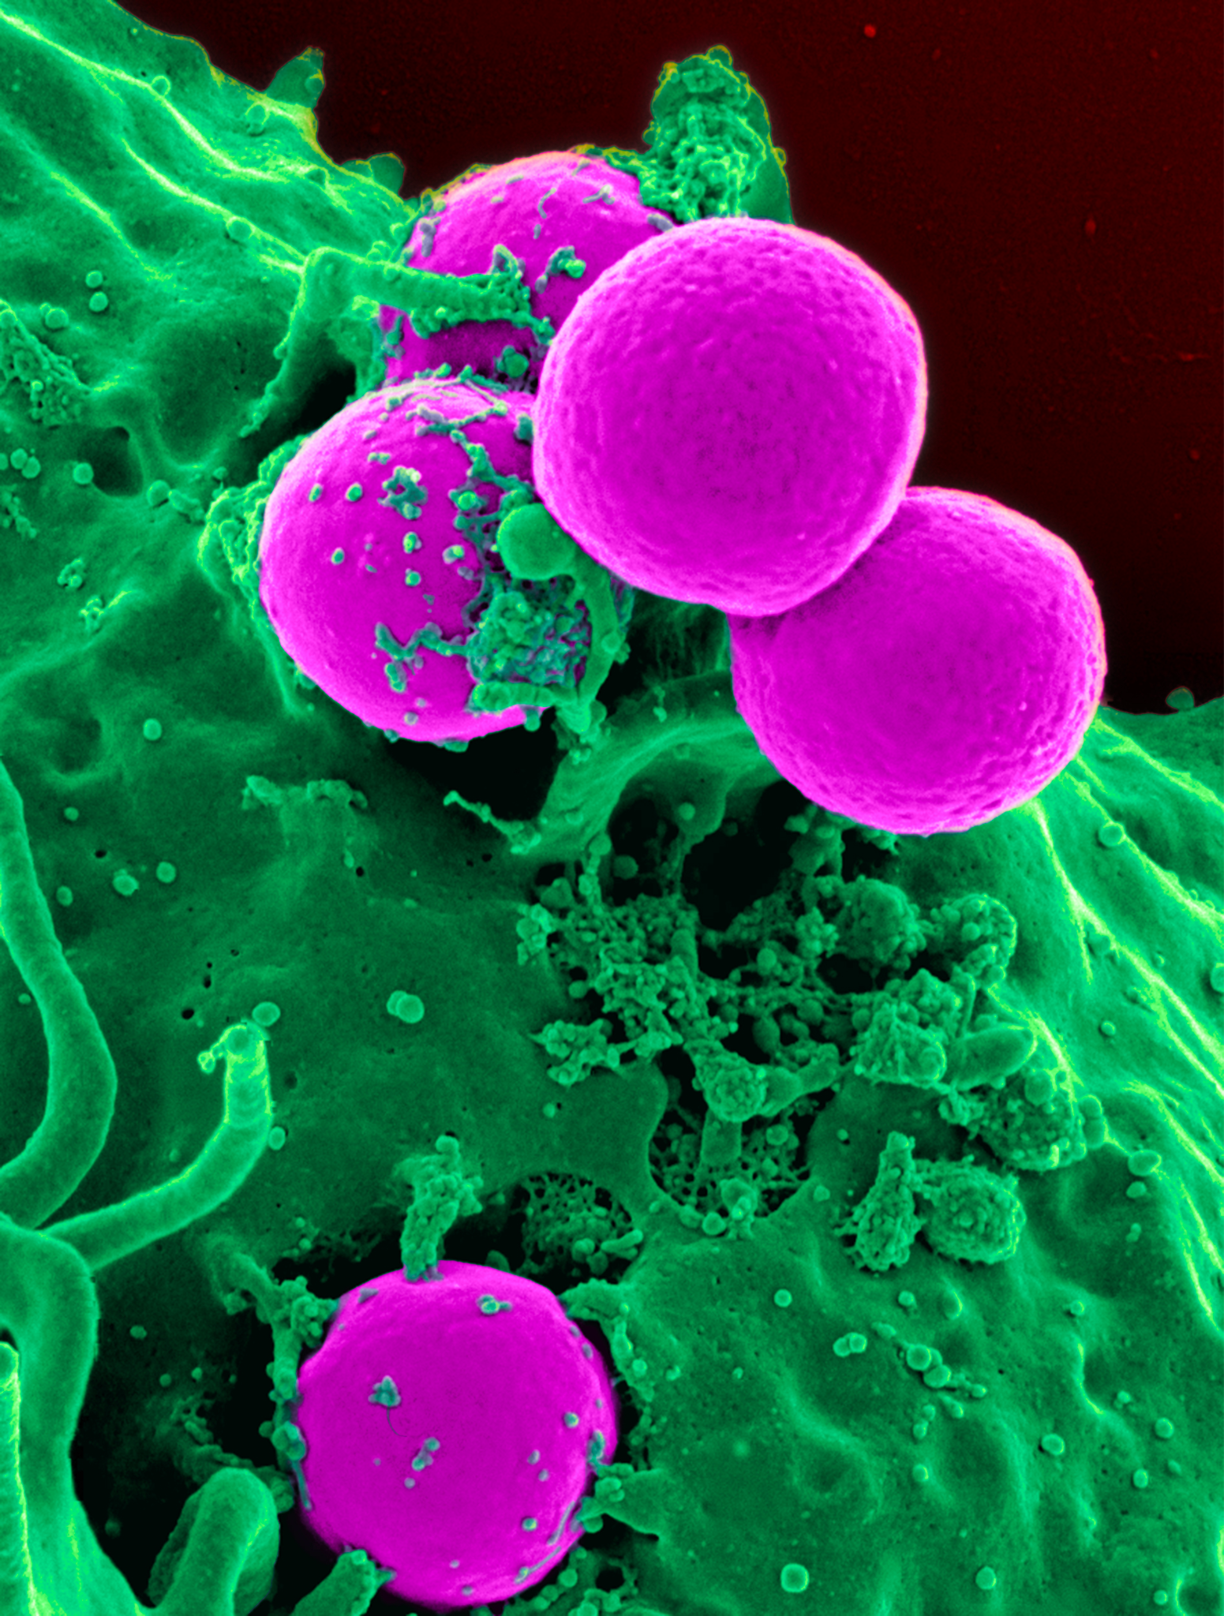
ANTIBIOTIC RESISTANT PATHOGENS
2.8 million cases reported annually in the United States
35,000 deaths reported annually in the United States
https://en.wikipedia.org/wiki/Methicillin-resistant_Staphylococcus_aureus
Centers for Disease Control and Preventions (CDC), 2021a
Rutledge

Slide 6
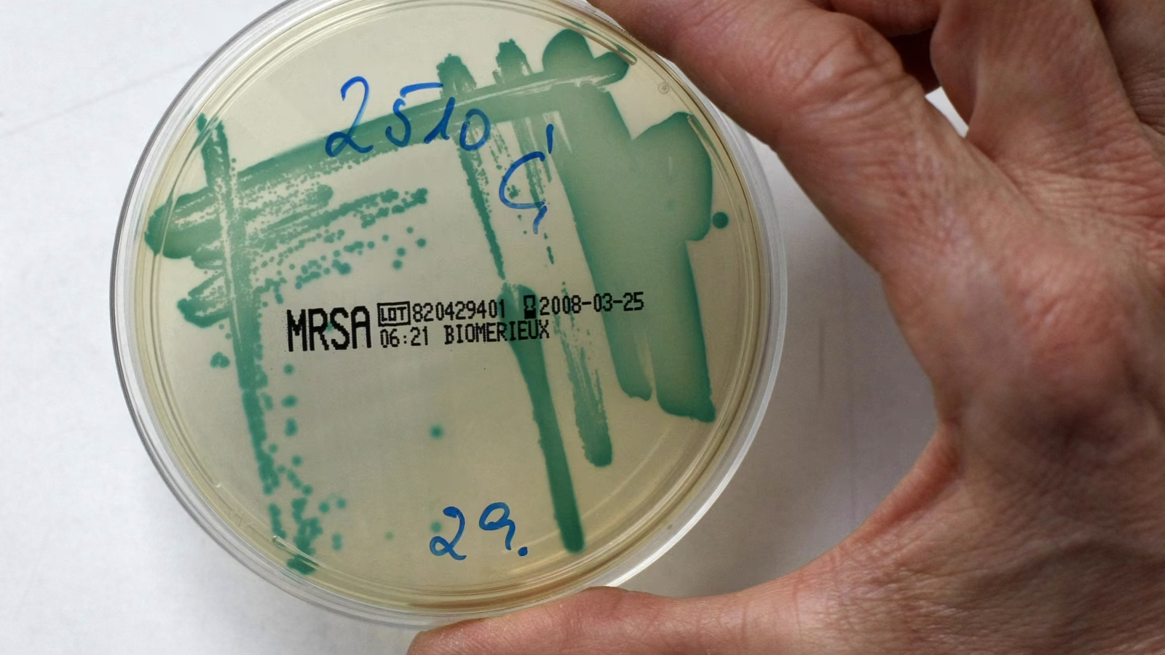
Methicillin Resistant Staphylococcus aureus (MRSA): AN EVER INCREASING ISSUE
In recent years hospitals nationwide have seen a rapid emergence of drug resistant bacteria within the medical field. Recent studies show Methicillin-resistant Staphylococcus aureus (MRSA) is responsible for approximately half of all deaths due to antibiotic resistant organisms. Researches have began developing new ways to slow the spread of this superbug.
https://cdn.theatlantic.com/thumbor/all0XPMAr547vcYXsPc59IDPYW0=/0x228:2730x1764/1952x1098/media/img/mt/2017/10/RTR1XRWF/original.jpg
Fukunaga, B. T., et al., 2016
Rutledge

Slide 7
WAYS TO LIMIT THE NOSOCOMIAL SPREAD
HOSPITAL ENVIRONMENT
HAND HYGIENE & ELIMINATING STANDARD PRECAUTIONS
The hospital environment that an individual works in determines the effectiveness of screenings
Hand hygiene is the easiest and cost effective way to limit the spread of MRSA in hospital settings. Forgoing these precautions allow for improved care for MRSA patients
PROMOTING PROPER ANTIBIOTIC USE
PHAGE THERAPY
Forgoing these precautions allow for improved care for MRSA patients
Lifestyle changes involve making modifications to an individual's diet, exercise habits, or other behaviors
Martin et al., 2016 ; Curie et al., 2019; Marimuthu et al., 2014 ;
Rutledge

Slide 8
LIMITING THE SPREAD: ENVIRONMENT
MRSA screenings upon admission into the hospital are imperative to the early detection and proper implementation of methods to limit the spread of this superbug between patients.
Many institutions have implemented feedback systems to communicate to nurses about the quality of their screenings and establish a work environment that promotes proper screening tactics.
It is imperative that nurses conduct quality screenings and remain diligent to increase positive patient outcomes and reduce the spread of MRSA.
Curie et al., 2019; Marimuthu et al., 2014.
Rutledge

Slide 9
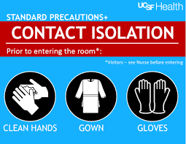
LIMITING THE SPREAD: HAND HYGIENE AND STANDARD PRECAUTIONS
Contact precautions as well as hand hygiene have been a common practice when dealing with MRSA patients
Studies have determined that the discontinuation of standard contact precautions had no effect on the transmission of MRSA and proved instead to be a cost-effective move for hospitals
This also led to better patient outcomes as the precautions that were previously implemented were resulting in less bedside visits, inadequate documentation by providers, and increased hospital spending
While elimination of these precautions has not been implemented in hospitals nationwide, this research demonstrates many benefits to overall patent health with no increase in the spread of this disease
Martin et al., 2016.
https://infectioncontrol.ucsfmedicalcenter.org/contact-isolation-sign
Rutledge

Slide 10
LIMITING THE SPREAD: PROMOTING PROPER PRESCRIPTION USE
Doctors should only prescribe antibiotics when necessary
Educate patients on taking prescriptions exactly as prescribed
Limit the prescription of broad spectrum antibiotics
Never take antibiotics prescribed for someone else or from a previous infection
https://medlineplus.gov/images/AntibioticsAndAbscess_share.jpg
Centers for Disease Control and Prevention (CDC), 2021b
Rutledge

Slide 11
LIMITING THE SPREAD: PHAGE THERAPY
Phage therapy involves the use of bacteriophages, a type of virus that targets bacteria specifically, as a form of therapy against multi-drug resistant bacteria.
Essentially, the phages are administered into the body via a specific route, where they then hunt down the bacteria.
Despite the concept of using phages to treat bacterial infections being around for some time, it is still considered extremely experimental and somewhat controversial.
https://www.genome.gov/genetics-glossary/Virus
Avila

Slide 12
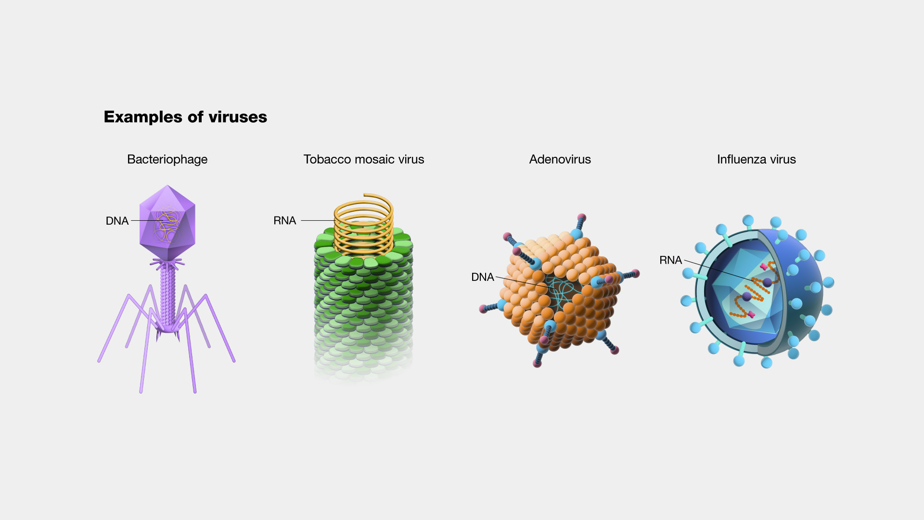
WHAT ARE VIRUSES?
A virus is a simple, small, non-living organism
They are much smaller and much more numerous than bacteria
Unlike regular cellular organisms, viruses contain no organized cell structures within
They simply consist of genetic material (DNA or RNA) encased by a protein coat known as a capsid
They infect other organisms, take over their host’s reproductive machinery, and then force them to make more viruses
There are a myriad of different viruses with numerous different classifications
One of the more prominent classification methods involves what kind of organism the virus infects.
Norris, T. & Taun, R., 2020
https://www.genome.gov/genetics-glossary/Virus
Avila

Slide 13
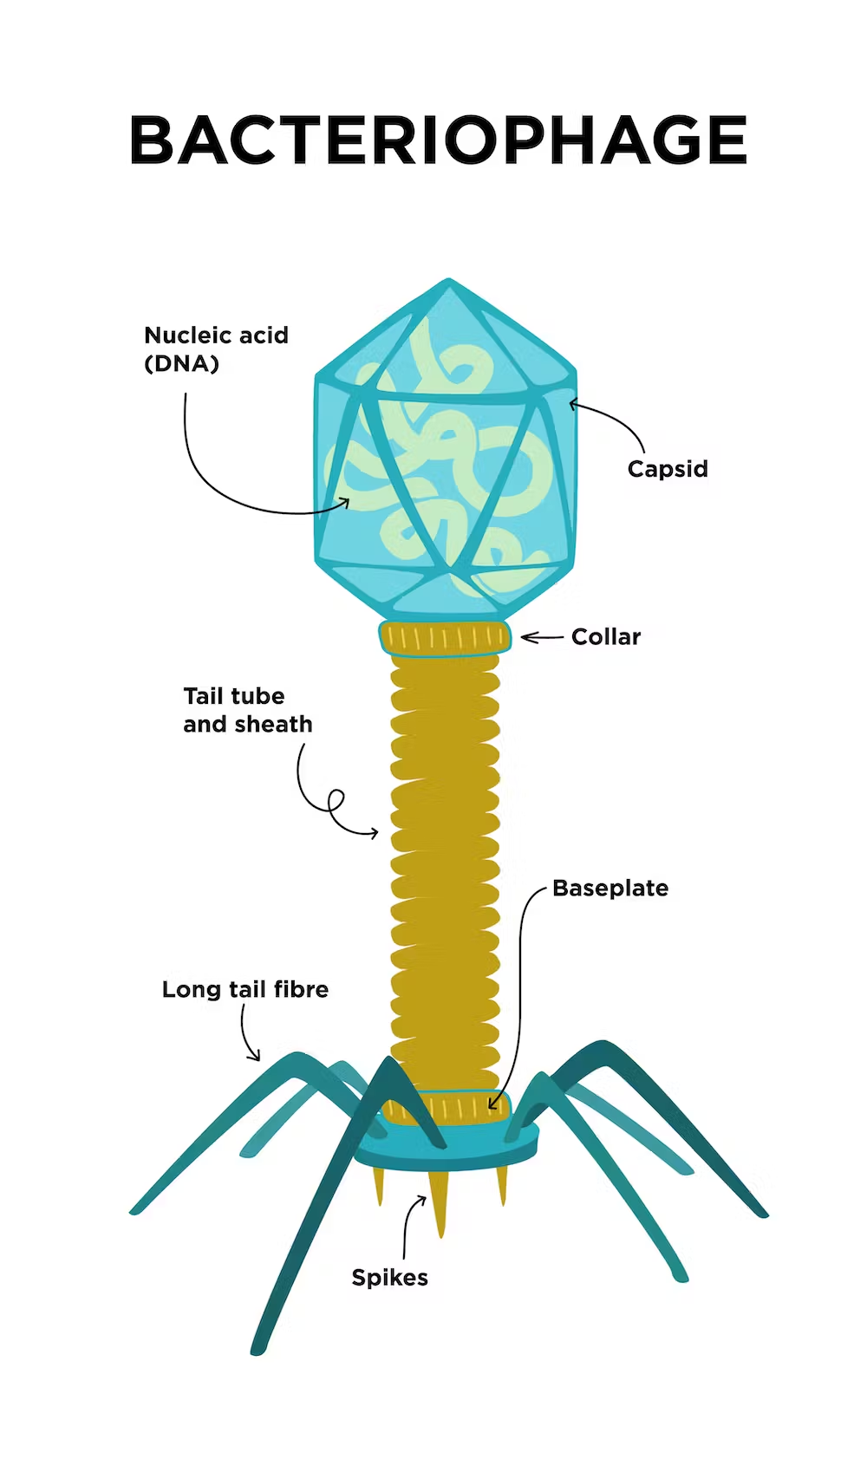
WHAT ARE BACTERIOPHAGES?
Bacteriophages, or phages, are a class of viruses that solely target, infect, and kill bacteria.
Since their lifespan is dependent on their specific host, they are readily found around the same environment as their hosts’
The phages first use their long tail fibers to land on bacteria
Then they use their spikes to penetrate the membrane of the bacteria
Their genome is then carried down the tail tube into the bacteria
The genetic material then hijacks the host's machinery and forces them to create copies of the phage
Barron, M, 2022; Petrovic Fabijan et al., 2020
https://umbc.edu/stories/viruses-are-both-the-villains-and-heroes-of-life-as-we-know-it/
Avila

Slide 14
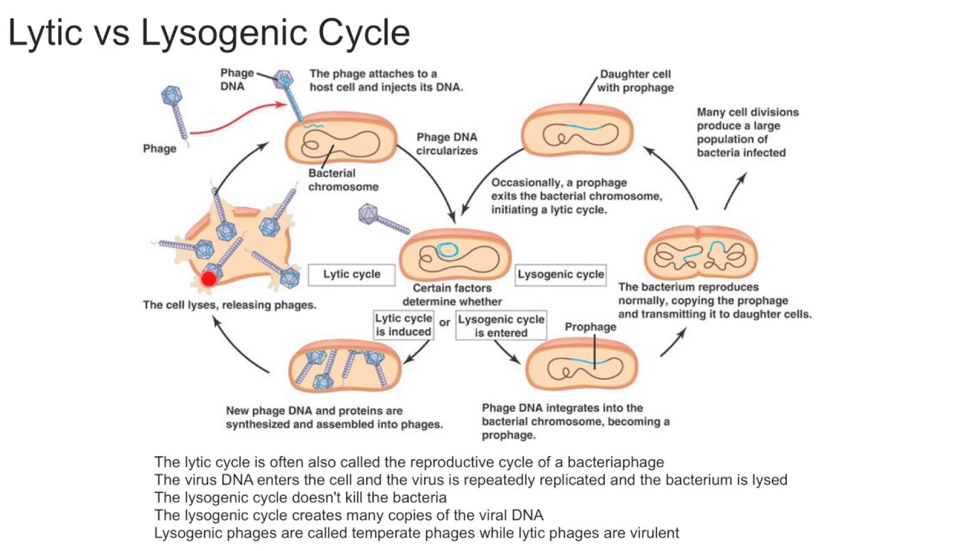
How bacteriophages work w/ picture
The ideal therapeutic phage purely utilizes the lytic cycle and never goes dormant.
Image from: https://www.youtube.com/watch?v=QNKlE4IsDME
Avila
Notes:
The ideal therapeutic phage purely utilizes the lytic cycle and never goes dormant.

Slide 15
DISCOVERY OF BACTERIOPHAGES
1915
Frederick William Twort
Isolated from Vaccinia virus cultures
Contaminated with Staphylococcus
1917 & *1927
Felix d’Herrelle
Shigella bacillus (Dysentery)
Self ingested Shigella bacteriophages cocktail – safety check
Administered to 12-year-old boy with success
*Cholera In India
Traditional Treatment Was Fluids & Salts (63% Mortality)
Bacteriophages (8% Mortality)
Aswani et al., 2021; Gelman et al., 2018
Marklund

Slide 16
REPORTED BACTERIOPHAGE USE IN THE UNITED STATES
1922
Wilburt Davidson concluded no therapeutic effect
2 of 12 children were negative for Shigella
1924
Spence & McKinley bacillary dysentery
Death Rate
Treatment group (10.5%) & control group (41.6%)
Recovery Time
Treatment group (5.8 Days) & control group (12.8 Days)
1929
Larkhum successfully treated furunculosis, skin infections, & osteomyelitis
1932
Shultz successfully treated dental infections
Aswani et al., 2021; Gelman et al., 2018
Marklund

Slide 17
REPORTED BACTERIOPHAGE USE IN THE UNITED STATES
1931
Major pharmaceutical companies produced commercial bacteriophages
Treatment for Staphylococci & colon bacillus (Escherichia coli)
Eli Lilly
Produced gel form
E.R. Squibb & Sons & Swan-Myers (Abbott)
Produced fluid filtrates
Filtrates/gel of mixture were re-tested with new batch of bacteria
Assumed bacteriophage propagate
Tests showed diminished effect with subsequent generations
Bactericidal effect of original preparation contributed to preservative
Realized lack of high-quality bacteriophages preparation
Aswani et al., 2021; Gelman et al., 2018
Marklund

Slide 18
REPORTED BACTERIOPHAGE USE IN THE UNITED STATES
1934
Growing debate on utility of bacteriophage
Microbe or enzyme?
American Medical Association reported on efficacy of bacteriophage therapy
Decreased interest in bacteriophages as therapeutic agents in the United States
1939
Electron microscope visualized virus
1940
Bacteriophage genome (1st genome sequence)
Advent of Antibiotic Agents
Used extensively during WWII
Aswani et al., 2021; Gelman et al., 2018
Marklund

Slide 19
REPORTED BACTERIOPHAGE USE IN THE UNITED STATES
1942
Harvard & University of Pennsylvania bacteriophage studies continued
Anti-dysentery
Typhoid Fever
Chronic staphylococcal infections (Continued until 1987)
1953
DNA was discovered
Currently
National Institute of Health
Adequate control groups
Purified bacteriophage preparations
Sophisticated data analyses
Provide treatments for patients with unsuccessful antibiotic agent results
Aswani et al., 2021; Gelman et al., 2018
Marklund

Slide 20
INTERNATIONAL REPORTED BACTERIOPHAGE USAGE
1924-1928
Ludwik Hirszfeld discovered ABO blood types
1930
Felix d'Herelle left France & joined George Eliava (Georgian scientist)
Eliava Institute of Bacteriophages Microbiology & Virology in Tbilisi, Georgia (USSR)
Largest bacteriophages producer in the world
Intestinal bacteriophages to supply the Red Army
*Currently
Thriving medical tourist industry (Antibiotic failure)
1941
Ludwik Hirzfeld
Organized secret medical courses in Warsaw Ghetto during WWII
Suppressed typhus epidemic
Aswani et al., 2021; Gelman et al., 2018
Marklund

Slide 21
INTERNATIONAL REPORTED BACTERIOPHAGE USAGE
1942 -1943
Operation Barbarossa
Wound Therapy
Significant reduction of gangrene & amputations among Soviet soldiers
Stalingrad
Cholera outbreak
50,000 Russian civilian/military treated successfully
1952
Polish Ludwik Hirszfeld Institute of Immunology & Experimental Therapy
Established terminology for ABO blood group system
Focused on application of human treatments
2,000 patients treated bacteriophages after antibiotic therapy failure
Currently
Eastern Europe is improving efficacy of bacteriophages
Replacing antibiotic agents
Aswani et al., 2021; Gelman et al., 2018
Marklund

Slide 22
COMPARING BACTERIOPHAGES & ANTIBIOTICS
Typical antibiotics don’t specifically target bad bacteria; good bacteria are harmed in the process.
When good bacteria are harmed (such as gut microbiota) bad bacteria take their place and cause secondary complications.
As opposed to antibiotics, bacteriophages have evolved to specifically target specific strains or species.
This allows us to specifically target bad bacteria without harming the good ones.
This allows us to specifically target bad bacteria without harming the good ones.
Phages are available in an limitless supply.
Phages are non-toxic to our environment and body
Only small and singular doses are needed as they replicate by themselves.
Phages evolve automatically over time to outsmart bacterial defenses.
Lack of cross-resistance with antibiotics.
Avila
Loc-Carrillo, C., & Abedon, S. T., 2011

Slide 23
CURRENT APPLICATIONS OF BACTERIOPHAGES
At present, phage therapy is very limited in use overall and isn’t approved for use in humans in many places.
FDA has approved its use in application to foods as a preventative measure to stop bacteria from growing and causing food-related illnesses.
Has been used as a last resort in the cases of multiple-drug resistant bacterial infections, in which there is no medicine that can rid the body of the infection.
El-Shibiny, A., & El-Sahhar, S. 2017
Avila

Slide 24
DEVELOPMENTAL ISSUES
The emergence of antibiotics back in the 20th century essentially eliminated all efforts to research bacteriophages.
There was no need expend resources on alternative cures, and as a result, little amount of clinical trials have been performed to demonstrate the efficacy of phage therapy in bacterial infections.
Currently, trials have had varying success. This is largely in part due to our lack of information of the pharmacokinetics and pharmacodynamics of phages in the human body.
Some examples of information that we don’t fully understand yet include: not knowing which route of administration is most conducive to phage proliferation, how to properly and effectively isolate specific strands of phages, and proper dosing.
Avila
Petrovic et al., 2020

Slide 25
THERAPEUTIC FUTURE FOR BACTERIOPHAGES
Despite the many challenges phage therapy has faced, the outlook for the future of phage therapy is promising.
The developmental stagnation of antibiotics along with dire projections for multi-drug resistant bacterial infection related deaths, phage therapy is increasingly being explored as an alternative cure.
Genetically engineering phages is also being explored as a way to circumvent the primary disadvantages of phages. Engineering efforts currently being explored involve ways that give us more control over the phages, such as being able to modify their target hosts or increasing their overall activity.
Gamachu, S. B., & Debalo, M., 2022
Avila

Slide 26
References
Adedeji, W. A. (2016, December). The treasure called antibiotics. Annals of Ibadan postgraduate medicine. https://www.ncbi.nlm.nih.gov/pmc/articles/PMC5354621/
Aswani, V. & Shukla, S. (2021). An early history of phage therapy in the United States: Is it time to reconsider? Clinical Medicine & Research, 19(2), 82-89. https://doi.org/10.3121/cmr.2021.1605
Barron, M. (2022, August 31). Phage therapy: Past, present and future. American Society for Microbiology. Retrieved February 12, 2023, from https://asm.org/Articles/2022/August/Phage-Therapy-Past,-Present-and-Future
Centers for Disease Control and Prevention. (2021a, November 23). 2019 antibiotic resistance threats report. Centers for Disease Control and Prevention. https://www.cdc.gov/drugresistance/biggest-threats.html
Centers for Disease Control and Prevention. (2021b, December 17). Antibiotic / antimicrobial resistance. Centers for Disease Control and Prevention. https://www.cdc.gov/drugresistance/index.html
Currie, K., King, C., McAloney-Kocaman, K., Roberts, N. J., MacDonald, J., Dickson, A., Cairns, S., Khanna, N., Flowers, P., Reilly, J., & Price, L. (2019). Barriers and enablers to methicillin-resistant staphylococcus aureus admission screening in hospitals: A mixed-methods study. Journal of Hospital Infection, 101(1), 100–108. https://doi.org/10.1016/j.jhin.2018.08.006
Czerwinski, M., Kaczmarek, R., and Glensk, U. (2021). Ludwik Hirszfeld: A pioneer of transfusion and immunology during the world wars and beyond. Vox Sanguinis, 117, 467-475. https://doi.org/10.1111/vox.13214
El-Shibiny, A., & El-Sahhar, S. (2017). Bacteriophages: The possible solution to treat infections caused by pathogenic bacteria. Canadian Journal of Microbiology, 63(11), 865–879. https://doi.org/10.1139/cjm-2017-0030

Slide 27
References
Fukunaga, B. T., et al. (2016). Hospital-Acquired Methicillin-resistant Staphylococcus aureus Bacteremia Related to Medicare Antibiotic Prescriptions: A State-Level Analysis. Hawai'i journal of medicine & public health : a journal of Asia Pacific Medicine & Public Health, 75(10), 303–309.
Gamachu, S. B., & Debalo, M. (2022, September 27). Review of bacteriophage and its applications. International Journal of Veterinary Science and Research. https://www.peertechzpublications.com/articles/IJVSR-8-226.php
Gelman, D., Eisenkraft, A., Chanishvili, N., Nachman, K., Copenhagem Glazer, S., and Hazan, R. (2018). The history and promising future of phage therapy in the military service. Trauma Acute Care Surgery, 85(1), Suppl 1,S18 – S26. https://doi.org/10.1097/TA.0000000000001809
Loc-Carrillo, C., & Abedon, S. T. (2011). Pros and cons of phage therapy. Bacteriophage, 1(2), 111–114. https://doi.org/10.4161/bact.1.2.14590
Marimuthu, K., Pittet, D., & Harbarth, S. (2014). The effect of improved hand hygiene on nosocomial MRSA control. Antimicrobial Resistance and Infection Control, 3(1). https://doi.org/10.1186/2047-2994-3-34
Martin, E. M., Russell, D., Rubin, Z., Humphries, R., Grogan, T. R., Elashoff, D., & Uslan, D. Z. (2016). Elimination of routine contact precautions for endemic methicillin-resistant staphylococcus aureus and vancomycin-resistant enterococcus: A retrospective quasi-experimental study. Infection Control & Hospital Epidemiology, 37(11), 1323–1330. https://doi.org/10.1017/ice.2016.156

Slide 28
References
Norris, T. & Taun, R. (2020) Essentials of pathophysiology (5th ed.). Wolters Kluwer.
Petrovic Fabijan, A., Khalid, A., Maddocks, S., Ho, J., Gilbey, T., Sandaradura, I., Lin, R. C., Ben Zakour, N., Venturini, C., Bowring, B., & Iredell, J. R. (2020). Phage therapy for severe bacterial infections: a narrative review. The Medical Journal of Australia, 212(6), 279–285.

