Slide 1
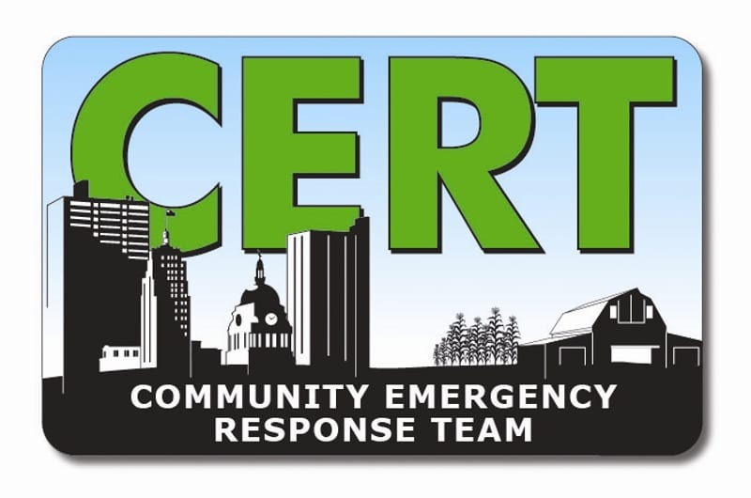
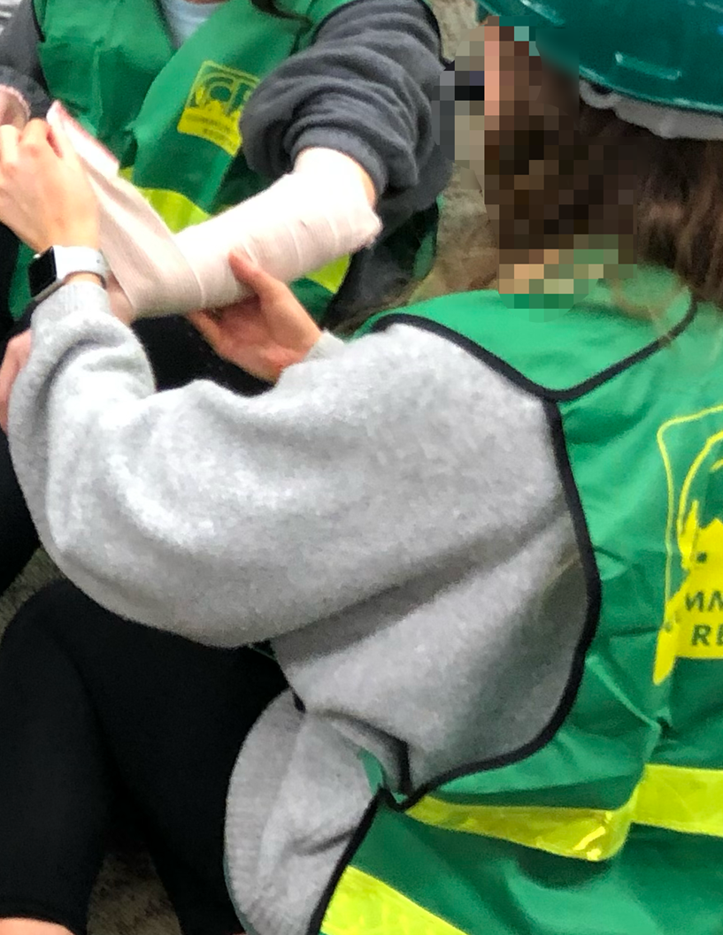
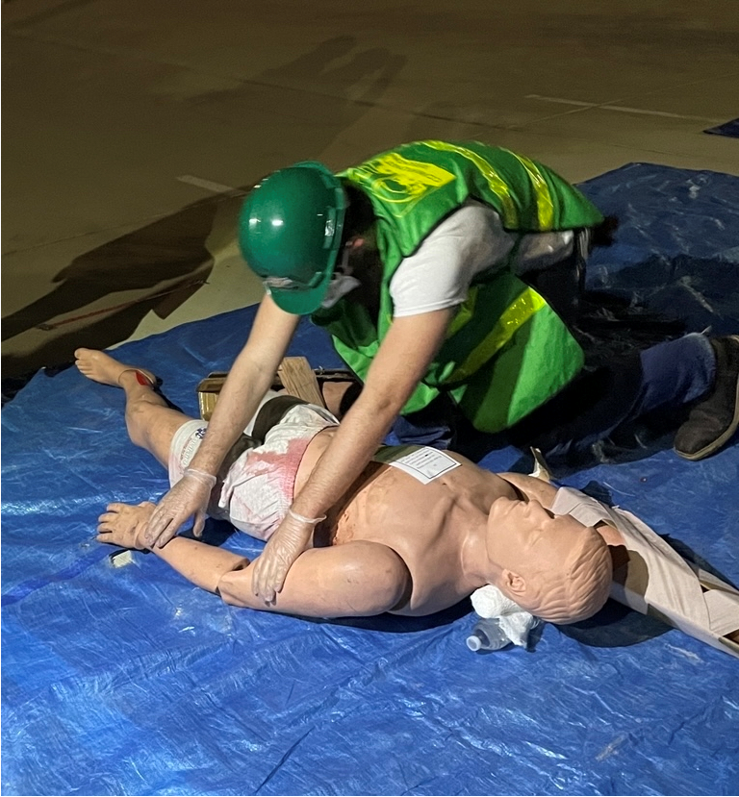
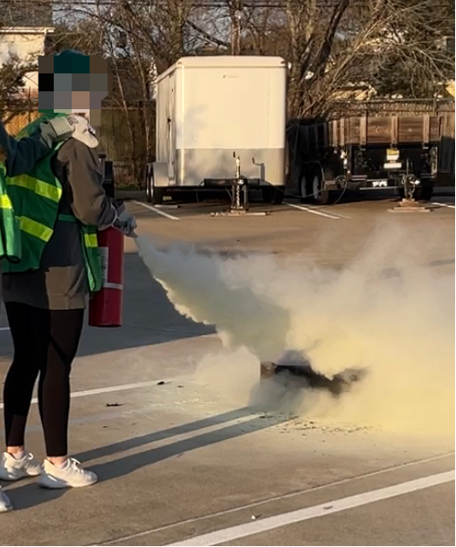
Aggie Campus Community Emergency Response Team (CERT): Why & How
Leander Casenas
Sena Gbanaglo
Kyana Calvo
Suzie Van (Faculty Advisor)
LeRoy Marklund (Faculty Advisor)
Community Emergency Response Team (CERT)
WHY
HOW
What Is CERT?
The original CERT program was initiated by the Los Angeles Fire Department in 1985. Disasters during the 1980;s showed there were needs to empower trained community members to respond in a timely manner to all-hazard disasters.
CERT became a national program in 1993 and expanded to over 2,700 local CERT programs in all 50 states along with dozens of Campus CERT programs.
Currently, there are more than 600,000 CERT trained volunteers within the U.S.
CERT team members can:
Assist emergency services personnel when requested in accordance with local standard operating procedures (SOPs) developed by the sponsoring agency.
Assume basic medical and limited rescue functions in the event of a disaster, when local emergency services personnel are overwhelmed .
Educate residents about disaster preparedness and assist neighbors during an emergency when first responders are not immediately available
Why CERT Is Needed On University Campus?
Studies found that healthcare workers are “insufficiently prepared and do not feel confident responding effectively to disasters” (Labrague et al., 2018).
Declared disasters are increasing worldwide (Tussing et al., 2022).
Types of Disasters:
Natural (e.g., earthquakes, wildfires, floods, extreme heat, hurricanes, landslides, thunderstorms, tornadoes, tsunamis, volcanic eruptions, winter storms)
Man-Made (e.g., mass shootings, bombs, etc.)
Technological and Accidental (e.g., hazardous material spill, nuclear power plant accident)
Terrorism (e.g., chemical, biological, radiological, nuclear, explosive weapons)
Rationale For Campus CERT:
Disasters can happen to anyone at anytime.
Volunteer CERT members are trained to response to disaster with skills such as:
Fire suppression & safety
Light search and rescue
Disaster medical operations
Team dynamics
How Are Campus CERTs Established?
Form a student steering committee to develop the new student organization – Aggie Campus CERT.
Submit paperwork to become an official student organization.
Identify a Sponsoring Agencies and collaborate with school’s governing body to get the new student organization approved.
Appoint faculty advisors who are CERT certified and proficient in disaster response and field medicine.
Have student leaders and faculty advisors complete required University training related to managing approved student organization(s).
Upon approval of Campus CERT recruit new student members who are willing to attend required CERT training.
Campus CERT at Texas A&M University
Student recruitment pool at Texas A&M University included Corps of Cadets, ROTC Cadets, School of Medicine, and School of Nursing students.
Offer CERT training to interested students at no cost.
Goal is to form a Student Response Team.
References
Labrague, L. J., Hammad, K., Gloe, D. S., McEnroe-Petitte, D. M., Fronda, D. C., Obeidat, A. A., Leocadio, M. C., Cayaban, A. R., & Mirafuentes, E. C. (2018). Disaster preparedness among nurses: a systematic review of literature. International nursing review, 65(1), 41–53. https://doi.org/10.1111/inr.12369.
Tussing, T. E., Chesnick, H., & Jackson, A. (2022). Disaster Preparedness: Keeping Nursing Staff and Students at the Ready. The Nursing clinics of North America, 57(4), 599–611. https://doi.org/10.1016/j.cnur.2022.06.008.

