Slide 1
They Think It’s Just Fun and Games

Slide 2
Computer Applications
Quizlet
Blooket
Quizizz
Brainscape
Gimkit
GetMarked

Slide 3
Think Outside the Box
Be Creative
Fiddlestick Jenga Connect 4 Go Fish Bowling Erasable Dice | Fishing Game Word Pong Matching Egg Hunt Review Indoor Volleyball/Basketball Let your students be creative

Slide 4
Quizlet
Pros: User friendly, most students are familiar, autosaves work
Cons: Now limiting students’ free access to features. Easy for crammers to find AES questions.
Teacher Quizlet Plus Pricing: Free 30-day trial then $35.99/year.
Better student data. Can add your own photos for diagram labeling sets. Can customize your sets for more challenging distractors.

Slide 5
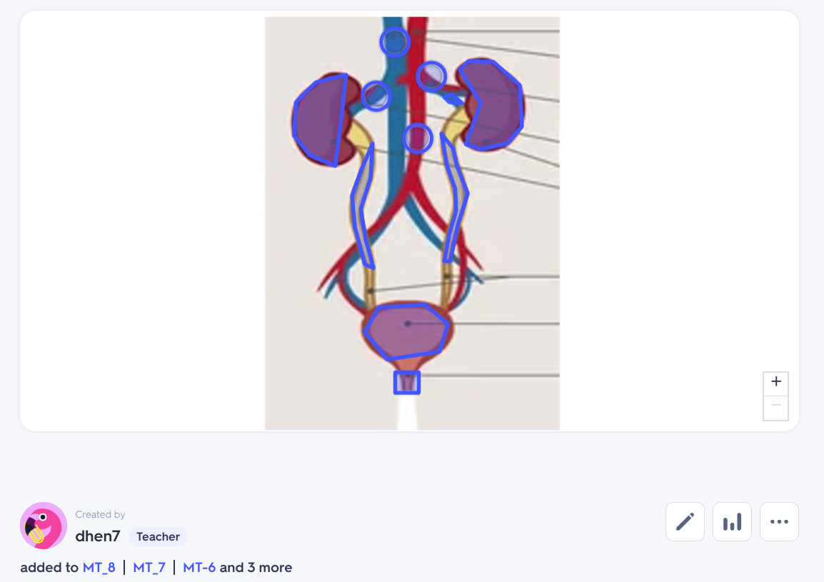
Quizlet Teacher Plus

Slide 6
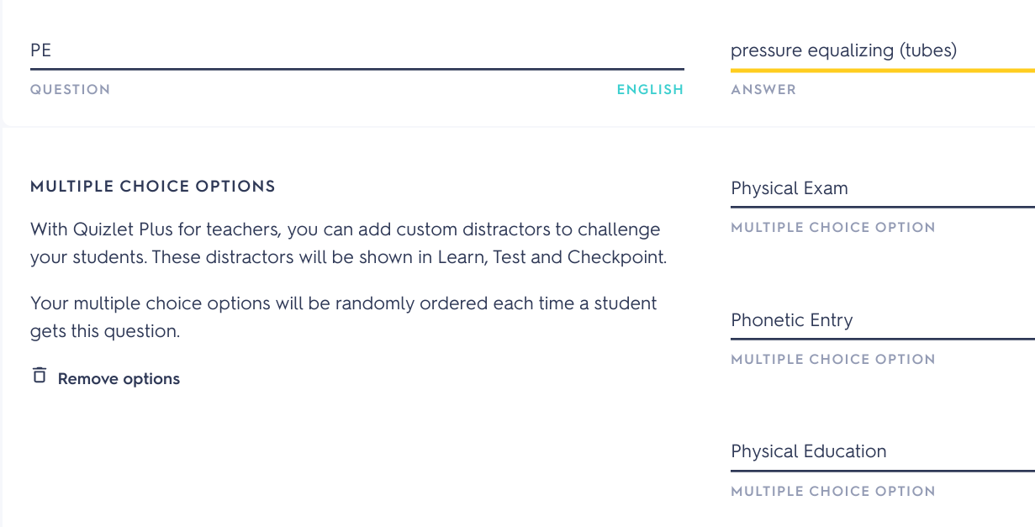
Add custom distractors in Quizlet Plus

Slide 7
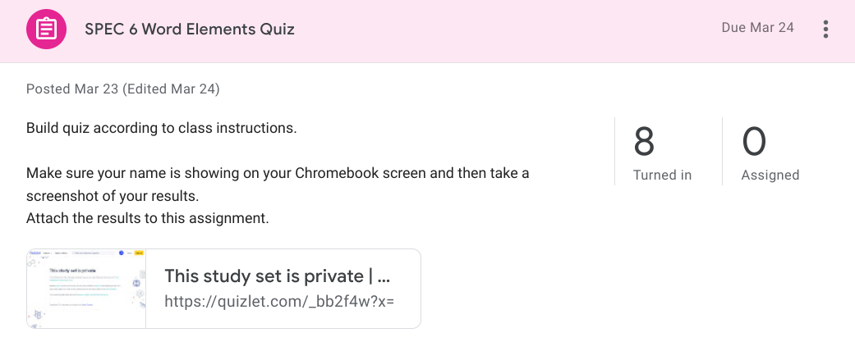
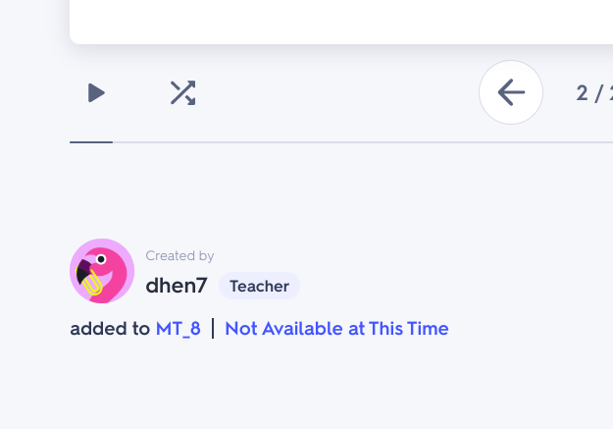
Quizlet Formative Assessment
Students are added to a Quizlet class. A curated set I’ve created for a quiz is not open to their class until I go in and add them to my list. Otherwize the set is in a group called “Not Available at This Time”

Slide 8
Quizlet Live Varieties
Traditional / Straight Through
Stop at 8 - our favorite!
Hot Seat
Call Out
Silent Treatment

Slide 9
Blooket “BLUE -kit”
Con: Score reports and question analysis so you can identify areas that we may need to review again as a class. Can see individual scores, but not individual names. Email to Blooket confirms that they do not collect any personal identifying information.
Pro: All of their essential features are free! Unlimited number of questions set and host a game with up to 60 people.
Biggest Pro: Use your Quizlet set to create a Blooket…and your students can create their own Blooket, too.
Premium pricing: $2.99 paid yearly ($35.88), or a pay-per-month fee of $4.99. Organize sets into folders, Copy / duplicate sets (good for combining or paring down)

Slide 10
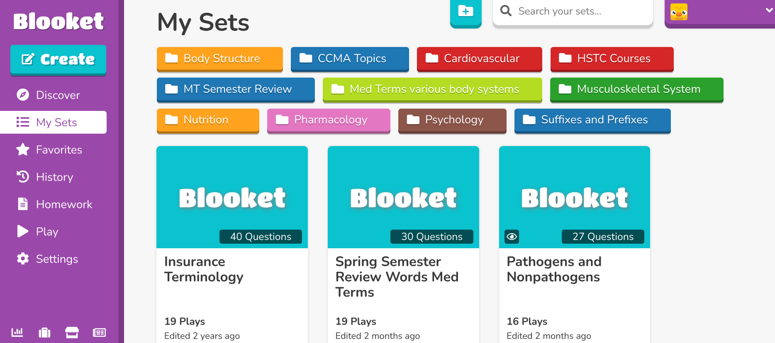
Blooket

Slide 11
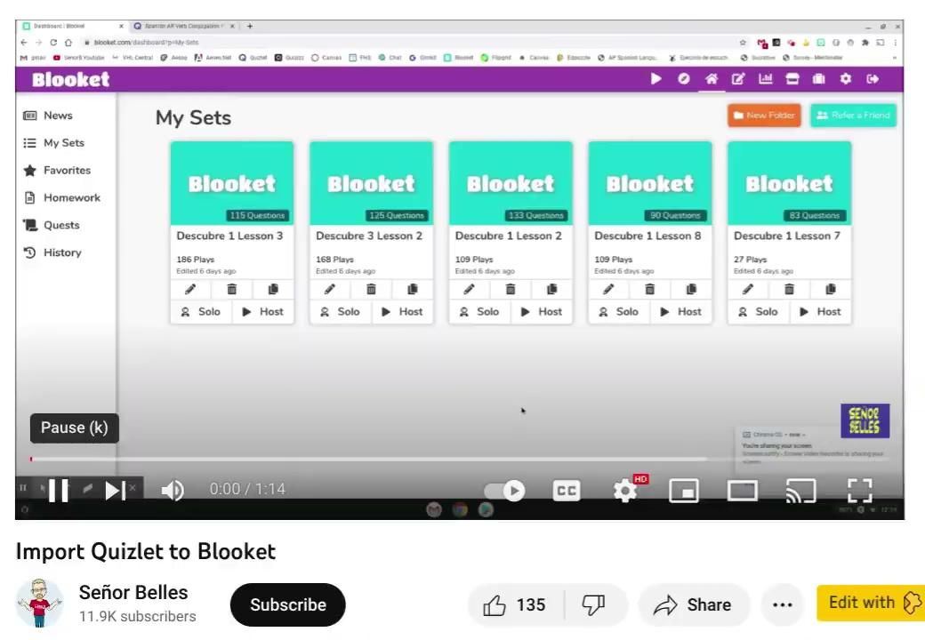
Use Your Already Created Quizlet Sets!

Slide 12
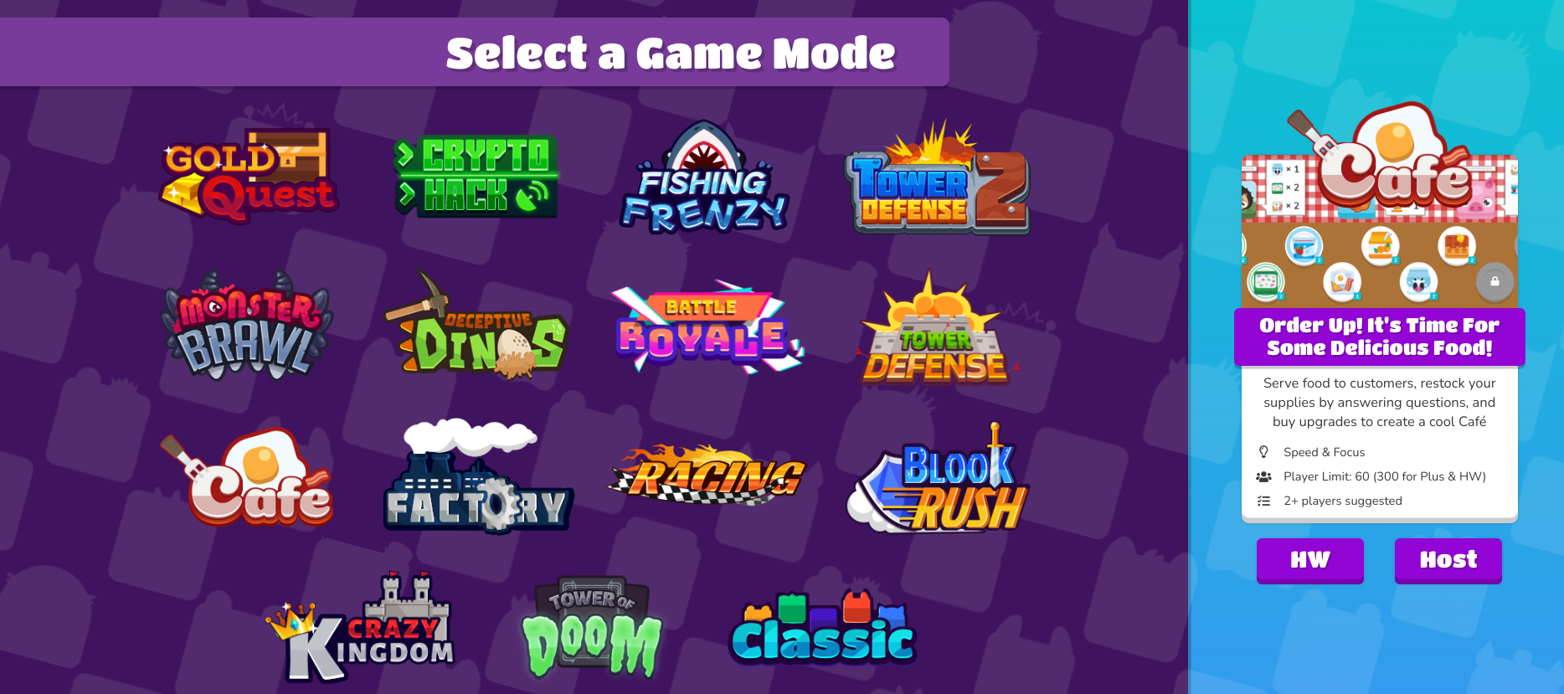
Some games are only for live play, others you can create as homework so students can choose to work at their own pace.

Slide 13
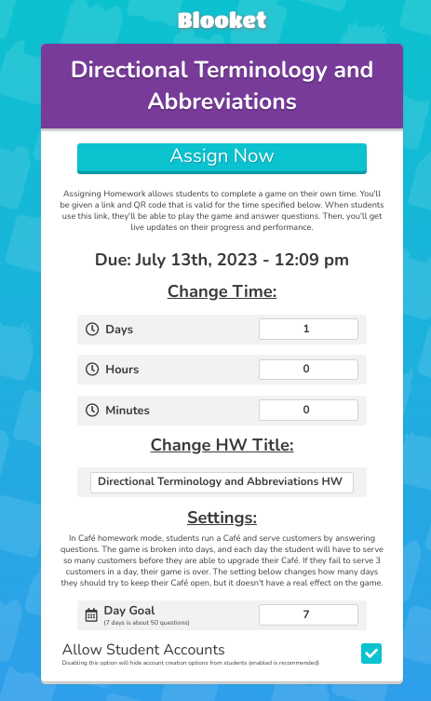
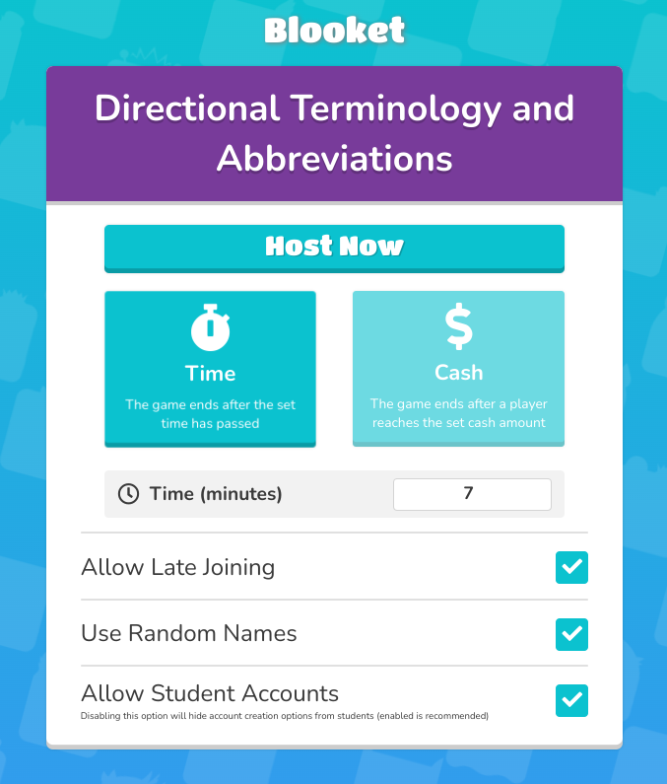
OR

Slide 14
Quizizz
August 2023, you will be able to have only 20 lessons / quizzes in your library on the Basic (free) plan. You can add a new one in the future, but you’ll have to remove a lesson to make room for the new one. Lessons/quizzes you have previously created will still be available.
Go home this week and get your libraries stocked up!

Slide 15
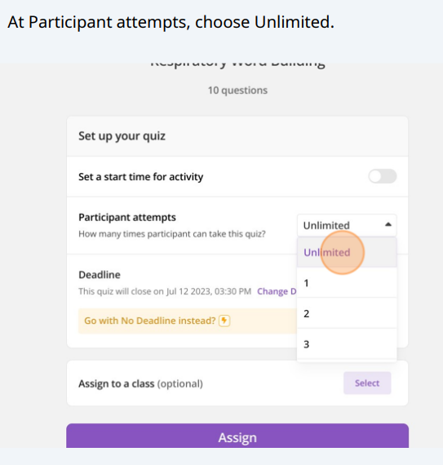
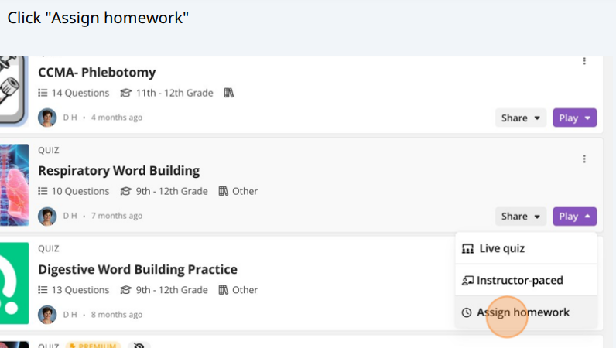
Setting up a No-Pressure Quizizz Homework Review Assignment

Slide 16
“I’ll know it if I see it.”

Slide 17
Brainscape
Cons: Student needs to be mature enough to self-report their ability to recall. No “fun” games.
Pros: Spaced repetition. Students felt this was a more efficient way of learning.

Slide 18
Brainscape Pricing
Quick import using .csv
Discount code for the first 50 subscribers (through August) = 50% off. THOA2023 Thank you, Brainscape!

Slide 19
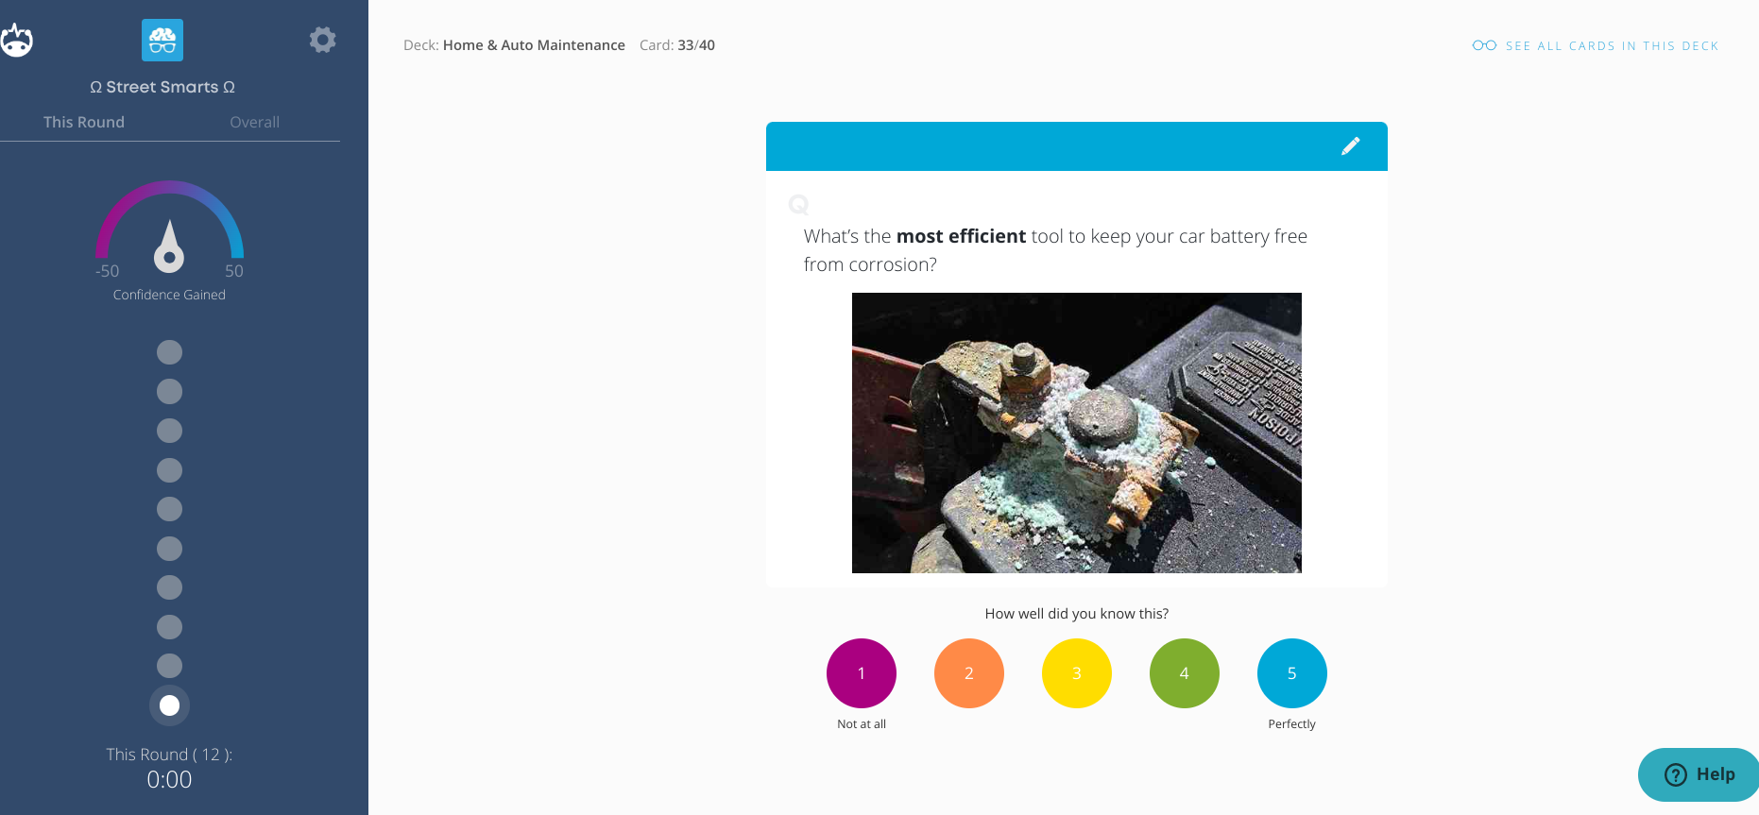
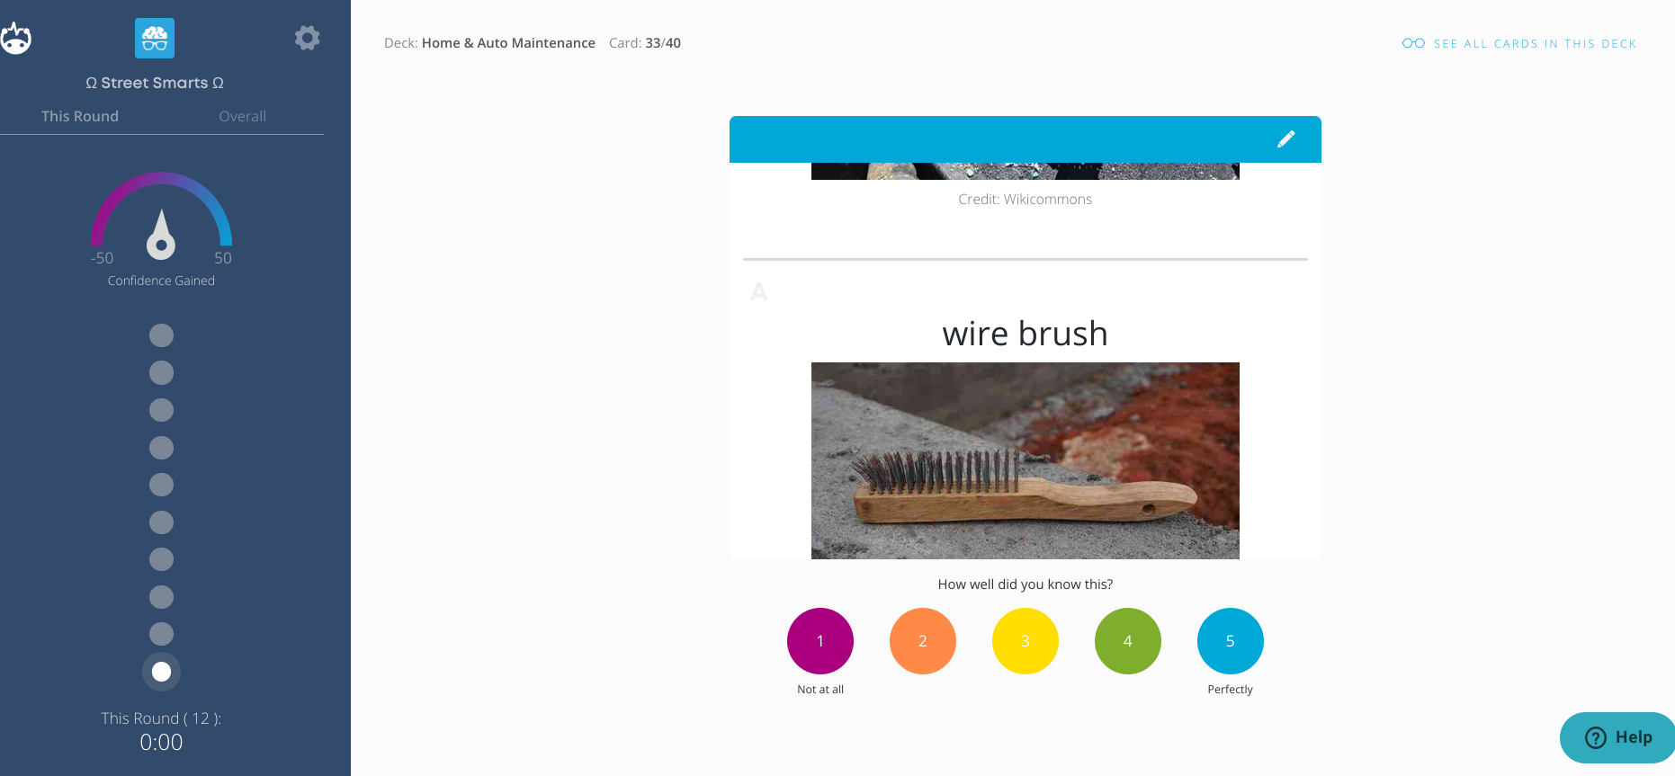
Working screen for Brainscape
Notice…not a multiple choice! How well can you recall the answer rather than just guess the right one?
Your self-assessment of how easily you recall the answer determines how often this flashcard is presented to you.
Link if you would like to play with a set: https://www.brainscape.com/p/536L5-LH-CPVQT

Slide 20
Brainscape vs Quizlet: Which did my Med Terms Students prefer?
“I think they are both effective, they both have a lot of things that I like. I really liked on Quizlet the test and the games. On Brainscape you can't really do any of that, but I do like the fact that you can choose how well you know it and it showing up again if you don't know it that well.”
“I really liked brainscape. I feel like during the test and word building I was figuring out the word elements faster. I also really liked that I didn't have to worry about ads or only being able to go through the cards once without having to buy anything. The only con is that it doesn't allow you to play the games, take the test, or use the write section to learn how to correctly spell the word.”
“I will say i do feel like i learn more with brainscape but for long term but with quizlet it is good for quick studying and short term memory. “
“I prefer Quizlet because there is so much to do compared to Brainscape. I think it is easier and more fun to be able to play games instead of flipping through cards the entire time.

Slide 21
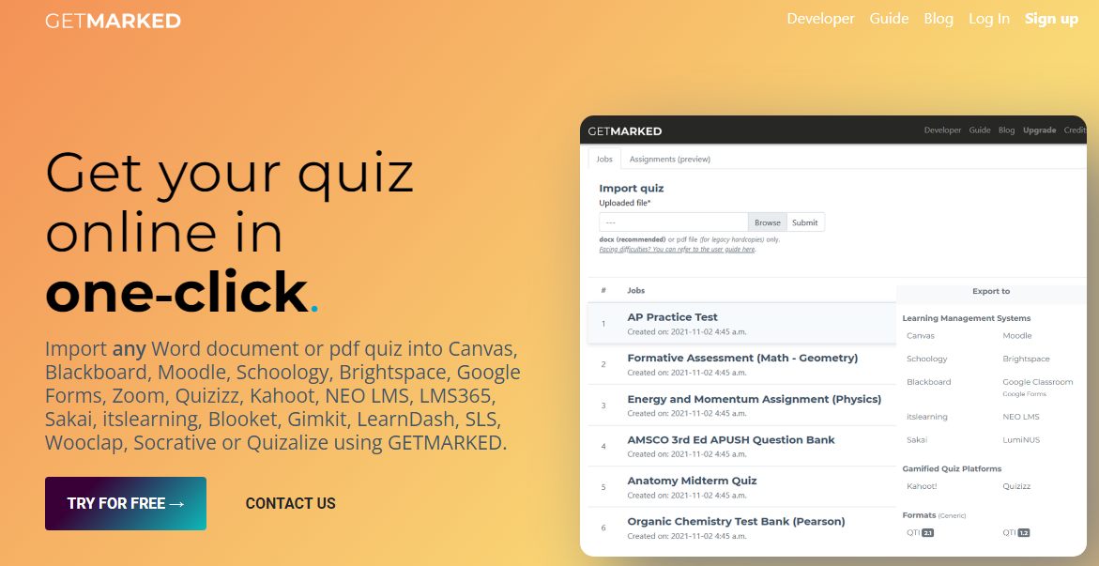
GETMARKED https://digitaliser.getmarked.ai

Slide 22
Ball Toss
Get to know you - questions
Vocabulary - Words
Question and Answer - questions or numbers
Toss the ball around when caught answer/define the one that is closest to right/left thumb
LET’S PLAY

Slide 23
Gimkit
Kits - words and definitions (can be created with quizlet list by copying and pasting
Live play - in class - different settings
Time - set your time to play
Race - set your dollar amount to acheive to win
All in - set collective dollar amount for completion

Slide 24
Gimkit
Classes - Roster for each class to track
Assignments - Individual play or homework
Folders - use to organize assignments by class
Reports - questions answer correct/incorrect, percent accuracy
NEW Creative - Create your own game!!

Slide 25
Gimkit
Basic - Free *Set Up Classes *Collect reports *Play Feature Modes Only —rotates *Creative 3 maps | Pro - $59.88/ year *Set Up Classes *Collect reports *Access to Play all Modes ****23 different games *Assignments - Homework or individual play *Upload images to questions *Add Audio to questions *Creative 10 maps

Slide 26
Lets take a look at gimkit
https://www.gimkit.com/

Slide 27
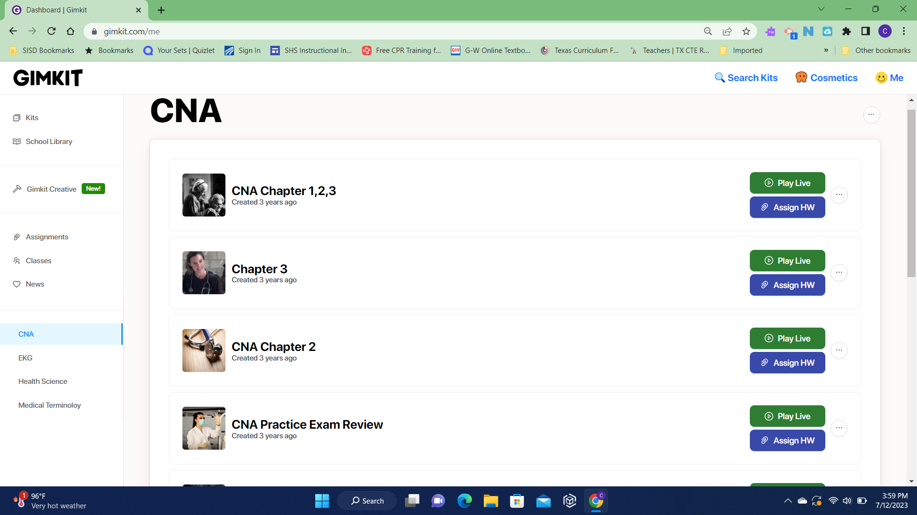
Class with Kits - Live play - Assignments

Slide 28
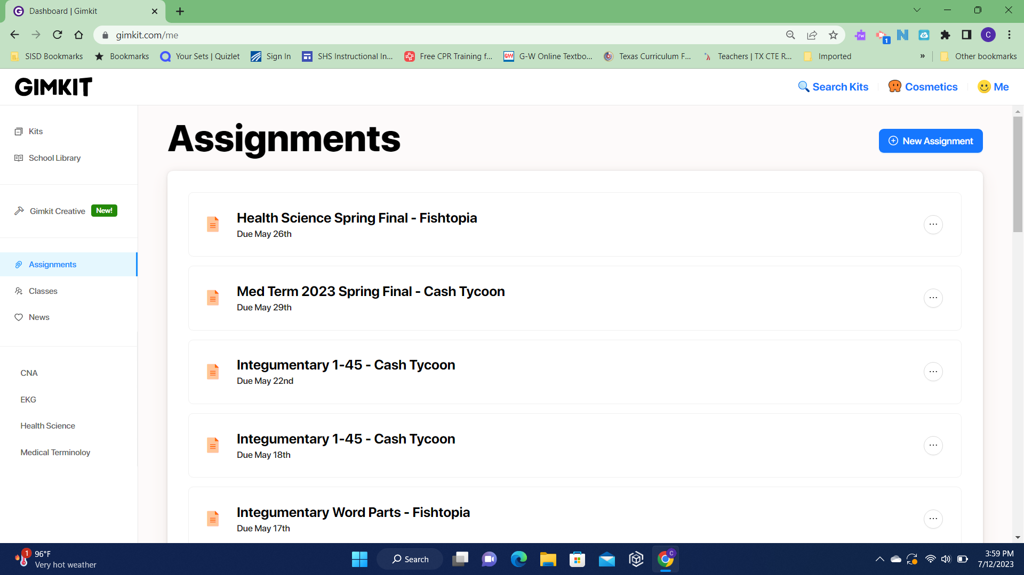
Assignments

Slide 29
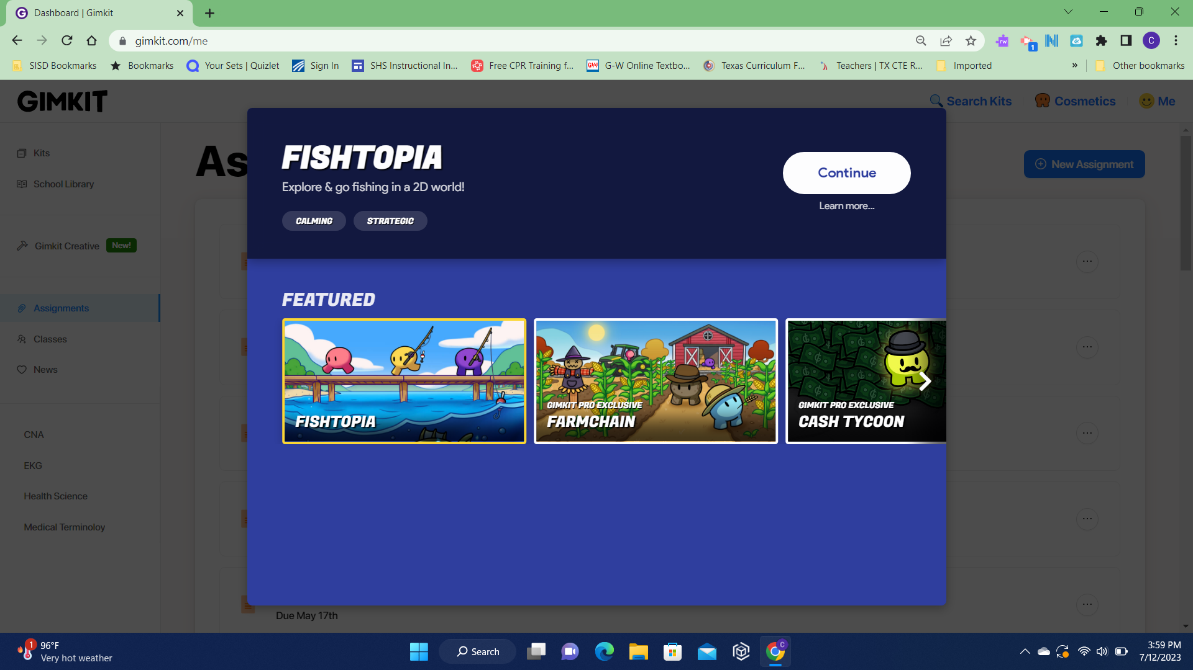
Assignments are 2-D games

Slide 30
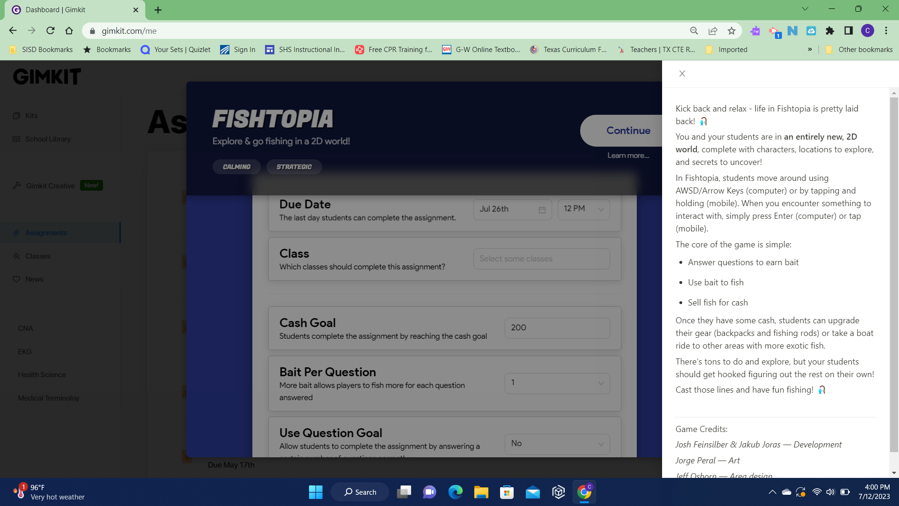
Set due date, assign to a class, set money or question goal

Slide 31
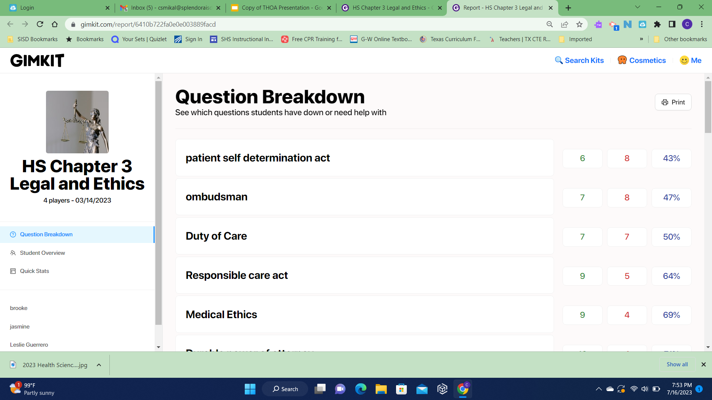

Slide 32
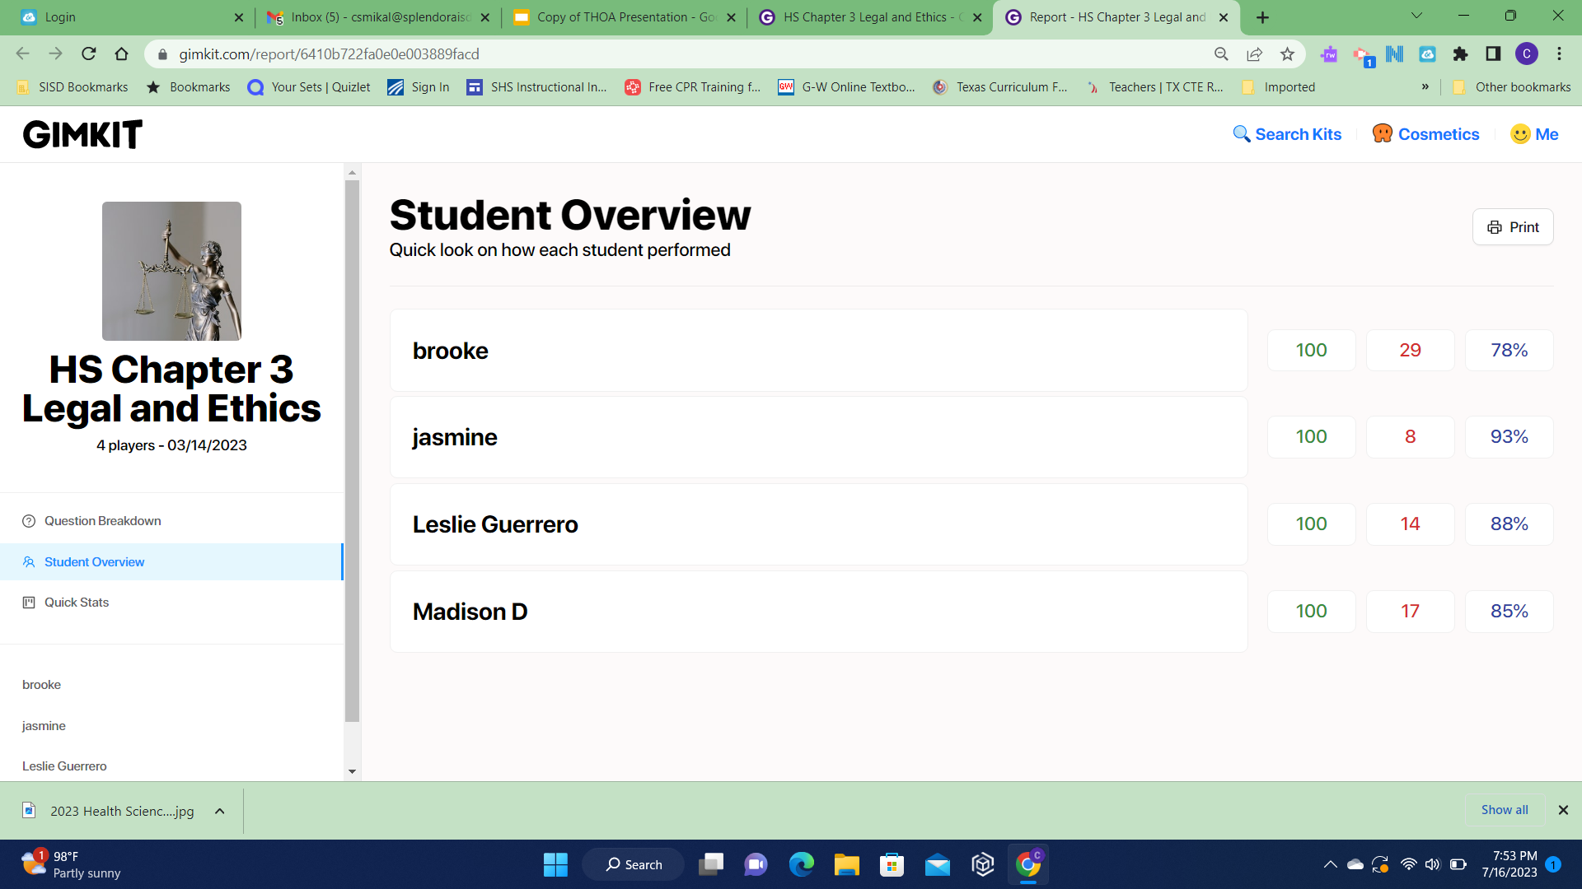

Slide 33
Fiddle sticks
Handout on tables
https://docs.google.com/document/d/1XAOkAIEfA24G3opaMbp5n78L2LQb9grZE5livxLyZR8/edit?usp=sharing

Slide 34
Think Outside the Box
Be Creative
Jenga Connect 4 Go Fish Bowling Erasable Dice Fishing Game | Word Pong Matching Egg Hunt Review Indoor Volleyball/Basketball Let your students be creative

Slide 35
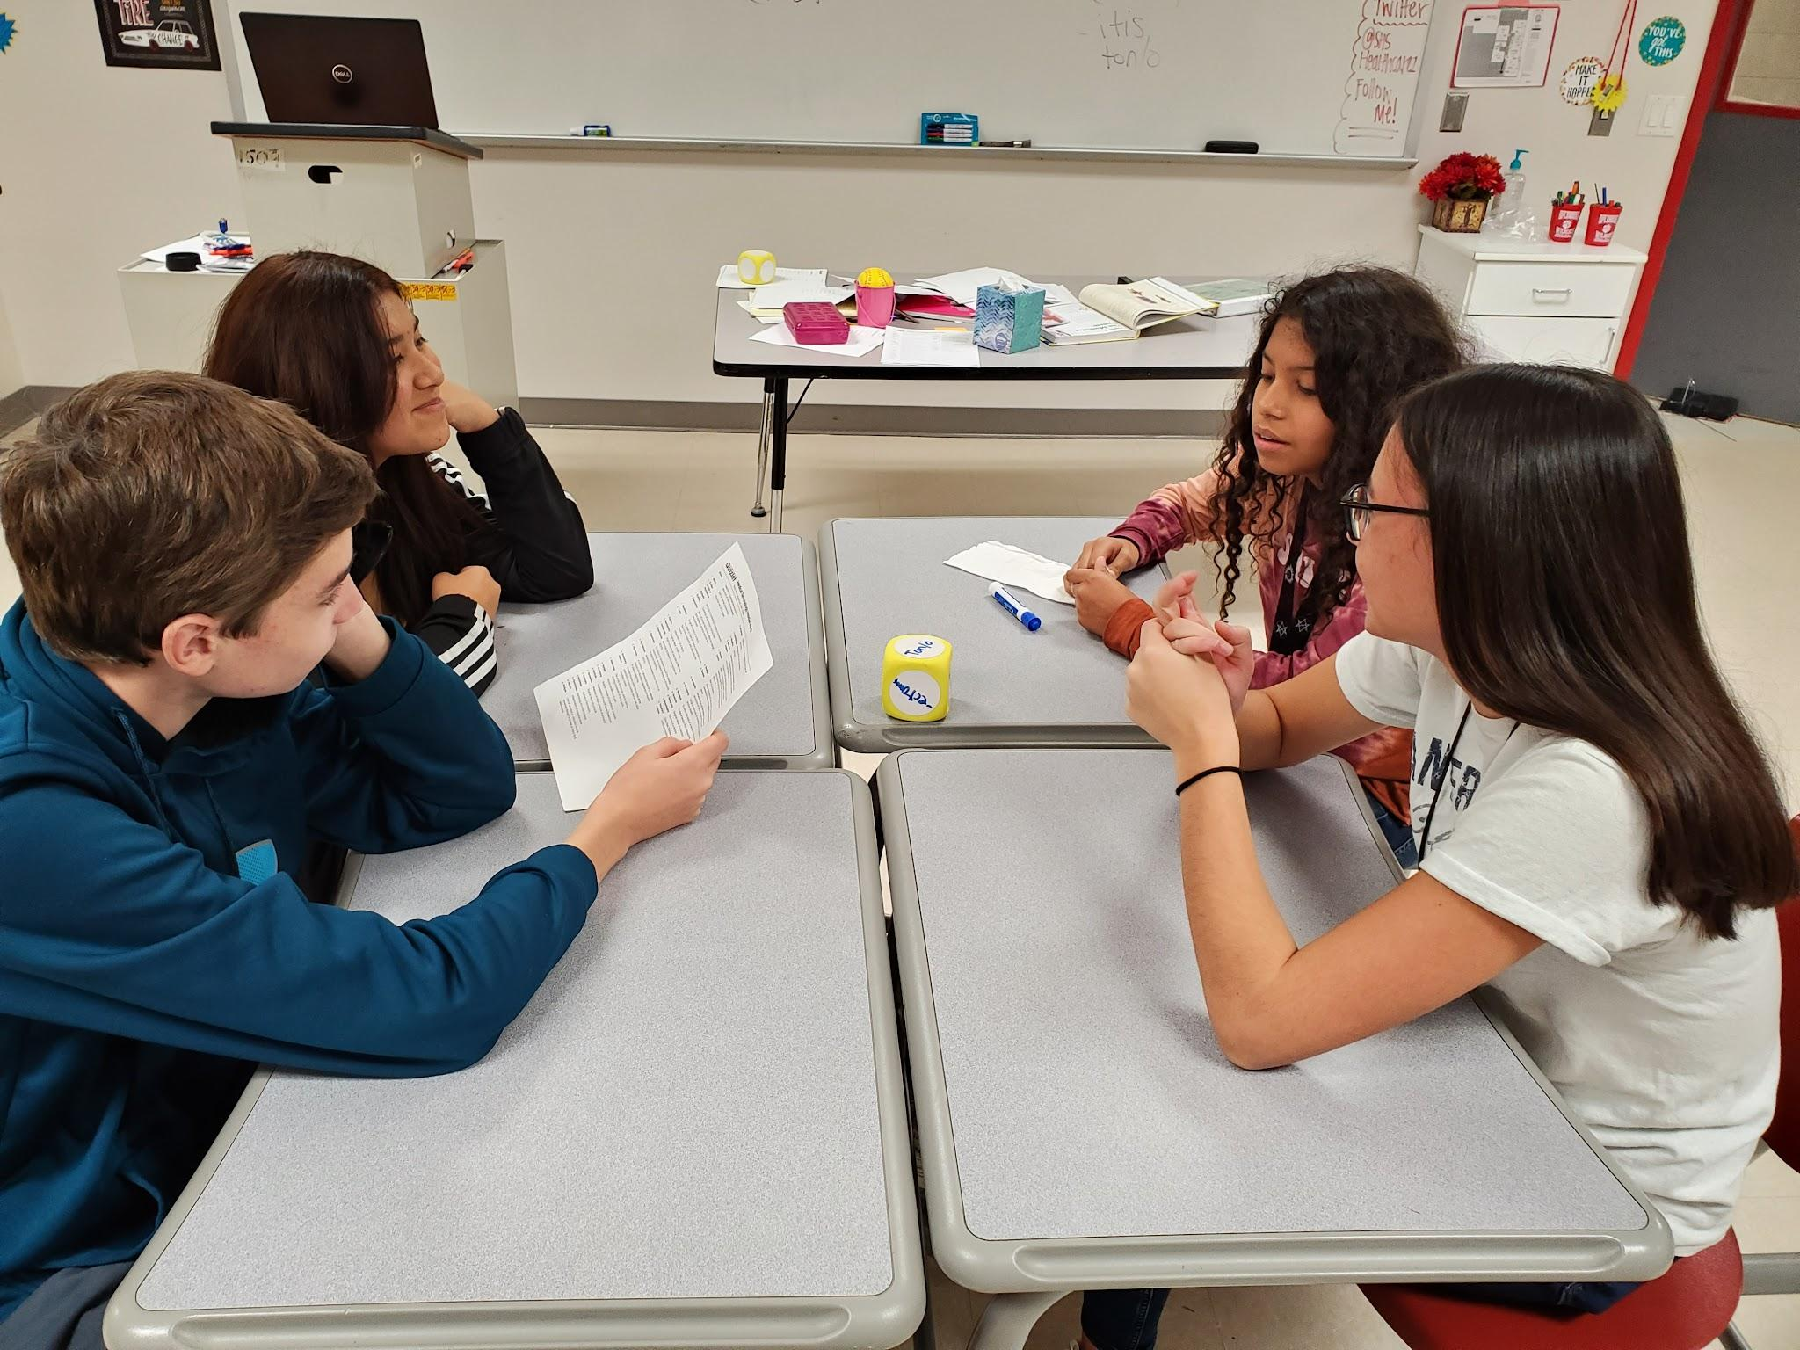
Erasable dice - Suffix on the die - students had to make a word and define it

Slide 36
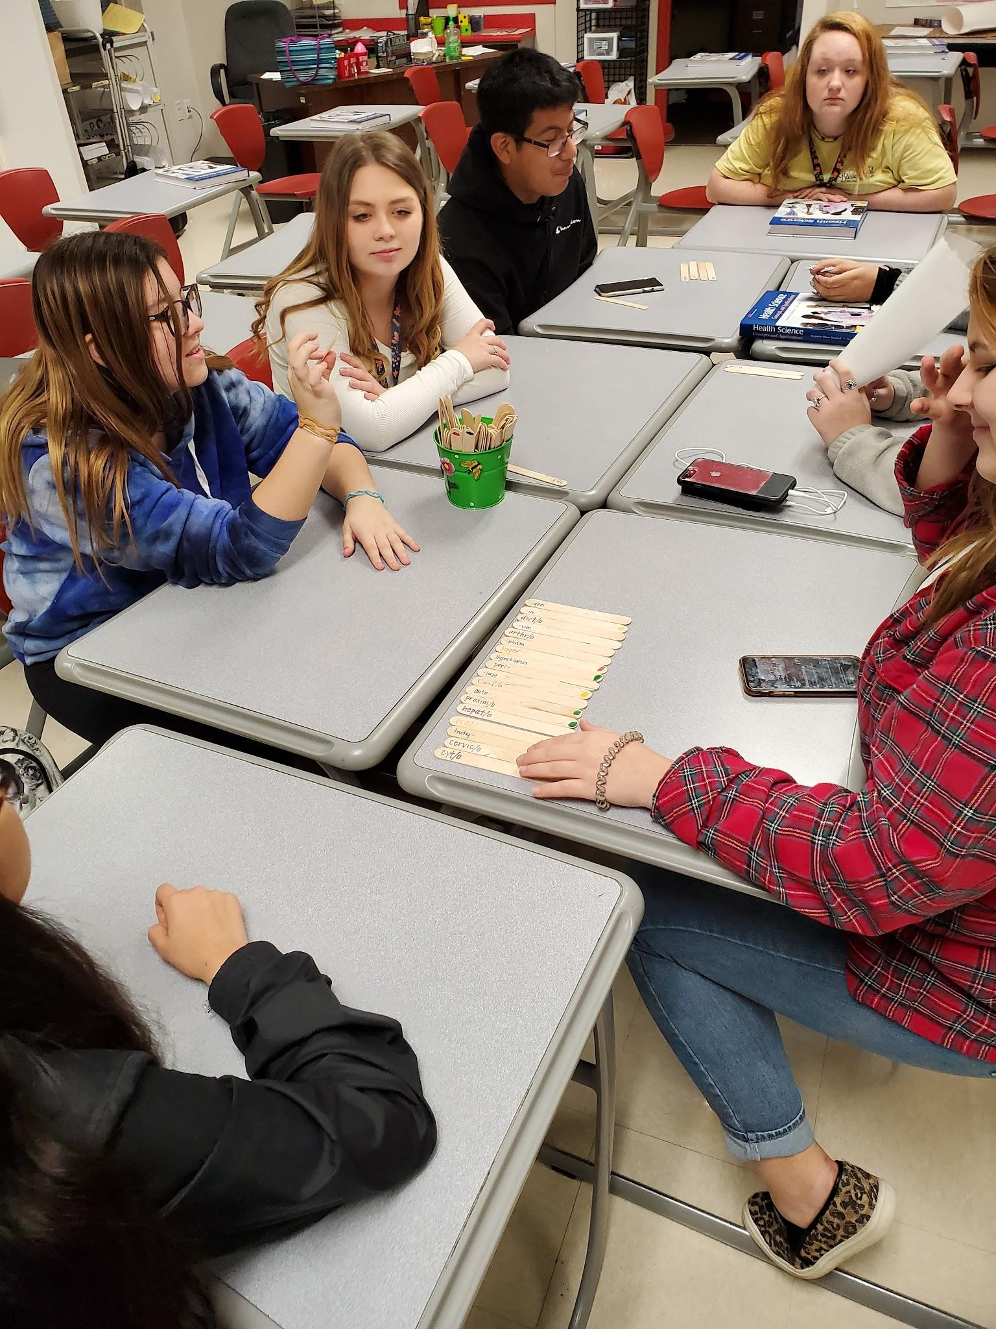
Fiddle sticks

Slide 37
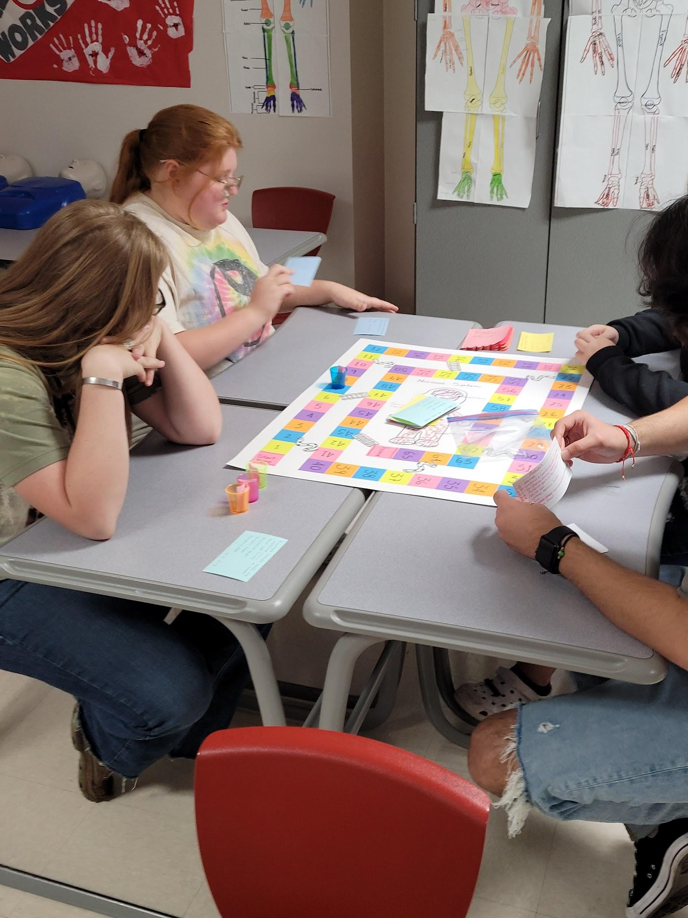
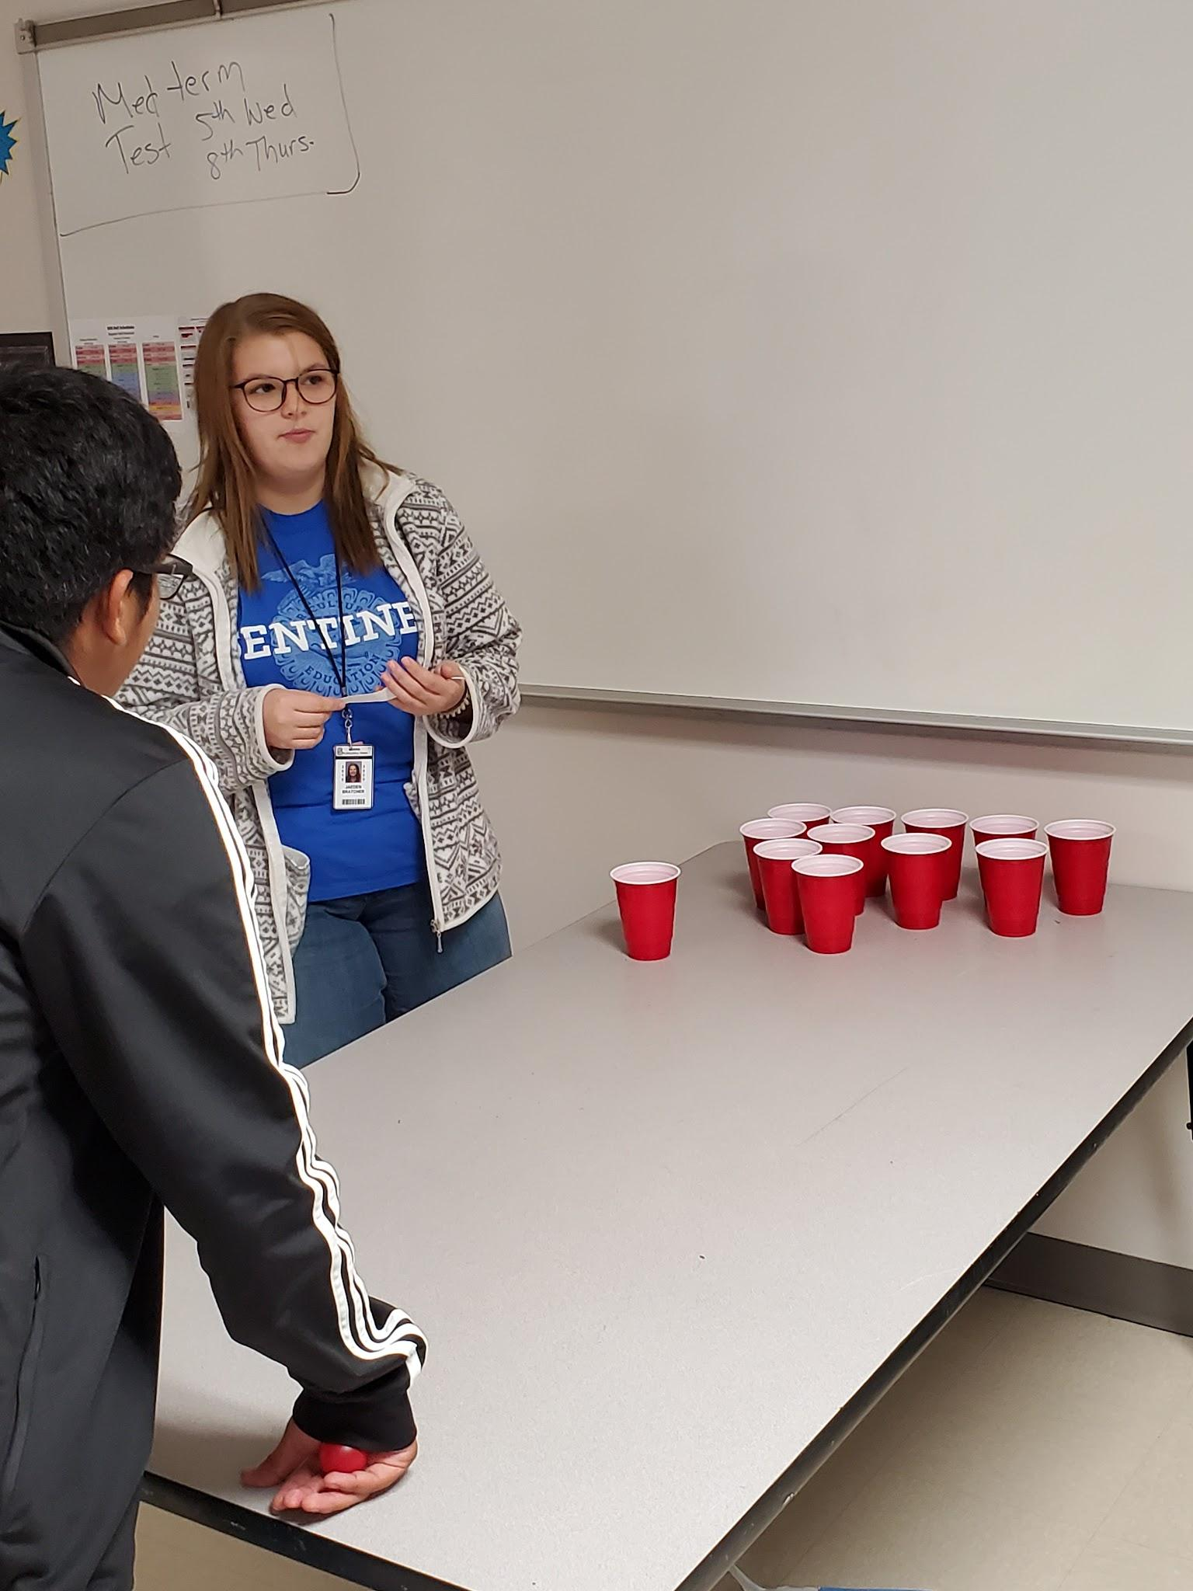
Student Created board game and word pong

Slide 38
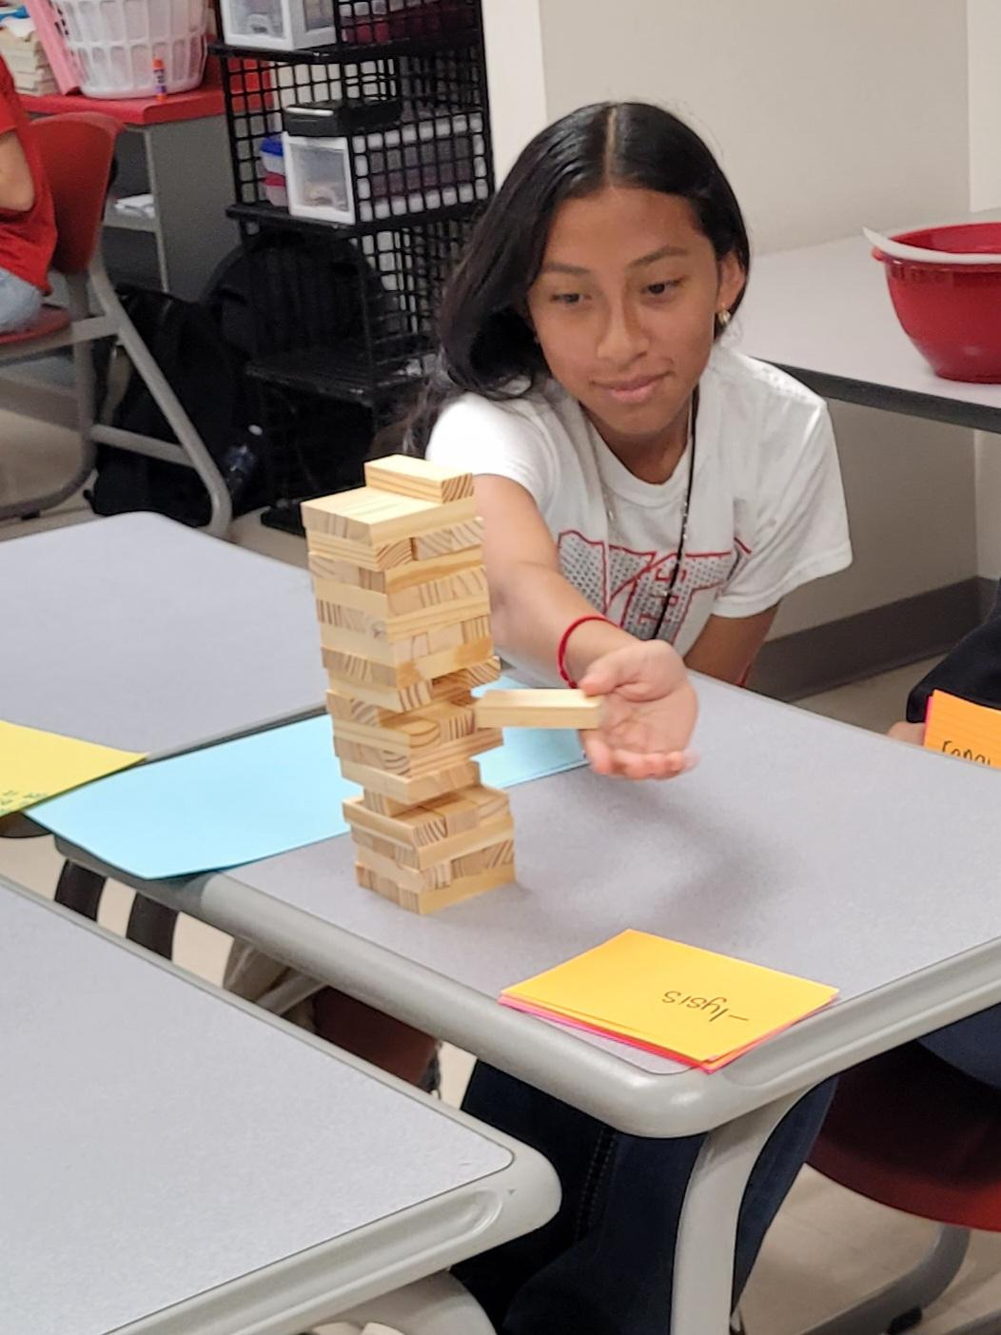
Jenga

Slide 39
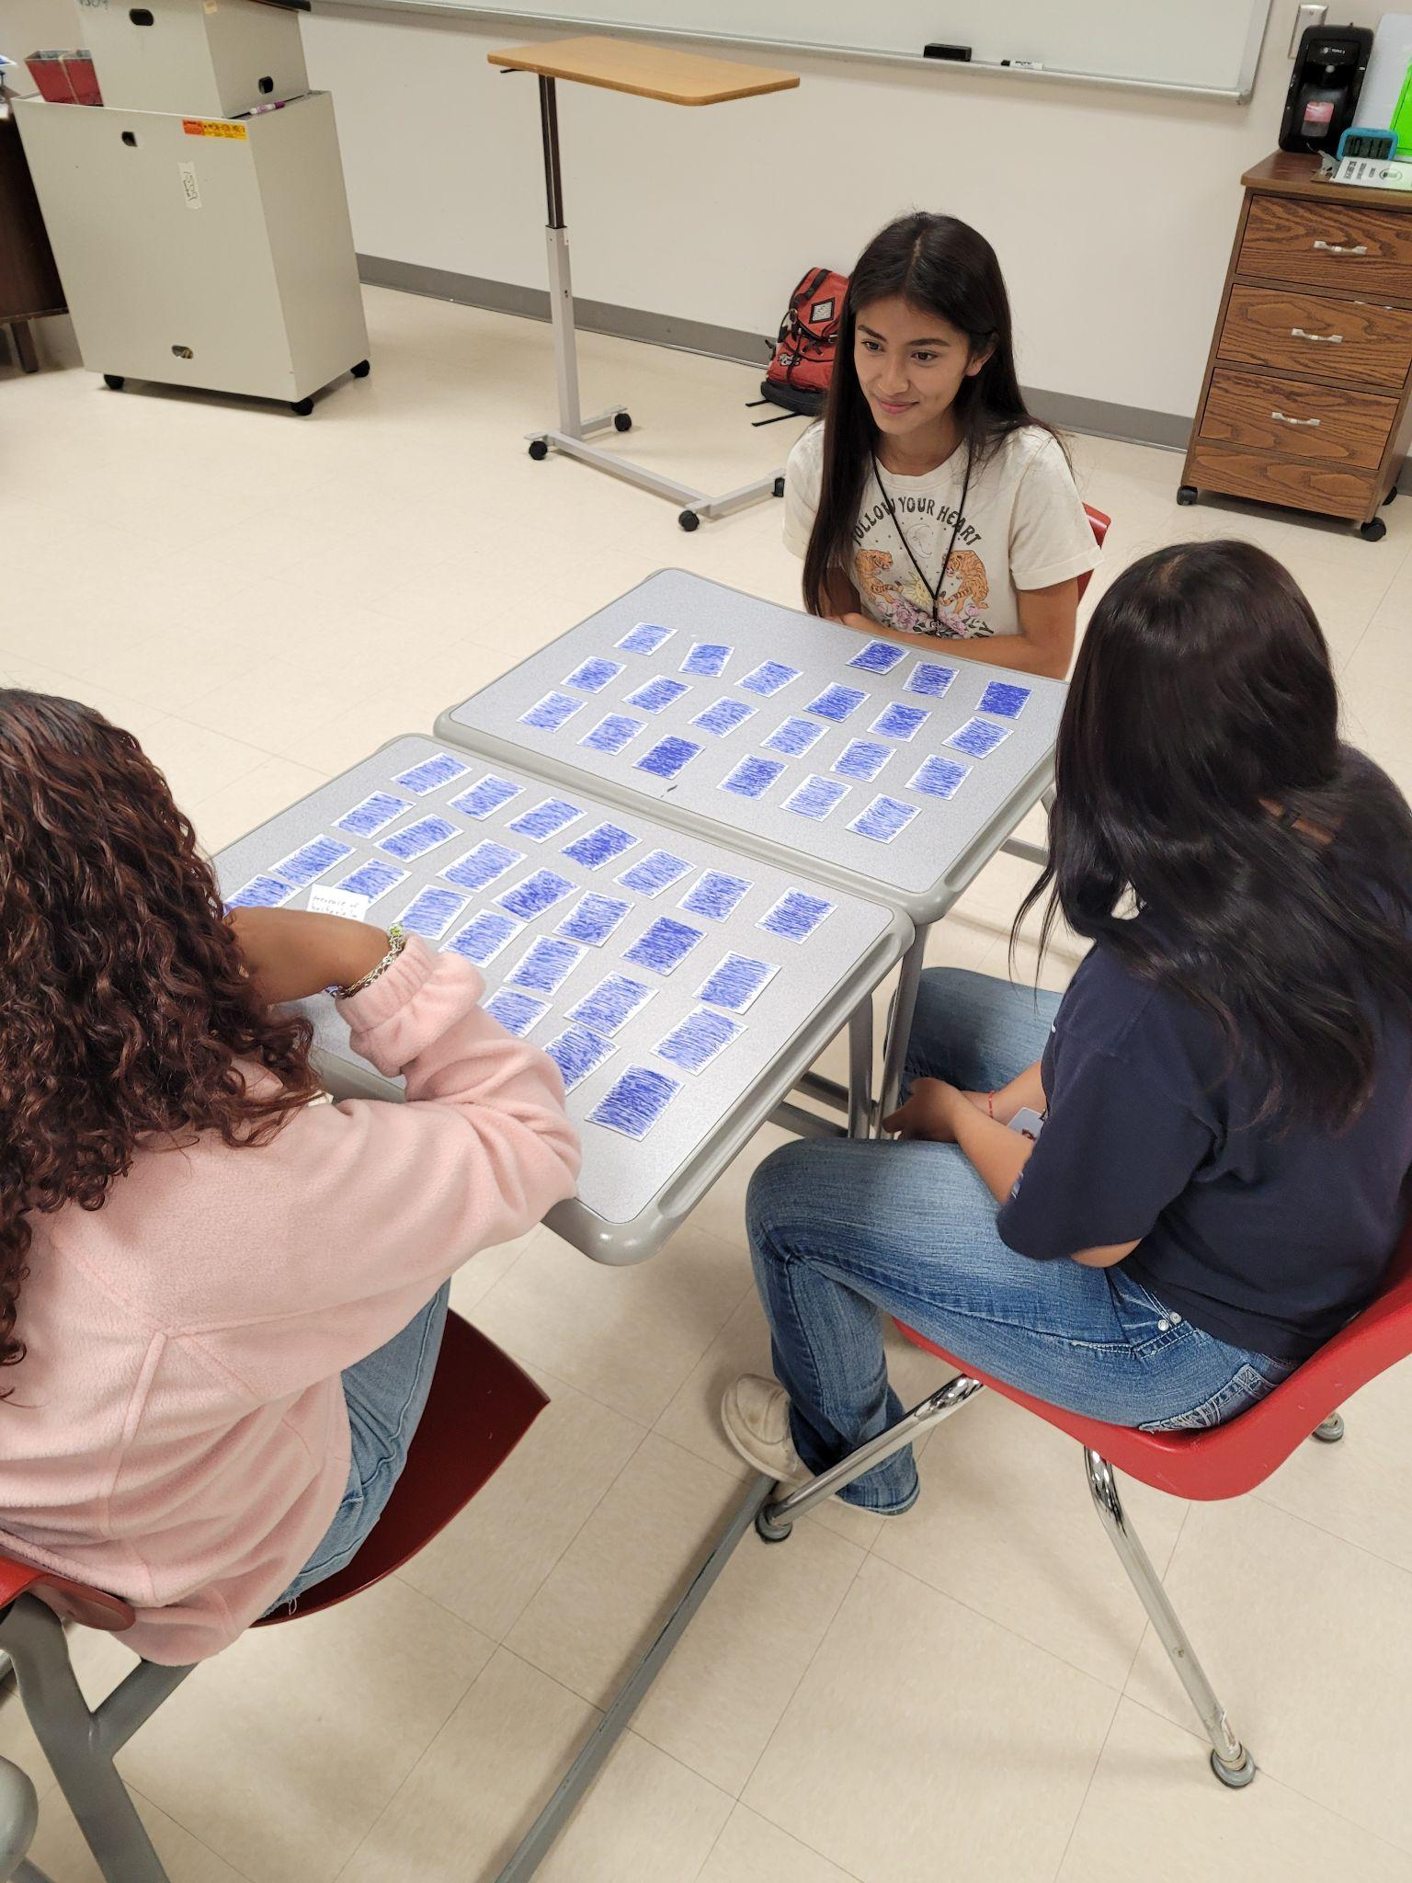
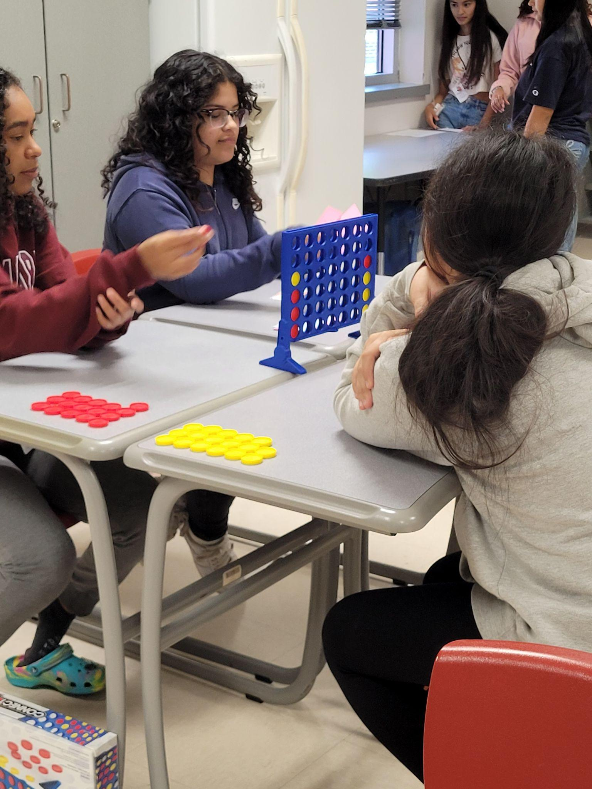
Matching Challenge Connect Four

Slide 40
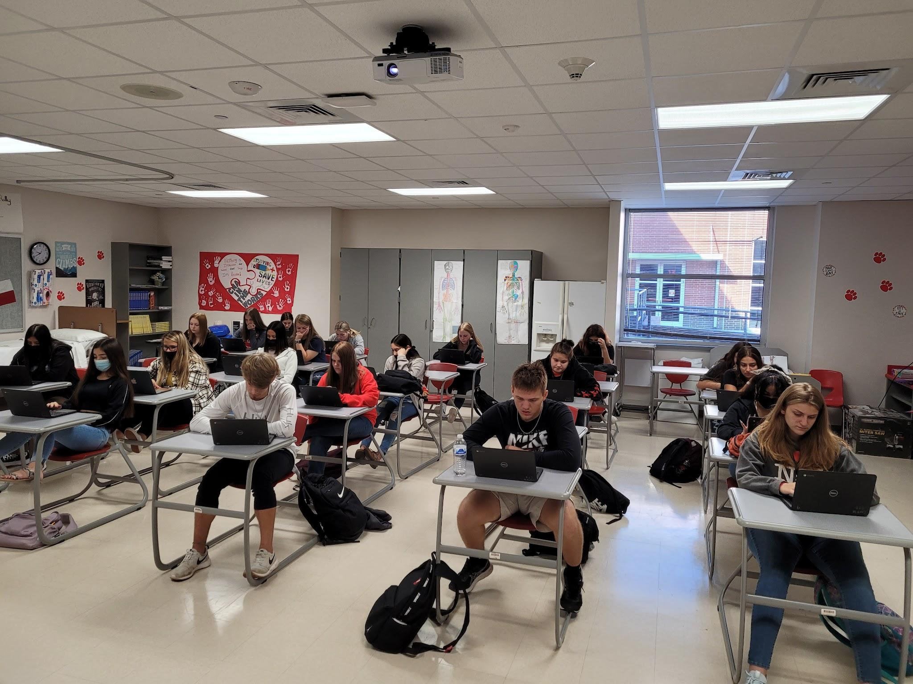
Fully Engaged in Gimkit

Slide 41
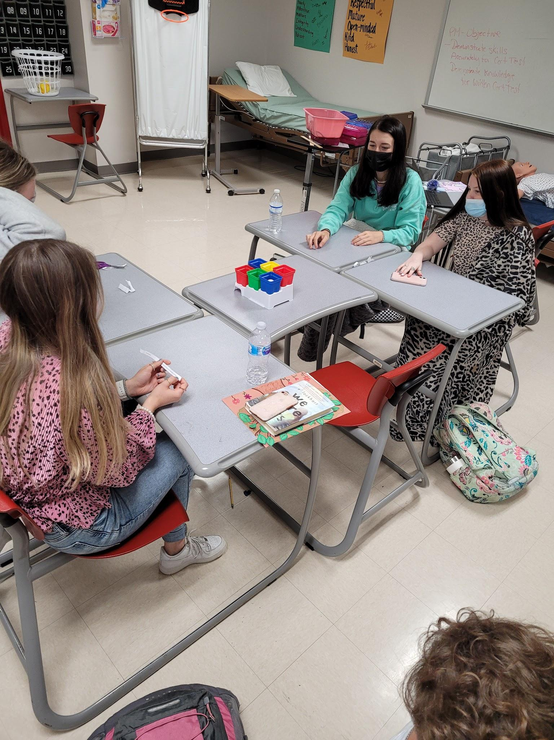

Slide 42
Christine Smikal csmikal@splendoraisd.org
Darcie Henke henked@calcoisd.org
We do not receive any monetary benefits from the resources presented. Prices discussed were published on the products’ web sites at the time of research and this presentation is no guarantee of prices.

