Slide 1

healthscienceconsortium.org
Notes:
Speak briefly about the Consortium.

Slide 2

Top
29
Health Careers
in
2023
Notes:
Program has 25…BUT we added a bonus 4 more!

Slide 3
A Growing Healthcare Workforce Shortage
Projections estimate that the US healthcare system will face a shortage of 3.2 million medical professionals in the next five years.
If current trends continue, our country will face a nursing shortage of approximately 500,000 registered nurses by 2025.
The World Health Organization (WHO) predicts a shortage of 18 million healthcare workers worldwide by 2030 if no action is taken to address this pressing need.

Slide 4

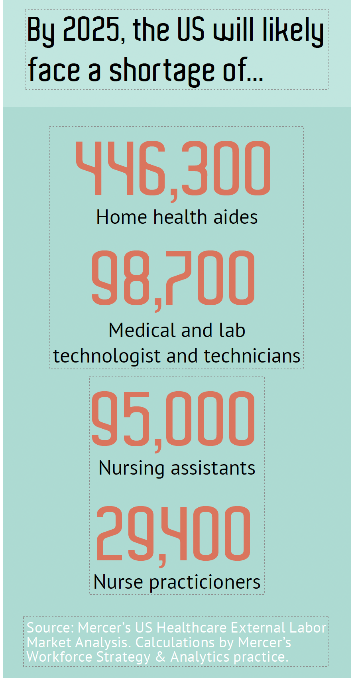

Slide 5
Free download on our website
Notes:
Hand out this Career Specialty Chart – a free resource on our site. Way to visually share with students, career counselors and parents the extensive health science career opportunities.
But, we know that you are offering career exploration opportunities in your program. Let’s break into groups of four (4) to discuss what you currently do.
Give 5 minutes for discussion.
Ask participants to share out.
IDEAS: Research; Community/Clinical Partners (Classroom Speakers); Incorporate Soft Skills and Stress Soft Skills Importance; CTSO—HOSA; Hands-On Activities, Job Shadowing, or Clinical Rotations

Slide 6


2023 Best Healthcare Jobs
U.S. News & World Report
Projected Jobs Through 2031
Notes:
Published annually …. Great information about healthcare jobs. Projected jobs between 2023-2031. Embellish these careers as you like and engage with the audience for their input. The salaries are mean nationwide. Labor of Bureau Statistics has great info also. Top 25 re included here. Didn’t go into details about the length of medical school, etc….but fill time as needed. Also, could focus on career ladders associated w/ some of these careers.
TREND IN NURSING RELATED POSITIONS AND DENTISTRY.

Slide 7

#1
Best Jobs in
Healthcare
Nurse Practitioner
Median Salary: $120,680
What they do: Take patient histories, perform physical exams, order labs, analyze lab results, prescribe medicines, authorize treatments and educate patients and families on continued care
Entry Level: Master’s degree RNs with advanced education
Projected Jobs: 112,700
#2 in 100 Best Jobs in America

Slide 8

Physician Assistant
#2
Best Jobs in Healthcare
Median Salary: $121,530
What they do: Practice medicine in healthcare settings, from hospitals to emergency rooms to private practice to operating suites
Entry Level: Master’s Degree
Projected Jobs: 38,400
#4 in 100 Best Jobs in America

Slide 9

Physical Therapist
#3
Best Jobs in Healthcare
Median Salary: $95,630
What they do: Plan and execute rehabilitative programs designed to improve the patient's mobility, increase his or her strength and relieve or at least lessen his or her pain
Entry Level: Doctorate
Projected Jobs: 40,400
#6 in 100 Best Jobs in America

Slide 10

Dentist
#4 Best Jobs Healthcare
Median Salary: $160,370
What they do:
Identify and treat problems concerning a patient's mouth, gums and teeth
Entry Level: Doctorate
Projected Jobs: 7700
#10 in 100 in Best Jobs in America

Slide 11

Veterinarian
#5
Best Healthcare Jobs
Median Salary: $100,730
What they do:
  Care for the health of animals by diagnosing, treating and researching medical conditions and diseases of pets, livestock and other animals
Entry Level: Doctorate
Number of Jobs: 16,800
#12 in 100 Best Jobs in America

Slide 12

Physician
#6
Best Jobs in Healthcare
Median Salary: $208,000 to 353,000
What they do:
Diagnose and treat injuries or illnesses. Provide surgeries on patients to treat injuries, diseases and deformities
Entry Level: Doctorate
Number of Jobs: 19,400
#13 in 100 Best Jobs in America

Slide 13

Orthodontist
#7
Best Jobs Healthcare
Median Salary: $277,590
What they do:
Concentrate on fixing irregularities in teeth and jaws. Straighten teeth and help correct overbites and underbites
Entry Level: Doctorate
Number of Jobs: 300
#14 in 100 Best Jobs in America

Slide 14

Registered
Nurse
#8
Best Jobs in Healthcare
Median Salary: $77,600
What they do:
Care for sick, injured and healthy patients in a variety of settings, and they teach members of the public about health and wellness best practices
Entry Level: 2- to 4-year degree
Number of Jobs: 195,400
#17 in 100 Best Jobs in America

Slide 15

Oral and Maxillofacial Surgeon
#9 Best Jobs in Healthcare
Median Salary:$331,210
What they do:
Perform surgeries on the face, mouth and jaw. Dentists with 4+ years of additional surgery training. Treat facial traumas to fixing cleft lips. Diagnose and treat patients with head, neck and oral cancer. Perform cosmetic surgeries.
Entry Level: Doctorate
Number of Jobs: 300
#24 in 100 Best Jobs in America

Slide 16

Nurse
Anesthetist
#10 Best Jobs Healthcare
Median Salary: $195,610
What they do:
Anesthesia services to patients in hospitals, physician’s offices, & clinics.
Entry Level: Master’s degree
Number of Jobs: 5300
#25 in 100 Best Jobs in America

Slide 17

Speech
Language
Pathologist
#11 Best Jobs Healthcare
Median Salary: $79,690
What they do:
Assess, diagnose, treat, and help to prevent communication and swallowing disorders in children and adults caused by stroke, brain injury, hearing loss, developmental delay, cleft palate, or autism.
Entry Level: Master’s degree
Number of Jobs: 34,000
#31 in 100 Best Jobs in America

Slide 18


Psychiatrist
#12
Best Jobs in Healthcare
Median Salary: $280,600
What they do;
Diagnose, treat and work to prevent disorders relating to the mind and mental health
Entry Level: Doctorate
Number of Jobs: 2400
#32 in 100 Best Jobs in America

Slide 19

Optometrist
#13 Best Jobs Healthcare
Median Salary: $124,300
What they do:
Examine the eyes and diagnose and treat visual problems and manage diseases, injuries and other disorders of the eyes.
Entry Level: Doctor of Optometry
Number of Jobs: 4000
#33 in 100 Best Jobs in America

Slide 20
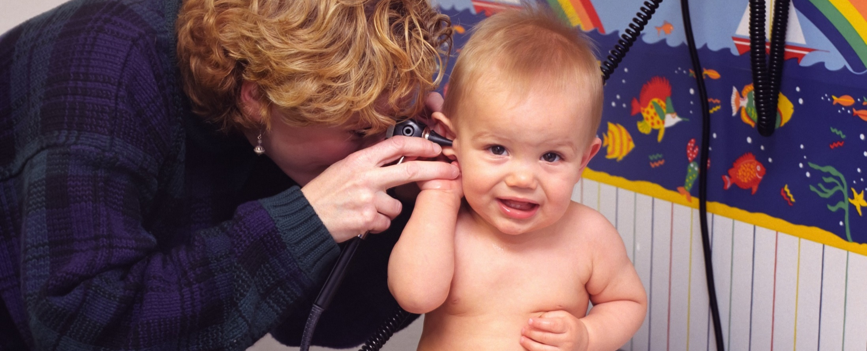
Pediatrician
#14
Best Healthcare Jobs
Median Salary: $203,690
What they do:
Concerned with physical, emotional and social well-being of children from infancy to young adulthood. Specialty ranging from neonatology, oncology and hematology to developmental-behavioral pediatrics and psychiatry.
Entry Level: Doctorate
Number of Jobs: 400
#34 in The Best 100 Jobs in America

Slide 21


Respiratory Therapist
#15 Best Jobs Healthcare
Median Salary: $61,830
What they do:
Heart and lung problems. Asthma, chronic bronchitis, emphysema, cystic fibrosis or sleep apnea; Respond emergency situations, like those experiencing a heart attack or suffering a stroke.
Entry Level: Associate Degree
Number of Jobs: 18,400
#36 in The Best 100 Jobs in America

Slide 22
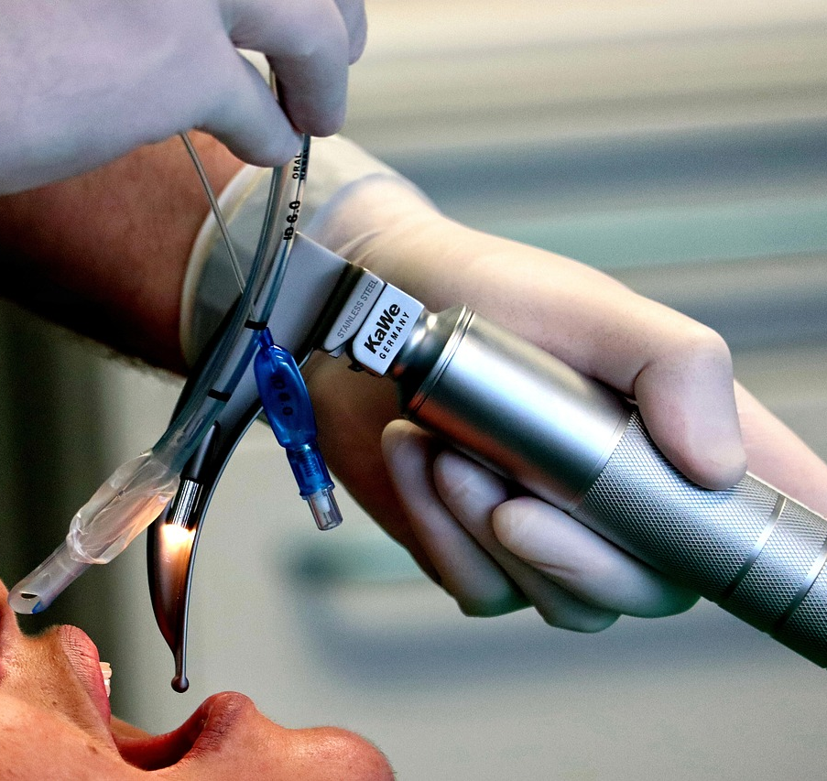
#16 Best Jobs Healthcare (tie)
Anesthesiologist
Median Salary: $349,590
What they do:
Administer general or regional anesthesia; allows surgeons and other physicians to complete invasive procedures with little to no discomfort to the patient. Monitor a patient's vital signs and critical life functions before, during and after a surgery; pain management
Entry Level: Doctorate
Number of Jobs: 400
#41 in the Best 100 Jobs in America (stress!)

Slide 23
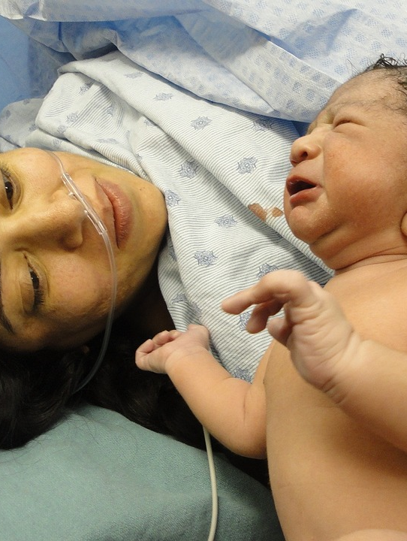
Obstetrician/
Gynecologist
#16 Best Jobs
Healthcare (tie)
Median Salary: $290,320
What they do:
Bring new life into the world and care for the spectrum of women's reproductive health
Entry Level: Doctorate
Number of Jobs: 400
#41 in Best 100 Jobs in America

Slide 24

Chiropractor
Chiropractor
#18 Best Jobs
Healthcare
Median Salary: $75,000
What they do:
Treat neuro-musculoskeletal system in patients by using spinal adjustments and manipulation
Entry Level: Doctor of Chiropractic
Number of Jobs: 5500
#46 in 100 Best Jobs in America

Slide 25
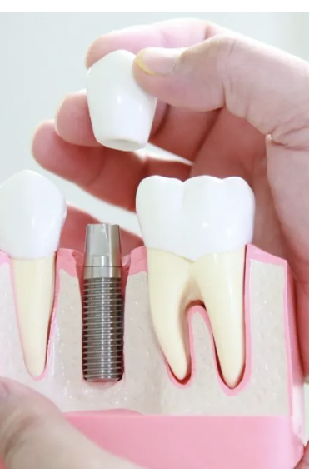
Prosthodontist
(Cosmetic Dentist)
#19 Best Jobs Healthcare
Median Salary: $143,730
What they do:
Dental specialists who restore and replace teeth to improve the function of your mouth or the look of your smile
Entry Level: Doctorate
Number of Jobs: 0
#67 in 100 Best Jobs in America

Slide 26
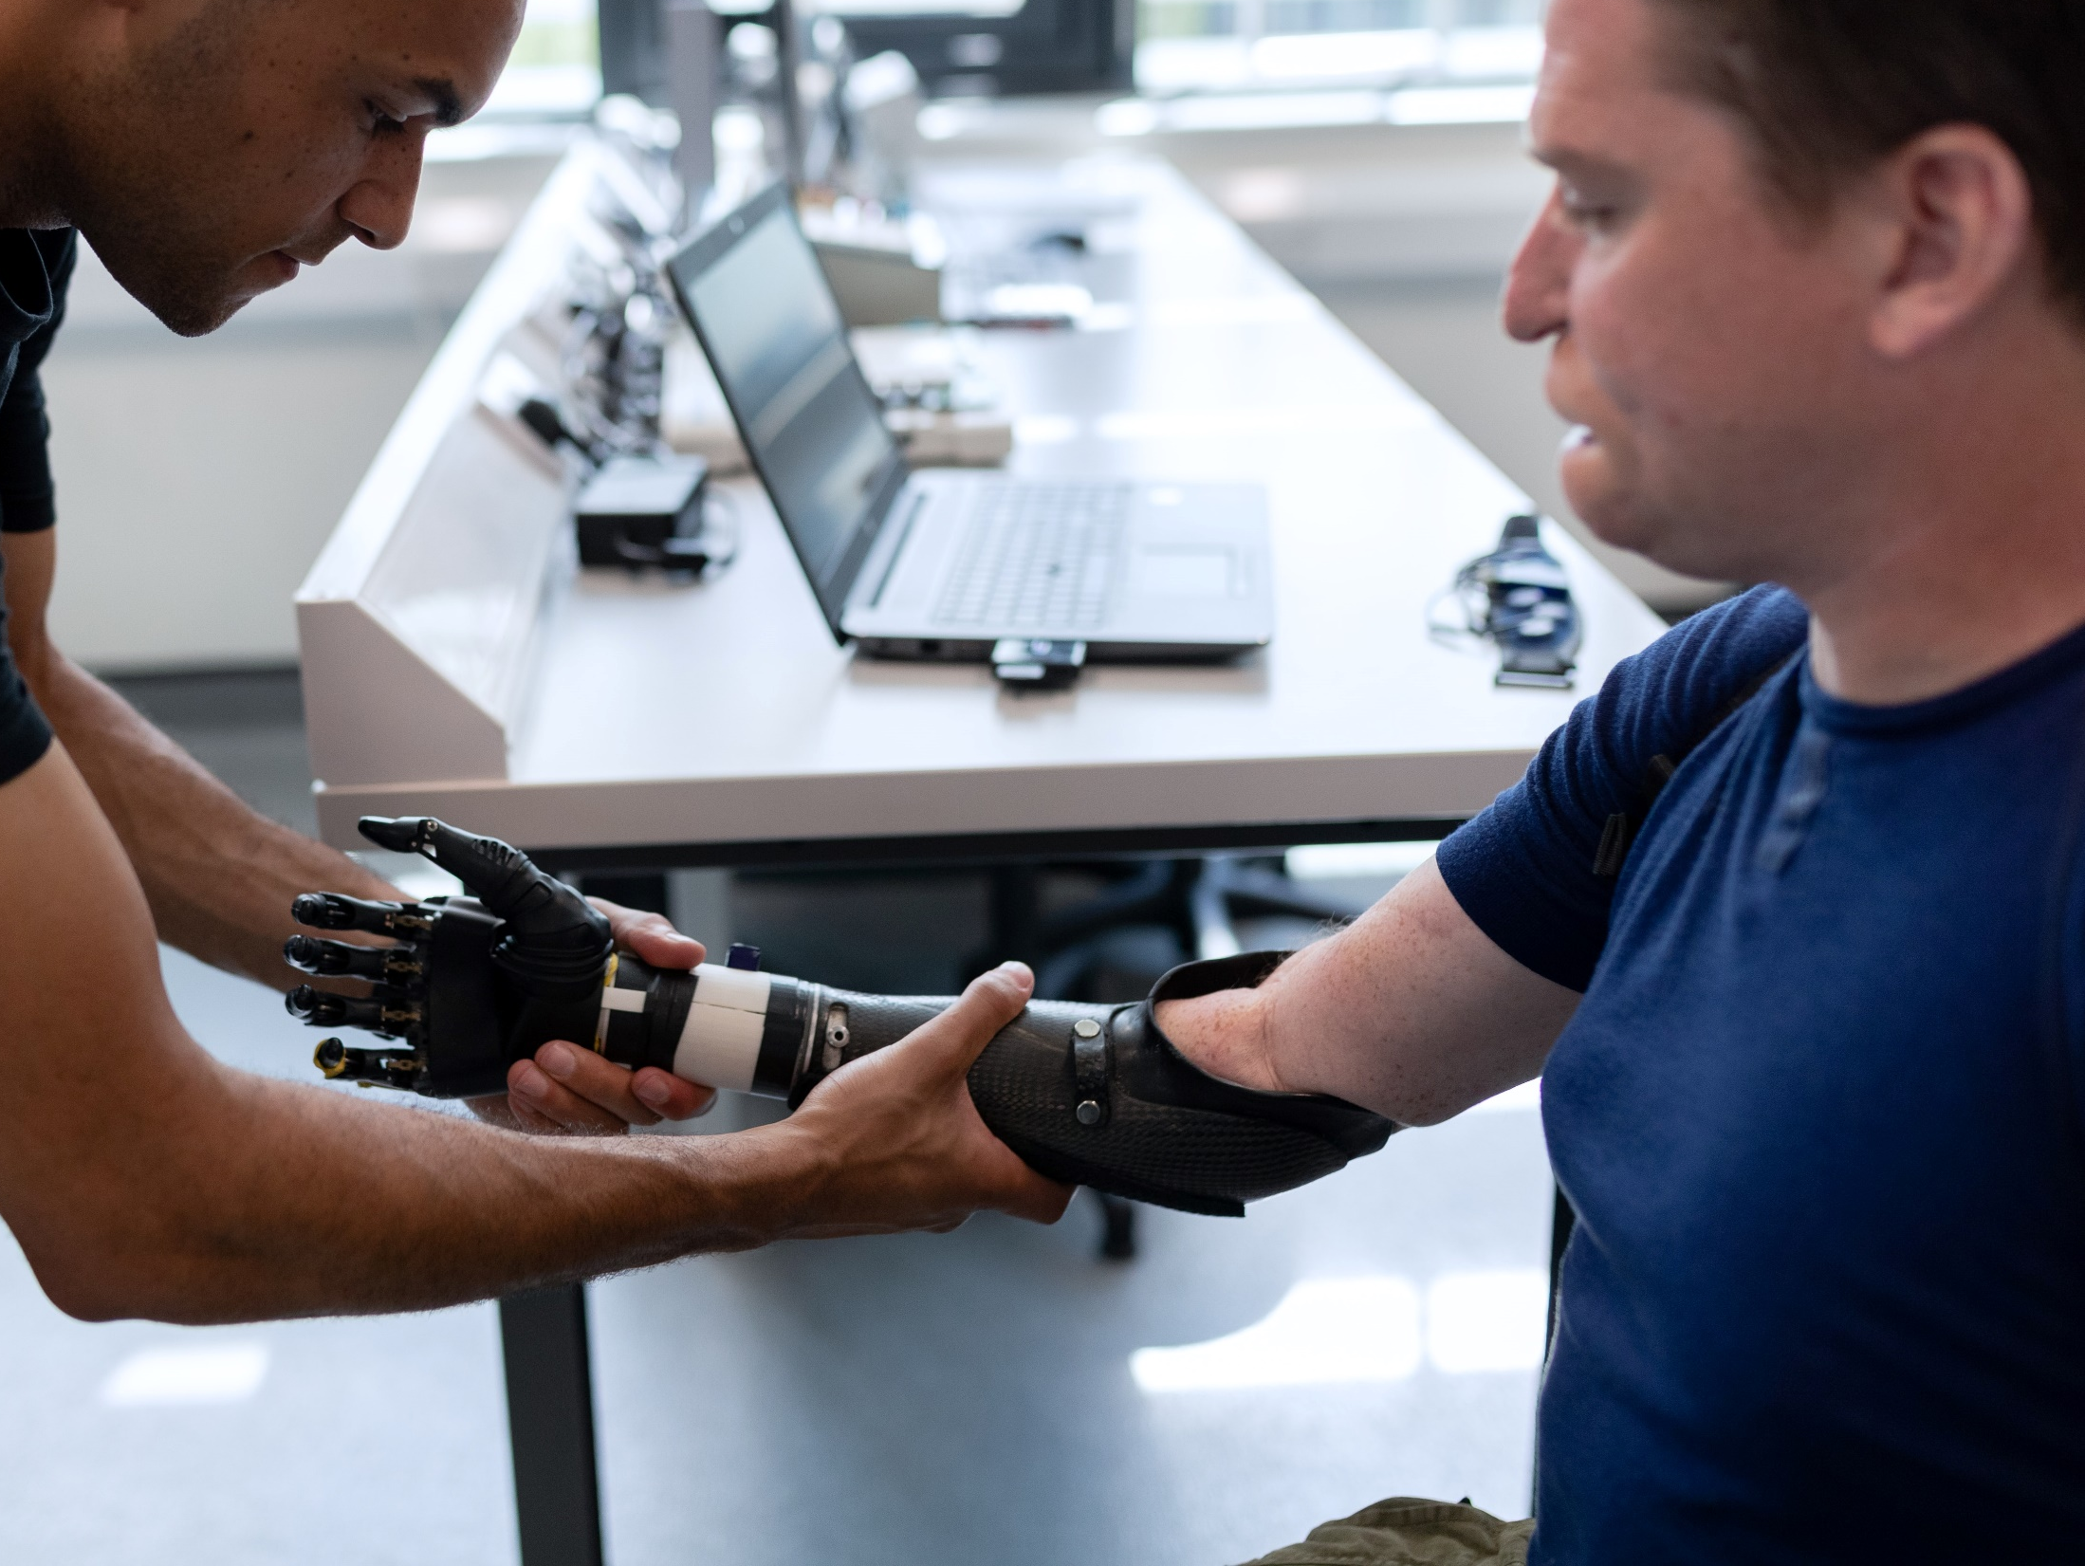
Occupational Therapist
#20 Best Jobs Healthcare
Median Salary: $85,570
What they do:
Treat injured, ill, or disabled patients through therapeutic use of everyday activities
Entry Level: Master’s degree
Number of Jobs: 18,600
#72 in 100 Best Jobs in America

Slide 27

Dietitian/
Nutritionist
#21 Best Jobs Healthcare
Median Salary: $61,650
What they do:
Experts in use of food and nutrition to promote health and manage disease. Advise on healthy lifestyle eating or how to achieve a health-related goal.
Entry Level: Bachelor’s degree
Number of Jobs: 51,000
#76 in100 Best Jobs in America

Slide 28

Pharmacist
#22 Best Jobs Healthcare
Median Salary: $128,570
What they do:
Dispense prescription medications to patients and offer expertise in the safe use of prescriptions. Conduct health screenings, provide immunizations and provide patient education
Entry Level: Doctorate
Number of Jobs: 7700
#89 in 100 Best Jobs in America

Slide 29
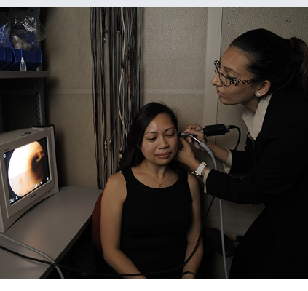
Audiologist
#23 Best Jobs Healthcare
Median Salary: $78,950
What they do:
Diagnose, manage and treat a patient’s hearing, balance or ear problems
Entry Level: Doctorate
Number of Jobs: 1500
#90 in 100 Best Jobs in America

Slide 30
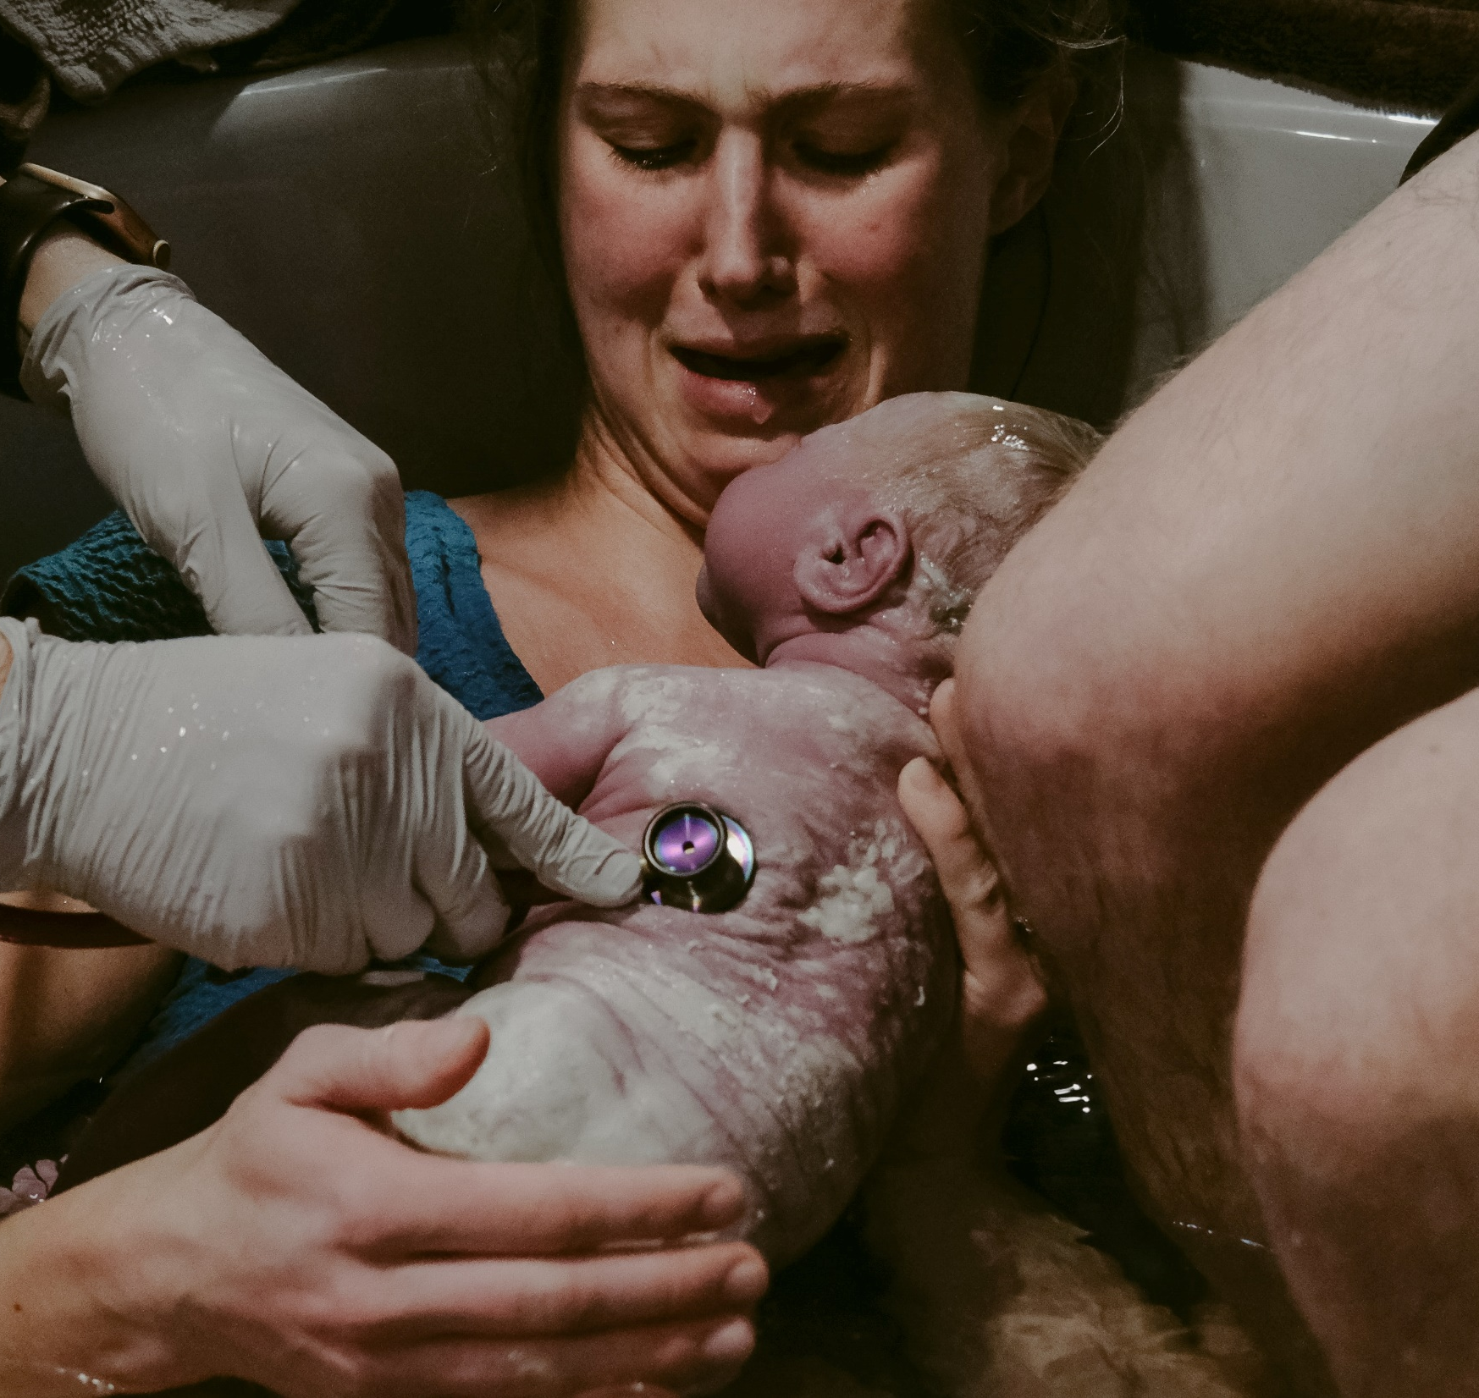
Nurse Midwife
#24 Best Jobs Healthcare
Median Salary: $114,210
What Do They Do:
Advanced practice registered nurses (APRNs); treat women of all ages for annual exams, regular pregnancy exams, delivery, menopausal care and more
Entry Level: Graduate Degree in Midwifery
Number of Jobs: 600

Slide 31

Esthetician and Skincare Specialist
#25 Best Jobs Healthcare
Median Salary: $37,300
What they do:
Cleanse and exfoliate, wax and laser, moisturize and apply makeup to enhance a person's overall appearance.
Entry Level: State-approved cosmetology or esthetician program - pass a state exam for licensure
Number of Jobs: 13,400

Slide 32

Surgeon
#26 Best Jobs in Healthcare
Median Salary: $208,000++
What they do: Operate on patients who suffer from injuries, diseases or deformities. These professionals can train toward becoming general surgeons, or they can choose a specialization, such as orthopedic, neurological, cardiovascular or plastic surgery.
Entry Level: Medical Doctor
Number of Jobs: 2000

Slide 33
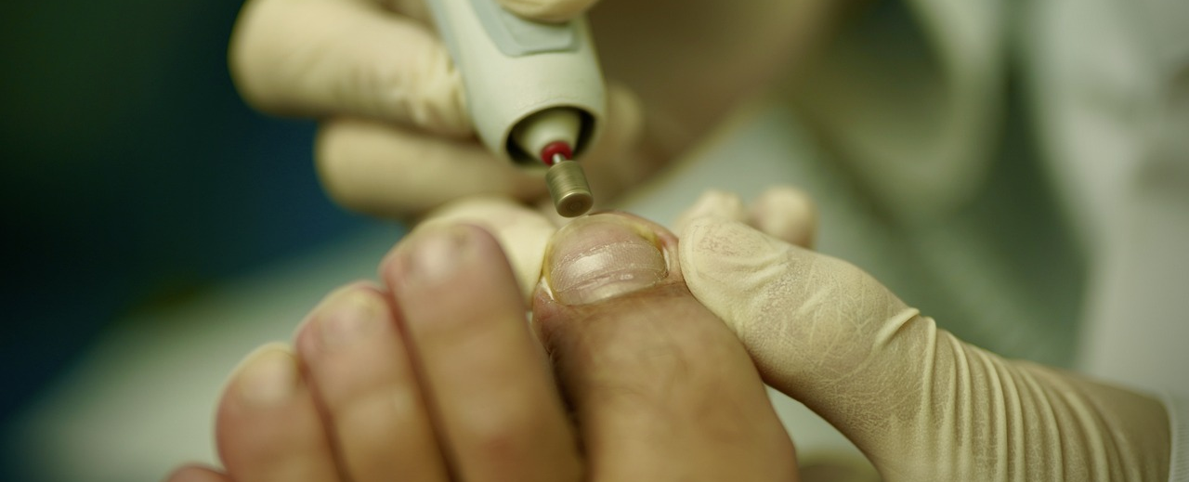
Podiatrist
#27 Best Jobs in Healthcare
Median Salary: $145,840
What Do They Do: Physicians who diagnose and treat conditions of the foot and ankle, ranging from ingrown nails and bunions to fractured ankles and bone spurs. Treatment as simple as prescribing orthotic shoes or as complicated as performing total ankle implant surgery.
Entry Level: Doctorate
Number of Jobs: 200

Slide 34

Radiation Therapist
#28 Best Jobs in Healthcare
Median Salary: $82,790
What they do: Carry out radiation treatment plans created by radiation oncologists and dosimetrists. Work with CAT scans, X-rays and Cone beam computed tomography before radiation is even administered. Accurately position cancer. Experts on computer technologies, which will appropriate the correct doses of radiation.
Entry Level: Associate’s
Number of Jobs: 1000

Slide 35

Rehabilitation Counselor
#29 Best Jobs in Healthcare
Median Salary: $38,560
What they do: Help people affected by emotional and physical disabilities live independently. Services to people from traumatic injuries to diabetes to mental. Provide and coordinate services, talk therapy, individual evaluations and treatment plans. Arrange for patients to receive equipment, wheelchairs and assistive technology, and facilitate career training. Advocates for needs of people with disabilities inside and outside of the workplace.
Entry Level: Master’s
Number of Jobs: 9800

Slide 36

Health Careers for Entry Level after High School
Certified Nursing Assistant
Central Supply Technician
Dental Assistant
EMT
Home Health Aide
Medical Assistant
Personal Care Aide
Pharmacy Technicians
Phlebotomists
Psychiatric Technicians
Telehealth Presenter
Veterinary Assistants
Others?
Notes:
This may vary across the nation based on state regulations for certifications, education requirements, etc.

Slide 37


Websites
Healthcare Occupations: Occupational Outlook Handbook, Bureau of Labor Statistics, Sept 2022
https://www.bls.gov/ooh/healthcare/home.htm

Slide 38
100 Best Jobs in America 2023
US News and World Report
https://money.usnews.com/careers/best-jobs/rankings/best-healthcare-jobs

Slide 39


100 Best Jobs in America 2023
US News & World Report https://money.usnews.com/careers/best-jobs/rankings/the-100-best-jobs
50 of the
BEST 100 jobs are in healthcare!

Slide 40

www.explorehealthcareers.org
Notes:
Examples of health career awareness websites – national and state examples.

Slide 41


https://explorehealthcareers.org/hpw/
Free health career explorations for students!
Notes:
Health Professions Week offered 2x/year.

Slide 42

BeSomethingAmazing.com

Slide 43

MissouriHealthCareers.com

Slide 44
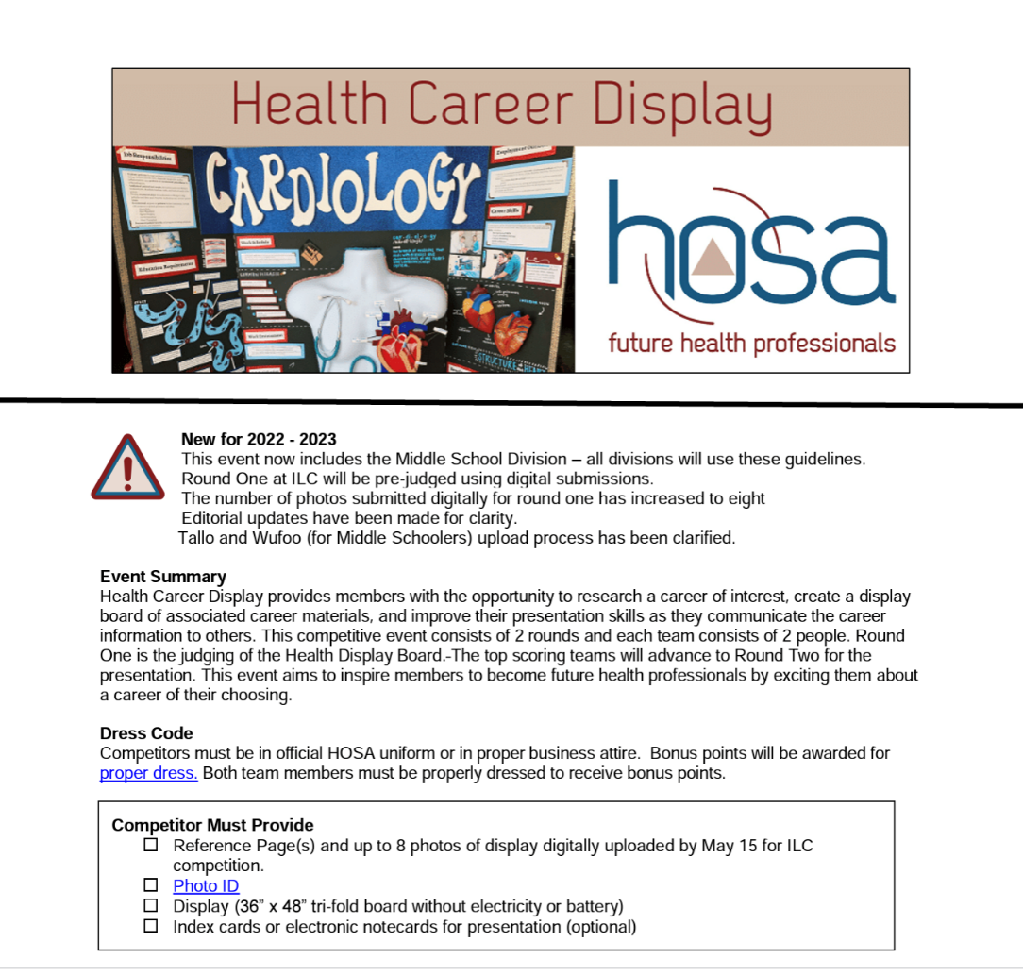
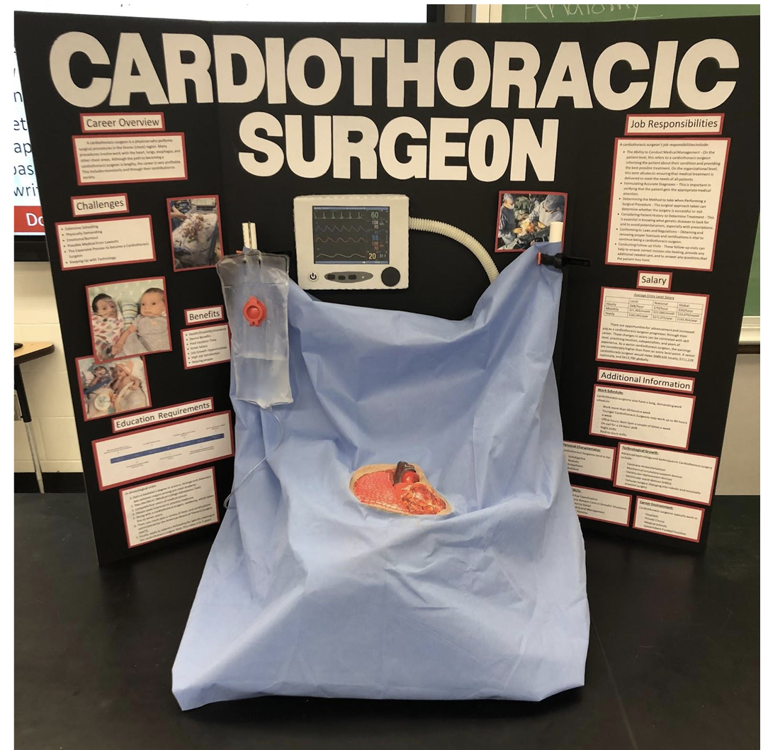

www.hosa.org/guidelines
Health Career Display
Excellent rubric for career search project
Instant way to decorate your room for open house
Notes:
Health Career Display – HOSA CE. Great project when teaching introduction to health professions. All students could develop health careers displays. Rubric is free download for teachers to use for grading. Great way to decorated a health science classroom for open house night!

Slide 45

healthscienceconsortium.org
Found on homepage with printing instructions

Slide 46



National Authority for
Health Science Education
Collaboratively defines and advances a consistent health science education framework over 32 years
Notes:
Introduce NCHSE- who we are …. our work and our mission. How we were formed. Celebrating 30 years of achievement.

Slide 47

Notes:
Launched in 2018. Today 2000 educators strong from across the nation.

Slide 48

Health Science Teachers Professional Learning Community

Slide 49
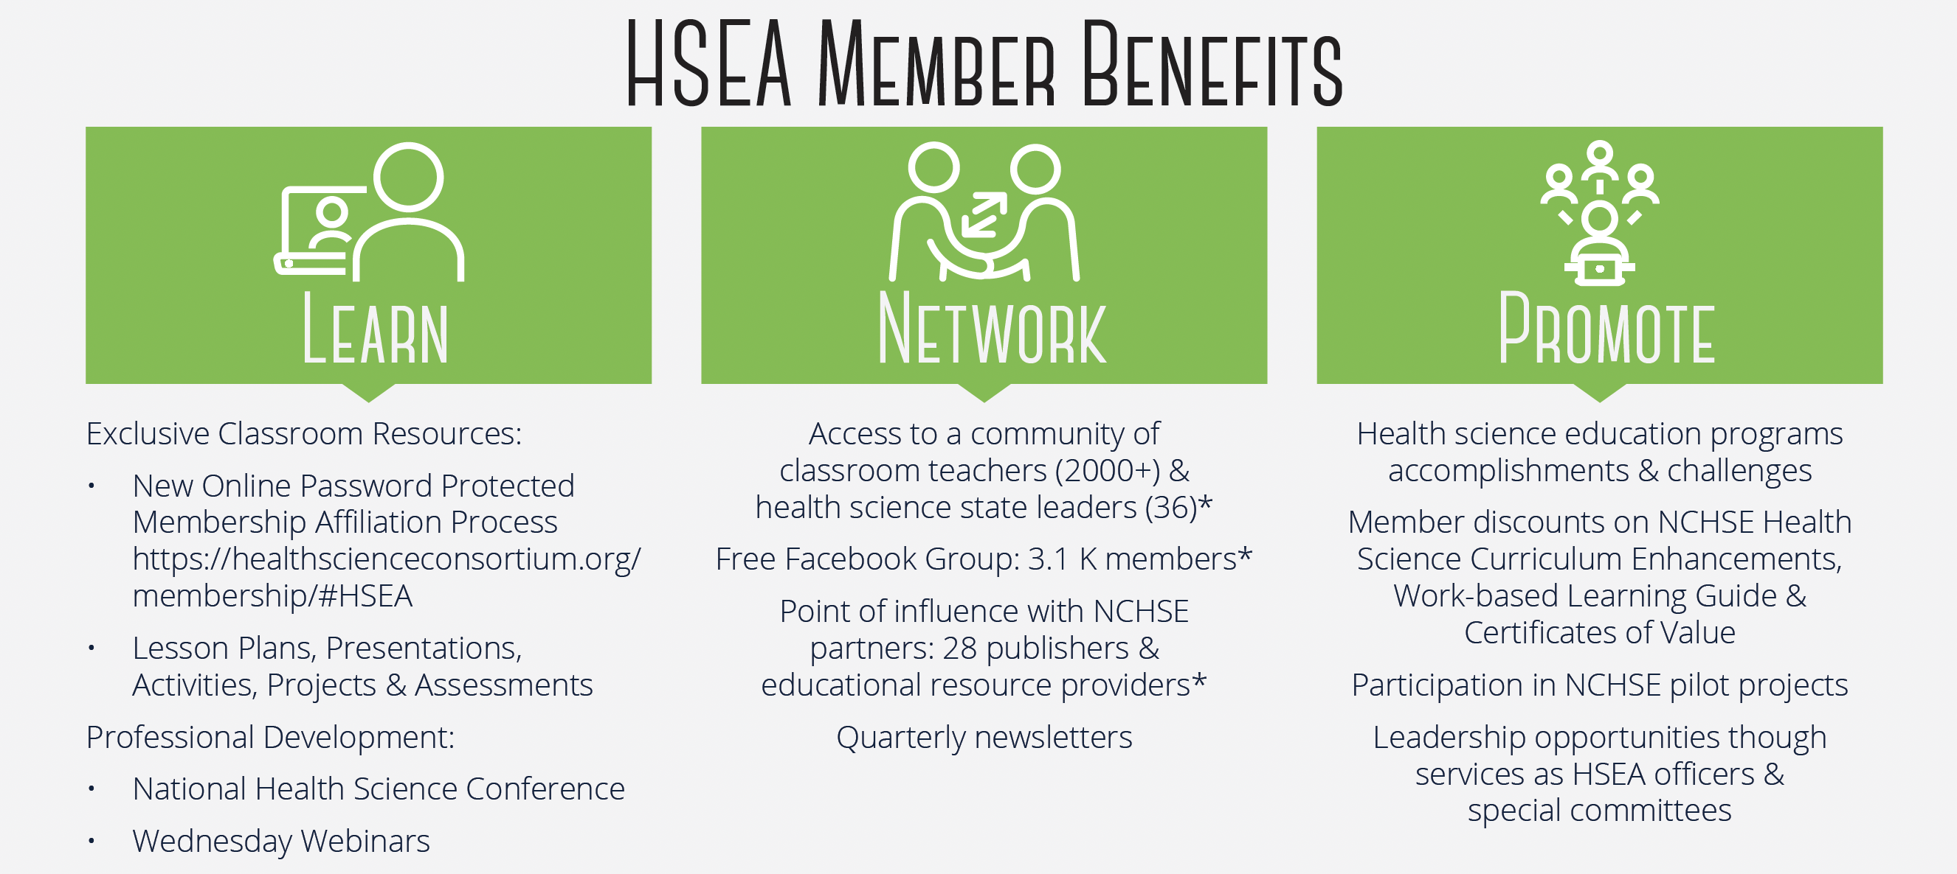

Slide 50
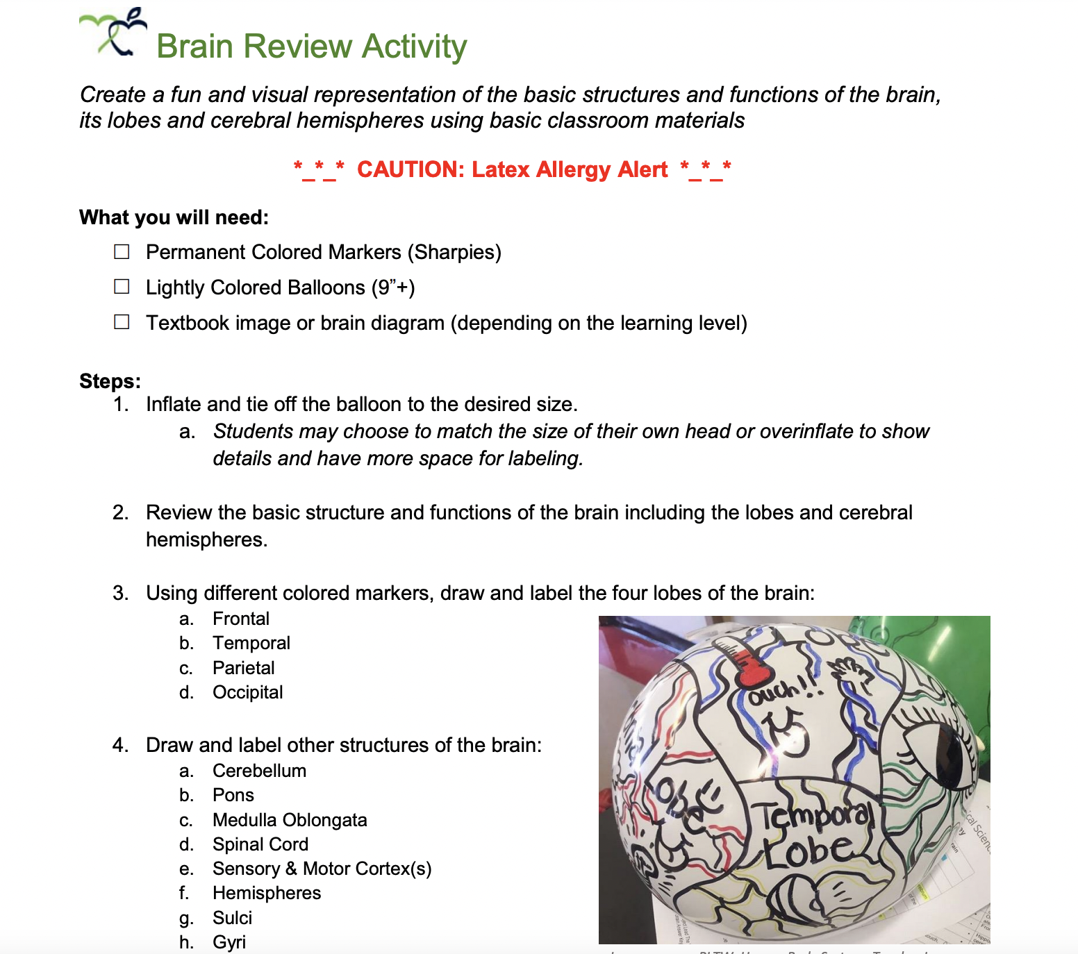
Exclusive Classroom Resources
Notes:
If everyone will share their email addresses, we will send you a copy of this activity. This is an example of the content in HSEA exclusive classroom resources.

Slide 51


11 State HSEA Affiliates
AL, GA, KY, MI, MO, OK, OR, SC, TX, WI, & WV
Notes:
Applaud Michigan as the first state to become at state affiliate of HSEA three years ago. Set the stage for more state to come onboard. TEXAS is one!

Slide 52
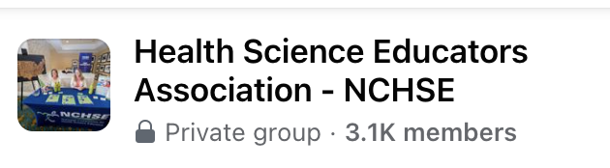

Facebook Group Open to All Health Science Teachers
Notes:
.

Slide 53

FREE Wednesday Webinars
Notes:
Explain FREE WWs; Fall offerings will posted on our website. registration links on NCHSE website at events tab. Scheduled 2-3x month on Wednesdays at 4:00 PM (ET) August to May…..relevant content for classroom teachers. Certifications of participation to document one hr of prof. dev. Available for live attendees. All are recorded and posted on our website for those unable to attend live. Invite them to visit archived webinars for valuable content. Webinars are organized by topics.

Slide 54

Notes:
Only national CTE conference that is 100% health science focused.

Slide 55

2023 National Health Science Conference Page

Slide 56
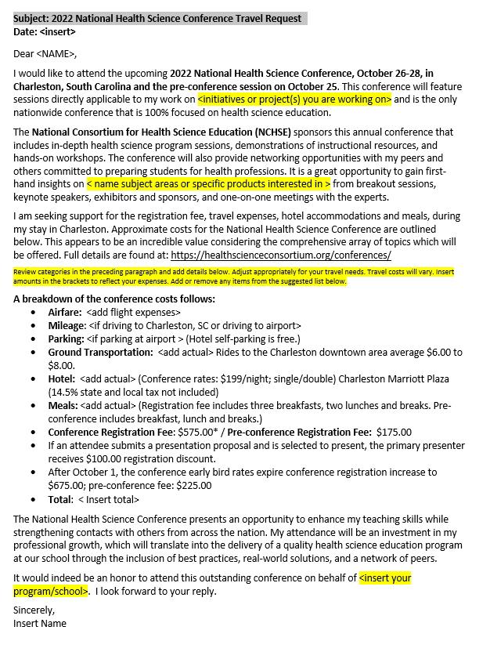

Request to attend letter template
available on NCHSE conference page.
$100 off registration for
primary presenter
Deadline: Aug 18

Slide 57

Expanding Classroom Resources
NCHSE Curriculum Enhancements 7.0 Version
NEW RELEASE:
Available for purchase for August 2023
Instructional strategies to deliver the National Health Science Standards
Notes:
Created by teachers for teachers; over 600 files….content outlines, PPTs, projects, activities, websites and test items. In PDF and Word for easy editing. Available at our online store for $500 or discounted to $350 for teachers whose state education agency is a NCHSE member or if the teacher is a HSEA member.

Slide 58


Slide 59

Questions?
Shelly Wehmeyer,
NCHSE Chair email:
Hello@healthscienceconsortium.org
Website: healthscienceconsortium.org

