Slide 1
So, You Want to Be in Health Care? How to Get What You Want...It's Possible!
Dr. Rebecca Burns

Slide 2
Agenda
Introduction
1
Primary Target-HC Pathways
2
Professional Plan-Timeline
3
Summary, Mock Interview, & Questions
5
Interviewing, Cover Letters and Resumes
4

Slide 3
Introduction
During this session, attendees will be introduced to pathways to varying healthcare careers, interview techniques, and resume-building strategies that have proven to be extremely effective for standing out in a crowd and landing your dream job. This information can be valuable to individuals, teachers, and their students through dissemination. Interview role-playing and audience interaction will be included and encouraged.
Audience Polling

Slide 4







Primary Target
What is your Target?
Healthcare Paths

Slide 5
Pathways
Pharmacy
Dentistry
Respiratory Therapy
Nursing
Medicine

Slide 6
Top Healthcare Professions*
Rank | Discipline | Median Salary Projection | Projected Jobs | Education
1 | NP | 113,000 | 121,000 | Masters
2 | PA | 38,400 | 123,000 | Masters
3 | Physical Therapist | 96,000 | 40,400 | Doctorate
4 | Dentist | 161,000 | 7700 | Doctorate
5 | Veterinarian | 101,000 | 16,800 | Doctorate
6 | Physician | 208,000 | 19400 | Doctorate
7 | Orthodontist | 208,000 | 300 | Doctorate
8 | Registered Nurse | 78,000 | 200K | Bachelor

Slide 7
The first one through the wall always gets bloody.
“
”
~Moneyball

Slide 8
Plan for Your Professional Launch
Be aware of timelines
Planning
Research programs nationally
Preparation
Prepare yourself for competition
Marketing
Foster relationships that mentor you
Launch
Strategy
Consider style of learning
Consider cost and financing
Location and availability of learning
Make smart choices with you education
Start building your identity
Make connections
Establish and nurture relationships
Volunteer if possible
Always live the profession
Avoid toxicity
See yourself as a living resume
Find and treasure tools that are resourceful
Know your program requirements and meet them
Constantly revise intent letters (cover letters)
Seek and accept critique
Be aware of resources you will need
Seek out grants and or employee-based funding
1
2
3
4
5

Slide 9
Sample Professional Plan Timeline
Sep 20XX
Nov 20XX
Jan 20XX
March 20XX
May 20XX

Slide 10
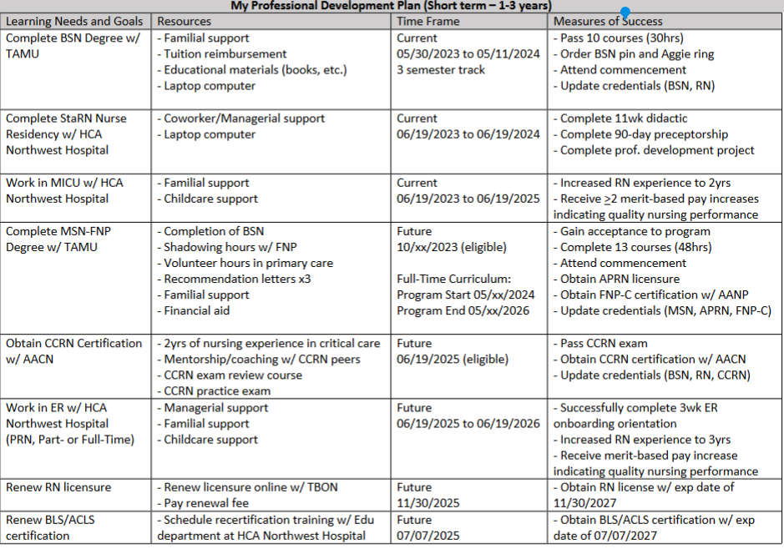

Slide 11

How to Build Your
Cover Letters and Resumes

Slide 12
Before you start…BRAINSTORM.
How has what you’ve done in the past relate to “X” profession?
Think about…
Customer Service Skills, Working in Teams, Patient Care/Health Care Experience, Technology/Databases or Electronic Records Experience, Management, etc.

Slide 13
Customer Service Skills
Ability to communicate effectively with a wide range of customers
1
Experience of working in a busy, inbound call center
2
Always looking at different ways to improve service given to customers
3
Ensured that a high level of customer care was exercized at all times
4
Projecting a professional image face-to-face, on the phone and via e-mail
5
Ability to remain calm when dealing with emotional, difficult, or distressed people
6
Handled complex queries and complaints
7
Directing requests and unresolved issues to other colleagues
8

Slide 14
Management
Flexible team player who prospers in a fast-paced work environment based on experience (balancing a full course load with employment, working off hours, a busy office, etc.)
Kept track of all team deadlines and targets
Experienced at managing a team of 50 employees from different regions of the country which also included 4 business units and 7 nationalities
Exceptional leadership skills developed through work experience in (government position, tutoring, student mentor/leader, teacher, supervisory role, etc.)
Prepared payroll data for processing and covered all employee vacations/absences to maintain smooth-running operation.

Slide 15
Technology
Maintaining up to date paper and computer-based files and administrative systems
Proficient computer literacy proven through work experience in (Front desk IT, software programming and applications, spreadsheet tabulations, social media coordination, etc.)
Managed a broad range of installation, upgrade, roll-out and troubleshooting projects for Windows-based network with focus on network systems and customer billing
List all Tech Certifications i.e., Microsoft, Cisco, etc.

Slide 16
Cover Letters

Slide 17
Source: Office of Career Services, Harvard University, https://ocs.fas.harvard.edu/resumes-cvs-cover-letters
A writing sample and an important part of the screening process.
Your opportunity to describe the very specific reasons why you are the ideal candidate for THIS position at THIS organization.
Effective cover letters:
Explain your interest in the position.
Highlight your MOST relevant skills and experiences.
Express a high level of interest and knowledge about the position and company.

Slide 18
The Basics
Use the same Heading for your Cover Letter and your Resume
Single-space your cover letter
Three basic Paragraphs:
    Introduction
    Argument
    Closing
Leave a space between each paragraph
Leave three spaces between your closing (such as "Sincerely“) and typed name
Either align all paragraphs to the left of the page, or indent the first line of each paragraph to the right
Use standard margins
Sign your name in ink between your salutation and typed name OR use an electronic signature

Slide 19
Getting Started
GET THE POSITION DESCRIPTION
This is the most important item to have when writing your cover letter AND your resume. If you don’t have access to a current description, look for old position descriptions or jobs that closely align to what you are seeking.
Look For:
What is Preferred
What technology/electronic records they use
GO TO THE WEBSITE
Look For:
Missions & Values
FAQ’s
GET CONNECTED
Look For:
Instagram, Facebook, Twitter, etc.

Slide 20
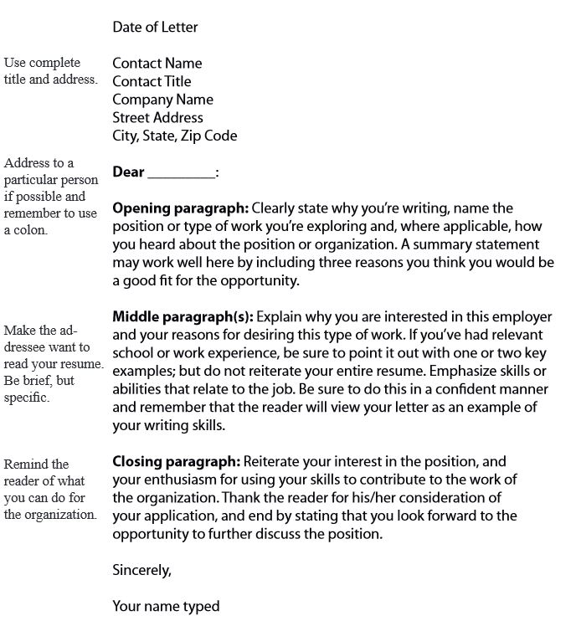
Organizing your Cover Letter
A cover letter has four essential parts:
Heading
Introduction
Argument
Closing

Slide 21
The Heading
At the top, include your contact information (use the identical format you use for your resume):
Name
Address
Phone number
Email address
Date – in which you are applying
Contact Information - Whenever possible, you should address your letter to a specific individual, the person in charge of interviewing and hiring (the hiring authority)
A Salutation, such as “Dear Mr. Roberts”

Slide 22

The Introduction
This is your Opening Paragraph
Clearly state why you're writing, name of the position or type of work you're employing and how you heard about the position (if applicable).
A summary statement may be good here; include three reasons you think you would be a good fit for the opportunity

Slide 23
The Argument
This is your middle paragraph
Explain why you are interested in this employer and this specific position
Emphasize skills and abilities directly related to this job; be specific
If you’ve had relevant experience, be sure to point it out with one or two key examples
Do not reiterate your entire resume, however!

Slide 24

The Closing
Reiterate your interest in the position and your enthusiasm for using your skills to contribute to the work of the organization.
Thank the reader for his/her consideration and end by stating that you look forward to the opportunity to further discuss this position.

Slide 25

Cover Letter Tips
Address the specific position advertised.
Pay very close attention to the job description and include how you meet the qualifications listed in your cover letter.
Use standard fonts (Times New Roman or Arial are the most readable); make sure to use the exact same font sizes as your resume.
Save your Cover Letter (and Resume) using your full name (do not save as “My resume).
This is not a time to demonstrate your “Bedazzle” talents

Slide 26
The Resume

Slide 27

Employers typically look at a resume for 20 seconds, thus, your resume should show the employer, briefly, what you excel at and why they should hire you.

Slide 28
What is the #1 Largest Resume Oversight?
Characterized Email Addresses
Real Examples:
Melissahotfriday@gmail.com
Johnnybgoodinthesack@yahoo.com
Ggknotchinpost@gmail.com

Slide 29

Resume Rules
Keep your resume to one page.
Use standard fonts (Times New Roman or Arial are the most readable); ranging from 11 to 12, using single-space.
Use action verbs instead of passive language.
Proofread carefully. Use the University Writing Center to help proofread, etc. https://writingcenter.tamu.edu/

Slide 30
Resume Rules
Highlight all professional (discipline specific) experience.
List jobs in reverse chronological order.
List your job information in order of importance to the reader.
In listing your jobs, what's generally most important is your title/position. So, list in this preferred order:
Title/position
name of employer
city/state of employer,
dates of employment.

Slide 31

Resume Rules
Quantify whenever possible.
Use numbers to tell employers how many people you supervised, how many patients you cared for, how many beds were in the hospital, clinic, or unit, the percent by which you decreased medication mistakes, etc.

Slide 32
DO NOT:
List you High School information
Use personal pronouns (I, my, me)
Don't emphasize skills and job activities you don't want to do in the future
Just list past job responsibilities; instead, include your highest professional achievements, not just your job descriptions
List references on your resume (they need their own page)
Abbreviate
Use a narrative style

Slide 33
The Interview – Dress for Success

Slide 35
Don’t Sell Yourself Short
Where did you graduate from?
(ex. TAMU is a Tier 1 university)
Attributes of that program
Ex. Aggie core values-#3 Best BSN Programs In The united states (RN-BSN, Trad, 2nd degree)
You don’t get what you don’t ask for
100% of students from previous semesters have obtained the positions they wanted, in the specialty they wanted
Sell yourself
If you don’t toot your own horn, no one else will….Do no waste this opportunity

Slide 36
How Does My Resume Compare?
Links
  UWC Resume/CV Link
  Resume Writing and Review
  Resume Checklist
  Create a Great Resume
  How to Write a Great Resume

Slide 37
Things to Include
Education
Professional Experience
Work experience to date
Put only the jobs that compliment your leadership, organizational and time management skills
Short and sweet-avoid long explanations
Consider higher level words (ex. Homemaker=home management specialist
Volunteer experience
Educational Experience
List course title-organization
Can place small summary of your role
May place professional involvement/development here too
Disaster day Committee member
Leadership organization member
Any workshops attended
Student government, etc.
Ex: TAMU CON, UTMB, UT
1st degree (if you are 2nd degree students)
Skills
BLS, ACLS, PALS
Honors/awards
STTI Honor Society

Slide 38
Summary and Mock Interaction
It’s your turn!

Slide 39
Thank you!
Dr. Rebecca Burns
rburns@tamu.edu
979-220-5801 (cell)
https://nursing.tamu.edu/faculty-staff/faculty/rebecca-burns.html

