Slide 1
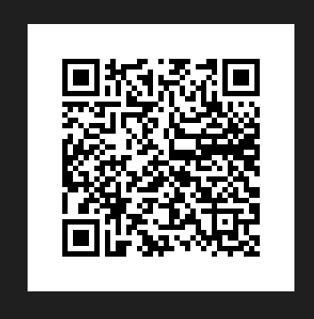
Welcome
START!
Linda Stanhope
Kim Turnbull

Slide 2
50 Ways to Teach Med Term
Session One
Activities
Labs
Scenarios
Drills
Research
Notes:
Using a shoulder partner tell one another how your typical meal compares to the recommended MyPlate

Slide 3
Medical Term Scavenger Hunt - Chapter Opener
In this chapter, you will learn medical word parts and terms related to basic anatomy and physiology. Before you begin this chapter, read the scenario that follows.
Norah Le, a 16 y/o Asian female, comes to the ER c c/o pain in the RLQ of the abdominal area. The nurse places her in lateral position until the doctor comes in, @ which time pt. is placed in a supine position. Upon PE, while palpating in the Rt iliac region, the pain becomes more intense. Dr. Jutte orders a STAT CBC, UA, HCG, and ultrasound of the abdomen to r/o appendicitis.
For each highlighted medical term or abbreviation, search through this chapter to find the meaning. Some of these terms and abbreviations were introduced in the previous chapter.

Slide 4
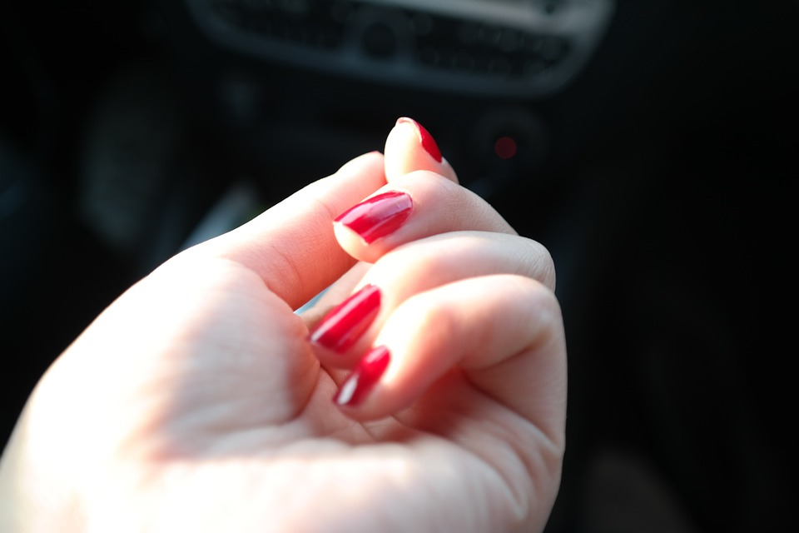
Fingernails
The fingernails are said to cover the dorsal surfaces of the distal phalanges (the bone segments that are the farthest away from the wrist in each hand). From a common-sense point of view, this might seem inaccurate. Should fingernails be located on the anterior, or front, of each hand? Remember, however, that in science and medicine, locations and positions on the human body are described from the perspective of anatomical position. In anatomical position, the body is erect
with the arms at the sides and the palms facing forward. From this point of view, the fingernails cover the dorsal surfaces of the distal phalanges.
NEXT!
Ponder This

Slide 5
Career to Consider
A prosthetist (PRAHS-thuh-tist) measures,
designs, fabricates, fits, and services a prosthesis
(prahs-THEE-sis), or artificial limb.
CREDITS
A licensed
physician can prescribe a prosthesis for the
replacement of an extremity due to amputation,
congenital deformity, or absence. A prosthetist
must have at least a master’s degree and complete
a one-year residency to obtain certification.
Prosthetist

Slide 6
Table of Contents
Official Event Resource
Sports Medicine
Career Health
Display
Biomedical Debate
Medical Spelling
Epidemiology
Notes:
Use students and create a story about why one may need more than another.

Slide 7
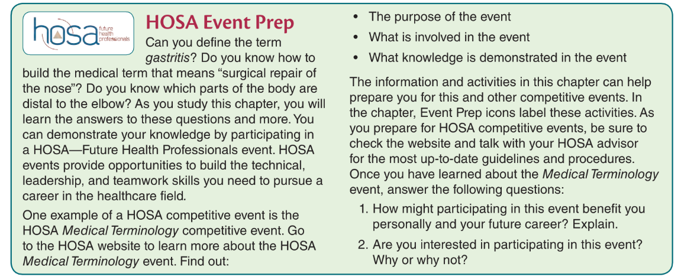
Table of Contents
Event Prep
Sports Medicine
Career Health
Display
Biomedical Debate
Medical Spelling
Epidemiology
Notes:
Use students and create a story about why one may need more than another.

Slide 8
The purpose of the event
What is involved in the event?
What knowledge is demonstrated in the event The information and activities in this chapter can help prepare you for this and other competitive events.
1. How might participating in this event benefit you personally and your future career? Explain.
2. Are you interested in participating in this event? Why or why not?
Event Prep
Check it out!

Slide 9
Table of Contents
Event Prep
Sports Medicine
Career Health
Display
Biomedical Debate
Medical Spelling
Epidemiology
Excellent time to encourage your students to participate in Forensic Science. Each chapter suggests different events. This is an excellent opportunity to incorporate HOSA in the classroom.
Notes:
Use students and create a story about why one may need more than another.

Slide 10
Table of Contents
Event Prep
Sports Medicine
Career Health
Display
Biomedical Debate
Medical Spelling
Epidemiology
Notes:
Use students and create a story about why one may need more than another.

Slide 11
New Labs in Intro to Medical Terminology, 2nd Ed
Inquiring Minds
Labeling the Body
Skin Function
Fingerprints
Understanding Calcium - chicken bones
Rigor Mortis
Blood Type & Cross
Pulse points
Arrhythmias
Rhinovirus - research lab
Virus mutations - research COVID mutations
Digestion in Oral Cavity
Diarrheal Diseases - top 5
Diarrheal Diseases - top 5
Developmental Disabilities - research
Neuro VS
Supertasters
Taste and Smell
Type I & Type II DM - research
Hydration - group lab
Prostate Cancer Tx - research
Types of Birth Control - small group research
PMS - research
DNA Testing

Slide 12
Kitchen Labs
Lesson for Osmosis to help students understand concepts of
Hypertonic
Hypotonic
Isotonic
Fetal Alcohol Syndrome

Slide 13
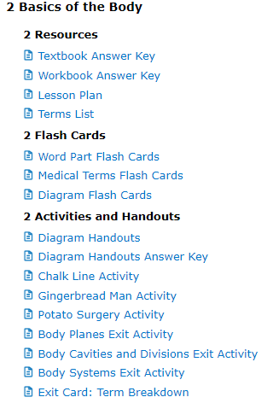
Menu
Lesson Plans
Scope & Sequence
Games
Teaching Strategies
Chapter Reviews
Cumulative Reviews
!
Additional Labs found in Teacher Resources
Textbook LABS

Slide 14
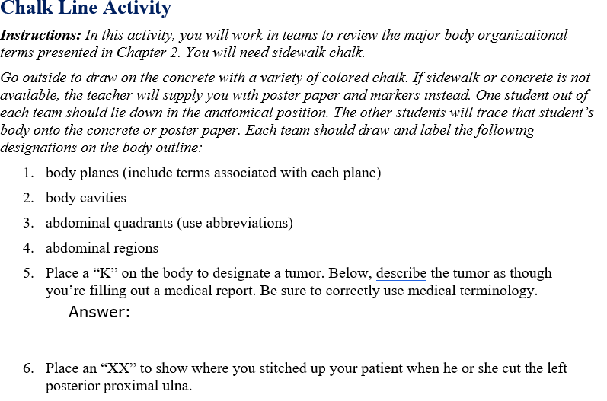
Menu
Lesson Plans
Scope & Sequence
Games
Teaching Strategies
Chapter Reviews
Cumulative Reviews
CHALK LINE ACTIVITY
ExamView

Slide 15
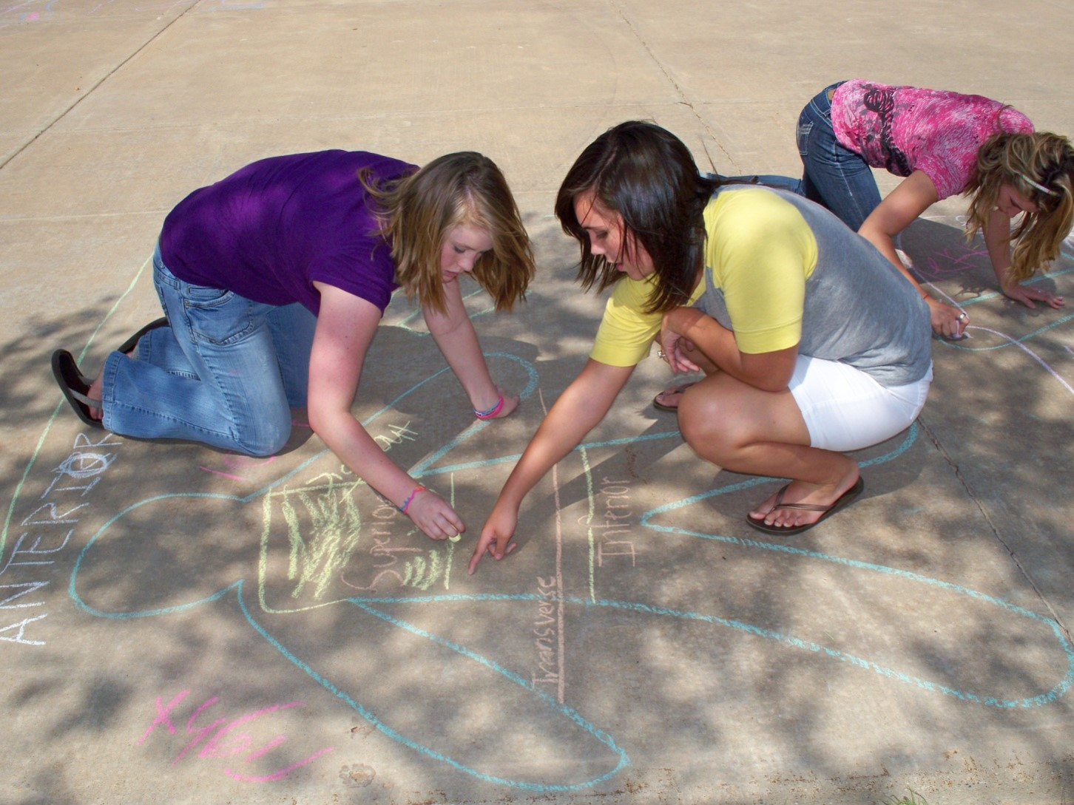
Menu
Lesson Plans
Scope & Sequence
Games
Teaching Strategies
Chapter Reviews
Cumulative Reviews
CHALK LINE ACTIVITY
ExamView

Slide 16
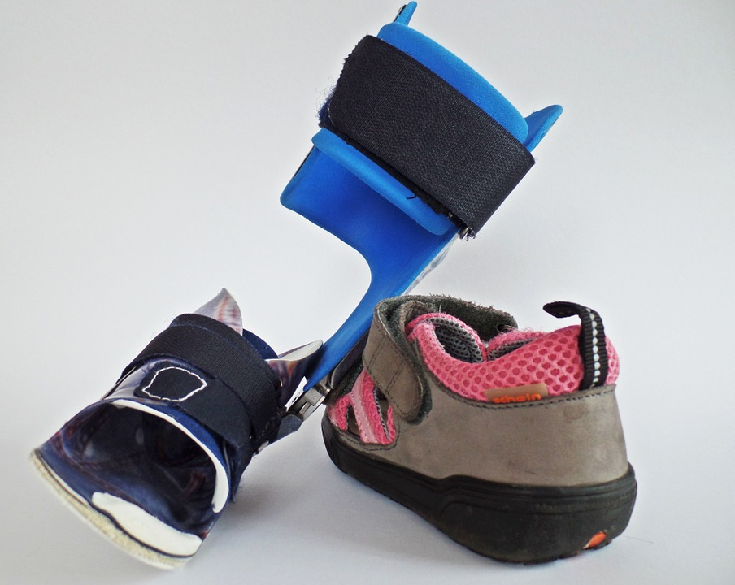
Walk in the patient’s shoes -
Literally
Help teach students empathy for their patients through simulations of disabilities
Breathing problems- have students' breath through straws and compression binders
Aging- have students wear braces and use canes and walkers
Hemiparesis/stroke – tie down limbs with braces or torn rags to restrict movement
Notes:
Have students act out/be visuals for the organs!

Slide 17
Student Challenge - 1 of 30
Percentage Body Weight
Blake weighs 140 pounds, 60 pounds of which are muscle. What percentage of Blake’s body weight is muscle?
¼ = 25%
Calculate this
The ratio of muscle to total body weight is often expressed as a percentage. Percentages can also be expressed as fractions. To calculate a percentage, first set up a fraction. Then divide the numerator (top number) by the denominator (bottom number).
2. What is the percentage of muscle weight for an 80-pound female with 35 pounds of muscle?
Math!!

Slide 18
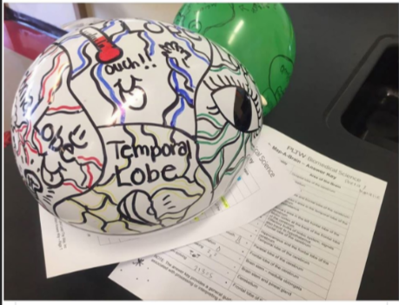
Make a Model
:
Understanding the brain

Slide 19
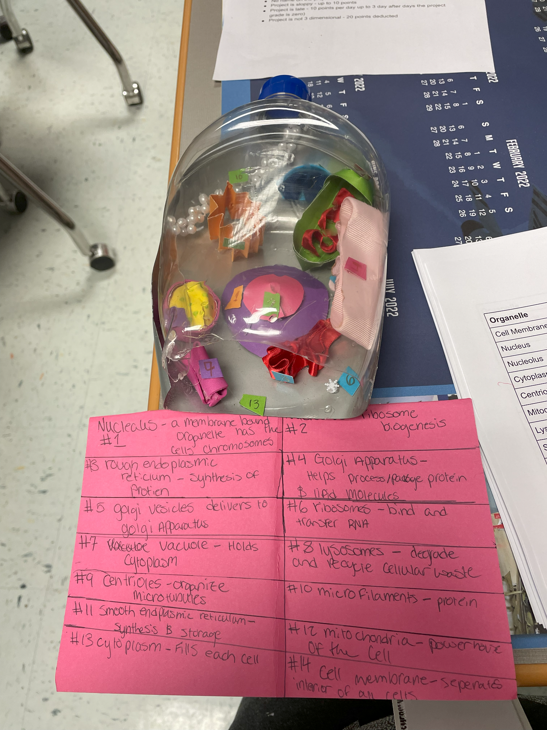
Make a Model
:
Trash Cell model

Slide 20
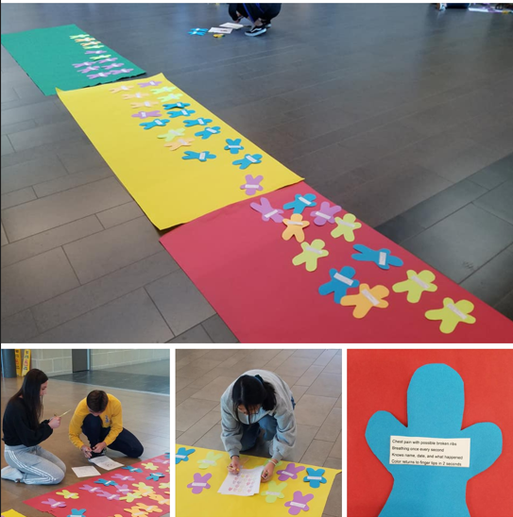
Make a Model
:
Give them a patient

Slide 21
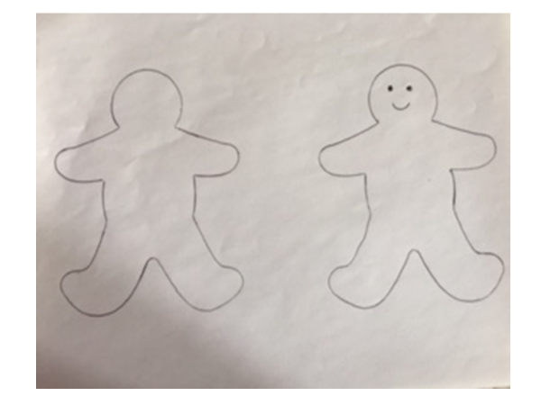
Make a Model
:
Give them a patient

Slide 22
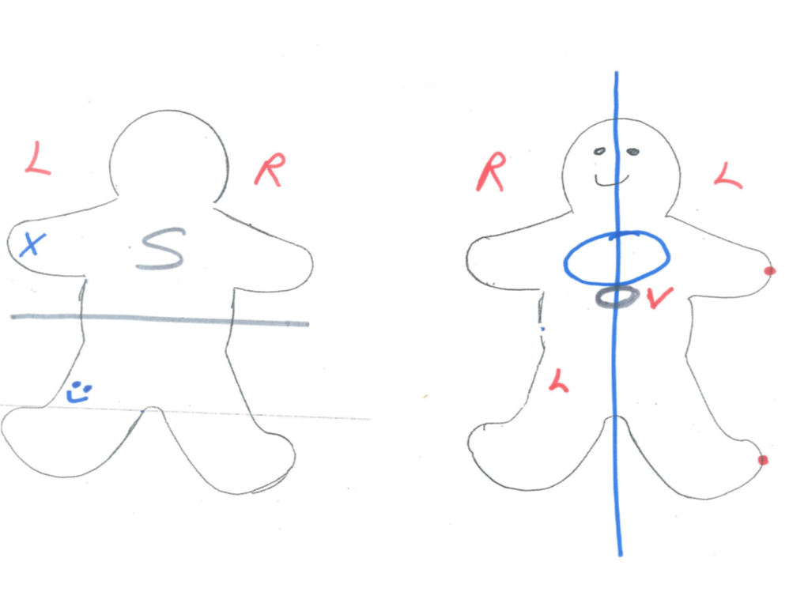
Make a Model
:
Give them a patient

Slide 23
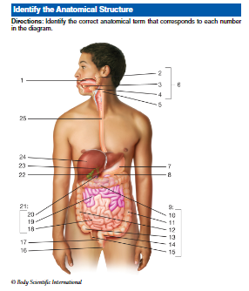
Team Challenge
:
List the organs in order
Alimentary Canal pathway

Slide 24
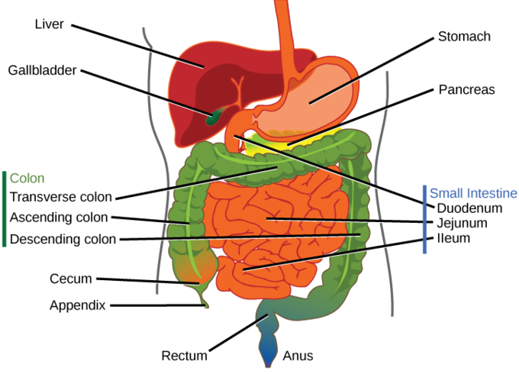
This Is a Map!
Table of Contents
Stomach
Duodenum
Jejunum
Ileum
Colon
Team Challenge

Slide 25
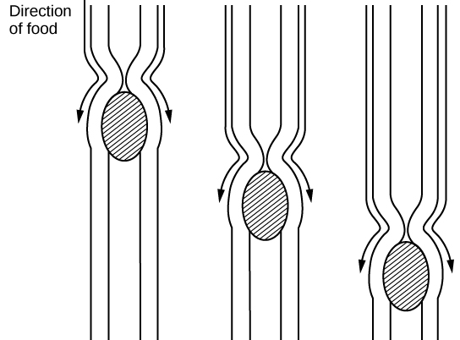
What happens to the “Corn” we eat?
Team Challenge
The organs,
Enzymes and how long does it take
DIG DEEPER

Slide 26
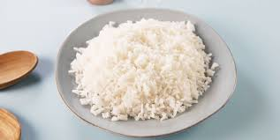
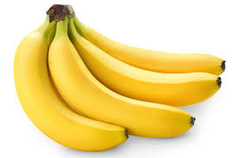
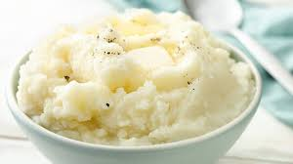
Collage ideas!
Notes:
Bland

Slide 27
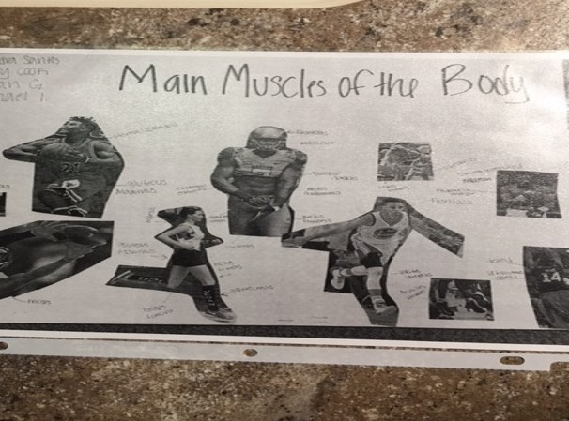
Collage ideas!
Notes:
Bland

Slide 28
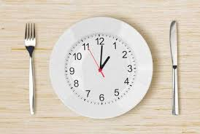
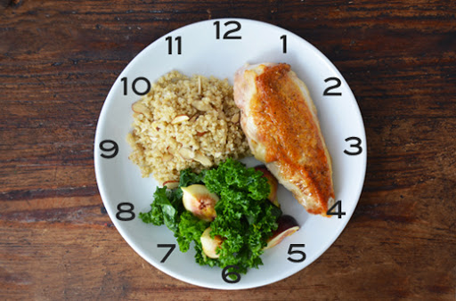
Student Challenge
If the patient is unable to see and would like to feed himself, describe the position of the food on the tray.
Ie - cold liquids in the left corner, hot liquids in the right corner.
Describe the food on the plate in terms of a clock face.

Slide 29
Work Place SKILLS,
in every chapter
Skill #17
Height & Weight
SKILL #10
Feeding the Dependent
Resident
Skill #4
Range of Motion
Skill # 8
Taking a Pulse

Slide 30
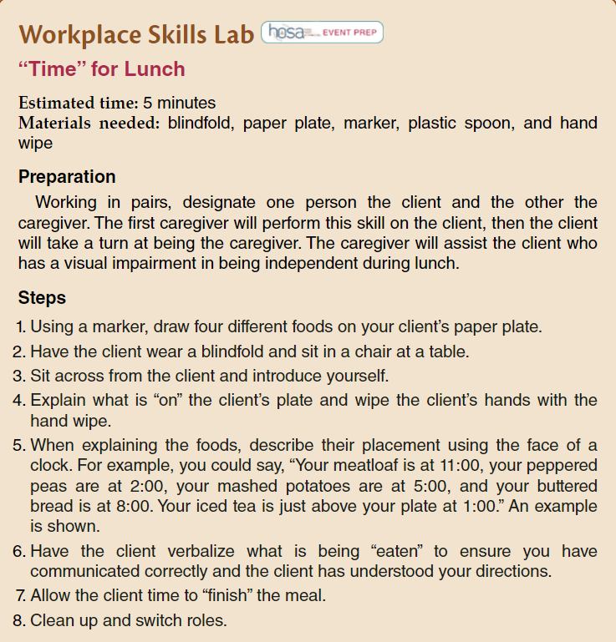
Work Place SKILLS in every chapter

Slide 31
Team Challenge (Brain break) 5 in 1 minute
Study of Life
Structure or tissue surrounding the heart
Surgical repair of the nose
Tumor or mass of the connective tissue
Inflammation of the small intestines

Slide 32
End of Chapter Reviews in the Book
Word Surgery and Word construction.
Medical Records Practice and Doctors orders
Word Parts
And
Abbreviations
Anatomy
and Physiology
Matching
Spelling
Pronunciation
Exercises

Slide 33
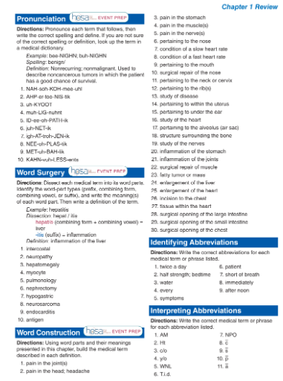
End of Chapter Reviews in the Book
Notes:
Bland

Slide 34
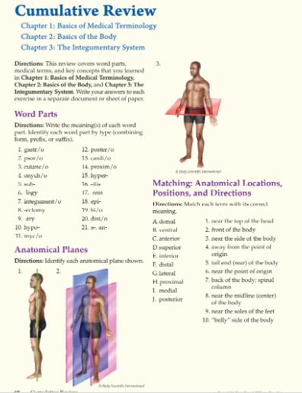
Cumulative Reviews in addition
Notes:
Bland

Slide 35
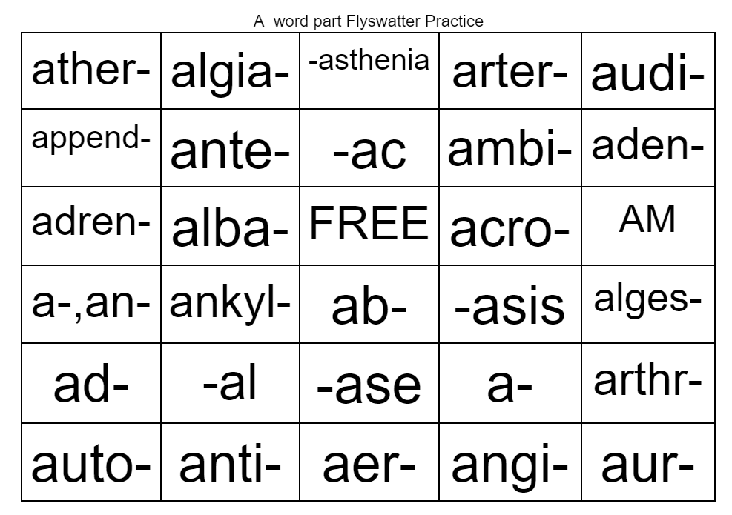
Flyswatter/Bingo
Template is available in Teacher Resources
Notes:
Have students act out/be visuals for the organs!

Slide 36
Direction found in Lesson Plans
Foldables
Bell ringers
Exit Tickets
Labs
Flash
cards
Games
White Boards
Review Activities
Models
Table Groups
Small group Races
Diagram cards
Word Surgery
Word Construction
Diagram Drills
Bingo
Flyswatter
Kahoot
Gimlet
Quizlet

Slide 37
Word Surgery

Slide 38
Rhino/rhea

Slide 39
Runny nose

Slide 40
Cephal/algia

Slide 41
H/A
Headache

Slide 42
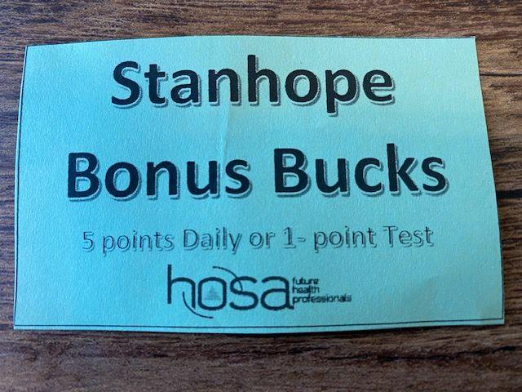

Slide 43
Direction found in Lesson Plans
Foldables
Bell ringers
Exit Tickets
Labs
Flash
cards
Games
White Boards
Review Activities
Models
Table Groups
Small group Races
Diagram cards
Word Surgery
Word Construction
Diagram Drills
Bingo
Flyswatter
Kahoot
Gimlet
Quizlet

Slide 44
Flashcards- table groups
Drills
Term
Definition
Tricho-
hair
Practice!!

Slide 45
Direction found in Lesson Plans
Foldables
Bell ringers
Exit Tickets
Labs
Flash
cards
Games
White Boards
Review Activities/Diagram cards
Models
Table Groups
Small group Races
Diagram cards
Word Surgery
Word Construction
Diagram Drills
Bingo
Flyswatter
Kahoot
Gimlet
Quizlet

Slide 46
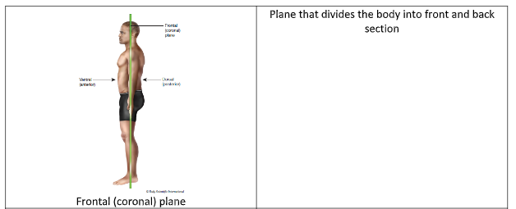
Diagram Card
Notes:
Have students act out/be visuals for the organs!

Slide 47
??????
Yes LOTS of Different ideas
Next session
Questions
Answers

Slide 48
??????
Please Clean up and leave bag at table for next session
Questions
Answers

Slide 49
Contact Information
kim.turnbull62@gmail.com
Introduction to Medical Terminology
2nd Edition
linda.stanhope6@gmail.com
www.g-w.com

Slide 50
Thanks!
Table of Contents
Section 1
Section 2
Section 3
Section 4
Credits
Do you have any questions?
Mallory Dufek, Acquisition Editor - mdufek@g-w.com
Abigail Hess, Marketing Manager - ahess@g-w.com
G-W Goodheart-Willcox Publisher
Please keep this slide for attribution.

