Slide 1
Why you should consider becoming a CASA
(Court Appointed Special Advocate)

Slide 2
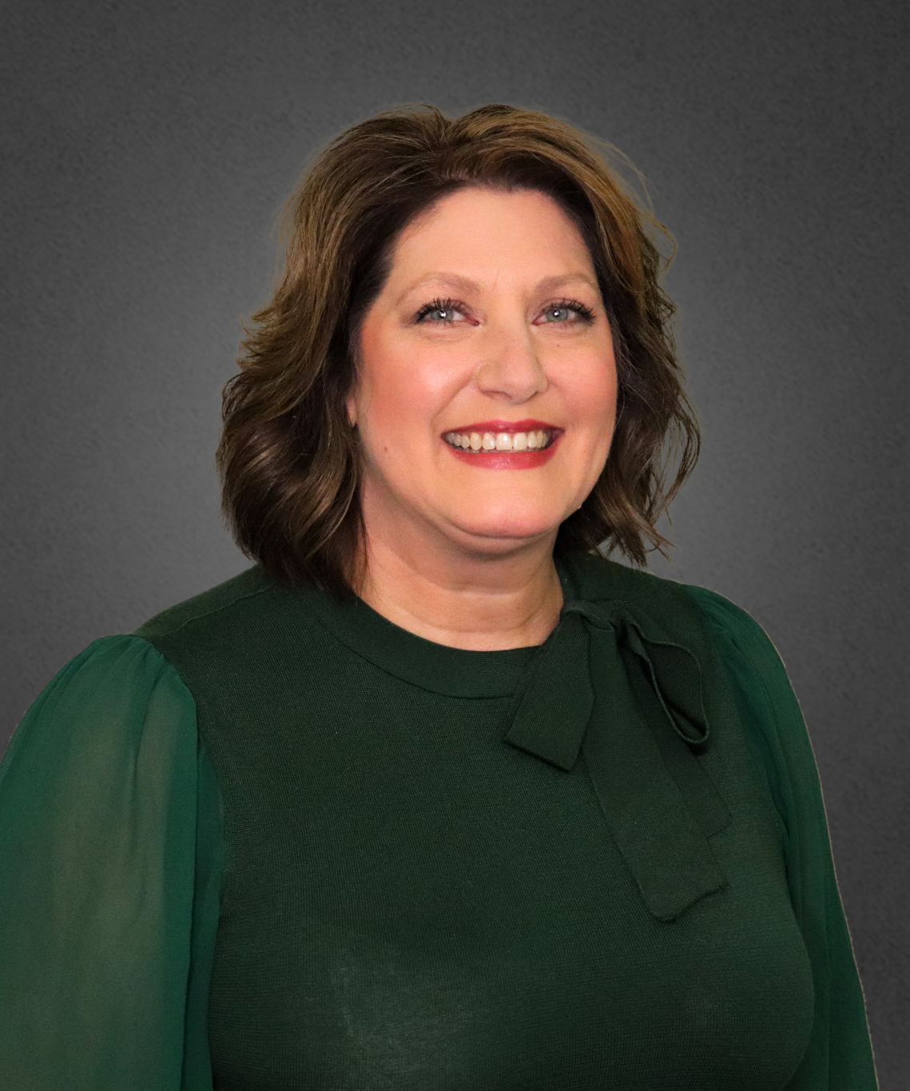
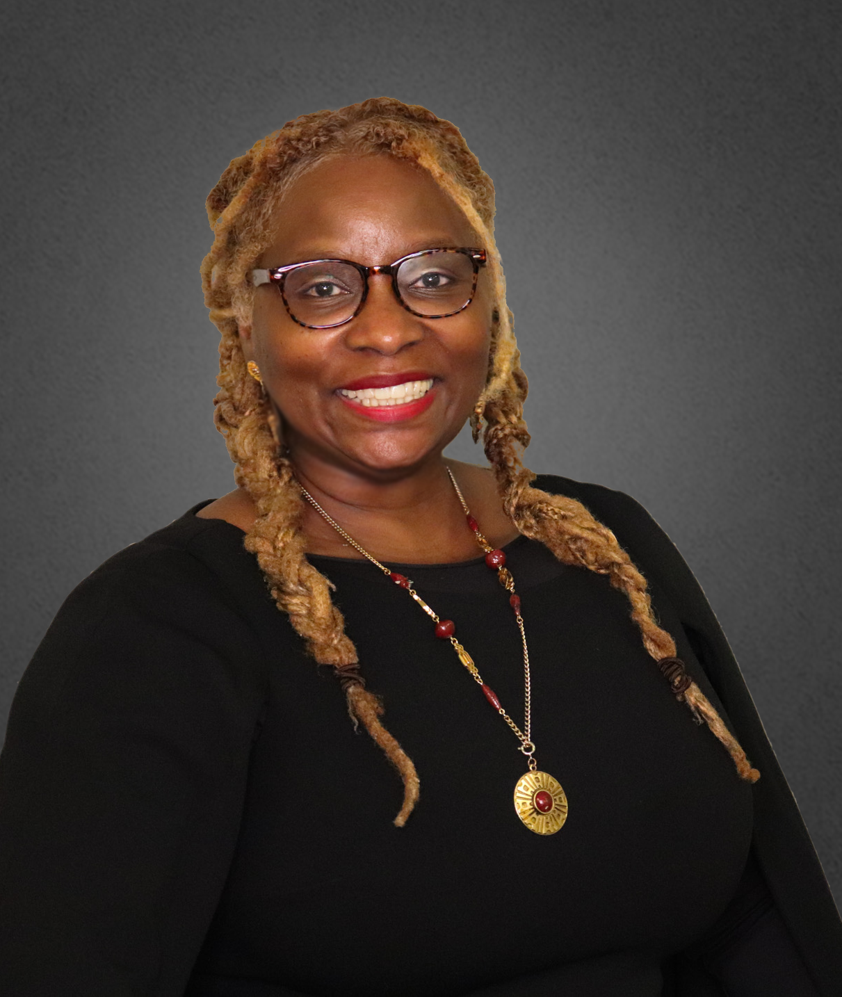
Who we are…
Sara Lynn
Willis
CJ
Spencer
CASA &
Health Science Teacher
Recruitment & Training Coordinator
Career: 20 yrs as an Ophthalmic Technician & 6 yrs as Health Science teacher
Favorite summer vacation spot: beach, but not Texas
Cannot live without: Diet Dr. Pepper
Career: 20+ yrs as a health and safety provider/trainer (corporate and nonprofit) in Missouri & 1+ years with Voices for Children
Favorite summer spots: Valencia, Spain & Sarasota, Florida
Cannot live without: coffee, any brand, any time

Slide 3
Our Mission
Voices for Children works to improve the lives of children in foster care through powerful volunteer advocacy, until each child is placed in a safe and permanent home.

Slide 4
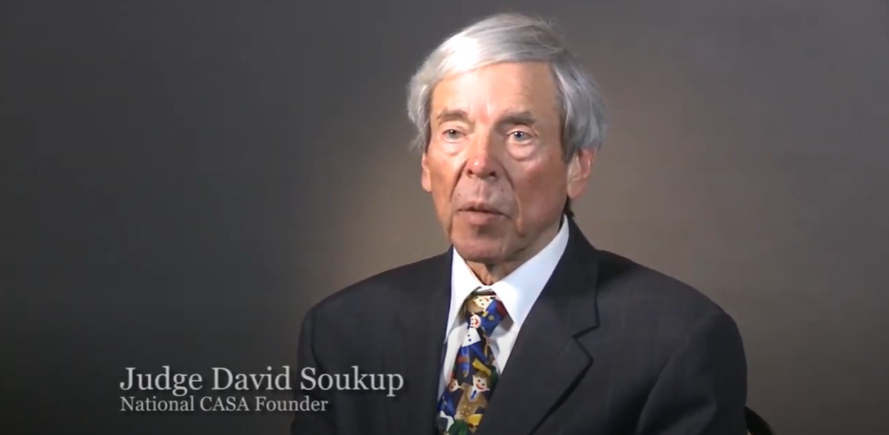
Our History
2000
Voices for Children is founded.
1977
The first CASA program is established in Seattle, Washington by Judge Soukup, a superior court judge.
2001
Voices for Children trains its first class of advocates.
1989
The CASA movement came to Texas. Texas CASA is founded. There are currently 73 CASA programs in the state of Texas.
2022
Voices for Children is currently serving 5 counties in the Brazos Valley region- Brazos, Burleson, Grimes, Madison and Leon.

Slide 5
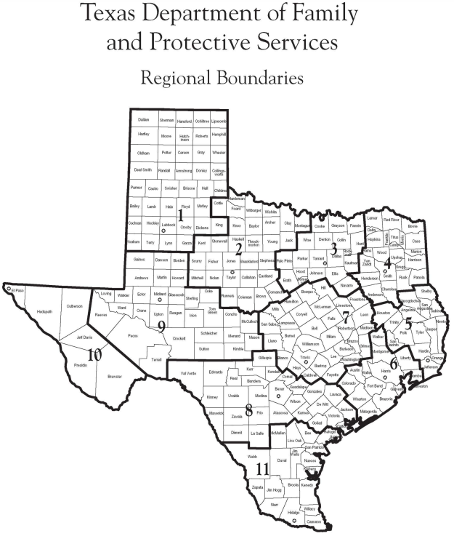
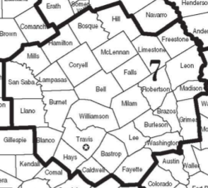
Source: Map of DFPS Region

Slide 6
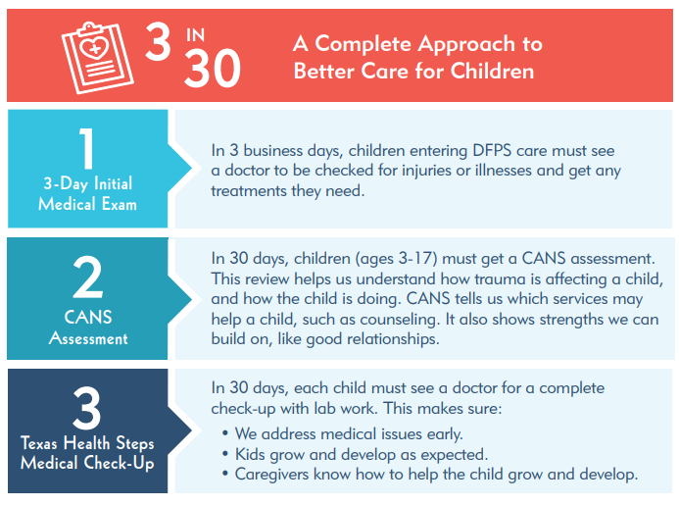
CASA’s Lens for Health Advocacy

Slide 8
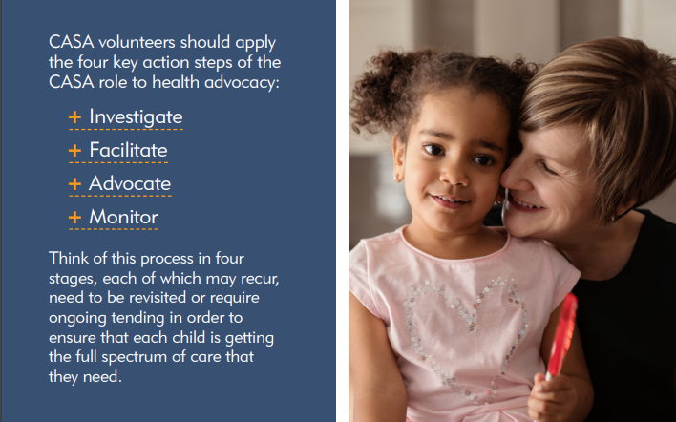
CASA’s Role in Health Advocacy

Slide 9
What’s the CASA Connection to the Texas Health Occupations Association?
Both Professional Development Opportunities Both value the science, for VFC that includes the science behind the trauma (ACES), medical, educational advocacy | Both have high professional standards for our teams (volunteers, members, etc.) Both are agents for the dissemination of information related to our respective communities

Slide 10
Ever wondered…?

Slide 11
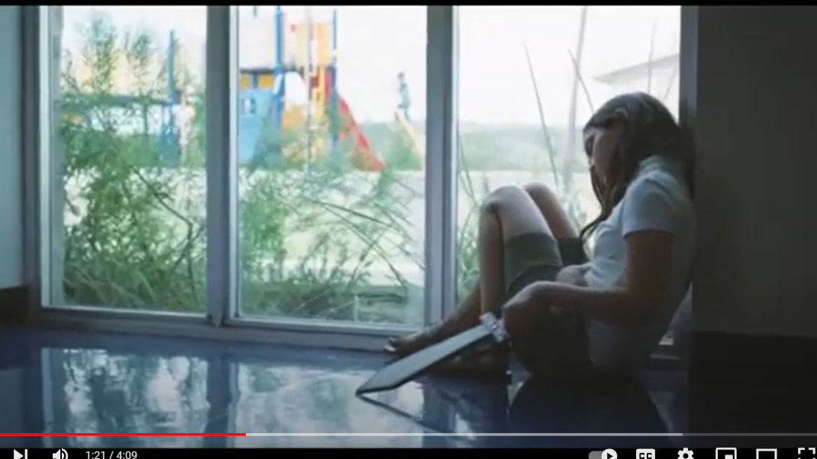
So, let’s meet Emily!

Slide 12
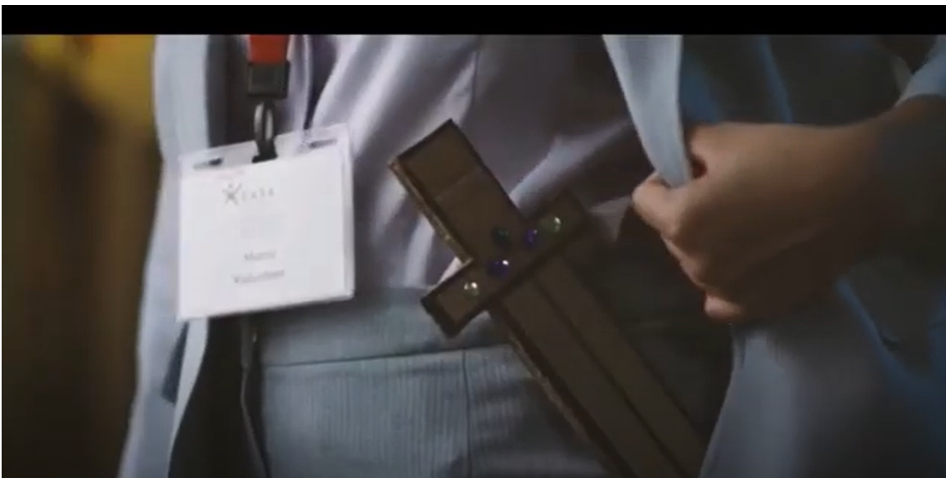
“When a child enters the foster care system because his or her home is no longer safe, we would hope that there’s someone there who may be the one consistent adult in their life.”

Slide 13
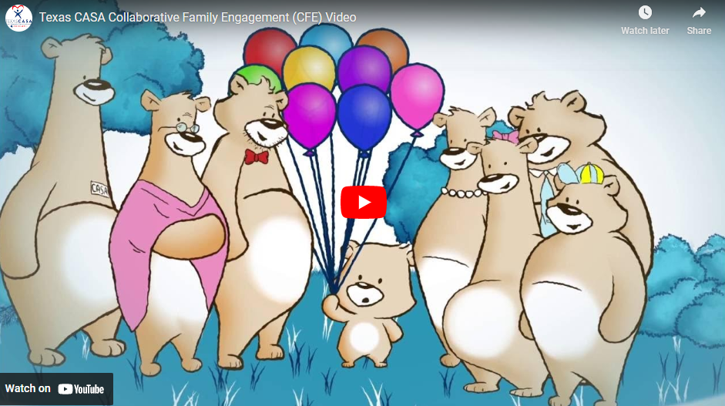
Advocacy & Connections!

Slide 14
TEKS Standards for Health Science courses
The student uses verbal and nonverbal communication skills. The student is expected to: (B) demonstrate effective communication skills for responding to the needs of individuals in a diverse society; The student implements the leadership skills necessary to function in a democratic society. The student is expected to: (C) demonstrate the ability to effectively conduct and participate in meetings. The student recognizes the rights and choices of the individual. The student is expected to: (A) identify situations related to autonomy; (B) identify wellness strategies for the prevention of disease; (C) evaluate positive and negative effects of relationships on physical and emotional health such as peers, family, and friends in promoting a healthy community; (D) review documentation related to rights and choices; and (E) demonstrate an understanding of diversity and cultural practices influencing contemporary aspects of health care.

Slide 15
TEKS Standards for Health Science (cont.)
The student analyzes and evaluates communication skills for maintaining healthy relationships throughout the lifespan. The student is expected to: (A) evaluate how healthy relationships influence career goals; (B) demonstrate communication skills in building and maintaining healthy relationships; (C) demonstrate strategies for communicating needs, wants, and emotions; and (D) evaluate the effectiveness of conflict resolution techniques in various simulated situations. The student relates appropriate information to the proper authority in a simulated classroom setting. The student is expected to: (A) identify and retrieve reportable information; and (B) report simulated information according to facility policy. The student identifies problems and participates in the decision-making process. The student is expected to: (A) analyze systematic procedures for problem solving; (B) evaluate the impact of decisions; and (C) suggest modifications based on decision outcomes.

Slide 16
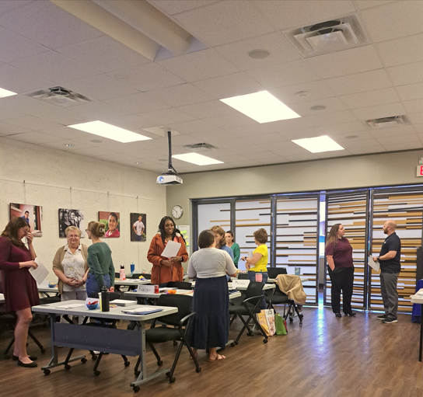
Training Topics
Pre-Service Curriculum Categories Session 1: The CASA/GAL Volunteer Role Session 2: The Well-Being of the Child Session 3: Trauma, Resilience and Communication Skills Session 4: Mental Health, Poverty and Confidentiality Session 5: Substance Abuse, Diversity & Disproportionality Session 6: Domestic Violence, Bias and Cultural Competence Pre-Service Session 7: Educational Advocacy, Older Youth and LGBTQ Youth Pre-Service Session 8: Moving Forward as an Advocate

Slide 17
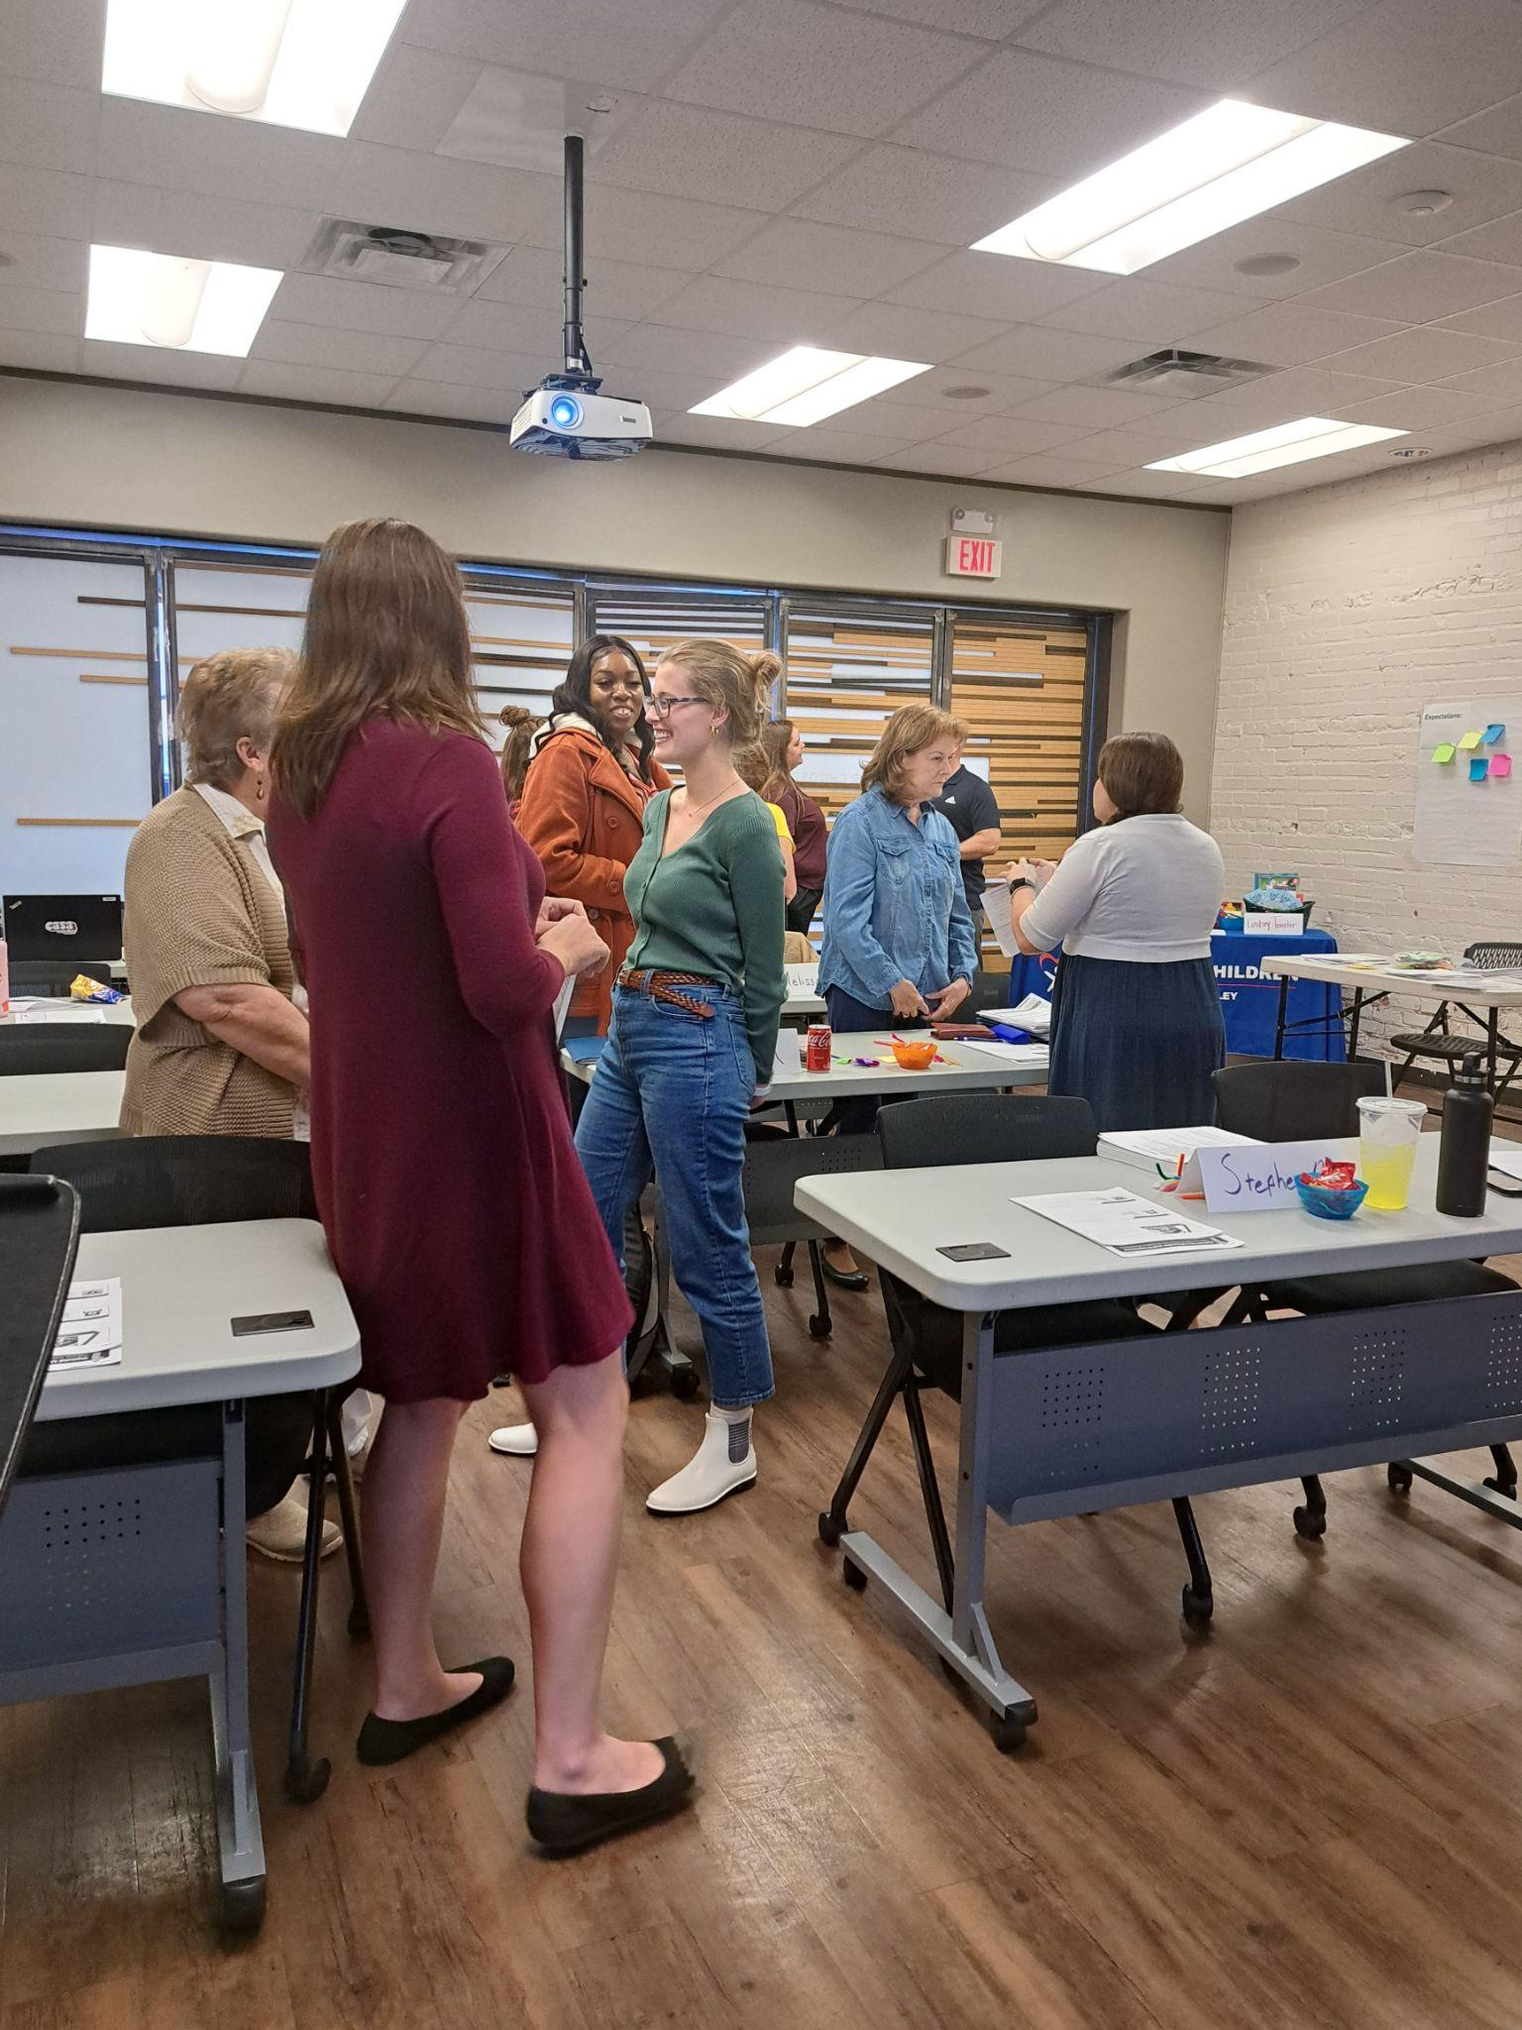
Training Schedule (A)
A) Summer Fast Track 2023 Mon, Jul 24, 2023 9:00am - 12:30pm Tue, Jul 25, 2023 9:00am - 12:30pm Wed, Jul 26, 2023 9:00am - 12:30pm (Court Observation) Thu, Jul 27, 2023 9:00am - 12:30pm Fri, Jul 28, 2023 9:00am - 12:30pm Mon, Jul 31, 2023 9:00am - 12:30pm Tue, Aug 1, 2023 9:00am - 12:30pm Wed, Aug 2, 2023 9:00am - 12:30pm (Court Observation) Thu, Aug 3, 2023 9:00am - 12:30pm Fri, Aug 4, 2023 9:00am - 12:30pm

Slide 18
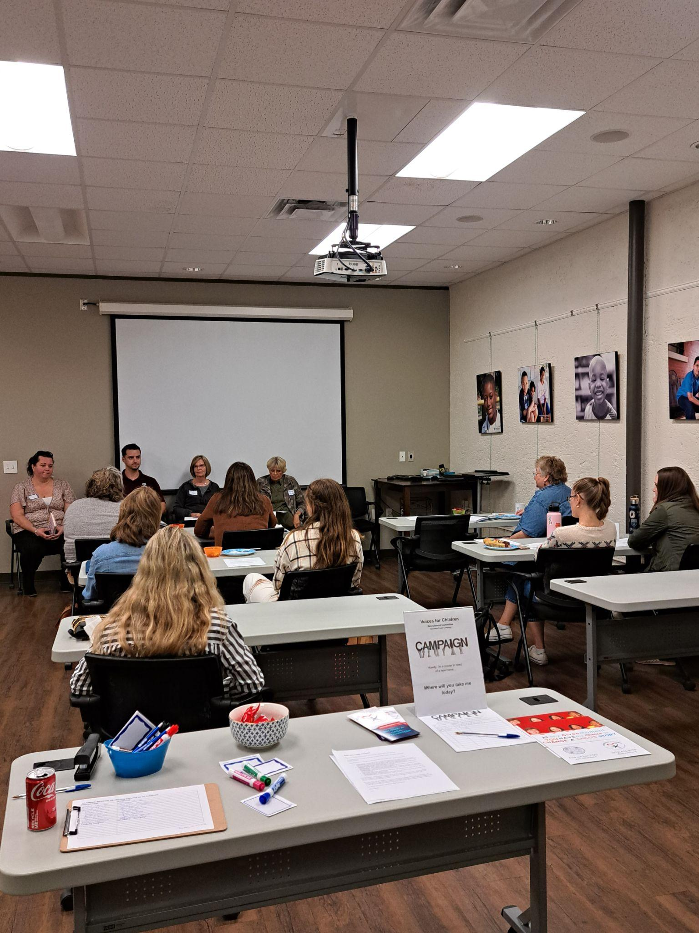
Training Schedule (B)
B) Fall Traditional Series 2023 Mon, Sep 25, 2023 5:30pm - 9pm Thu, Sep 28, 2023 5:30pm - 9pm Mon, Oct 2, 2023 5:30pm - 9pm Thu, Oct 5, 2023 5:30pm - 9pm Sat, Oct 7, 2023 12pm - 2pm (Optional Training Lab) Mon, Oct 9, 2023 5:30pm - 9pm Thu, Oct 12, 2023 5:30pm - 9pm Mon, Oct 16, 2023 5:30pm - 9pm Thu, Oct 19, 2023 5:30pm - 9pm

Slide 19
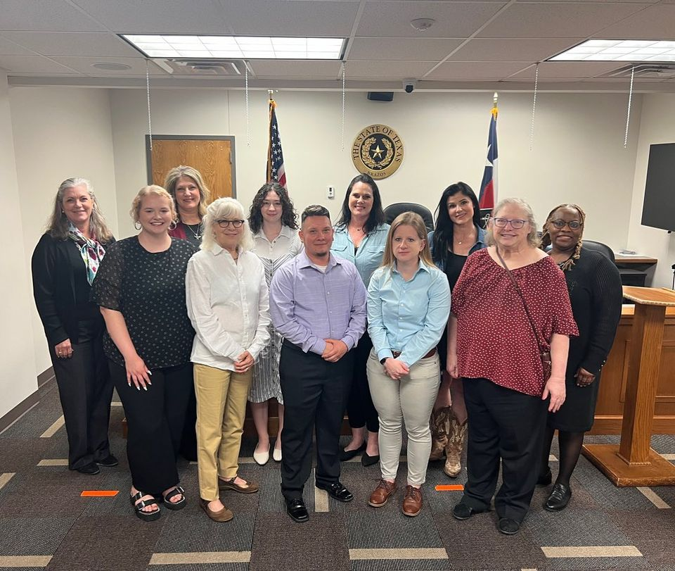
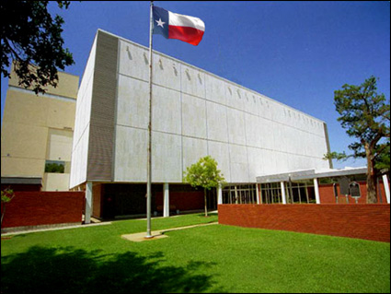
After Training

Slide 20
Time Involved

Slide 21
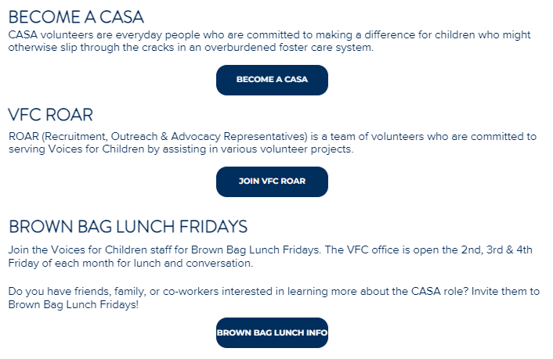

Slide 22
Prevention: Year Round!

Slide 23
Questions?

Slide 24
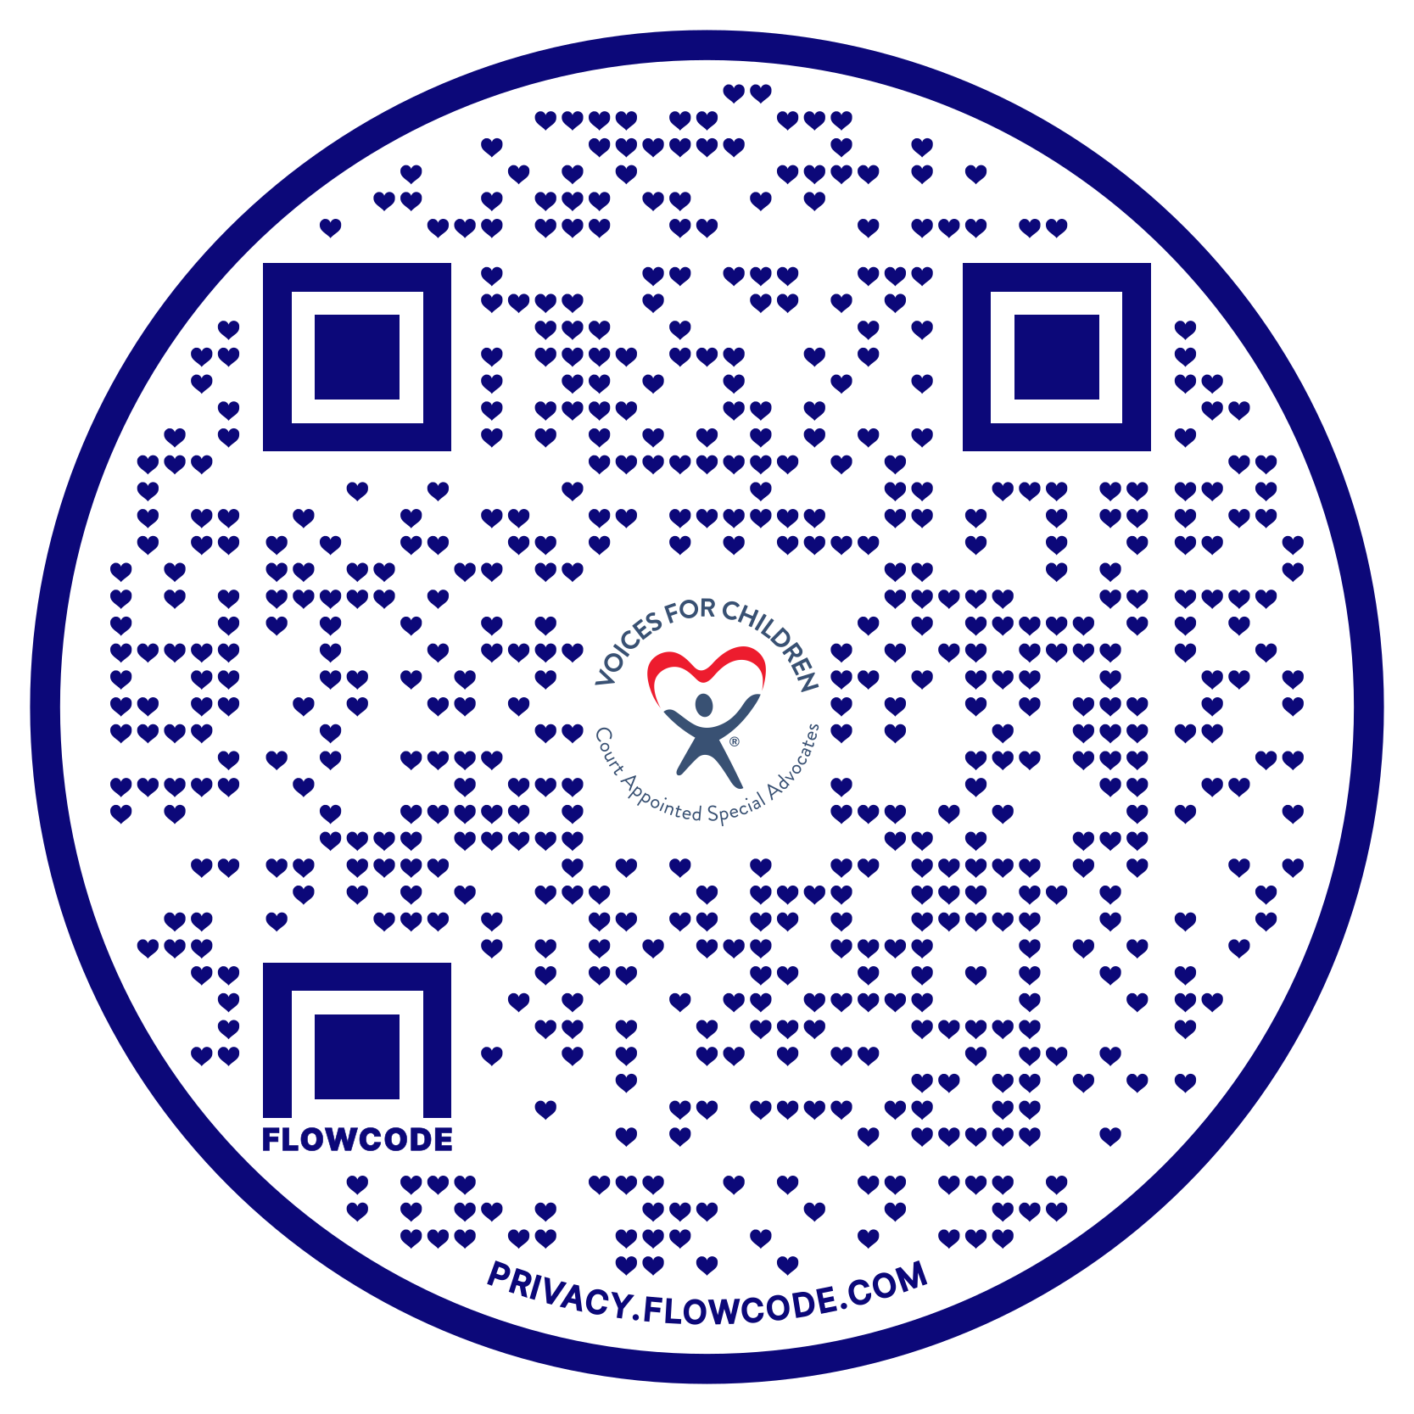
FIND US,
JOIN US,
SHARE US!
@vfcbrazos
@vfcbrazos
Subscribe to our monthly newsletter at the bottom of our website’s main page!
@vfcbrazos
vfcbrazos
vfcbrazos.org

