Slide 1
Disaster medical operations (part 2)
Community emergency response team

Slide 2
Texas Essential Knowledge and Skills (TEKS)
The student analyzes the concepts medical disaster operations. The student is expected to:
(A) explain the need to determine scene safety for the disaster response team;
(B) identify the components of the chain of infection;
(C) demonstrate proper hand washing to prevent the spread of infection;
(D) identify personal protective equipment needed to respond to a disaster;
(E) investigate proper waste management in a disaster response;
(F) recognize the components of the respiratory and circulatory systems;

Slide 3
Texas Essential Knowledge and Skills (TEKS)
(G) describe how shock effects the human body systems;
(H) perform head-to-toe patient assessment;
(I) simulate treatment of life threatening injuries
  i. recognize and treat an airway obstruction, bleeding, and shock;
(J) analyze the principles of triage
  i. describe the START triage system;
  ii. conduct simulated disaster triage evaluations;
(K) evaluate through documentation a disaster drill;
(L) predict the equipment and supply needs for a disaster response.

Slide 4
Disaster Medical Operations (Part 2)
What you will learn about:
Public Health Considerations: How to maintain hygiene and sanitation.
Functions of Disaster Medical Operations: What the five major functions of disaster medical operations are and how they are set up.

Slide 5
Disaster Medical Operations (Part 2)
What you will learn about:
Disaster Medical Treatment Areas: How to establish them and what their functions are.
Patient Evaluation: How to perform a head-to-toe assessment to identify and treat injuries.

Slide 6
Disaster Medical Operations (Part 2)
Basic Treatment—How to:
Treat burns
Dress and bandage wounds
Treat fractures, dislocations, sprains, and strains
Treat hypothermia
Treat heat-related injuries
Control nasal bleeding
Treat bites and stings

Slide 7
Disaster Medical Operations (Part 2)
Introduction and Unit Overview
Unit Objectives
At the end of this unit, you should be able to:
Take appropriate sanitation measures to protect public health.
Perform head-to-toe patient assessments.
Establish a treatment area.
Apply splints to suspected fractures and sprains
Employ basic treatments for other injuries

Slide 8
Unit Topics
The unit topics are:
Public Health Considerations
Functions of Disaster Medical Operations
Establishing Medical Treatment Areas
Conducting Head-to-Toe Assessments
Treating Burns
Wound Care
Treating Fractures, Dislocations, Sprains, and Strains
Nasal Injuries
Treating Cold-Related Injuries
Treating Heat-Related Injuries
Bites and Stings

Slide 9
Disaster Medical Operations (Part 2)
Public Health Considerations
When disaster victims are sheltered together for treatment, public health becomes a concern. Measures must be taken, both by individual CERT members and CERT operations, to avoid the spread of disease.
The primary public health measures include:
Maintaining proper hygiene
Maintaining proper sanitation
Purifying water (if necessary)
Preventing the spread of disease

Slide 10
Disaster Medical Operations (Part 2)
Public Health Considerations
Maintaining Hygiene
Maintenance of proper personal hygiene is critical even under makeshift conditions. Some steps that individuals should take to maintain hygiene are to:
Wash hands frequently using soap and water. Hand washing should be thorough (at least 15 to 20 seconds of vigorous rubbing on all surfaces of the hand).

Slide 11
Disaster Medical Operations (Part 2)
Public Health Considerations
Maintaining Hygiene
Alcohol-based hand sanitizers — which don’t require water — are a good alternative to hand washing. The Centers for Disease Control (CDC) recommends products that are at least 60% alcohol. To use an alcohol-based hand sanitizer, apply about ½ teaspoon of the product to the palm of your hand. Rub your hands together, covering all surfaces, until hands are dry.

Slide 12
Disaster Medical Operations (Part 2)
Public Health Considerations
Maintaining Hygiene
Wear non-latex exam gloves at all times. Change or disinfect gloves after examining and/or treating each patient. As explained earlier, under field conditions, individuals can use rubber gloves that are sterilized between treating victims using bleach and water (1 part bleach to 10 parts water).

Slide 13
Disaster Medical Operations (Part 2)
Public Health Considerations
Maintaining Hygiene
Wear an N95 mask and goggles.
Keep dressings sterile. Do not remove the overwrap from dressings until use. After opening, use the entire package of dressing, if possible.

Slide 14
Disaster Medical Operations (Part 2)
Public Health Considerations
Maintaining Hygiene
Thoroughly wash areas that come in contact with body fluids with soap and water or diluted bleach as soon as possible.

Slide 15
Disaster Medical Operations (Part 2)
Public Health Considerations
Maintaining Sanitation
Poor sanitation is also a major cause of infection. CERT medical operations personnel can maintain sanitary conditions by:
Controlling the disposal of bacterial sources (e.g., soiled exam gloves, dressings, etc.)

Slide 16
Disaster Medical Operations (Part 2)
Public Health Considerations
Maintaining Sanitation
Putting waste products in plastic bags, tying off the bags, and marking them as medical waste. Keep medical waste separate from other trash, and dispose of it as hazardous waste.
Burying human waste. Select a burial site away from the operations area and mark the burial site for later cleanup.

Slide 17
Disaster Medical Operations (Part 2)
Public Health Considerations
Water Purification
Potable water supplies are often in short supply or are not available in a disaster. Water can be purified for drinking, cooking, and medical use by heating it to a rolling boil for 1 minute or by using water purification tablets or non-perfumed liquid bleach.

Slide 18
Disaster Medical Operations (Part 2)
Public Health Considerations
Water Purification
The bleach to water ratios are:
8 drops of bleach per gallon of water
16 drops per gallon of water, if the water is cloudy or dirty

Slide 19
Disaster Medical Operations (Part 2)
Public Health Considerations
Water Purification
Let the bleach and water solution stand for 30 minutes. Note that if the solution does not smell or taste of bleach, add another six drops of bleach, and let the solution stand for 15 minutes before using.

Slide 20
Disaster Medical Operations (Part 2)
Public Health Considerations
Water Purification
Rescuers should not put anything on wounds other than purified water. The use of other solutions (e.g., hydrogen peroxide) on wounds must be the decision of trained medical personnel.

Slide 21
Disaster Medical Operations (Part 2)
Public Health Considerations
Preventing the Spread of Disease
CERT members must use non-latex exam gloves, goggles, and an N95 mask during all medical operations. Cover all open wounds as a way of preventing the spread of infection.

Slide 22
Disaster Medical Operations (Part 2)
Functions of Disaster Medical Operations
There are five major functions of disaster medical operations:
Triage: The initial assessment and sorting of victims for treatment based on the severity of their injuries
Treatment: The disaster medical services provided to victims
Transport: The movement of victims from incident location to the treatment area
Morgue: The temporary holding area for victims who have died at the treatment area. Those who are tagged as “Dead” during triage are not removed from the incident site.
Supply: The hub for crucial supply procurement and distribution

Slide 23
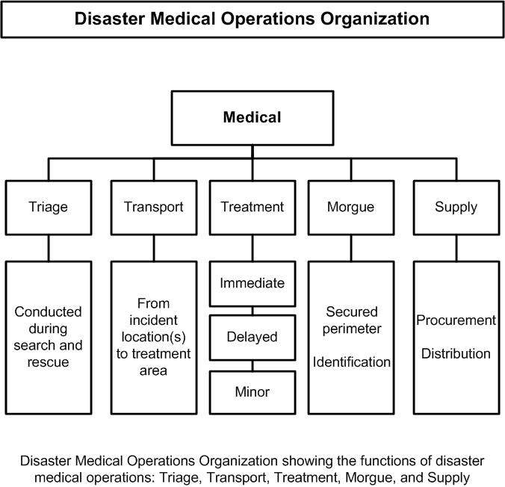
Disaster Medical Operations (Part 2)

Slide 24
Disaster Medical Operations (Part 2)
Establishing Medical Treatment Areas
Because time is critical when CERTs activate, CERT medical operations personnel will need to select a site and set up a treatment area as soon as injured victims are confirmed.

Slide 25
Disaster Medical Operations (Part 2)
Establishing Medical Treatment Areas
Determining the best location(s) for the CERT treatment area should include the following overall considerations:
Safety for rescuers and victims
Most effective use of resources, e.g., CERT members themselves, time, medical supplies

Slide 26
Disaster Medical Operations (Part 2)
Establishing Medical Treatment Areas
Safety for rescuers and victims
As victims are located, rescued, and triaged, they are moved to a location where they can be treated. The severity of the damage and the safety of the immediate environment determine where the initial CERT treatment area should be located. In all cases, remember that your safety is the number one priority.

Slide 27
Disaster Medical Operations (Part 2)
Establishing Medical Treatment Areas
Safety for rescuers and victims
In structures with light damage, CERT members triage the victims as they are located. Further medical treatment is performed in a safe location inside the structure where victims are organized according to the extent of their injuries.
In structures with moderate damage, CERT members also triage the victims as they are located; however, victims are sent to a medical treatment location that is a safe distance from the incident location. Victims are organized according to the extent of their injuries.

Slide 28
Disaster Medical Operations (Part 2)
Establishing Medical Treatment Areas
Safety for rescuers and victims
Whether the treatment area is set up inside or a safe distance from the structure, a morgue may need to be set up as a temporary holding area for victims who die at the treatment area.

Slide 29
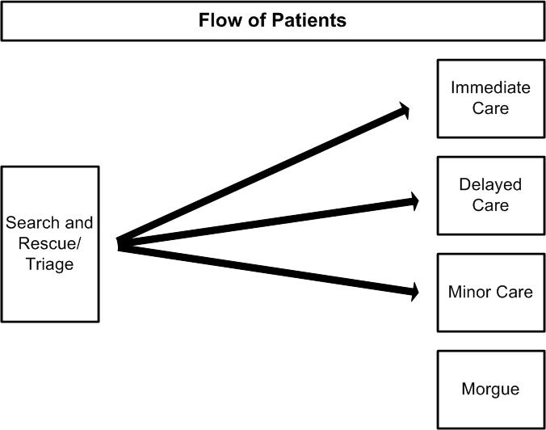
Disaster Medical Operations (Part 2)

Slide 30
Disaster Medical Operations (Part 2)
Establishing Medical Treatment Areas
Safety for rescuers and victims
In addition to the severity of the damage to the structure where victims are found, there are two other important safety considerations:
The treatment area itself must be free of hazards and debris.
The site should be close to but uphill and upwind from the hazard zone.

Slide 31
Disaster Medical Operations (Part 2)
Establishing Medical Treatment Areas
Most Effective Use of CERT Resources
In addition to the safety of rescuers and victims, a second overall consideration for setting up treatment areas is how to make the best use of CERT resources, e.g., CERT members themselves, time, medical supplies, and equipment.

Slide 32
Disaster Medical Operations (Part 2)
Establishing Medical Treatment Areas
Most Effective Use of CERT Resources
To help meet the challenge of limited resources, particularly if initial treatment operations will continue for some time, CERT may need decentralized treatment locations and/or may establish one central medical treatment location, depending on the circumstances. The CERT may need to include one or both in their medical operations plan:

Slide 33
Disaster Medical Operations (Part 2)
Establishing Medical Treatment Areas
Most Effective Use of CERT Resources
Decentralized Treatment Sites: In a widespread event with many injured, it is sometimes necessary to set up and maintain more than one medical treatment location, especially when a central treatment location would be a considerable distance from the initial treatment site.

Slide 34
Disaster Medical Operations (Part 2)
Establishing Medical Treatment Areas
Most Effective Use of CERT Resources
A medical treatment location would be set up close to, but a safe distance from, each of the damage sites. Each of the treatment locations would include areas for Immediate, Delayed, and Minor victims and a morgue.
Victims remain under treatment at the location until they can be transported to a location for professional medical care or to the CERT’s main treatment area.

Slide 35
Disaster Medical Operations (Part 2)
Establishing Medical Treatment Areas
Most Effective Use of CERT Resources
Centralized Treatment Site: In an event with one or a few injured victims at each of a number of sites, the CERT may need to establish one central medical treatment location. A centralized location may need to be set up even when there are decentralized sites established.

Slide 36
Disaster Medical Operations (Part 2)
Establishing Medical Treatment Areas
Most Effective Use of CERT Resources
The location would include treatment areas for Immediate, Delayed, and Minor victims, and a morgue.
Victims are moved from where they were rescued, triaged, and initially treated to the central location, and remain under treatment there until they can be transported to a location for professional medical treatment.

Slide 37
Disaster Medical Operations (Part 2)
Establishing Medical Treatment Areas
Most Effective Use of CERT Resources
A central medical treatment location allows for effective use of resources since a limited number of CERT medical operation personnel in one location can take care of a greater number of victims.
EMS or other medical professionals will generally be able to transport the injured more efficiently from one central location than from multiple decentralized locations.

Slide 38
Disaster Medical Operations (Part 2)
Establishing Medical Treatment Areas
Most Effective Use of CERT Resources
Whether a treatment site is centralized or one of a number of decentralized sites, the location(s) selected should be:
Accessible by transportation vehicles (ambulances, trucks, helicopters, etc.)
Expandable

Slide 39
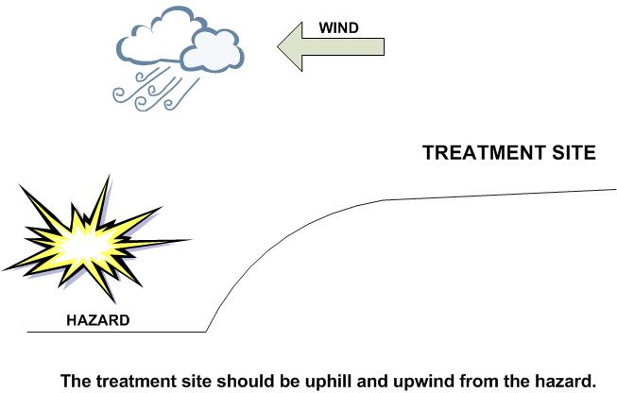
Disaster Medical Operations (Part 2)

Slide 40
Disaster Medical Operations (Part 2)
Establishing Medical Treatment Areas
Treatment Area Layout
The treatment area must be protected and clearly delineated. Signs should be used to identify the subdivisions of the area:
“I” for Immediate care
“D” for Delayed care
“M” for Minor injuries/walking wounded
“DEAD” for the morgue

Slide 41
Disaster Medical Operations (Part 2)
Establishing Medical Treatment Areas
Treatment Area Layout
The “I” and “D” areas should be relatively close to each other to allow:
Verbal communication between workers in the treatment areas
Shared access to medical supplies (which should be cached in a central location)
Easy transfer of patients whose status has changed

Slide 42
Disaster Medical Operations (Part 2)
Establishing Medical Treatment Areas
Treatment Area Layout
Victims who have been identified with minor injuries may choose to stay at the treatment area or leave. If they stay, they can assist CERT personnel. If they leave, it should be documented.

Slide 43
Disaster Medical Operations (Part 2)
Establishing Medical Treatment Areas
Treatment Area Layout
Patients in the treatment area should be positioned in a head-to-toe configuration, with 2 to 3 feet between victims.
This system will provide:
Effective use of space
Effective use of available personnel. As a team member finishes one head-to-toe assessment, he or she turns around and is at the head of the next patient.

Slide 44
Disaster Medical Operations (Part 2)
Establishing Medical Treatment Areas
Treatment Area Layout
The morgue site should be secure, away from and not visible from the treatment area. This will help minimize traffic near the area and reduce the potential psychological impact on those in the treatment area.

Slide 45
Disaster Medical Operations (Part 2)
Establishing Medical Treatment Areas
Treatment Area Layout
Pre-planning for CERT medical operations includes equipment needed to set up the treatment area, such as ground covers or tarps and signs for identifying divisions (“I”, “D”, “M”,” DEAD”).

Slide 46
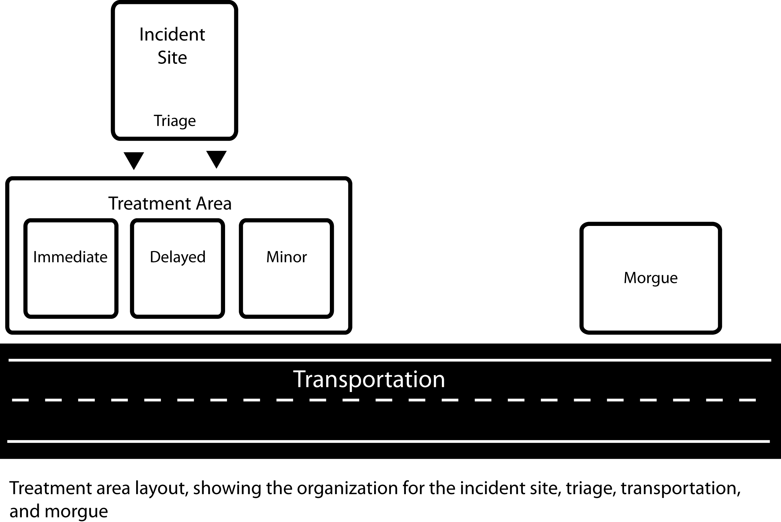
Disaster Medical Operations (Part 2)

Slide 47
Disaster Medical Operations (Part 2)
Establishing Medical Treatment Areas
Treatment Area Layout
The distance shown between the Incident Site/Triage and the Treatment Area will depend on whether or not the treatment location is site specific or more centralized in the CERT’s service area.

Slide 48
Disaster Medical Operations (Part 2)
Establishing Medical Treatment Areas
Treatment Area Organization
There is an obvious need for planning before disaster strikes, including roles of personnel assigned to the treatment area. The CERT must assign leaders to maintain control in each of the medical treatment area subdivisions. These leaders will:
Ensure orderly victim placement
Direct team members to conduct head-to-toe assessments

Slide 49
Disaster Medical Operations (Part 2)
Establishing Medical Treatment Areas
Treatment Area Organization
It is very important to thoroughly document the victims in the treatment area, including:
Name, address, and phone number if victim is able to talk
Description (age, sex, body build, estimated height)
Clothing
Injuries
Treatment
Transfer location

Slide 50
Disaster Medical Operations (Part 2)
Conducting Head-to-Toe Assessments
The first steps that you will take when working with a victim will be to conduct triage and rapid treatment. After all victims in an area have been triaged and moved to a medical treatment area, CERT members will begin a thorough head-to-toe assessment of each victim’s condition.

Slide 51
Disaster Medical Operations (Part 2)
Conducting Head-to-Toe Assessments
During triage, you are keeping an eye out for “the killers”:
Airway obstruction
Excessive bleeding
Signs of shock
A head-to-toe assessment goes beyond the “killers” to try to gain more information to determine the nature of the victim’s injury. The entire assessment must be performed before initiating treatment.

Slide 52
Disaster Medical Operations (Part 2)
Conducting Head-to-Toe Assessments
Objectives of Head-to-Toe Assessments
The objectives of a head-to-toe assessment are to:
Determine, as clearly as possible, the extent of injuries
Determine what type of treatment is needed
Document injuries
Remember to always wear your safety equipment when conducting head-to-toe assessments.

Slide 53
Disaster Medical Operations (Part 2)
Conducting Head-to-Toe Assessments
What to Look for in Head-to-Toe Assessments
The medical community uses the acronym DCAP-BTLS to remember what to look for when conducting a rapid assessment. DCAP-BTLS stands for the following:
Deformities
Contusions (bruising)
Abrasions

Slide 54
Disaster Medical Operations (Part 2)
Conducting Head-to-Toe Assessments
What to Look for in Head-to-Toe Assessments
Punctures
Burns
Tenderness
Lacerations
Swelling

Slide 55
Disaster Medical Operations (Part 2)
Conducting Head-to-Toe Assessments
What to Look for in Head-to-Toe Assessments
When conducting a head-to-toe assessment, CERT members should look for DCAP-BTLS in all parts of the body.
Remember to provide IMMEDIATE treatment for life-threatening injuries.
You should pay careful attention to how people have been hurt (the mechanism of injury) because it provides insight to probable injuries suffered.

Slide 56
Disaster Medical Operations (Part 2)
Conducting Head-to-Toe Assessments
How to Conduct a Head-to-Toe Assessment
Whenever possible, ask the person about any injuries, pain, bleeding, or other symptoms. If the victim is conscious, CERT members should always ask permission to conduct the assessment. The victim has the right to refuse treatment. Talking with the conscious patient reduces anxiety.

Slide 57
Disaster Medical Operations (Part 2)
Conducting Head-to-Toe Assessments
How to Conduct a Head-to-Toe Assessment
Head-to-toe assessments should be:
Conducted on all victims, even those who seem all right
Verbal (if the patient is able to speak)
Hands-on. Do not be afraid to remove clothing to look.

Slide 58
Disaster Medical Operations (Part 2)
Conducting Head-to-Toe Assessments
How to Conduct a Head-to-Toe Assessment
It is very important that you conduct head-to-toe assessments systematically; doing so will make the procedure quicker and more accurate with each assessment. Remember to:
Pay careful attention
Look, listen, and feel for anything unusual
Suspect a spinal injury in all unconscious victims and treat accordingly
Remember to check your own hands for patient bleeding as you perform the head-to-toe assessment.

Slide 59
Disaster Medical Operations (Part 2)
Conducting Head-to-Toe Assessments
How to Conduct a Head-to-Toe Assessment
Check body parts from the top to the bottom for continuity of bones and soft tissue injuries (DCAP-BTLS) in the following order:
Head
Neck
Shoulders
Chest
Arms
Abdomen
Pelvis
Legs

Slide 60
Disaster Medical Operations (Part 2)
Conducting Head-to-Toe Assessments
How to Conduct a Head-to-Toe Assessment
While conducting a head-to-toe assessment, CERT members should always check for:
PMS (Pulse, Movement, Sensation) in all extremities
Medical ID emblems on bracelet or on neck chain

Slide 61
Disaster Medical Operations (Part 2)
Conducting Head-to-Toe Assessments
Closed-Head, Neck, and Spinal Injuries
When conducting head-to-toe assessments, rescuers may come across victims who have or may have suffered closed-head, neck, or spinal injuries.
A closed-head injury for the participants is a concussion-type injury, as opposed to a laceration, although lacerations can be an indication that the victim has suffered a closed-head injury.

Slide 62
Disaster Medical Operations (Part 2)
Conducting Head-to-Toe Assessments
Closed-Head, Neck, and Spinal Injuries
The main objective when CERT members encounter suspected injuries to the head or spine is to do no harm. Minimize movement of the head and spine while treating any other life-threatening conditions.

Slide 63
Disaster Medical Operations (Part 2)
Signs of a Closed-Head, Neck, or Spinal Injury
The signs of a closed-head, neck, or spinal injury most often include:
Change in consciousness
Inability to move one or more body parts
Severe pain or pressure in head, neck, or back
Tingling or numbness in extremities

Slide 64
Disaster Medical Operations (Part 2)
Signs of a Closed-Head, Neck, or Spinal Injury
Difficulty breathing or seeing
Heavy bleeding, bruising, or deformity of the head or spine
Blood or fluid in the nose or ears
Bruising behind the ear

Slide 65
Disaster Medical Operations (Part 2)
Signs of a Closed-Head, Neck, or Spinal Injury
“Raccoon” eyes (bruising around eyes)
“Uneven” pupils
Seizures
Nausea or vomiting
Victim found under collapsed building material or heavy debris

Slide 66
Disaster Medical Operations (Part 2)
Signs of a Closed-Head, Neck, or Spinal Injury
If the victim is exhibiting any of these signs, he or she should be treated as having a closed-head, neck, or spinal injury.

Slide 67
Disaster Medical Operations (Part 2)
Signs of a Closed-Head, Neck, or Spinal Injury
Stabilizing the Head
In a disaster environment, ideal equipment is rarely available. CERT members may need to be creative by:
Looking for materials that can be used as a backboard — a door, desktop, building materials — anything that might be available.
Looking for items that can be used to stabilize the head on the board — towels, draperies, or clothing — by tucking them snugly on either side of the head to immobilize it.

Slide 68
Disaster Medical Operations (Part 2)
Signs of a Closed-Head, Neck, or Spinal Injury
Remember: Moving victims with suspected head, neck, or spinal injury requires sufficient victim stabilization. If the rescuer or victim is in immediate danger, however, safety is more important than any potential spinal injury and the rescuer should move the victim from the area as quickly as possible.

Slide 69
Disaster Medical Operations (Part 2)
Exercise: Conducting Head-to-Toe Assessment
Purpose: This exercise will give you a chance to practice conducting head-to-toe assessments.

Slide 70
Disaster Medical Operations (Part 2)
Exercise: Conducting Head-to-Toe Assessment
Instructions:
After breaking into pairs, the person on the right will be the victim.
The rescuer will conduct a head-to-toe assessment following the previously demonstrated procedure. Repeat.
After making two observed head-to-toe assessments, the victim and the rescuer swap roles.

Slide 71
Disaster Medical Operations (Part 2)
Treating Burns
As always, the first step in treating burns is to conduct a thorough sizeup.
A few examples of burn-related sizeup questions to ask are:
What caused the burn?
Is the danger still present?
When did the burning cease?

Slide 72
Disaster Medical Operations (Part 2)
Treating Burns
The objectives of first aid treatment for burns are to:
Cool the burned area
Cover with a sterile cloth to reduce the risk of infection (by keeping fluids in and germs out)

Slide 73
Disaster Medical Operations (Part 2)
Treating Burns
Burns may be caused by heat, chemicals, electrical current, or radiation. The severity of a burn depends on the:
Temperature of the burning agent
Period of time that the victim was exposed
Area of the body that was affected
Size of the area burned
Depth of the burn

Slide 74
Disaster Medical Operations (Part 2)
Treating Burns
Burn Classifications
The skin has three layers:
The epidermis, or outer layer of skin, contains nerve endings and is penetrated by hairs.
The dermis, or middle layer of skin, contains blood vessels, oil glands, hair follicles, and sweat glands.
The subcutaneous layer, or innermost layer, contains blood vessels and overlies the muscles.
Depending on the severity, burns may affect all three layers of skin.

Slide 75
Disaster Medical Operations (Part 2)
TREATING BURNS
Burn Classification:
Classification | Skin Layers Affected | Signs
Superficial | Epidermis | Reddened, dry skin Pain Swelling (possible)
Partial Thickness | Epidermis Partial destruction of dermis | Reddened, blistered skin Wet appearance Pain Swelling (possible)
Full Thickness | Complete destruction of epidermis and dermis Possible subcutaneous damage (destroys all layers of skin and some or all underlying structures) | Whitened, leathery, or charred (brown or black) Painful or relatively painless
Burn Classification

Slide 76
Disaster Medical Operations (Part 2)
LIST OF GUIDELINES FOR TREATING BURNS
Remove the victim from the burning source. Put out any flames and remove smoldering clothing unless it is stuck to the skin.

Slide 77
Disaster Medical Operations (Part 2)
LIST OF GUIDELINES FOR TREATING BURNS
Cool skin or clothing, if they are still hot, by immersing them in cool water for not more than 1 minute or covering with clean compresses that have been soaked in cool water and wrung out. Cooling sources include water from the bathroom or kitchen; garden hose; and soaked towels, sheets, or other cloths. Treat all victims of full thickness burns for shock.

Slide 78
Disaster Medical Operations (Part 2)
LIST OF GUIDELINES FOR TREATING BURNS
Infants, young children, and older persons, and persons with severe burns, are more susceptible to hypothermia. Therefore, rescuers should use caution when applying cool dressings on such persons. A rule of thumb is do not cool more than 15% of the body surface area (the size of one arm) at once, to reduce the chances of hypothermia.

Slide 79
Disaster Medical Operations (Part 2)
LIST OF GUIDELINES FOR TREATING BURNS
Cover loosely with dry, sterile dressings to keep air out, reduce pain, and prevent infection.

Slide 80
Disaster Medical Operations (Part 2)
LIST OF GUIDELINES FOR TREATING BURNS
Wrap fingers and toes loosely and individually when treating severe burns to the hands and feet.

Slide 81
Disaster Medical Operations (Part 2)
LIST OF GUIDELINES FOR TREATING BURNS
Loosen clothing near the affected area. Remove jewelry if necessary, taking care to document what was removed, when, and to whom it was given.

Slide 82
Disaster Medical Operations (Part 2)
LIST OF GUIDELINES FOR TREATING BURNS
Elevate burned extremities higher than the heart.

Slide 83
Disaster Medical Operations (Part 2)
LIST OF GUIDELINES FOR TREATING BURNS
Do not use ice. Ice causes vessel constriction.

Slide 84
Disaster Medical Operations (Part 2)
LIST OF GUIDELINES FOR TREATING BURNS
Do not apply antiseptics, ointments, or other remedies.

Slide 85
Disaster Medical Operations (Part 2)
LIST OF GUIDELINES FOR TREATING BURNS
Do not remove shreds of tissue, break blisters, or remove adhered particles of clothing. (Cut burned-in clothing around the burn.)

Slide 86
Disaster Medical Operations (Part 2)
TREATING BURNS
Dos and Don’ts of Burn Treatment
When treating a burn victim, DO:
Cool skin or clothing if they are still hot.
Cover loosely with dry, sterile dressings to keep air out, reduce pain, and prevent infection.
Elevate burned extremities higher than the heart.

Slide 87
Disaster Medical Operations (Part 2)
TREATING BURNS
Dos and Don’ts of Burn Treatment
When treating a burn victim:
Do NOT use ice. Ice causes vessel constriction.
Do NOT apply antiseptics, ointments, or other remedies.
Do NOT remove shreds of tissue, break blisters, or remove adhered particles of clothing. (Cut burned-in clothing around the burn.)

Slide 88
Disaster Medical Operations (Part 2)
TREATING BURNS
Dos and Don’ts of Burn Treatment
Infants, young children, and older persons, and persons with severe burns, are more susceptible to hypothermia. Therefore, rescuers should use caution when applying cool dressings on such persons. A rule of thumb is do not cool more than 15% of the body surface area (the size of one arm) at once, to prevent hypothermia.

Slide 89
Disaster Medical Operations (Part 2)
TREATING BURNS
General Guidelines for Treating Chemical and Inhalation Burns
Chemical and inhalation burns vary from traditional heat-related burns in their origin and treatment. Keep in mind that suspicion of either chemical or inhalation burns elevates the victim’s status to “I.”

Slide 90
Disaster Medical Operations (Part 2)
TREATING BURNS
General Guidelines for Treating Chemical Burns
Unlike more traditional burns, chemical burns do not result from extreme heat, and therefore treatment differs greatly.

Slide 91
Disaster Medical Operations (Part 2)
TREATING BURNS
General Guidelines for Treating Chemical Burns
Chemical burns are not always obvious. You should consider chemical burns as a possibility if the victim’s skin is burning and there is no sign of a fire. If chemical burns are suspected:

Slide 92
Disaster Medical Operations (Part 2)
TREATING BURNS
General Guidelines for Treating Chemical Burns
Protect yourself from contact with the substance. Use your protective gear — especially goggles, mask, and gloves.
Ensure that any affected clothing or jewelry is removed

Slide 93
Disaster Medical Operations (Part 2)
TREATING BURNS
General Guidelines for Treating Chemical Burns
If the irritant is dry, gently brush away as much as possible. Always brush away from the eyes and away from the victim and you.
Use lots of cool running water to flush the chemical from the skin for 15 minutes. The running water will dilute the chemical fast enough to prevent the injury from getting worse.

Slide 94
Disaster Medical Operations (Part 2)
TREATING BURNS
General Guidelines for Treating Chemical Burns
Apply cool, wet compress to relieve pain.
Cover the wound very loosely with a dry, sterile or clean cloth so that the cloth will not stick to the wound.
Treat for shock if appropriate.

Slide 95
Disaster Medical Operations (Part 2)
TREATING BURNS
Guidelines for Treating Inhalation Burns
Remember that 60 to 80% of fire fatalities are the result of smoke inhalation. Whenever fire and/or smoke is present, CERT members should assess victims for signs and symptoms of smoke inhalation. These are indicators that an inhalation burn is present:

Slide 96
Disaster Medical Operations (Part 2)
TREATING BURNS
Guidelines for Treating Inhalation Burns
Sudden loss of consciousness
Evidence of respiratory distress or upper airway obstruction
Soot around the mouth or nose
Singed facial hair
Burns around the face or neck

Slide 97
Disaster Medical Operations (Part 2)
TREATING BURNS
Guidelines for Treating Inhalation Burns
The patient may not present these signs and symptoms until hours (sometimes up to a full 24 hours) after the injury occurred, and such symptoms may be overlooked when treating more obvious signs of trauma.

Slide 98
Disaster Medical Operations (Part 2)
TREATING BURNS
Guidelines for Treating Inhalation Burns
Smoke inhalation is the number one fire-related cause of death. If CERT members have reason to suspect smoke inhalation, be sure the airway is maintained, and alert a medical professional as soon as possible.

Slide 99
Disaster Medical Operations (Part 2)
Wound Care
The main treatment for wounds includes:
Control bleeding
Clean the wound
Apply dressing and bandage

Slide 100
Disaster Medical Operations (Part 2)
Wound Care
Treatment for controlling bleeding was covered in Unit 3. The focus of this section is on cleaning and bandaging, which will help to prevent secondary infection.

Slide 101
Disaster Medical Operations (Part 2)
Wound Care
Cleaning and Bandaging Wounds
Wounds should be cleaned by irrigating with clean, room temperature water.
NEVER use hydrogen peroxide to irrigate the wound.
You should not scrub the wound. A bulb syringe is useful for irrigating wounds. In a disaster, a turkey baster may also be useful.

Slide 102
Disaster Medical Operations (Part 2)
Wound Care
Cleaning and Bandaging Wounds
When the wound is thoroughly cleaned, you will need to apply a dressing and bandage to help keep it clean and control bleeding.
There is a difference between a dressing and a bandage:
A dressing is applied directly to the wound. Whenever possible, a dressing should be sterile.
A bandage holds the dressing in place.

Slide 103
Disaster Medical Operations (Part 2)
Wound Care
Cleaning and Bandaging Wounds
If a wound is still bleeding, the bandage should place enough pressure on the wound to help control bleeding without interfering with circulation.

Slide 104
Disaster Medical Operations (Part 2)
Wound Care
Rules of Dressing
You should follow these rules:
If there is active bleeding (i.e., if the dressing is soaked with blood), redress over the existing dressing and maintain pressure and elevation to control bleeding.
In the absence of active bleeding, remove the dressings, flush the wound, and then check for signs of infection at least every 4 to 6 hours.

Slide 105
Disaster Medical Operations (Part 2)
Wound Care
Rules of Dressing
Signs of possible infection include:
Swelling around the wound site
Discoloration
Discharge from the wound
Red striations from the wound site

Slide 106
Disaster Medical Operations (Part 2)
Wound Care
Rules of Dressing
If necessary and based on reassessment and signs of infection, change the treatment priority (e.g., from Delayed to Immediate).

Slide 107
Disaster Medical Operations (Part 2)
Wound Care
Amputations
The main treatments for an amputation (the traumatic severing of a limb or other body part) are to:
Control bleeding
Treat shock

Slide 108
Disaster Medical Operations (Part 2)
Wound Care
Amputations
When the severed body part can be located, CERT members should:
Save tissue parts, wrapped in clean material and placed in a plastic bag, if available. Label them with the date, time, and victim’s name.
Keep the tissue parts cool, but NOT in direct contact with ice
Keep the severed part with the victim

Slide 109
Disaster Medical Operations (Part 2)
Wound Care
Impaled Objects
Sometimes, you may also encounter some victims who have foreign objects lodged in their bodies — usually as the result of flying debris during the disaster.

Slide 110
Disaster Medical Operations (Part 2)
Wound Care
Impaled Objects
When a foreign object is impaled in a patient’s body, you should:
Immobilize the affected body part
Not attempt to move or remove the object, unless it is obstructing the airway
Try to control bleeding at the entrance wound without placing undue pressure on the foreign object
Clean and dress the wound making sure to stabilize the impaled object. Wrap bulky dressings around the object to keep it from moving.

Slide 111
Disaster Medical Operations (Part 2)
Treating Fractures, Dislocations, Sprains, and Strains
The objective when treating a suspected fracture, sprain, or strain is to immobilize the injury and the joints immediately above and below the injury site.

Slide 112
Disaster Medical Operations (Part 2)
Treating Fractures, Dislocations, Sprains, and Strains
Because it is difficult to distinguish among fractures, sprains, or strains, if uncertain of the type of injury, CERT members should treat the injury as a fracture.

Slide 113
Disaster Medical Operations (Part 2)
Treating Fractures, Dislocations, Sprains, and Strains
Fractures
A fracture is a complete break, a chip, or a crack in a bone. There are several types of fractures.
A closed fracture is a broken bone with no associated wound. First aid treatment for closed fractures may require only splinting.
An open fracture is a broken bone with some kind of wound that allows contaminants to enter into or around the fracture site.

Slide 114
Disaster Medical Operations (Part 2)
Treating Fractures, Dislocations, Sprains, and Strains
Closed and Open Fractures

Slide 115
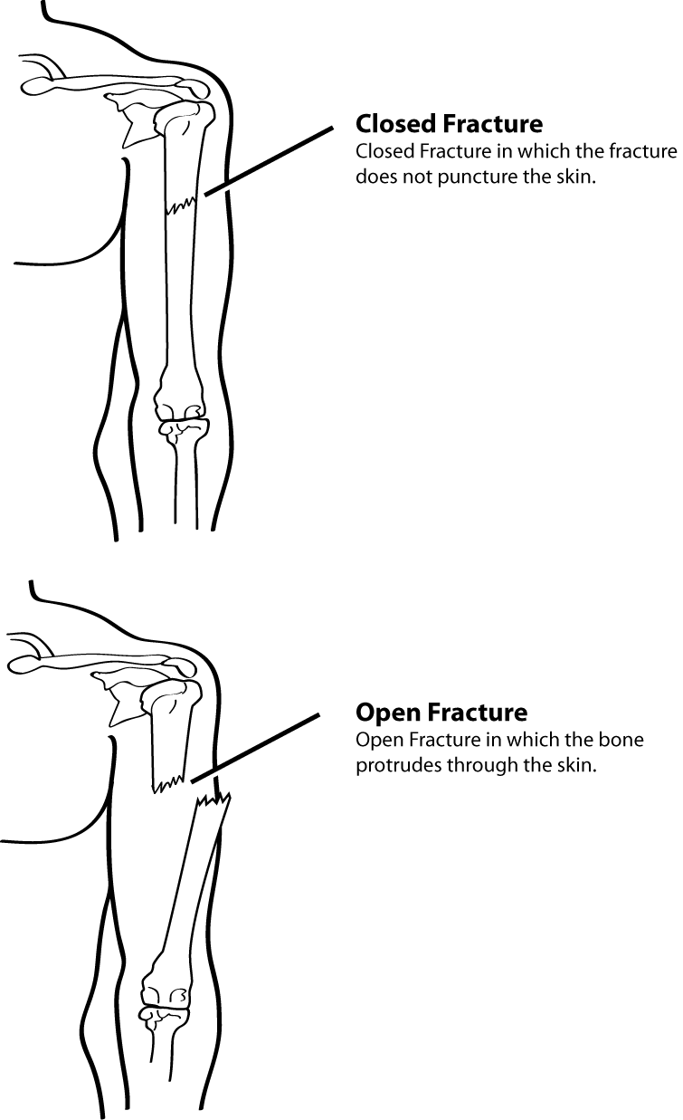
Disaster Medical Operations (Part 2)
Closed Fracture>
Open Fracture>

Slide 116
Disaster Medical Operations (Part 2)
Treating Fractures, Dislocations, Sprains, and Strains
Treating an Open Fracture
Open fractures are more dangerous than closed fractures because they pose a significant risk of severe bleeding and infection. Therefore, they are a higher priority and need to be checked more frequently.
When treating an open fracture:
Do not draw the exposed bone ends back into the tissue.
Do not irrigate the wound.

Slide 117
Disaster Medical Operations (Part 2)
Treating Fractures, Dislocations, Sprains, and Strains
Treating an Open Fracture
You should:
Cover the wound with a sterile dressing
Splint the fracture without disturbing the wound
Place a moist 4 by 4-inch dressing over the bone end to keep it from drying out

Slide 118
Disaster Medical Operations (Part 2)
Treating Fractures, Dislocations, Sprains, and Strains
Treating an Open Fracture
If the limb is angled, then there is a displaced fracture. Displaced fractures may be described by the degree of displacement of the bone fragments.
Nondisplaced fractures are difficult to identify, with the main signs being pain and swelling. You should treat a suspected fracture as a fracture until professional treatment is available.

Slide 119
Disaster Medical Operations (Part 2)
Treating Fractures, Dislocations, Sprains, and Strains
Displaced and Nondisplaced Fractures

Slide 120
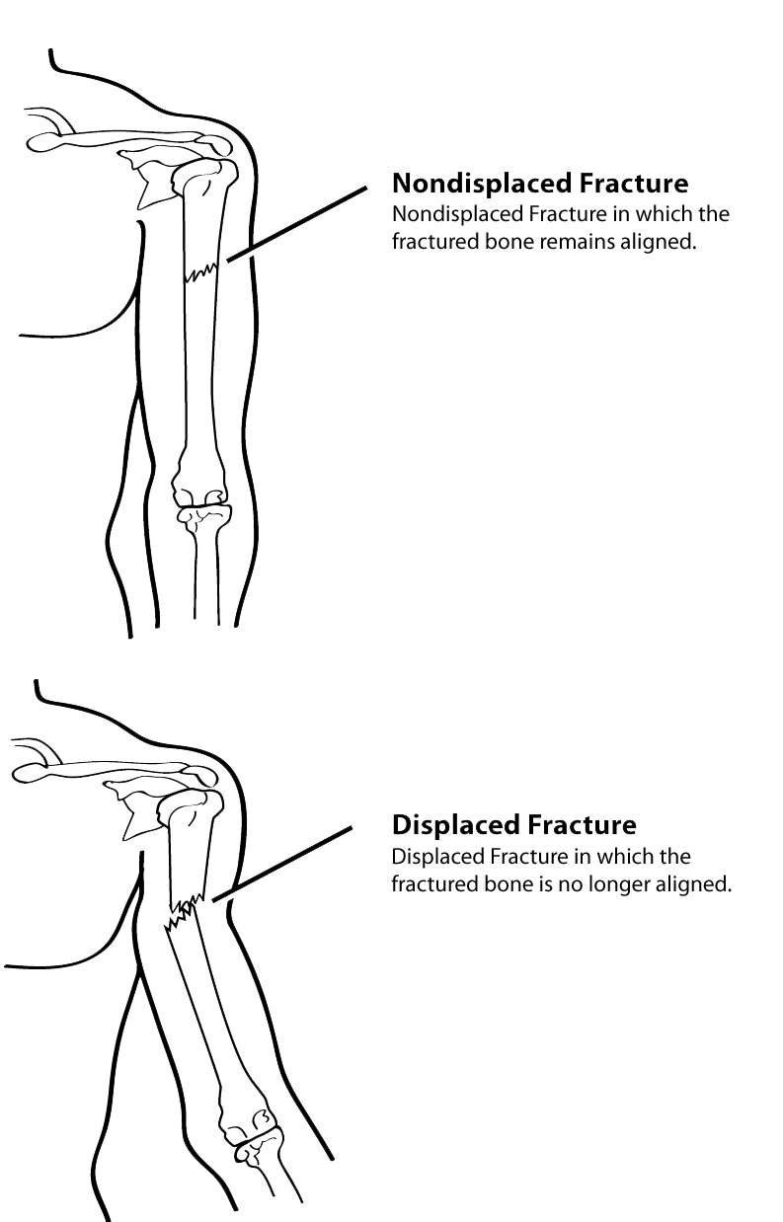
Disaster Medical Operations (Part 2)
Nondisplaced Fracture
Displaced Fracture

Slide 121
Disaster Medical Operations (Part 2)
Treating Fractures, Dislocations, Sprains, and Strains
Dislocations
Dislocations are another common injury in emergencies.
A dislocation is an injury to the ligaments around a joint that is so severe that it permits a separation of the bone from its normal position in a joint.

Slide 122
Disaster Medical Operations (Part 2)
Treating Fractures, Dislocations, Sprains, and Strains
Dislocations
The signs of a dislocation are similar to those of a fracture, and a suspected dislocation should be treated like a fracture.
If dislocation is suspected, be sure to assess PMS (Pulse, Movement, Sensation) in the affected limb before and after splinting/immobilization. If PMS is compromised, the patient’s treatment priority is elevated to “I.”

Slide 123
Disaster Medical Operations (Part 2)
Treating Fractures, Dislocations, Sprains, and Strains
Dislocations
You should not try to relocate a suspected dislocation. You should immobilize the joint until professional medical help is available.

Slide 124
Disaster Medical Operations (Part 2)
Treating Fractures, Dislocations, Sprains, and Strains
Sprains and Strains
A sprain involves a stretching or tearing of ligaments at a joint and is usually caused by stretching or extending the joint beyond its normal limits.
A sprain is considered a partial dislocation, although the bone either remains in place or is able to fall back into place after the injury.

Slide 125
Disaster Medical Operations (Part 2)
Treating Fractures, Dislocations, Sprains, and Strains
Sprains and Strains
The most common signs of a sprain are:
Tenderness at the site of the injury
Swelling and/or bruising
Restricted use or loss of use

Slide 126
Disaster Medical Operations (Part 2)
Treating Fractures, Dislocations, Sprains, and Strains
Sprains and Strains
The signs of a sprain are similar to those of a nondisplaced fracture. Therefore, you should not try to treat the injury other than by immobilization and elevation.
A strain involves a stretching and/or tearing of muscles or tendons. Strains most often involve the muscles in the neck, back, thigh, or calf.
In some cases, strains may be difficult to distinguish from sprains or fractures. Whether an injury is a strain, sprain, or fracture, treat the injury as if it is a fracture.

Slide 127
Disaster Medical Operations (Part 2)
Treating Fractures, Dislocations, Sprains, and Strains
Splinting
Splinting is the most common procedure for immobilizing an injury.
Cardboard is the material typically used for makeshift splints but a variety of materials can be used, including:
Soft materials. Towels, blankets, or pillows, tied with bandaging materials or soft cloths
Rigid materials. A board, metal strip, folded magazine or newspaper, or other rigid item

Slide 128
Disaster Medical Operations (Part 2)
Treating Fractures, Dislocations, Sprains, and Strains
Splinting
Anatomical splints may also be created by securing a fractured bone to an adjacent unfractured bone. Anatomical splints are usually reserved for fingers and toes, but, in an emergency, legs may also be splinted together.

Slide 129
Disaster Medical Operations (Part 2)
Treating Fractures, Dislocations, Sprains, and Strains
Splinting
Soft materials should be used to fill the gap between the splinting material and the body part.
With this type of injury, there will be swelling. Remove restrictive clothing, shoes, and jewelry when necessary to prevent these items from acting as unintended tourniquets.

Slide 130
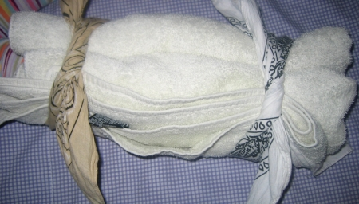
Disaster Medical Operations (Part 2)
Splint Using a Towel

Slide 131
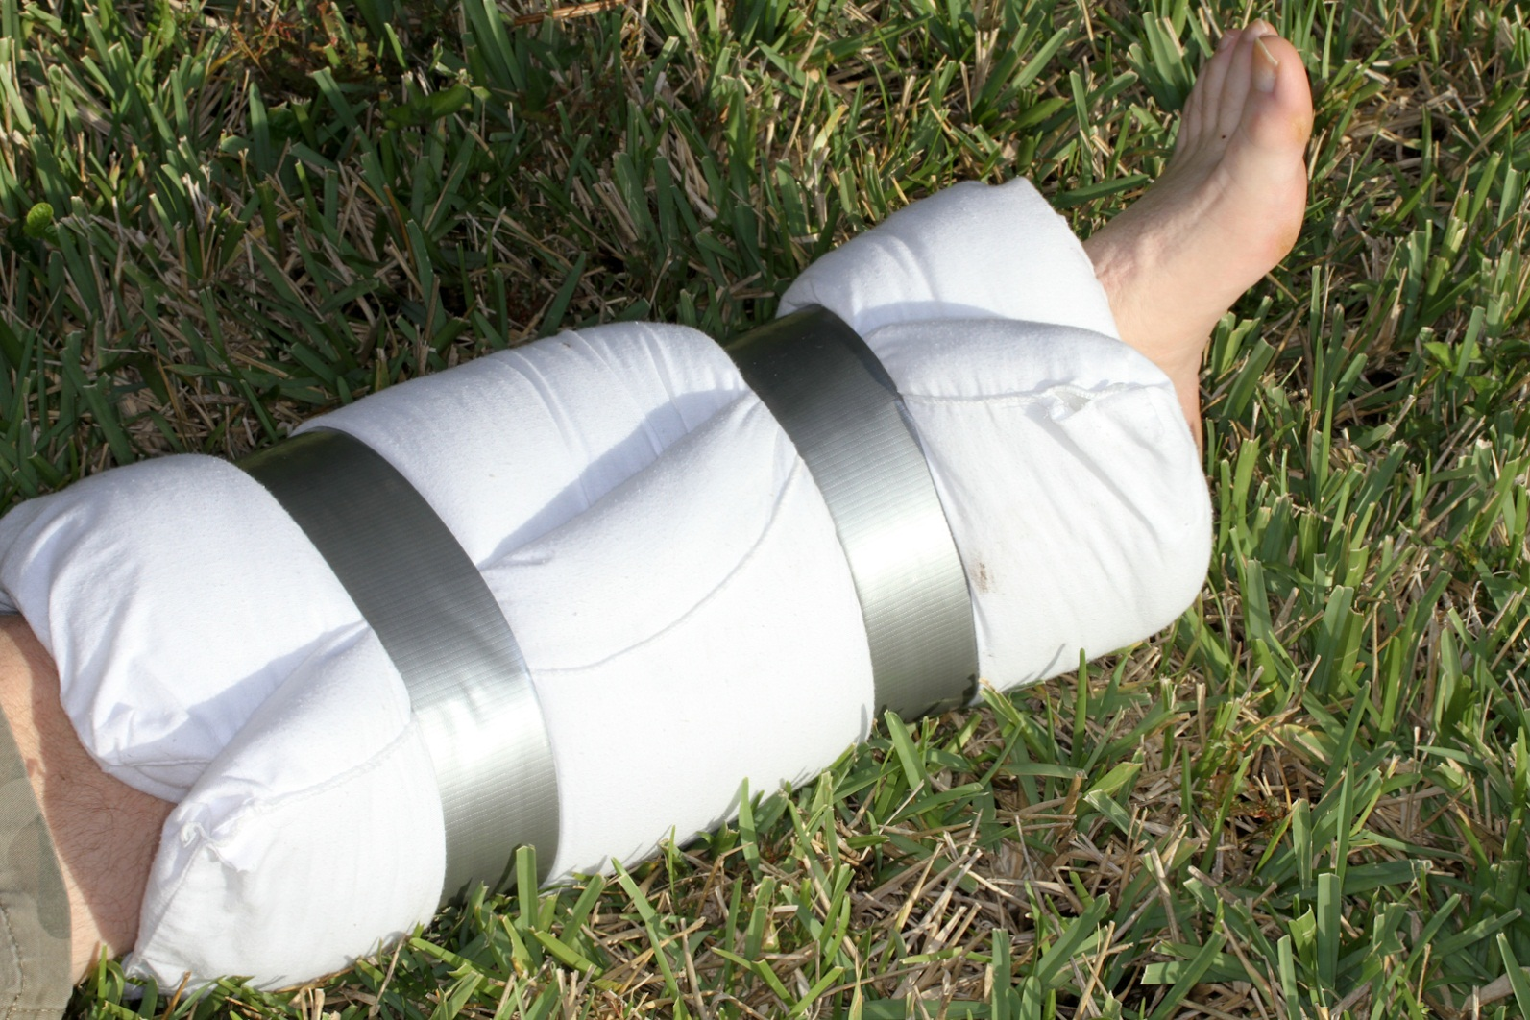
Disaster Medical Operations (Part 2)
Splint Using a Pillow

Slide 132
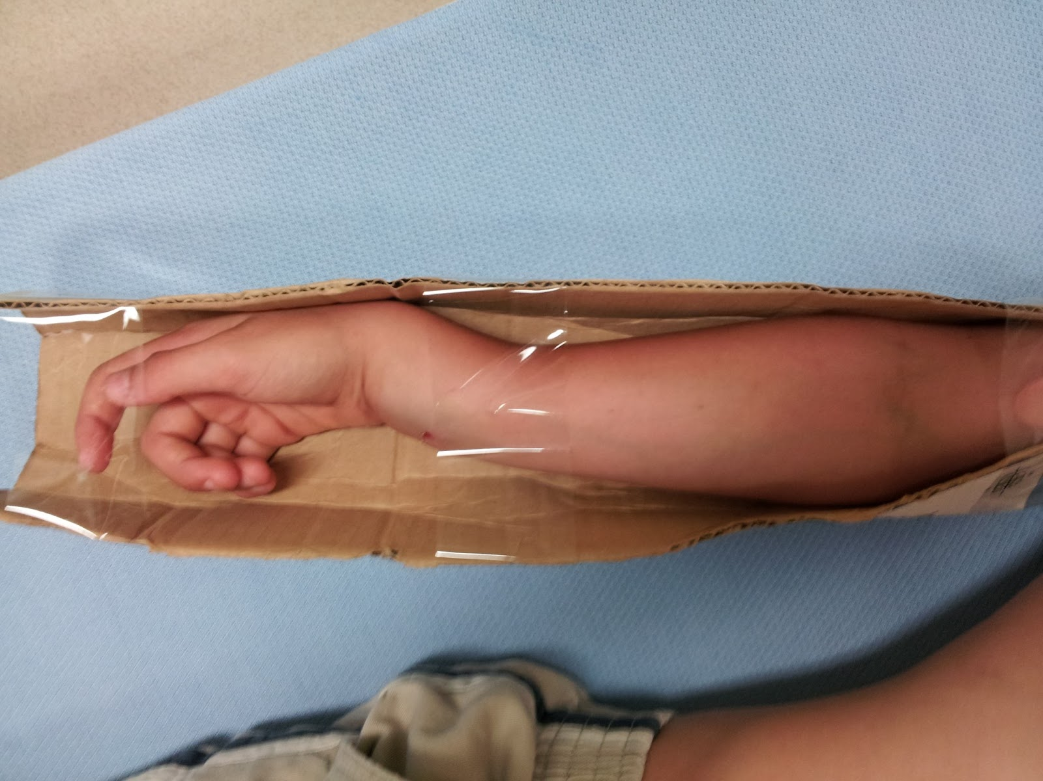
Disaster Medical Operations (Part 2)
Splint Using Cardboard

Slide 133
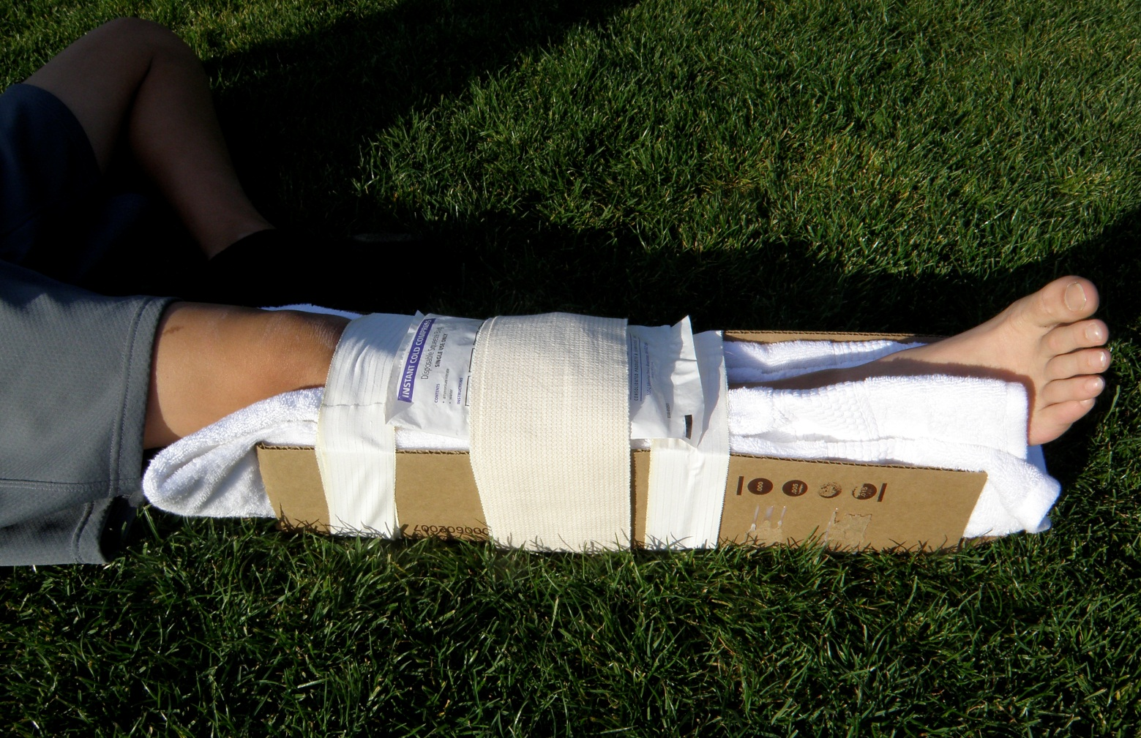
Disaster Medical Operations (Part 2)
Splint Using Cardboard & Pillow

Slide 134
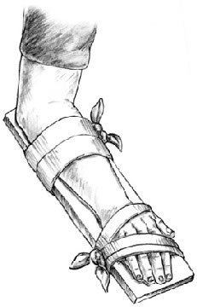
Disaster Medical Operations (Part 2)
Splint Using book, hard Surface, etc.

Slide 135
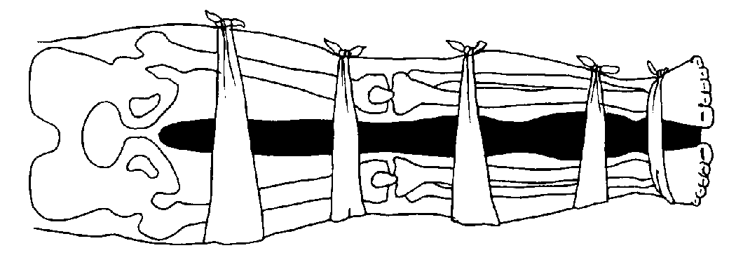
Disaster Medical Operations (Part 2)
Anatomical Splint

Slide 136
Disaster Medical Operations (Part 2)
Anatomical Splint
Anatomical splint in which the injured leg is tied at intervals to the non-injured leg, using a blanket as padding between the legs.

Slide 137
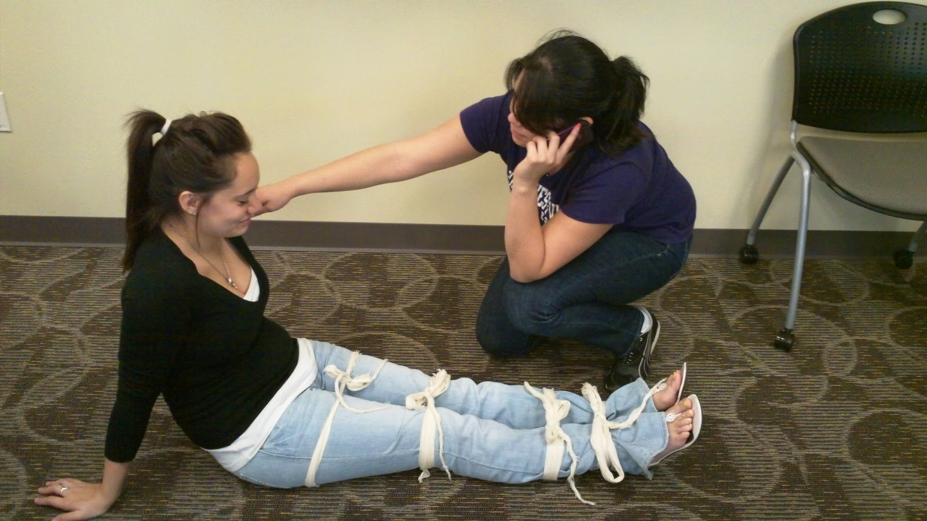
Disaster Medical Operations (Part 2)
Anatomical Splint

Slide 138
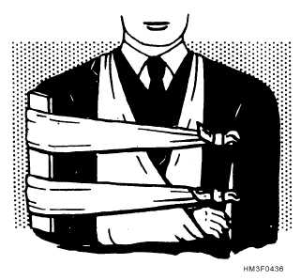
Disaster Medical Operations (Part 2)
Upper Arm Splint

Slide 139
Disaster Medical Operations (Part 2)
Treating Fractures, Dislocations, Sprains and Strains
Exercise: Splinting
Purpose: This exercise will provide you with a chance to practice your splinting techniques.

Slide 140
Disaster Medical Operations (Part 2)
Treating Fractures, Dislocations, Sprains and Strains
Instructions:
Break down into pairs of two. One person will be the rescuer, the other will be the victim.
The rescuer will place a splint on the victim’s upper arm, and then one on the victim’s lower leg.
After several observed attempts at splinting, the rescuer and the victim will swap roles.

Slide 141
Disaster Medical Operations (Part 2)
Nasal Injuries
Bleeding from the nose can have several causes. Bleeding from the nose can be caused by:
Blunt force to the nose
Skull fracture
Nontrauma-related conditions such as sinus infections, high blood pressure, and bleeding disorders

Slide 142
Disaster Medical Operations (Part 2)
Nasal Injuries
A large blood loss from a nosebleed can lead to shock. Actual blood loss may not be evident because the victim will swallow some amount of blood. Those who have swallowed large amounts of blood may become nauseated and vomit.
These are methods for controlling nasal bleeding:
Pinch the nostrils together
Put pressure on the upper lip just under the nose

Slide 143
Disaster Medical Operations (Part 2)
Nasal Injuries
While treating for nosebleeds, you should:
Have the victim sit with the head slightly forward so that blood trickling down the throat will not be breathed into the lungs. Do not put the head back.
Ensure that the victim’s airway remains open
Keep the victim quiet. Anxiety will increase blood flow.

Slide 144
Disaster Medical Operations (Part 2)
Treating Cold-Related Injuries
Cold-related injuries include:
Hypothermia, which is a condition that occurs when the body’s temperature drops below normal
Frostbite, which occurs when extreme cold shuts down blood flow to extremities, causing tissue death

Slide 145
Disaster Medical Operations (Part 2)
Treating Cold-Related Injuries
Hypothermia
Hypothermia may be caused by exposure to cold air or water or by inadequate food combined with inadequate clothing and/or heat, especially in older people.

Slide 146
Disaster Medical Operations (Part 2)
Treating Cold-Related Injuries
Hypothermia
The primary signs and symptoms of hypothermia are:
A body temperature of 95° F (37° C) or lower
Redness or blueness of the skin
Numbness accompanied by shivering

Slide 147
Disaster Medical Operations (Part 2)
Treating Cold-Related Injuries
Hypothermia
In later stages, hypothermia will be accompanied by:
Slurred speech
Unpredictable behavior
Listlessness

Slide 148
Disaster Medical Operations (Part 2)
Treating Cold-Related Injuries
Hypothermia
Because hypothermia can set in within only a few minutes, you should treat victims who have been rescued from cold air or water environments.
Remove wet clothing.
Wrap the victim in a blanket or sleeping bag and cover the head and neck.
Protect the victim against the weather.
Provide warm, sweet drinks and food to conscious victims. Do not offer alcohol.
Do not attempt to use massage to warm affected body parts.

Slide 149
Disaster Medical Operations (Part 2)
Treating Cold-Related Injuries
Hypothermia
Place an unconscious victim in the recovery position:
Place the victim’s arm that is nearest to you at a right angle against the ground, with the palm facing up.
Move the victim’s other arm across his or her chest and neck, with the back of the victim’s hand resting against his or her cheek.

Slide 150
Disaster Medical Operations (Part 2)
Treating Cold-Related Injuries
Hypothermia
Place an unconscious victim in the recovery position:
Grab a hold of the knee furthest from you and pull it up until the knee is bent and the foot is flat on the floor.
Pull the knee toward you and over the victim’s body while holding the victim’s hand in place against his or her cheek.
Position the victim’s leg at a right angle against the floor so that the victim is lying on his or her side.

Slide 151
Disaster Medical Operations (Part 2)
Treating Cold-Related Injuries
Hypothermia
If the victim is conscious, place him or her in a warm bath.
Do not to allow the victim to walk around even when he or she appears to be fully recovered. If the victim must be moved outdoors, cover the victim’s head and face.

Slide 152
Disaster Medical Operations (Part 2)
Treating Cold-Related Injuries
Frostbite
A person’s blood vessels constrict in cold weather in an effort to preserve body heat. In extreme cold, the body will further constrict blood vessels in the extremities in an effort to shunt blood toward the core organs (heart, lungs, intestines, etc.). The combination of inadequate circulation and extreme temperatures will cause tissue in these extremities to freeze, and in some cases, tissue death will result. Frostbite is most common in the hands, nose, ears, and feet.

Slide 153
Disaster Medical Operations (Part 2)
Treating Cold-Related Injuries
Frostbite
There are several key signs and symptoms of frostbite:
Skin discoloration (red, white, purple, black)
Burning or tingling sensation, at times not localized to the injury site
Partial or complete numbness

Slide 154
Disaster Medical Operations (Part 2)
Treating Cold-Related Injuries
Frostbite
A patient suffering from frostbite must be warmed slowly! Thawing the frozen extremity too rapidly can cause chilled blood to flow to the heart, shocking and potentially stopping it.
Immerse injured area in warm (NOT hot) water, approximately 107.6° F.
Do NOT allow the body part to re-freeze as this will exacerbate the injury.
Do NOT attempt to use massage to warm body parts.

Slide 155
Disaster Medical Operations (Part 2)
Treating Cold-Related Injuries
Frostbite
Wrap affected body parts in dry, sterile dressing. Again, it is vital this task be completed carefully. Frostbite results in the formation of ice crystals in the tissue; rubbing could potentially cause a great deal of damage!

Slide 156
Disaster Medical Operations (Part 2)
Treating Heat-Related Injuries
There are several types of heat-related injuries that you may encounter in a disaster scenario:
Heat cramps are muscle spasms brought on by over-exertion in extreme heat.
Heat exhaustion occurs when an individual exercises or works in extreme heat, resulting in loss of body fluids through heavy sweating. Blood flow to the skin increases, causing blood flow to decrease to the vital organs. This results in a mild form of shock.
Heat stroke is life-threatening. The victim's temperature control system shuts down, and body temperature can rise so high that brain damage and death may result.

Slide 157
Disaster Medical Operations (Part 2)
Treating Heat-Related Injuries
Heat Exhaustion
The symptoms of heat exhaustion are:
Cool, moist, pale, or flushed skin
Heavy sweating
Headache
Nausea or vomiting
Dizziness
Exhaustion

Slide 158
Disaster Medical Operations (Part 2)
Treating Heat-Related Injuries
Heat Exhaustion
A patient suffering heat exhaustion will have a near normal body temperature. If left untreated, heat exhaustion will develop into heat stroke.

Slide 159
Disaster Medical Operations (Part 2)
Treating Heat-Related Injuries
Heat Stroke
Heat stroke is characterized by some or all of the following symptoms:
Hot, red skin
Lack of perspiration
Changes in consciousness
Rapid, weak pulse and rapid, shallow breathing

Slide 160
Disaster Medical Operations (Part 2)
Treating Heat-Related Injuries
Heat Stroke
In a heat stroke victim, body temperature can be very high — as high as 105º F. If an individual suffering from heat stroke is not treated, death can result

Slide 161
Disaster Medical Operations (Part 2)
Treating Heat-Related Injuries
Treatment
Treatment is similar for both heat exhaustion and heat stroke.
Take the victim out of the heat and place in a cool environment.
Cool the body slowly with cool, wet towels or sheets. If possible, put the victim in a cool bath.

Slide 162
Disaster Medical Operations (Part 2)
Treating Heat-Related Injuries
Treatment
Treatment is similar for both heat exhaustion and heat stroke.
Have the victim drink water, SLOWLY, at the rate of approximately half a glass of water every 15 minutes. Consuming too much water too quickly will cause nausea and vomiting in a victim of heat sickness.
If the victim is experiencing vomiting, cramping, or is losing consciousness, DO NOT administer food or drink. Alert a medical professional as soon as possible, and keep a close watch on the individual until professional help is available.

Slide 163
Disaster Medical Operations (Part 2)
Bites and Stings
In a disaster environment, everything is shaken from normalcy, including insects and animals. In this time of chaos, insect bites and stings may be more common than is typical as these creatures, like people, are under additional stress.

Slide 164
Disaster Medical Operations (Part 2)
Bites and Stings
When conducting a head-to-toe assessment, you should look for signs of insect bites and stings. The specific symptoms vary depending on the type of creature, but, generally, bites and stings will be accompanied by redness and itching, tingling or burning at the site of the injury, and often a welt on the skin at the site.

Slide 165
Disaster Medical Operations (Part 2)
Bites and Stings
Treatment for insect bites and stings follows these steps:
Remove the stinger if still present by scraping the edge of a credit card or other stiff, straight-edged object across the stinger. Do not use tweezers; these may squeeze the venom sac and increase the amount of venom released.
Wash the site thoroughly with soap and water.
Place ice (wrapped in a washcloth) on the site of the sting for 10 minutes and then off for 10 minutes. Repeat this process.

Slide 166
Disaster Medical Operations (Part 2)
Bites and Stings
You may help the victim take his or her own allergy medicine (Benadryl, etc.), but you may NOT dispense medications.

Slide 167
Disaster Medical Operations (Part 2)
Bites and Stings
Bites and Stings and Allergic Reactions
The greatest concern with any insect bite or sting is a severe allergic reaction, or anaphylaxis. Anaphylaxis occurs when an allergic reaction becomes so severe that the airway is compromised. If you suspect anaphylaxis:
Check airway and breathing.
Calm the individual.

Slide 168
Disaster Medical Operations (Part 2)
Bites and Stings
Bites and Stings and Allergic Reactions
Remove constrictive clothing and jewelry as the body often swells in response to the allergen.
If possible, find and help administer a victim’s Epi-pen. Many severe allergy sufferers carry one at all times.
  DO NOT administer medicine aside from the Epi-pen. This includes pain relievers, allergy medicine, etc.
Watch for signs of shock and treat appropriately.

Slide 169
Disaster Medical Operations (Part 2)
UNIT SUMMARY
To safeguard public health, take measures to maintain proper hygiene and sanitation, and purify water if necessary. All public health measures should be planned in advance and practiced during exercises.

Slide 170
Disaster Medical Operations (Part 2)
UNIT SUMMARY
Disaster medical operations include five functions:
Triage
Treatment
Transport
Morgue
Supply

Slide 171
Disaster Medical Operations (Part 2)
UNIT SUMMARY
Treatment areas must be established as soon as casualties are confirmed. Treatment areas should be:
In a safe area that is close to, but uphill, upwind, and, if possible, upstream from the hazard area
Accessible by transportation vehicles
Expandable

Slide 172
Disaster Medical Operations (Part 2)
UNIT SUMMARY
Depending on the circumstances, a CERT may establish a central medical treatment location and/or treatment locations at incident sites where many victims have been injured.

Slide 173
Disaster Medical Operations (Part 2)
UNIT SUMMARY
Head-to-toe assessments should be verbal and hands-on. Always conduct head-to-toe assessments in the same way — beginning with the head and moving toward the feet. If injuries to the head, neck, or spine are suspected, the main objective is to not cause additional injury. Use in-line stabilization and a backboard if the victim must be moved.

Slide 174
Disaster Medical Operations (Part 2)
UNIT SUMMARY
Burns are classified as superficial, partial thickness, or full thickness depending on severity and the depth of skin layers involved. Treatment for burns involves removing the source of the burn, cooling the burn, and covering it. For full thickness burns, always treat for shock.

Slide 175
Disaster Medical Operations (Part 2)
UNIT SUMMARY
The main first aid treatment for wounds consists of:
Controlling bleeding
Cleaning
Dressing and bandaging

Slide 176
Disaster Medical Operations (Part 2)
UNIT SUMMARY
In the absence of active bleeding, dressings must be removed and the wound checked for infection at least every 4 to 6 hours. If there is active bleeding, a new dressing should be placed over the existing dressing.

Slide 177
Disaster Medical Operations (Part 2)
UNIT SUMMARY
Fractures, dislocations, sprains, and strains may have similar signs. Treat all suspected fractures, sprains, and strains by immobilizing the affected area using a splint.

Slide 178
Disaster Medical Operations (Part 2)
UNIT SUMMARY
The key to treatment of cold-related injuries such as hypothermia and frostbite is to warm the victim slowly.

Slide 179
Disaster Medical Operations (Part 2)
UNIT SUMMARY
Anaphylaxis is the most critical concern when an insect bite is suspected. Know how to use an Epi-pen and make sure to monitor the victim’s airway until professional help arrives.

