Slide 1
Disaster medical operations (part 1)
Community emergency response team

Slide 2
Texas Essential Knowledge and Skills (TEKS)
The student analyzes the concepts medical disaster operations. The student is expected to:
(A) explain the need to determine scene safety for the disaster response team;
(B) identify the components of the chain of infection;
(C) demonstrate proper hand washing to prevent the spread of infection;
(D) identify personal protective equipment needed to respond to a disaster;
(E) investigate proper waste management in a disaster response;
(F) recognize the components of the respiratory and circulatory systems;

Slide 3
Texas Essential Knowledge and Skills (TEKS)
(G) describe how shock effects the human body systems;
(H) perform head-to-toe patient assessment;
(I) simulate treatment of life threatening injuries
  i. recognize and treat an airway obstruction, bleeding, and shock;
(J) analyze the principles of triage
  i. describe the START triage system;
  ii. conduct simulated disaster triage evaluations;
(K) evaluate through documentation a disaster drill;
(L) predict the equipment and supply needs for a disaster response.

Slide 4
What you will learn
Life-Threatening Conditions: How to recognize and treat an airway obstruction, bleeding, and shock.
Triage: Principles of triage and how to conduct triage evaluations.

Slide 5
introduction
The need for CERTs to learn disaster medical operations is based on two assumptions:
The number of victims could exceed the local capacity for treatment.
Survivors will attempt to assist others. As CERT members you will need to know lifesaving first aid or post-disaster survival techniques.

Slide 6
introduction
CERT medical operations can play a vital role in limiting deaths from trauma. The phases of death from trauma are:
Phase 1: Death within minutes as a result of overwhelming and irreversible damage to vital organs
Phase 2: Death within several hours as a result of excessive bleeding
Phase 3: Death in several days or weeks as a result of infection or multiple-organ failure (i.e., complications from an injury)

Slide 7
introduction
These phases underlie why disaster medical operations are conducted as they are (by identifying those with the most serious injuries as soon as possible and treating those with life-threatening injuries first). Some disaster victims in the second and third phases of death could be saved by providing simple medical care.

Slide 8
introduction
In a disaster there may be more victims than rescuers, and assistance from medical professionals may not be immediately available. CERT personnel are trained to be part of disaster medical operations and to provide:
Treatment for life-threatening conditions — airway obstruction, bleeding, and shock — and for other, less urgent conditions
The greatest good for the greatest number of people by conducting simple triage and rapid treatment

Slide 9
START
Simple Triage And Rapid Treatment (START) is a critical concept for initially dealing with casualties in a disaster.

Slide 10
START
History has proven that 40% of disaster victims can be saved with simple (rapid!) medical care. START is based on the premise that a simple medical assessment and rapid treatment based on that assessment will yield positive — often lifesaving — results.

Slide 11
START
STart = Simple Triage: The first phase of START is the process by which victims are sorted based on injury and priority of treatment.
stART = And Rapid Treatment: The second phase of START consists of rapid treatment of the injuries assessed and prioritized in the first phase.

Slide 12
START
All CERT participants are encouraged to take basic first aid and CPR training; however, if you have taken first aid courses you will need to understand that CERT covers disaster medical operations where time is critical to conduct triage and treat many victims. CPR is not taught in this course because it is labor intensive and not appropriate when there are many victims and professional help will be delayed.

Slide 13
objectives
At the end of this unit, you should be able to:
Identify the “killers.”
Apply techniques for opening the airway, controlling bleeding, and treating for shock.
Conduct triage under simulated disaster conditions.
Remember, the goal of disaster medical operations is to do the greatest good for the greatest number. In a disaster with many victims, time will be critical. CERT members will need to work quickly and efficiently to help as many victims as possible.

Slide 14
objectives
This session will introduce you to the principles of triage, including treating the “three killers”: airway obstruction, excessive bleeding, and shock.
Throughout the unit, you will have opportunities to practice the treatment techniques and, at the end of the unit, you will have the opportunity to conduct triage evaluations in a simulated disaster.

Slide 15
Treating Life-Threatening Conditions
In emergency medicine, airway obstruction, bleeding, and shock are “killers” because without treatment they will lead to death. The first priority of medical operations is to attend to those potential killers by:
Opening the airway
Controlling excessive bleeding
Treating for shock
This section will train you to recognize the “killers” by recognizing their symptoms and their effects on the body.

Slide 16
Treating Life-Threatening Conditions:
Approaching the Victim
Rescuers must first ensure that they are wearing safety equipment:
Helmet
Goggles
Gloves
N95 mask
Sturdy shoes or boots
Non-latex exam gloves

Slide 17
Treating Life-Threatening Conditions:
Approaching the Victim
A good time-saving technique is to wear non-latex exam gloves under your work gloves. Then, when you find a victim, you can remove your work gloves and are ready to work with the victim.
Remember to use non-latex exam gloves to prevent potential reaction by individuals who are allergic to latex.

Slide 18
Treating Life-Threatening Conditions:
There are several steps to take when approaching a victim. When ready to approach a victim:
If the victim is conscious, be sure he or she can see you.
Identify yourself by giving your name and indicating the organization with which you are affiliated.

Slide 19
Treating Life-Threatening Conditions:
ALWAYS request permission to treat an individual. If the individual is unconscious, he or she is assumed to have given “implied consent,” and you may treat him or her. Ask a parent or guardian for permission to treat a child, if possible.
Whenever possible, respect cultural differences. For example, in some Muslim traditions it is customary to address the male when requesting permission to treat a female member of his family.

Slide 20
Treating Life-Threatening Conditions:
Remember, all medical patients are legally entitled to confidentiality (HIPAA). When dealing with victims, always be mindful and respectful of the privacy of their medical condition.

Slide 21
Treating Life-Threatening Conditions:
Opening the Airway
The respiratory system includes the following components:
Lung
Bronchus
Larynx
Pharynx
Nasal Cavity
Trachea

Slide 22
Treating Life-Threatening Conditions:
Opening the Airway
In an unconscious or semiconscious victim, especially one positioned on his or her back, the most common airway obstruction is the tongue. The tongue — which is a muscle — may relax and block the airway. A victim with a suspected airway obstruction must be checked immediately for breathing and, if necessary, the airway must be opened.

Slide 23
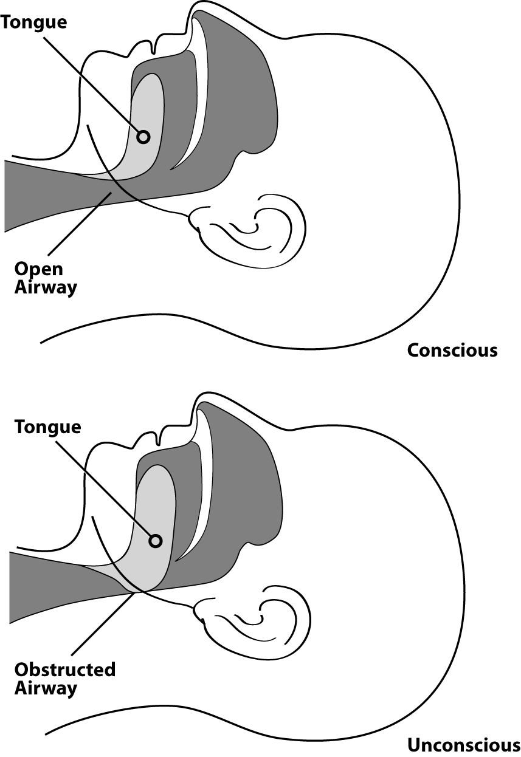
Treating Life-Threatening Conditions:
Airway Obstructed by the Tongue

Slide 24
Treating Life-Threatening Conditions:
The Head-Tilt/Chin-Lift Method
When an airway obstruction is suspected because a victim is unconscious or semiconscious, CERT members should clear the airway using the Head-Tilt/Chin-Lift method.
In addition to opening the airway, this method causes little or no cervical-spine manipulation because only the head is manipulated.
Proper technique is always important in opening an airway, but so is speed.

Slide 25
Treating Life-Threatening Conditions:
The Head-Tilt/Chin-Lift Method
STEP #1:
At an arm’s distance, make contact with the victim by touching the shoulder and asking, “Can you hear me?” Speak loudly, but do not yell.

Slide 26
Treating Life-Threatening Conditions:
The Head-Tilt/Chin-Lift Method
STEP #2:
If the victim does not or cannot respond, place the palm of one hand on the forehead.

Slide 27
Treating Life-Threatening Conditions:
The Head-Tilt/Chin-Lift Method
STEP #3
Place two fingers of the other hand under the chin and tilt the jaw upward while tilting the head back slightly.

Slide 28
Treating Life-Threatening Conditions:
The Head-Tilt/Chin-Lift Method
STEP #4
Place your ear close to the victim’s mouth, looking toward the victim’s feet, and place a hand on the victim’s abdomen.

Slide 29
Treating Life-Threatening Conditions:
The Head-Tilt/Chin-Lift Method
STEP #5
Look for chest rise.

Slide 30
Treating Life-Threatening Conditions:
The Head-Tilt/Chin-Lift Method
STEP #6
Listen for air exchange.
  Document abnormal lung sounds (wheezing, gasping, gurgling, etc.).

Slide 31
Treating Life-Threatening Conditions:
The Head-Tilt/Chin-Lift Method
STEP #7
Feel for abdominal movement.

Slide 32
Treating Life-Threatening Conditions:
The Head-Tilt/Chin-Lift Method
STEP #8
If breathing has been restored, the clear airway must be maintained by keeping the head tilted back. If breathing has not been restored, repeat steps 2-7.

Slide 33
Treating Life-Threatening Conditions:
The Head-Tilt/Chin-Lift Method
Exercise: Opening the Airway
Purpose: Practice using the Head-Tilt/Chin-Lift method of opening the airway.
Be sure to use the steps in the Head-Tilt/Chin-Lift method.

Slide 34
Treating Life-Threatening Conditions:
The Head-Tilt/Chin-Lift Method
Maintaining The Airway
If breathing has been restored, the clear airway still must be maintained by keeping the head tilted back. One option is to ask another person to hold the head in place; even another victim with minor injuries could do this. The airway also can be maintained by placing soft objects under the victim’s shoulders to elevate the shoulders slightly and keep the airway open.

Slide 35
Treating Life-Threatening Conditions:
The Head-Tilt/Chin-Lift Method
Maintaining The Airway
Remember that part of your mission is to do the greatest good for the greatest number of people. For that reason, if breathing is not restored on the first try using the Head-Tilt/Chin-Lift method, CERT members should try again using the same method. If breathing cannot be restored on the second try, CERT members must move on to the next victim.

Slide 36
Treating Life-Threatening Conditions:
The Head-Tilt/Chin-Lift Method
Maintaining The Airway
You should always be concerned with head, neck, or spinal injuries (all of which are common in structural collapses). Used properly, the Head-Tilt/Chin-Lift method for opening an airway causes little spinal manipulation because the head pivots on the spine.

Slide 37
Treating Life-Threatening Conditions:
The Head-Tilt/Chin-Lift Method
Maintaining The Airway
Remember the importance of opening the airway as quickly as possible. When treating the three killers, checking for airway obstruction is always first.

Slide 38
Treating Life-Threatening Conditions:
Controlling Bleeding
Controlling Bleeding
Uncontrolled bleeding initially causes weakness. If bleeding is not controlled, the victim will go into shock within a short period of time and finally will die. An adult has about 5 liters of blood. Losing 1 liter can result in death.

Slide 39
Treating Life-Threatening Conditions:
Controlling Bleeding
Controlling Bleeding
There are three types of bleeding and the type can usually be identified by how fast the blood flows:
  Arterial bleeding: Arteries transport blood under high pressure. Blood coming from an artery will spurt.
  Venous bleeding: Veins transport blood under low pressure. Blood coming from a vein will flow.
  Capillary bleeding: Capillaries also carry blood under low pressure. Blood coming from capillaries will ooze.

Slide 40
Treating Life-Threatening Conditions:
Controlling Bleeding
Controlling Bleeding
There are three main methods for controlling bleeding:
  Direct pressure
  Elevation
  Pressure points
Direct pressure and elevation will control bleeding in 95% of cases.

Slide 41
Treating Life-Threatening Conditions:
Procedures for Controlling Bleeding
Method
Procedure
Direct Pressure
Place direct pressure over the wound by putting a clean dressing over the wound and pressing firmly.
Maintain pressure on the dressing over the wound by wrapping the wound firmly with a pressure bandage and tying with a bow.

Slide 42
Treating Life-Threatening Conditions:
Procedures for Controlling Bleeding
Method
Procedure
Elevation
Elevate the wound above the level of the heart.

Slide 43
Treating Life-Threatening Conditions:
Procedures for Controlling Bleeding
Method
Procedure
Pressure Points
Put pressure on the nearest pressure point to slow the flow of blood to the wound. Use the:
  Brachial point for bleeding in the arm
  Femoral point for bleeding in the leg
  Popliteal point for bleeding in the lower leg

Slide 44
Treating Life-Threatening Conditions:
Procedures for Controlling Bleeding
Direct Pressure
This is the procedure for controlling bleeding through direct pressure:
Step 1: Place direct pressure over the wound by putting a clean dressing over it and pressing firmly.
Step 2: Maintain pressure on the dressing over the wound by wrapping firmly with a bandage.
Direct pressure and elevation can take 5 to 7 minutes to stop the bleeding completely. The use of a dressing and pressure bandage allows the rescuer to move on to the next victim.

Slide 45
Treating Life-Threatening Conditions:
Procedures for Controlling Bleeding
A pressure bandage should be tied with a bow, so that it can be loosened — rather than cut — to examine the wound, and then retied. This procedure helps to conserve supplies and saves time.
The bandage maintains the direct pressure needed to stop the bleeding. CERT members continue to assess the victim’s status. If the victim’s limb is turning blue or becoming numb below the bandage, then it should be loosened.

Slide 46
Treating Life-Threatening Conditions:
Procedures for Controlling Bleeding
Elevation
Elevation can be used in combination with direct pressure. Elevate the wound above the level of the heart.
The body has great difficulty pumping blood against gravity; therefore, elevating a wound above the heart will decrease blood flow and loss of blood through the wound.

Slide 47
Treating Life-Threatening Conditions:
Procedures for Controlling Bleeding
Pressure Points
There are also pressure points that can be used to stem the flow of bleeding.
The pressure points most often used are the:
  Brachial point in the arm
  Femoral point in the leg
  Pressure point behind the knee

Slide 48
Treating Life-Threatening Conditions:
Procedures for Controlling Bleeding
Pressure Points
The pressure point to use depends on the location of the wound. The correct pressure point is between the wound and the heart.

Slide 49
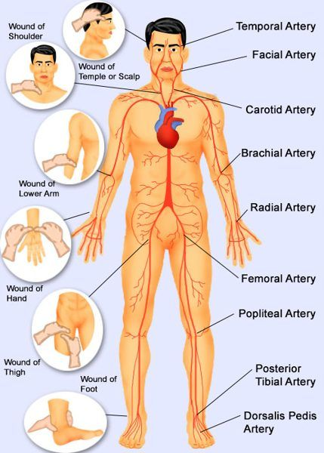
Pressure Points
Brachial
Femoral
Behind knee

Slide 50
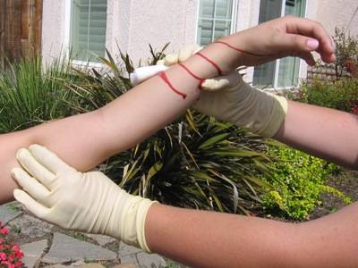
Treating Life-Threatening Conditions:
Pressure Points
Brachial Pressure Point

Slide 51
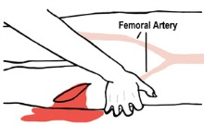
Treating Life-Threatening Conditions:
Pressure Points
Femoral Pressure Point

Slide 52
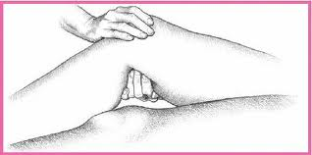
Treating Life-Threatening Conditions:
Pressure Points
Popliteal Pressure Point

Slide 53
Pressure Points
Brachial
Femoral
Behind knee

Slide 54
Treating Life-Threatening Conditions:
Exercise: Controlling Bleeding
Purpose: This exercise will provide a chance to practice using the techniques for controlling bleeding.

Slide 55
Treating Life-Threatening Conditions:
Exercies: Controlling Bleeding
Instructions:
After breaking into pairs, identify one person to take the role of the victim.
Respond as if the victim has an injury on the right forearm, just below the elbow.
Apply a pressure bandage and elevate the arm.
Repeat the process twice.
Swap roles and have the new rescuer complete the above steps.

Slide 56
Treating Life-Threatening Conditions:
Toutniquets
Tourniquets (Optional)
CERTs will use direct pressure on pressure points and elevation to manage most bleeding. However, if bleeding cannot be stopped using these methods and professionals are delayed in responding, a tourniquet may be a viable option to save a person from bleeding to death. However, a tourniquet is absolutely a last resort (life or limb) when other preferred means have failed to control bleeding in an arm or a leg.

Slide 57
Treating Life-Threatening Conditions:
Tourniquets
Tourniquets (Optional)
While the use of a tourniquet is extremely rare, it may have a use when part of an extremity is amputated or crushed and bleeding cannot be stopped by any other preferred means.

Slide 58
Treating Life-Threatening Conditions:
Tourniquets
A tourniquet is a tight bandage which, when placed around a limb and tightened, cuts off the blood supply to the part of the limb beyond it.

Slide 59
Treating Life-Threatening Conditions:
Tourniquets
A tourniquet can do harm to the limb, but it can halt severe blood loss when all other means have failed and professional help will not arrive in time to help stop the bleeding before the person dies.

Slide 60
Treating Life-Threatening Conditions:
Tourniquets
Use any long, flat, soft material (bandage, neck tie, belt, or stocking). Do not use materials like rope, wire, or string that can cut into the patient’s flesh.

Slide 61
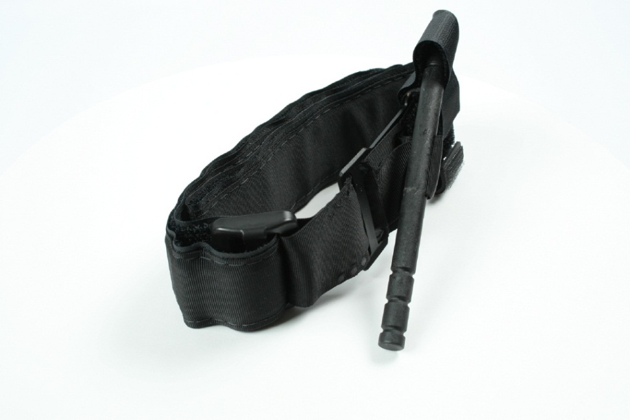
Treating Life-Threatening Conditions:
Tourniquets
Emergency Tourniquet

Slide 62
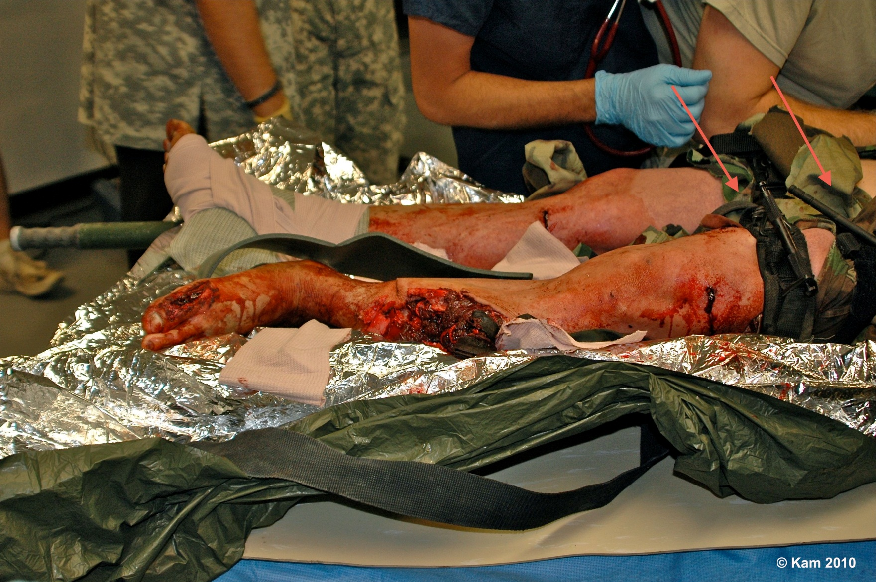
Treating Life-Threatening Conditions:
Tourniquets

Slide 63
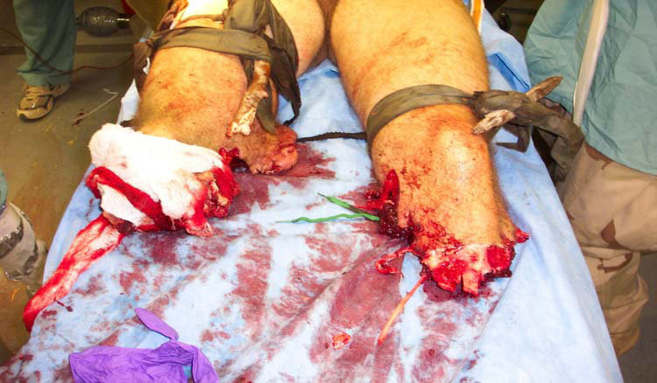
Treating Life-Threatening Conditions:
Tourniquets

Slide 64
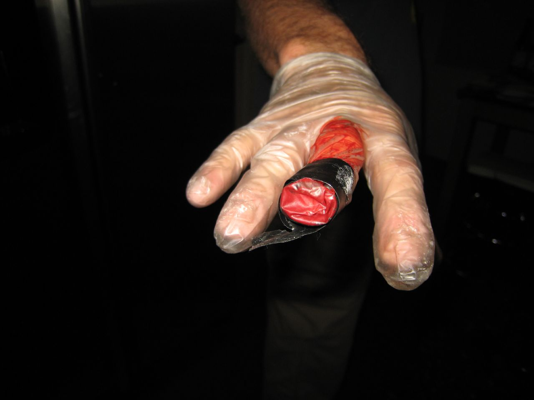
Treating Life-Threatening Conditions:
Tourniquets

Slide 65
Treating Life-Threatening Conditions:
Tourniquets
To Tie a Tourniquet: Step #1
Place the tourniquet between the wound and the heart (for example, if the wound is on the wrist, you would tie the tourniquet around the forearm).

Slide 66
Treating Life-Threatening Conditions:
Tourniquets
To Tie a Tourniquet: Step #2
Tie the piece of material around the limb.

Slide 67
Treating Life-Threatening Conditions:
Tourniquets
To Tie a Tourniquet: Step #3
Place a stick, pen, ruler, or other sturdy item against the material and tie a knot around the item, so that the item is knotted against the limb.

Slide 68
Treating Life-Threatening Conditions:
Tourniquets
To Tie a Tourniquet: Step #4
Use the stick or other item as a lever to twist the knot more tightly against the limb, tightening the bandage until the bleeding stops.

Slide 69
Treating Life-Threatening Conditions:
Tourniquets
To Tie a Tourniquet: Step #5
Tie one or both ends of the lever against the limb to secure it and maintain pressure.

Slide 70
Treating Life-Threatening Conditions:
Tourniquets
To Tie a Tourniquet: Step #6
Mark the patient in an obvious way that indicates that a tourniquet was used and include the time it was applied.

Slide 71
Treating Life-Threatening Conditions:
Tourniquets
To Tie a Tourniquet: Step #7
Do not loosen a tourniquet once it has been applied.

Slide 72
Treating Life-Threatening Conditions:
Tourniquets
To Tie a Tourniquet: Step #8
Only proper medical authorities should remove a tourniquet.

Slide 73
Treating Life-Threatening Conditions:
Review: Controlling Bleeding
Controlling Bleeding Review:
What are the three main ways to control excessive bleeding:
Direct pressure
Elevation
Pressure points

Slide 74
Treating Life-Threatening Conditions:
Review: Controlling Bleeding
REMEMBER:
Bleeding must be controlled as quickly as possible so as not to endanger the victim’s life from blood loss.
You should always wear your non-latex exam gloves, goggles, and an N95 mask as a protection against blood-borne pathogens, such as hepatitis and HIV.

Slide 75
Treating Life-Threatening Conditions:
Shock
Shock is a condition that occurs when the body is not getting enough blood flow. When blood doesn’t circulate, oxygen and other nutrients are not carried to tissues and organs…
Blood vessels begin to close and organs are damaged and, if left untreated, will shut down completely. Shock can worsen very rapidly.

Slide 76
Treating Life-Threatening Conditions:
Shock
Remaining in shock will lead to the death of:
Cells
Tissues
Entire organs

Slide 77
Treating Life-Threatening Conditions:
Breathing
Evaluate Breathing:
Note if the victim’s breathing is rapid and shallow, i.e., more than 30 breaths per minute.

Slide 78
Treating Life-Threatening Conditions:
CIRCULATION
Evaluate Circulation:
One way to test for circulation is the blanch test. A good place to do the blanch test is the palm of one hand. Sometimes, a nail bed is used. The blanch test is used to test capillary refill. You should see the color return to the tested area within 2 seconds.

Slide 79
Treating Life-Threatening Conditions:
CIRCULATION
Evaluate Circulation:
Because the blanch test is not valid in children, mental status should be used instead as the main indicator.

Slide 80
Treating Life-Threatening Conditions:
CIRCULATION
Evaluate Circulation:
Another way to check for circulation is the radial pulse test. This is an alternative to the blanch test and can be used in the dark or where it is cold.

Slide 81
Treating Life-Threatening Conditions:
CIRCULATION
Evaluate Circulation:
To perform the radial pulse test, place your middle and ring finger over the interior of the victim’s wrist where the thumb meets the arm. A normal pulse rate is 60-100 beats per minute.

Slide 82
Treating Life-Threatening Conditions:
MENTAL STATUS
Evaluate Mental Status:
There are several ways to evaluate mental status.
Ask, “Are you okay?”
Give a simple command such as “Squeeze my hand.”
If you are concerned that there might be a language barrier or hearing impairment, reach out with both hands and squeeze one of the victim’s hands. The person will squeeze back if they can.

Slide 83
Treating Life-Threatening Conditions:
SHOCK
Treating for Shock:
The body will initially compensate for blood loss and mask the symptoms of shock; therefore, shock is often difficult to diagnose. It is possible — and, in fact, common — for an individual suffering from shock to be fully coherent and not complaining of pain. Pay attention to subtle clues, as failure to recognize shock will have serious consequences.

Slide 84
Treating Life-Threatening Conditions:
SHOCK
Treating for Shock:
Avoid rough or excessive handling. It is important to maintain the victim’s body temperature. If necessary, place a blanket or other material under and/or over the victim to provide protection from extreme ground temperatures (hot or cold). Position the victim on his or her back and elevate the feet 6 to 10 inches above the level of the heart to assist in bringing blood to the vital organs.

Slide 85
Treating Life-Threatening Conditions:
SHOCK
Treating for Shock:
Although victims who are suffering from shock may be thirsty, they should not eat or drink anything initially because they may also be nauseated.

Slide 86
Treating Life-Threatening Conditions:
Procedures for controlling SHOCK
STEP #1:
Maintain an open airway

Slide 87
Treating Life-Threatening Conditions:
Procedures for controlling SHOCK
STEP #2:
Control obvious bleeding

Slide 88
Treating Life-Threatening Conditions:
Procedures for controlling SHOCK
STEP #3:
Maintain body temperature (e.g., cover the ground and the victim with a blanket if necessary).

Slide 89
Treating Life-Threatening Conditions:
Procedures for controlling SHOCK
NOTE:
Avoid rough or excessive handling.
Do not provide food or drink.

Slide 90
Treating Life-Threatening Conditions:
EXERCISE: TREATING SHOCK
Purpose: This exercise offers you a chance to practice the steps for treating shock.

Slide 91
Treating Life-Threatening Conditions:
EXERCISE: TREATING SHOCK
Instructions:
Break into the previous groups.
The person who was the victim first in the previous exercise will now be the rescuer first.
Pretend that you are in the following situation:
  You have come upon an unconscious victim who has been bleeding profusely from a wound of the upper arm for an undetermined period of time. You have controlled the bleeding.
  What do you need to do next?
Switch places and have the victim become the rescuer.

Slide 92
Treating Life-Threatening Conditions:
TRIAGE
In mass casualty events, medical personnel:
Identify the dead and those who are too severely injured to be saved
Send those with relatively minor injuries and wounds to a holding area to await treatment
Identify those who would die from life-threatening injuries and treat them immediately

Slide 93
Treating Life-Threatening Conditions:
TRIAGE
The term for this is triage — a French term meaning “to sort.”

Slide 94
Treating Life-Threatening Conditions:
TRIAGE
During medical triage, victims’ conditions are evaluated and the victims are prioritized into four categories:
Immediate (I): The victim has life-threatening injuries (airway, bleeding, or shock) that demand immediate attention to save his or her life; rapid, lifesaving treatment is urgent. These victims are marked with a red tag or labeled “I.”

Slide 95
Treating Life-Threatening Conditions:
TRIAGE
During medical triage, victims’ conditions are evaluated and the victims are prioritized into four categories:
Delayed (D): Injuries do not jeopardize the victim’s life. The victim may require professional care, but treatment can be delayed. These victims are marked with a yellow tag or labeled “D.”

Slide 96
Treating Life-Threatening Conditions:
TRIAGE
During medical triage, victims’ conditions are evaluated and the victims are prioritized into four categories:
Minor (M): Walking wounded and generally ambulatory. These victims are marked with a green tag or labeled “M.”

Slide 97
Treating Life-Threatening Conditions:
TRIAGE
During medical triage, victims’ conditions are evaluated and the victims are prioritized into four categories:
Dead (DEAD): No respiration after two attempts to open the airway. Because CPR is one-on-one care and is labor intensive, CPR is not performed when there are many more victims than rescuers. These victims are marked with a black tag or labeled “DEAD.”

Slide 98
Treating Life-Threatening Conditions:
TRIAGE
From triage, victims are taken to the designated medical treatment area (immediate care, delayed care, or the morgue).

Slide 99
Treating Life-Threatening Conditions:
TRIAGE
CERT members do not rescue those tagged DEAD. If the scene is deemed safe and it is appropriate to do so, CERT members may move the DEAD to the morgue.

Slide 100
Treating Life-Threatening Conditions:
TRIAGE
It is crucial to the physical and mental well-being of disaster survivors that the morgue be placed away from the other groups. Traditionally, blue tarps are used to identify and conceal the morgue area.

Slide 101
Treating Life-Threatening Conditions:
RESCUER SAFETY TRIAGE
If hazardous materials are present, rescuer safety is paramount. CERT members should leave the scene to avoid harm to themselves and to reduce the risk of spreading the contamination.

Slide 102
Treating Life-Threatening Conditions:
RESCUER SAFETY TRIAGE
Rescuer safety is crucial during triage. Rescuers must wear all safety equipment, including non-latex exam gloves, goggles, a helmet, and an N95 mask when examining victims and should try to change gloves between victims. Because of limited supplies, it may not be possible to use a new pair of gloves for every victim.

Slide 103
Treating Life-Threatening Conditions:
RESCUER SAFETY TRIAGE
If this is the case, gloves may be sterilized between treating victims using 1 part bleach to 10 parts water. Your disaster kit should have a box of non-latex gloves. Bleach and potable water should also be available at the CERT’s medical treatment area.

Slide 104
Treating Life-Threatening Conditions:
EXERCISE: REMOVING EXAM GLOVES
Purpose: This exercise will allow you to practice proper technique for removing soiled exam gloves without spreading contaminants.

Slide 105
Treating Life-Threatening Conditions:
EXERCISE: REMOVING EXAM GLOVES
Instructions:
Put on a pair of gloves.
Remove and dispose of your gloves as instructed.

Slide 106
Treating Life-Threatening Conditions:
TRIAGE IN A DISASTER ENVIRONMENT
Here is the general procedure for CERTs to conduct triage:

Slide 107
Treating Life-Threatening Conditions:
TRIAGE IN A DISASTER ENVIRONMENT
Step 1: Stop, Look, Listen, and Think
Before your team starts, stop and size up the situation by looking around and listening. Think about your safety, capability, and limitations, and decide if you will approach the situation. If you decide to proceed, quickly make a plan about your approach that all members understand.

Slide 108
Treating Life-Threatening Conditions:
TRIAGE IN A DISASTER ENVIRONMENT
Step 2: Conduct voice triage
Begin by calling out, “Community Emergency Response Team. If you can walk, come to the sound of my voice.” Speak loudly and firmly. If there are survivors who are ambulatory, tag them M and direct them to a designated location. If rescuers need assistance and there are ambulatory survivors, then these survivors should be asked to provide assistance. These persons may also provide useful information about the location of the victims.

Slide 109
Treating Life-Threatening Conditions:
TRIAGE IN A DISASTER ENVIRONMENT
Step 3: Start where you stand, and follow a systematic route
Start with the closest victims and work outward in a systematic fashion.

Slide 110
Treating Life-Threatening Conditions:
TRIAGE IN A DISASTER ENVIRONMENT
Step 4: Evaluate each victim and tag them
“I” (immediate), “D” (delayed), “M” (minor), or DEAD. Remember to evaluate the walking wounded. Remember to ASK for permission to treat if the individual is conscious.

Slide 111
Treating Life-Threatening Conditions:
TRIAGE IN A DISASTER ENVIRONMENT
Step 5: Treat I victims immediately
Initiate airway management, bleeding control, and/or treatment for shock for Category I victims.

Slide 112
Treating Life-Threatening Conditions:
TRIAGE IN A DISASTER ENVIRONMENT
Step 6: Document triage results for:
Effective deployment of resources
Information on the victims’ locations
A quick record of the number of casualties by degree of severity.
Remember that your safety is paramount during triage. It is important to wear proper protective equipment so as not to endanger your own health.

Slide 113
Treating Life-Threatening Conditions:
EVALUATING A VICTIM DURING TRIAGE
STEP #1
Check airway/breathing. At an arm’s distance, make contact with the victim and speak loudly. If the victim does not respond:
Position the airway.
Look, listen, and feel.
Check breathing rate. Abnormally rapid respiration (above 30 per minute) indicates shock. Maintain the airway and treat for shock and tag “I.”
If below 30 per minute, then move to Step 2.
If the victim is not breathing after two attempts to open airway, then tag “DEAD.”

Slide 114
Treating Life-Threatening Conditions:
EVALUATING A VICTIM DURING TRIAGE
STEP #2
Check circulation/bleeding.
Take immediate action to control severe bleeding.
Check circulation using the blanch test (for capillary refill) or a radial pulse test.
  Press on an area of skin until normal skin color is gone. Time how long it takes for normal color to return. Treat for shock if normal color takes longer than 2 seconds to return, and tag “I.”
  Or check the radial pulse.
    If present, continue to step 3.
    Note if the pulse is abnormal (rapid, thready, weak, etc.)
    If absent, tag “I” and treat for bleeding and shock.

Slide 115
Treating Life-Threatening Conditions:
EVALUATING A VICTIM DURING TRIAGE
STEP #3
Check mental status. Inability to respond indicates that immediate treatment for shock is necessary. Treat for shock and tag “I.”

Slide 116
Treating Life-Threatening Conditions:
EVALUATING A VICTIM DURING TRIAGE
Time will be critical in a disaster. You will not be able to spend very much time with any single victim. Remember that you want to do the greatest good for the greatest number of victims.

Slide 117
Treating Life-Threatening Conditions:
EVALUATING A VICTIM DURING TRIAGE
In order to respond effectively in a mass casualty event CERT members must:
Have a plan based on a thorough sizeup
Follow that plan
Document actions throughout

Slide 118
Treating Life-Threatening Conditions:
EVALUATING A VICTIM DURING TRIAGE
Triage must be practiced to avoid triage pitfalls. Triage pitfalls include:
No team plan, organization, or goal
Indecisive leadership
Too much focus on one injury
Treatment (rather than triage) performed

Slide 119
Treating Life-Threatening Conditions:
EXERCISE: CONDUCTING TRIAGE
Purpose: This exercise will allow you to practice conducting triage in a high pressure situation.

Slide 120
Treating Life-Threatening Conditions:
EXERCISE: CONDUCTING TRIAGE
Instructions:
Divide into three groups. Tape your medical status card to your shirt.
There will be three rounds. In each round, one group will be rescuers and the other two will be victims.
The rescuers will have a limited amount of time to:
  Size up the situation and develop a plan of action
  Conduct triage and tag each victim for treatment
  Document the number of victims in each category of triage (Immediate, Delayed, Minor, Dead)
.

Slide 121
Treating Life-Threatening Conditions:
UNIT SUMMARY
CERT members’ ability to open airways, control bleeding, and treat shock is critical to saving lives.
Use the Head-Tilt/Chin-Lift method for opening airways.
Control bleeding using direct pressure, elevation, and/or pressure points.
If there is a question about whether a victim is in shock, treat for shock as a precaution.

Slide 122
Treating Life-Threatening Conditions:
UNIT SUMMARY
Triage is a system for rapidly evaluating victims’ injuries and prioritizing them for treatment.
  There are 4 triage categories:
    Immediate
    Delayed
    Minor
    Dead

Slide 123
Treating Life-Threatening Conditions:
UNIT SUMMARY
Triage in a disaster environment consists of 6 important steps:
Stop, Look, Listen and Think, and make a quick plan.
Conduct voice triage.
Begin where you stand and work systematically.
Evaluate and tag all victims.
Treat those tagged “I” immediately.
Document your findings.

Slide 124
Treating Life-Threatening Conditions:
UNIT SUMMARY
The procedure for conducting triage evaluations involves checking:
The airway and breathing rate
Circulation and bleeding
Mental status
.

Slide 125
Treating Life-Threatening Conditions:
QUESTIONS
ANY QUESTIONS?

