Slide 1

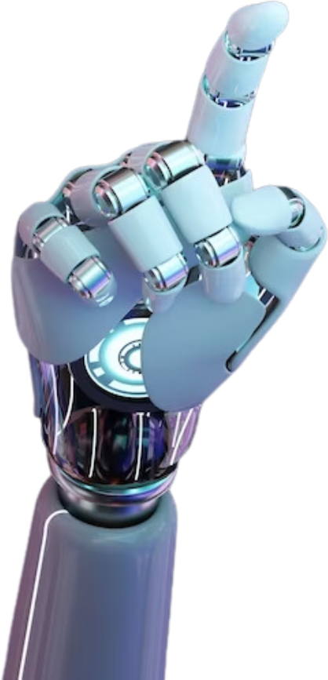

AI for Smarties
Presented by Barbara White & Aileen Noll
Notes:
Introduce ourselves and tell our background in the medical field and how long we have taught and which classes.

Slide 2

  AI stands for Artificial Intelligence
  The type of AI for this talk will be Generative Intelligence
  Generative Intelligence contains tools that generate new content
AI

Slide 3

  Do not upload sensitive and/or confidential data!
  Generative AI responses and output are not always correct or factual!
  Don’t use links - copy/paste text
  Use clear and concise language - make sure to edit and put it in your own words
  Fast-paced, always updating
Things to keep in mind with using any AI:

Slide 4


Question? (Open-Ended)
What do you currently know about AI for teachers?

Slide 5
Question? (Poll)
What AI do you currently use?
Curipod, Chatgpt, Magic School, Brisk, and Eduaid

Slide 6
  Upload or create a new PowerPoint
  Create questions: multiple choice, open-ended, and true/false
  Look at the results of class participation
  Moderator View (on-the-spot correction)
Curipod
www.curipod.com

Slide 7
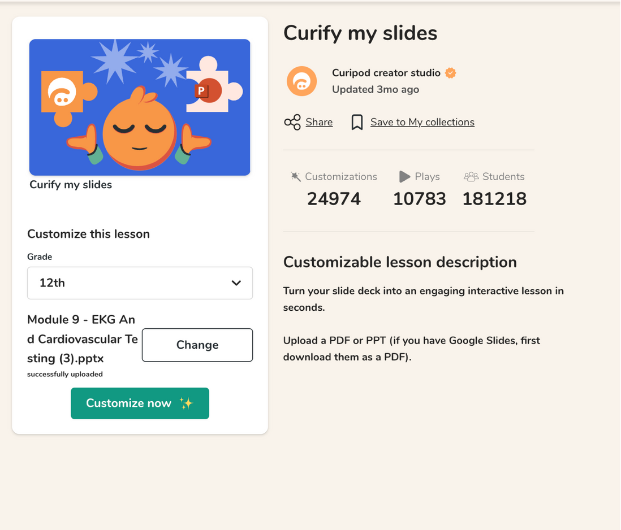
Curify current slides by uploading
Curipod

Slide 8
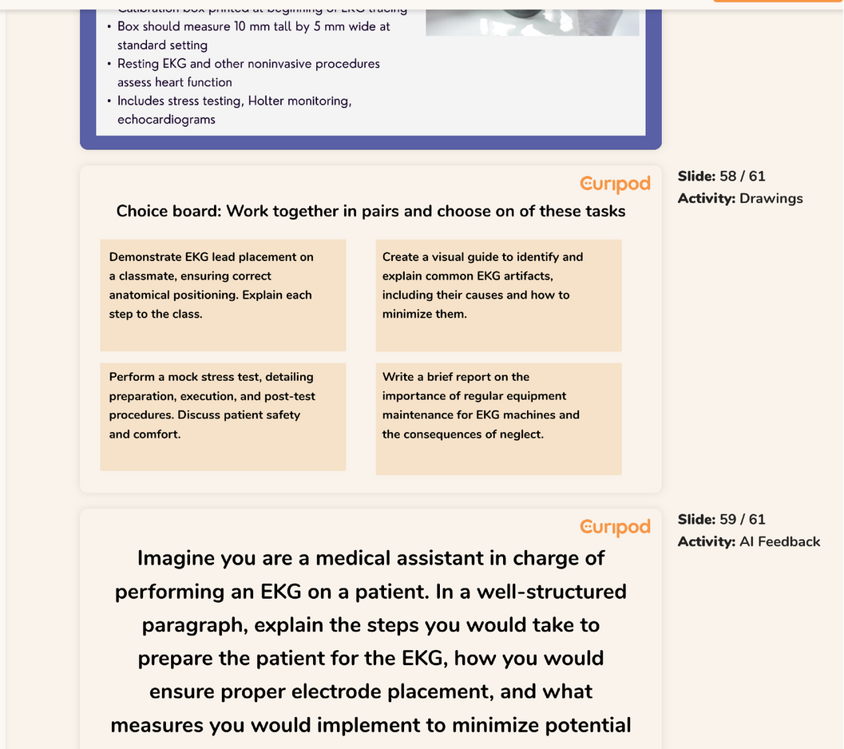
Curify current slides by uploading
Curipod

Slide 9
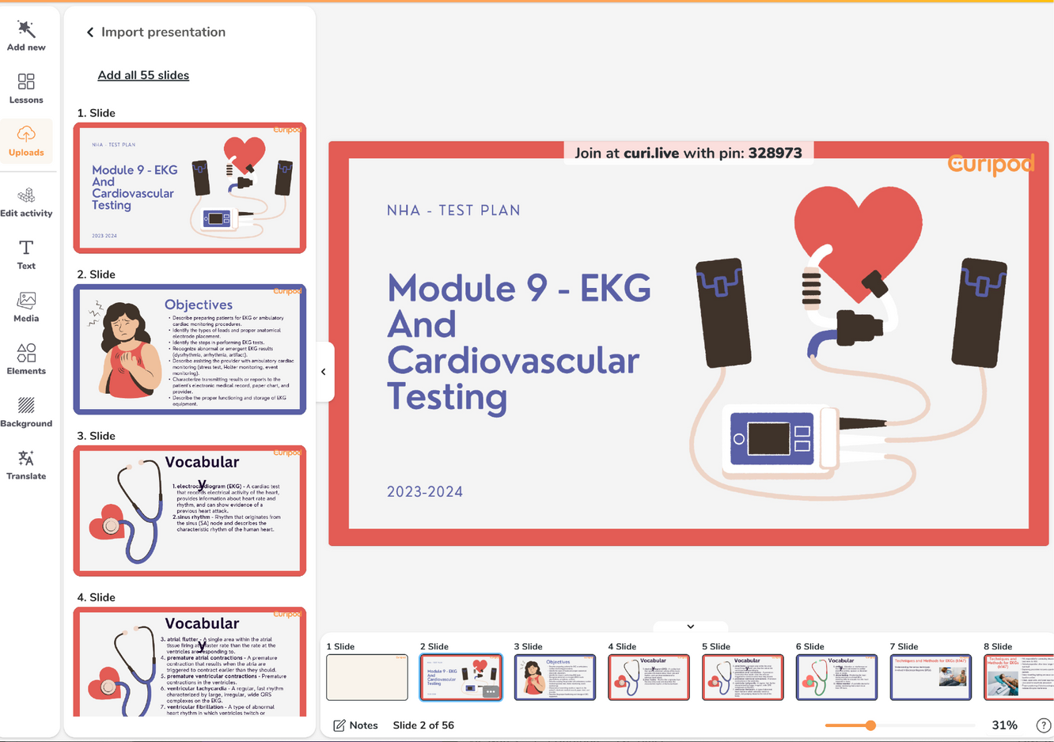
Upload Current Slides
Curipod

Slide 10
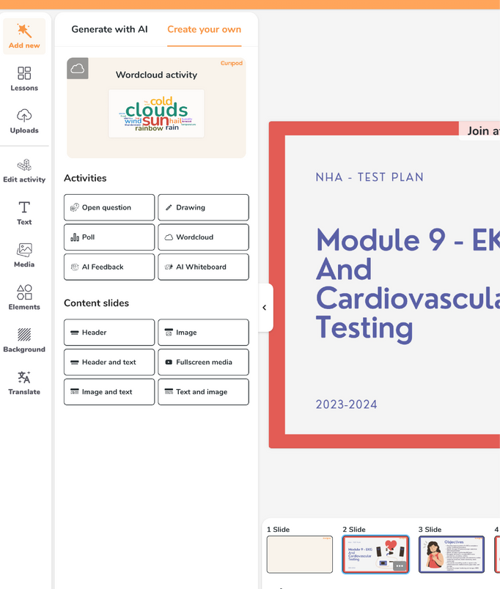
Create questions:
multiple choice, open-ended, true/false, etc...
Curipod

Slide 11
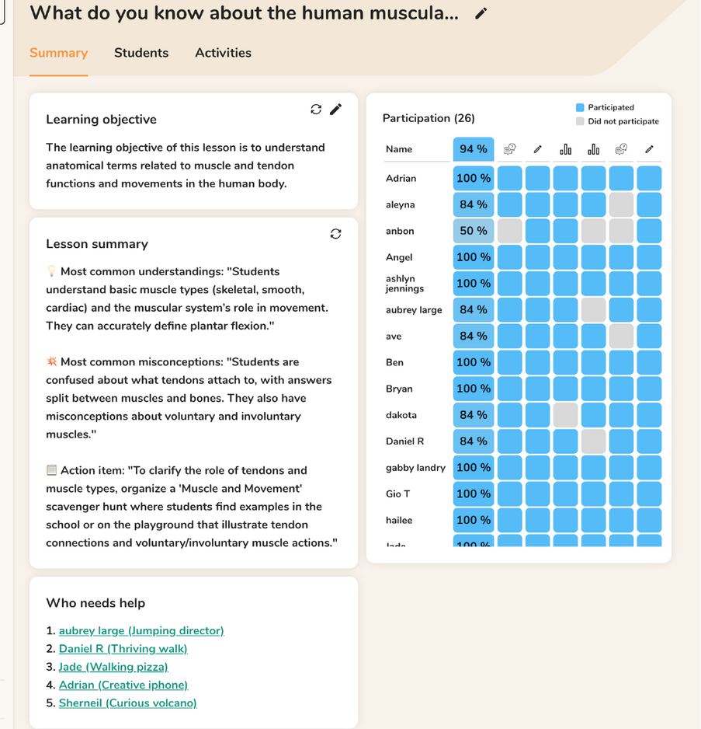
Look at the results of each participant.
Curipod

Slide 12
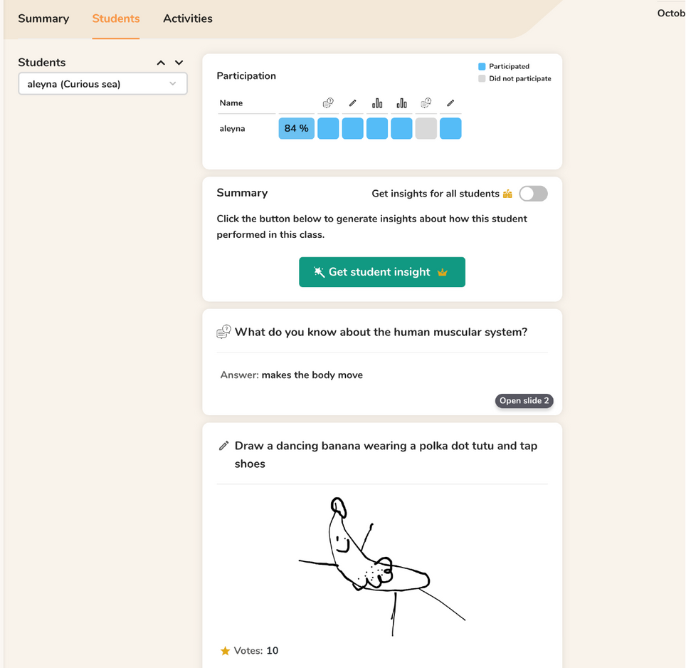
Look at the results of each participate
Curipod

Slide 13
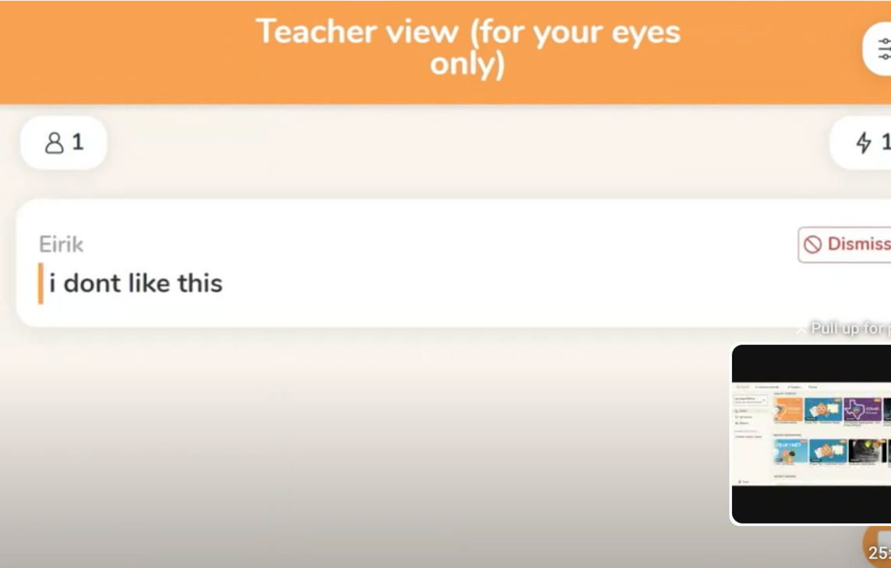
Moderator View (on-the-spot correction)
Curipod

Slide 14


Chatgpt
www.chatgpt.com
What is it?
(Chat Generative Pre-Trained Transformer) is an artificial intelligence (AI) chatbot that can understand and respond to human language.

Slide 15
Chatgpt
What is it?
(Chat Generative Pre-Trained Transformer) is an artificial intelligence (AI) chatbot that can understand and respond to human language.

Slide 16

How do you create a lesson plan?
Chatgpt
Create in 5e Model
Engage, Explore, Explain, Elaborate, and Evaluate.

Slide 17
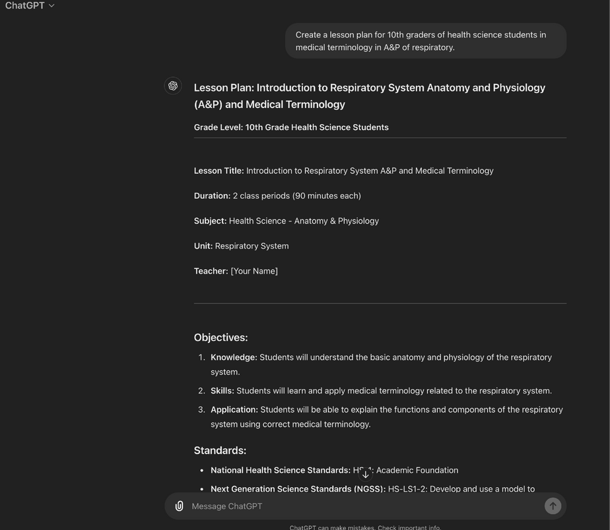

Prompt: (feel free to insert your own class and topic being covered)
Example: Create a lesson plan using the 5e model for 10th-grade Health Science students in medical terminology for A&P of the respiratory system.
Create your own lesson plan

Slide 18
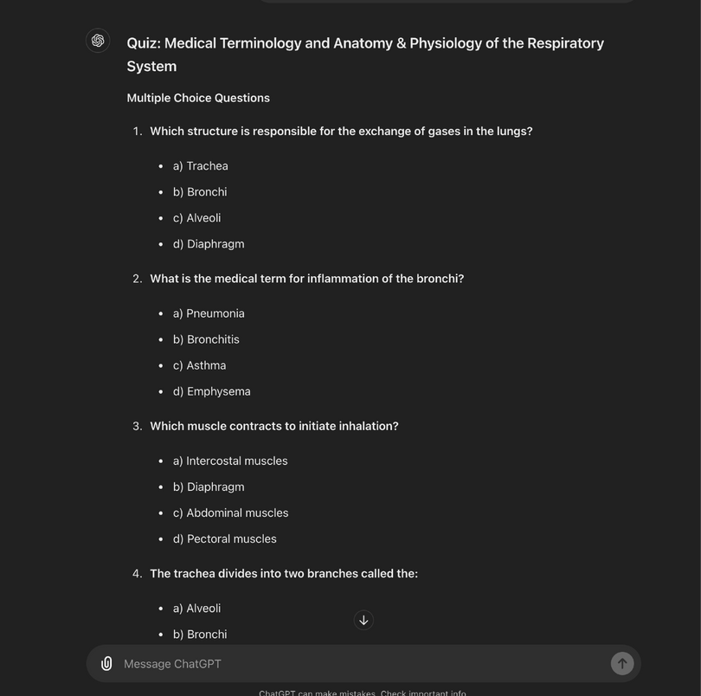
Be specific
Example: Create a 10-question quiz with answers using multiple choice, open-ended, and true/false quizzes for 10th-grade Health Science students in medical terminology for A&P of the respiratory system.
Create Quizzes or Exams

Slide 19
Email/Feedback to Parents
Takes the subjective view out of the email and focuses on objective data.

Slide 20
Email/Feedback to Parents (commonly written)
Dear Parents of Jane Doe,
I hope you are doing well. I wanted to let you know about your child's status in my 4th-period, Medical Terminology Class. I have spoken with Jane on numerous occasions about putting her phone away and how it has been causing a distraction in completing her classwork. Jane currently is missing 4 assignments and has a current grade of 62. Please let me know how I could better help Jane to be more successful in my class.
Thank you, Mrs. Noll
Medical Terminology Teacher

Slide 21
ARD Feedback
You want to observe the strengths and weaknesses of the student.

Slide 22
ARD Feedback
(Chatgpt prompt)
Create some notes for an ARD meeting for the following student. Jane Doe is in my Medical Terminology class. She is prompt to class, turns in assignments periodically (states she doesn’t understand the material), is respectful to classmates, and does not ask for help promptly or while I walk about to assist students who don’t understand. I have suggested to the students that immediately after receiving the assignment she should ask questions. The student confirms understanding.

Slide 23
Email/Feedback to Parents (Guided by Chatgpt)
Subject: Jane Doe's Progress in Medical Terminology Class
Dear [Parent's Name],
I hope this message finds you well. I am writing to inform you about Jane's current status in my 4th-period Medical Terminology class.
Jane has been struggling with distractions caused by her phone, which has affected her ability to complete classwork. Despite several discussions with her about this issue, she is currently missing four assignments and has a grade of 62.
I am committed to helping Jane succeed and would appreciate any suggestions or strategies you might have to support her better. Please let me know if there are any specific ways I can assist Jane in improving her performance in class.
Thank you for your understanding and support.
Best regards,
Mrs. Noll
Medical Terminology Teacher

Slide 24
ARD Feedback (Chatgpt response)
Observations:
  Jane is consistently prompt in class.
  She turns in assignments periodically but often states that she does not understand the material.
  Jane is respectful to her classmates.
  She does not ask for help promptly, even when I walk around the classroom to assist students who need help.
  I have suggested to the students, including Jane, that they should ask questions immediately after receiving an assignment if they do not understand. Jane has acknowledged this suggestion and stated that she understands.
Recommendations:
  Encourage Jane to seek help more proactively by raising her hand during class or approaching me after class.
  Consider additional support or tutoring to help Jane grasp the material better.
  Explore potential learning strategies or accommodations that might assist Jane in understanding and completing her assignments.

Slide 25
Student Letter of Recommendation (LOR)
For colleges and scholarships

Slide 26
Student LOR
(Chatgpt prompt)
Create a letter of recommendation for Jane Doe is a student in my medical terminology class at John Marshall Harlan High School. I have had the pleasure of having Jane in my class for the last 2 years. This student has always turned in assignments on time, asks for help frequently, and serves as a useful resource to her classmates. Jane has served on the marching band at Harlan for the last 2 years. She has maintained an A average in class. She is dependable and hard-working. I highly recommend her for a scholarship with your organization as she will maximize its use to further her career. Aileen Noll, Health Science Teacher at John Marshall Harlan

Slide 27
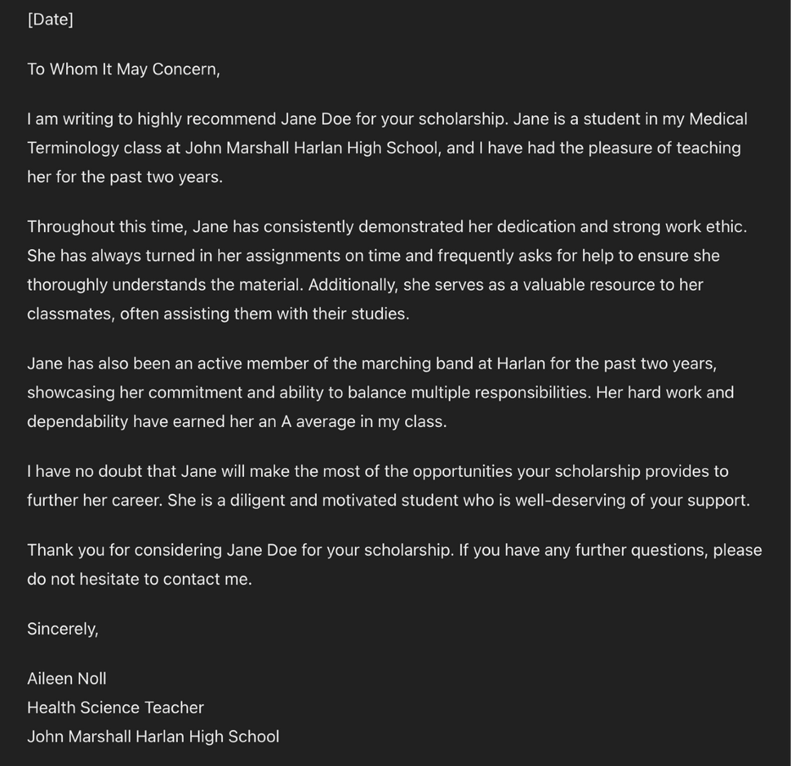
Student LOR
(Chatgpt response)

Slide 28
What is YAMM?
YAMM (Yet Another Mail Merge) is a Google Sheets add-on that enables you to send personalized bulk emails using Gmail and Sheets.
Great for parent updates, student reminders, and event invites
Works with your Gmail and a contact spreadsheet
Add names, grades, progress, custom notes, etc.
Automatically tracks opens & responses
YAMM
Yet another mail merge

Slide 29
How Teachers Use It
📩 Weekly grade reports
🧭 Behavior updates
🧪 Missing assignments alerts
📅 Parent-teacher conference
invites
🏅 HOSA reminders or events
follow-ups
YAMM
Yet another mail merge

Slide 30
How It Works – 3 Simple Steps
Create a Google Sheet
Include: Email, First Name, Class, Custom Message, Grade, etc.
Draft a Gmail Message
Use tags like {{First Name}} or {{Grade}} for personalization.
Start the Mail Merge in YAMM
Open Google Sheet → Extensions → Yet Another Mail Merge → Start Mail Merge
Choose your Gmail draft → Click send!
✅ Done. Track opens, clicks, and responses.

Slide 31
Quick Demo (Optional)
https://youtu.be/qZXXY9LAkRQ?si=1AYBIrQlMkqCT_bD
YAMM
Yet another mail merge

Slide 32
Example Email Script
Subject: Weekly Update for {{First Name}}
Hi {{Parent Name}},
This is a quick update on {{Student Name}}’s progress in Health Science.
Current Grade: {{Grade}}
Missing Assignments: {{Missing Work}}
Behavior Notes: {{Behavior}}
Let me know if you have any questions or need support.
Best,
Mrs. Noll

Slide 33
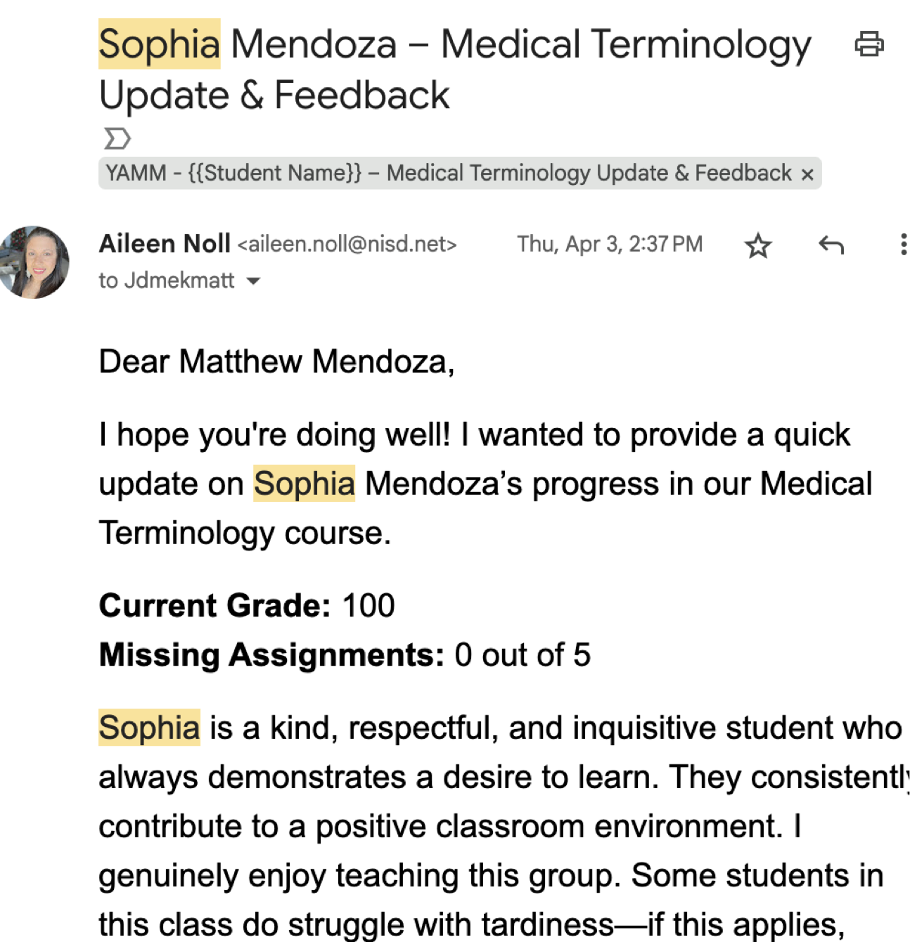
YAMM
Yet another mail merge

Slide 34
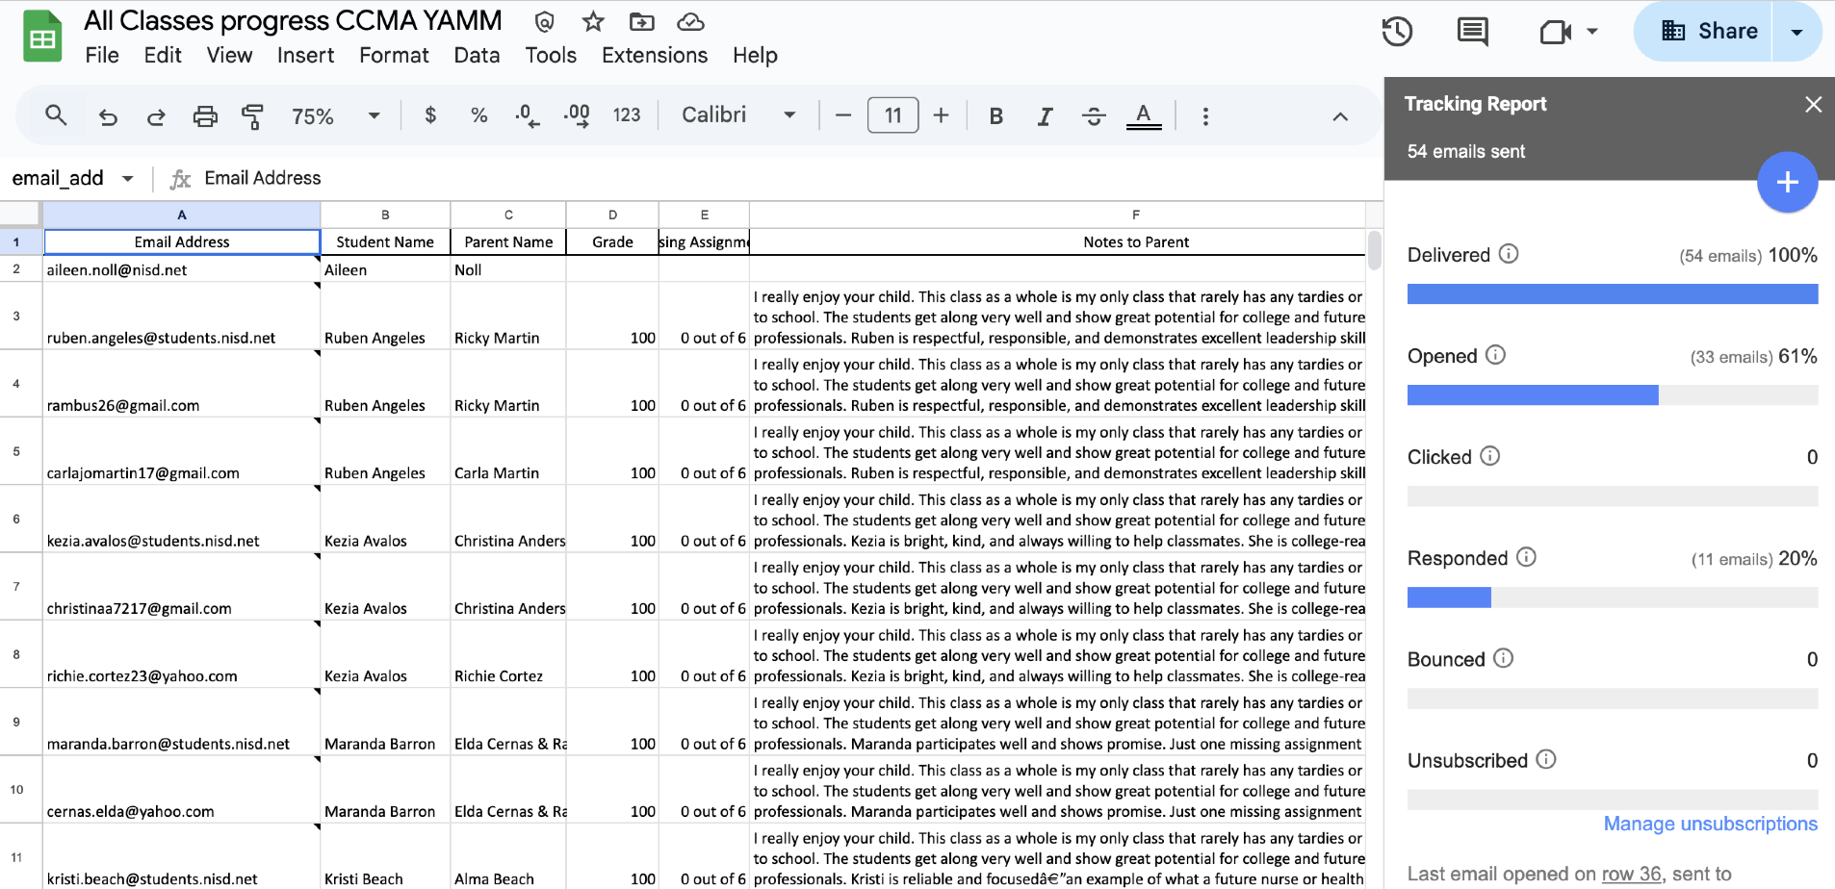
YAMM
Yet another mail merge

Slide 35
Why Add YAMM to Your Toolbox?
⚡ Saves time every week
🤖 Combine with ChatGPT for smart
email scripting
📊 Tracks who’s opening and
responding
🧠 Great for communicating with
100+ students quickly
YAMM
Yet another mail merge

Slide 36
Magic School - Components
  Newsletter
  Letter of Recommendation
  Clear Direction
  Email Family
  Rubric Generator
  Youtube video question
  Worksheet
https://www.magicschool.ai/

Slide 37
Offers:
  Articles
  Vocabulary
  Quizzes
  Writing prompts
Diffit
www.diffit.com

Slide 38
Offers:
  AI-Powered Tools: Create lesson plans, quizzes, rubrics, and more with AI assistance.
  Administrative Support: Simplifies tasks like writing emails, newsletters, and recommendation letters.
  Curriculum Integration: Works seamlessly with Google Docs, Google Slides, YouTube, etc.
Brisk
https://www.briskteaching.com/

Slide 39
Offers: (continued)
  Time-Saving Features: Automate tasks like translating, adjusting reading levels, and differentiating materials.
  Multi-language Support: Over 40 language translations available.
Brisk
https://www.briskteaching.com/

Slide 40
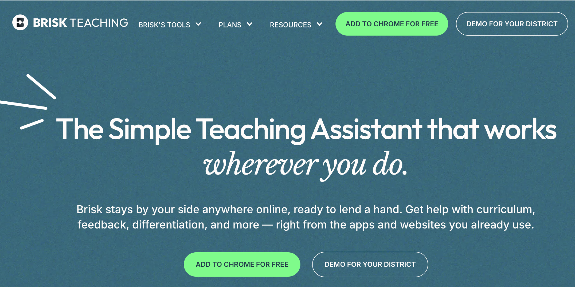
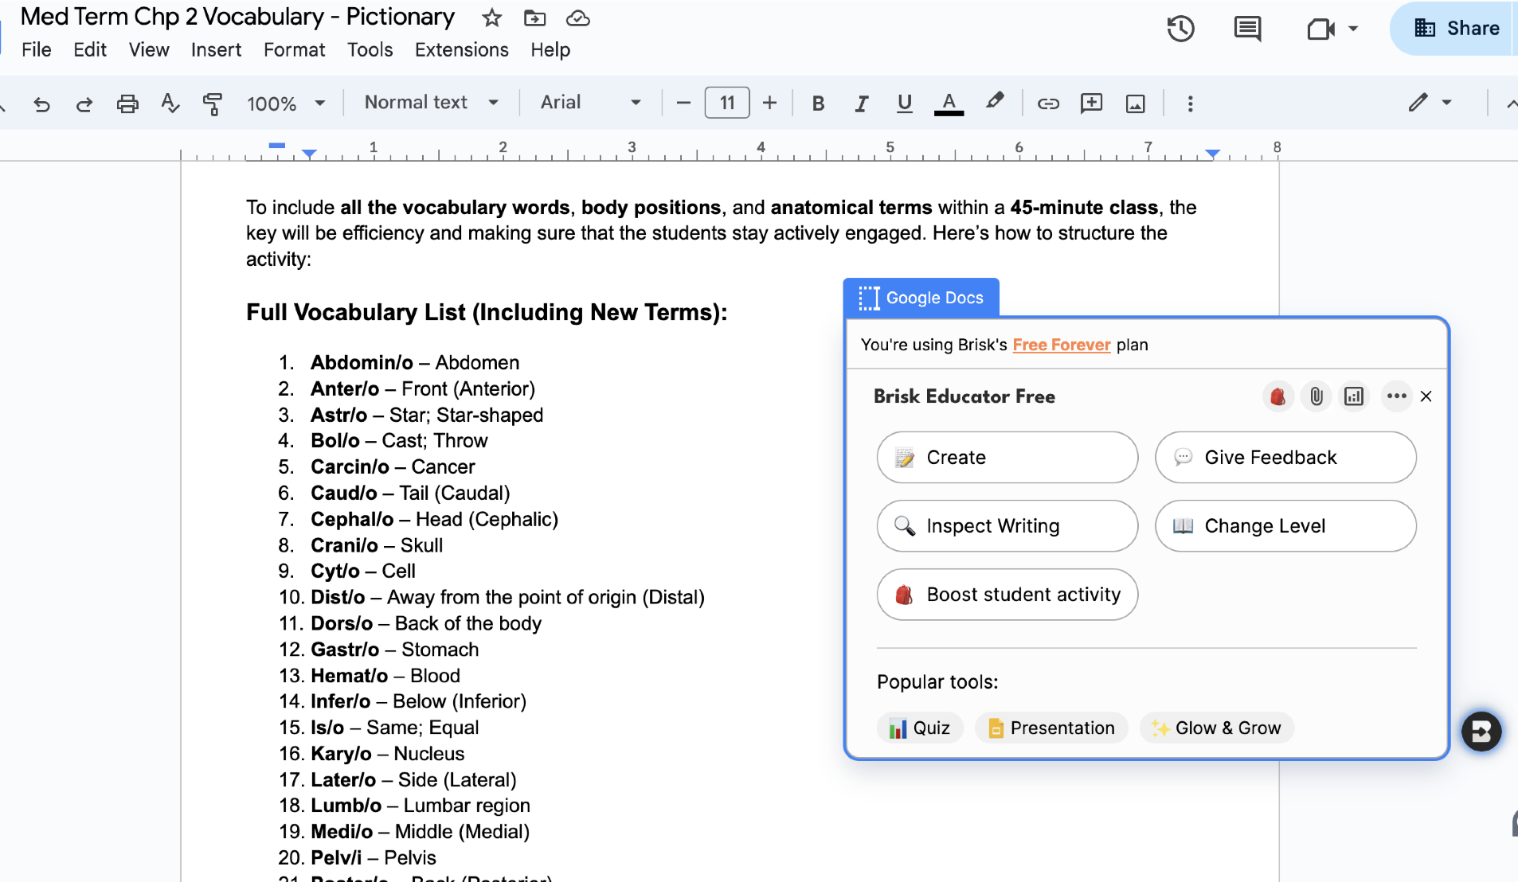
Brisk
https://www.briskteaching.com/

Slide 41
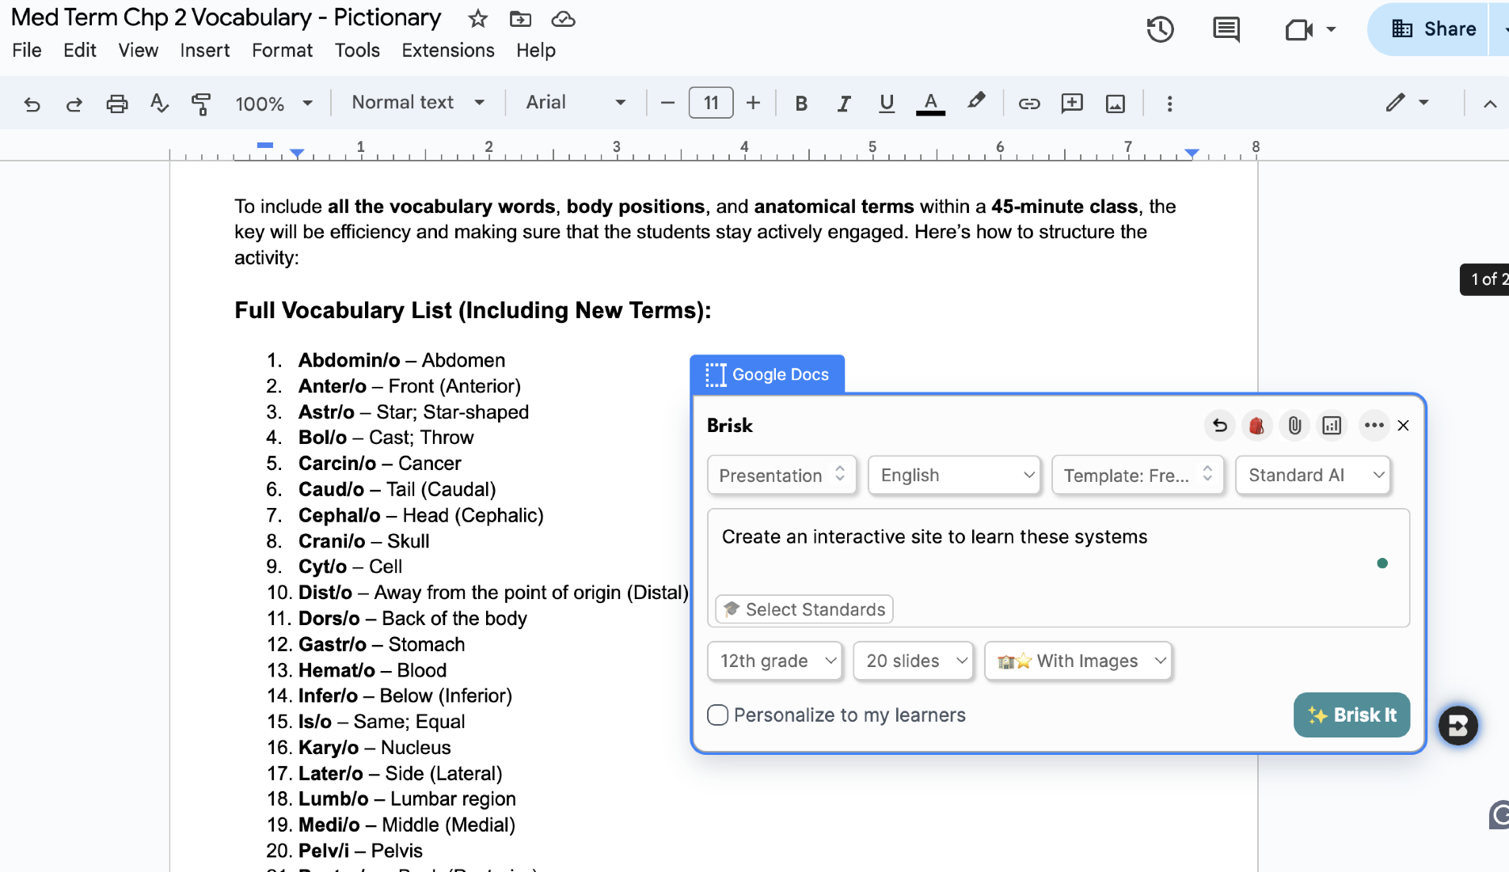
https://docs.google.com/presentation/d/1GTeOTFJ8FYy87nf88EB8rkQoSBlo4iJsz_n_MioX4jY/edit?usp=sharing
https://my.clevelandclinic.org/health/body/21048-skeletal-system
Brisk
https://www.briskteaching.com/

Slide 42
Question? (Poll)
Did you find this presentation useful?

Slide 43
Question? (Open-Ended)
What did you learn from this presentation?

Slide 44
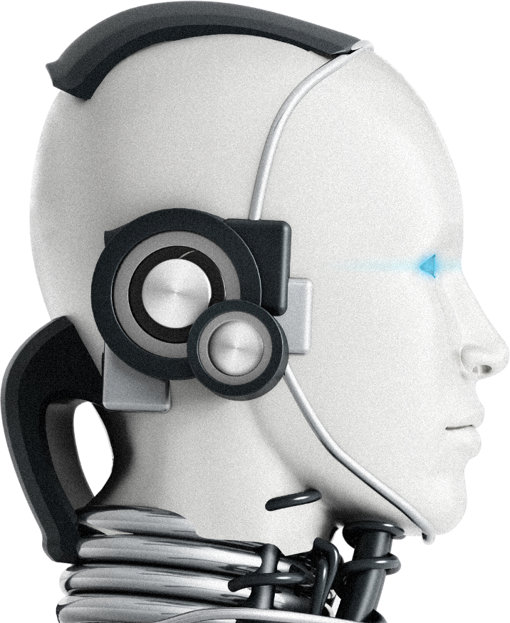
Questions?

Slide 45
Thank you

