Slide 1
Power Up Your Pass Rates: Fun, Flexible and Shared Strategies for Exam Success
Cheryl Newsome, RPH
Dual Credit Pharmacy Instructor
Bill R. Johnson, CTE/Lamar State College

Slide 2

GET TO KNOW
Icebreaker! You have three minutes to find someone that you do not know and share your:
Name, the city you’re from, and one interesting fact about yourself!

Slide 3

ABOUT YOUR SPEAKER,
CHERYL NEWSOME
Longview-Houston-Fort Worth, Texas
Married 32 yrs, 4 children, 3 grandchildren
BSPharm- Texas Southern University
Eckerd, Hughley Hospital, Albertsons, Merck Medco, JPS, Walgreens, CVS & Bill R. Johnson, CTE
Hobbies- PILATES, TRAVELING, experimenting w/ holistic possibilities
Member of Delta Sigma Theta Sorority
TPA (Texas Pharmacy Association)
SkillsUSA Texas Board Directors Secretary
2025 GOAL: 100% passing rate/100% employed

Slide 4
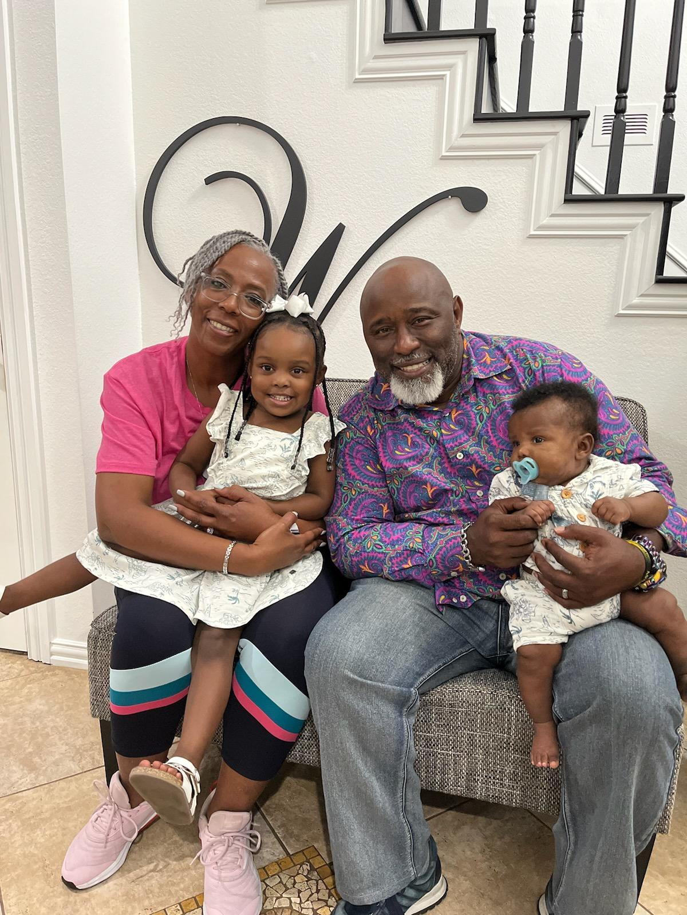

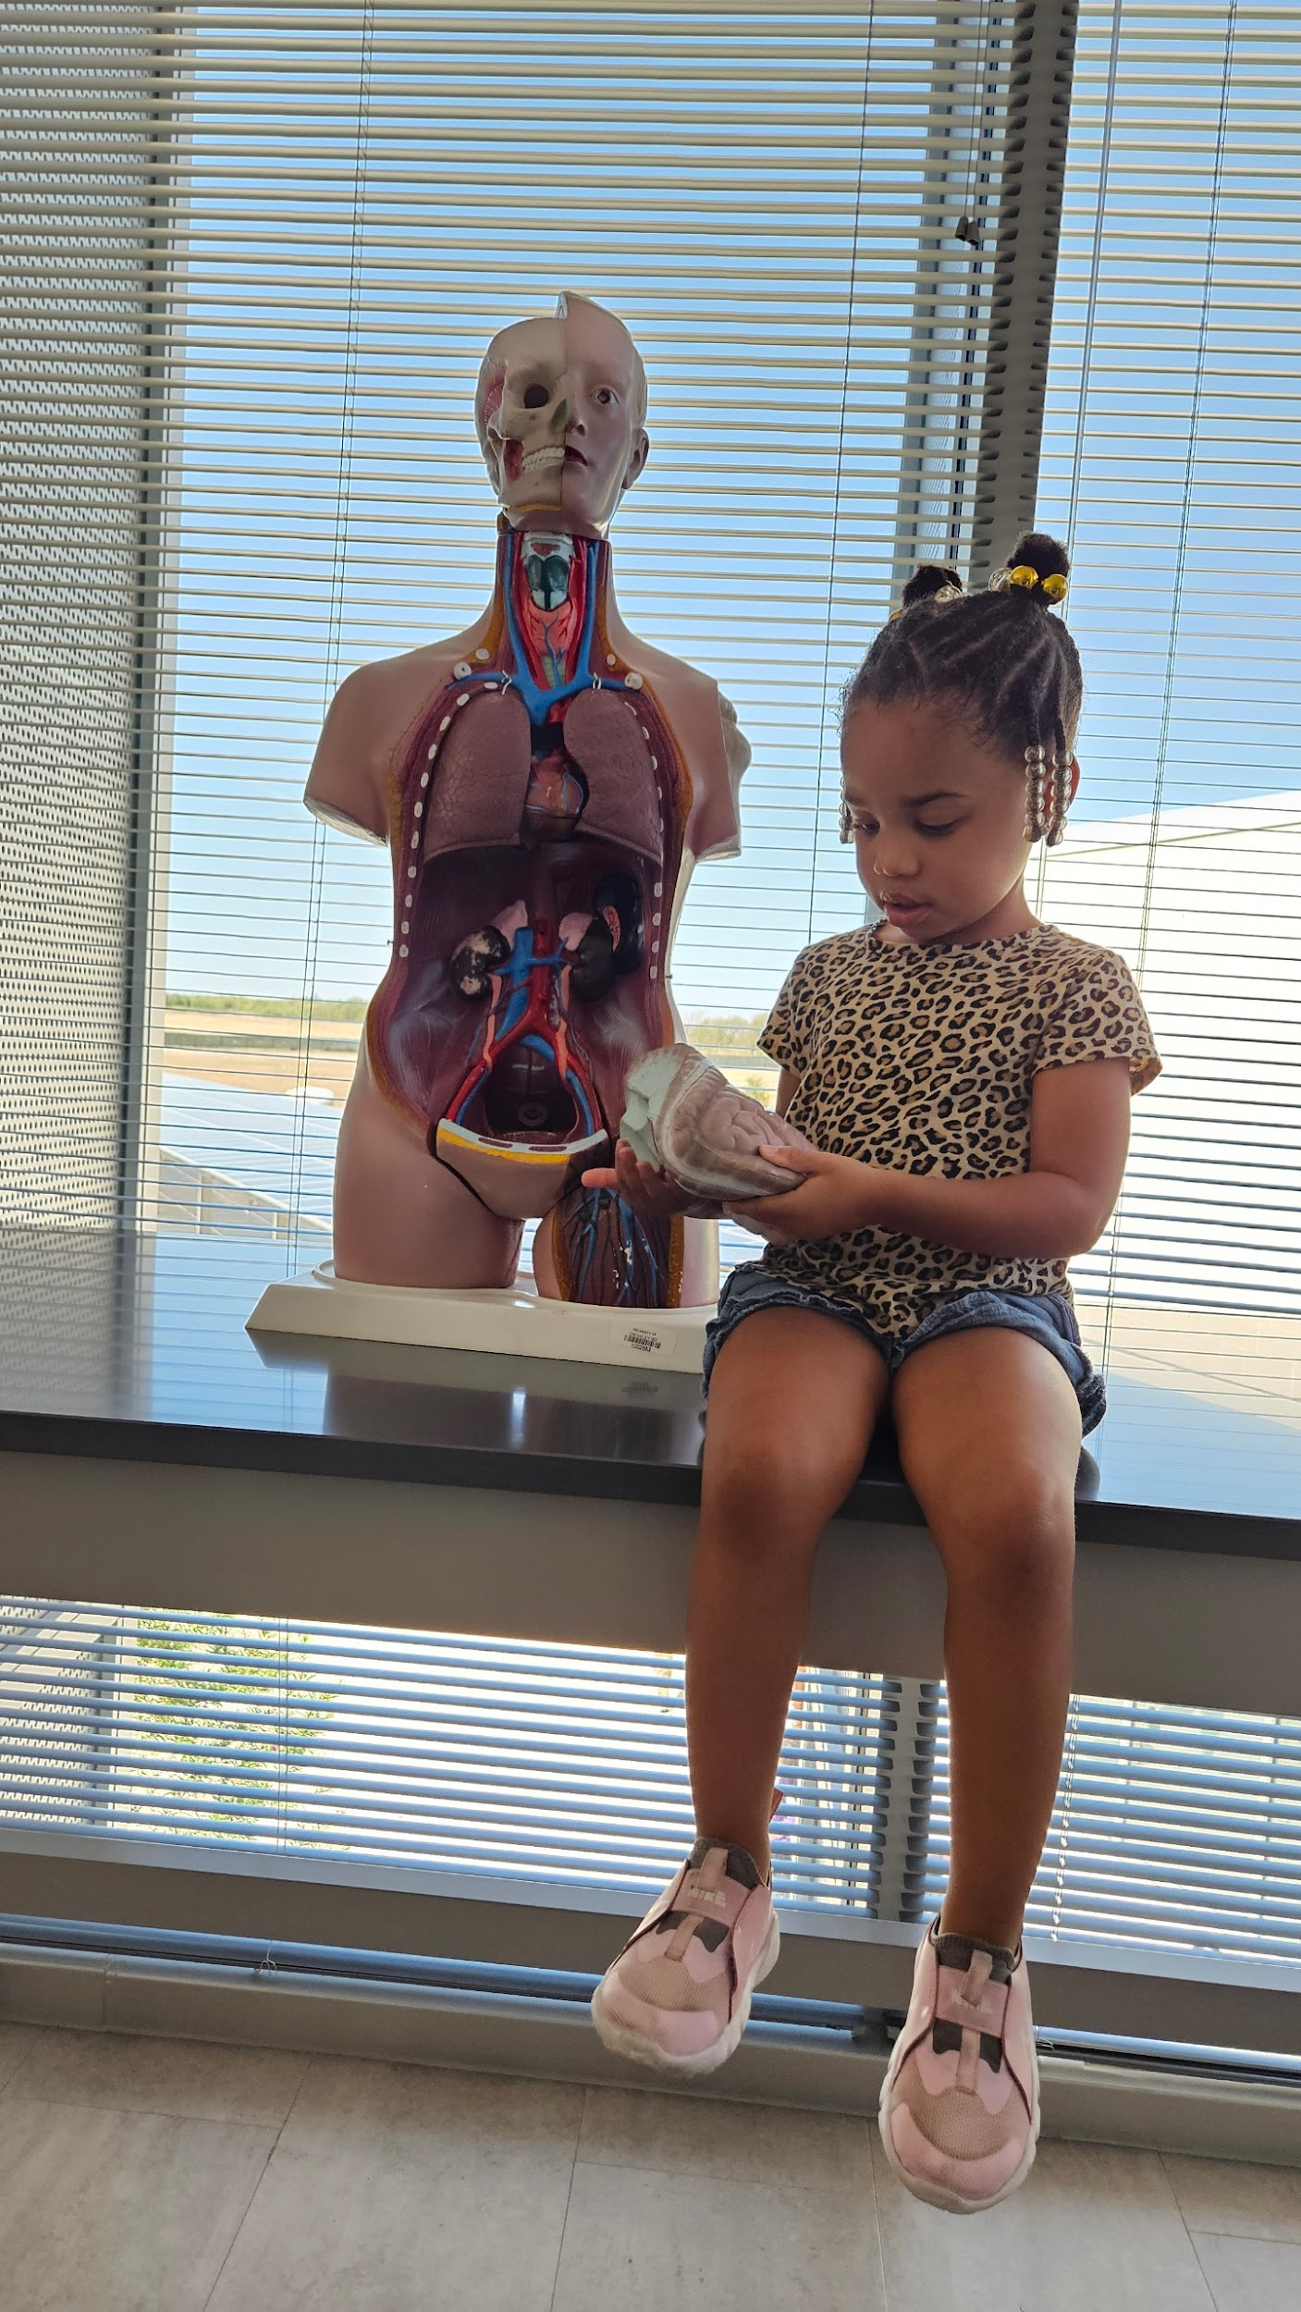
MY FAMILY

Slide 5
INTRODUCTION
Which certification exam do you prefer? ExCPT or PTCE?
PTCE-more widely accepted & recognized by hospital employers. Passing rate in 2023 (69%) .
2024 Job Task Analysis by PTCB: updates effective January 2026 (Jasmine Meadows 7/22@1pm)
EXCPT-recognized by retail and some hospital employers. Passing rate in 2023 (63%). NHA exam included 8 new areas of coverage effective 7/9/2025 (Sunday @1pm nigora.mcgill@nhanow.com)

Slide 6

WHERE is YOUR STUDENT’S GREATEST OPPORTUNITY for
IMPROVEMENT?
TESTING ANXIETY/LOW SELF-ESTEEM
MOTIVATION/CAREER CLARITY
C. MATH SKILLS: practice
TEST TAKING STRATEGIES
EXPOSURE TO REAL-WORLD SCENARIOS
RETENTION OF DRUG NAMES/CLASSES: practice
ACCESS TO QUALITY PRACTICE RESOURCES
INSTRUCTIONAL SUPPORT

Slide 7
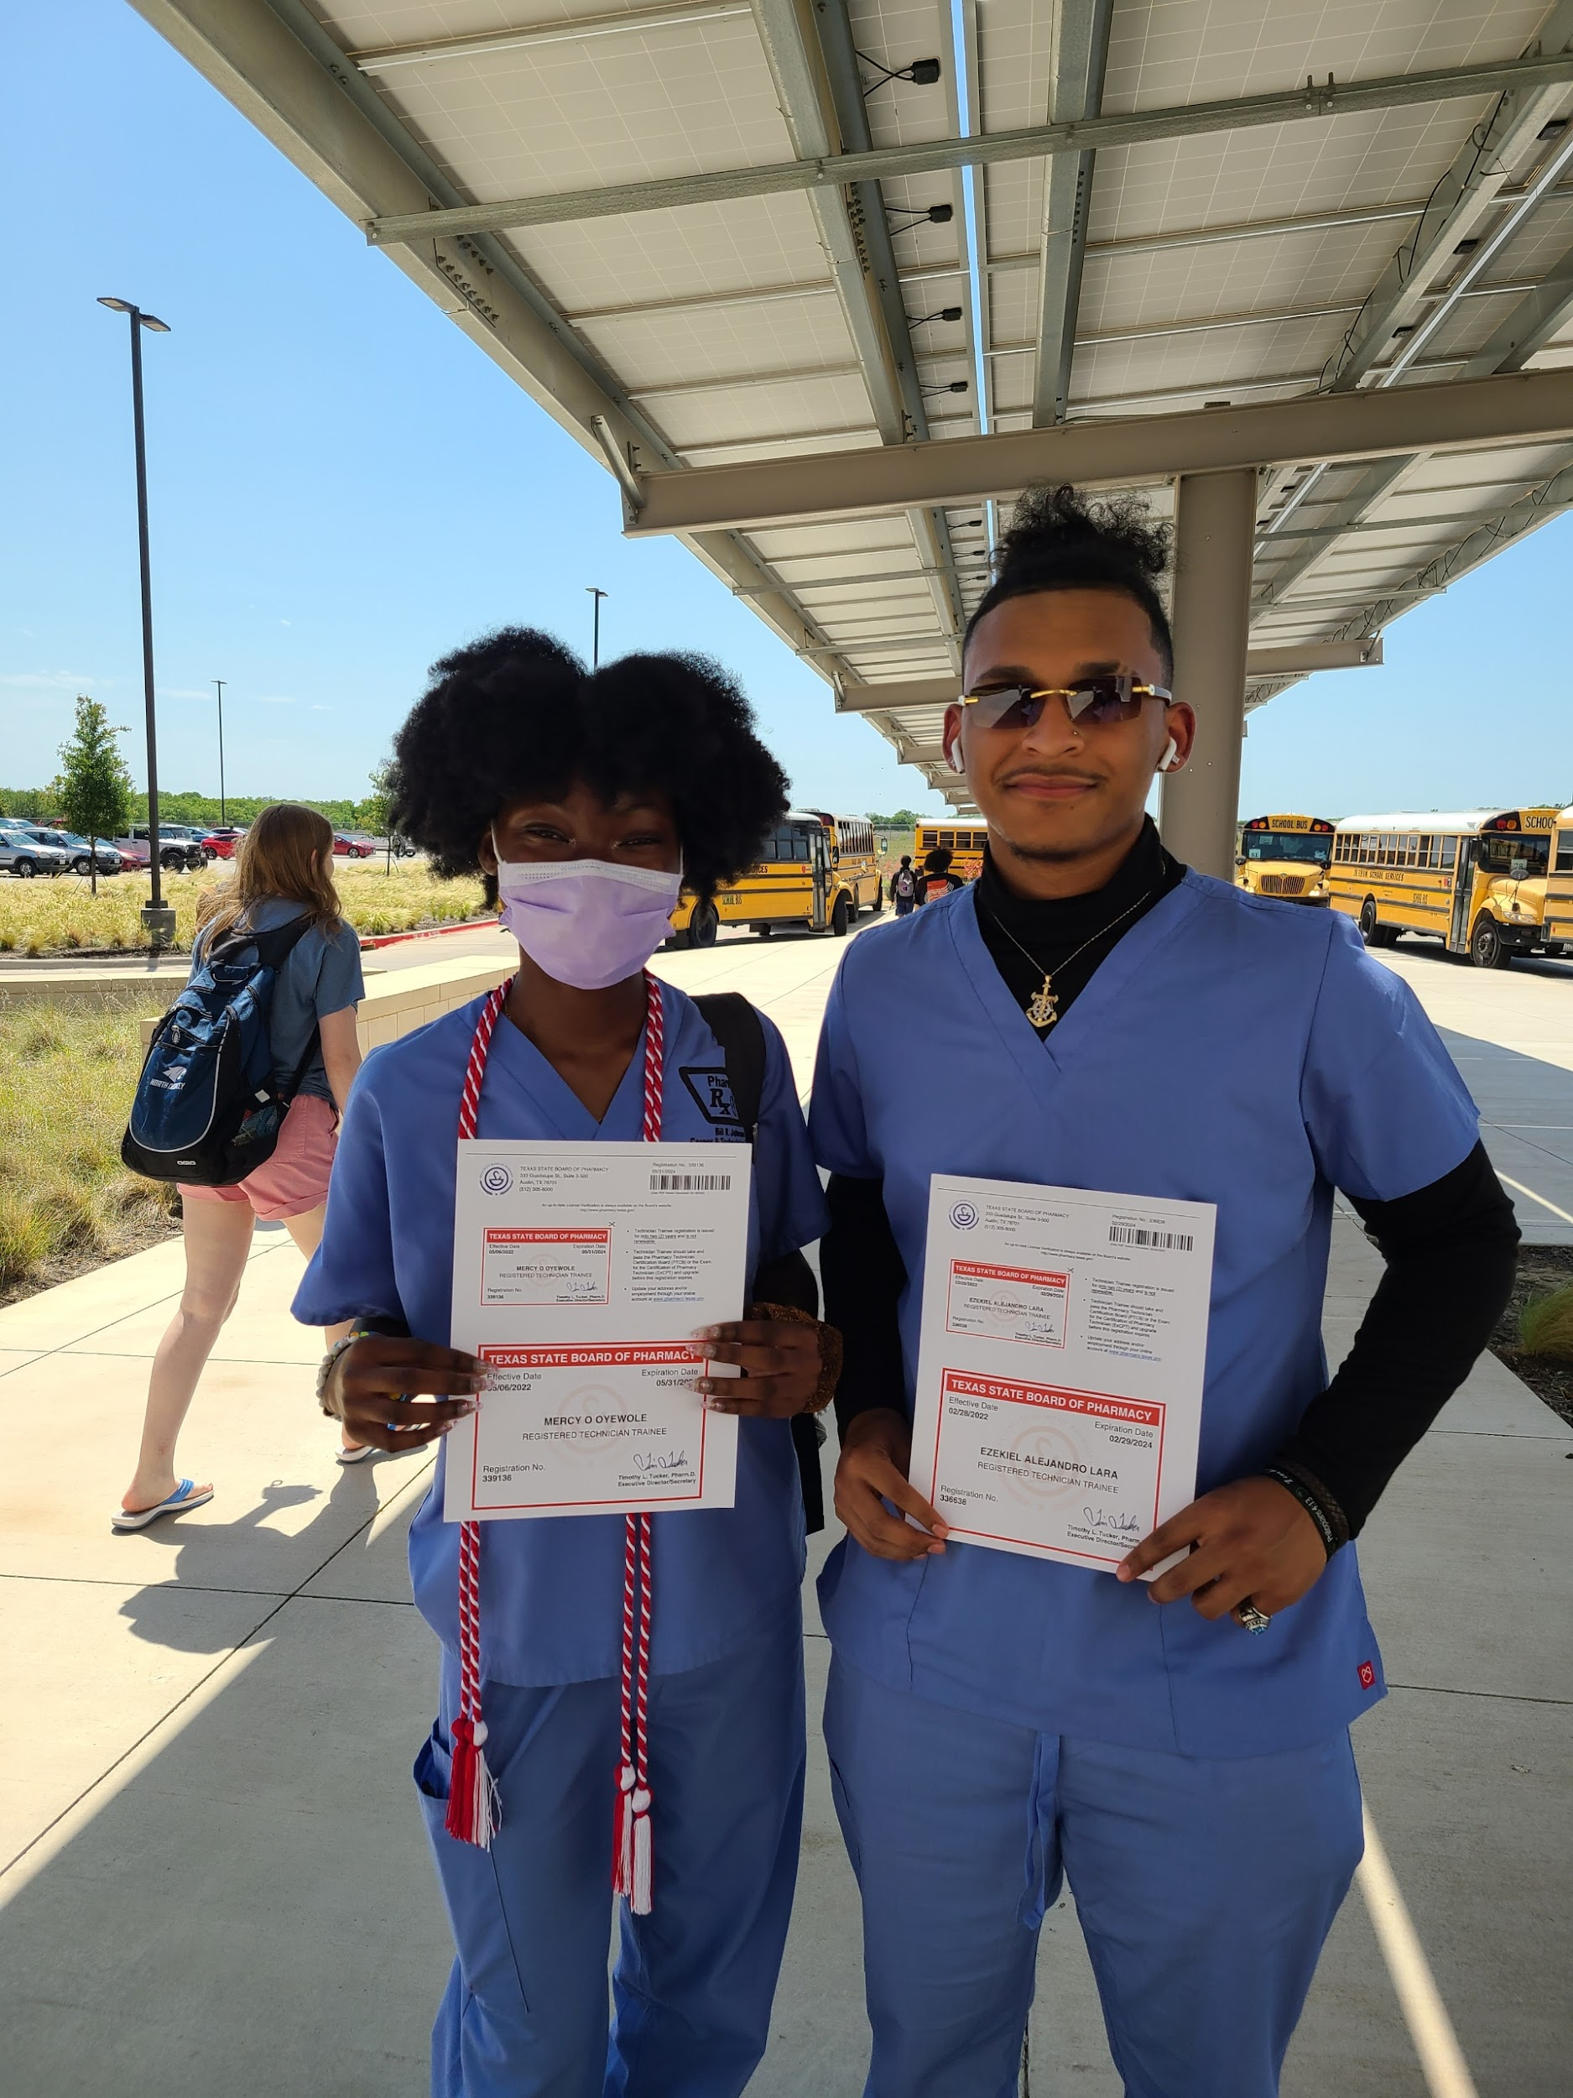
PHARMACY TECHNICIAN EXTERNSHIPS
MOTIVATION AND CAREER CLARITY *showcase career oaths, wages, and success stories (alumni)
E. EXPOSURE TO REAL WORLD SCENARIOS *Externship, job shadowing, role-play, simulation labs
H. INSTRUCTIONAL SUPPORT: Training Plan!!!! THOA ,PHARM TECH FACEBOOK

Slide 8
DESIGNING THE EXTERNSHIP PROGRAM
STRUCTURING THE EXTERNSHIP CURRICULUM
TEKS OBJECTIVES
INDUSTRY STANDARDS- EXTENSIVE LIST

Slide 9
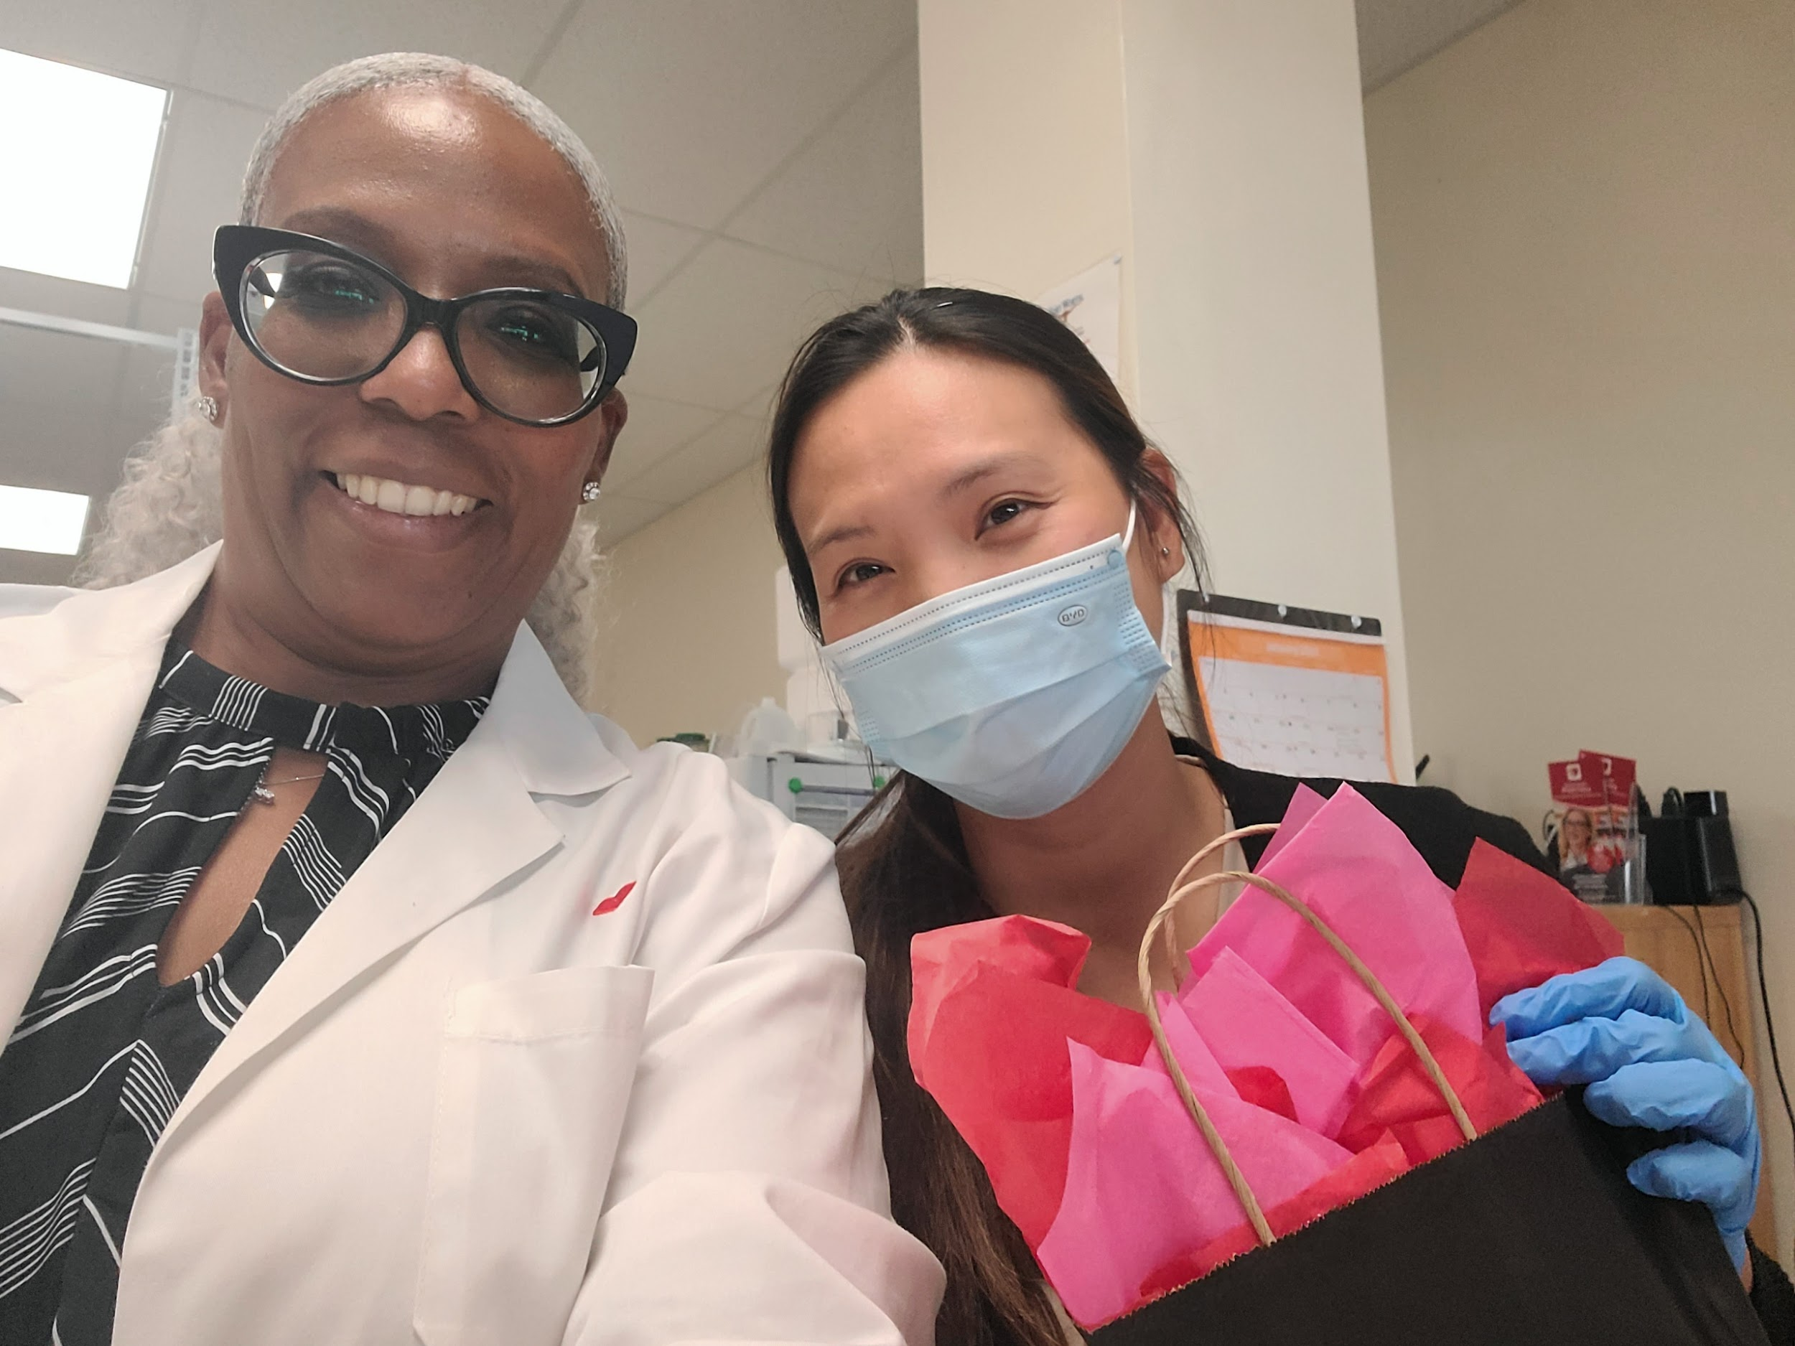
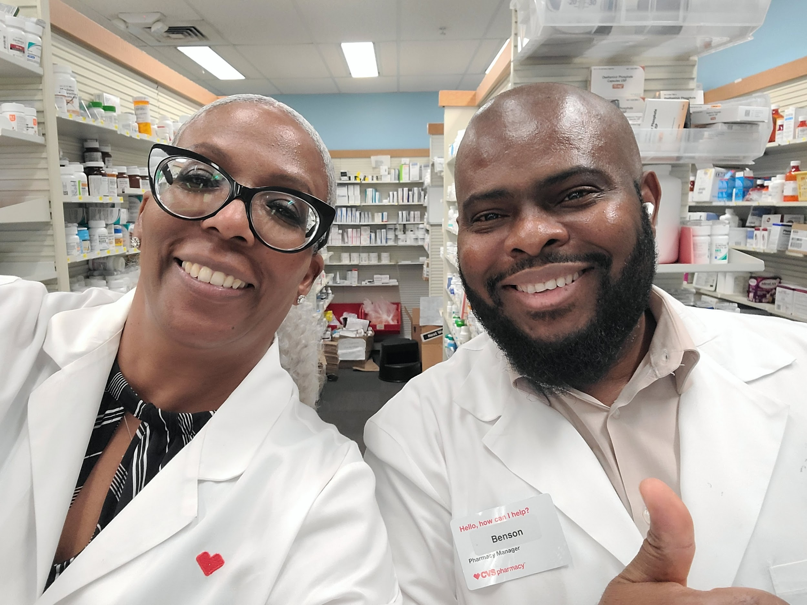
ESTABLISHING PARTNERSHIPS
IDENTIFYING POTENTIAL PHARMACY PARTNERS
BUILDING RELATIONSHIPS WITH PHARMACY MANAGERS, STAFF AND STORE MANAGERS

Slide 10


LEGAL AND ETHICAL CONSIDERATIONS
HIPAA COMPLIANCE AND PATIENT CONFIDENTIALITY
WORKPLACE SAFETY AND INSURANCE COVERAGE

Slide 11
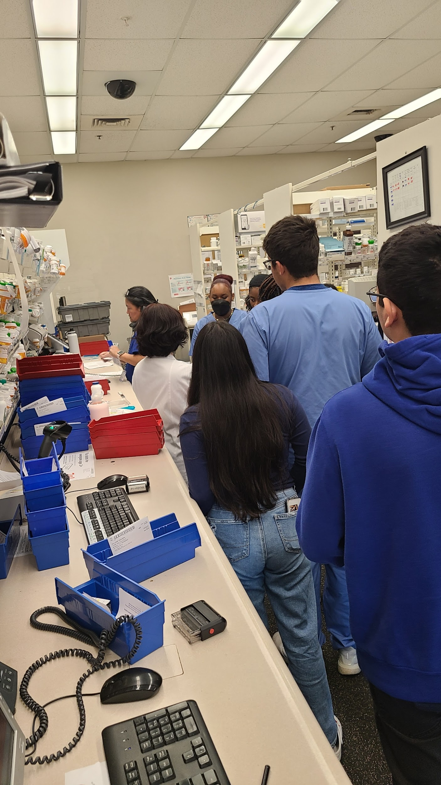
TRAINING & ORIENTATION
Orientation for select students
Training plan and schedule
Paid vs. Unpaid training plans
2023 revised training plan on TEA /WBL website

Slide 12
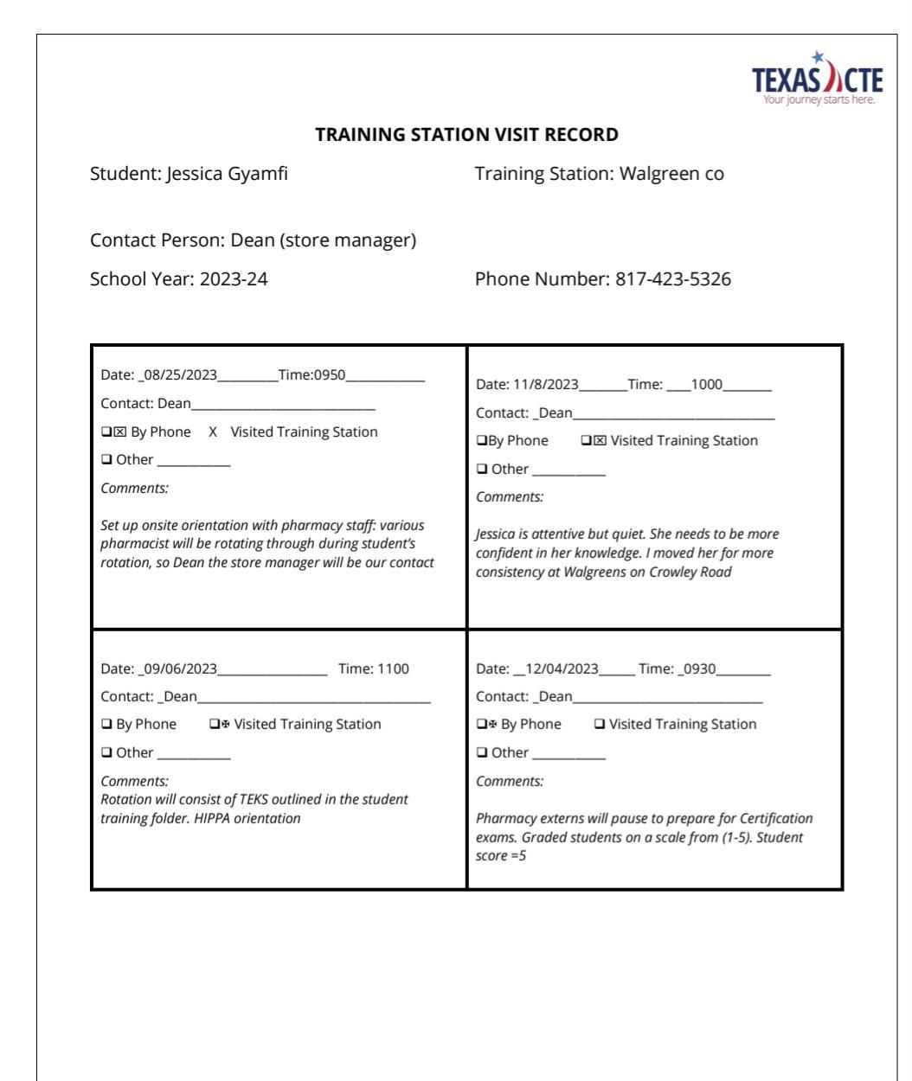
MONITORING & EVALUATION
Methods for monitoring student progress
Feedback mechanisms for continuous improvement
Internship ready checklist
Training Station visit record- Site visit or simulation

Slide 13

LET’S TAKE A 5 MINUTE BREAK!

Slide 14
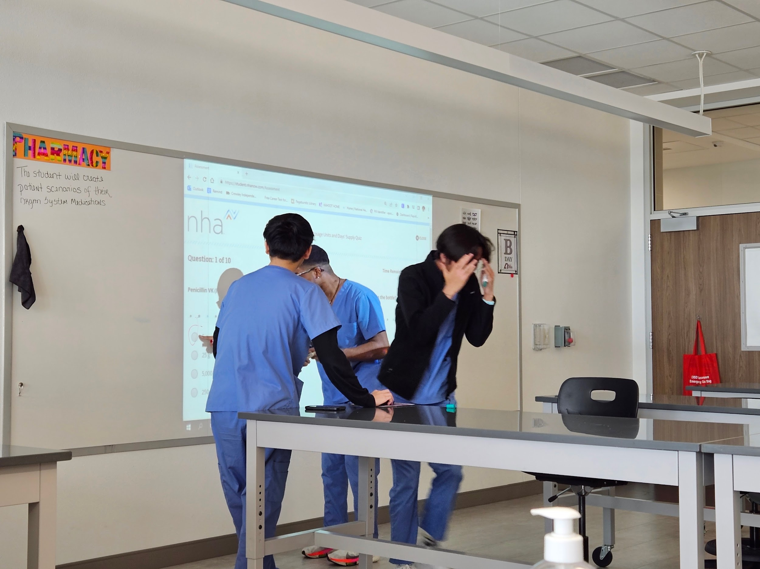
TEST TAKING ANXIETY/SELF ESTEEM
Normalize test practice
Incorporate mindfulness
Breathing techniques
Celebrate small wins during review
*ACTIVITY**Dr. Livingood
Breathe Routine ( 1minute)
Silent Solve (2-3 minutes)
Share/Celebrate (2-3 minutes
Quick Debrief( 1 minute))

Slide 15
MATH SKILLS AND DRUG NAMES
Daily practice with scaffolded math instruction into content.-MATH
Use active learning tools like flashcards, apps, games and mnemonic devices-DRUGS
BELL RINGER/EXIT TICKET KAHOOTS
Divide equally and assign students to create:
Top 200 drugs https://kahoot.it/challenge/08622134?challenge-id=c70bca1b-d210-4788-9787-ff7a4bb6cc3a_1753012638116
Math conversions https://kahoot.it/challenge/07412367?challenge-id=c70bca1b-d210-4788-9787-ff7a4bb6cc3a_1753012756972
(REMIND : EXTERNSHIP check in AND out)

Slide 16
RESOURCES AND SUPPORT
AVAILABLE EDUCATION MATERIALS AND TOOLS
SUPPORT SYSTEMS FOR STUDENTS AND TEACHERS
YOUTUBE-LAW (https://www.youtube.com/watch?v=imPUZBpPuko)
MOSBY’S
NHA FOCUS REVIEW AND DATA ANALYSIS

Slide 17

Q & A SESSION
Q & A SESSION

Slide 18

CONCLUSION
NEXT STEPS/ACTION PLANS:
CONTACT/EMAIL YOUR POTENTIAL INDUSTRY PARTNERS DURING PROFESSIONAL DEVELOPMENT
FILL OUT ANY UNPAID TRAINING PLANS
PREPARE! PREPARING STUDENTS FOR THEIR EXTERNSHIP IS HUGE! REMEMBER, YOU ONLY HAVE ONE CHANCE TO MAKE A FIRST IMPRESSION!

Slide 19
I EMPOWER YOU WITH THIS…
“You can’t lead the people if you don’t love the people. You can’t save the people if you don’t serve the people..” Cornel West

