Slide 1
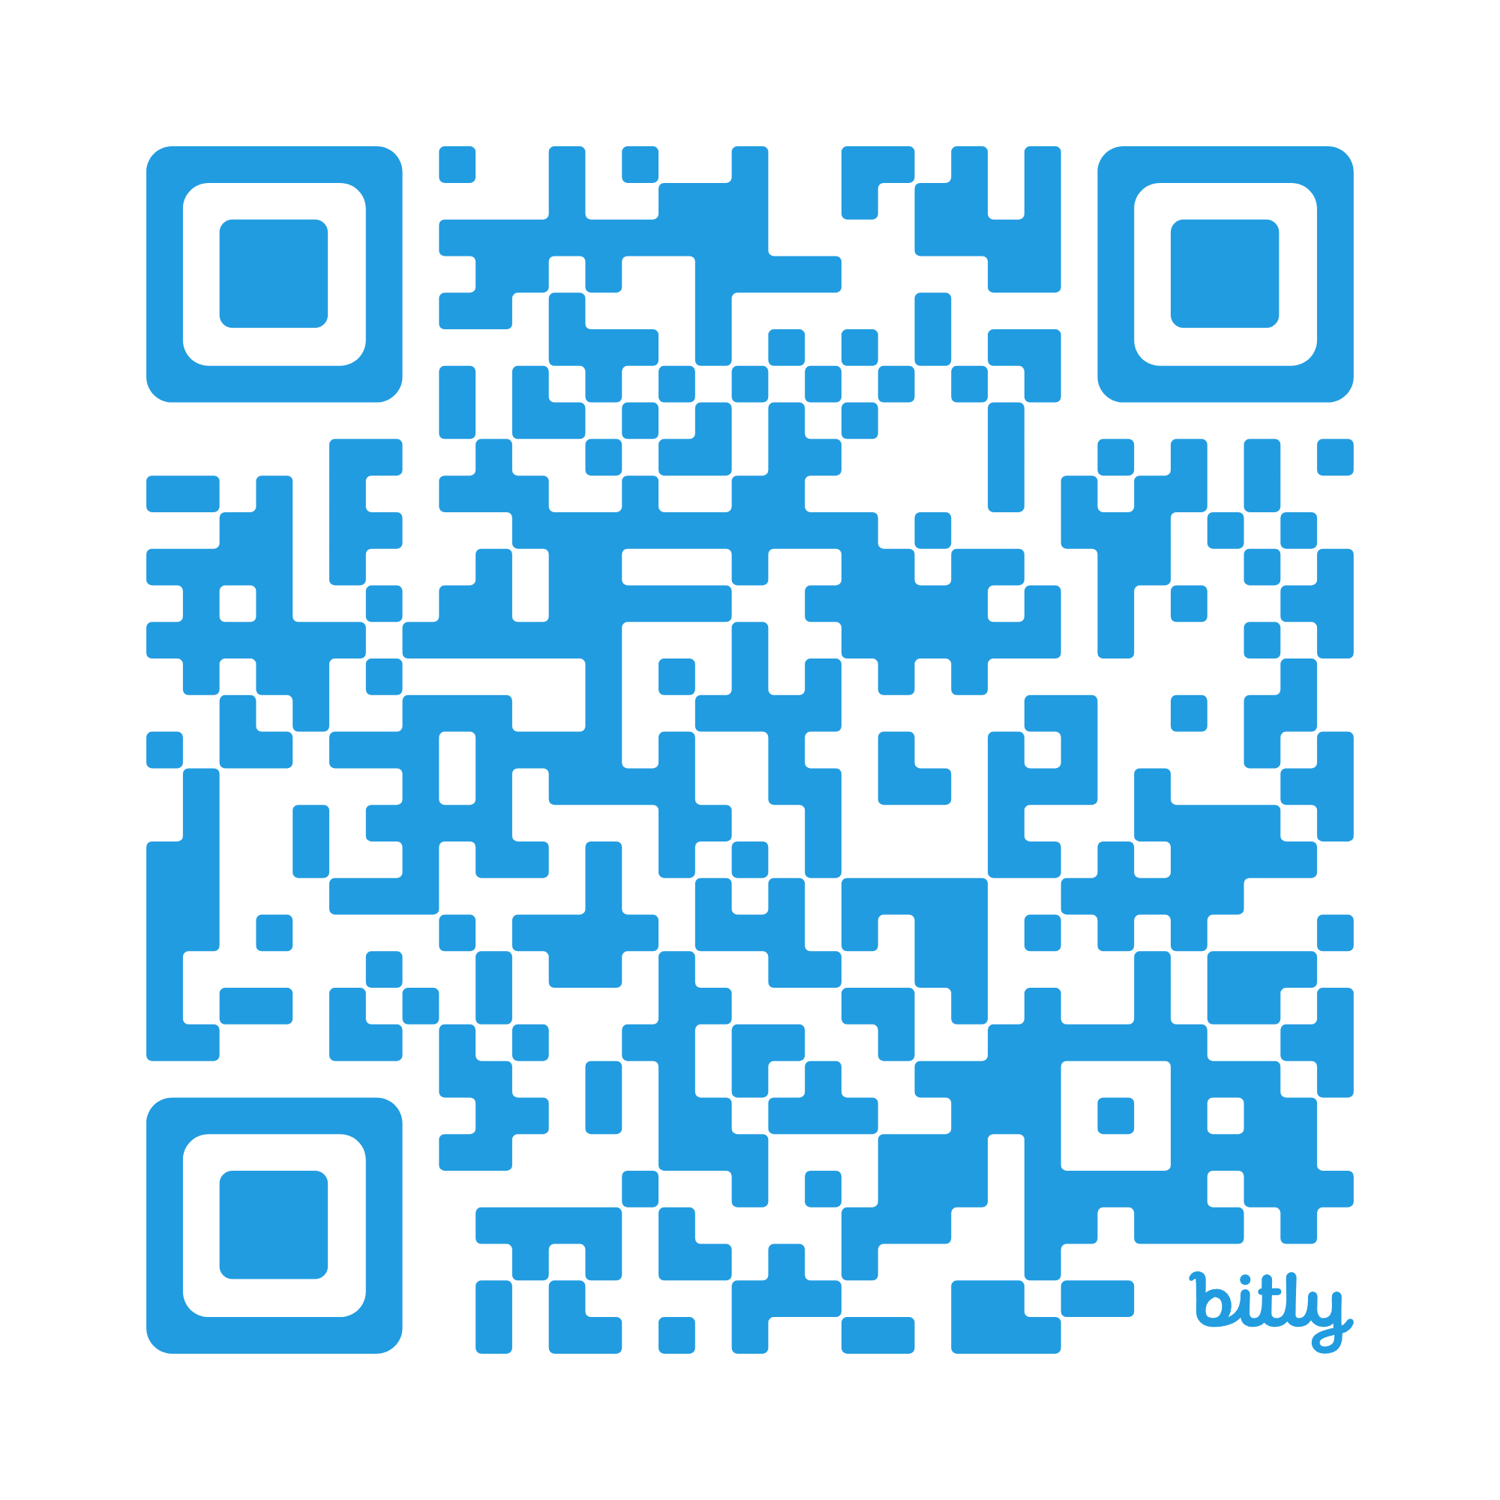
Exploring National
Board Certification
Session Presenter: Wendy Avery, NBCT
bit.ly/NBC4HST

Slide 2
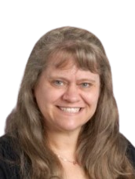
Hello! I’m Wendy Avery
I have taught Health Science at Klein Cain HS in Klein ISD for the last 8 years. Prior to this, I worked as a Certified Pharmacy Technician, I taught Elementary Sp Ed, subbed in the Gen Ed classroom, and was a SAHM when my 3 kids were younger.
I currently teach Pharmacology, the Pharm Tech Practicum, and HS Theory. I earned my National Board Certification in December 2024.

Slide 3
Table of contents.
01 | Who?
02 | What?
03 | When?
Who is eligible to pursue NBCT?
What do you have to do?
When is everything due?
04 | Where?
05 | How?
06 | Why?
Where is all the information?
How do I even get started?
Why should I do this?

Slide 4
Who is eligible to pursue NBCT?
01
There are specific eligibility requirements the National Board Candidates must possess.

Slide 5
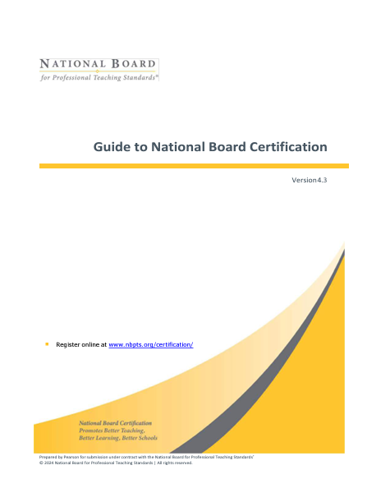
Eligibility
Click here to access the “Guide to National Board Certification”
National Board candidates must possess:
● a bachelor’s degree [NOTE: Candidates for the
Career and Technical Education certificate are
required to hold a bachelor’s degree only if their
state requires one for their current license, which
TEXAS DOES]
● a valid state teaching license
● three (3) years of classroom or school counselor experience prior to starting the certification process by June 30 of your 3rd year of candidacy

Slide 6
What do you have to do?
02
The National Board Certification process is an intensive process that has the teacher describe, analyze, and reflect on all aspects of their teaching.

Slide 7

5 Core Propositions
Click here to read more about these in “What Teachers Should Know and be Able to Do”
01
Teachers are committed to students and their learning.
02
Teachers know the subjects they teach and how to teach those subjects to students.
03
Teachers are responsible for managing and monitoring student learning.
04
Teachers think systematically about their practice and learn from experience.
05
Teachers are members of learning communities.

Slide 8
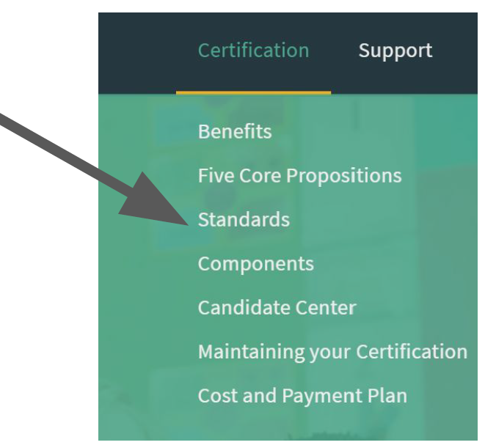
National Board Standards
National Board Standards define what accomplished teachers should know and be able to do in 25 certificate areas. They cover 16 different subject areas and four developmental levels and are applicable to most teachers in U.S. public schools.

Slide 9
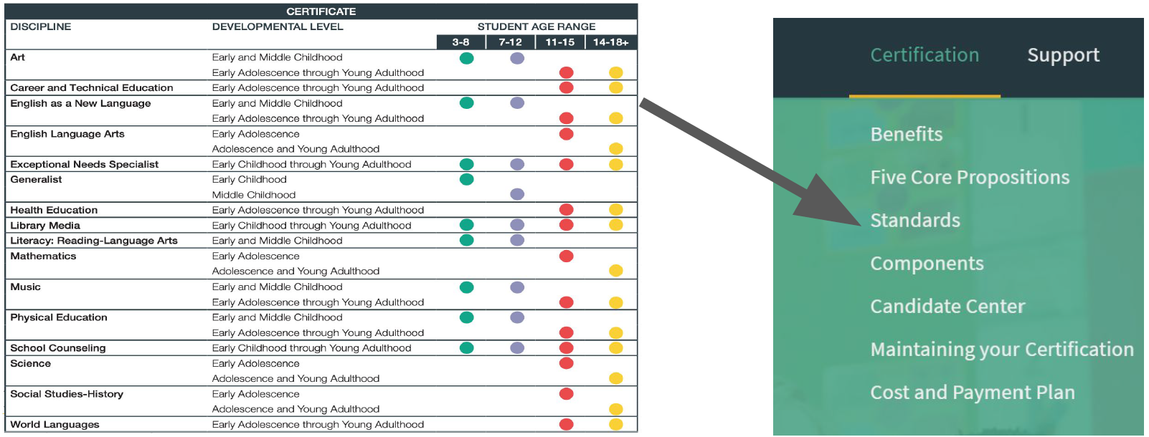
National Board Certificate Areas

Slide 10

Architecture of Accomplished Teaching

Slide 11

Career & Technical Education - Early Adolescence thru Young Adulthood (CTE - EAYA)
Standards:
Knowledge of Students
Responding to Diversity
Knowledge of Content
Learning Environments and Instructional Practices
Assessment
Postsecondary Readiness
Program Design and Management
Partnerships and Collaborations
Leadership in the Profession
Reflective Practice
Click here for a more detailed look at the CTE Standards.

Slide 12
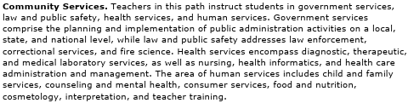
Career & Technical Education - Early Adolescence thru Young Adulthood (CTE - EAYA)
The CTE certificate area encompasses all the programs that are offered in our school; however, it is divided into 8 different pathways (you choose which pathway when you register). Health Science fall under “Community Services”.

Slide 13
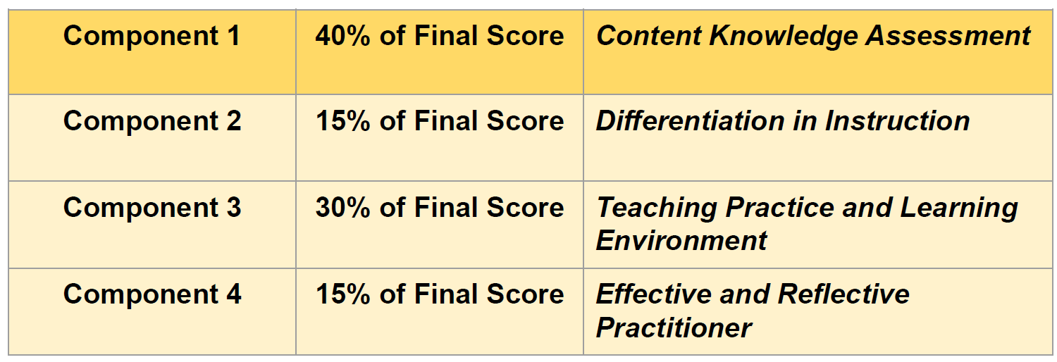
The Process and Scoring

Slide 14
Component 1: Computer-based Content Test
Measures developmentally appropriate content knowledge and pedagogical practices in the chosen certificate area
Taken spring to early summer
Three constructed response items
  30 minutes to complete each
45 selected response items
  Time allowed: 60 minutes
  Accommodations are available (need to request them before you go to the testing center)
Total time for entire exam: 3 hours

Slide 15
Component 2: Differentiation in Instruction
Highlights ability to evaluate learning strengths and needs for individual students; plan and implement appropriate instruction; and analyze and modify strategies and materials based on ongoing assessment.
Classroom-based portfolio entry:
  Samples of student work that demonstrate the students’ growth over time
  Accompanying written commentary that analyzes the candidate’s instructional choices
Collect evidence anytime now to mid-May submission

Slide 16
Component 3: Teaching Practice & Learning
Environment
Highlights how candidates engage students and impact their learning
Video recordings of interactions between candidates and their students.
  Two written commentaries, in which the candidate describes, analyzes and reflects on their teaching and interactions
Collect evidence anytime now to mid-May submission

Slide 17
Component 4: Effective & Reflective Practitioner
Highlights understanding of assessments and assessment practices to plan for/positively impact student learning
Demonstrating practices with a class of students
Evidence of collaboration with families, community, and colleagues
Candidate’s contributions to learning communities to advance student growth
Collect evidence anytime now to mid-May submission

Slide 18
Here’s what I had to do for my portfolio submission:

Slide 19
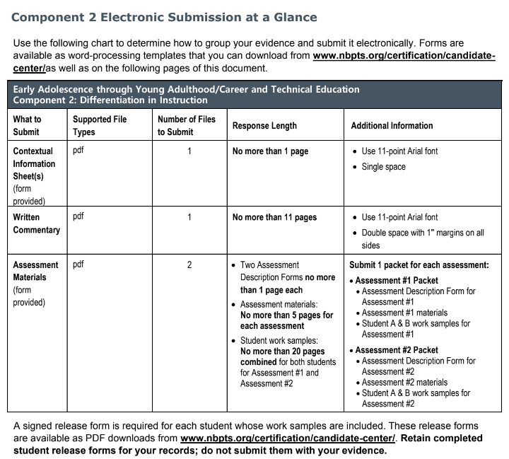
Form writing: 3 pages
Evidence: 20 pages
Written commentary: 11 pages

Slide 20
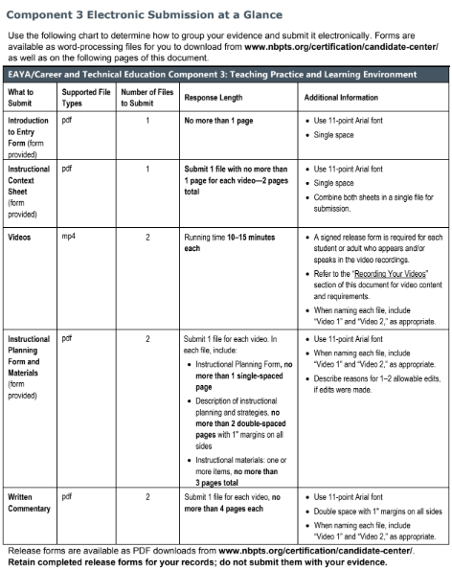
Form writing: 9 pages
Evidence: 6 pages
Videos: 2, 10-15 minutes each
Written commentary: 8 pages

Slide 21
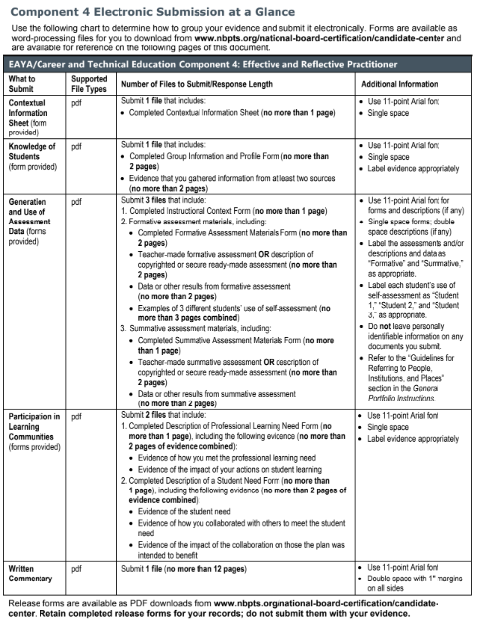
Form writing: 9 pages
Evidence: 17 pages
Written commentary: 12 pages

Slide 22
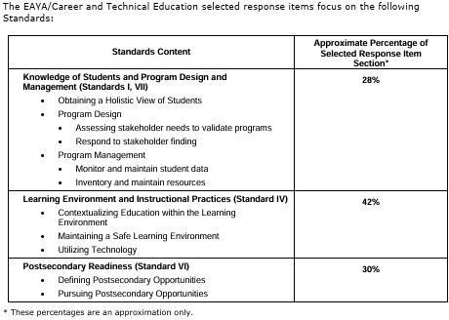
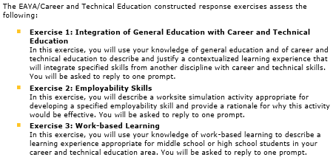
45 multiple-choice & 3 essay questions
[Since this certification covers the “Community Services” pathway, you will have questions that ask about the other courses, such as CJ, FCS, and Cosmetology]

Slide 23
IN TOTAL:
Form writing: 21 pages
Evidence: 43 pages
Videos: 2, 14-15 minutes each
Written commentary: 31 pages
Content Exam: 3 written response + 45 multiple choice questions
95 pages of writing
& documentation, 2 videos, & content exam

Slide 24
When is everything due?
03
National Board has a very specific timeline of when items must be submitted.

Slide 25
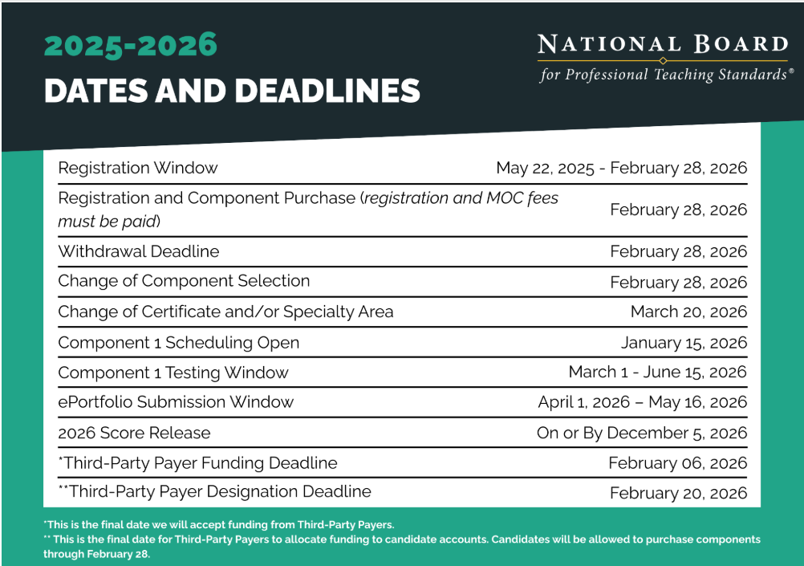
2025-2026 Timeline
YES, there is a 6-month waiting period for scores to be released.

Slide 26
Important Dates to Remember
Feb
Mar - June
May
May - Dec
Dec
Registration & Purchase
Component 1 Window
Portfolio Submission
Wait Patiently
Score Release
Wait patiently for score release. They WILL NOT be released early.
Scores will be released.
Deadline to choose and purchase components (usually the last day of the month).
Component 1 testing window.
ePortfolio submissions due (usually the 3rd Saturday).

Slide 27
Costs
Registration - $75 non-refundable and non-transferable paid during EACH assessment cycle
01
02
$475 fee for EACH of the four required components
Purchase only the components you plan to complete during the assessment cycle
03
04
No interest payment plan available for the components you purchase each assessment cycle (available early Fall)
Under the Texas Incentive Allotment (TIA), you can get reimbursement from your school district (verify first).
05

Slide 28
Where is all the information?
04
There is LOTS of information to help you with the journey!!

Slide 29
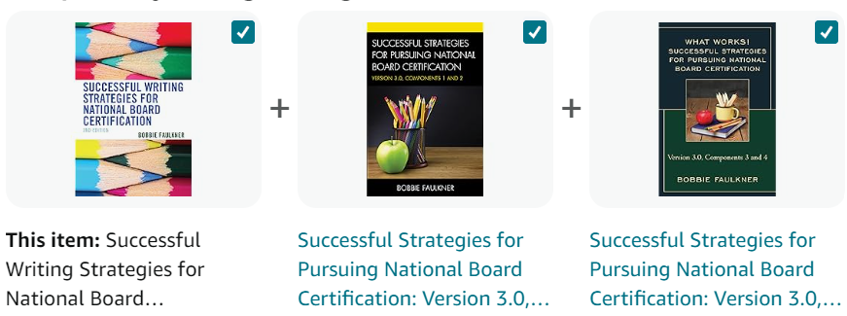
Resources
National Board for Professional Teaching Standards Website
Tracey Bryant Stuckey
Bobbie McKee Faulkner’s books on Amazon
She’s an NBPTS coach with 25 years of experience mentoring other teachers thru this process. She offers classes for each component, a newsletter, and assistance for teachers.
Three great books with amazing advice for each component - highly recommended by many teachers!
This is THE place to start. They have all the handbooks, required documents, and other needed items. You can also sign up for a monthly newsletter and webinars.

Slide 30


Facebook groups
There are CTE-specific groups you can join, but I cannot recommend these two groups enough (the were SO HELPFUL!!):
National Board Certification Initial Candidate NBPTS Support (ran by Tracey Bryant Stuckey)
National Board Certification Survival Group (ran by Bobbie McKee Faulkner)

Slide 31
How do I even get started?
05
I know this whole process sounds overwhelming, but it does not have to be. Take it a little at a time.

Slide 32

Homeroom (linked here)

Slide 33
More Resources/Advice
Getting Started
Get Organized!!
Sample Timelines
Set up a dedicated Google Drive for all your information and documents.
EXAMPLE
Checklist
READ YOUR COMPONENTS!!
Get Release Forms signed right away!!
Timeline #1
Timeline #2
Timeline #3

Slide 34


Slide 35
Why should I do this?
06
In addition to taking your teaching to the next level, there are some financial rewards to this process.

Slide 36
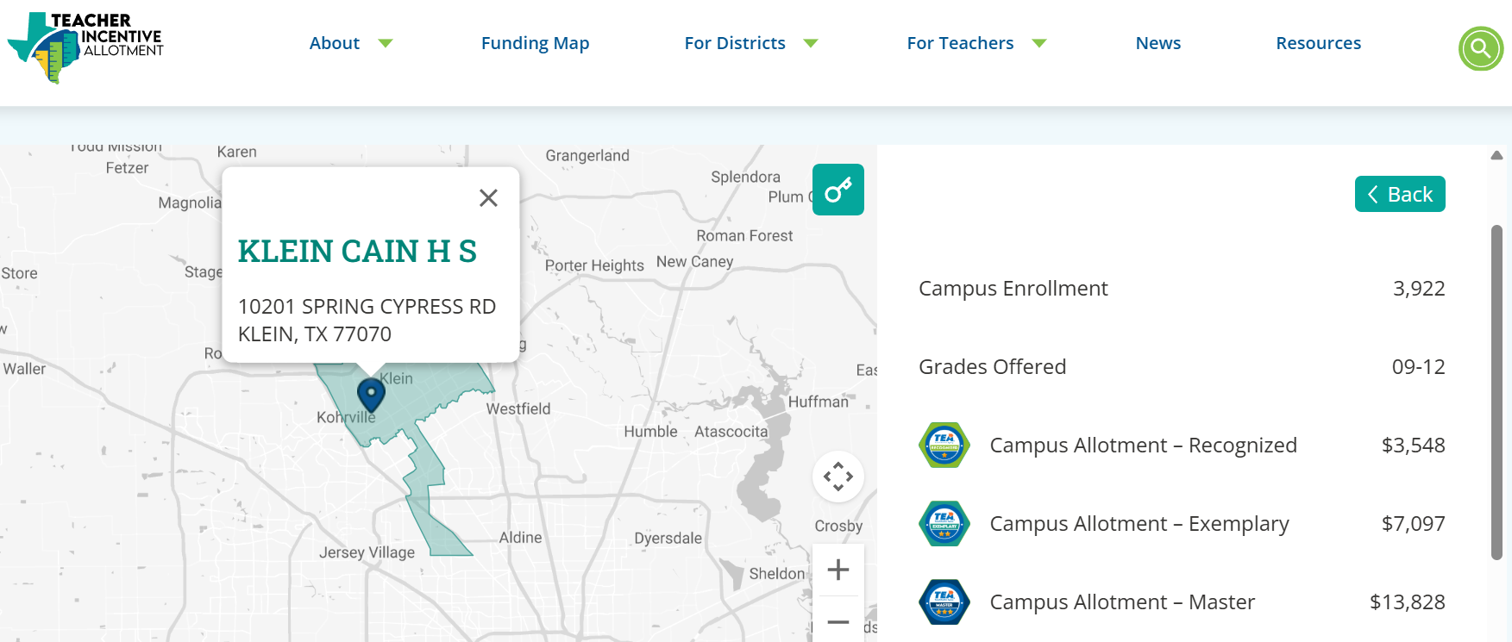
TIA: Teacher Incentive Allotment for 2024-2025
(90% of this goes to the teacher, 10% to the district for administrative costs)
Click on the map to see what it would look like for YOUR district
National Board Distinction

Slide 37
Currently, there are only 41 Nationally Certified CTE teachers in Texas.

Slide 38

This is what you’ll see when you log into your account in December if you are successful - FIREWORKS!!

Slide 39
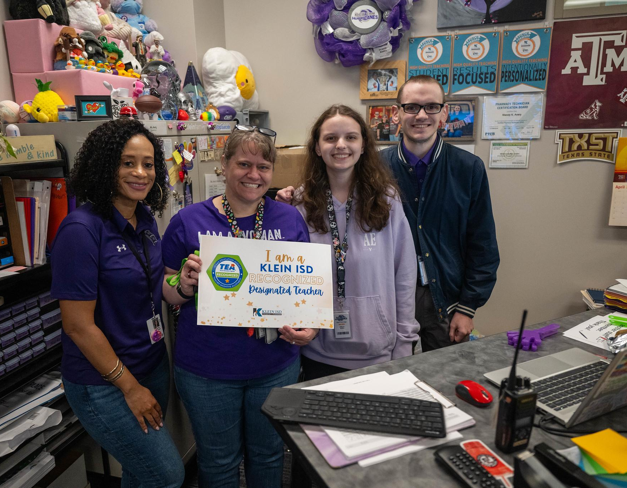
Earning Recognized Designation
This is the day my campus awarded / announced my TEA “Recognized” Designation. Everyone came out with lots of bells, whistles, and noise. I got to share this moment with 2 of my 3 kids (1 Senior, 1 working as a sub).
Ultimately, I did this for ME. I’m always looking for ways to improve and this journey was absolutely one that made me look at all aspects of my teaching. I definitely recommend it for all teachers!!

Slide 40
Thank you!
Do you have any questions?
Wendy Avery, NBCT
wavery1@kleinisd.net

