Slide 1
The Power of
Prevention
How Daily Choices Impact Lifelong Health
Allyson Carter, McKenzie Gilbreath, Claire Lobo, Lindsay Monroe, Savannah Switzer & Claire Walzel

Slide 2
ABSTRACT
Most Americans do not understand that many diseases can be preventable. There is overwhelming clinical research showing that small lifestyle choices greatly impact the trajectory of one’s life and well-being. This evidence-based research project explores the key components that contribute to holistic health: Nutrition, gut health, and vaccinations. These key components encourage the autonomy of patient care and act as a preventative measure against diseases throughout the lifespan. Education, research, and advocacy for disease prevention can influence our society’s well-being by promoting healthy choices.
Notes:
Tell the audience to read

Slide 3
Gut Brain Axis and Mental Health
What is the gut brain axis?
The gut normally has trillions of helpful bacteria
Multiple factors in life can cause dysbiosis (stress, poor diet, lack of sleep, etc.)
Poor gut brain axis can cause leaky gut syndrome
Mental health can become heavily affected by this, specifically anxiety and depression

Slide 4
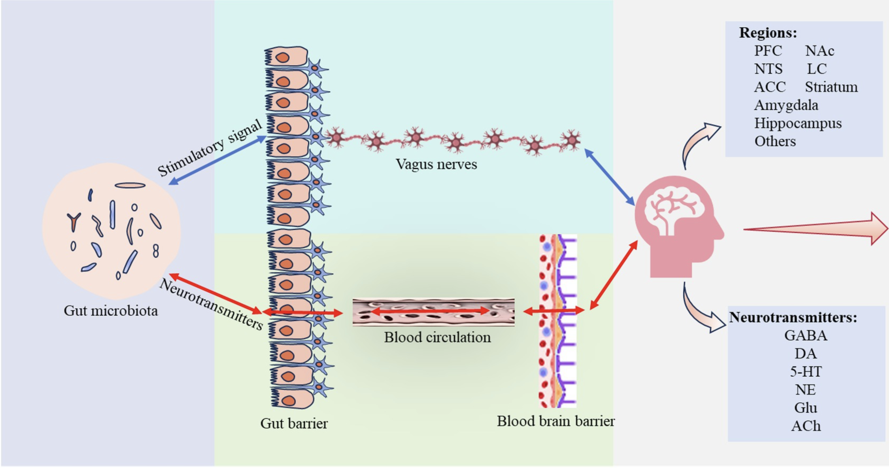

Slide 5
Gut Brain Axis and Mental Health
“The gut is a stable, resilient ecosystem… Disruptions in this stable microenvironment, beyond its self-repair capacity, can lead to diseases, including mental disorders like anxiety.” (Jiang et al., 2024, p. 2)
Inflamed gut--> neuroinflammation (inflammation of nervous tissue)--> reduced neurotransmitter availability which affects mood
In 2023, a RCT study was conducted consisting of 1401 subjects which found that probiotic use is "effective in the reduction of depressive and anxiety symptoms in clinically diagnosed patients."
Probiotic use can reduce chronic gut inflammation which is connected to neuroinflammation
Notes:
Add who said the quote;

Slide 6
ALZHEIMER'S DISEASE
Dementia impairs one's abilities to do daily tasks, causes memory loss and leads to dependance
Alzheimer's disease is caused by amyloid beta plaque buildup in the brain
Amyloid-beta plaques accumulate between nerve cells in the brain leading to decreased memory and progression of AD symptoms
In the gut, bacteria can produce similar amyloid proteins, leading to inflammation of the brain and body through the gut-brain axis
A healthy diet focused on reducing inflammation can strengthen the gut, prevent leaking, and reduce the neuroinflammation
Notes:
Transition from mental health to chronic nervous system disorders

Slide 7

Nutrition Prevention in Dementia
anti-inflammatory diet is key to prevent and slow dementia progression
MIND Diet
Leafy greens, berries, beans, nuts, and a weekly fish serving (MIND)
Avoid butter, sweets, pastries, cheese, and fried food
Improves cognition and reduces AD
Importance of the experiment at Rush University Medical Center

Slide 8
Why does it matter?
Many chronic diseases, as mentioned, have been seen to have a positive link between their diet and their morbidity.
The diet is imperative to longevity. Blue Zones, "areas inhabited by exceptionally long-living populations," are prime evidence of the influence of diet on longevity (Pes et. Al, 2022).
Notes:
Pes, G. M., Dore, M. P., Tsofliou, F., & Poulain, M. (2022). Diet and longevity in the Blue Zones: A set-and-forget issue?. Maturitas, 164, 31–37. https://doi.org/10.1016/j.maturitas.2022.06.004
Introduce the next person to discuss the slide
Fardet, A., & Boirie, Y. (2013). Associations between diet-related diseases and impaired physiological mechanisms: a holistic approach based on meta-analyses to identify targets for preventive nutrition. Nutrition reviews, 71(10), 643–656. https://doi.org/10.1111/nure.12052

Slide 9
Diet & Disease Prevention
An understanding of the importance of preventive medicine is associated with the ability to practice it.
Viral infections have multifactorial external drivers causing high morbidity and mortality rates worldwide.
Notes:
Anil, S., Zawahir, M. S., & Al-Naggar, R. A. (2016). Effectiveness of preventive medicine education and its determinants among medical students in Malaysia. Frontiers of medicine, 10(1), 91–100. https://doi.org/10.1007/s11684-016-0428-0
Harper, A., Vijayakumar, V., Ouwehand, A. C., Ter Haar, J., Obis, D., Espadaler, J., Binda, S., Desiraju, S., & Day, R. (2021). Viral Infections, the Microbiome, and Probiotics. Frontiers in cellular and infection microbiology, 10, 596166. https://doi.org/10.3389/fcimb.2020.596166

Slide 10
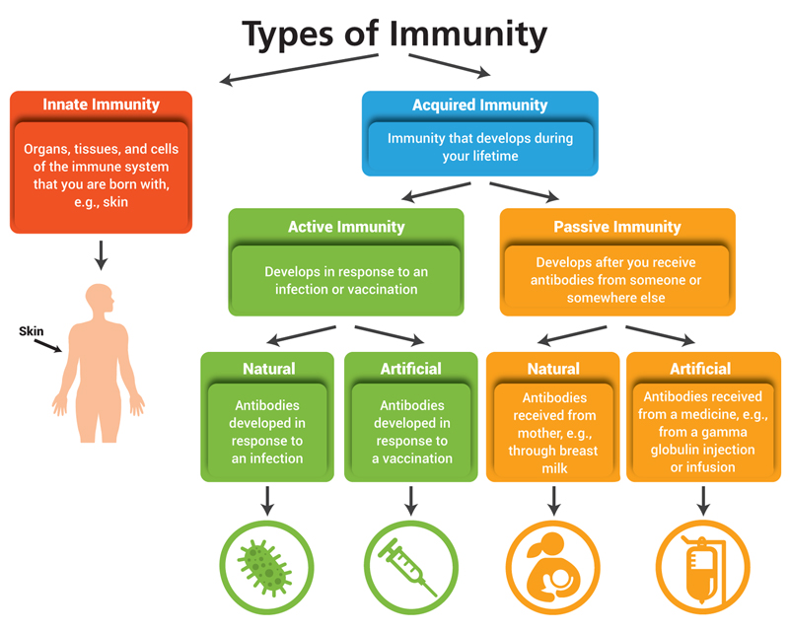
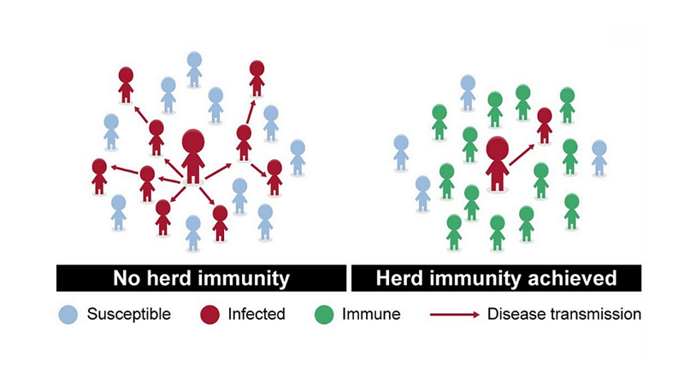
Building Immunity
Key interactions that shape the immune system include: "early life factors, antibiotic exposure, immunosenescence, diet, and inflammatory diseases" (Harper et. al, 2021).
Herd Immunity: a phenomenon where a certain percentage of the population is immune to a disease, making it difficult for it to spread
- Between 80-95% of the population depending on the disease
Notes:
Harper, A., Vijayakumar, V., Ouwehand, A. C., Ter Haar, J., Obis, D., Espadaler, J., Binda, S., Desiraju, S., & Day, R. (2021). Viral Infections, the Microbiome, and Probiotics. Frontiers in cellular and infection microbiology, 10, 596166. https://doi.org/10.3389/fcimb.2020.596166
Good segway to claire presenting

Slide 11
Influenza Vaccination
Influenza is a viral respiratory illness that infects the nose, throat, and lungs. The severity of the illness can vary. The Influenza virus changes each year, so the best way to prevent contracting the flu is yearly vaccination
The virus spreads by droplets when infected people cough, sneeze, and talk. We cannot always see these droplets, so proper hygiene and vaccination and vital for preparing the immune system
The vaccination in the US typically protects against multiple strains that are predicted to be the most prevalent. The vaccination is consistently evolving each season to strengthen its protective qualities

Slide 12

Misconceptions of Influenza
What are some misconceptions of the influenza vaccine?
Causes the recipient to contract the virus
The vaccine does not prevent sickness
Not necessary because the individual is healthy
What are the effects of these misconceptions?
Low vaccine participation
Higher risk populations in danger
Influenza outbreaks
What are some ways to combat these effects?
Patient education and effective communication
More convenient and accessible

Slide 13
Educating about Influenza
The flu vaccine is protective against influenza among both low-risk and high-risk populations, like those with chronic respiratory disorders and the elderly.
  Recipients of influenza vaccine were 40% protected from getting the flu in high-risk populations like those with COPD.
  There has been more protection in outpatient cases than inpatient cases
  Increasing influenza vaccination is preventative to COPD exacerbations and in preventing contracting of the disease by this group.
Evidence shows that receiving a flu vaccine has decreased the chances of secondary respiratory or cardiovascular complications in the elderly populations.
Adults older than 50 are prioritized for a flu vaccine during a vaccine shortage because they are an at-risk population.
  This population is at an increased risk for hospitalization and death and are more likely to have chronic health conditions that put them at risk for complications from contracting the flu.
Notes:
https://www.proquest.com/docview/1497393175?accountid=7082&sourcetype=Scholarly%20Journals
https://onlinelibrary-wiley-com.srv-proxy1.library.tamu.edu/doi/10.1111/irv.13270
https://www.cdc.gov/flu/vaccines/vaccinations.html

Slide 14
HPV Vaccination
HPV is a virus that affects the skin and mucous membranes. There are about 40 strains of the virus that are known to be cancer causing. The virus is most spread through sexual contact and about 13 million people contract HPV annually
High Risk - Strains 16 and 18 are most heavily linked to cervical, anal, throat, penile, vaginal, and vulvar cancers.
Low Risk - Strains 6 and 11 and linked to genital warts.
The Gaurdisil-9 vaccination protects against 9 HPV types, including 16 and 18. It is made from protein particles of the virus and does NOT cause HPV
Age at First Dose | Doses | Schedule | Notes
9-14 years | 2 | Dose 2 is recommended 6-12 months after first dose | May need 3rd vaccination if the second dose is received before 6 months
15-26 years | 3 | Seconds dose at 2 months and third dose at 6 months after the first dose
>26 years | 3 | Seconds dose at 2 months and third dose at 6 months after the first dose | Consult with a doctor before receiving
Notes:
HPV is a virus that affects skin and mucous membranes. There are around 40 different versions of HPV that are known to be cancer causing , but there are hundred of strains out there. The virus is most commonly spread through sexual contact.
Every year, around 13 million people contract HPV. For many people, they present with no symptoms, and eventually, the body is able to fight off the virus on its own.
Unfortunately, there are many high risk strains that are not so easily fought off by the body. This is why vaccination is important. For strains 16 and 18, which are heavily linked to a variety of cancers, the HPV vaccination protects against these.
The vaccination includes parts of the HPV viruses, but does not have a live virus in it. This means that the vaccination does NOT cause HPV.
The CDC recommeneds that the vaccination is recived between ages 9-14. IT is a 3 dose series with the second dose 6-12 months after the first
For those 15-26, it is a 3 dose series with the second and third dose received at 2 and 6 months after the first dose. Those over 26 should consult a doctor before getting vaccinated

Slide 15
Misconceptions of HPV
What are some misconceptions about the HPV vaccine?
Encourages sexual activity in the younger population
Not necessary if the individual is not sexually active
What are the effects of these misconceptions?
Development of cancerous lesions
Increased vaccine hesitancy
What are some ways to combat these effects?
Education and effective communication
Healthcare provider recommendations
Males do not need this vaccination
Higher rates of HPV
Further spread of misinformation
Providing evidence based resources
Notes:
Misconceptions
This vaccination is only for women https://link.springer.com/article/10.1007/s13187-020-01824-z
Increasing rates of cancer in the oropharynx in males from HPV
No screening tests to detect HPV in men
Misconception could be due to not recommending vaccination in males until 2011 when the recommened for females in 2006
Study data: "Despite all mothers reporting that males could transmit HPV, the majority (n = 16) reported they did not perceive the need for boys to be vaccinated against HPV. This was true for mothers who had only daughters, only sons, and daughters and sons"
https://www.tandfonline.com/doi/full/10.1080/21645515.2025.2494452#abstract
The vaccine promotes sexual activity
Some people believe that letting their child receive the vaccine is giving permission to engage in these activities or that they do not need to give their child this vaccinination because they are not having sex. Effectiveness of the vaccination is dependent on age and that is why preteens are recommened to get vaccinated.
This vaccine is unneccesary if someone is not sexually active (https://journals.plos.org/plosone/article?id=10.1371/journal.pone.0313887)
One of the biggest misconceptions is that the vaccine encourages the younger population to engage in sexual activity at a younger age. A study conducted showed that the stigma around this vaccine was due to the mode of transmission of HPV itself and that this vaccine did not change the rates of sexual activity of younger populations. Another misconception is that if the individual is not sexually active, then the vaccine is not necessary to get. While HPV is generally transmitted through sexual activity, it is still important to receive the vaccine due to the high prevalence. A study found that 80% of women who are sexually active can acquire the infection by 45 years old. Also, a meta-analysis stated that the younger population described having discussions about their sexual life with their parents as challenging and therefore might not be a reliable determinant if the child is engaging in sexual activity. There is a delay between the presence of symptoms and the start of the infection due to the pathology of the HPV infection. Due to this, it makes it difficult for the population to directly see the complications of the infection and the importance of the vaccine. The lesions from the HPV infection can become cancerous if left untreated, so it is important to take this infection seriously and catch it early. These misconceptions caused an increase in vaccine hesitancy, so it is important to educate the community and patients on the benefits of the vaccine. Recommendation of this vaccine by healthcare providers can also encourage patients to receive the vaccine.

Slide 16
Educating about HPV
Cervical cancer can be eliminated by increasing rates of HPV vaccination, with 46% U.S. adolescents having been vaccinated, and 80.2% of Australian adolescents being vaccinated, they are on track to eliminated this disease.
High rates of vaccination are due to high accessibility, encouragement and education
It is important that people, especially those who work in schools, provide factual education on the HPV vaccine and educate about its importance in preventing cancer.
Some people do feel as though the vaccine should be targeted to older adolescents instead of preteens, and that parents have already made up their mind on the HPV vaccine and if their child will receive it.
Screening for cervical cancer not only detects the presence of abnormal cells but also is a preventative measure of the disease. Cervical cancer screenings are being done at lower rates due to the negative connotation from women who have or will receive them.
The appointments can seem like a hassle
There had been a previous negative experience
Not enough information is provided
The results may be upsetting
It is important to educate the importance of proper screening and safe sex practicies
Vaccination is not a 100% guarantee. While vaccination can significantly protect a person from contracting a harmful strain of HPV and this vaccination does not protect against all STIs.
Notes:
https://journals-sagepub-com.srv-proxy1.library.tamu.edu/doi/full/10.1177/10598405231206109
https://web-p-ebscohost-com.srv-proxy1.library.tamu.edu/ehost/pdfviewer/pdfviewer?vid=0&sid=52480c3f-133f-48f2-9ffd-4342d35271f8%40redis
Cervical cancer can be eliminated by increasing rates of HPV vaccination, with 46% U.S. adolescents having been vaccinated, and 80.2% of Australian adolescents being vaccinated, they are on track to eliminated this disease. High rates of vaccination are due to high accessibility and encouragement to receive it that is school-based. It is important that nurses, especially those who work in schools, should promote education on the HPV vaccine and educate about its importance in preventing cancer. Some nurses do feel as though the vaccine should be targeted to older adolescents instead of preteens, and that parents have already made up there mind on the HPV vaccine and if there child will receive it. Screening for cervical cancer not only detects the prescence of abnormal cells but also is a preventative measure of the disease. When it comes to screenings for cervical cancer, these screenings are being done at lower rates due to the negative contataion from women who have or will receive them. The appointments can seem like a hassle, there had been a previous negative experience, not enough information is provided, or the results may be upsetting. As the nurse it is important to educate the importance of receiving these screenings, and to be able to make patients feel comfortable. Nurses are appreciated and trusted; it is important to be welcoming, open, and honest with your patients and be someone they can trust during an appointment where they feel vulnerable during and after while waiting for the results.

Slide 17
MMR Vaccination
What are Measles, Mumps, and Rubella?
Highly contagious viral diseases that can lead to:
Measles - encephalitis and pneumonia
Mumps - hearing loss and meningitis
Rubella - birth defects and can be dangerous during pregnancy
This vaccination works by introducing parts of these viruses to the body's immune system so that it can recognize and fight these pathogens during a future exposure
Age | Dose
12-15 months | First Dose | Recommended start age
4-6 years | Second Dose | At least 28 days after first dose
Women of childbearing age | Before Pregnancy | Live vaccine – not safe for pregnancy
Notes:
https://www.cdc.gov/measles/vaccines/index.html?CDC_AA_refVal=https%3A%2F%2Fwww.cdc.gov%2Fvaccines%2Fvpd%2Fmmr%2Fpublic%2Findex.html

Slide 18

Misconceptions of MMR
What are some misconceptions about the MMR vaccine?
Developmental disabilities like Autism
Bowel disorders like Irritable Bowel Syndrome, Ulcerative Colitis, and Crohn's Disease
What are the effects of these misconceptions?
Low public confidence in vaccines
Large outbreaks of measles
What are some ways to combat these effects?
Communication and relationships between providers and patients
Educating the community on vaccine benefits
Notes:
One of the biggest misconceptions is that the vaccine causes autism, which was suggested by a report published in 1998. The report was quickly retracted after it was published, but the damage to the vaccine’s reputation had already been done and compliance began to fall drastically. Autism is a developmental disability that has a strong genetic component that develops before one year of age, which is when the MMR vaccine is typically administered and therefore debunks this myth. Another misconception is that the MMR vaccine is linked to IBS or irritable bowel syndrome. However, a study was conducted that found no difference in the bowel biopsies of children who received the MMR vaccine and those who did not. Some effects of these misconceptions are a decrease in public confidence in vaccines and large outbreaks of measles. According to the Annual Review of Virology, public confidence in the safety of the MMR vaccine significantly dropped in the early 2000s from above 90% to below 80% in young children and in the early 2000s, there were several large outbreaks of measles with the most affected people being individuals who were not vaccinated. Some ways to combat these effects are educating the community about the benefits of the vaccine and promoting communication between patients and their providers.

Slide 19
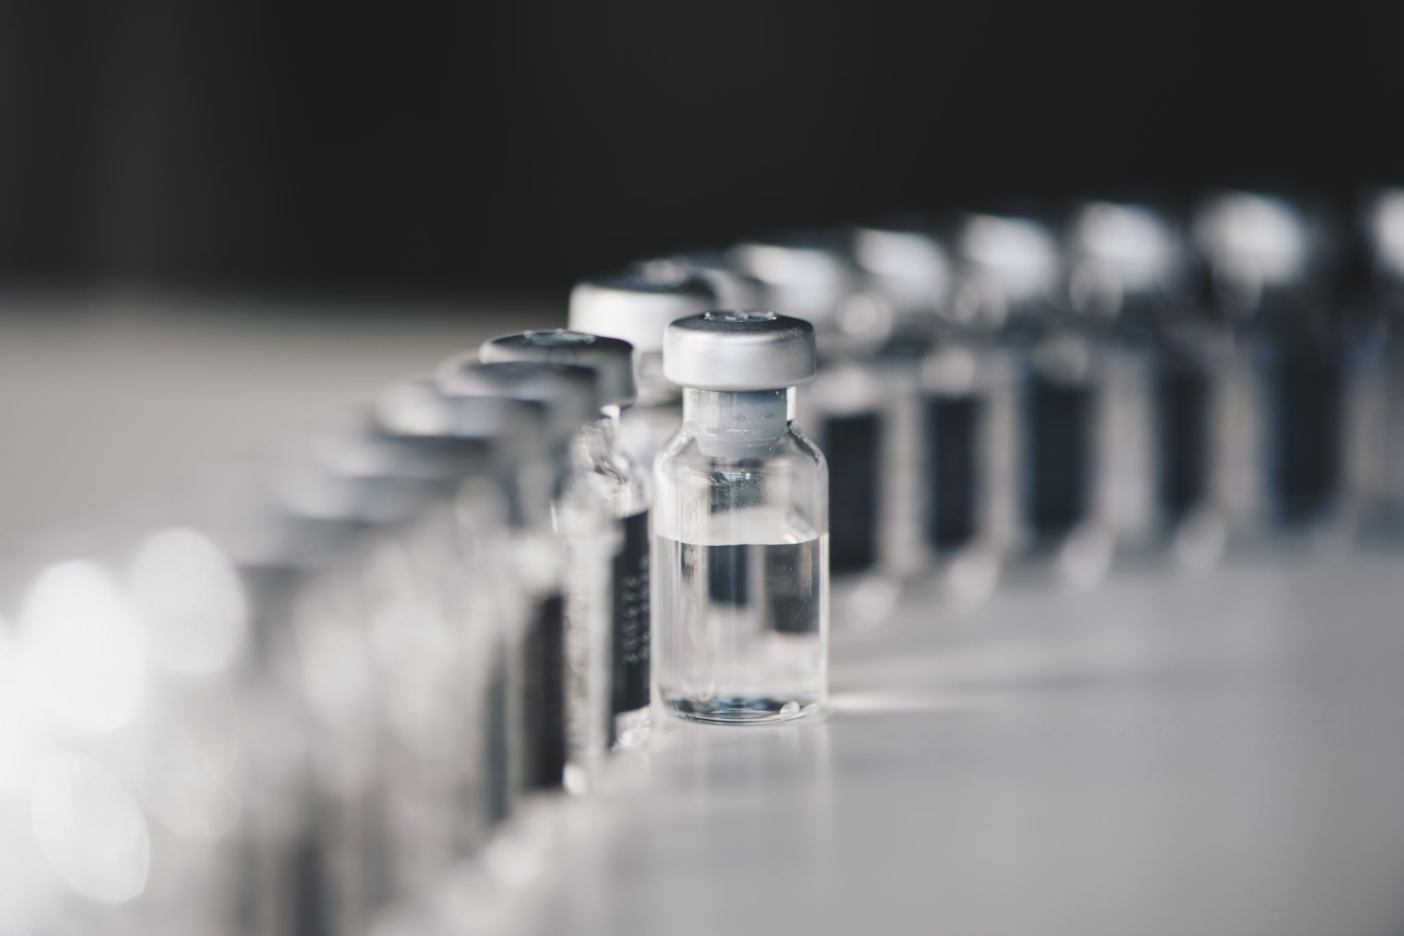
Educating about MMR
The MMR vaccine is 93% effective against measles, 72% effective against mumps, and 97% effective against rubella with one dose
  With two doses it is 97% effective against measles and 86% effective against mumps
Measles was once eradicated in the U.S., but as vaccination rates drop, measles cases began to rise. Getting the vaccine is more effective in protection against those that are not vaccinated against MMR.
  Herd immunity is only effective if 95% of the community is vaccinated. As community immunization has lowered, those that are not vaccinated are more susceptible than ever to contracting Measles, creating an influx of cases and deaths.
  There has been a decrease in kindergarten children vaccinated for measles, dropping from 95% in 2019-2020, to 93% in 2021-2022, increasing the chances of acquiring measles, and putting 250,000 kindergarteners at risk.
  The decreased rates of MMR vaccinations also puts healthcare workers at risk. As nurses, we must educate patients and the public about the vaccine itself, why it is important to receive it, and how it can protect those who are at highest risk of long-term complications.
Notes:
https://mdpi-res.com/vaccines/vaccines-11-00926/article_deploy/vaccines-11-00926-v4.pdf?version=1683541998
https://www.sciencedirect.com/science/article/pii/S0264410X21003856?via%3Dihub
https://www.cdc.gov/measles/vaccines/index.html
https://oce-ovid-com.srv-proxy1.library.tamu.edu/article/00152193-202412000-00006/HTML

Slide 20
References
Rush University Medical Center. (n.d.). MIND diet linked to better cognitive performance. https://www.rush.edu/news/mind-diet-linked-better-cognitive-performance
Centers for Disease Control and Prevention. (2024). HPV vaccination. U.S. Department of Health & Human Services. Retrieved July 14, 2025, from https://www.cdc.gov/hpv/vaccines/index.html
Centers for Disease Control and Prevention. (2025). Influenza (inactivated) vaccine information statement. U.S. Department of Health & Human Services. Retrieved July 14, 2025, from https://www.cdc.gov/vaccines/hcp/current-vis/influenza-inactivated.html
Centers for Disease Control and Prevention. (2025). Measles vaccination. U.S. Department of Health & Human Services. Retrieved July 14, 2025, from https://www.cdc.gov/measles/vaccines/index.html
Ding, S., Choi, S.-H., & Miller, Y. I. (2025). Amyloid β‑induced inflammarafts in Alzheimer's disease. International Journal of Molecular Sciences, 26(10), 4592. https://doi.org/10.3390/ijms26104592. https://www.frontiersin.org/journals/neuroscience/articles/10.3389/fnins.2024.1501134/full
World Health Organization. (2020, December 31). Coronavirus disease (COVID-19): herd immunity, lockdowns and COVID-19. World Health Organization. https://www.who.int/news-room/questions-and-answers/item/herd-immunity-lockdowns-and-covid-19
‌(2018). Hopkinsmedicine.org. https://www.hopkinsmedicine.org/-/media/images/newsreleases/2020/08/aug-25-image-for-story-2.jpeg?h=450&iar=0&w=800&hash=BFF1C1C38055E90073C27D5BCEFC4CC9
‌Immunity | NIH. (n.d.). Clinicalinfo.hiv.gov. https://clinicalinfo.hiv.gov/en/glossary/immunity
‌Pes, G. M., Dore, M. P., Tsofliou, F., & Poulain, M. (2022). Diet and longevity in the Blue Zones: A set-and-forget issue?. Maturitas, 164, 31–37. https://doi.org/10.1016/j.maturitas.2022.06.004
Fardet, A., & Boirie, Y. (2013). Associations between diet-related diseases and impaired physiological mechanisms: a holistic approach based on meta-analyses to identify targets for preventive nutrition. Nutrition reviews, 71(10), 643–656. https://doi.org/10.1111/nure.12052
Anil, S., Zawahir, M. S., & Al-Naggar, R. A. (2016). Effectiveness of preventive medicine education and its determinants among medical students in Malaysia. Frontiers of medicine, 10(1), 91–100. https://doi.org/10.1007/s11684-016-0428-0

Slide 21
References
Harper, A., Vijayakumar, V., Ouwehand, A. C., Ter Haar, J., Obis, D., Espadaler, J., Binda, S., Desiraju, S., & Day, R. (2021). Viral Infections, the Microbiome, and Probiotics. Frontiers in cellular and infection microbiology, 10, 596166. https://doi.org/10.3389/fcimb.2020.596166
Harper, A., Vijayakumar, V., Ouwehand, A. C., Ter Haar, J., Obis, D., Espadaler, J., Binda, S., Desiraju, S., & Day, R. (2021). Viral Infections, the Microbiome, and Probiotics. Frontiers in cellular and infection microbiology, 10, 596166. https://doi.org/10.3389/fcimb.2020.596166
Le Saux N. (2009). Dispelling myths held by parents about the influenza vaccine. Paediatrics & child health, 14(9), 618–622. https://doi.org/10.1093/pch/14.9.618
Chuaychoo, B., Wongsurakiat, P., Nana, A., Kositanont, U., & Maranetra, K. N. (2010). The immunogenicity of intradermal influenza vaccination in COPD patients. Vaccine, 28(24), 4045–4051. https://doi.org/10.1016/j.vaccine.2010.04.006
Palmu, A. A., Pepin, S., Syrjänen, R. K., Mari, K., Moore, T. M., Jokinen, J., Nieminen, H., Kilpi, T., Samson, S. I., & De Bruijn, I. (2024). High‐Dose quadrivalent influenza vaccine for prevention of cardiovascular and respiratory hospitalizations in older adults. Influenza and Other Respiratory Viruses, 18(4). https://doi.org/10.1111/irv.13270
Who needs a flu vaccine. (2024, October 3). Influenza (Flu). https://www.cdc.gov/flu/vaccines/vaccinations.html
McNally, K., Roess, A., Weinstein, A., Lindley, L., & Wallin, R. (2023). School nurses’ experiences and roles in promoting and administering the HPV vaccine: A systematic review using the socioecological framework. The Journal of School Nursing, 40(1), 43–57. https://doi.org/10.1177/10598405231206109
Damsgaard, S., Allergodt, K., & Handberg, C. (2024). Women’s experiences with opting out of cervical cancer screening and the role of the nurse in the women’s decision‐making process. Journal of Clinical Nursing, 33(7), 2674–2687. https://doi.org/10.1111/jocn.17067
Novilla, M. L. B., Goates, M. C., Redelfs, A. H., Quenzer, M., Novilla, L. K. B., Leffler, T., Holt, C. A., Doria, R. B., Dang, M. T., Hewitt, M., Lind, E., Prickett, E., & Aldridge, K. (2023). Why Parents Say No to Having Their Children Vaccinated against Measles: A Systematic Review of the Social Determinants of Parental Perceptions on MMR Vaccine Hesitancy. Vaccines, 11(5), 926. https://doi.org/10.3390/vaccines11050926
Gidengil, C., Goetz, M. B., Newberry, S., Maglione, M., Hall, O., Larkin, J., Motala, A., & Hempel, S. (2021). Safety of vaccines used for routine immunization in the United States: An updated systematic review and meta-analysis. Vaccine, 39(28), 3696–3716. https://doi.org/10.1016/j.vaccine.2021.03.079
Measles vaccination. (2025, January 17). Measles (Rubeola). https://www.cdc.gov/measles/vaccines/index.html
Measles: More than just a rash. (n.d.). https://oce.ovid.com/article/00152193-202412000-00006/HTML

Slide 22
Questions?

