Slide 1
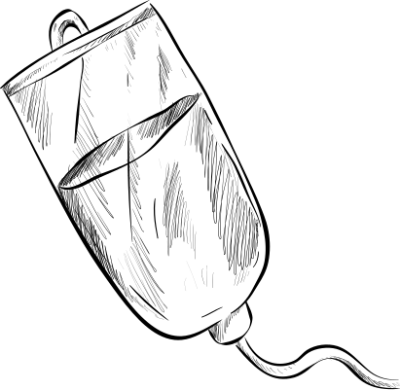





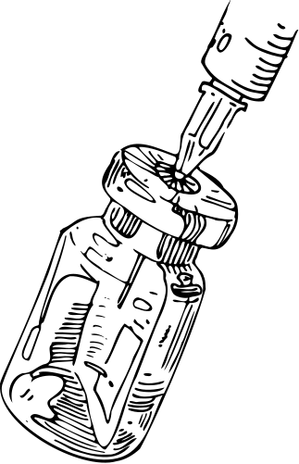
PHARMACY TECHNICIAN
Teachers Collaborative Discussion

Slide 2


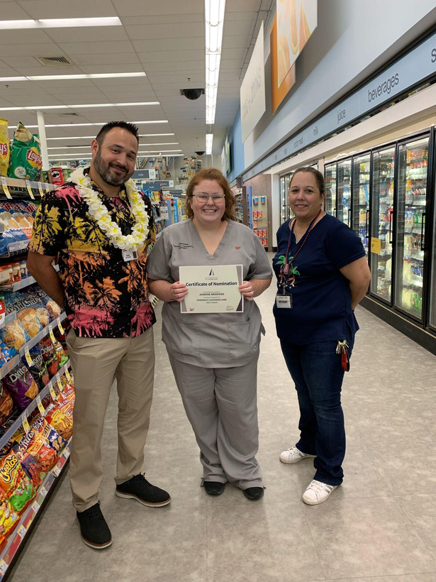



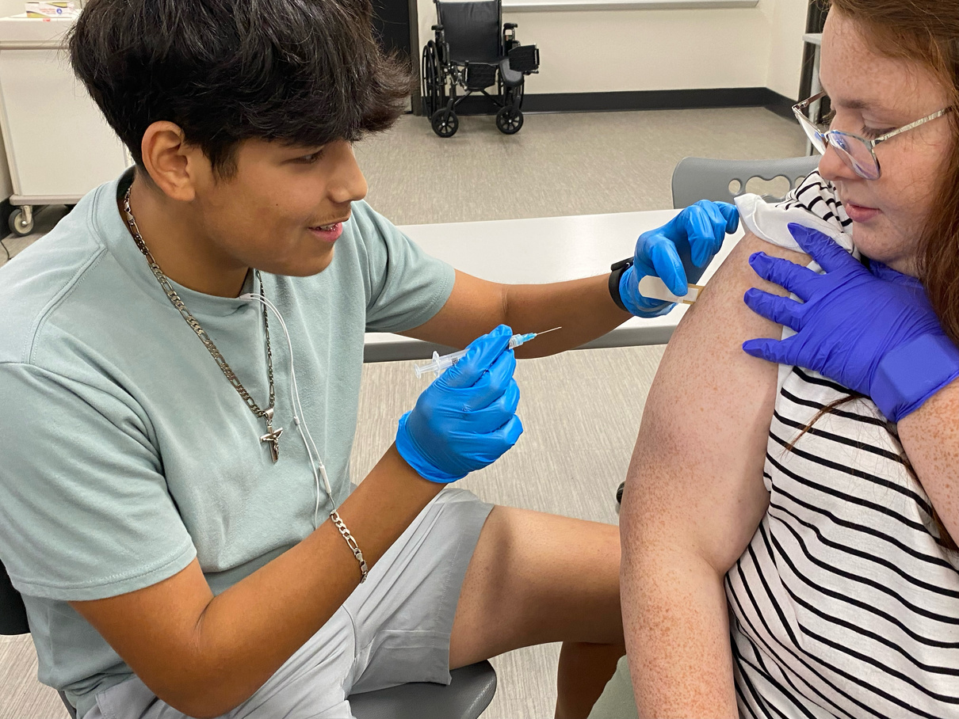

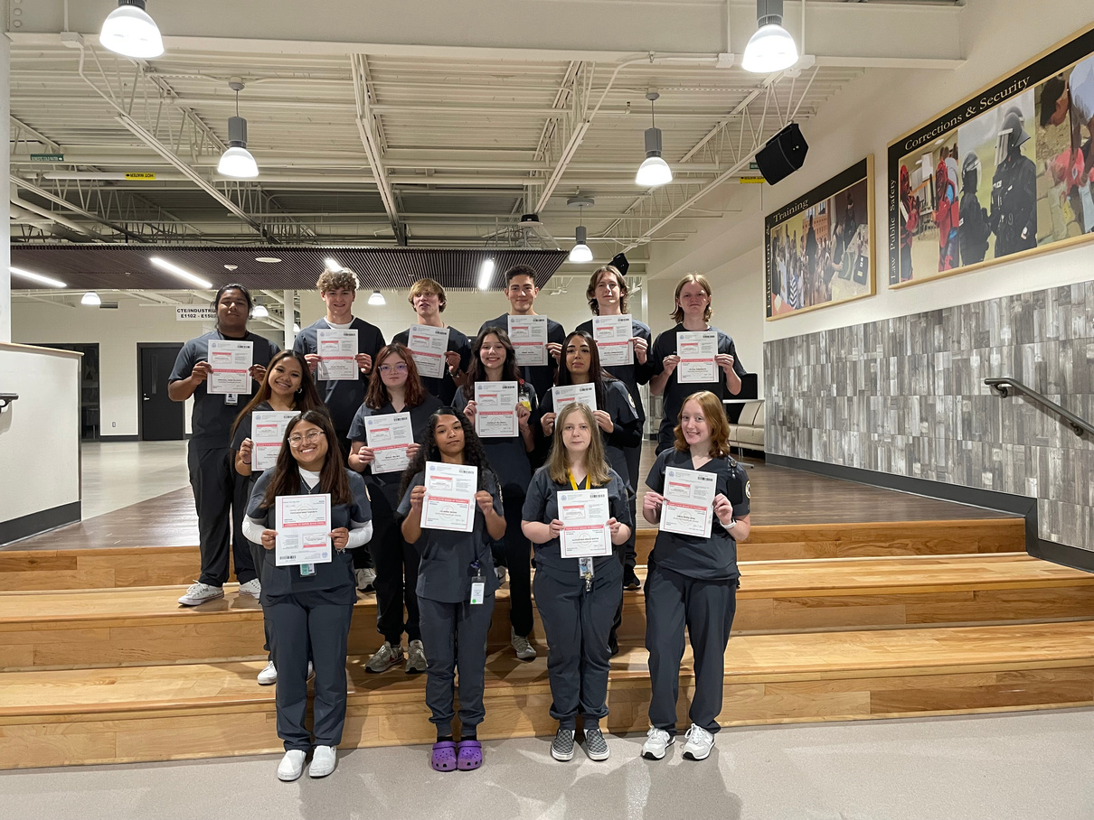

Jasmine Meadows, CPhT
  I work at Cleburne High School.
    I am going into my fourth year of teaching.
    I teach Med-Terms, Pharmacology, and Pharm-Tech
  I have worked in the Walgreens pharmacy since 2018.
    Trainee from 2018-2020
    Certified Aug. 2020- current
    Immunizer Aug. 2020- current

Slide 3




IN MY 3 YEARS TESTING PTCB
Year 1
Year 2
Year 3
30% Pass Rate
50% Pass Rate
75% Pass Rate
GOAL FOR NEXT YEAR
Pic of an updated Jacket Pride Wall
80-90% Pass Rate

Slide 4


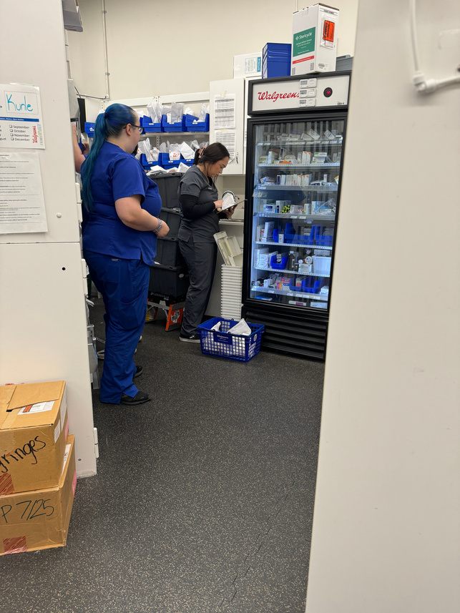
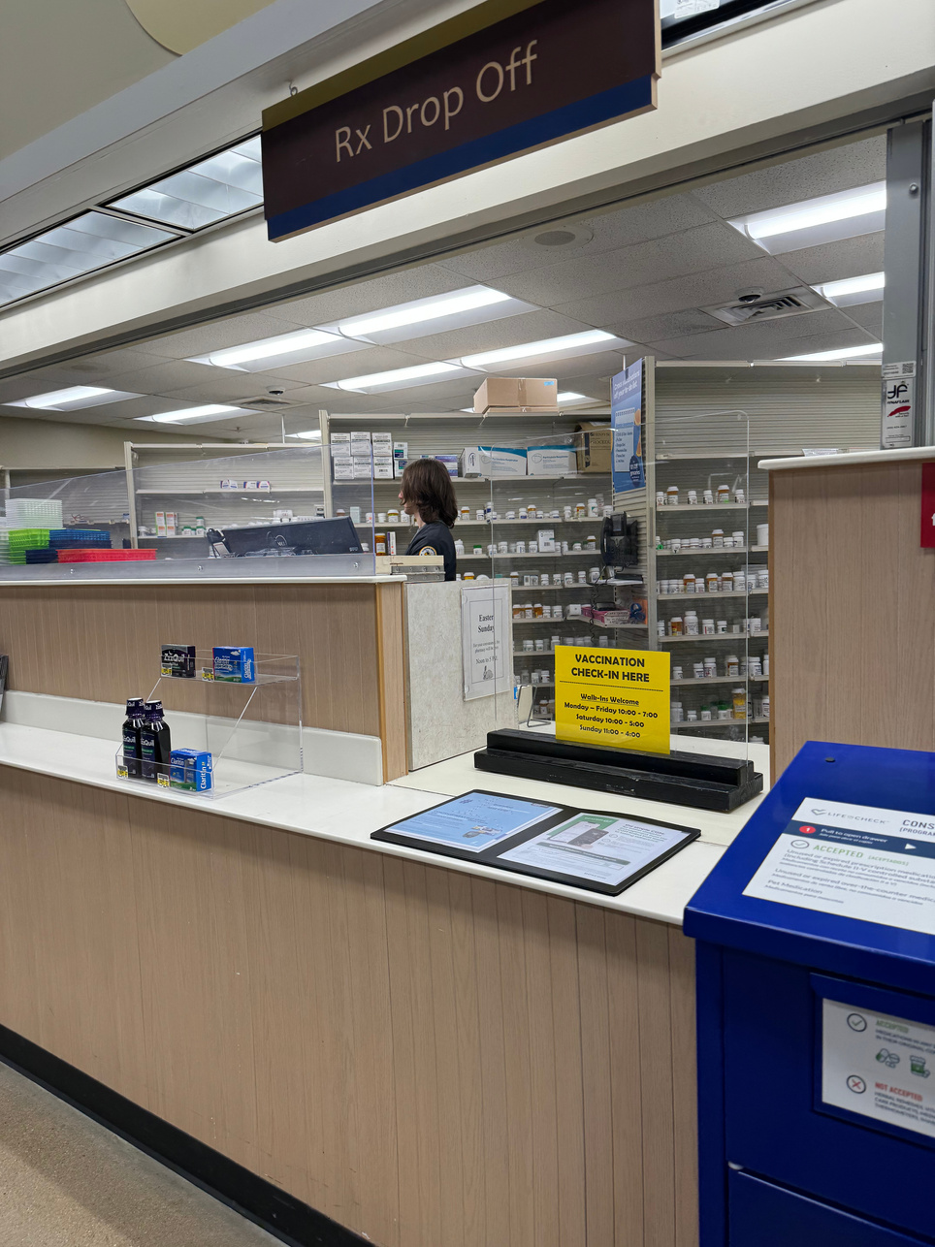



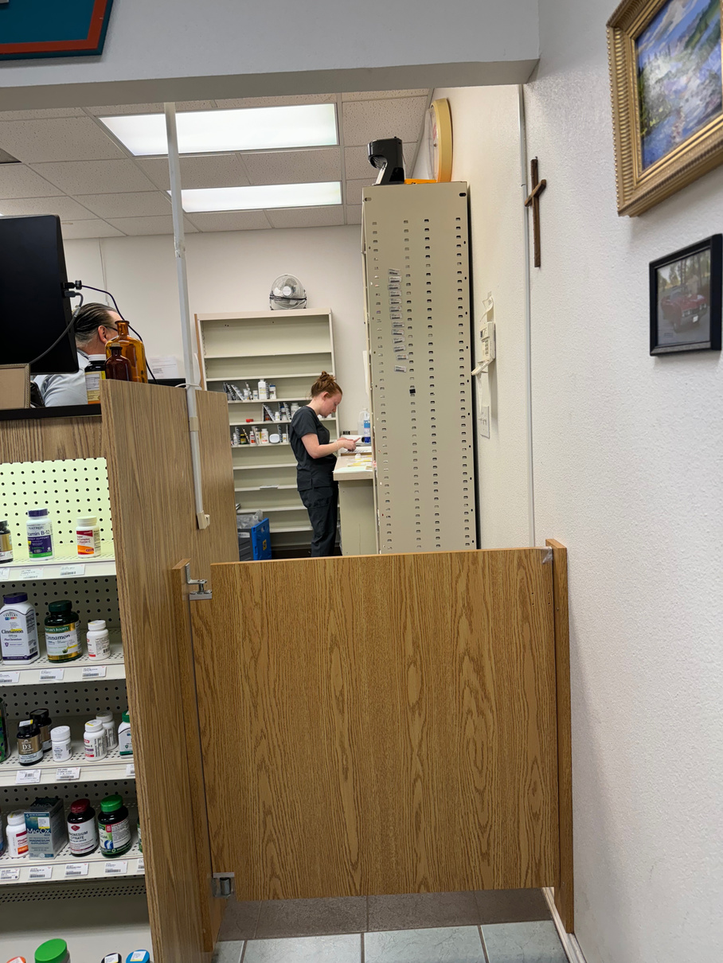

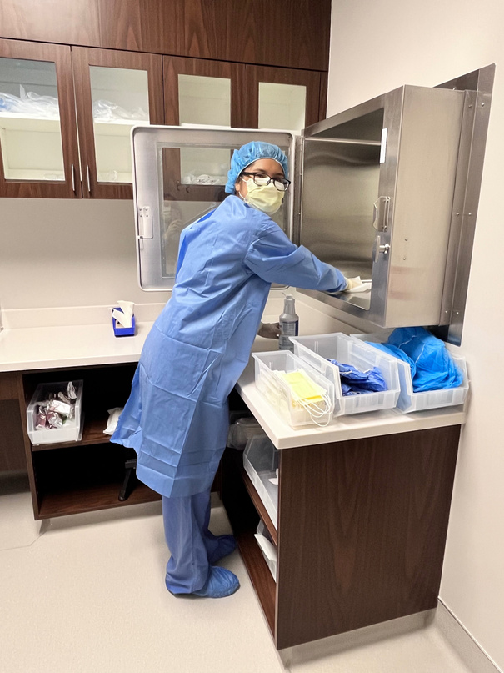

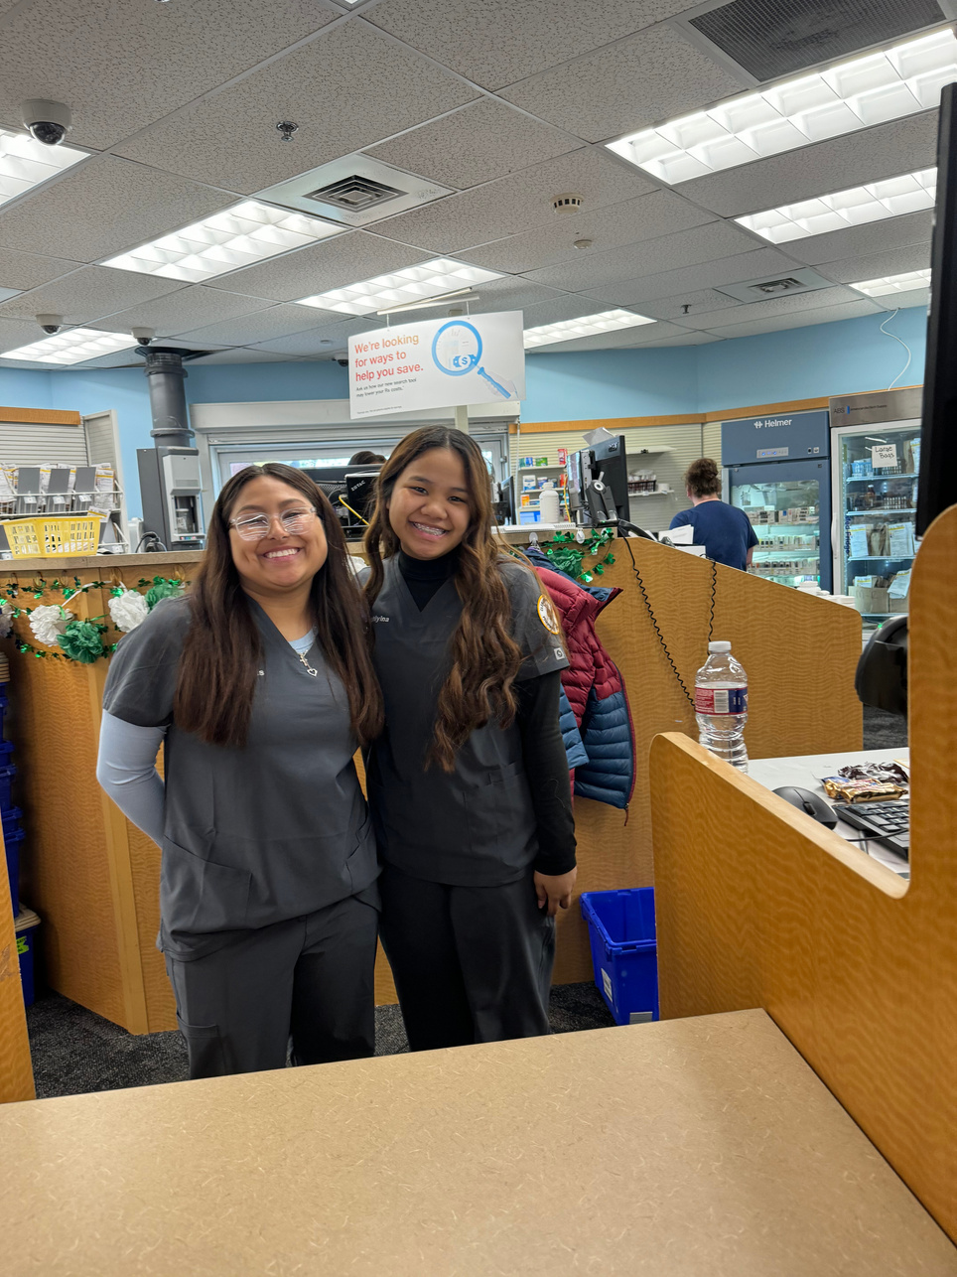
WHERE WE’VE
EXTERNED.
  Walgreens
  THC
  CVS
  Albertsons
  Private Owned (Keene Pharmacy)
I use TimeStation to track their extern hours and location.

Slide 5
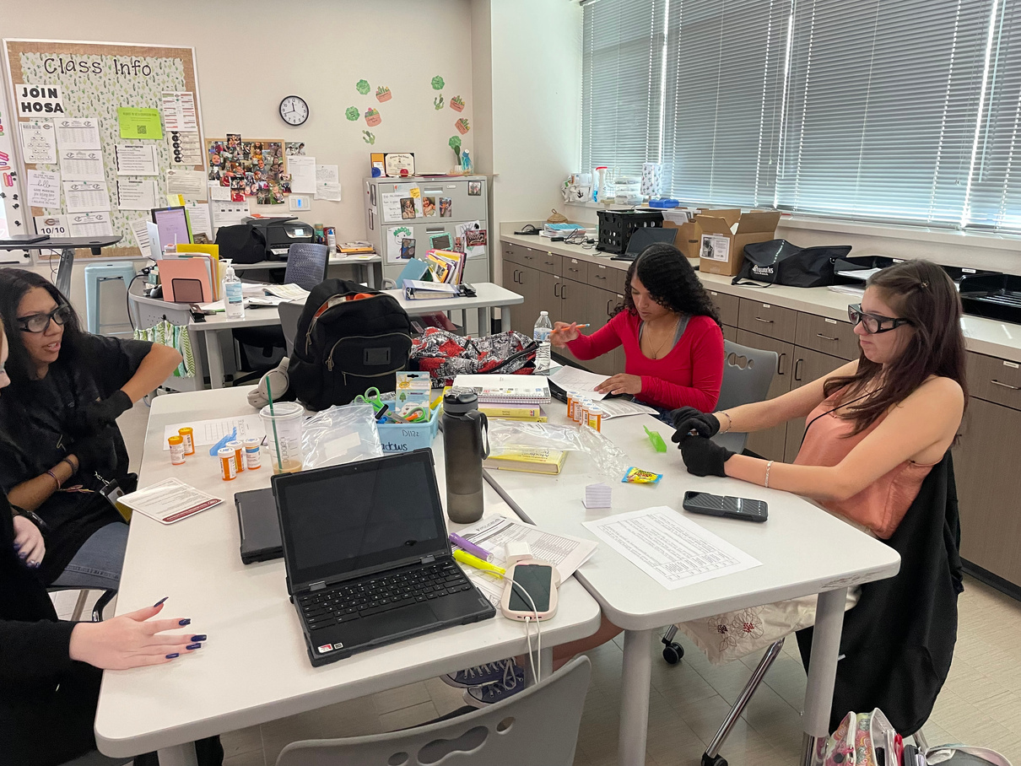
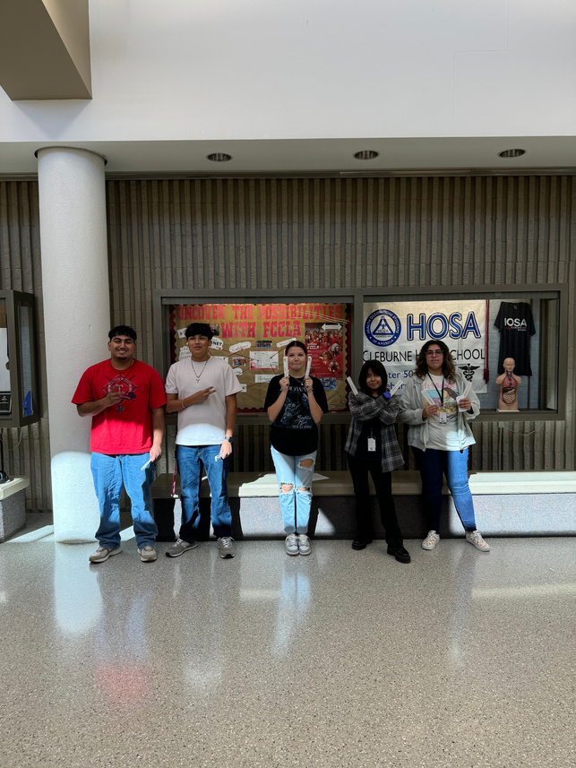
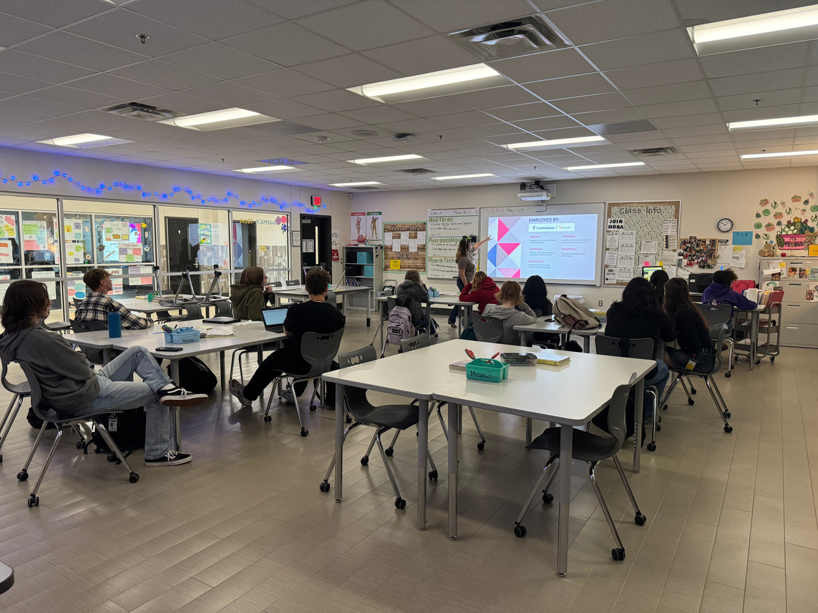
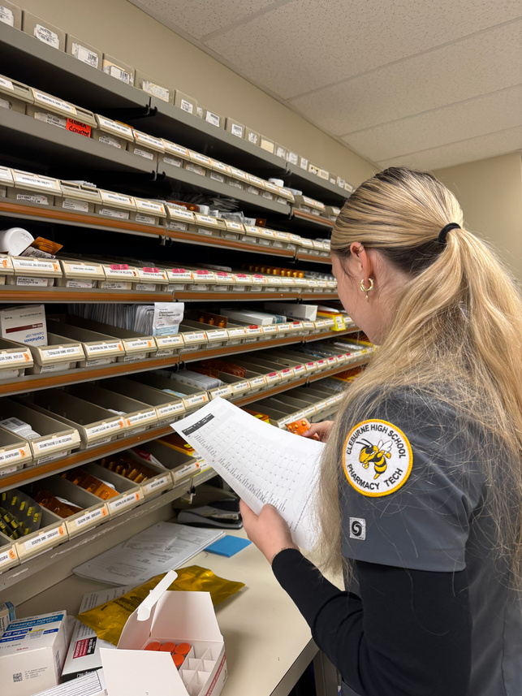
HOW I TEACH IT
I Follow the Program Curriuclum Map
Multiple Resources
  Complete Math Review for Pharmacy Technicians By: Williams A. Hopkins Jr.
  PTCB Exam Simplified By: David A. Heckman
  Mosby’s Pharmacy Technician
  PTCB Test Bank
  I know a lost of techs and pharmacist that work at a variety of pharmacies. If I have a question on a new law or regulation, I send a text.
    I bring in techs and pharmacist to talk to the students about the test and working in the pharmacy.
  What PTCB uses to Audit Programs.
  Teach by each section
Drug Lists
  I have 9 Drug List that cover each body system. (CNS is so big, I split it up)
    Quiz and test over these
Teach off experience/ hands on
  I still work as a tech PRN (mainly in the summer)
  They learn better when they get to go to the pharmacy.

Slide 6
QUESTIONS/ DISCUSSION
What are your sucesses and failures?
Out of their
Scope of Practice
  What has worked for you for getting better scores?
  What have been total busts for you?
How are you teaching things out of their scope of practice?
How are you Reviewing?
What are your best methods for reviewing stuff you covered at the beginning of the year?

Slide 7


Any questions for me or anyone else?

