Slide 1

What did I get in to?
Starting or restarting a health science program of study, this is how I did it.
Misty overfelt, mhs, lat, atc,emt

Slide 2
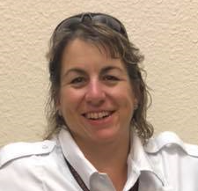
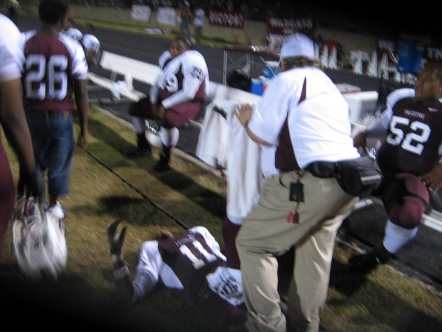

A SNAP SHOT ABOUT Me
MHS
LAT, ATC
Certified Health Science Technology teacher
EMT and licensed instructor in Texas
I have taught at a 6A, 4A, and 3A school

Slide 3

Health Science Career Pathways of Study
  Pathway:
    Exercise Science, Wellness and Restoration (Medical Therapy & Exercise Science & Wellness Combined)
      Medical Assistant
      Physical Therapy Technician/Aide Certification
    Health Informatics
      Medical Coder
    Diagnostic & Therapeutic Services (Healthcare Diagnostics & Healthcare Therapeutic, and courses from Medical Therapy combined)
      Medical Assistant
      Emergency Medical Technology
      Radiologic Technology/Science
    Nursing Science
      Medical Assistant
    Biomedical Science
      Medical Laboratory Technician
Notes:
Need to know this first. You want to work toward what your ending certification will be!
Your school doesn’t have a POS, then you decide along with your CTE director, principal and counselor it see what fits you best to teach and the students.

Slide 4

I got hired as a health science teacher!
Is there a Health Science pathway established already at your school?
Or are you starting a program/pathway?

Slide 5

No pathway established?
This is actually a great place to be
What are your certifications?
  Nurse, Athletic Trainer, Physical Therapist, Medical Coder, Respiratory Therapist, Paramedic, EMT, X-ray tech or whatever your medical career is/was
  This will help to decide

Slide 6
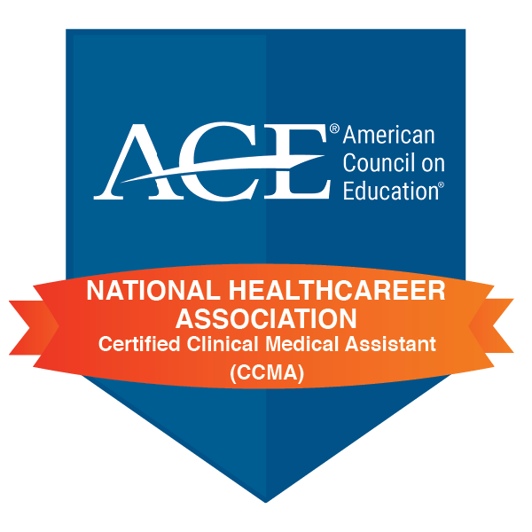

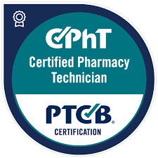
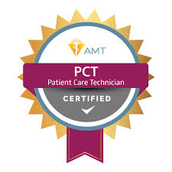
No pathway established?
Pick a pathway with your knowledge base!
  You want to be happy and enjoy what you are teaching.
  You are the expert in that area, so that will be good for the students and you can relate
Pick a pathway in which you can teach the certification!
  Here is just what I know about the ones we have tried to add or added. So this is just what I know, there are more options.
    CCMA – Health science technology certified or a nurse
    Pharmacy tech - Health science technology certified or a nurse
    Patient Care tech - Health science technology certified or a nurse
    EMT, you have to be an EMT or a Paramedic.
    CNA, you have to have 3 years of nursing experience in a nursing home (this is a tough one, especially if the teacher leaves, you must still meet this requirement)

Slide 7


Pathway established, now what?
How many teachers are teaching classes in the Health Science Pathway?
Are science teachers helping with some of the load?
OR
You are it!

Slide 8

Yeah, I have some help!
Thanks Science teachers!!!!
What are they teaching?
  Anatomy & Physiology and Medical Micro Biology?
    This is the most common, if not happening, reach out to principle and see if they can!
    This also depends on your school size usually
      At a large school, this is usually already being taught by science teachers
      At a small school…..lucky you, it’s probably you too. See next slide.
Talk to these people, talk to them about their YAG and what they are covering.
  How deep are they diving into certain topics
  Try not to be doing the same activities over the same topics
    Yes, there will be overlapping of information, just make the things you do different, help them learn all the things
Notes:
Get to know your science teachers, collaborate if possible! Invite them to come to this conference next year!
The science teachers that I have taught with and are teaching these classes in the pathway have all told me they benefited greatly from coming to THOA to see how it all fits together.

Slide 9

It’s just me!!!!
Take a deep breathe, you got this!
  I have been there with the all 6 preps in one year!
    It sucks, but do the best you can, your school knows it’s just you and they are glad to have you and the CTE possibilities you now bring
      You bring funding!!!
See what curriculum there is already in place or where to find it.
  I have been at a school that has nothing and I came up with everything
    Ask if you can look into getting with some publisher or company
      Check out all the folks out in the vendor booths and go to their sessions.
        Some will give you limited access to see what they have, which is really nice
  There is something in place, if you don’t know how to use it, ask the school to get you a meeting with the publisher or company and learn how to use/access all the things.
    Those places want to keep your school, and they will want you to be happy so that you tell your school to keep them
Notes:
Take advantage of THOA and check out what is out there. ICEV, G-W, SAVVAS, NHA, Cengage, etc,
I know I am missing several these are the ones that came to mind when I wanted to name a few.

Slide 10

Look at the certifications you want to offer and when in the pathway
Certifications equal money for your school district, keep that in mind

Slide 11
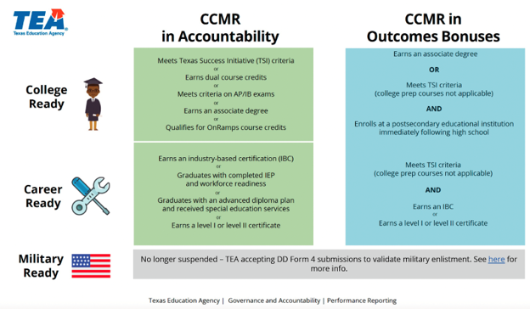
CCMR COMPLETE
It is about being CCMR (College, Career, and Military Readiness ) complete
  A CTE student who has met the requirements in the CTE pathway
    A student who has successfully completed three or more CTE courses, totaling four or more credits, including at least one advanced-level (level 3 or 4) course within a single program of study, according to the Texas Education Agency (TEA)

Slide 13

We know not all students are going to college!
  Get student prepared for a job after graduation! Get that IBC – Industry Based Certification!
    This is where funding comes in based on students who pass the certification exam
      IBC equals more money
        This is what pays your salary basically

Slide 14
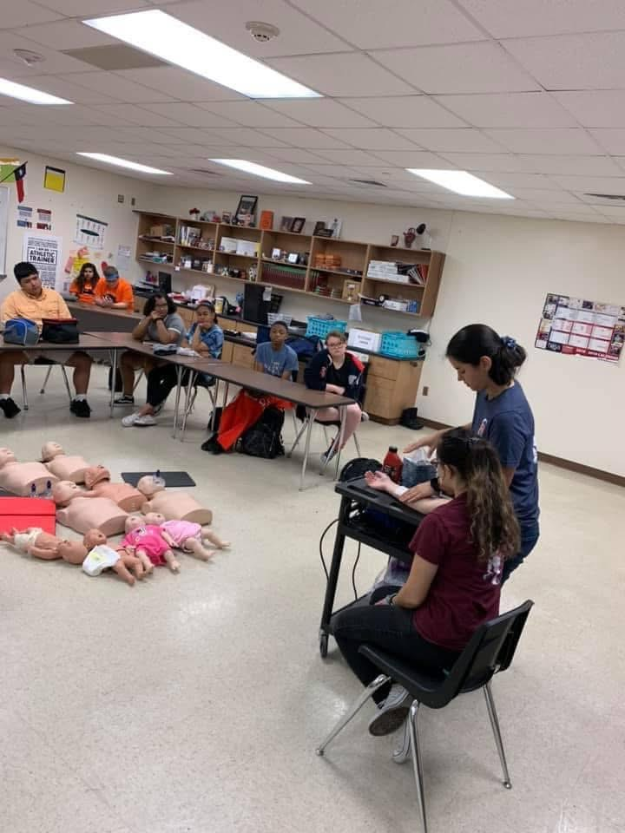
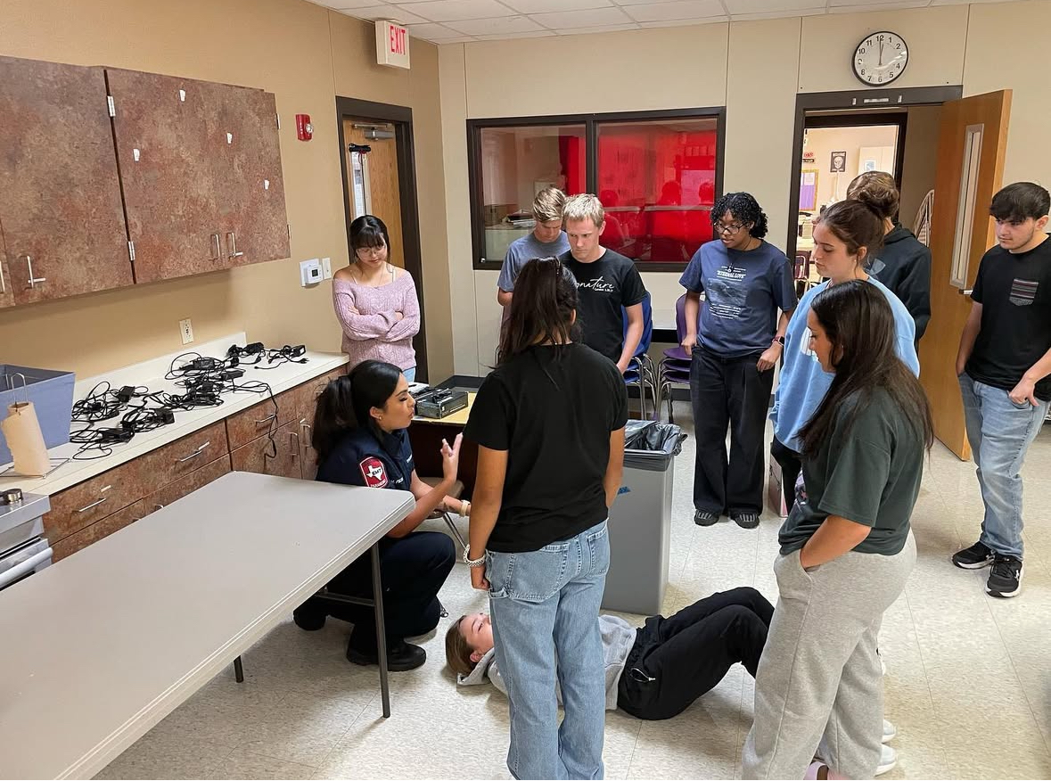
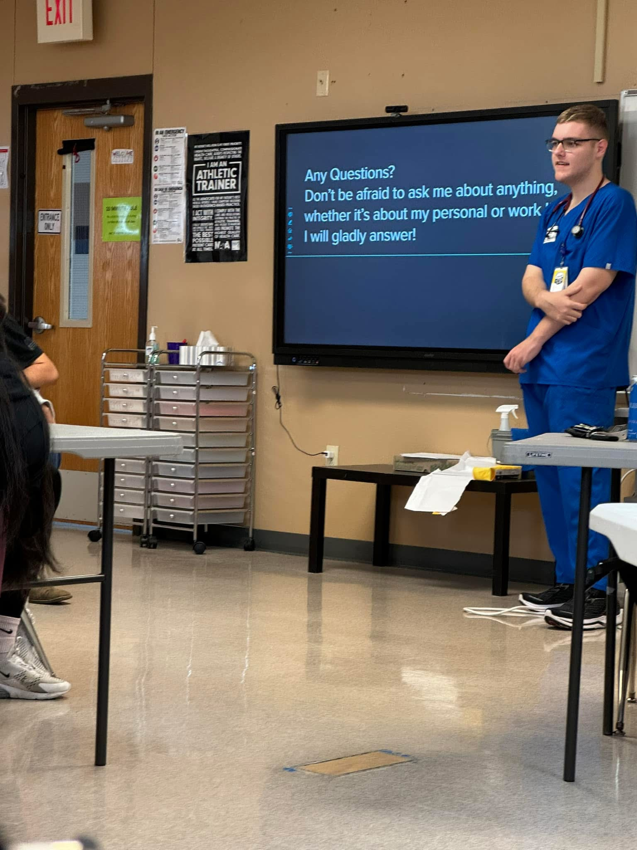
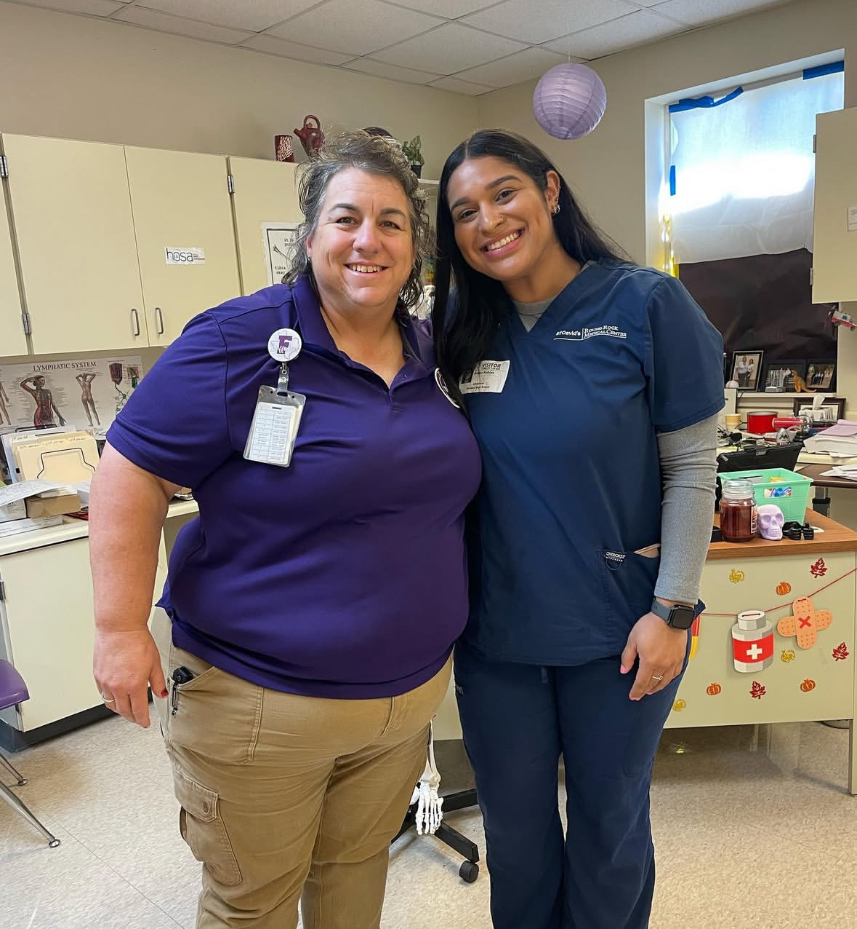
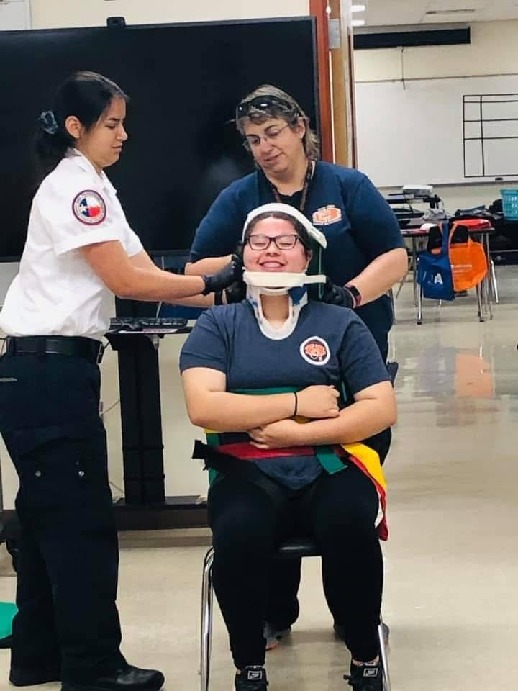
We know not all students are going to college!
  I have so many students that have joined the workforce and not gone to college.
    Bring them back as guest speakers
      They made the best guest speakers and help with recruiting

Slide 15

Let’s get started on what to do now that you know who all the players are and what certification(s) you have.
Lesson plan your way –Yes I said that out loud
  You need to have a way you can make sense of things.
  Yes your school will have you doing this, mine are due every Monday by 8 am.
    Once you have your plan your way, you can cut and paste to make them happy.
      Make sure you put something there, otherwise you get an email
        Some people look, especially if you don’t put something there. As long as you get it in on time, they will proably leave you alone. But make sure it makes some sense so if they check
Depending on how many preps you have, have a calendar where you can see all your preps at one time.
  Plan so that you aren’t kicking your butt with lots of work all day.
  Don’t spread yourself so thin in a day, that you are exhausted by lunch
  It’s okay to teach the same thing in a day, just change the rigor to the class being taught.

Slide 16

Be organized
If you are revamping or starting a program, you have to be organized
Organization will save your mental health and save you time
Don’t plan labs all day for all the classes, you will be crazy tired even before lunch.
It’s okay to have a mental health day/catch up day in one subject with a crazy schedule in another subject.
  My students love mental health/catch up day.
    In your lesson plan, label it as such and then explain it is a catch up day for that weeks work. Just don’t let them be on their phones. LOL.
      I have games available, many they are health related so that they are working on teamwork and communication.

Slide 17

Things I found helpful
Ask to go to another school and check out their set-up
Ask to go to or have another teacher who has started or revamped a program
  Make contact with some one and pick their brain, it will help with
Facebook
  THOA page
    This has been a life saver!!!
    People are quick to answer your questions
    The file has many useful resources, tools, tips and tricks
  Specific pages for your certifications too!
THOA drive
  Folders for the many subjects and ones with resources for all classes.

Slide 18

You got this and you can do it!
Make sure you work with your principal and your CTE director
  This could be 2 people or the same person
    Depends on your school, I have had both
Be honest with your Admin and your students.
  Let the admin know you need a day for planning if need be

Slide 19

This Photo by Unknown Author is licensed under CC BY

Slide 20

Misty Overfelt
mistyhoodoverfelt@gmail.com

Slide 21
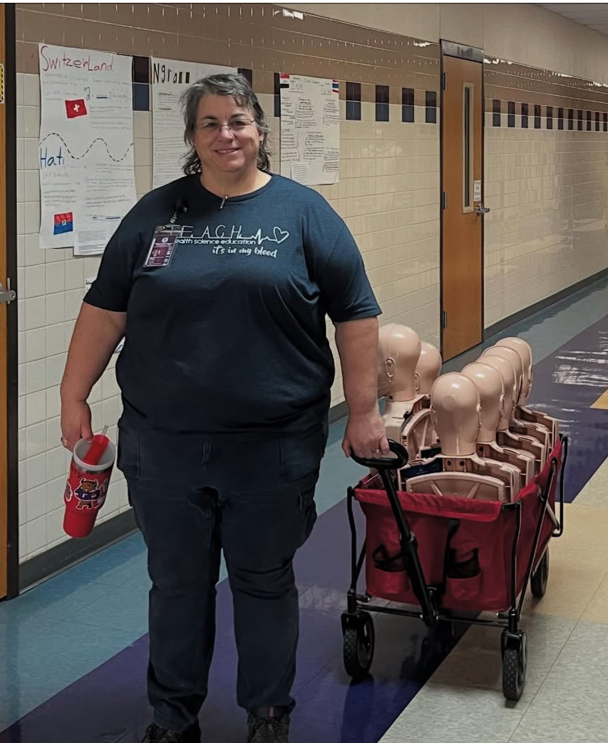
Contact information
Misty Overfelt
mistyhoodoverfelt@gmail.com
Feel free to email me, no matter if this is your first year or 20 plus year.

