Slide 1
What’s New at Carolina?
THOA Conference 2025

Slide 2
What’s New Overview
Introduction
Free Resources
New & Featured Products
Support
Q&A
2

Slide 3

Introduction
Sarah Knotts
Product Manager
Anatomy, Physiology, & Allied Health

Slide 4
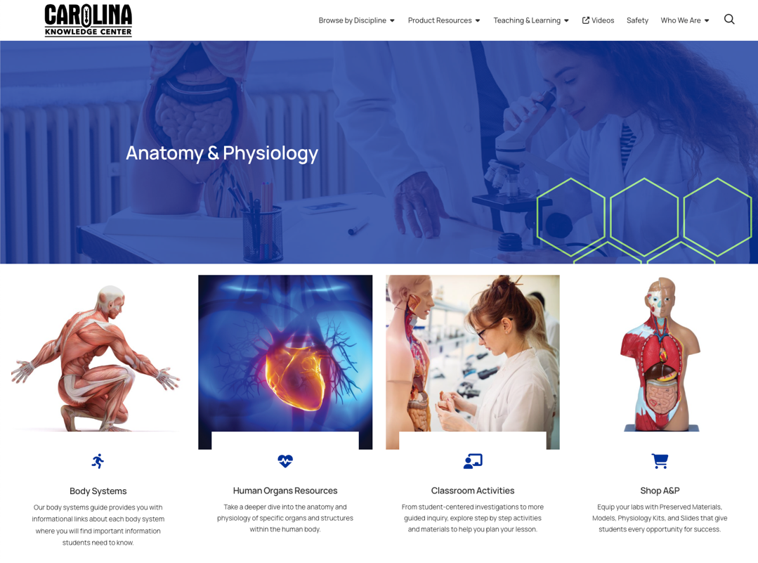

Free Resources

Slide 5
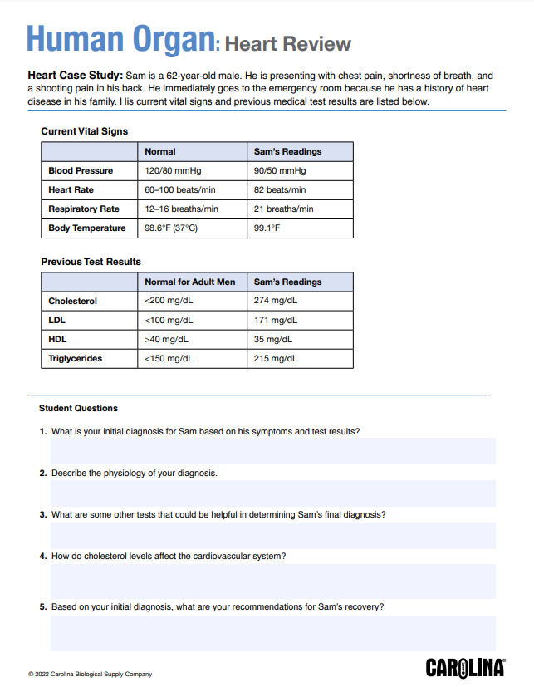
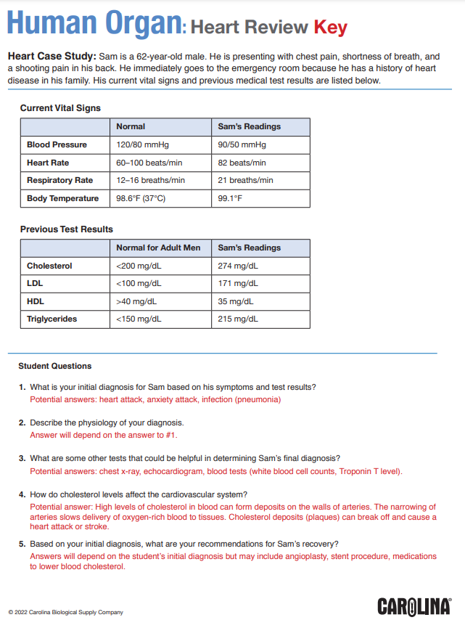
Free Resources: Introduce
Health-focused case study
Instructor answer key
5
5

Slide 6
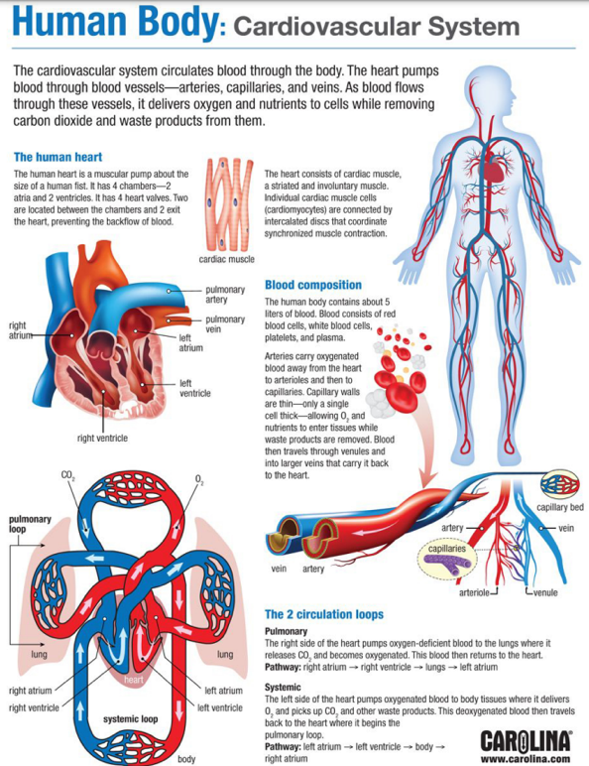
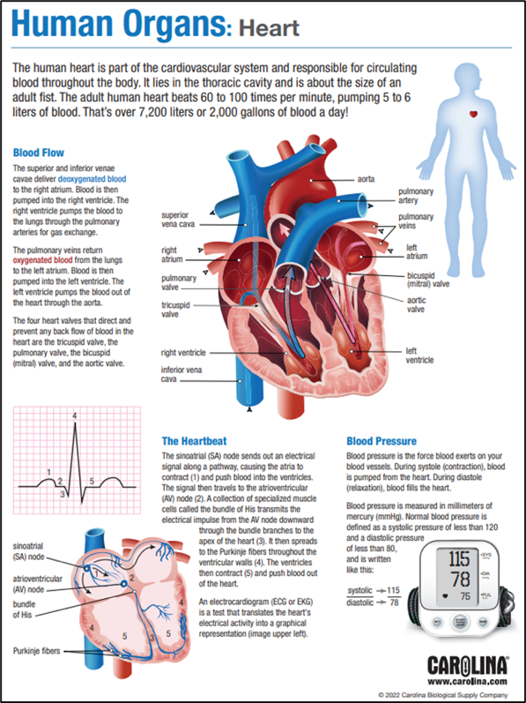
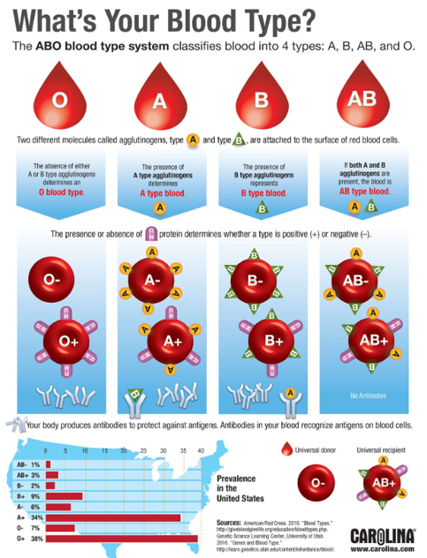
Free Resources: Reinforce
Clear, concise infographics
6
6

Slide 7
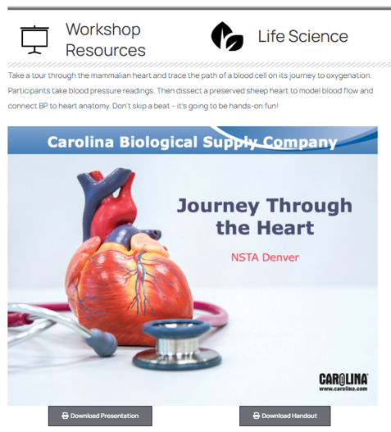
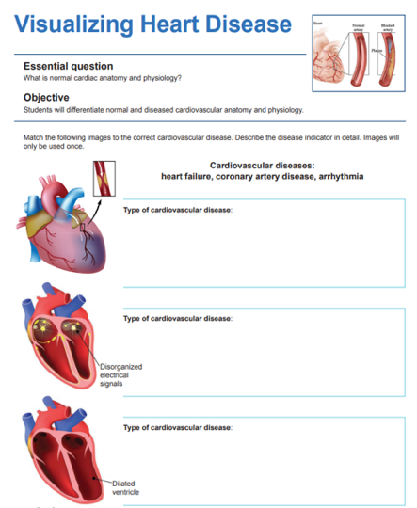
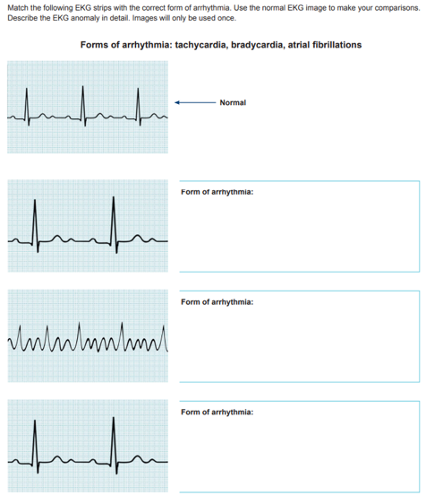
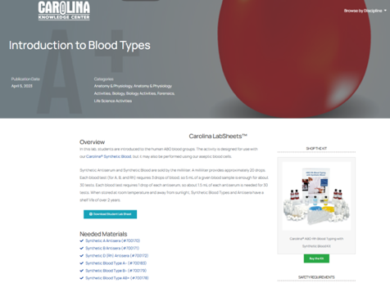
Free Resources: Reinforce
Engaging student activities
7
7

Slide 8
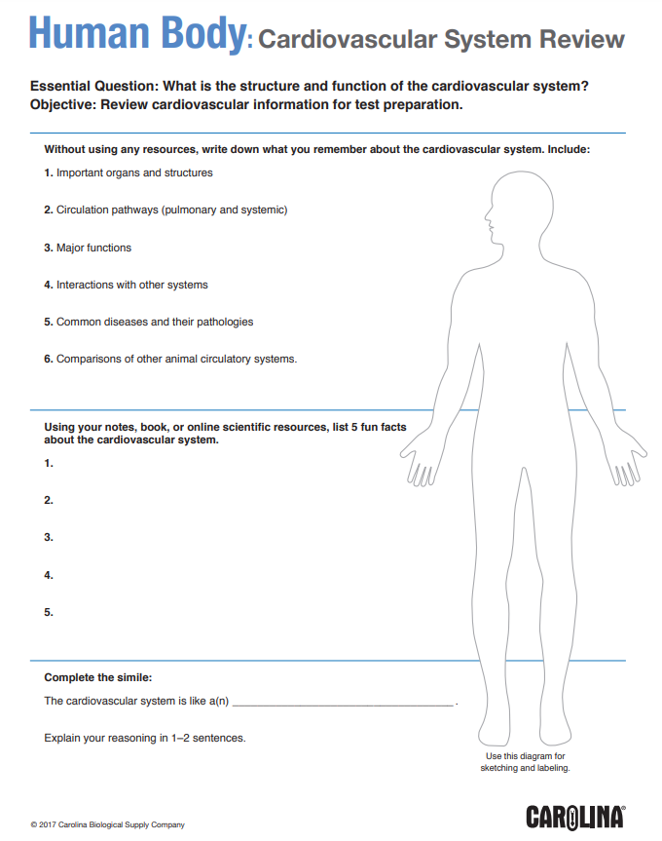

Free Resources: Review
Printable student assessment
All resources available at www.carolina.com/anatomy

Slide 9
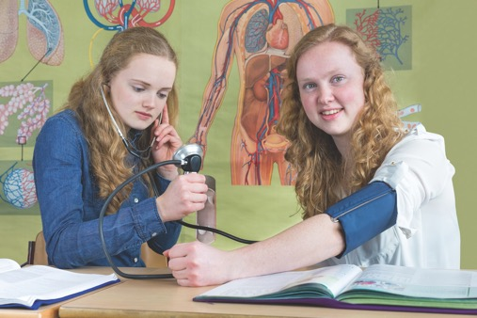
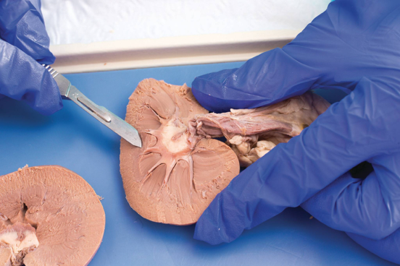

New & Featured Products
Dissection specimens and supplies
Anatomical models
Health science simulators & training devices
Blood typing products
Hands-on kits

Slide 10
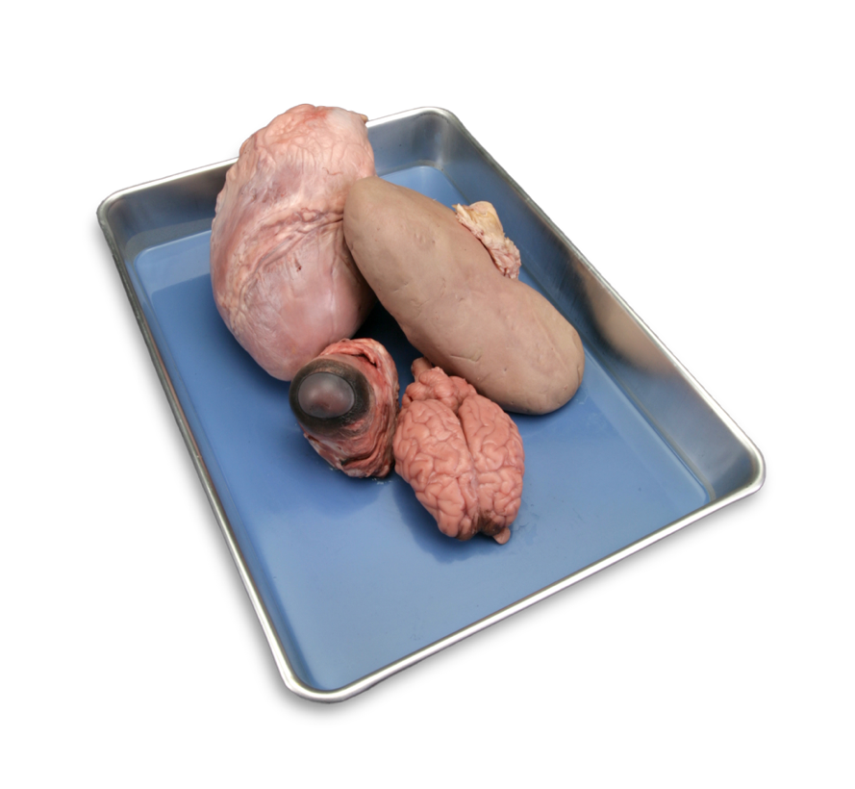
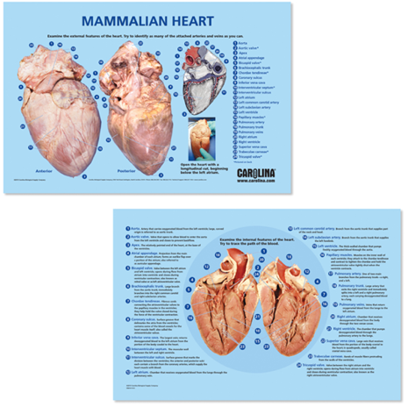
Dissection
Dissection Options
  Specimen
    Hearts (sheep, pig, cow)
    Brains
    Eyes
    Kidneys
    Sheep plucks
  Fixatives
    Carolina’s Perfect Solution®
    Formalin
  Package Types
    Vacuum sealed bag (1 per bag or bulk)
    Pail
  Supplies
    PPE
    Equipment
    Dissection mats, manuals, e-books

Slide 11
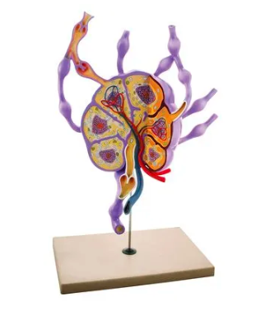
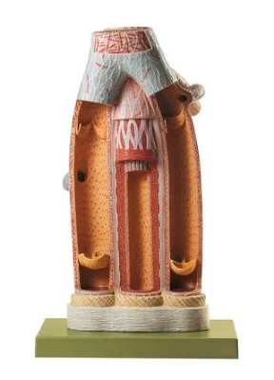
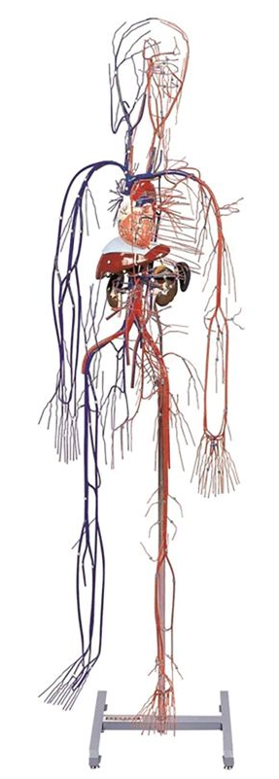
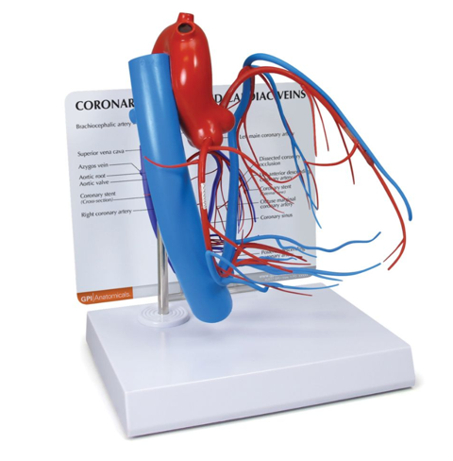
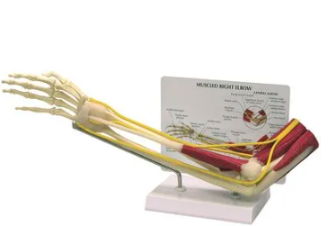
Anatomical Models
Wide variety
Anatomically accurate
Brands for every budget
Durable for years of use

Slide 12
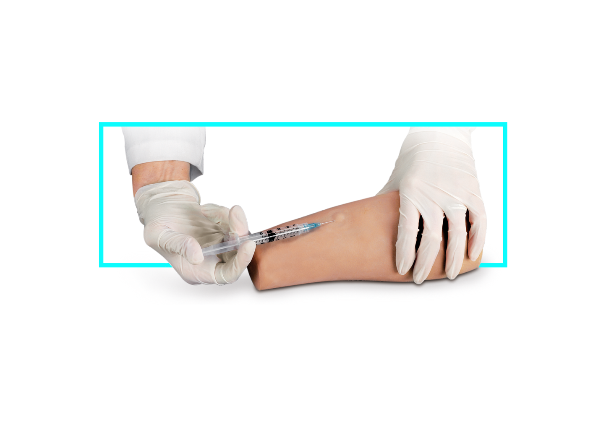
Health Science Simulators
Cutting-edge technology
Life-like medical situations and experiences
Controlled settings
Practice procedures, diagnose conditions, and collaborate

Slide 13
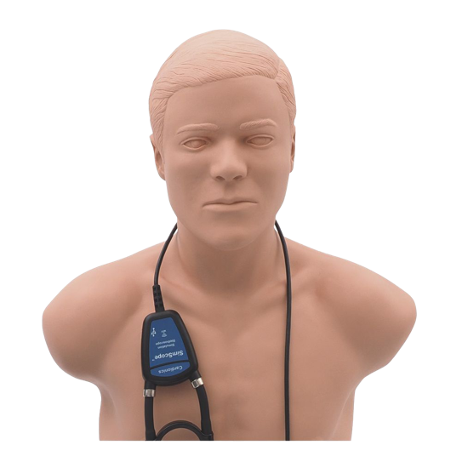
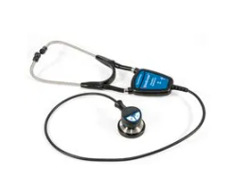
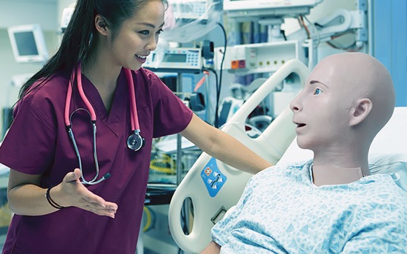
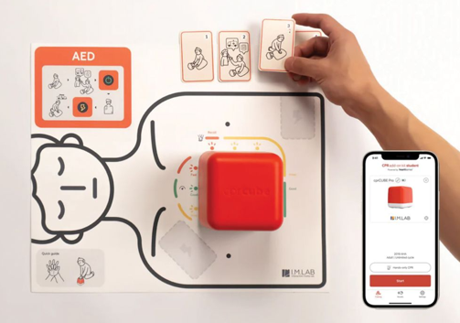

Health Science Simulators & Training Devices
Advanced Simulators
Provide realistic feedback and interactions in a controlled environment.
Nursing and Patient Care
Mimic various patient scenarios and allow students to practice skills and techniques.
Emergency
Used to practice the vital training needed to respond to critical situations.

Slide 14
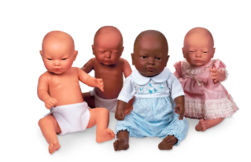
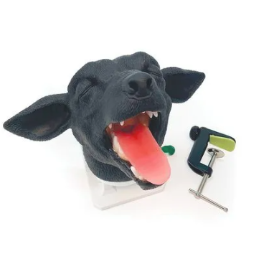
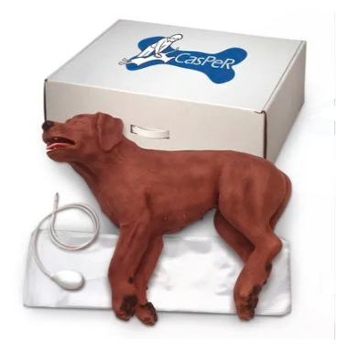
Health Science Simulators & Training Devices (cont.)
Parenting and Child Development
Provide safe environment to learn and practice valuable caregiving skills.
Veterinary
Valuable training experienced for veterinary technicians, nurses, and veterinarians.
Practice skills unique to the healthcare needs of animals.

Slide 15
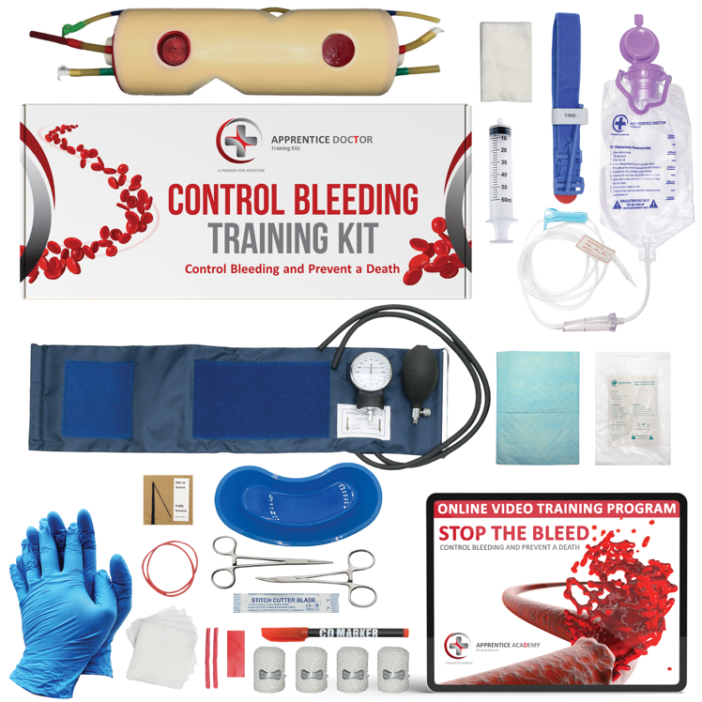
The Apprentice Doctor® Simulation Kits
Medical simulation practice
kits paired with online courses
Enables aspiring medical professionals
to master procedures like suturing, venipuncture, controlling bleeding, aseptic techniques, and orthopedic procedures
Online academy courses are divided into sections, each containing a teaching lesson followed by one or more practical projects

Slide 16

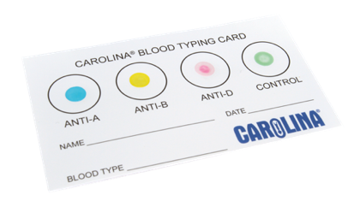
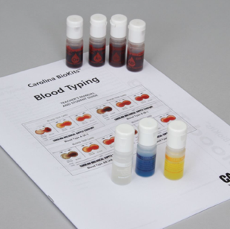
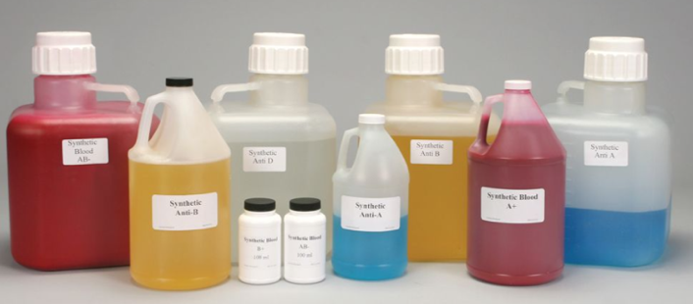
Blood Typing
Synthetic blood
Realistic blood typing results with no risk of transmitting blood borne disease.
Blood Typing Cards
Eldoncards
Carolina® Blood Typing Cards
Aseptic Red Blood Cells
Use real blood in your class while minimizing the risk of disease transmission associated with lancets and drawing blood.

Slide 17
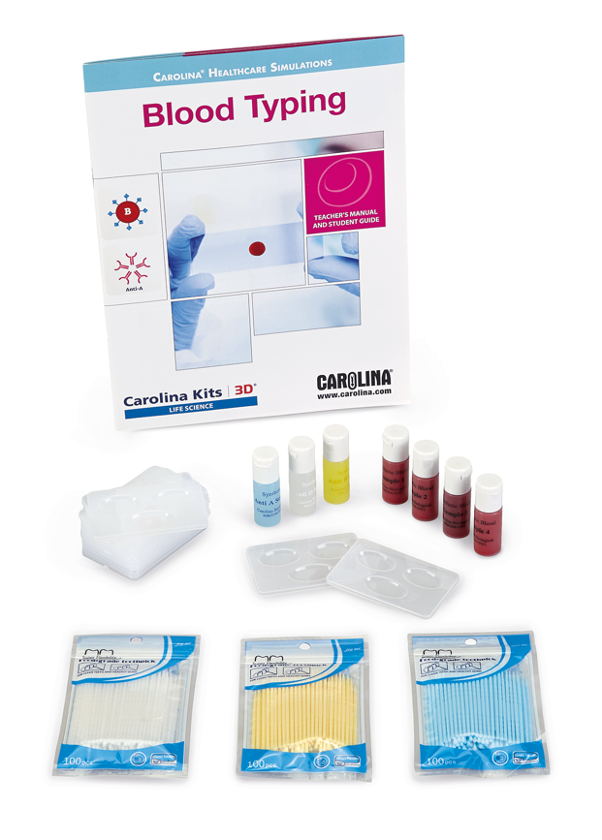
Carolina® Healthcare Simulations Series
Students practice clinical skills, techniques, and procedures
Simulations include a case study that provides students with background information about a patient who presents with relevant symptoms
Currently offering 5 kit options
  Blood Hematocrit Kit
  Blood Glucose Kit
  Blood Typing Kit
  Vital Signs Kit
  Urinalysis Kit

Slide 18

Support
Making it Easy
Expert technical support
Dedicated sales representatives
Quote requests for quantity discounts
Shipment scheduling to fit your needs
Multiple ordering options—phone, web, fax, mail
Online shopping lists

Slide 19
Q&A
Any Questions?

Slide 20

Thank You!
Visit Carolina.com/anatomy!
20

