Slide 1
Playing around in class

Slide 2
Ball Toss
Get to know you - questions
Vocabulary - Words
Question and Answer - questions or numbers
Toss the ball around when caught answer/define the one that is closest to right/left thumb
LET’S PLAY

Slide 3
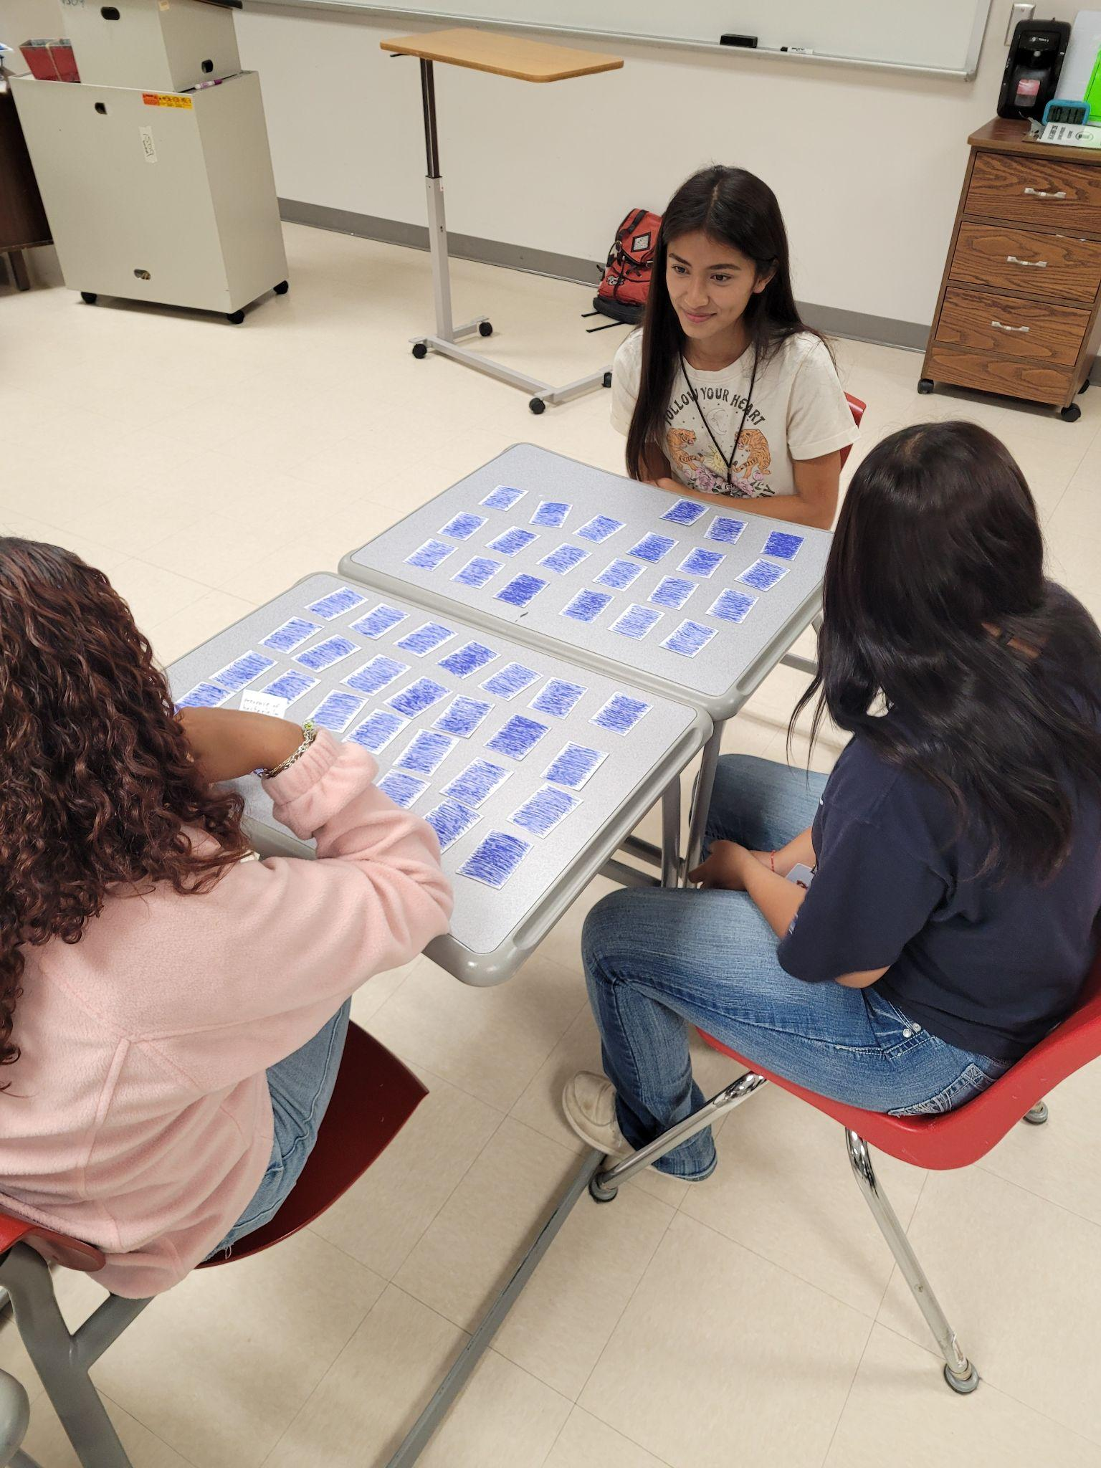
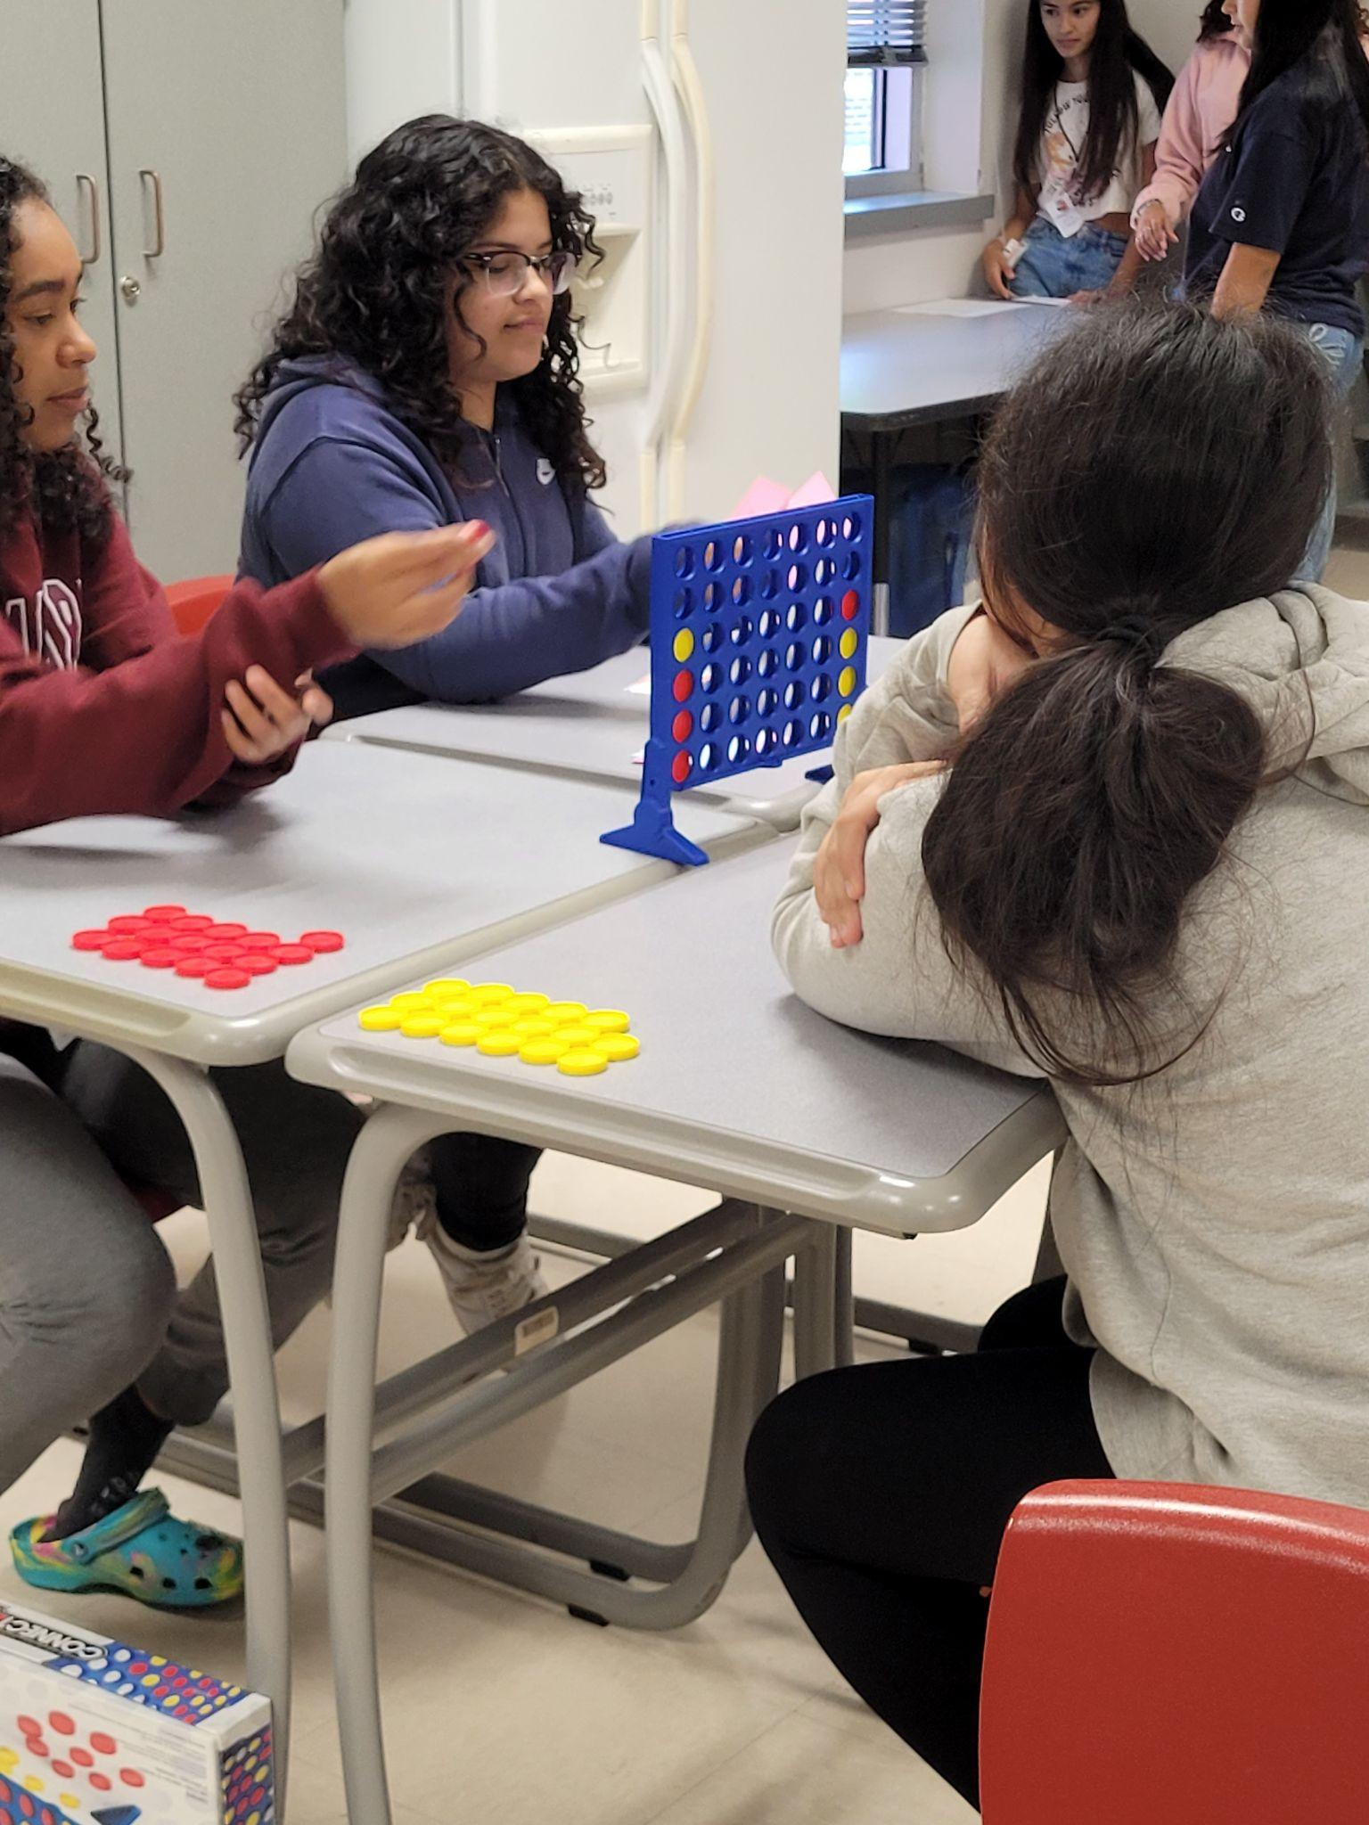
Matching Challenge Connect Four

Slide 4
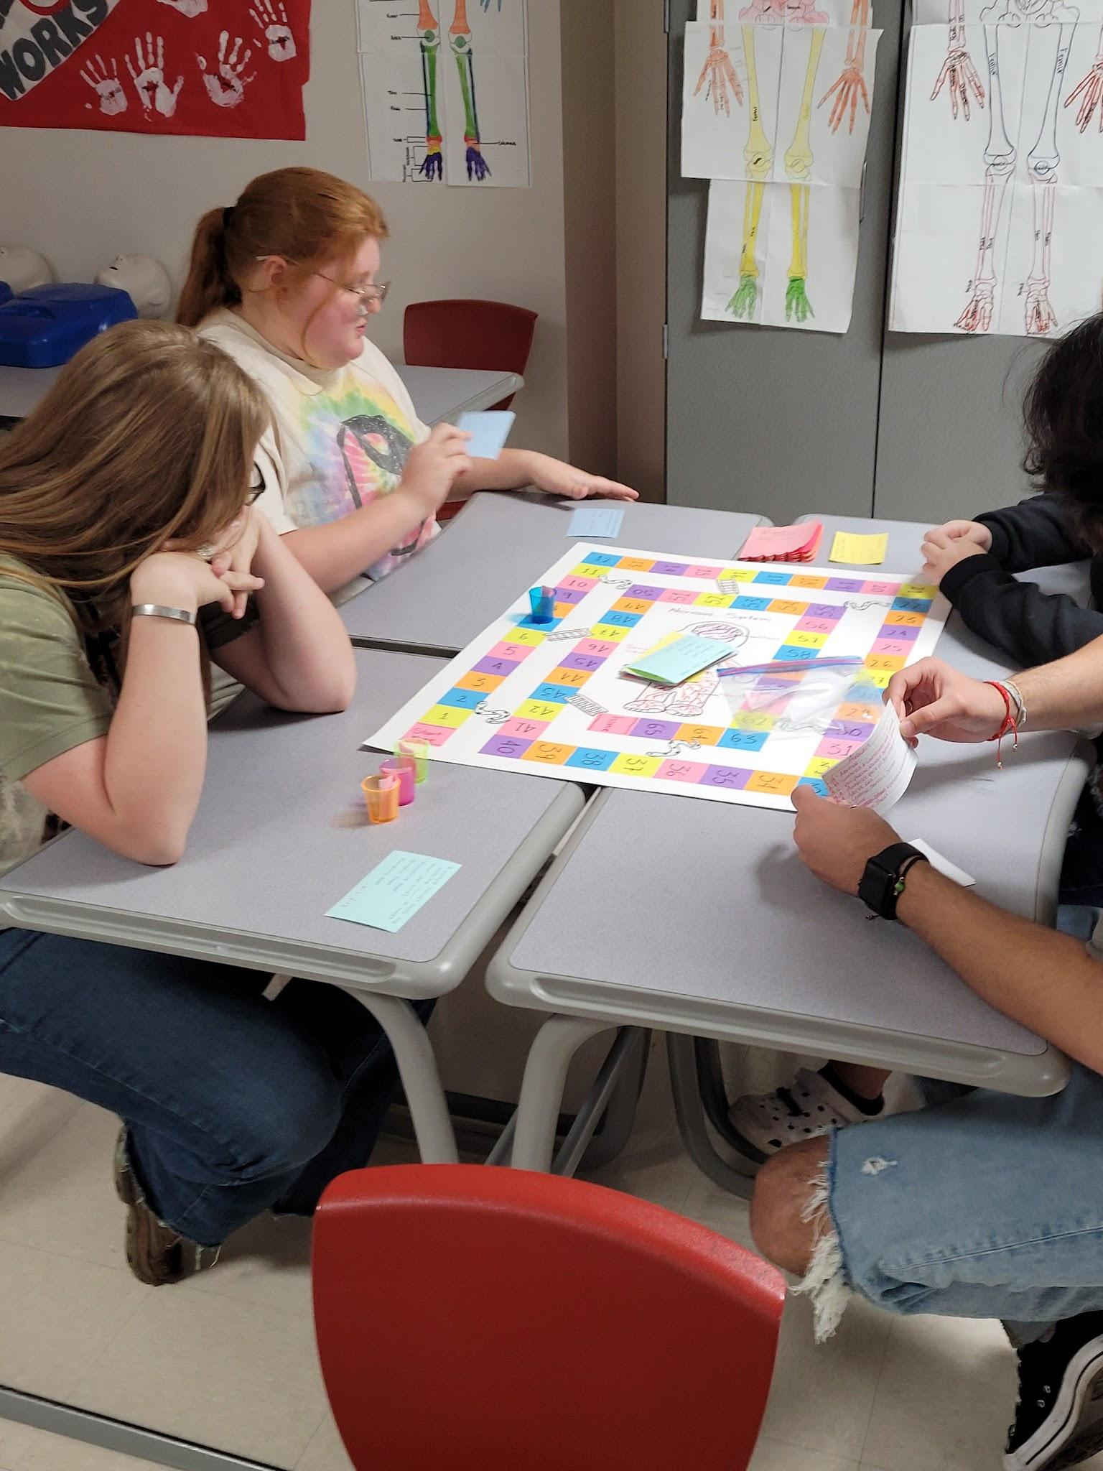
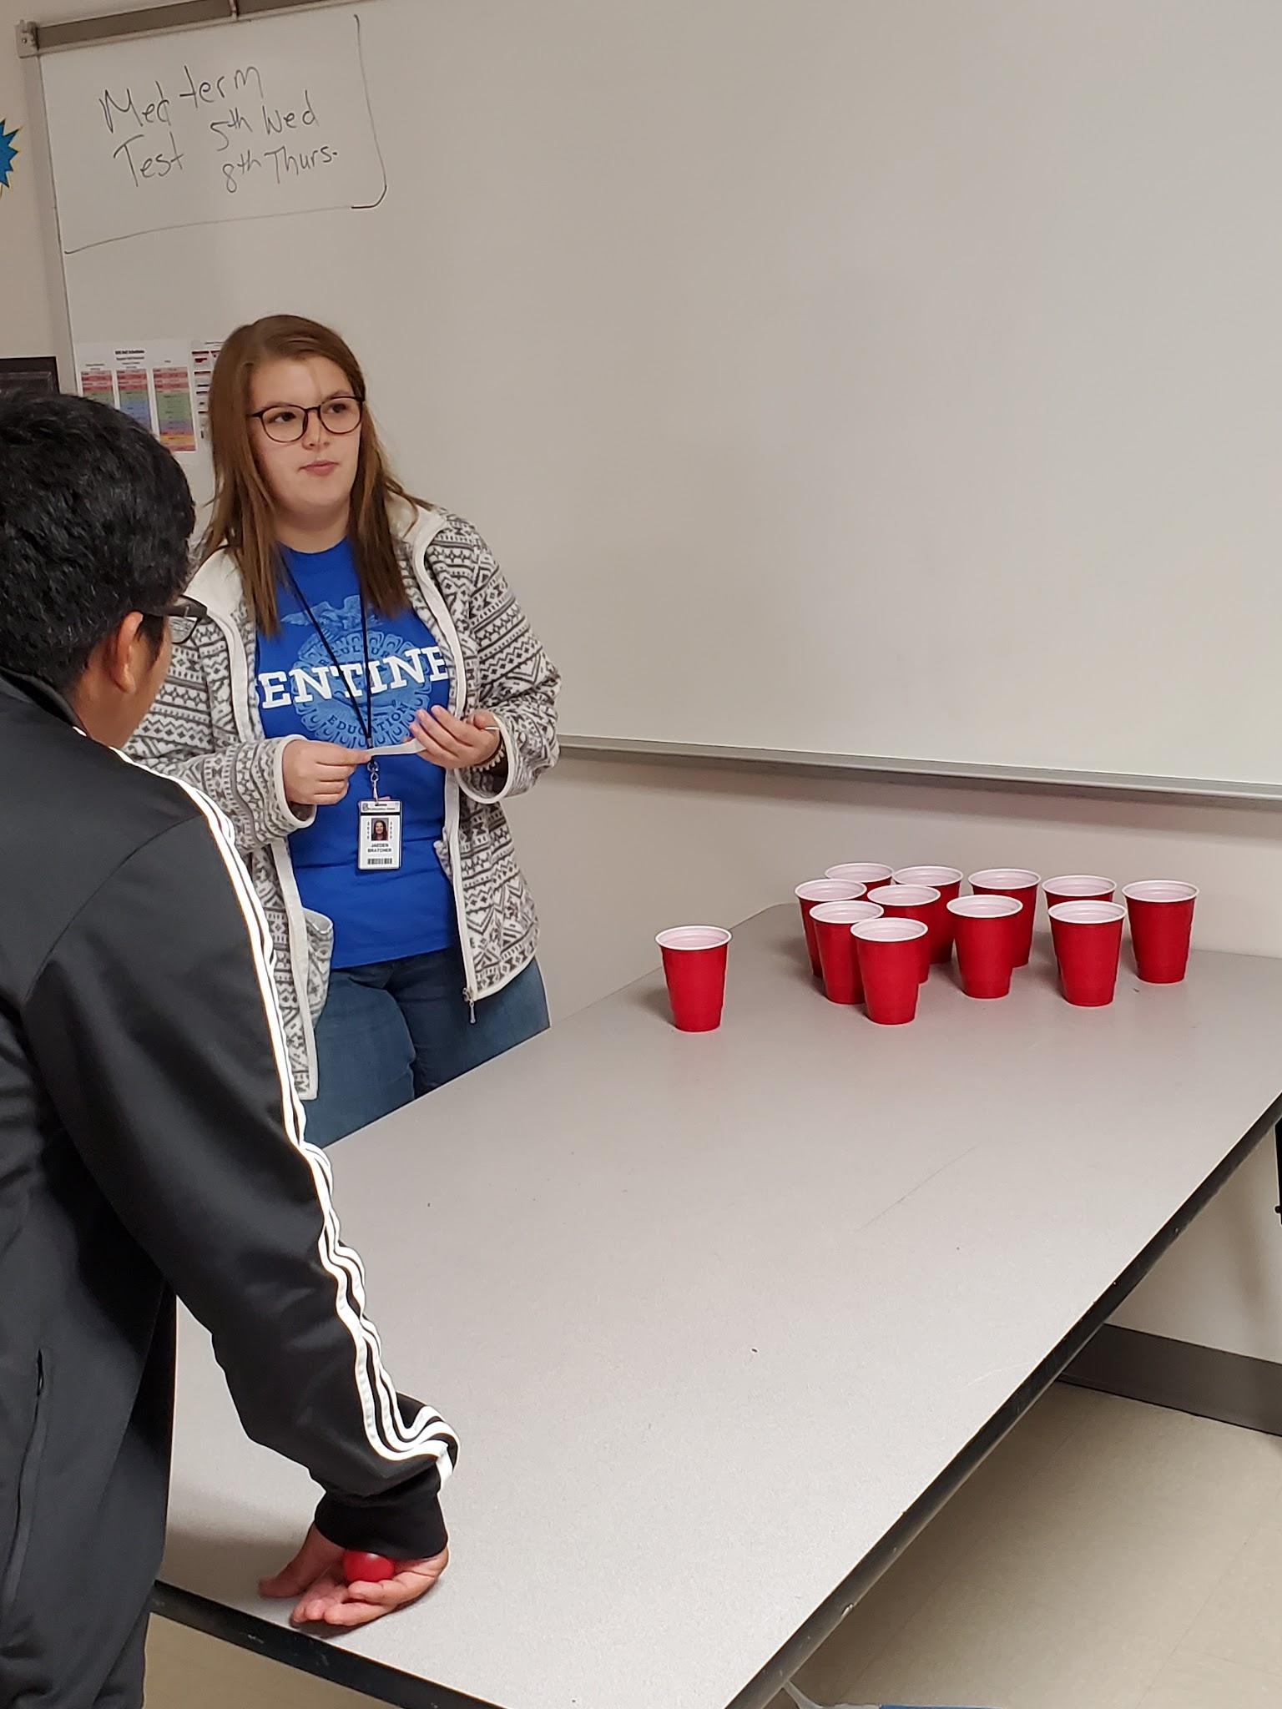
Student Created board game and word pong

Slide 5
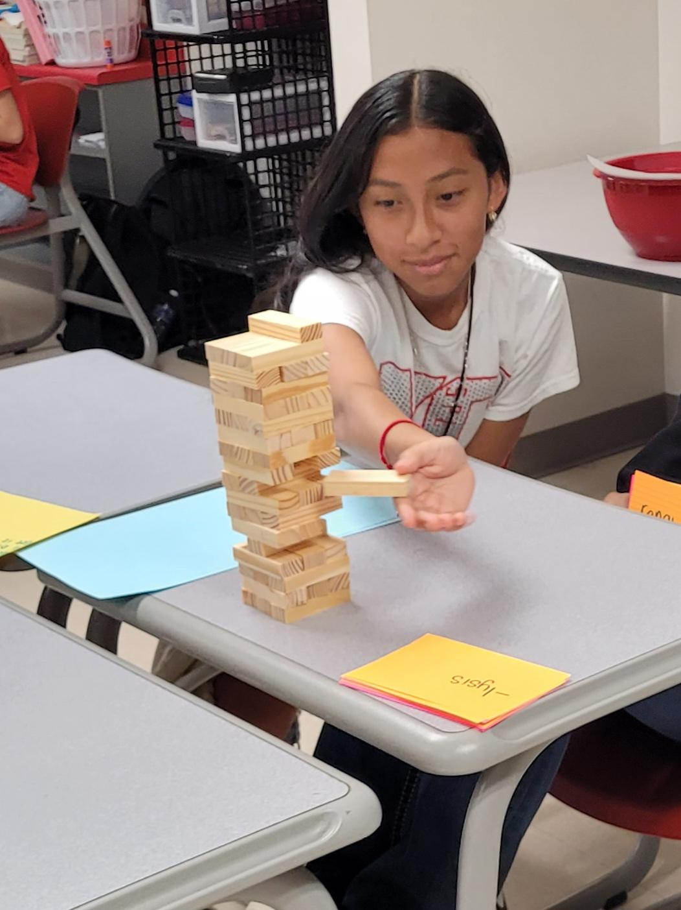
Jenga

Slide 6
Fiddle sticks
Preparation
Take Popsicle sticks and write 1 word or word part on each stick. Randomly place 1 color dot on some of the sticks. See colors below. Leave some blank. I do not provide the definitions so either someone in the group needs to know the answer or look it up. Last choice they ask me. I have them work in groups of 4-6.
https://docs.google.com/document/d/1XAOkAIEfA24G3opaMbp5n78L2LQb9grZE5livxLyZR8/edit?usp=sharing

Slide 7
Directions
Each student on their turn will pull 1 stick
Notify other players if there is a colored dot on the stick ( in the beginning have them state what the colored dot means}
Yellow – If you do not know the definition another player can give definition and steal all your sticks
Green - if you get the definition right you can steal all of the sticks from another player
Red – if you get the definition wrong you put all your sticks back in the cup.
Blue - Define the word part and state a word with the word part and it's definition.

Slide 8
Directions cont
If there is no dot – answer right and you keep the stick. Answer wrong put the stick back in the cup.
Read word part/word and define
If answer is correct or incorrect take the above action
Player with the most sticks at the end WINS

Slide 9
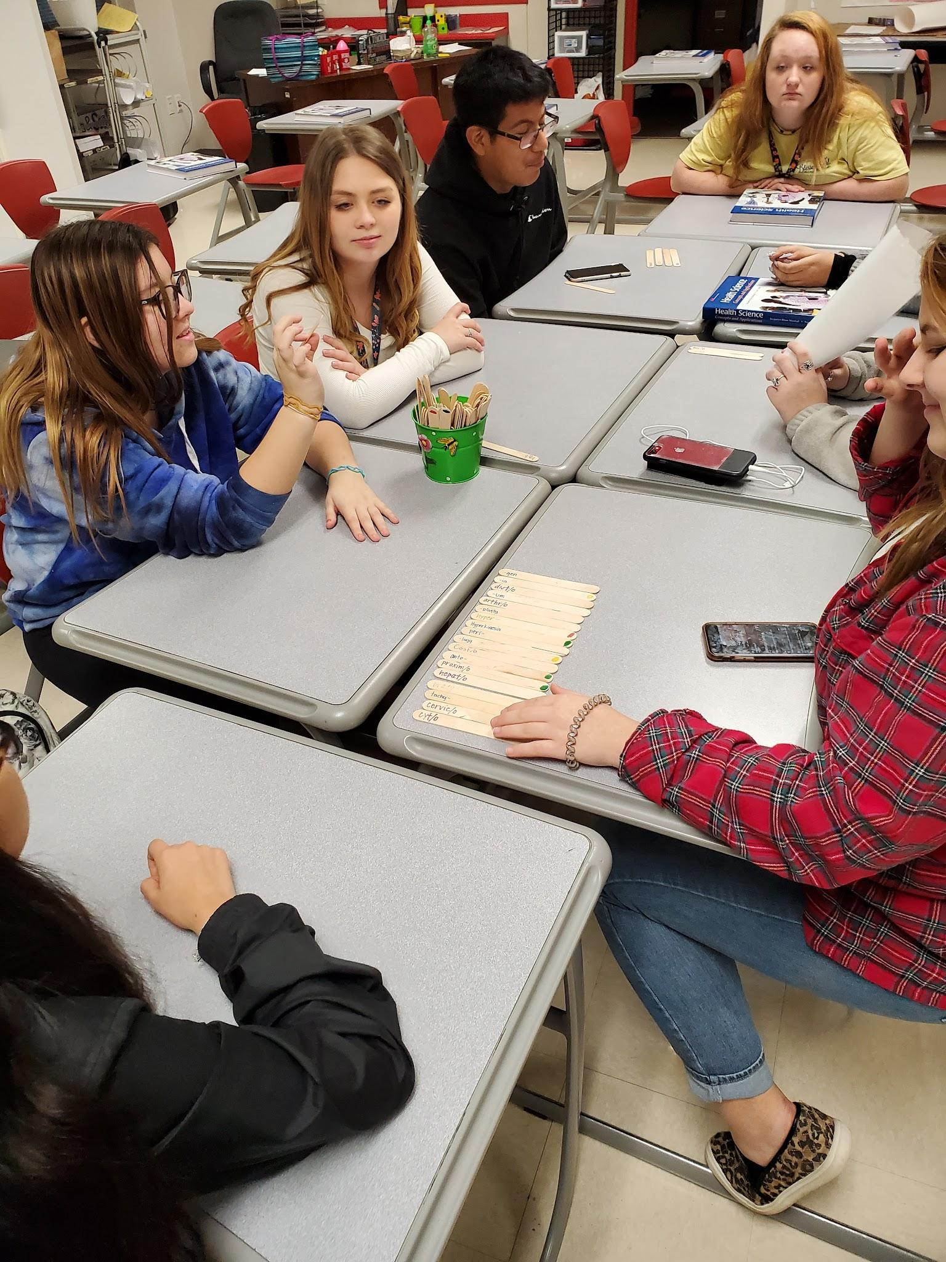
Fiddle Sticks

Slide 10
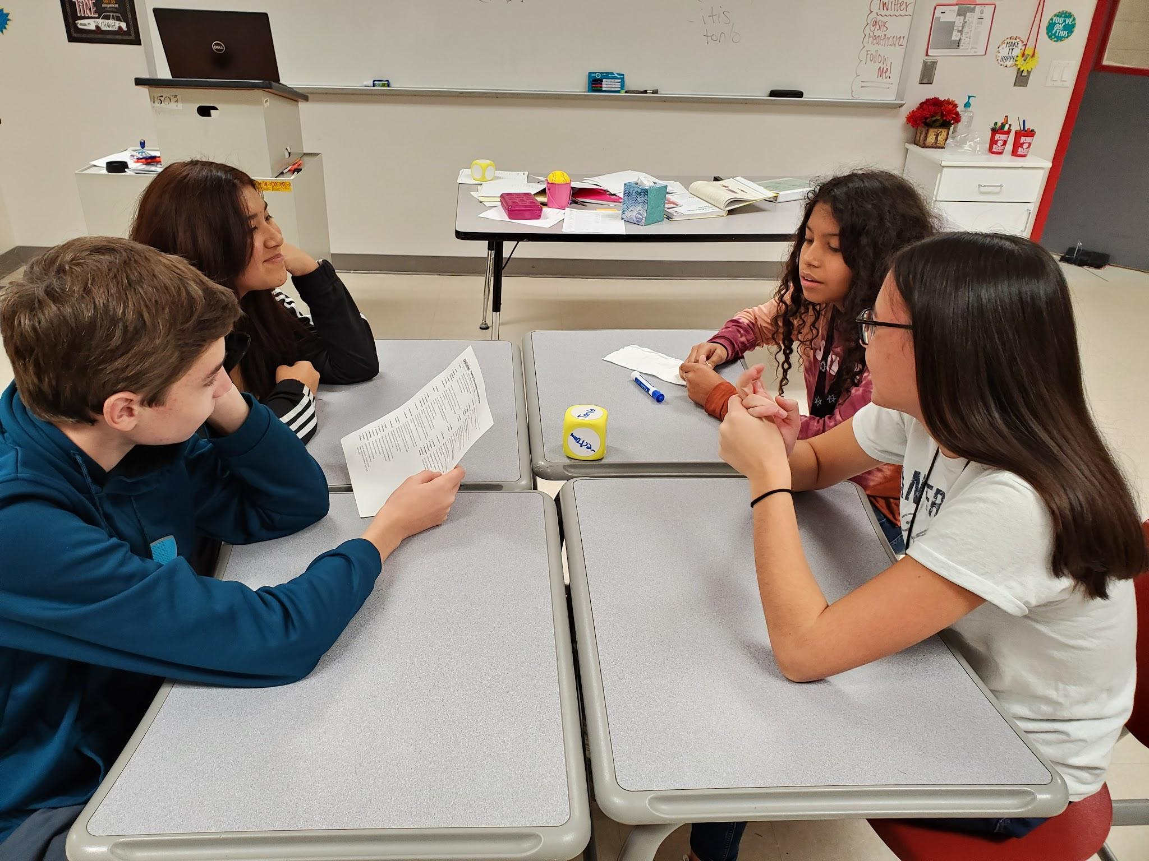
Erasable dice - Suffix on the die - students had to make a word and define it

Slide 11
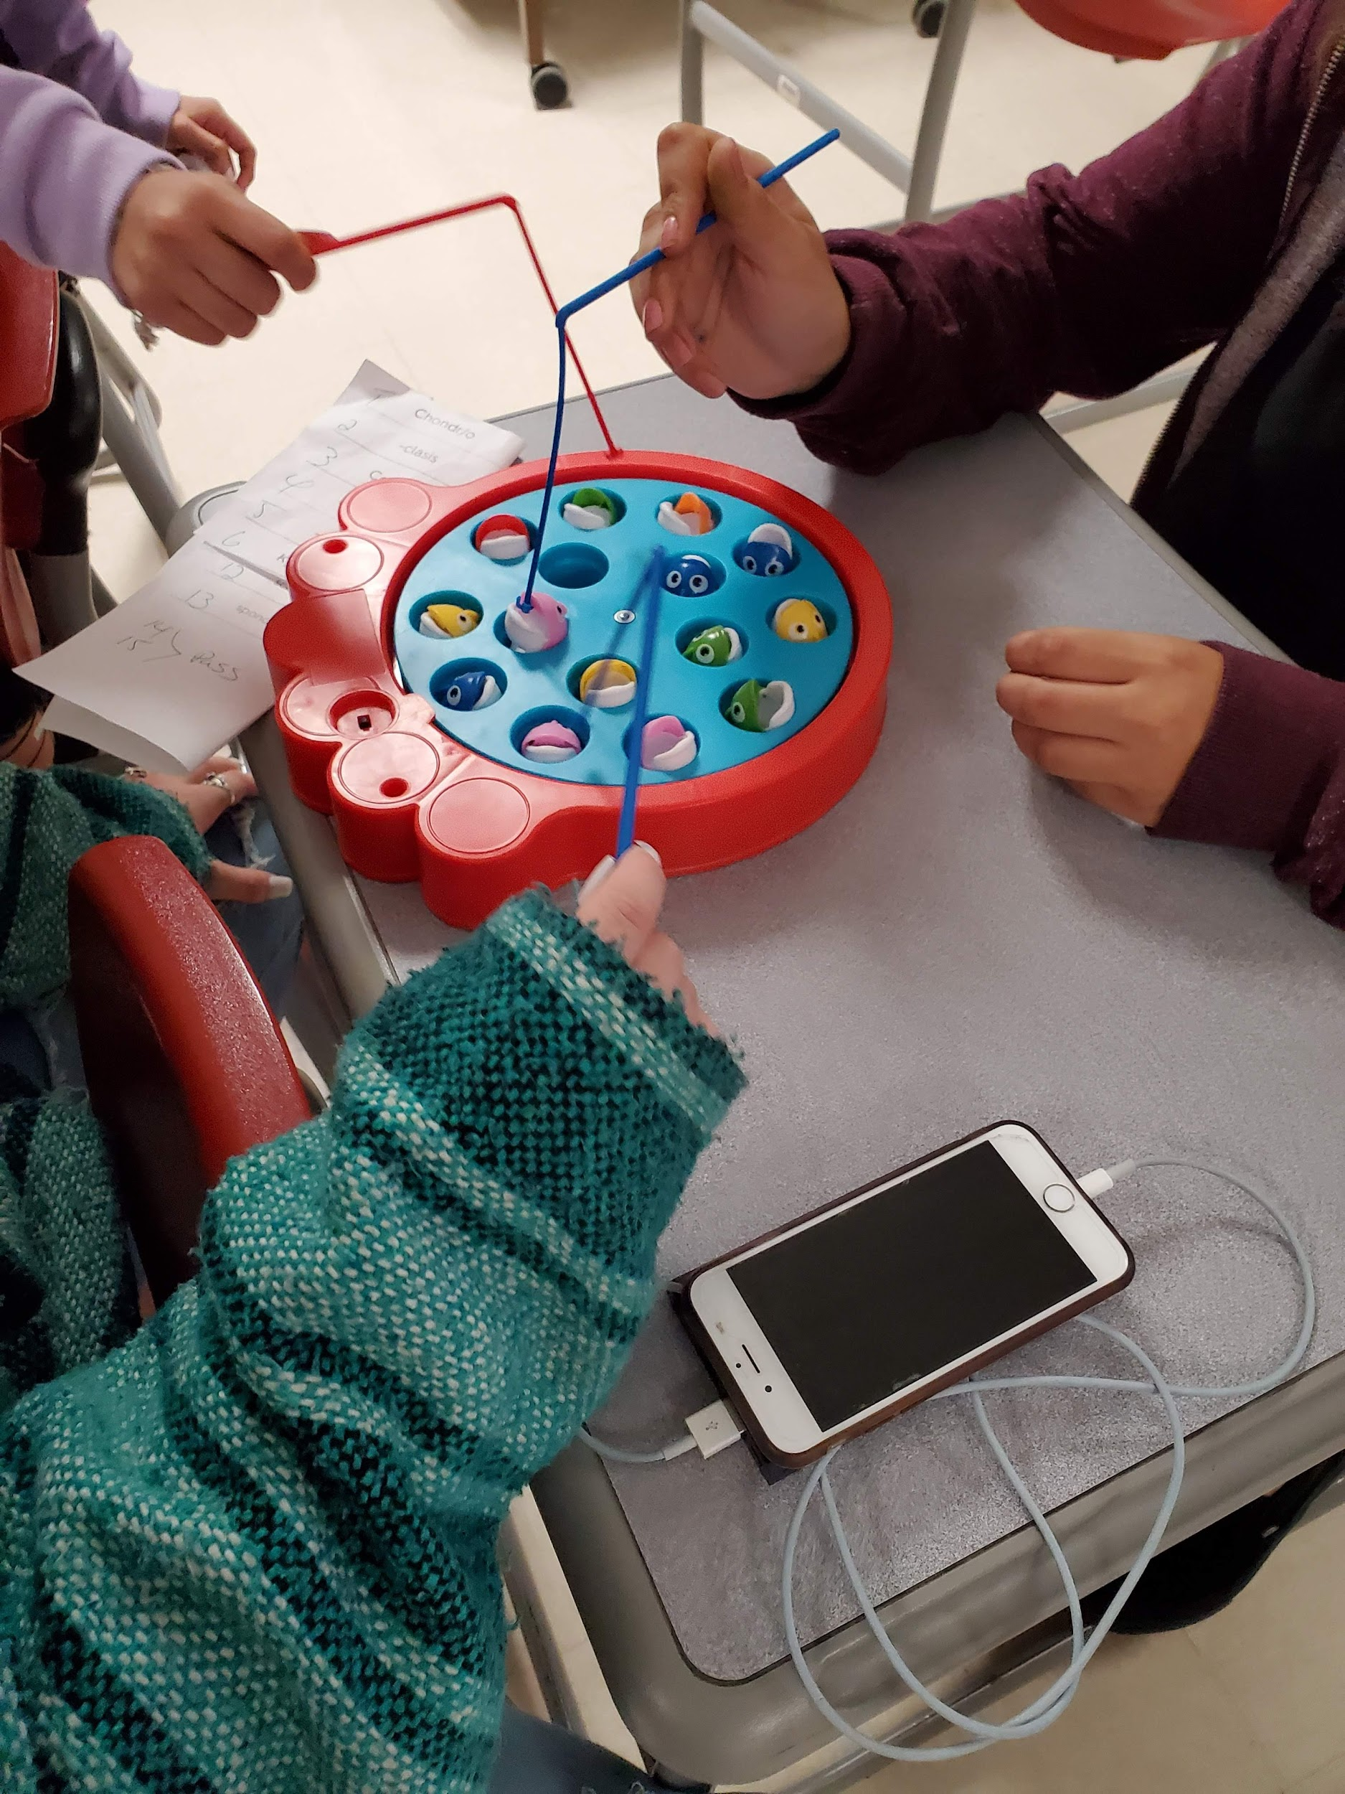
Fishing Game

Slide 12
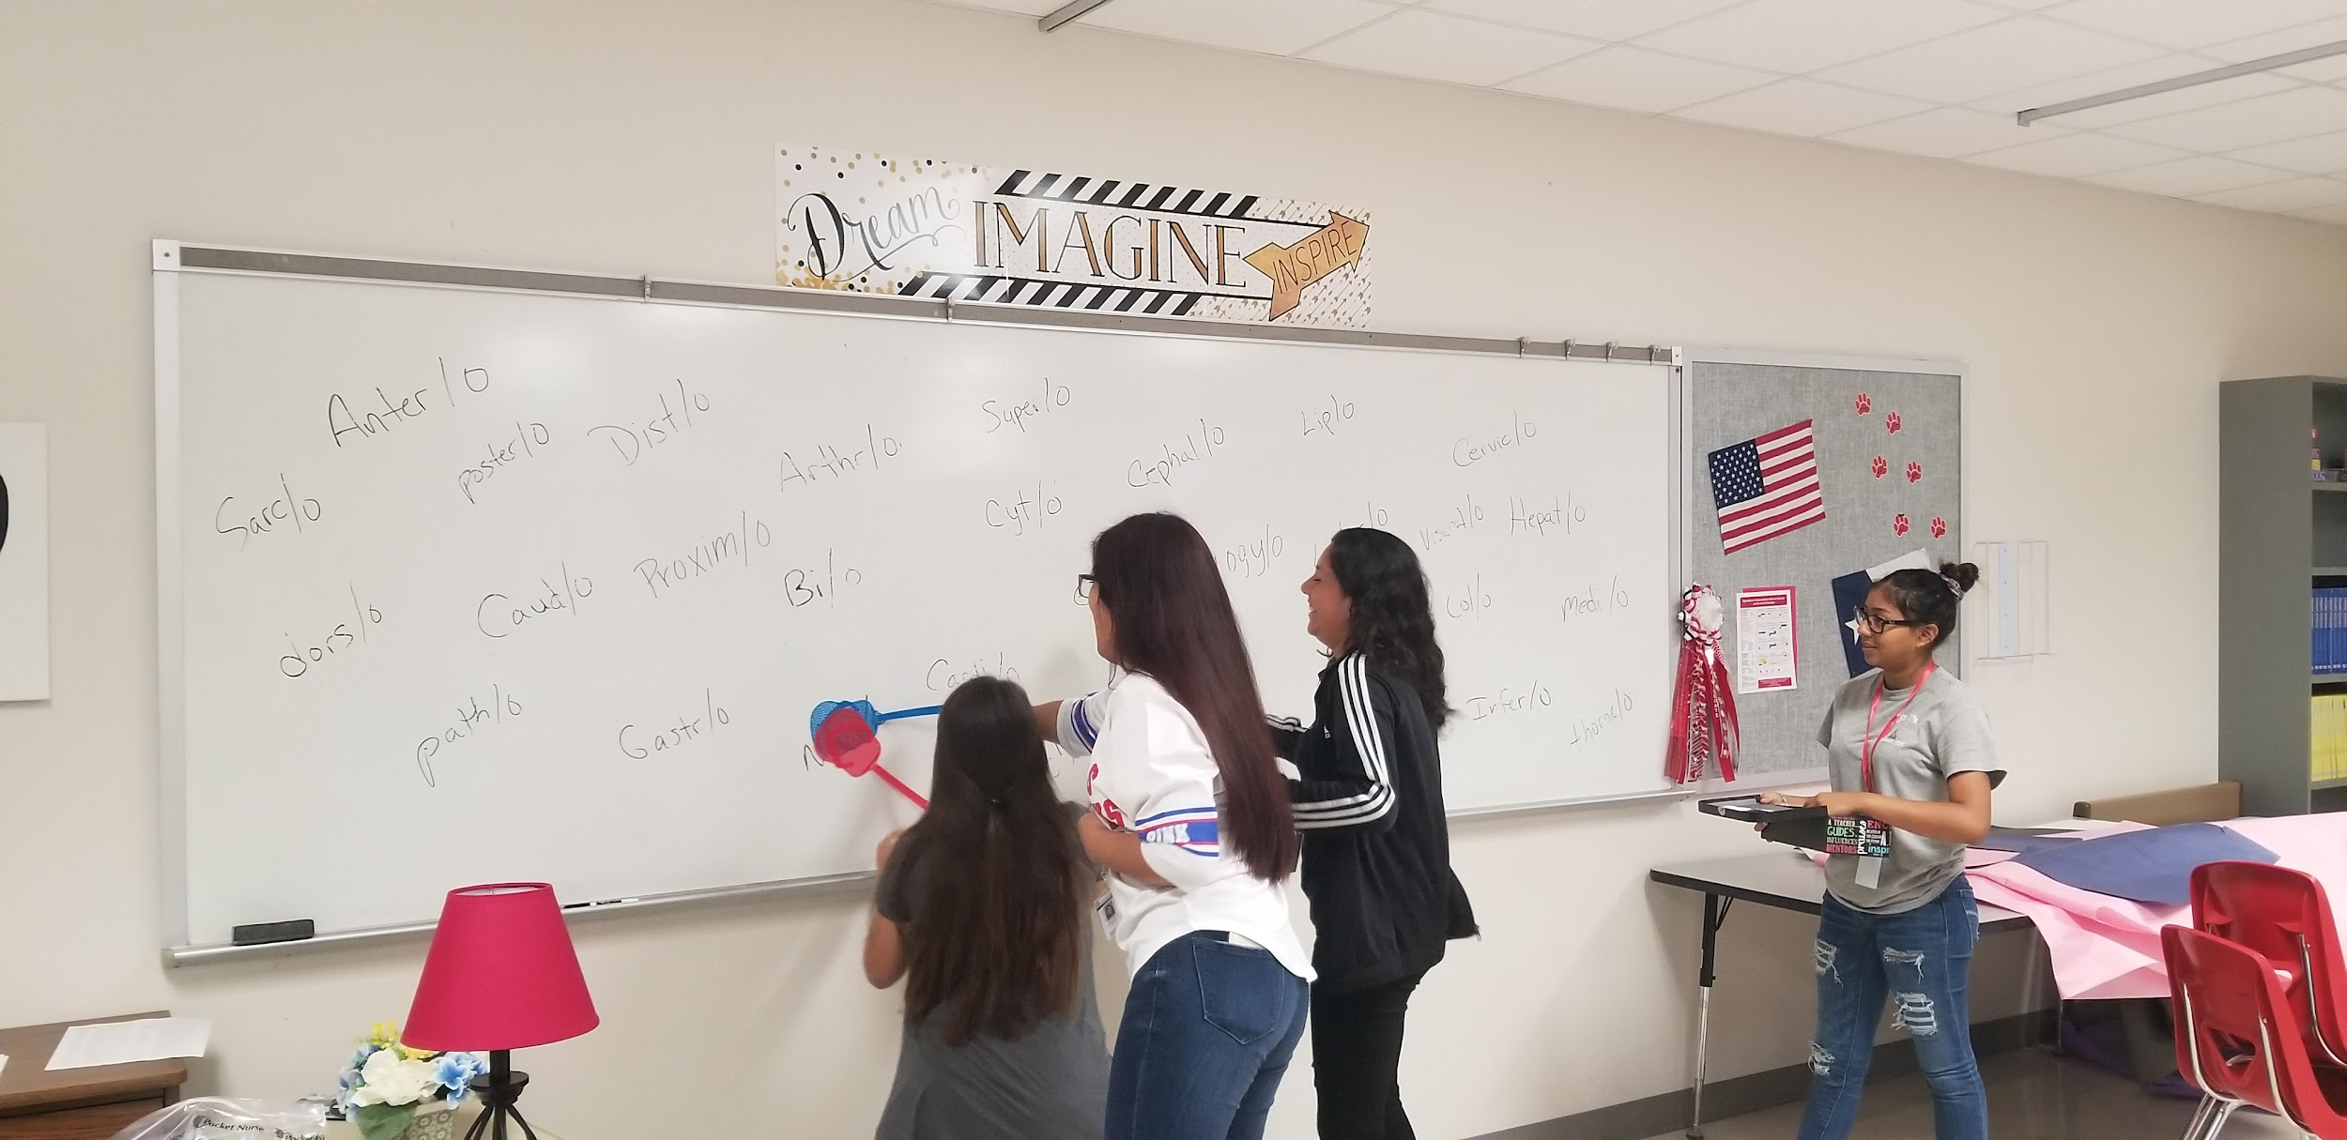
Fly Swatter

Slide 13
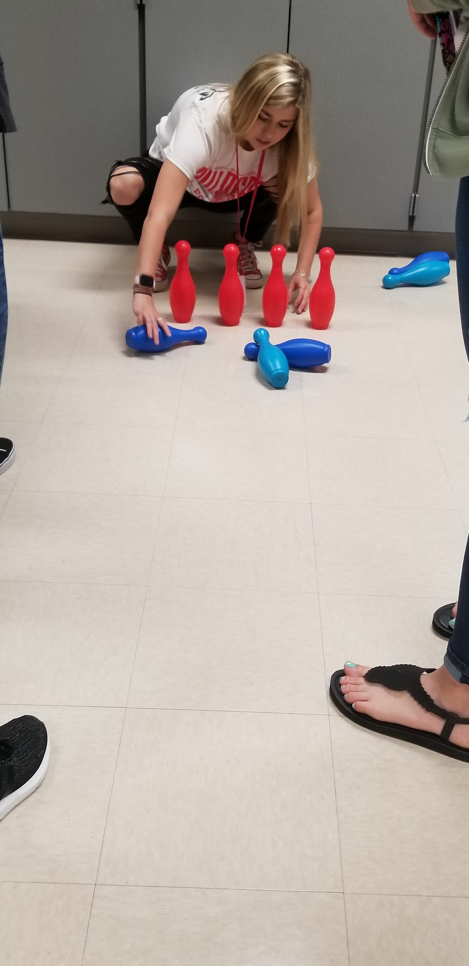
Bowling
Number of pins = pts or number of questions

Slide 14

Think Outside the Box
Be Creative
Fiddlestick Jenga Connect 4 Ball Toss Word Pong Erasable Dice Create game board | Fishing Game/ Go Fish Bowling Matching Egg Hunt Review Indoor Volleyball/Basketball And Baseball Fly Swatter

Slide 15
Computer Application
Quizlet Quizzez now Wayground
Blooket Gimkit

Slide 16
Quizlet
Free version available
$35.99 plus $2.38 in taxes for 1 year of Quizlet Plus for teachers.
https://quizlet.com/teachers what is included

Slide 17
Quizlet Live Varieties
Team or Individual
Shout Out - stay in seat - talk across the room to teammates
Join your team - have student teams gather together
Displays team progress on board

Slide 18
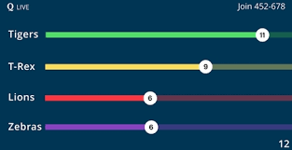

Slide 19
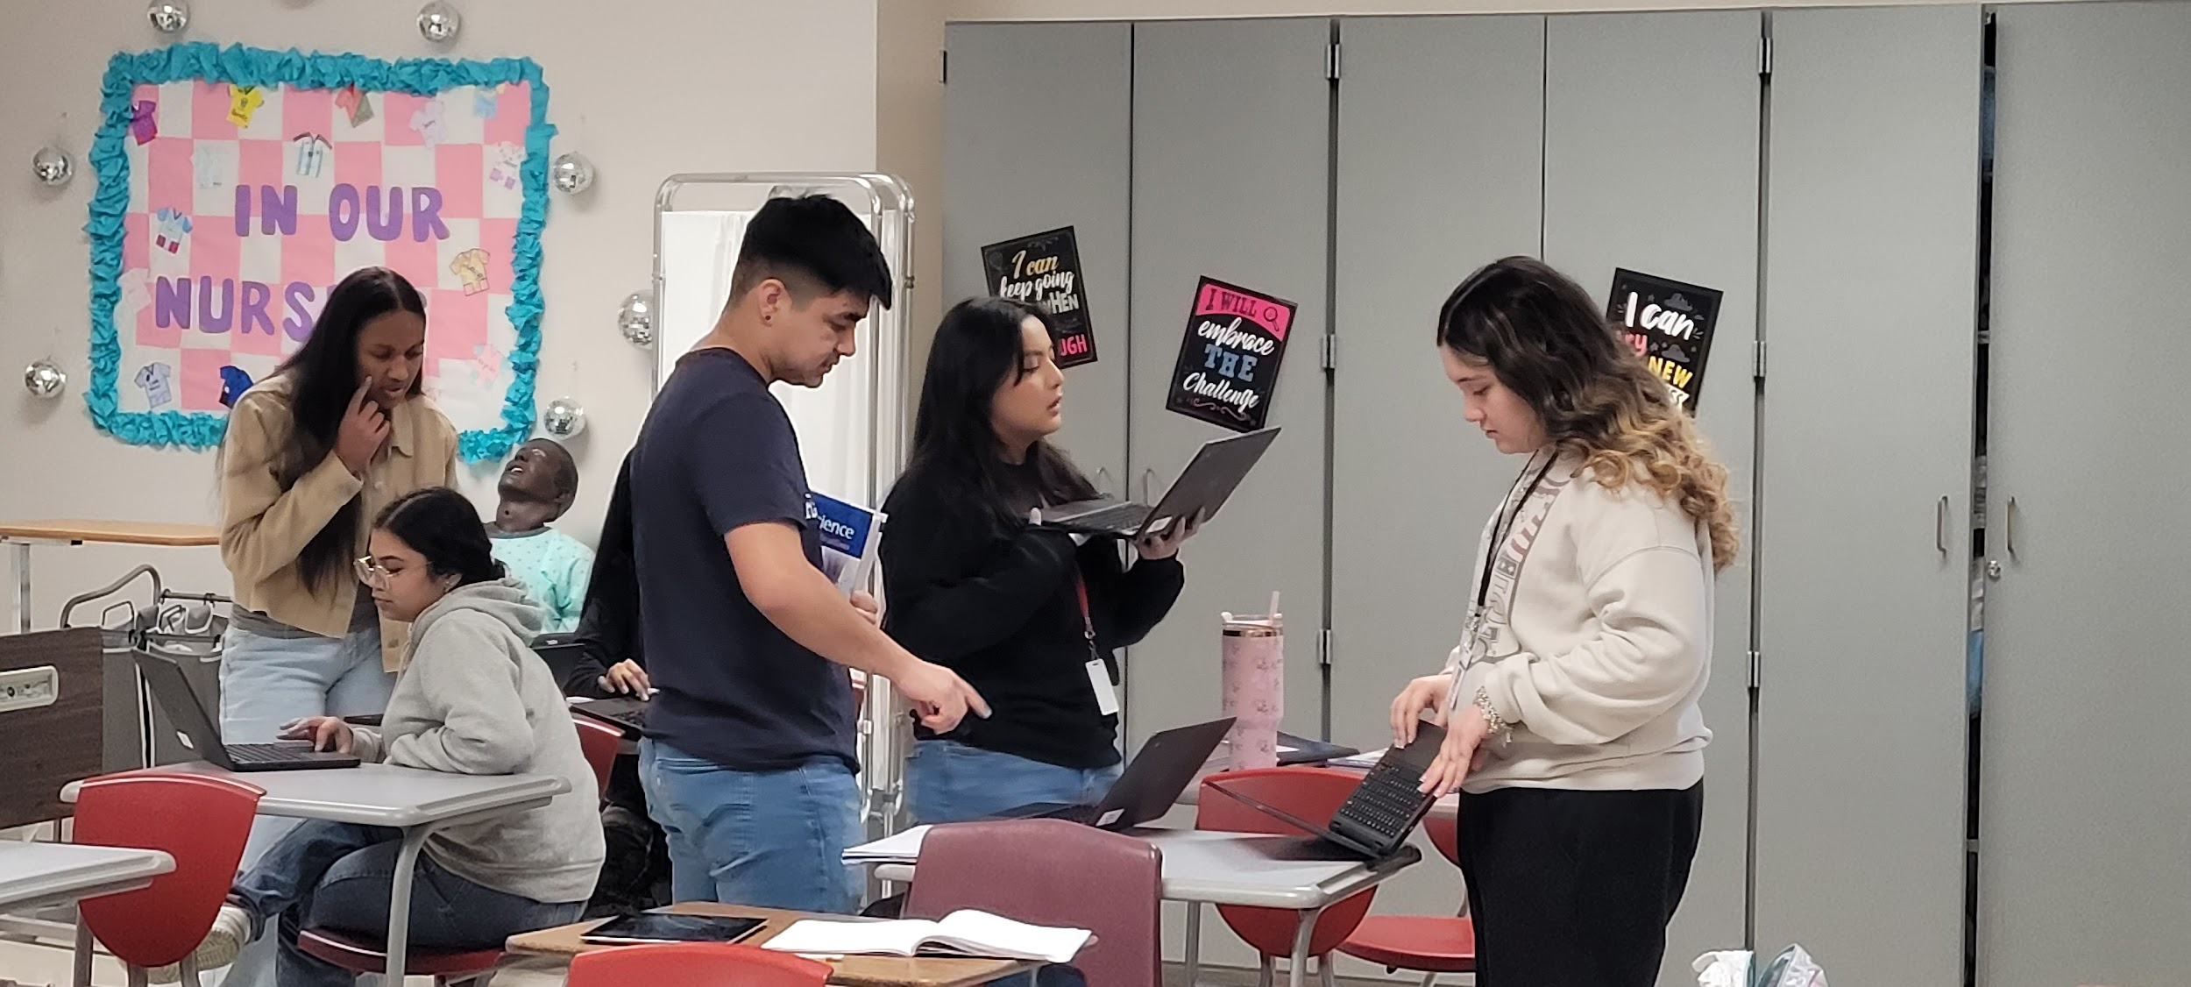
Students Collaborating using Quizlet Live

Slide 20
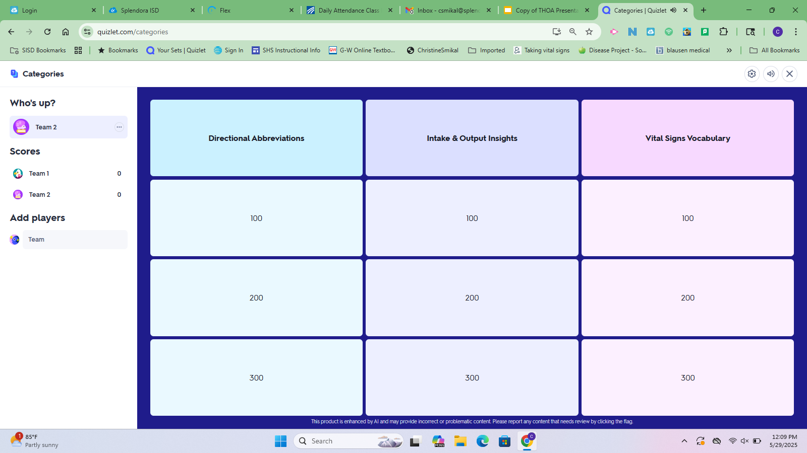

Slide 21
Blooket
Pro: All of their essential features are free! Unlimited number of questions set and host a game with up to 60 people.
Con: Score reports and question analysis so you can identify areas that we may need to review again as a class. Can see individual scores, but not individual names. Email to Blooket confirms that they do not collect any personal identifying information.
Biggest Pro: Use your Quizlet set to create a Blooket…and your students can create their own Blooket, too.
https://help.blooket.com/hc/en-us/articles/16182029397655-Blooket-Plus-Features

Slide 22
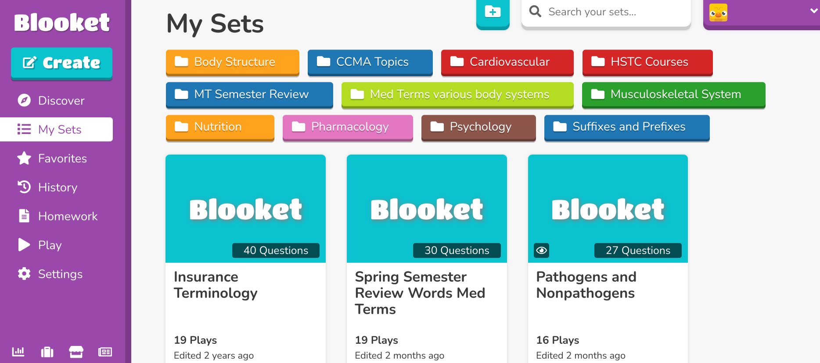
Blooket

Slide 23
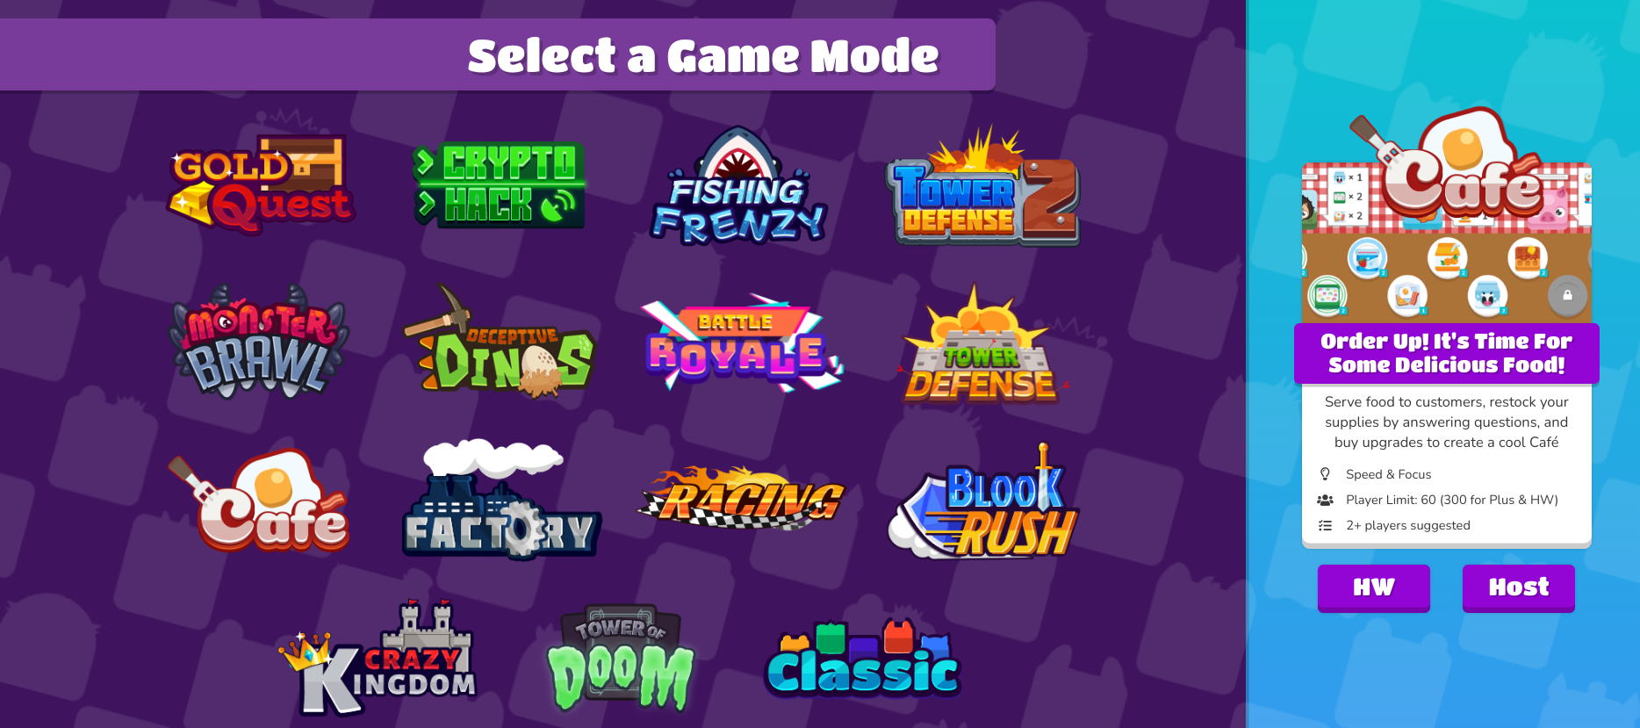
Some games are only for live play, others you can create as homework so students can choose to work at their own pace.

Slide 24
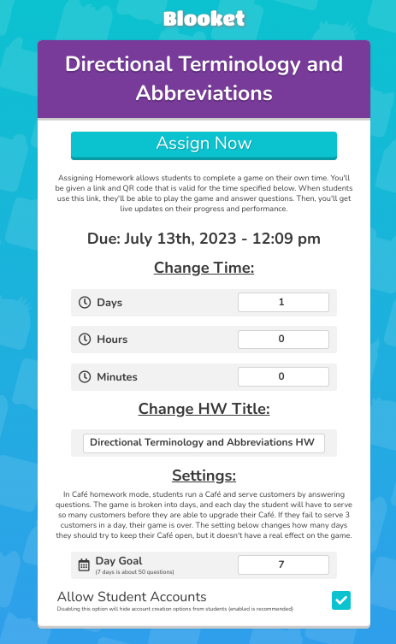
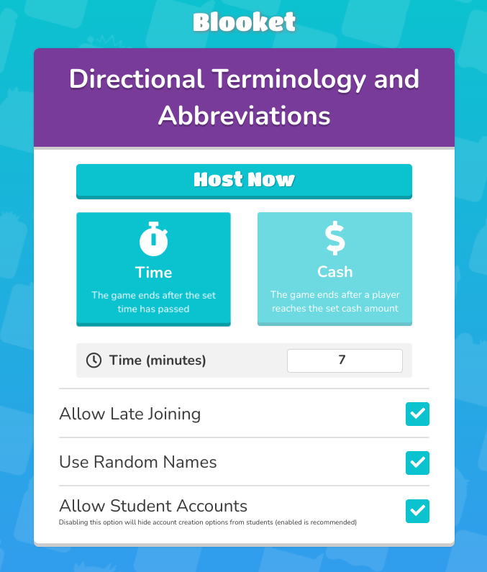
OR

Slide 25
What’s included in Blooket Plus
https://help.blooket.com/hc/en-us/articles/16182029397655-Blooket-Plus-Features
What does it cost
https://dashboard.blooket.com/upgrade

Slide 26
Gimkit
Kits - words and definitions (can be created with quizlet list by copying and pasting
Live play - in class - different settings
Time - set your time to play
Race - set your dollar amount to acheive to win
All in - set collective dollar amount for completion

Slide 27
Gimkit
Classes - Roster for each class to track
Assignments - Individual play or homework
Folders - use to organize assignments by class
Reports - questions answer correct/incorrect, percent accuracy

Slide 28
Gimkit
Basic - Free *Set Up Classes *Collect reports *Play Feature Modes Only —rotates *Creative 3 maps | Pro - $63.71/ year *Set Up Classes *Collect reports *Access to Play all Modes ****23 different games *Assignments - Homework or individual play *Upload images to questions *Add Audio to questions *Creative 10 maps

Slide 29
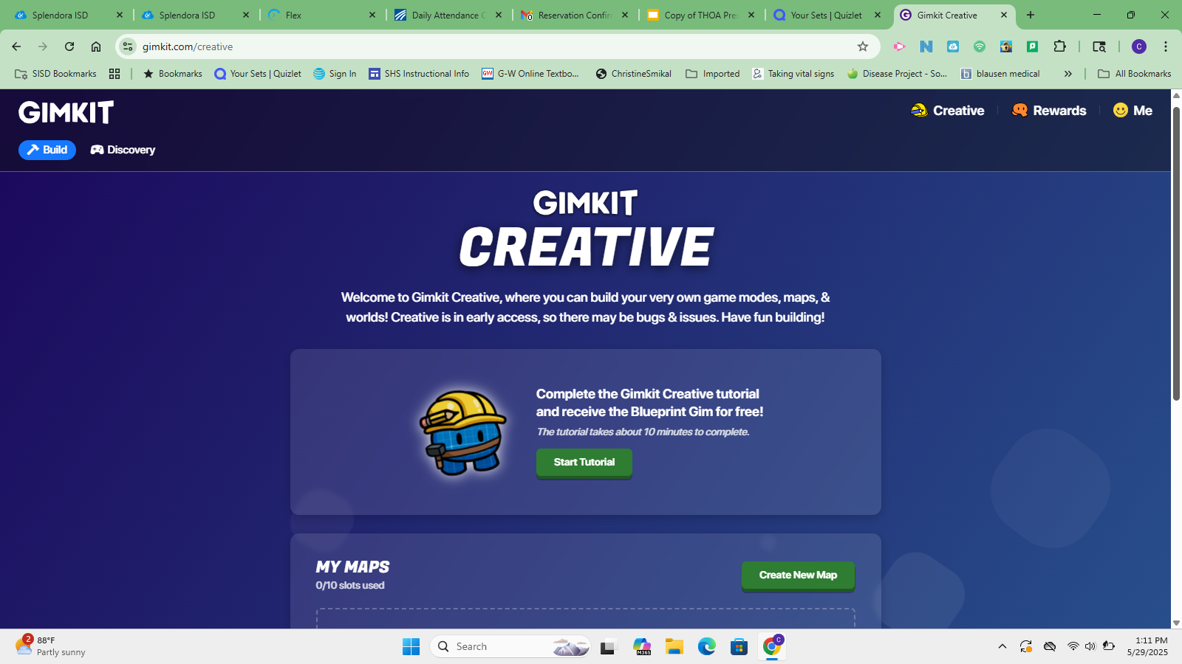

Slide 30
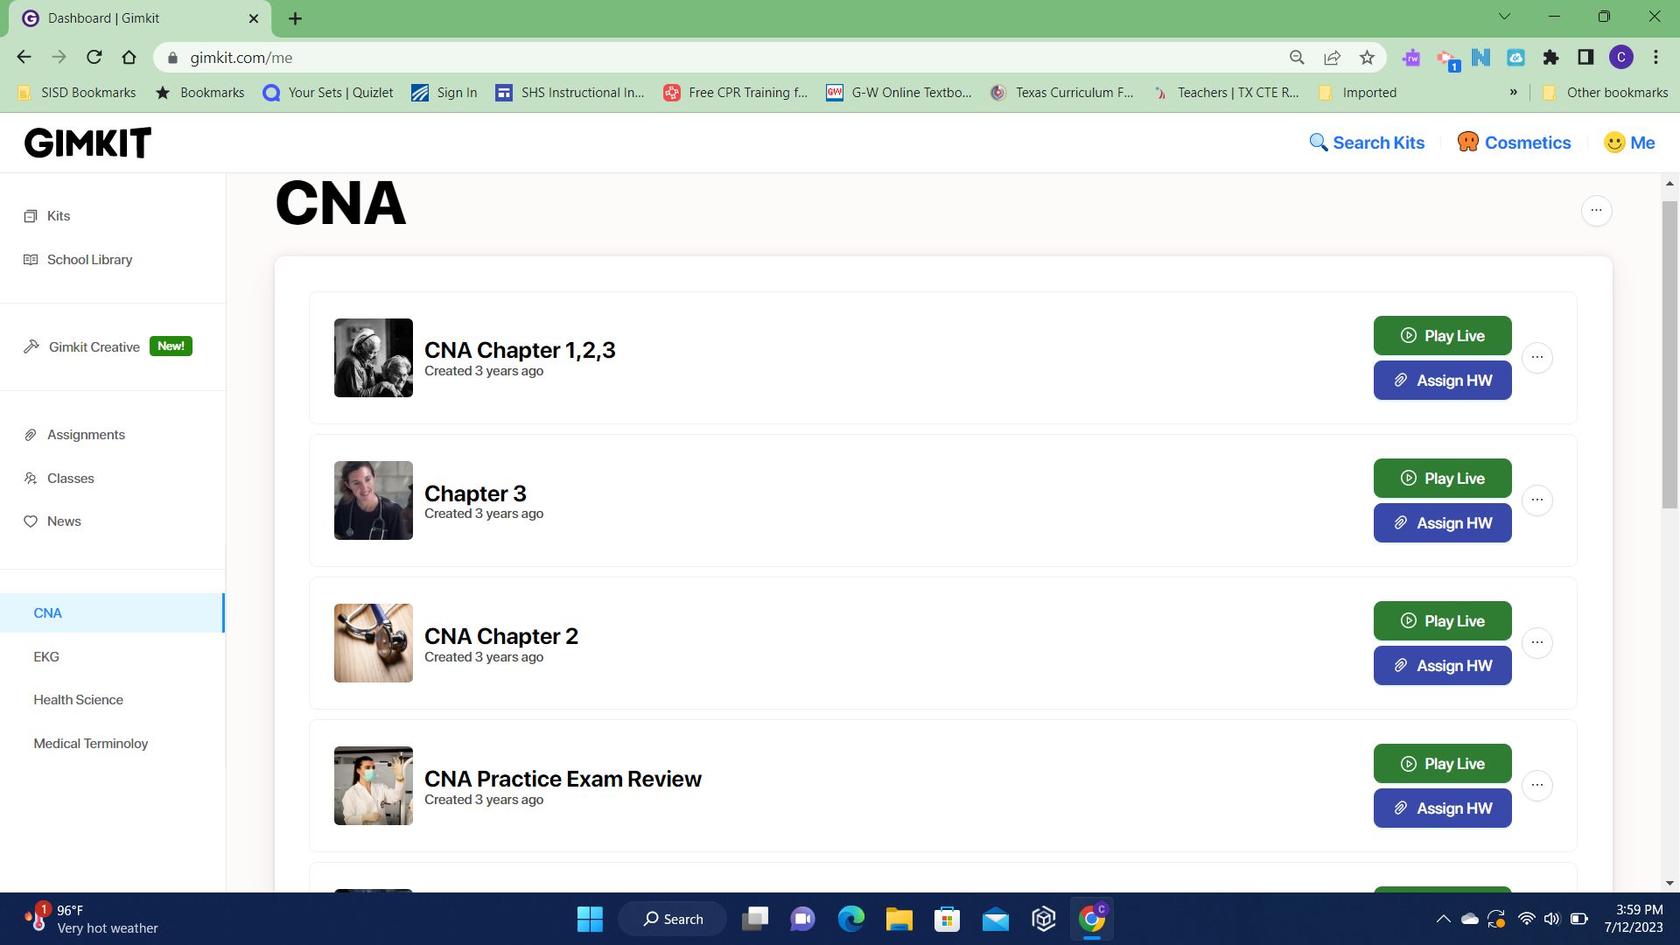
Class with Kits - Live play - Assignments

Slide 31
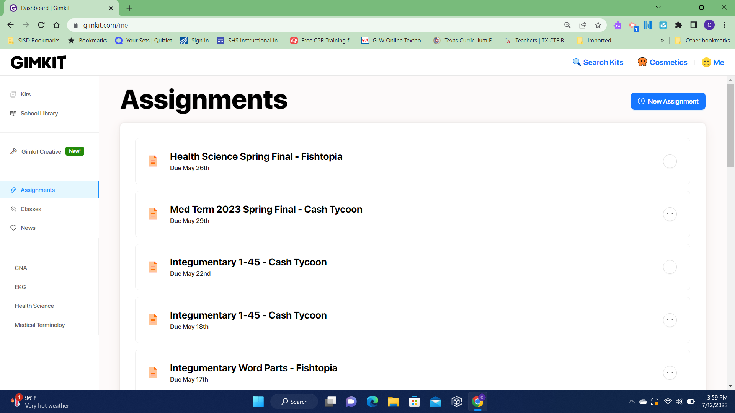
Assignments

Slide 32
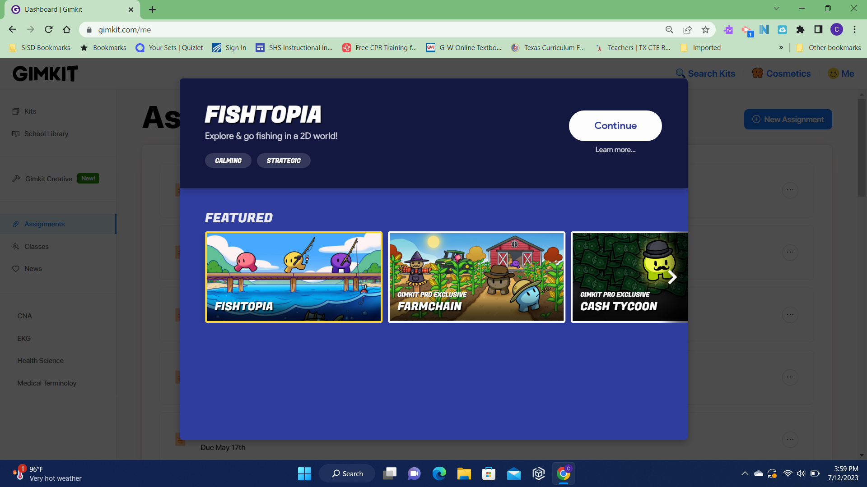
Assignments are 2-D games

Slide 33
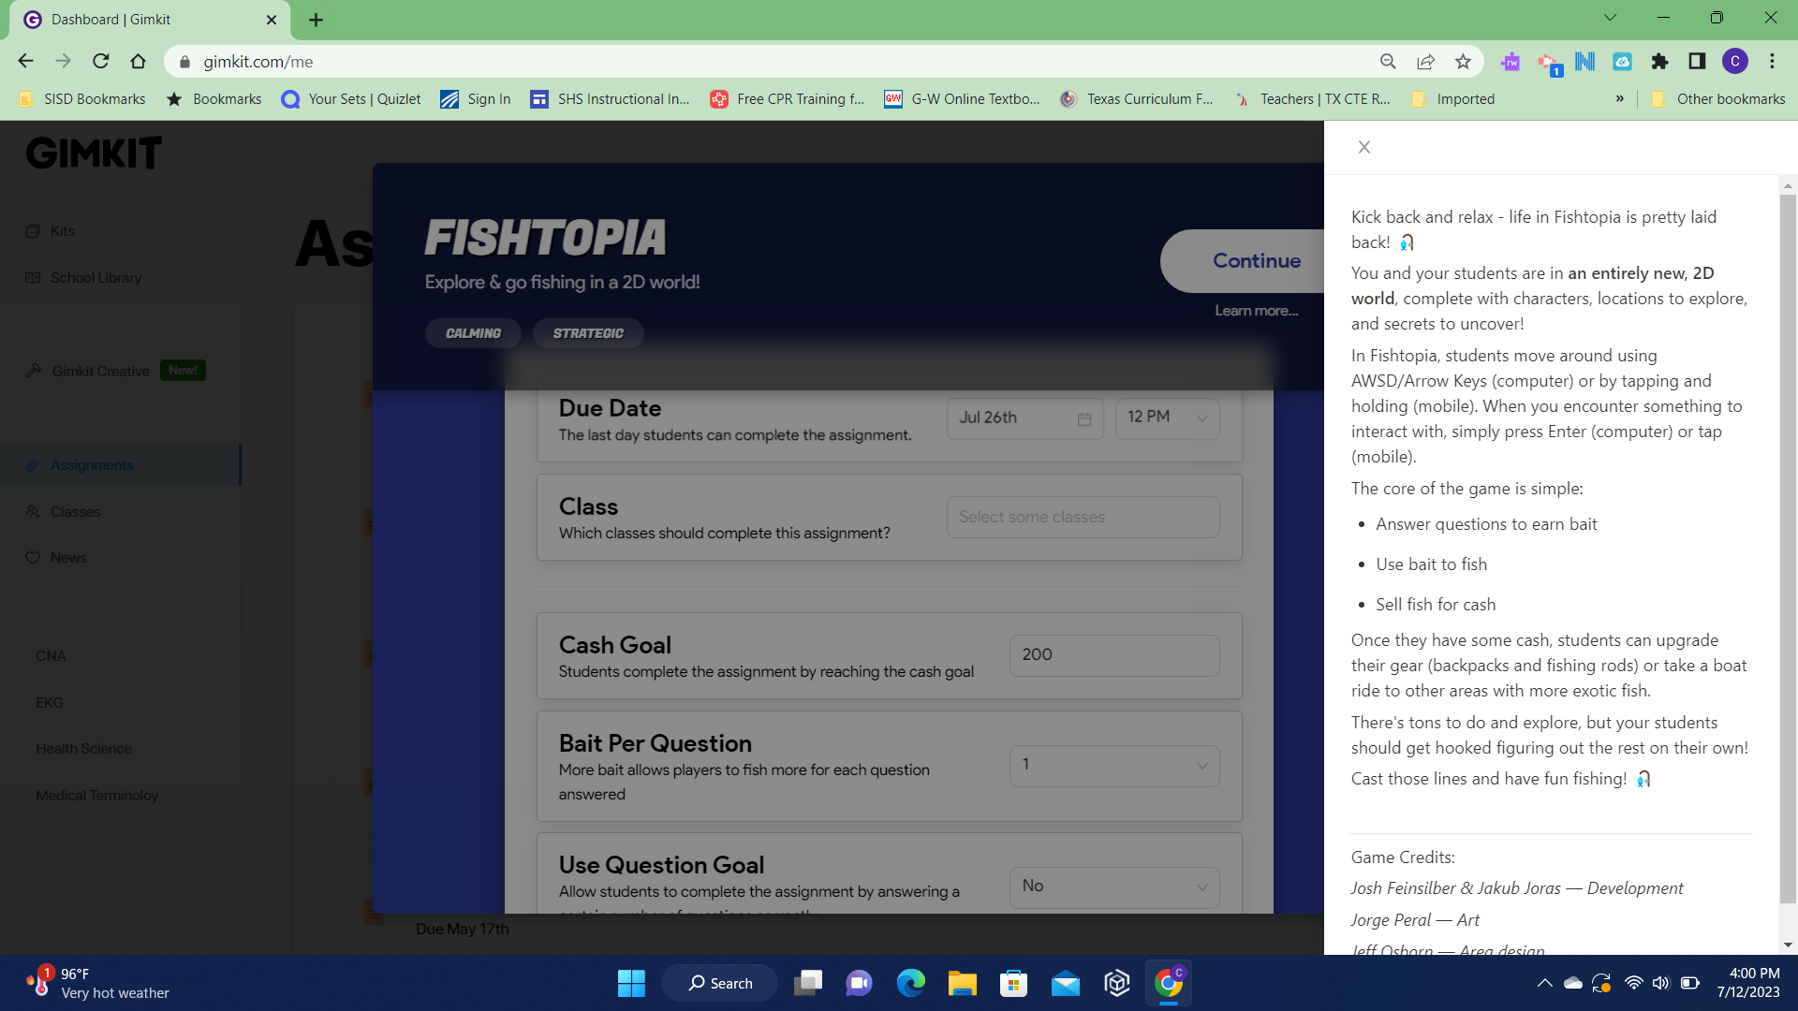
Set due date, assign to a class, set money or question goal

Slide 34
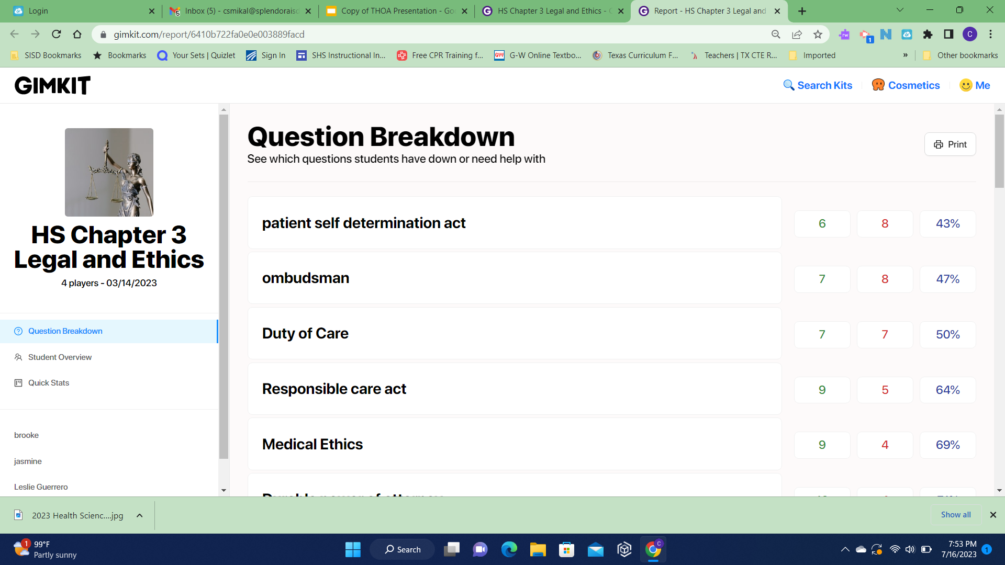

Slide 35
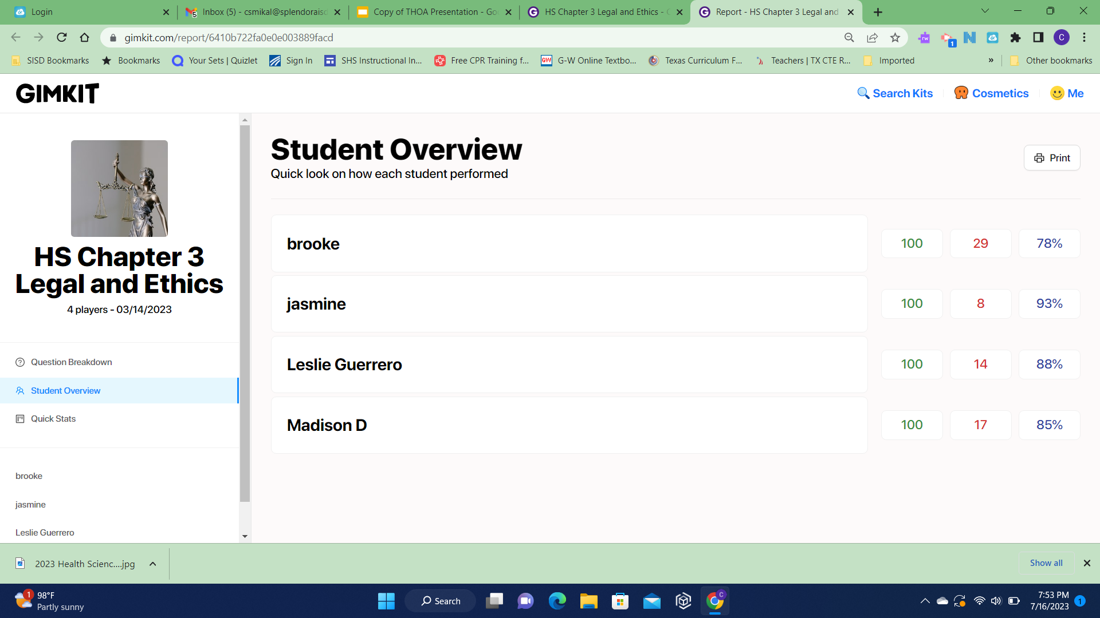

Slide 36
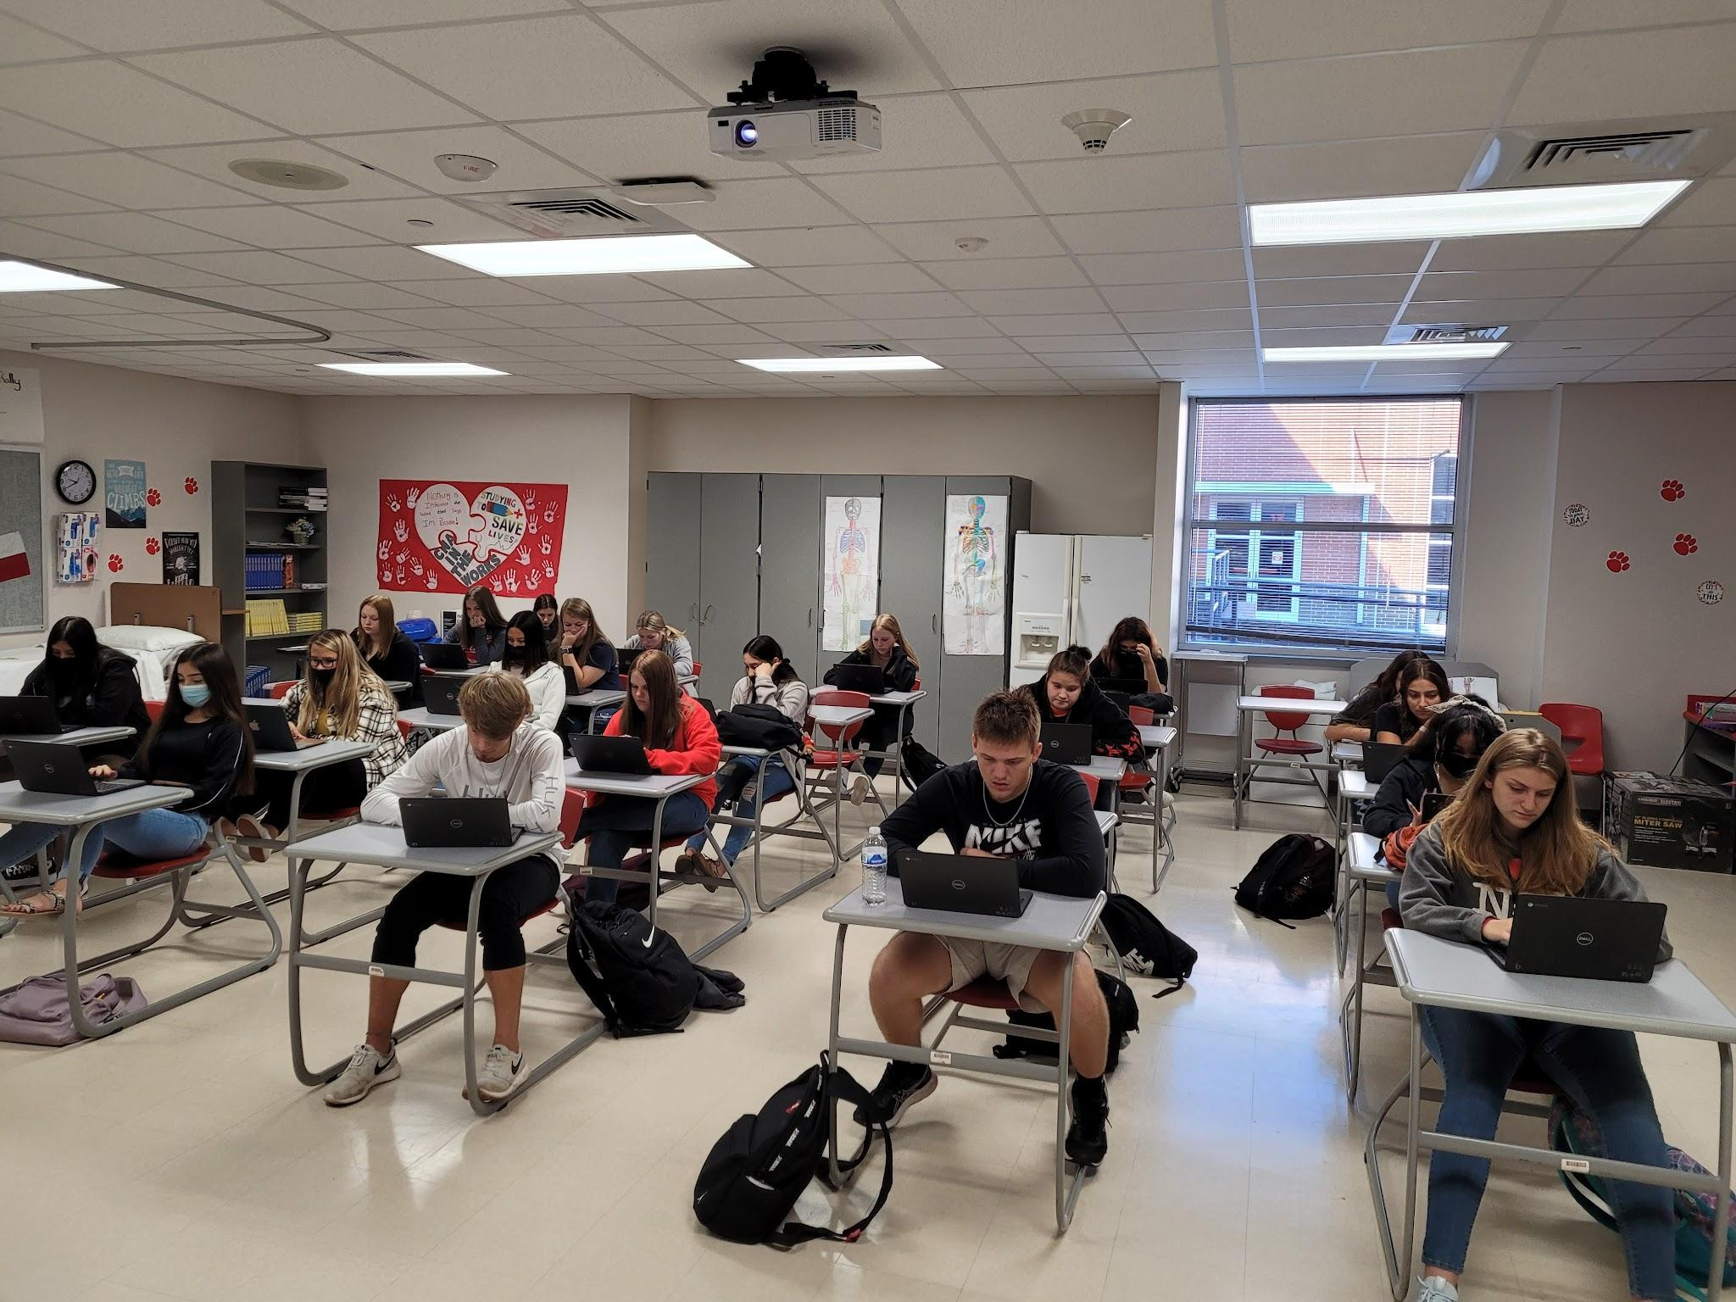
Fully Engaged in Gimkit

Slide 37
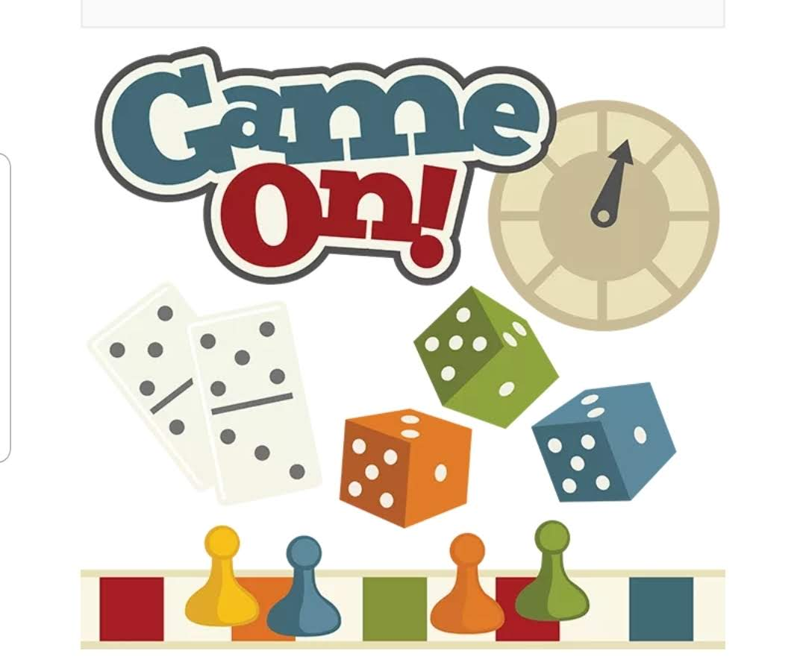
Go be creative and have fun!!!

Slide 38
Christine Smikal csmikal@splendoraisd.org
I did not receive any monetary benefits from the resources presented. Prices discussed were published on the products’ web sites at the time of research and this presentation is no guarantee of prices.

