Slide 1
Dare to Fail
Zoë Cook

Slide 2
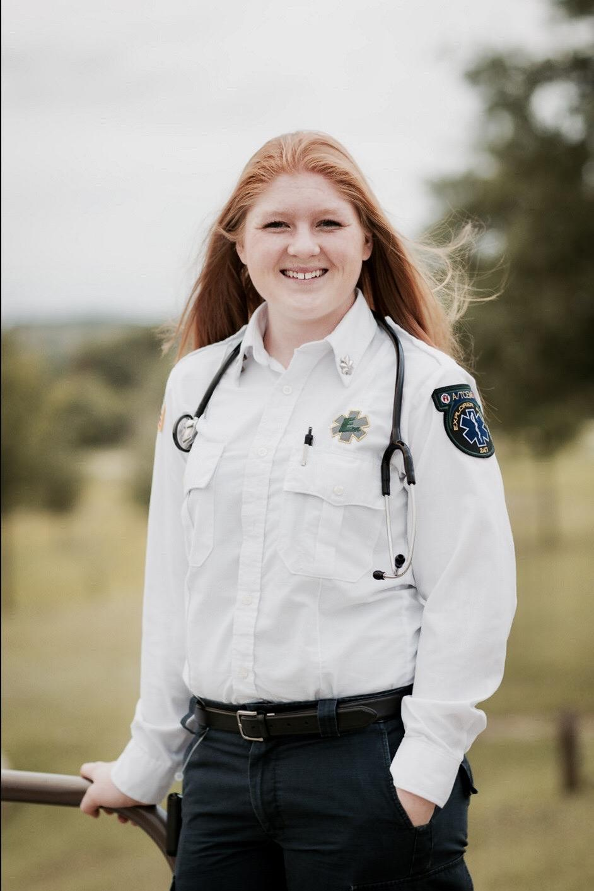
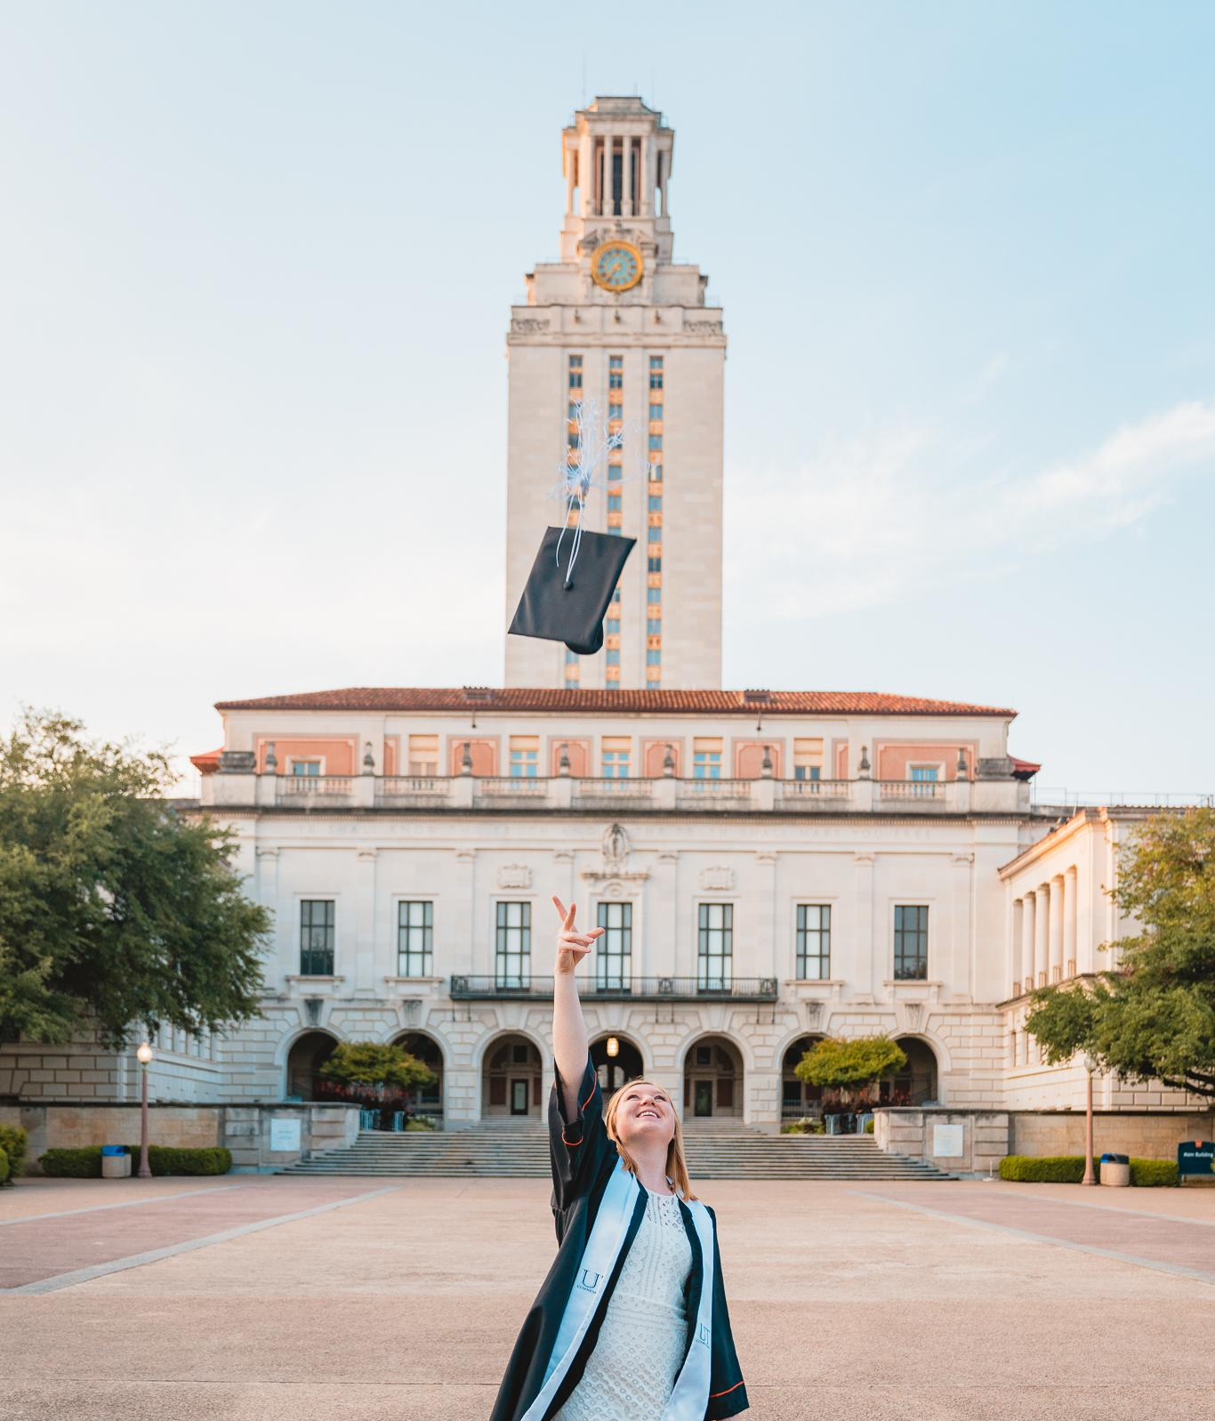
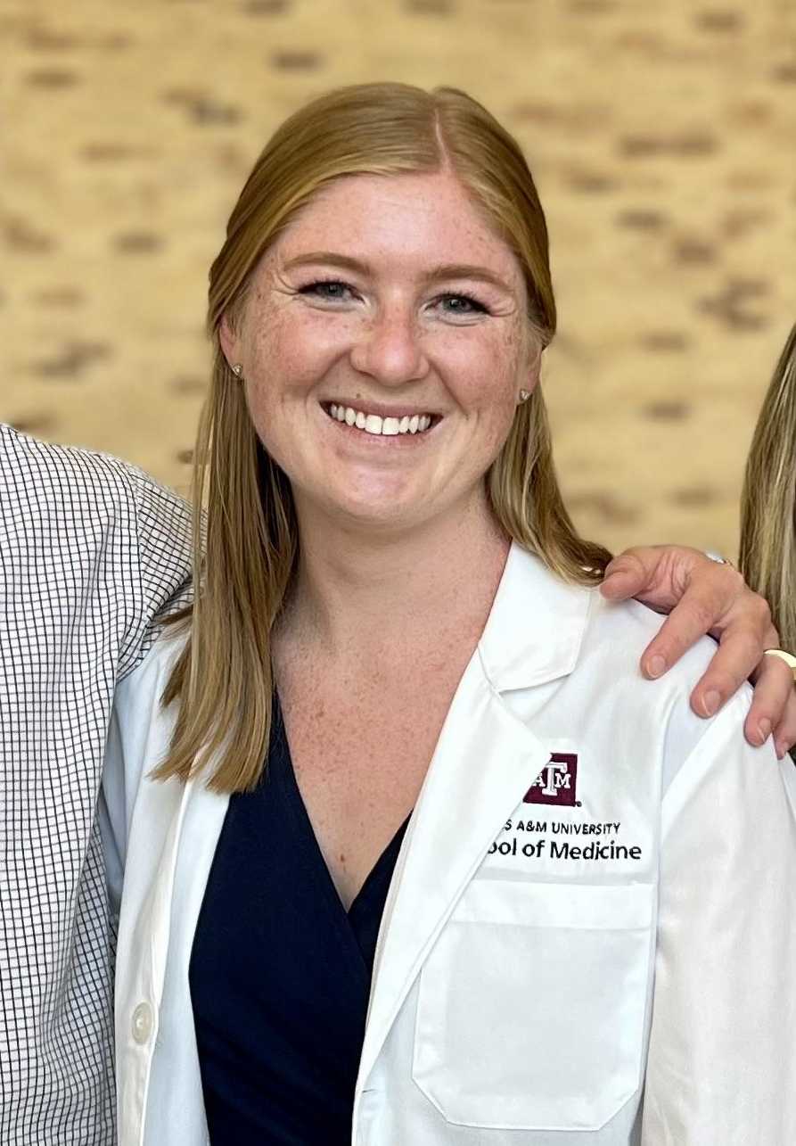
Who am I?
Westlake High School ‘16
UT Austin ‘20
Psychology B.S.
Texas A&M ‘26
School of Medicine
School of Law

Slide 3
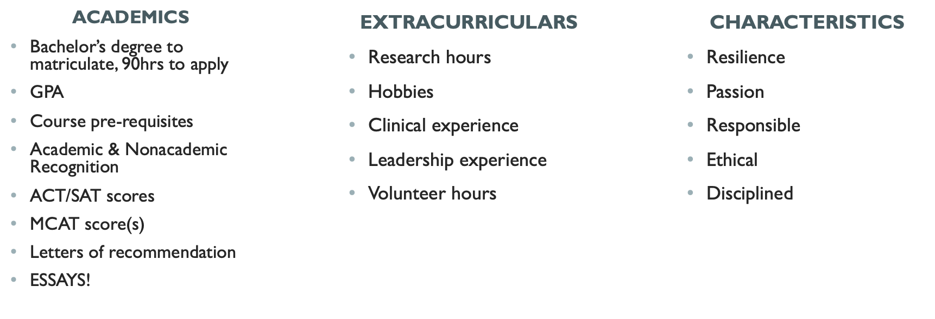
The path to medical school

Slide 4
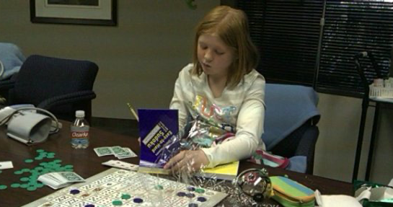
My first failure
“The primary outcome did not differ between groups.”

Slide 5
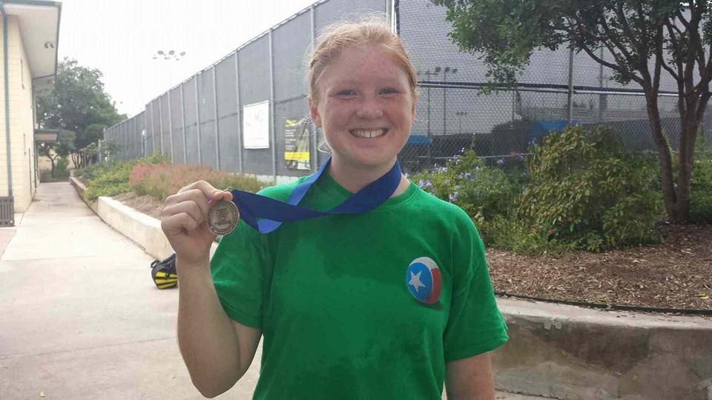
Failure #2: Middle School Tennis
“You’ll never be an athlete with diabetes.”

Slide 6
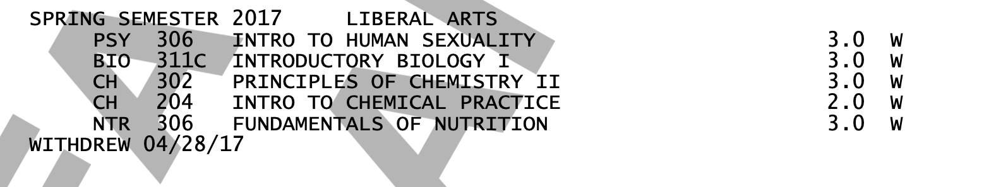
Failure #3: Freshman & Sophomore Year
“If you can’t complete your final exams you will need to withdraw.”

Slide 7
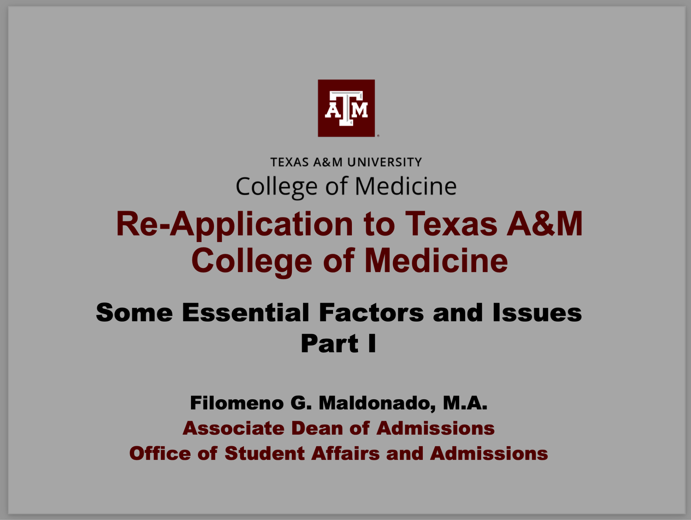
My Biggest Failure: rejected from medical school
“You did not match.”

Slide 8
Reframing Failure
“Lack of success.”
“The omission of expected or required action.”
“The action or state of not functioning.”
Lack of immediate success
Expect/require failure = no longer a failure
Everything we do functions in growth

Slide 9
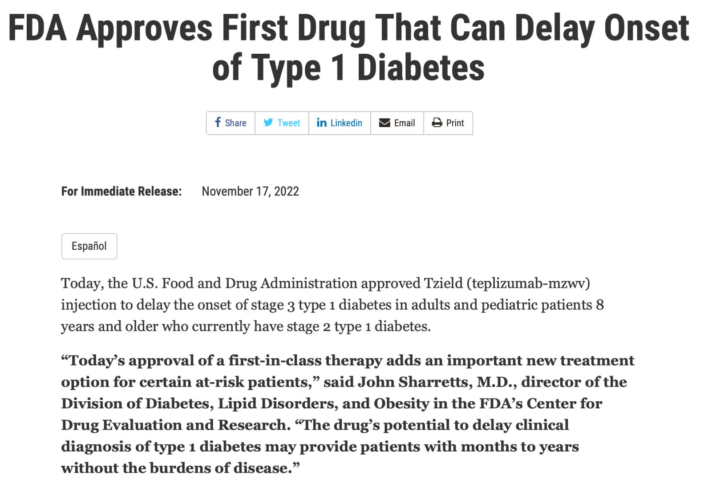

Slide 10
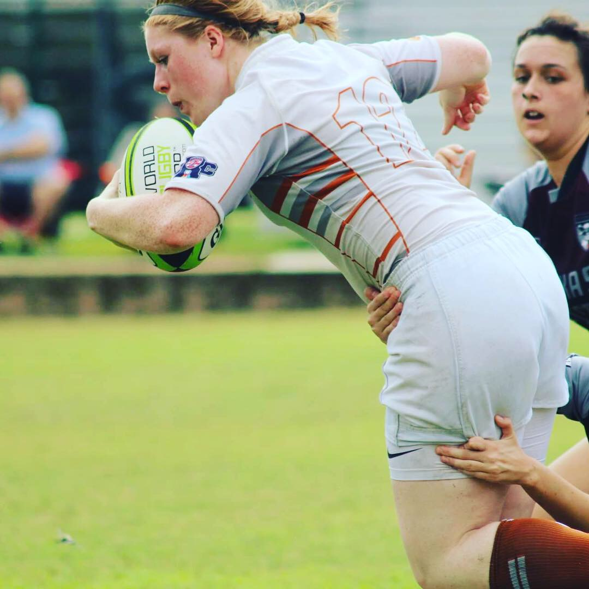
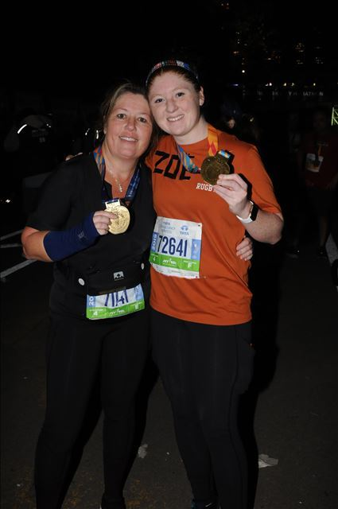
Notes:
tennis

Slide 12
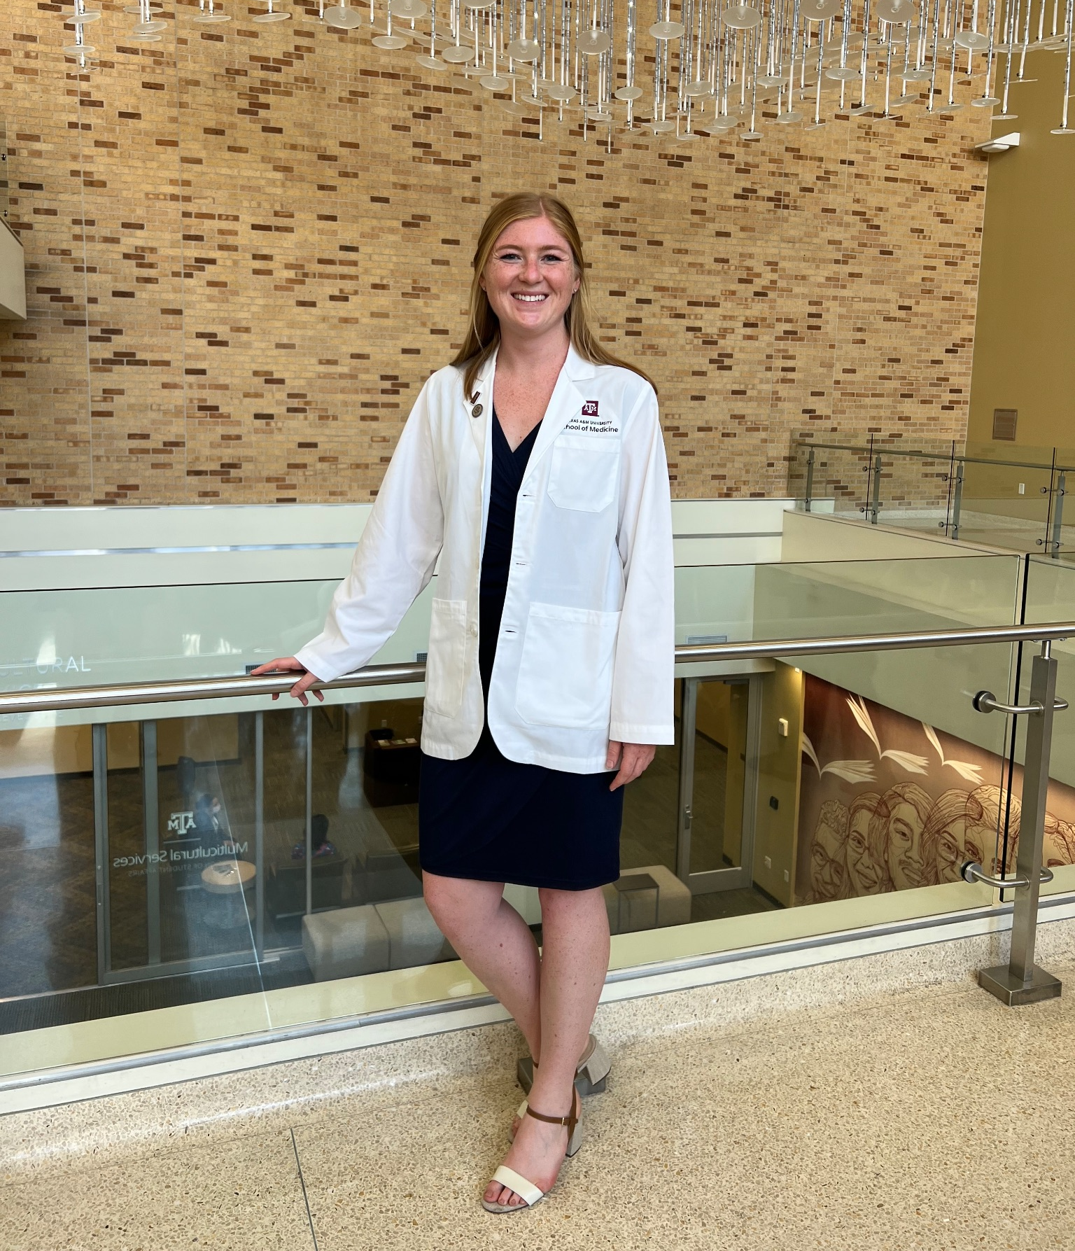
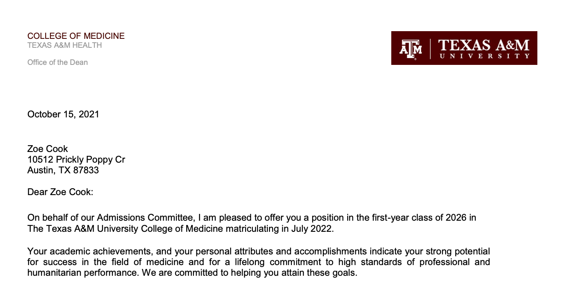
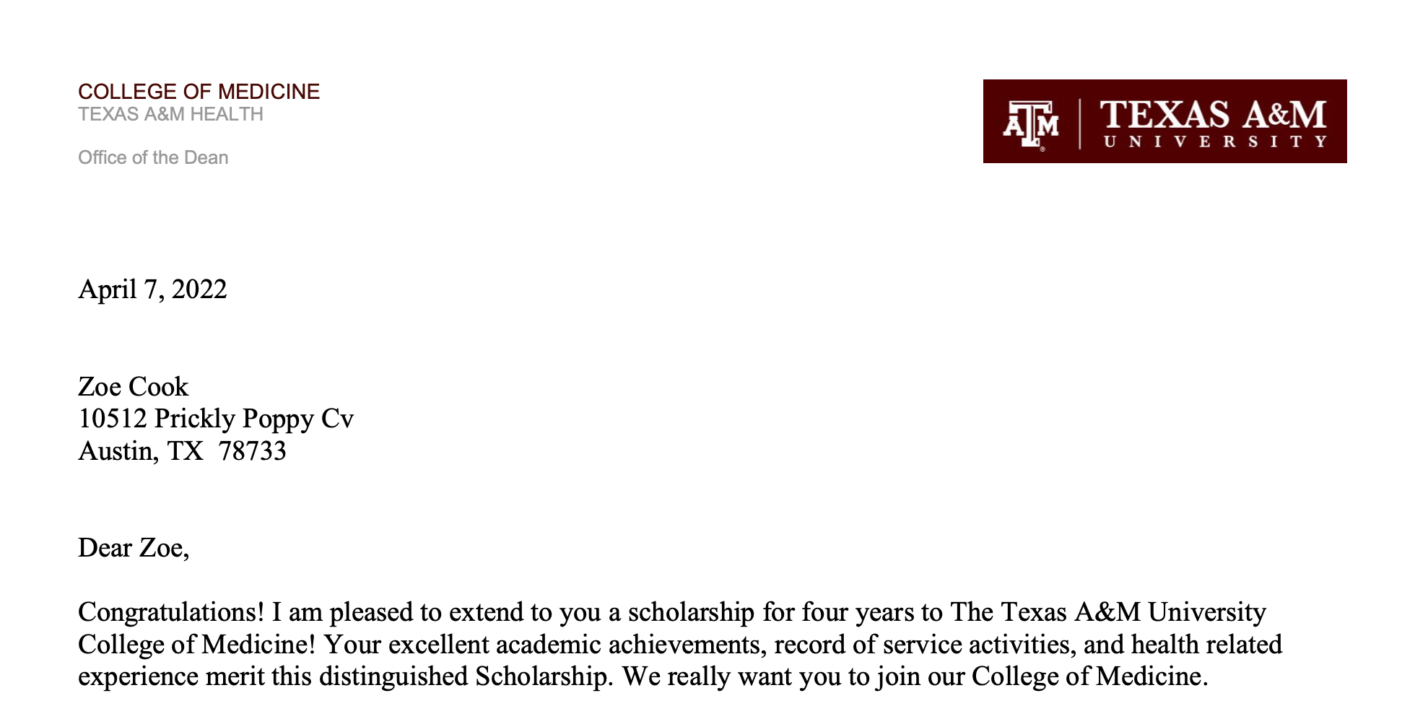

Slide 13
Failure #6: Anatomy Exam 2

Slide 14
We don’t fear failure, we fear shame & guilt.

Slide 15
“I have never met someone with so much courage to fail.”

Slide 16
“Courage does not always roar. Sometimes courage is the quiet voice at the end of the day saying, 'I will try again tomorrow.’ ”
Mary Anne Radmacher

Slide 17
Advice from Dr. Hairrell

Slide 18
Advice from Dr. Hairrell
Sleep and physical health are vital! You cannot study and learn well if you are unwell!

Slide 19
Advice from Dr. Hairrell
Sleep and physical health are vital! You cannot study and learn well if you are unwell!
Don’t be afraid to ask for help. Try to reach out before you need it!

Slide 20
Advice from Dr. Hairrell
Sleep and physical health are vital! You cannot study and learn well if you are unwell!
Don’t be afraid to ask for help. Try to reach out before you need it!
Use your resources.

Slide 21
Advice from Dr. Hairrell
Sleep and physical health are vital! You cannot study and learn well if you are unwell!
Don’t be afraid to ask for help. Try to reach out before you need it!
Use your resources.
Find what works for you and do it! Don’t be distracted by the next best shiny thing or what someone else is doing. Everyone learns differently! You do you!

Slide 22
Advice from Dr. Hairrell
Sleep and physical health are vital! You cannot study and learn well if you are unwell!
Don’t be afraid to ask for help. Try to reach out before you need it!
Use your resources.
Find what works for you and do it! Don’t be distracted by the next best shiny thing or what someone else is doing. Everyone learns differently! You do you!
Believe in yourself! Life is hard. Things happen. Be your own greatest cheerleader.

Slide 23
“Failure can become our most powerful path to learning if we’re willing to choose comfort over courage.”
“The credit belongs to those of us who are actually in the arena, whose face is marred by dust and sweat and blood. We strive valiantly and sometimes there's the triumph of achievement but at the worst, we fail, but at least we fail while daring greatly.”
Brené Brown

Slide 24
Dare to Fail.

