Slide 1
Aggie Campus Community Emergency Response Team (CERT): Why & How
Kyana Calvo, SN
Leander John Casenas, SN
Sena Gbanaglo, SN
Suzie Van, MSN, RN
LeRoy Marklund, DNP, RN

Slide 2
Objectives
Explain the benefit of disaster response training on college campuses.
Discuss building a CERT program.
Describe disaster preparedness and response activities offered by Texas A&M Health.

Slide 3
Benefits
Teaches ACCERT members and the community the importance of disaster preparedness and response.
Shortens response time to provide aid until first responders arrive
Encourages Aggie Core Values of Selfless Service, Leadership, and Excellence in the student population.
Creates a pool of trained CERT responders for unforeseen disaster events on campus.
ACCERT focuses on individual and community wide safety.

Slide 4
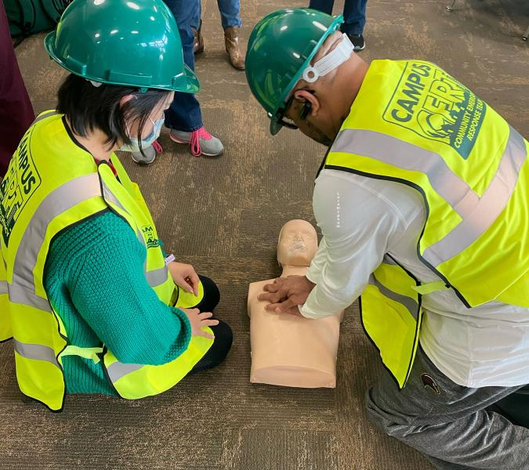
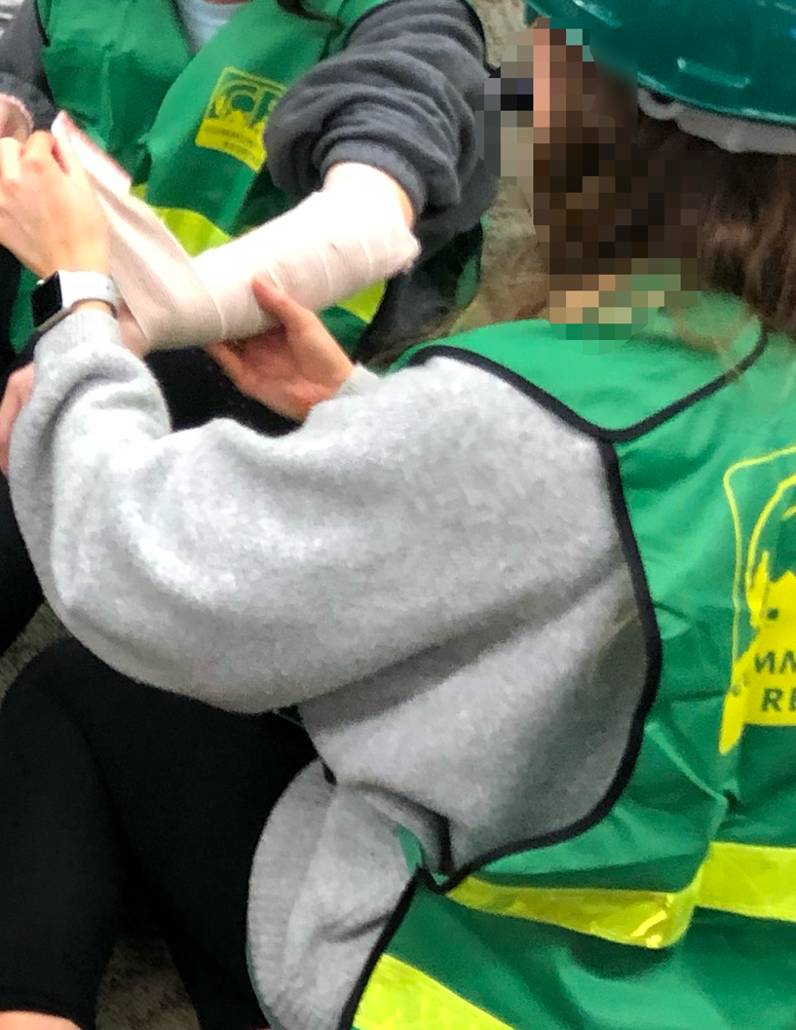
What is CERT?
Community Emergency Response Team (CERT)
Original CERT program was initiated by the Los Angeles Fire Department in 1985
Disasters in the 1980s demonstrated the necessity of empowering a trained community to quickly respond to all-hazard disasters.
CERT became a national program in 1993 and expanded to over 2,700 local CERT programs in all 50 states
Currently more than 600,000 CERT trained volunteers
Very few have campus CERT programs across the U.S.
What Can CERT Team Members DO?
Assist emergency services personnel when requested in accordance with local standard operating procedures (SOPs) developed by the sponsoring agency.
Assume basic medical and limited light rescue functions in the event of a disaster, when local emergency services personnel are overwhelmed.
Educate residents about disaster preparedness.
Maintain a safe campus.

Slide 5
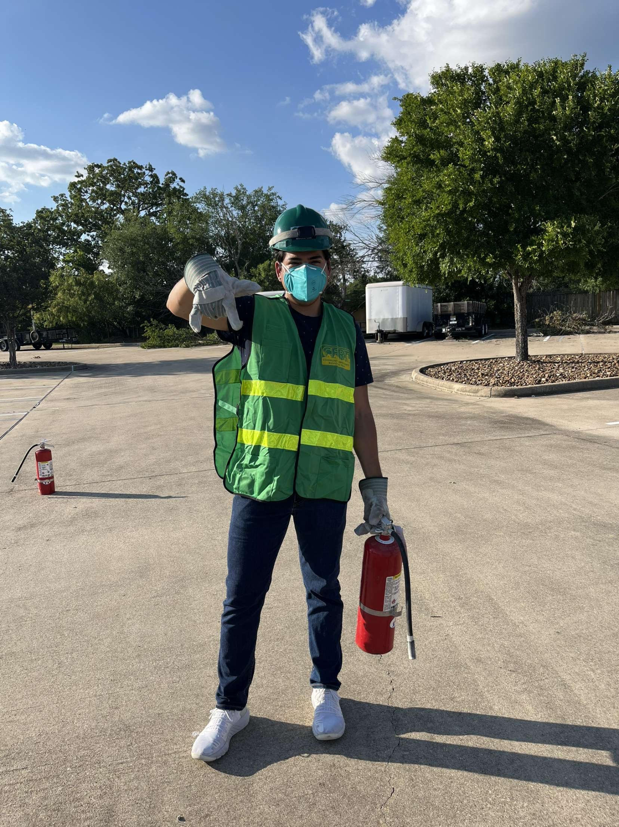
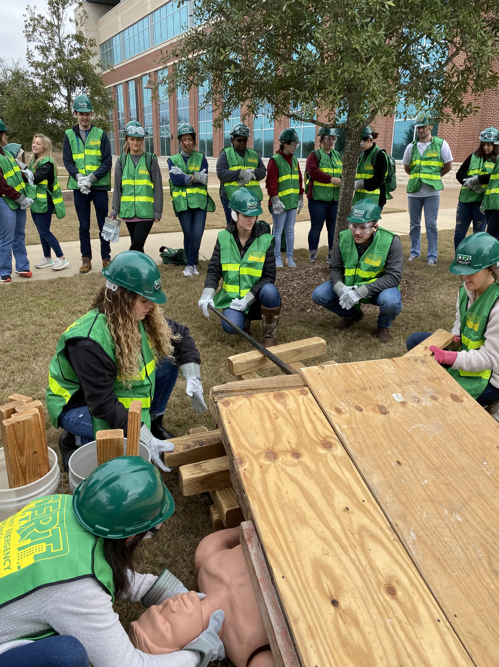
Why is CERT needed on campus?
Increase disaster PREPAREDNESS and response in OUR community
CERT members are trained on:
Fire suppression & safety
Search and rescue
Disaster medical operations
Team roles and delegation
Effective team organization
Types of Disasters:
Natural
Man-Made
Technological & Accidental
Terrorism
Community Support
Timely Response
PROMOTES
Teamwork & Communication
Safety & Preparedness
Notes:
pictures of disasters

Slide 6
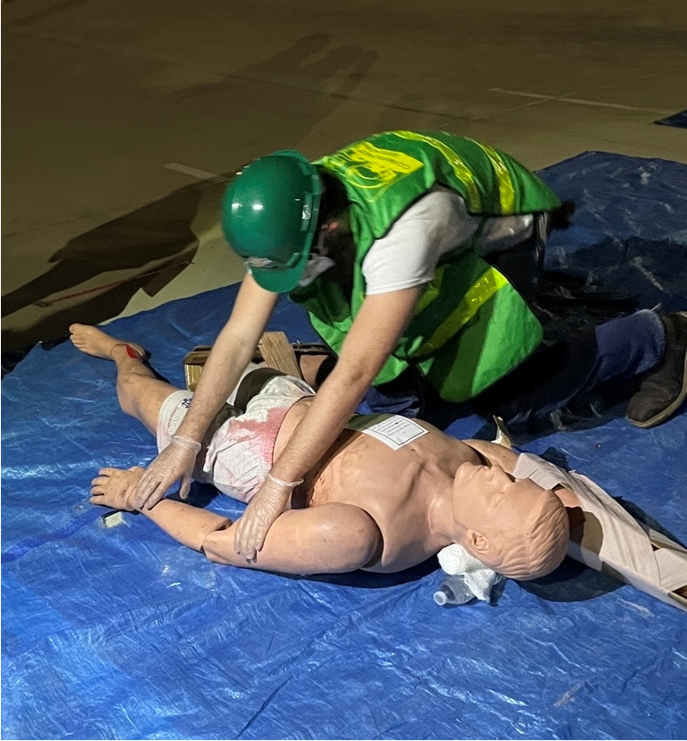
How are Campus CERTs established?
Steps to developing a Campus CERT:
Form a student steering committee to develop the new student organization – Aggie Campus CERT.
Establish a mission and goals.
Partner with local agencies in charge of disaster response.
Recruit faculty advisors who are CERT certified and proficient in disaster response and field medicine.
Form a student leadership team.

Slide 7
How are Campus CERTs established?
Steps to developing a Campus CERT: cont.
Collaborate with TAMU Student Activities (STUACT) department to get the new student organization recognized as an official student organization.
Have student leaders and faculty advisors complete required STUACT training.
Recruit new student members and offer CERT training courses.

Slide 8
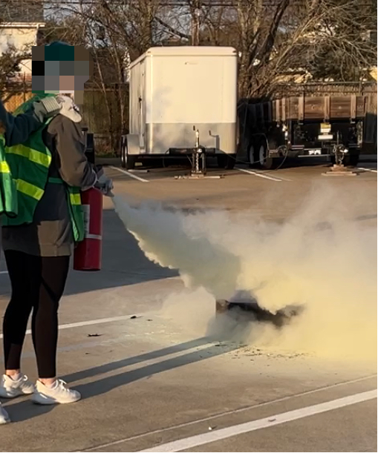
Campus CERT at Texas A&M University
Original CERT training started with School of Nursing students and has expanded to university wide.
Student recruitment pool includes Texas A&M University Corps of Cadets and health science center students.
Training is open campus-wide at no cost.
Participants include faculty, staff and students.

Slide 9
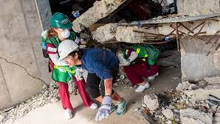
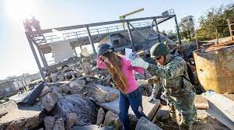
Aggie Campus Community Emergency Response Training
The Community Emergency Response Training (CERT) course teaches:
Fire safety
Light search and rescue
Disaster medical operations
Terrorism
Disaster psychology
CERT organization & incident command
Aggie Campus CERT (ACCERTs) ensures students on campus are prepared to respond and assist with all-hazard disasters.
(Federal Emergency Management Association. (n.d.) Community Emergency Response Training (CERT). https://community.fema.gov/PreparednessCommunity/s/welcome-to-cert?language=en_US)

Slide 10
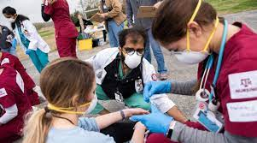
Disaster Preparedness
More opportunities to be prepared:
First Aid
Stop the Bleed training
Active Shooter Training
FEMA Online Modules (IS-100, 200, and 700)
Hospital Emergency Response Training
Texas A&M University’s Disaster Day
(Texas A&M Health. (n.d.) Disaster Day . https://health.tamu.edu/iper/disaster-day/index.html)
Notes:
Texas A&M University’s Disaster Day - the nation’s largest student-run interprofessional emergency response simulation.
Hospital Emergency Response Training – prepares students to respond to Chemical-Biological-Radiological-Nuclear-Explosive Incident

Slide 11
References
Labrague, L. J., Hammad, K., Gloe, D. S., McEnroe-Petitte, D. M., Fronda, D. C., Obeidat, A. A., Leocadio, M. C., Cayaban, A. R., & Mirafuentes, E. C. (2018). Disaster preparedness among nurses: a systematic review of literature. International Nursing Review, 65(1), 41–53. https://doi.org/10.1111/inr.12369.
Tussing, T. E., Chesnick, H., & Jackson, A. (2022). Disaster Preparedness: Keeping Nursing Staff and Students at the Ready. The Nursing Clinics of North America, 57(4), 599–611. https://doi.org/10.1016/j.cnur.2022.06.008.

