Slide 1
Successfully Implementing a Dual Credit PCT Program
Grace Barber, Dual Credit Instructor
Shari Harrington, Cluster Coordinator
Notes:
We first presented in the summer of 2020 to discuss planning and prep for starting our pathway.
They had previously only taken patho

Slide 2
Competing Programs in Dallas ISD
Magnet Programs https://www.dallasisd.org/Page/46031
Early College & Collegiate Academies https://www.dallasisd.org/Page/41445
NAF Academies (National Academy Foundation) https://www.dallasisd.org/domain/14173
NAF
Early College &
Collegiate
Magnet
Notes:
DISD receives grant for dual credit and all CTE DC classes must lead to a certification.
Had to find a pathway toward certification so we could continue to offer DC
We also hoped that it would make us more competitive with collegiate schools!

Slide 3
Steps to Creating a Dual Credit Pathway
Meet
Align
Create
Credential
Train
Implement
Notes:
DISD receives grant for dual credit and all CTE DC classes must lead to a certification. Had to find a pathway toward certification so we could continue to offer DC
Meet w/CCD
Align courses
Create HS course numbers
Credential instructors
Train instructors
Implement Pathway

Slide 4
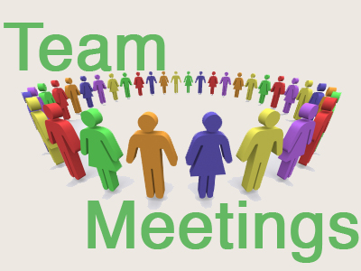
Meet with local College Partner to find appropriate pathway
https://www1.dcccd.edu/catalog/programs/matrix.cfm?loc=ECC

Slide 5
Align high school courses to college course and create pathway
HS Course = College Course

Slide 6
Create high school course numbers
Semester vs. Year Long
Credits: 0.5, 1, or 2
Notes:
PEIMS number
1 semester, 1 year, or double blocked for cluster classes

Slide 7
Challenges – planning phase
HPRS 1201
PHS
LNW
Compare DC course
and TEKS
LNW and PHS
PHS and HPRS
Any overlap?

Slide 8
Credential Instructors with CCD
https://dochub.com/shariharrington/vB1e3k/2019-instructor-credentialing-dual-credit-packet
Notes:
Challenges with college partner :(

Slide 9
Train Staff on Use of College Platform & Policies
Notes:
Schedule PD for staff to be provided by mentor teachers familiar with DC platform (initially done by college)
use of platform
syllabus creation
policies (especially those that differ from HS policies)
grading

Slide 10
Implement Pathway
Notes:
Add 1 year at a time
Year 1: 9th grade courses only
Year 2: 9th & 10th grade courses
Year 3: 9th, 10th, & 11th grade courses (a hiccup last year – no 11th)
Year 4: 9th, 10th, 11th, & 12th grade courses (no 12th)
Year 5: (next year) all 4 years :)

Slide 11
*Challenges * Successes * Lessons

Slide 12
Challenges for Teachers
Challenge for Teachers
Class online participation
Student tech issues
DCCCD – No extra material
Added content on Google Classroom
Notes:
Dual factor sign in issues (no phones)
Learning to navigate BLackboard
Provide resources on GCR -
SHOW posters - "what are your concerns?"

Slide 13
Challenges for Teachers
Challenge for Teachers
High School schedule vs. college schedule -
2 weeks before to prepare
2 weeks after – bonus topics
Notes:
Do Bio, show syllabus, rubrics and calendar
Survey after – Med term review and anatomy
Parent communication essential!
Letters before, AND during
SHOW letters – will post

Slide 14
Challenges for Students
Challenges for Students
Technical skills
Writing skills
College level writing
DISD mindset vs College expectations
Notes:
9th graders -
Poor grammar, spelling, etc.
PDF/Word Vs. Google Docs
What to write
Deadlines

Slide 15
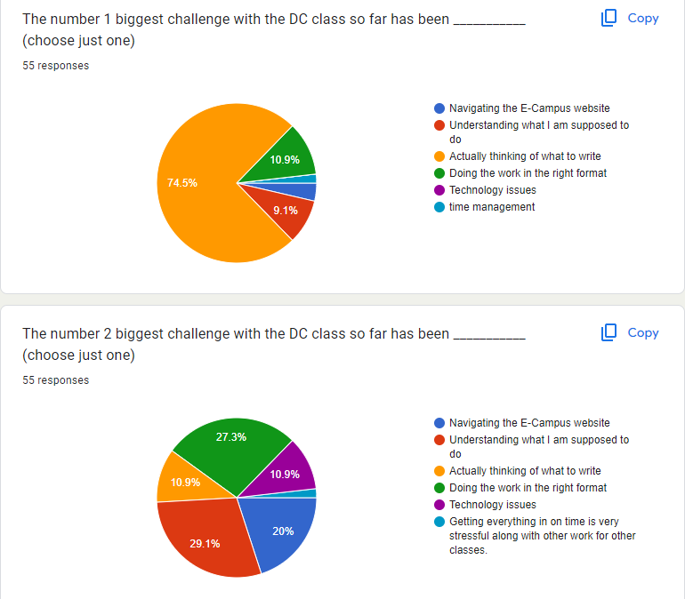

Slide 16
Student successes
Dallas ISD vs Dallas College
Pass rate:
9th grade: 95% HS
10th grade: 70% HS
11th grade: 100%
Notes:
Talk about teacher vacancies
Dallas College (totally online) vs.
HS teacher (college level work with HS level Support)
9th = 1 semester
10th and 11th = F/S semesters
Challenges for 11th in spring due to internship

Slide 17
End of year survey: Student comments and feedback

Slide 18
Student successes
What would have helped you to be better prepared for the workload and high expectations of the Dual Credit class?
What would IMPROVE the class for next year?
See posters also
Notes:
My survey

Slide 19
Student successes
Student suggestions:
I think something that would have helped me be better prepared would have been a small practice class on how to write discussion boards
I feel like if I practice how to right proper essay, it would've helped me a lot.
Notes:
T

Slide 20
Questions??
What else would
you like to know?
Resources to
share?

Slide 21
Contact info:
gbarber@dallasisd.org
sharring@dallasisd.org
School of Health Professions

