Slide 1
5 Strategies to Create Multi-Level Review Questions
Basic is Best

Slide 2
Emma Carter, The CTE Preceptor
I'm a health science teacher.
I'm a HOSA advisor.
I'm an athletic trainer.
I'm a mother of 2 teenage boys - football players.
I'm a small business owner.
...
Notes:
Explain name of company

Slide 3
TABLE OF CONTENTS
1
3
5
FLASHCARDS
LIFE IS TOUGH
DECIDE AND DRAW
2
4
TASK CARDS
3 WAY MATCH
The CTE Preceptor 2023

Slide 4
INTRODUCTION
Easy and practical strategies you can implement immediately to create multi-step and multi-level review questions for the benefit of you and your students.
The strategies may sound basic, but they will save you preparation time and guide your student through reviewing the course content.
The CTE Preceptor 2023

Slide 5
MULTI-LEVEL QUESTIONS
Level 1: Gathering - Students can point to an answer on a page in the textbook or notes.
Level 2: Processing - Students will make new connections with factual information.
Level 3: Applying - Students use knowledge and connections to predict, judge, hypothesize or evaluate.
The CTE Preceptor 2023

Slide 6
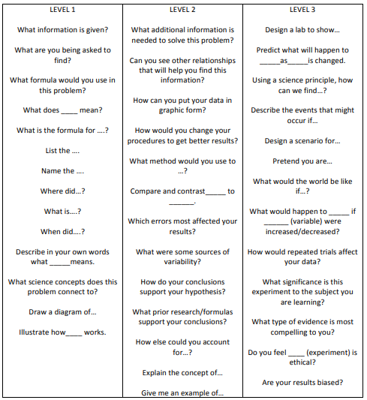
Costa’s
Levels of
Questions
https://www.asd5.org/cms/lib4/WA01001311/Centricity/Domain/145/Costas.pdf

Slide 7
Flipbook
https://youtu.be/VzA73av6SBQ
The CTE Preceptor 2023

Slide 8
WHAT
WHY
HOW
WHEN
The CTE Preceptor 2023

Slide 9
1
FLASHCARDS
The CTE Preceptor 2023

Slide 10
FLASHCARDS
A card containing a small about of information, held up for students to see, as an aid to learning.
The CTE Preceptor 2023
Notes:
What it is – base for all others

Slide 11
FLASHCARDS
WHY
Easy
Inexpensive
Durable
Repetitive Use
Various Formats
Various Uses
The CTE Preceptor 2023
Notes:
Why is it important

Slide 12
FLASHCARDS
HOW
Determine topics, terms, and definitions
Layout
Print format
Storage
Laminate
The CTE Preceptor 2023
Notes:
How to create

Slide 13
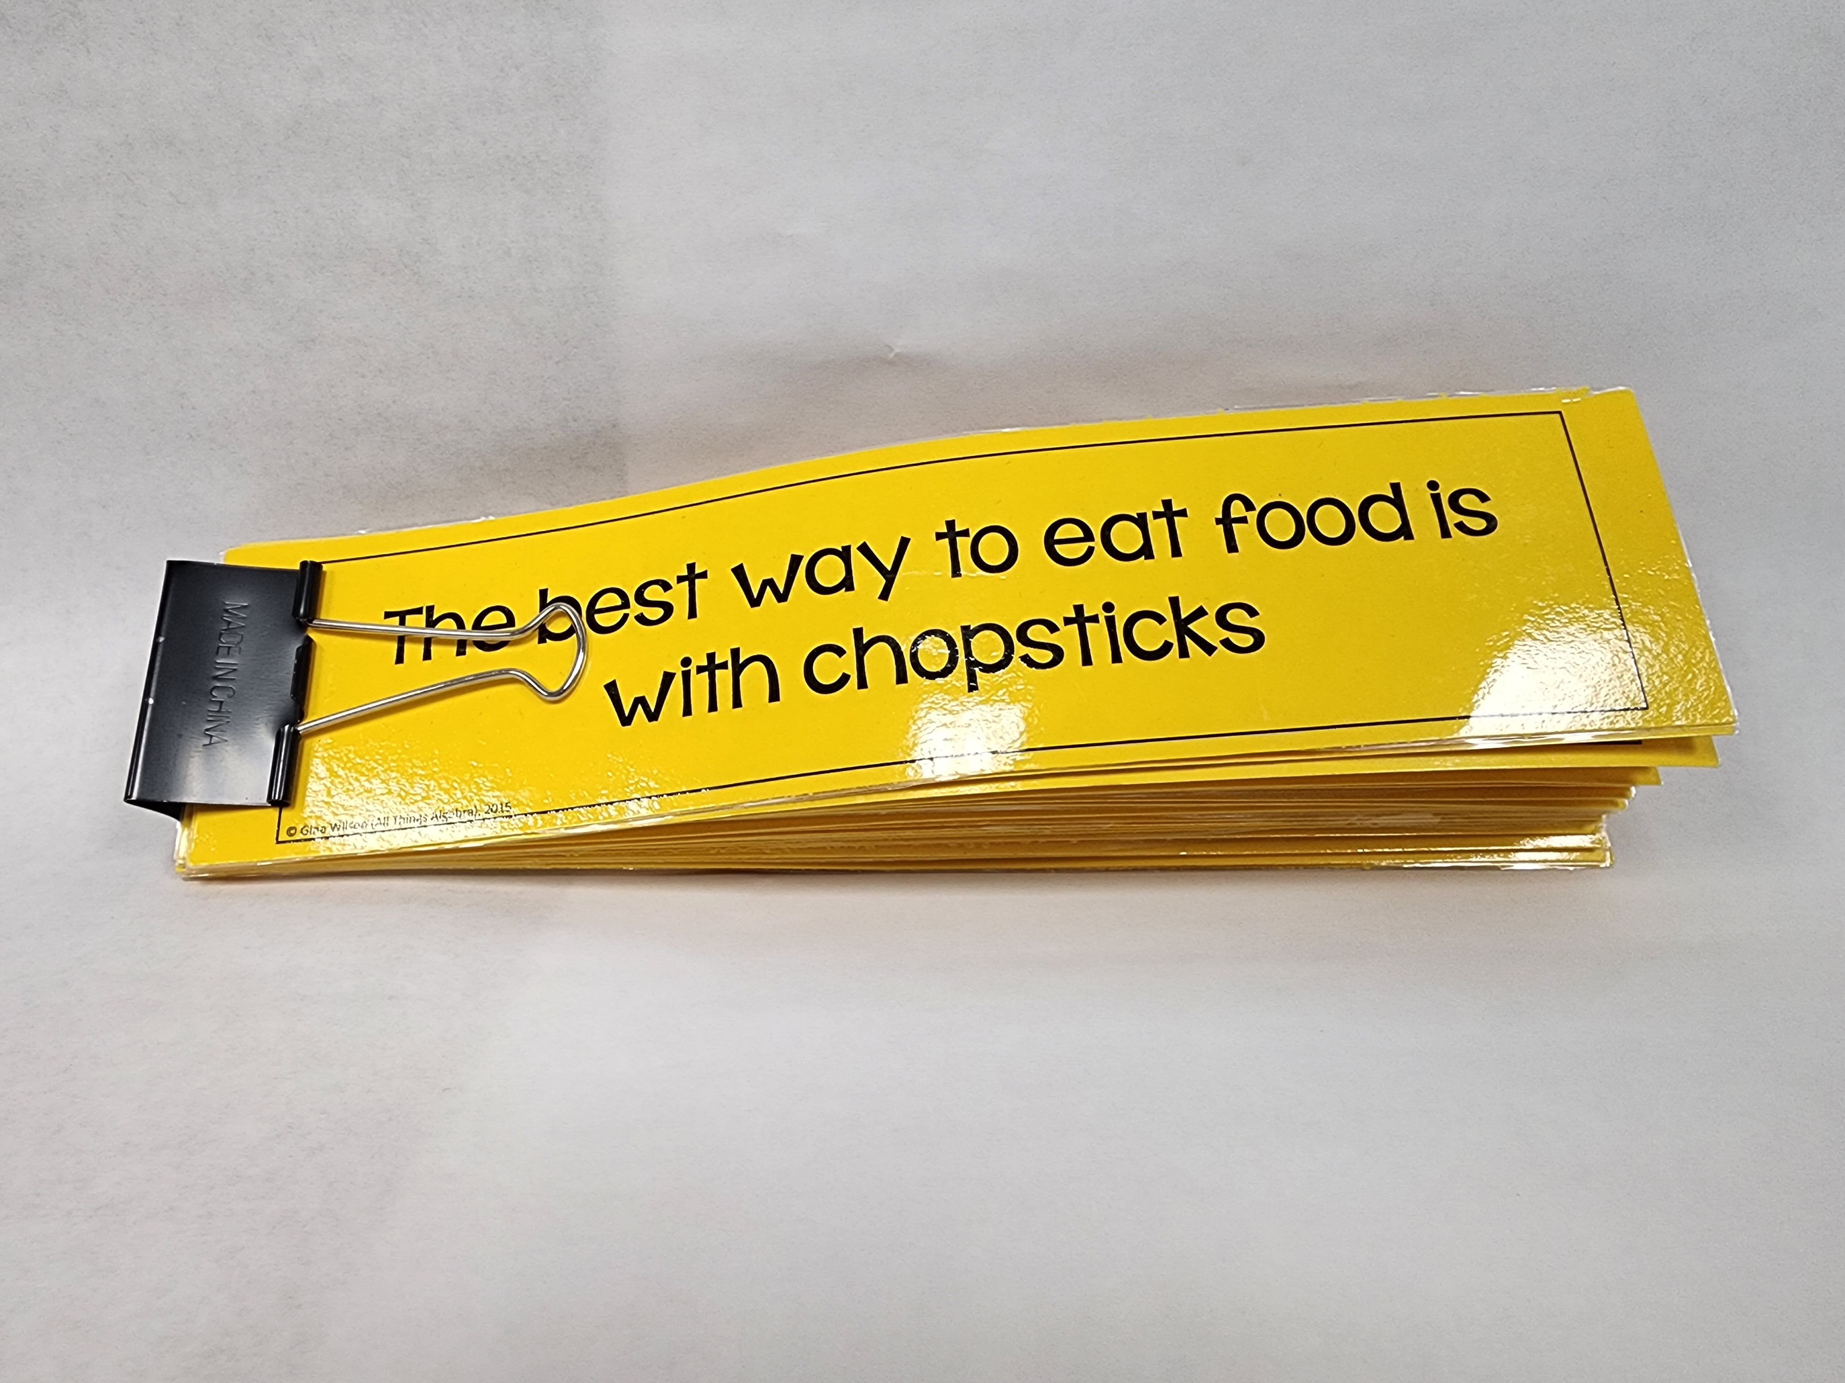
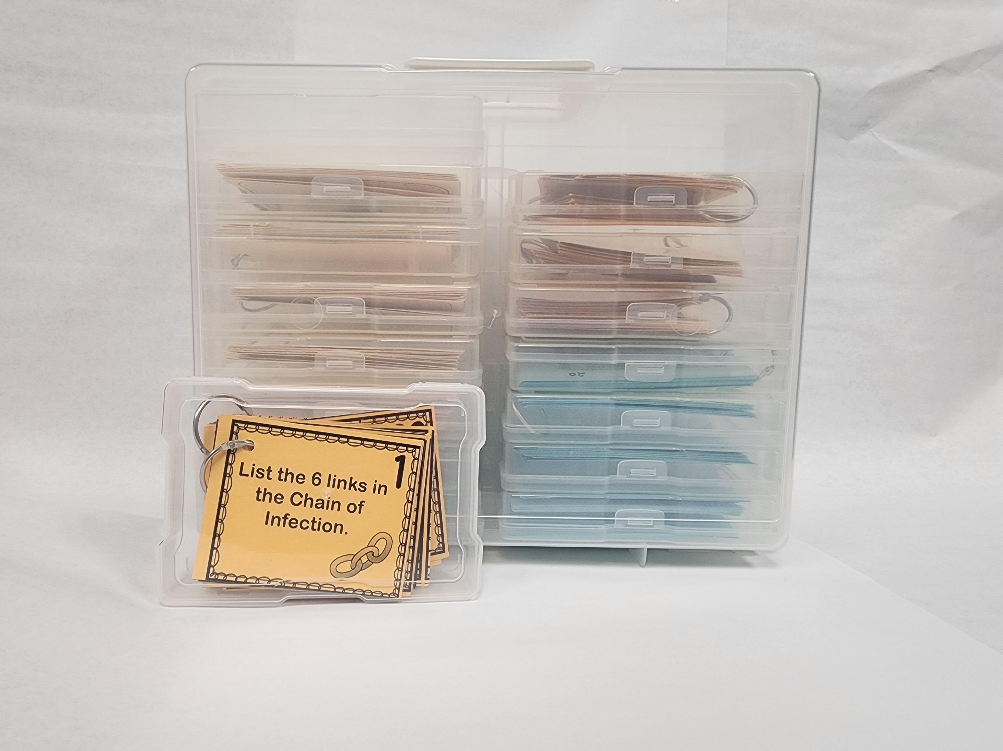
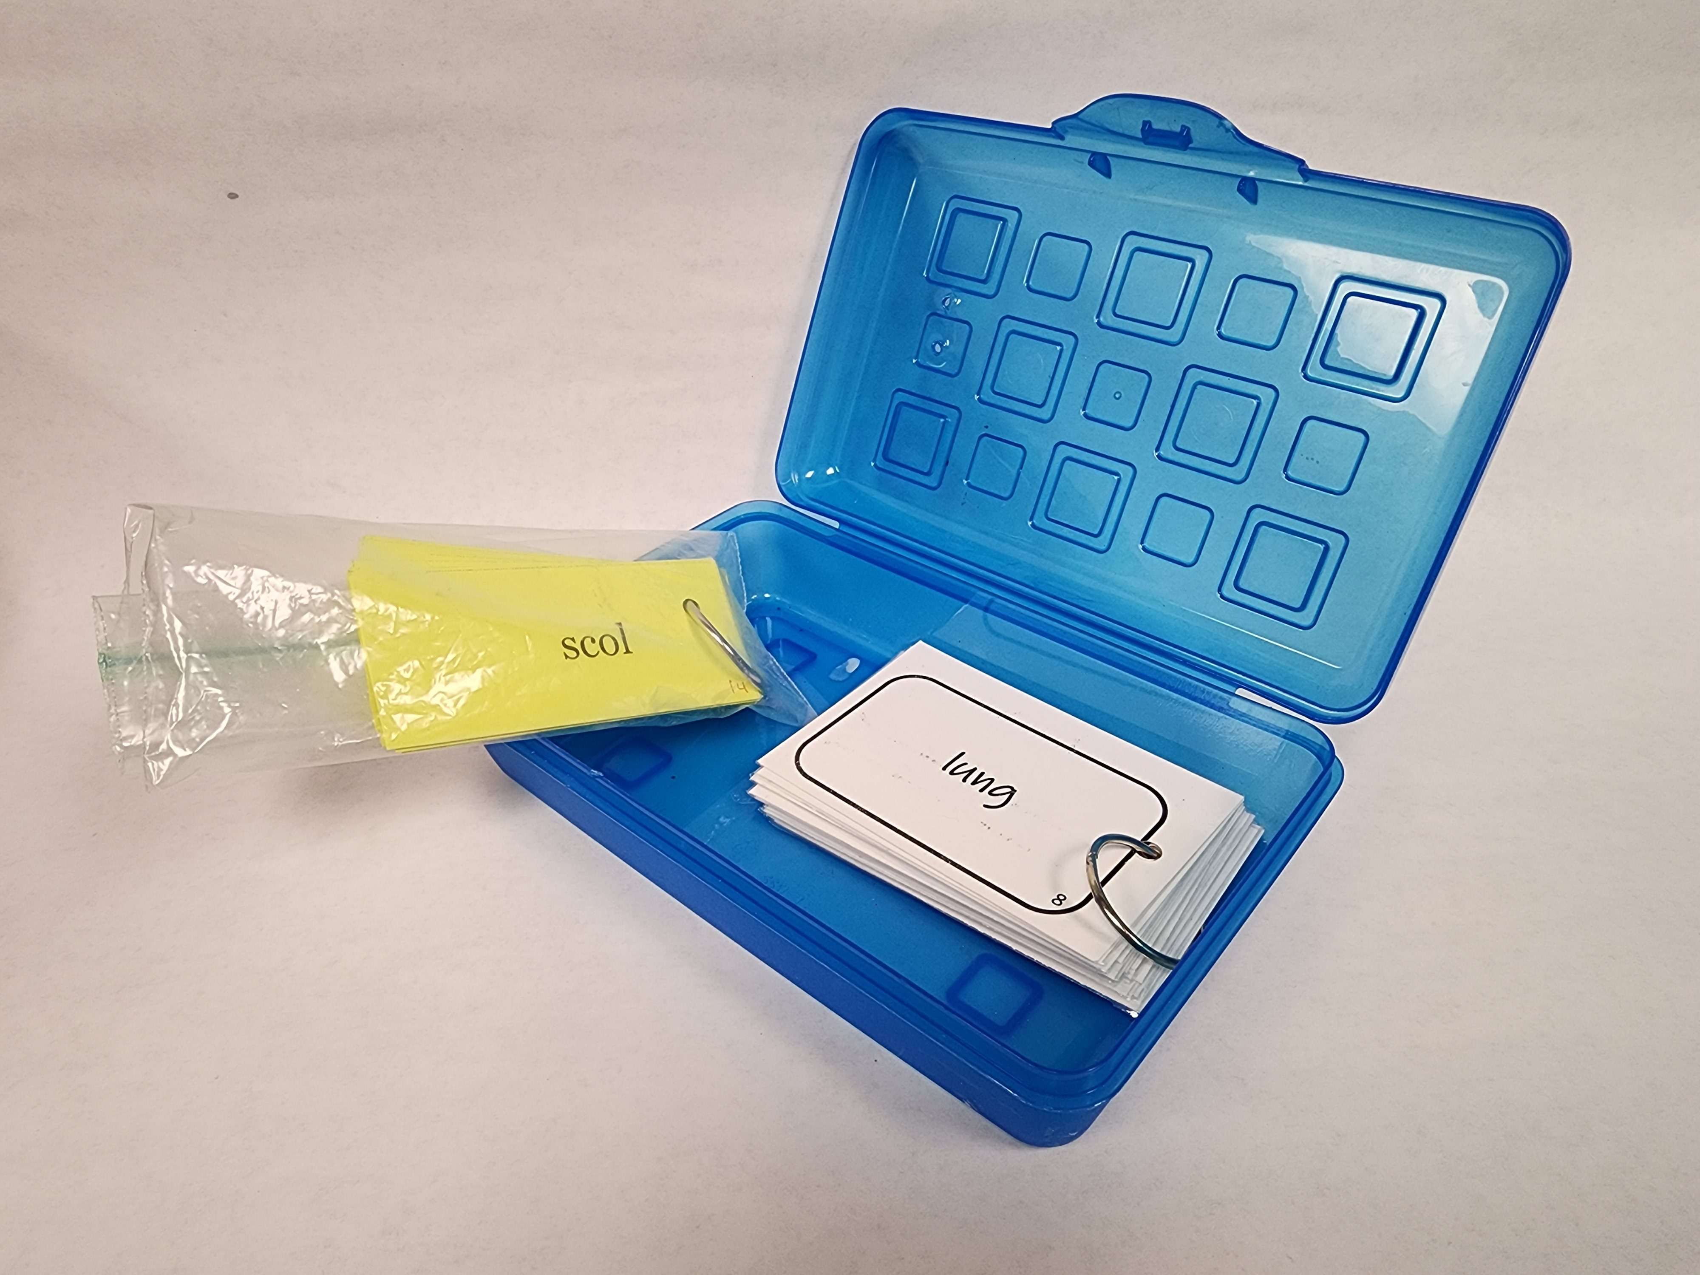

Slide 14
FLASHCARDS
WHEN
Individual
Partner
Matching / Go Fish
Memory
Race car
Ordering
Categorizing
The CTE Preceptor 2023
Notes:
Why is it important

Slide 15
2
TASK CARDS
The CTE Preceptor 2023

Slide 16
TASK CARDS
Cards that have a different task or assignment listed on them. Unlike worksheets, task cards have only one task per card.
The CTE Preceptor 2023
Notes:
Explain different than flash cards

Slide 17
TASK CARDS
WHY
Easy
Update
Solve a problem
Higher level thinking
Various formats
The CTE Preceptor 2023
Notes:
Why is it important – different from flash cards

Slide 18
TASK CARDS
HOW
Same as flashcards
Determine layout
(4 per sheet)
No answer
Answer key
The CTE Preceptor 2023
Notes:
How to create

Slide 19
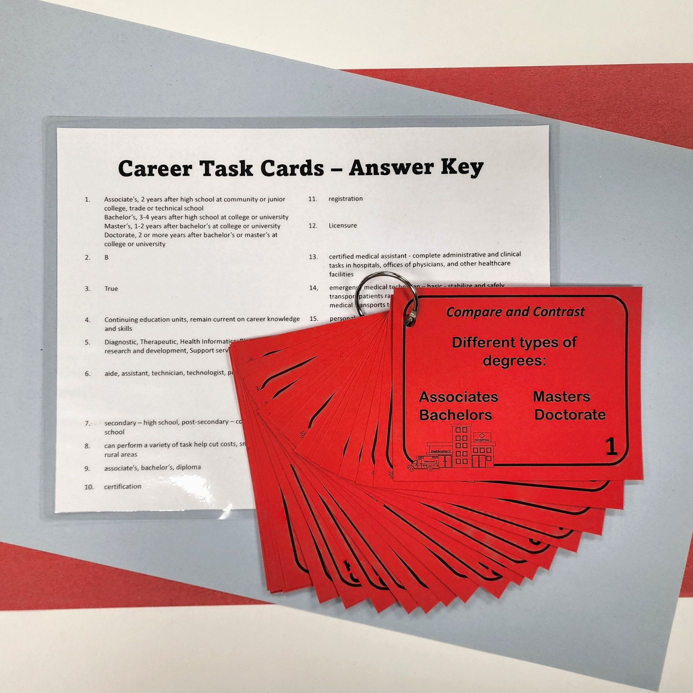

Slide 20
TASK CARDS
WHEN
Individual or group
Cards or slides
Stations
The CTE Preceptor 2023
Notes:
How – have qr code on the table

Slide 21
3
DECIDE AND DRAW
The CTE Preceptor 2023

Slide 22
DECIDE AND DRAW
Review game where students work in a group to answer multi-step questions using a drawing to document answers.
The CTE Preceptor 2023
Notes:
What it is – base for all others

Slide 23
DECIDE AND DRAW
WHY
Multi-step
Speed
Group work
Multiple units/lessons
Diagram
The CTE Preceptor 2023
Notes:
Why is it important – different from flash cards

Slide 24
DECIDE AND DRAW
HOW
Large diagram
Questions – 2 or more steps
Slides
Timer
The CTE Preceptor 2023
Notes:
How to create

Slide 25
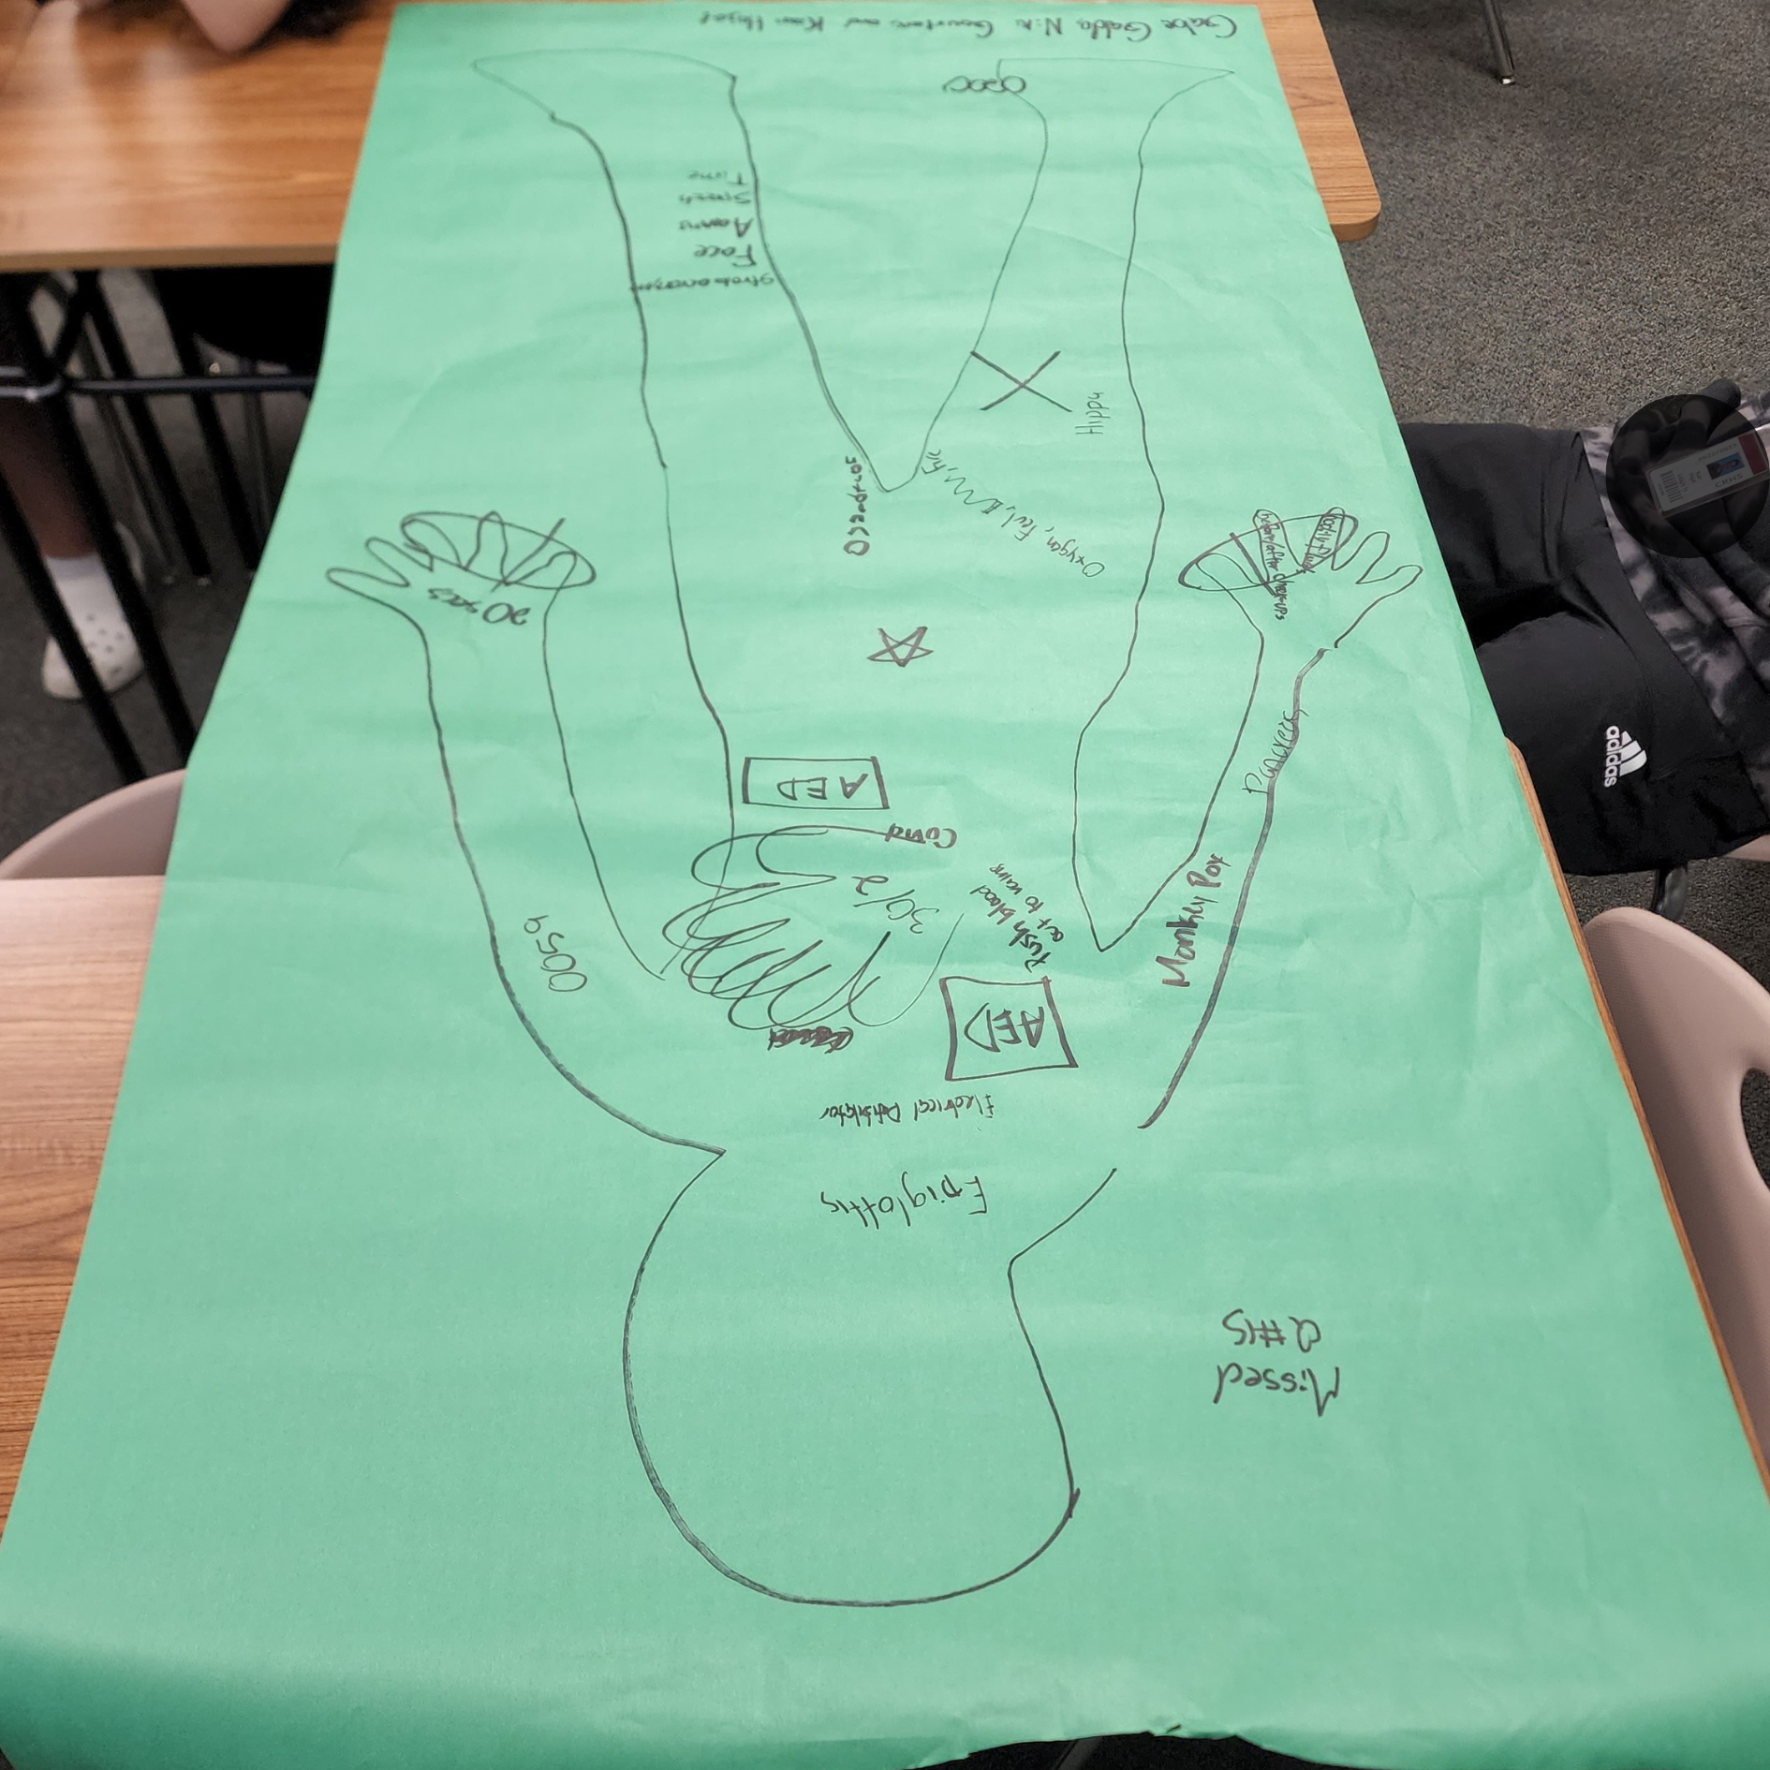

Slide 26
DECIDE AND DRAW
WHEN
Review PHS with HST
The CTE Preceptor 2023
Notes:
How – have qr code on the table

Slide 27
4
3 WAY MATCH
The CTE Preceptor 2023

Slide 28
3 WAY MATCH
Matching three items instead of two related to one topic.
Term
Definition
Example
The CTE Preceptor 2023
Notes:
Explain different than flash cards

Slide 29
3 WAY MATCH
WHY
Basic – flashcards
More than memorization
Words and pictures
The CTE Preceptor 2023
Notes:
Why is it important – different from flash cards

Slide 30
3 WAY MATCH
HOW
Flashcards (size)
3 parts
The CTE Preceptor 2023
Notes:
How to create

Slide 32
3 WAY MATCH
WHEN
Diseases with pictures
Categorize
Ordering
The CTE Preceptor 2023
Notes:
How – have qr code on the table

Slide 33
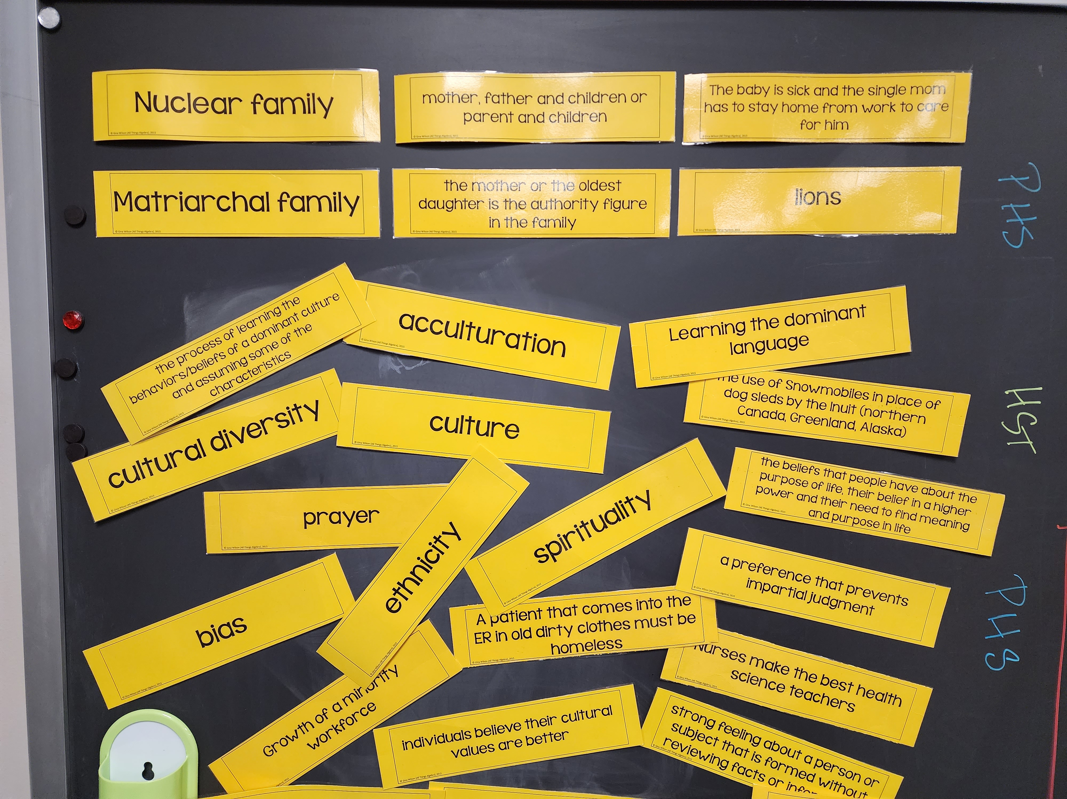

Slide 34
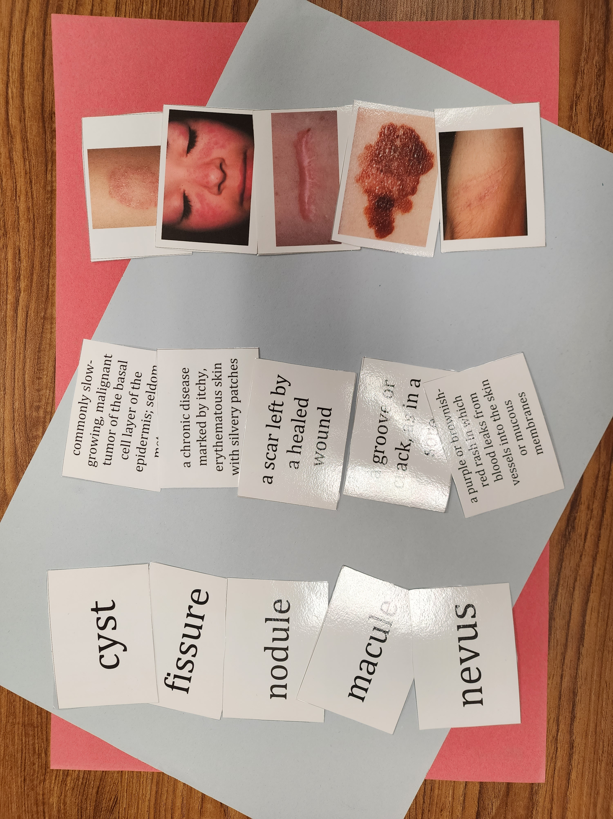

Slide 35
5
LIFE IS TOUGH
The CTE Preceptor 2023

Slide 36
LIFE IS TOUGH
Review game of chance where students work in groups to answer high-level questions with multiple steps.
The CTE Preceptor 2023
Notes:
What it is – base for all others

Slide 37
LIFE IS TOUGH
WHY
Game set-up
Teamwork
Student roles
Multi-level questions
Teacher involvement
Points
The CTE Preceptor 2023
Notes:
Why is it important – different from flash cards

Slide 38
LIFE IS TOUGH
HOW
Multi-step and multi-level questions
Slides
Points cards
Assign roles
Check answers
The CTE Preceptor 2023
Notes:
How to create

Slide 39
Blank

Slide 40
List and explain the four main vital signs. State normal ranges for vital signs.

Slide 41
Blank

Slide 42
LIFE IS TOUGH
WHEN
Endless
The CTE Preceptor 2023
Notes:
How – have qr code on the table

Slide 43
Free Task Cards
Contact Information
www.thectepreceptor.com
@thectepreceptor
https://biturl.top/eIb6zy
the cte preceptor
Health science habits

