Slide 1
MEDICAL TERMINOLOGY
BY BODY SYSTEM

Slide 2
THE SMARTEST WAY TO LEARN!
Dean Vaughn Career Prep® is a career pathing and education platform that makes learning fun and effective.
Students learn in a more natural way; through audionyms and illogical associations that make it impossible to forget the terms they learned.
Official reference and source for HOSA medical terminology competition.

Slide 3
Trusted by 12,000+ Academic & Business Institutions
Over the past 40 years, schools have trusted Dean Vaughn to help teach health science courses.
Leading employers in the healthcare field rely on Dean Vaughn for career pathing and to ensure their employees are compliant with proficiency standards.

Slide 4
HOW DOES IT WORK?
Dean Vaughn Total Career Prep® uses audionyms™ and illogical associations to make it incredibly easy to remember medical terminology.

Slide 5
pulmon- – pool/moon
WHAT IS AN AUDIONYM?
An audionym is a sound name – a sound-alike keyword (or keywords) for a medical element or word part we wish to remember.
-ectomy – egg/tomato

Slide 6
WHAT IS AN ILLOGICAL ASSOCIATION?
An illogical association is a familiar image that is altered “illogically” to link a medical word part to its meaning.

Slide 7
DEMONSTRATION
Medical Terminology by Body System teaches 275 medical elements – prefixes, roots, and suffixes – that combine to form thousands of complex medical terms.

Slide 8
To demonstrate how the Dean Vaughn Career Prep® works, we will show you how to remember just two medical elements and the meaning of each.
gastr- stomach
-itis inflammation

Slide 9
gastr- gas
truck
Let’s begin.
An audionym for gastr- could be gas truck.
gastr- • gas truck

Slide 10
gastr- gas
truck
To make it easier to remember that gastr- means stomach, we’ll change our gas truck into something that looks like this…

Slide 11
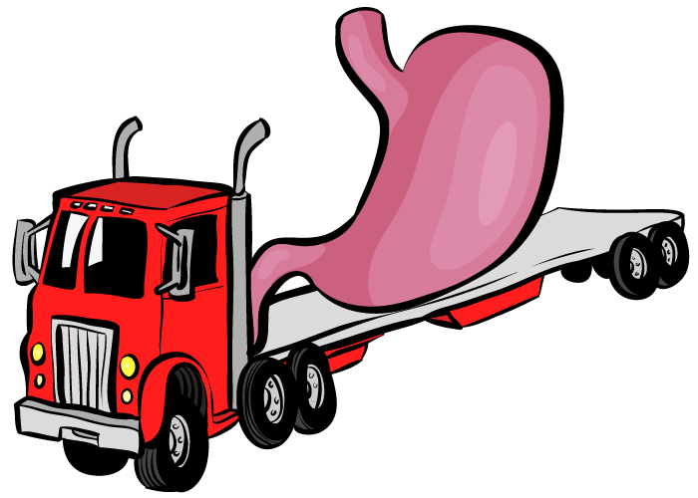
gastr- gas
truck
The gas truck has a stomach for a tank!
Can you imagine that?

Slide 12
gastr- gas
truck
stomach
See the gas truck with a stomach for a tank and it will be easier to remember that gastr- means stomach.

Slide 13
-itis eye test
Next, the medical element -itis.
An audionym for -itis could be eye test.
-itis • eye test

Slide 14
-itis eye test
To help us remember that -itis means
inflammation, we’ll change the eye test to look like this…

Slide 15
-itis eye test
Suddenly the eye test is in flames! Have you ever seen anything like this?
in flames

Slide 16
-itis eye test
inflammation
See the eye test in flames and you will more easily remember that -itis means inflammation.
in flames

Slide 17
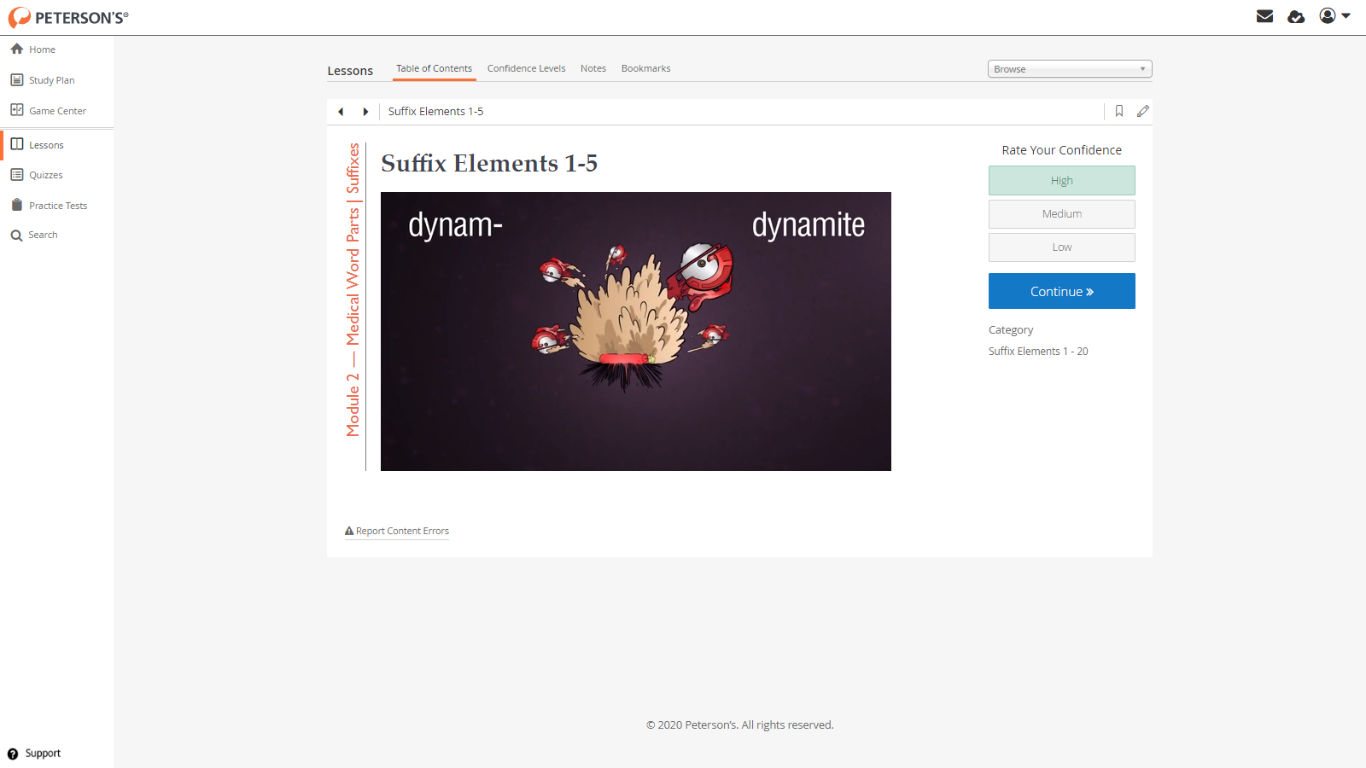
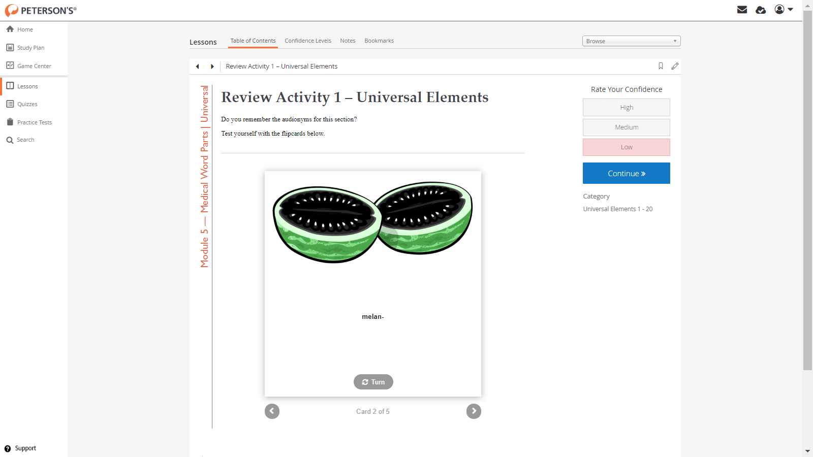
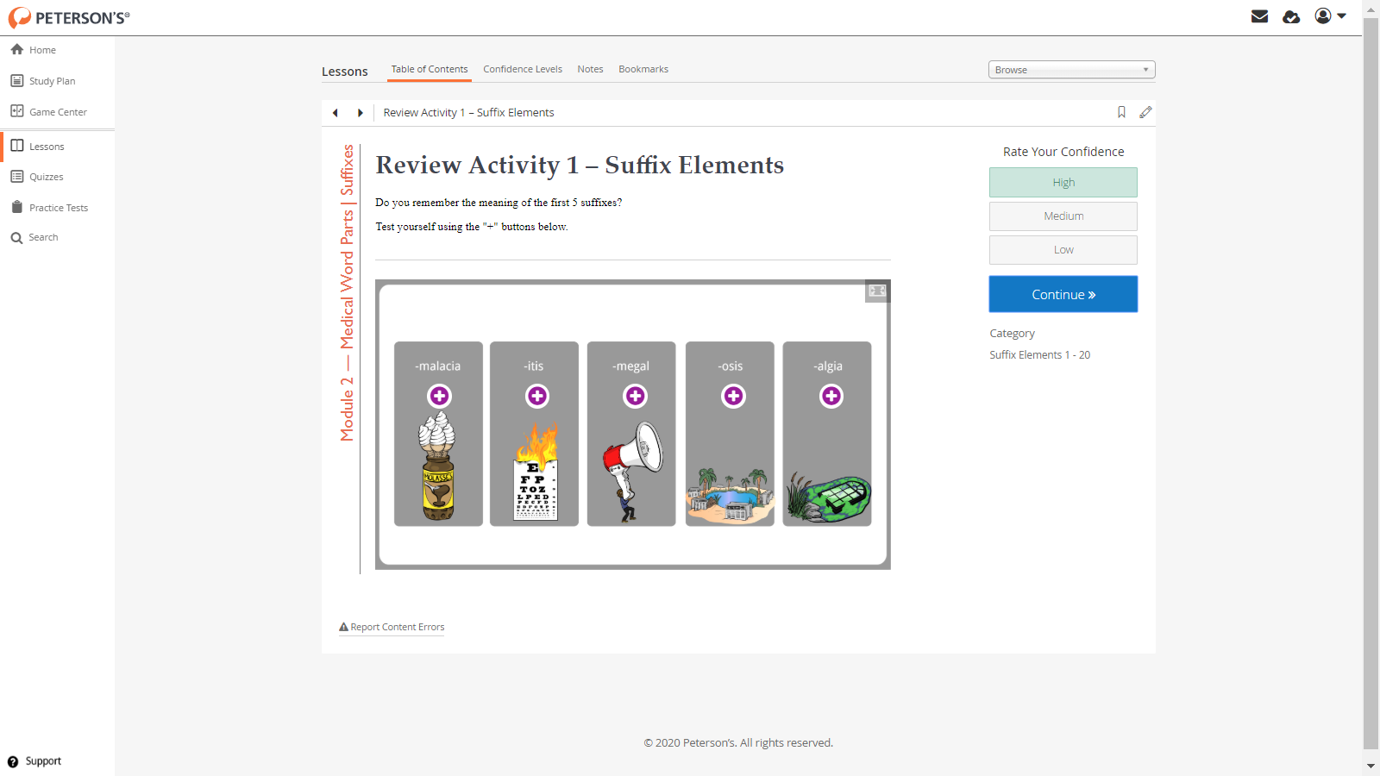
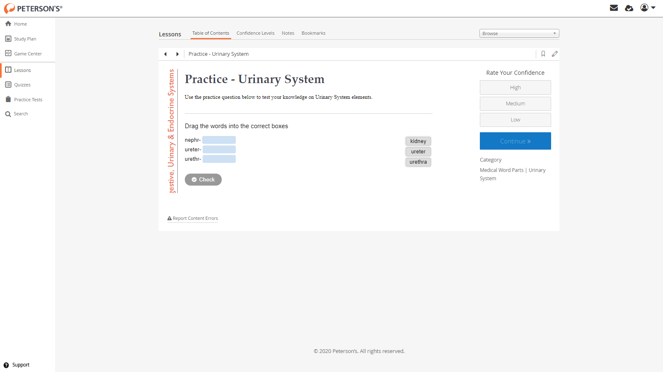
INTERACTIVE LEARNING ACTIVITIES
To engage your students, maximize learning, and reinforce retention.

Slide 18
MEDICAL TERMINOLOGY BY BODY SYSTEM
Sample screenshot ∙
Video lesson

Slide 19
MEDICAL TERMINOLOGY BY BODY SYSTEM
Sample screenshot ∙
Flashcards

Slide 20
MEDICAL TERMINOLOGY BY BODY SYSTEM
Sample screenshot ∙
Learning activity

Slide 21
MEDICAL TERMINOLOGY BY BODY SYSTEM
Sample screenshot ∙
Interactive activity

Slide 22
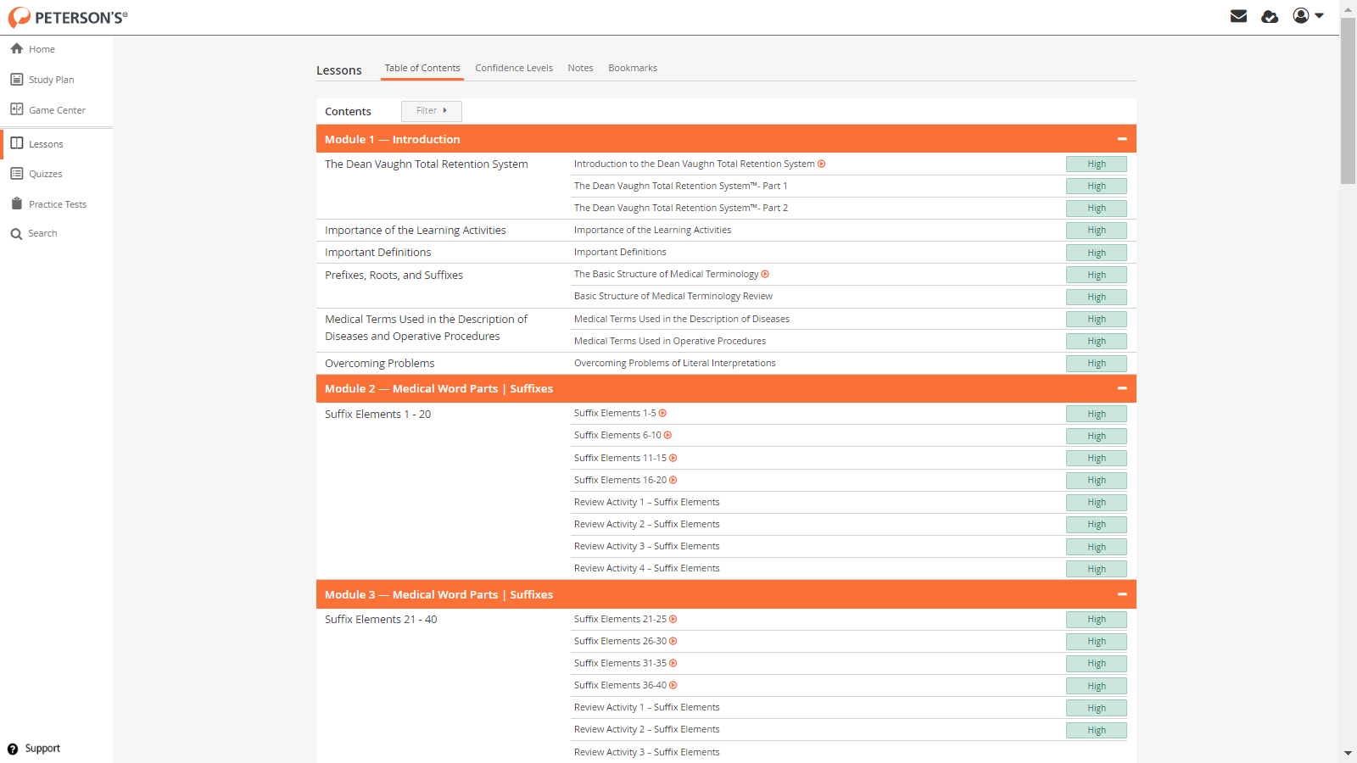
MEDICAL TERMINOLOGY BY BODY SYSTEM
Sample screenshot ∙
Course overview

Slide 23
LEARN & REMEMBER MEDICAL TERMINOLOGY
Pre-Test, Practice & Final Test to measure student learning and evaluate instruction
Basic design & structure of medical terminology
275 Greek & Latin word parts – prefixes, roots & suffixes
Interpret thousands of complex medical terms!

Slide 24
The Dean Vaughn Career Prep™
MEDICAL TERMINOLOGY BY BODY SYSTEM
Newly updated, interactive and fully online. No additional materials or prior knowledge needed to complete the course!
Available for institutional application and license
Teaches the basic design and structure of medical terminology, and how to easily remember the meanings of 275 Greek and Latin word parts
Organized and presented by body system, helping learners to hone-in on knowledge specific to medical specialties
Instructor-led or self-paced
Can be completed in as little as 12 hours or over a period of several weeks or months
Aligned with National Consortium for Health Science Education (NCHSE) standards

Slide 25
Dean Vaughn Career Prep®
MEDICAL TERMINOLOGY BY BODY SYSTEM
For more information about institutional licensing for businesses, schools & government agencies contact
Greg Newcomb at greg.newcomb@petersons.com
Or visit us at deanvaughn.com

