Slide 1
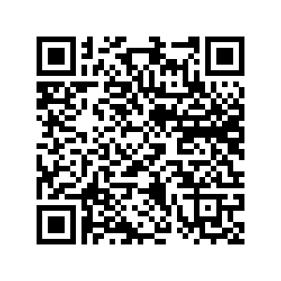
Welcome
START!
Linda Stanhope
Kim Turnbull

Slide 2
50 Ways to Teach Med Term
Session Two
Activities
Labs
Scenarios
Drills
Research
Notes:
Using a shoulder partner tell one another how your typical meal compares to the recommended MyPlate

Slide 3
Real Life
•
Medical Record Practice

Slide 4
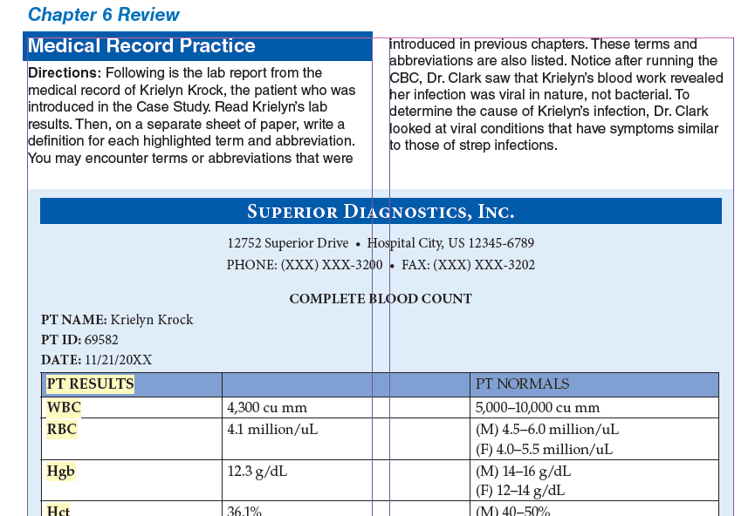
Labs
X-ray Reports
Consultations
H & P
Nurses Notes
MEDICAL RECORD
Notes:
Use students and create a story about why one may need more than another.

Slide 5
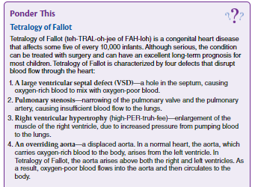
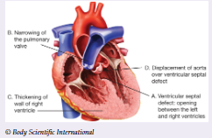
NEXT!
Ponder This

Slide 6
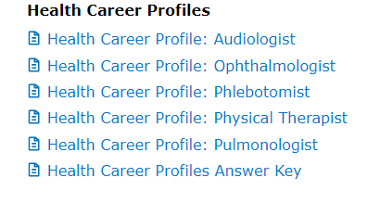
Career Spotlight
A Day in the Life
CREDITS
Career List
Phlebotomist

Slide 7
Career Spotlight
CREDITS
Phlebotomist

Slide 8
Table of Contents
Official Event Resource
Sports Medicine
Career Health
Display
Biomedical Debate
Medical Spelling
Epidemiology
Notes:
Use students and create a story about why one may need more than another.

Slide 9
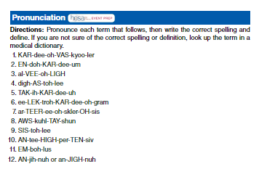
Table of Contents
Event Prep
Sports Medicine
Career Health
Display
Biomedical Debate
Medical Spelling
Epidemiology
Notes:
Use students and create a story about why one may need more than another.

Slide 10
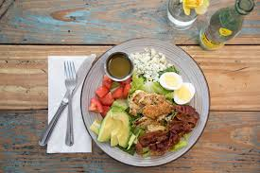
Inquiring Minds
Therapeutic Diet:
Any special diet
Enterally: Through a Feeding Tube
Parenteral: nutrition given
through an IV due to a non
functioning GI tract
Registered Dietitian: assesses nutritional status and plans diets according to needs of the patient.

Slide 11
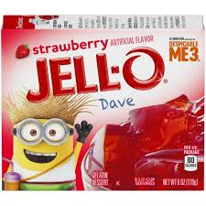
Specialized Diets for Patients
Inquiring Minds
Clear Liquid: Clear broth and juice, ginger ale, gelatin, popsicles, clear coffee, tea.
Requires minimal digestion - common after surgery
Full Liquid: Strained soups/cereals, coffee, fruit and veggie juice, ice cream, pudding + all clear liquids.
If unable to chew or swallow solid food (transition diet b/w clear liquid and solid food).
Soft and Bland
When a patient cannot swallow hard or coarse food.
Mechanical Soft: Soft diet except food is ground or strained.

Slide 12
Dipstick Lab
Workplace Lab
HOSA Competition
Real world application
Springboard discussion over hydration, infection, diabetes/disease conditions

Slide 13
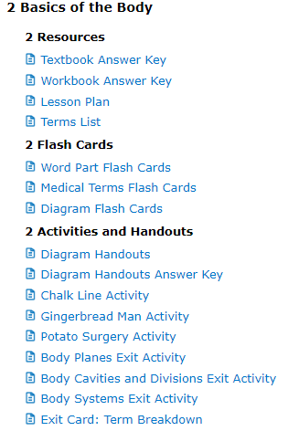
Menu
Lesson Plans
Scope & Sequence
Games
Teaching Strategies
Chapter Reviews
Cumulative Reviews
!
Additional Labs/Activities found in Teacher Resources
Textbook LABS

Slide 14
Walk in the patient’s shoes -
Literally
Help teach students empathy for their patients through simulations of disabilities
Vision- cheap readers, Vaseline, sleep mask
Arthritis- tape fingers/toes, rice or popcorn kernels in disposable gloves and socks, sticks
Sensory perception- thin or thick gloves and blindfolds
Hearing-earplugs and noise canceling headphones
Notes:
Have students act out/be visuals for the organs!

Slide 15
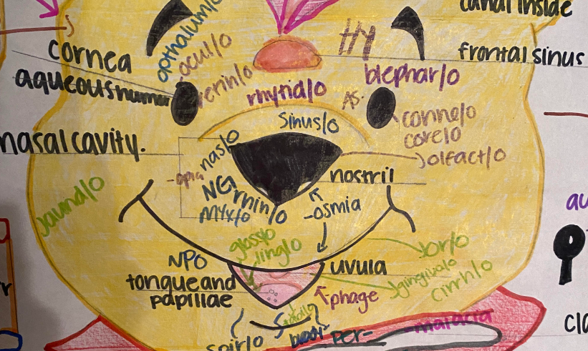
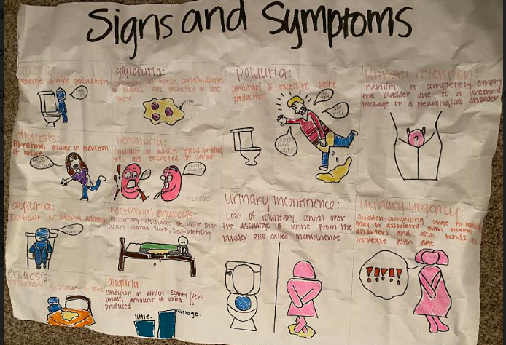
Labeling Practice & Drawing Terms
Practice
Word Parts
Terms
Practice!!

Slide 16
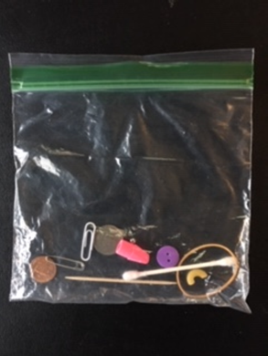
Student Challenge - oldy, but goody
What is
neuropathy?
In this activity students will work in pairs to perform a modified version of the
Some
materials
required
“Stereognosis Exam”

Slide 17
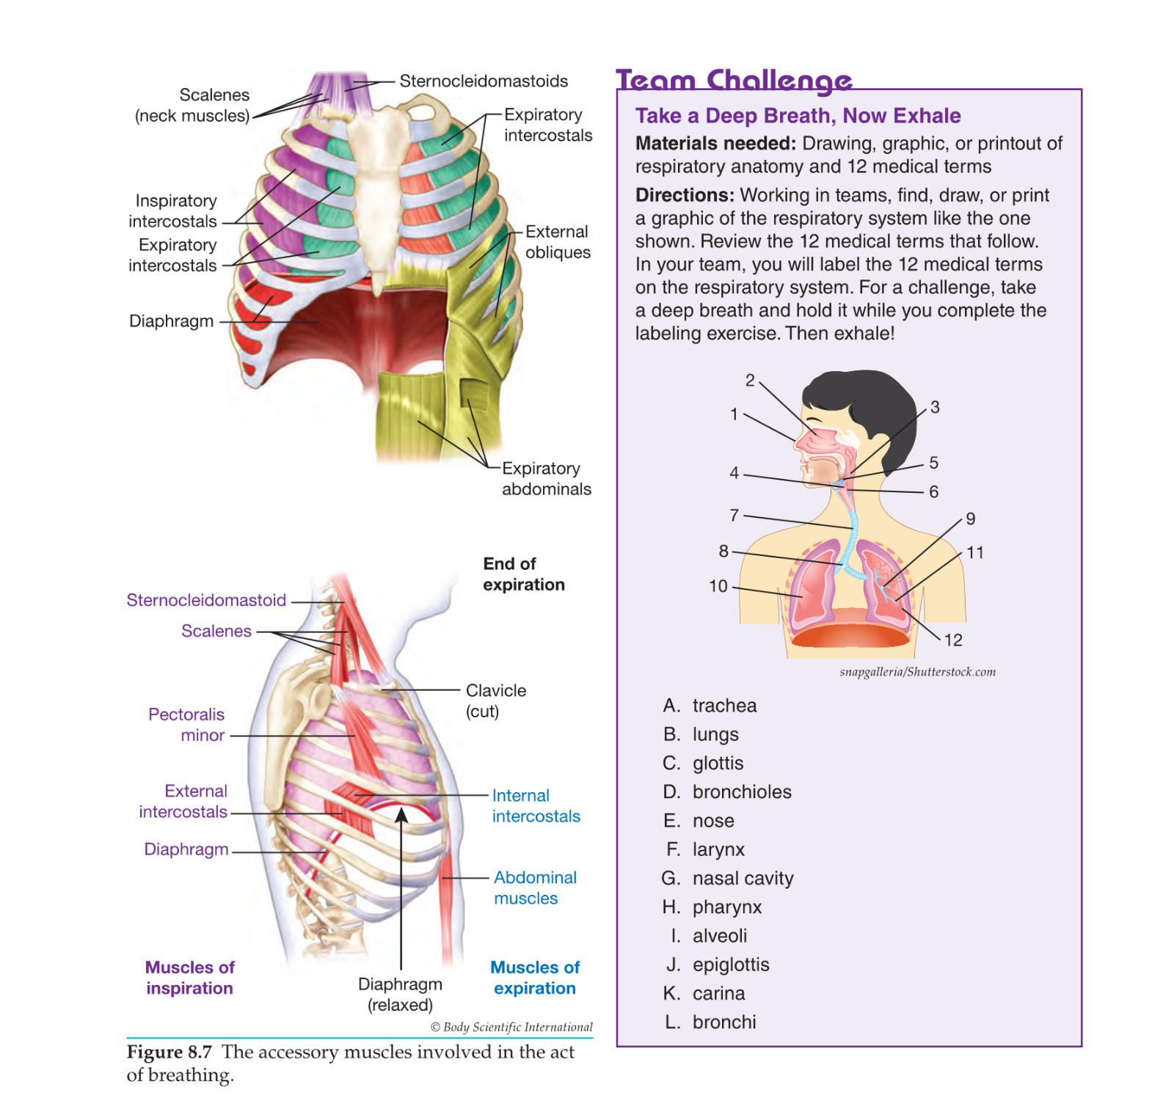
Team Challenge
:
Directions
Breathe In! Breathe Out!

Slide 18
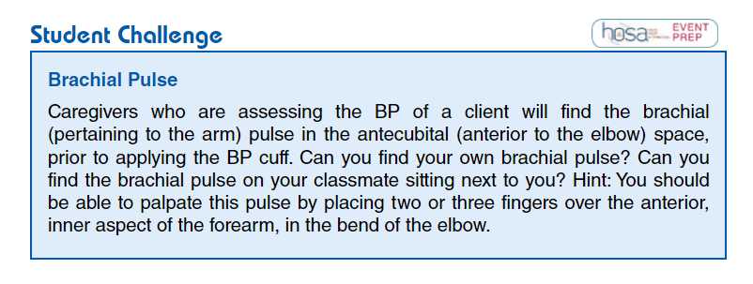
Student Challenge
:
Directions

Slide 19
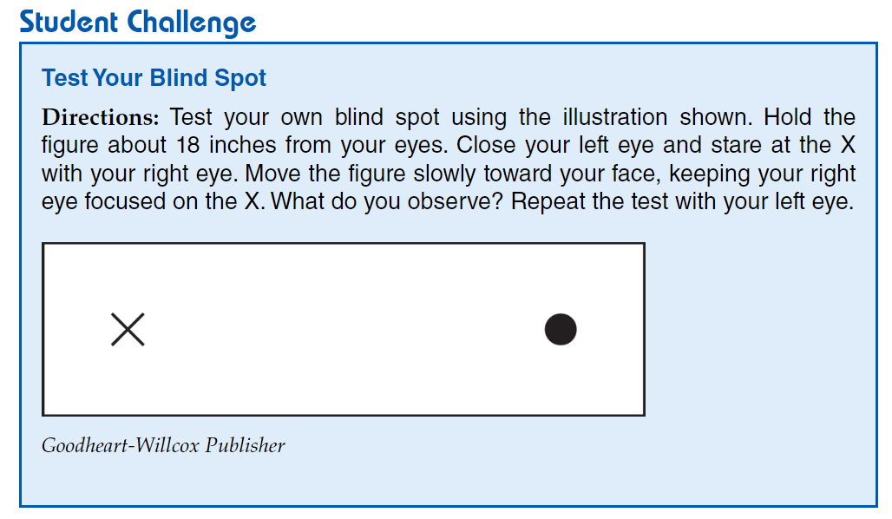
Student Challenge
:
Directions

Slide 20
Start with
terms students understand
Range of Motion
Snow Angel Arms
1
2
3
Brush your Hair
Open the door
Ankle circles
4
5
6
Passive ROM
Students take turns being patient and caregiver
WorkPlace Skill
Work Place Skills
Abduction
And
Adduction
Flexion
And
Extension
Pronation
And
Supination
Inversion
And
Eversion
Circumduction
Rotation
lateral/medial

Slide 21
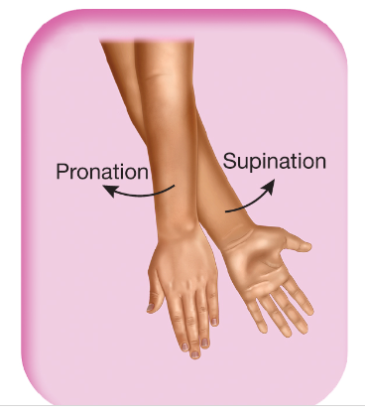
Start with
terms students understand
Range of Motion
Snow Angel Arms
1
2
3
Brush your Hair
Open the door
Ankle circles
4
5
6
Passive ROM
Students take turns being patient and caregiver
WorkPlace Skill
Work Place Skills
Abduction
And
Adduction
Flexion
And
Extension
Pronation
And
Supination
Inversion
And
Eversion
Circumduction
Rotation
lateral/medial

Slide 22
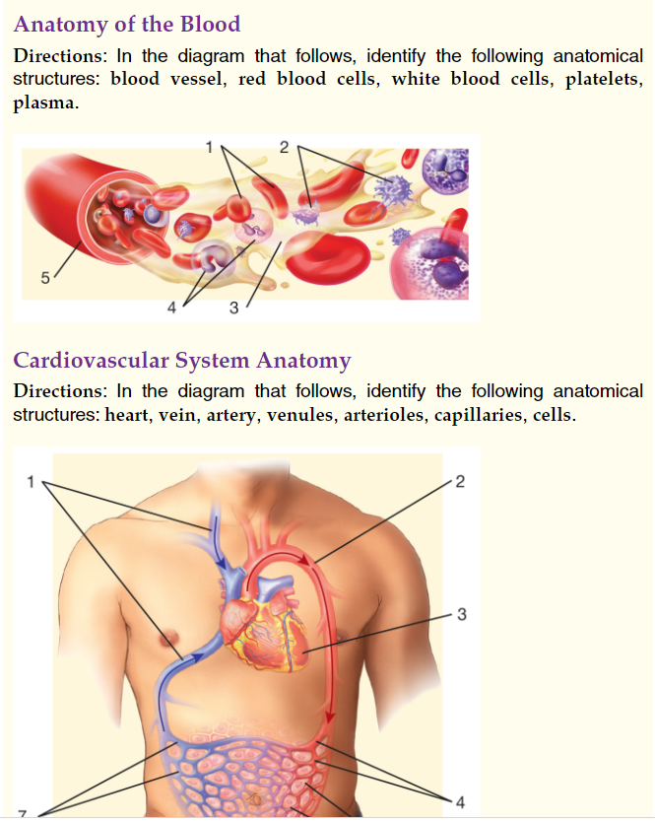
Cumulative Reviews
Notes:
Bland

Slide 23
Word Surgery

Slide 24
Bradycardia

Slide 25
Pertaining to slow heart (rate)

Slide 26
Word Construction

Slide 27
Incision into the vein

Slide 28
Phlebotomy

Slide 29
Direction found in Lesson Plans
Foldables
Bell ringers
Search the Source
Labs
Flash
cards
Games
White Boards
Review Activities
Models
Table Groups
Small group Races
Diagram cards
Word Surgery
Word Construction
Diagram Drills
Bingo
Flyswatter
Kahoot
Gimlet
Quizlet

Slide 30
Directions: Using reliable and credible online resources, complete the following activities.
1. The Ebola outbreak in 2014 was one of the largest Ebola outbreaks in history, and it was the first Ebola outbreak in West Africa. Visit the Centers for Disease Control and Prevention website and research signs and symptoms of Ebola hemorrhagic fever (EHF). Then study the graph below and answer the questions that follow.
A. What was the number of confirmed cases of Ebola in Guinea during the week of June 8, 2014? - Answer 33 B. What was the number of suspected cases the same week? -- Answer 4
C. Which time frame saw the highest number of confirmed cases of Ebola? Week of March 16, 2014 Week of April 13, 2014 Week of May 25, 2014
Search the Source
Notes:
Have students act out/be visuals for the organs!

Slide 31
Direction found in Lesson Plans
Foldables
Bell ringers
Exit Tickets
Labs
Flash
cards
Games
White Boards
Review Activities/Diagram Drills
Models
Table Groups
Small group Races
Diagram cards
Word Surgery
Word Construction
Diagram Drills
Bingo
Flyswatter
Kahoot
Gimlet
Quizlet

Slide 32
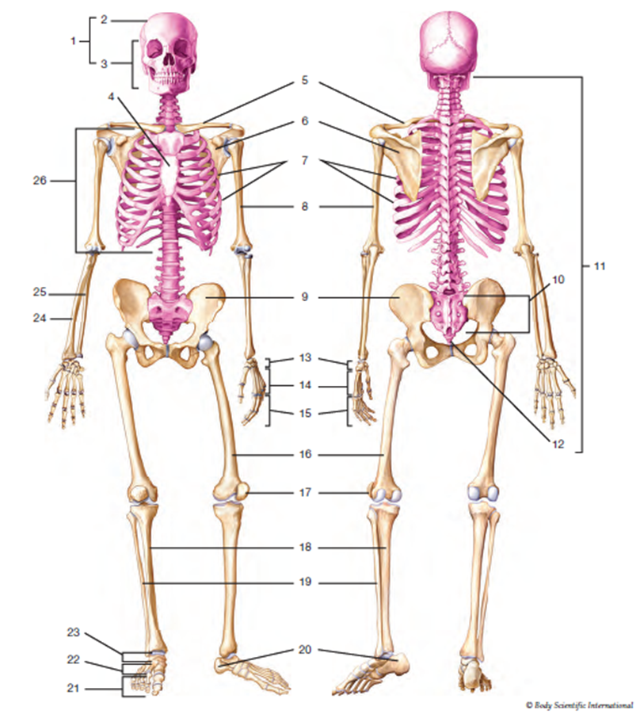
Diagram Drill
Diagram Drill
Notes:
Have students act out/be visuals for the organs!

Slide 33
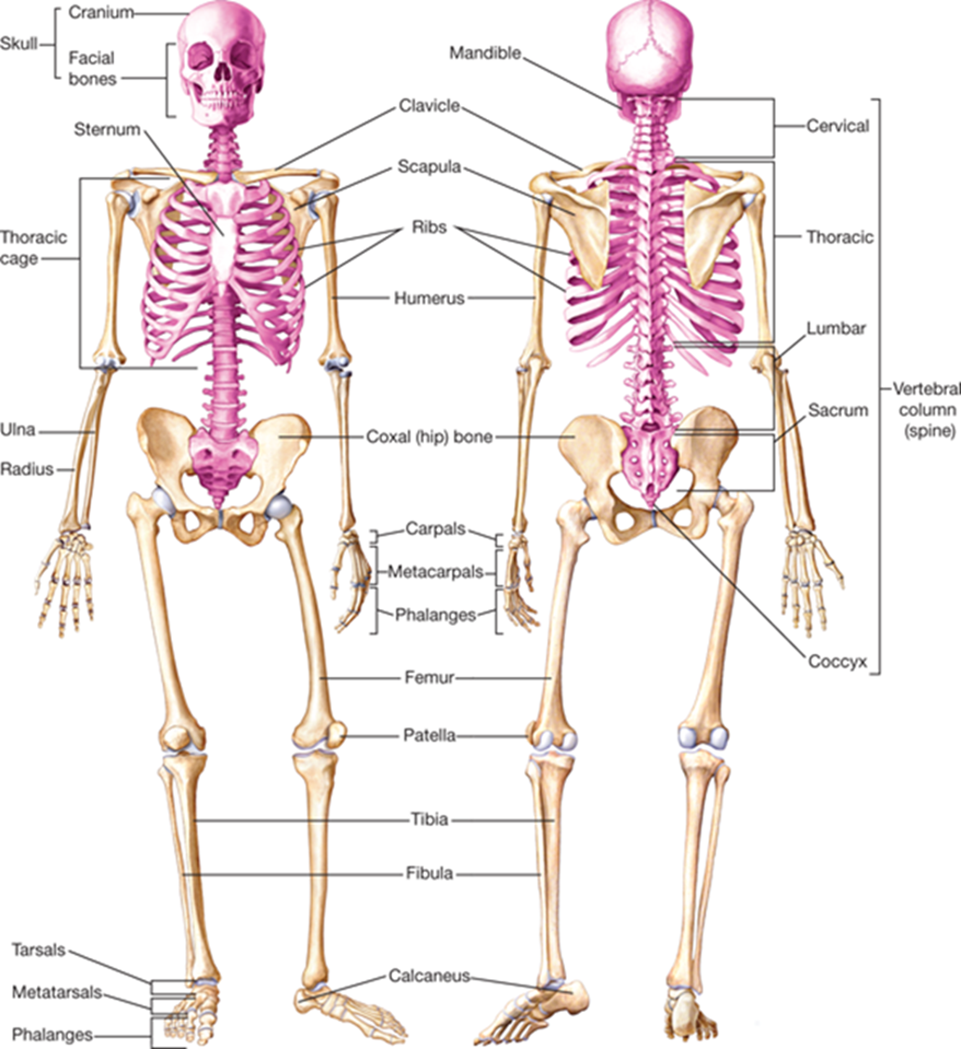
Diagram Drill
Diagram Drill
Notes:
Have students act out/be visuals for the organs!

Slide 34
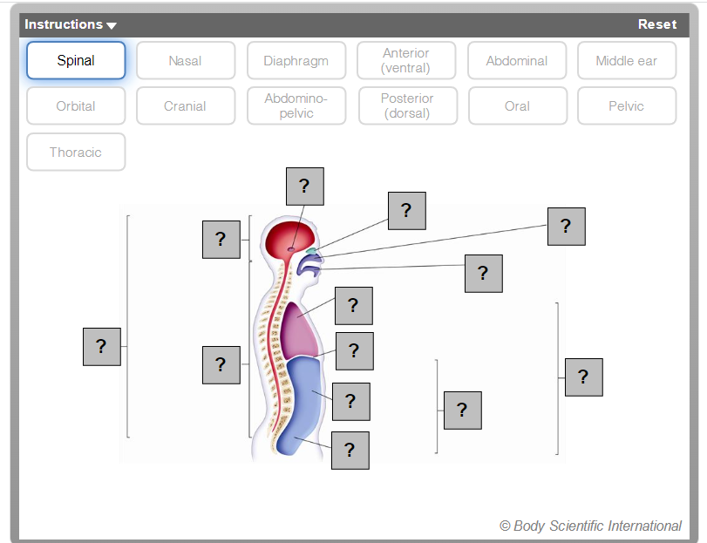
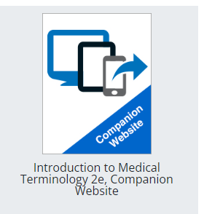
Companion Website
Notes:
Have students act out/be visuals for the organs!

Slide 35
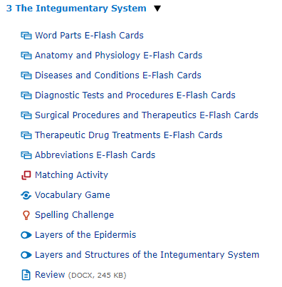
Companion Website
Notes:
Have students act out/be visuals for the organs!

Slide 36
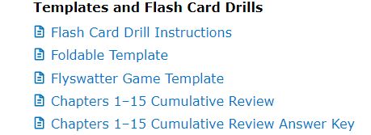
Direction found in Lesson Plans
Foldables
Bell ringers
Exit Tickets
Labs
Flash
cards
Games
White Boards
Review Activities/ Flashcards
Models
Table Groups
Small group Races
Diagram cards
Word Surgery
Word Construction
Diagram Drills
Bingo
Flyswatter
Kahoot
Gimlet
Quizlet

Slide 37
Flashcards- Small group race
Drills
Term
Definition
-otomy
incision
Practice!!

Slide 38
Direction found in Lesson Plans
Foldables
Bell ringers
Exit Tickets
Labs
Flash
cards
Games
White Boards
Review Activities/Flyswatter game
Models
Table Groups
Small group Races
Diagram cards
Word Surgery
Word Construction
Diagram Drills
Bingo
Flyswatter
Kahoot
Gimlet
Quizlet

Slide 39
Direction found in Lesson Plans
Foldables
Bell ringers
Exit Tickets
Labs
Flash
cards
Games
White Boards
Review Activities/Models
Models
Table Groups
Small group Races
Diagram cards
Word Surgery
Word Construction
Diagram Drills
Bingo
Flyswatter
Kahoot
Gimlet
Quizlet

Slide 40
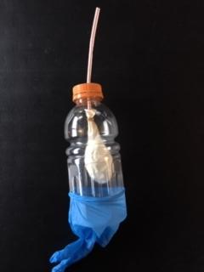
Make a Model!
Table of Contents
Trachea
Diaphragm
Lungs
Pharynx
Pleural cavity

Slide 41
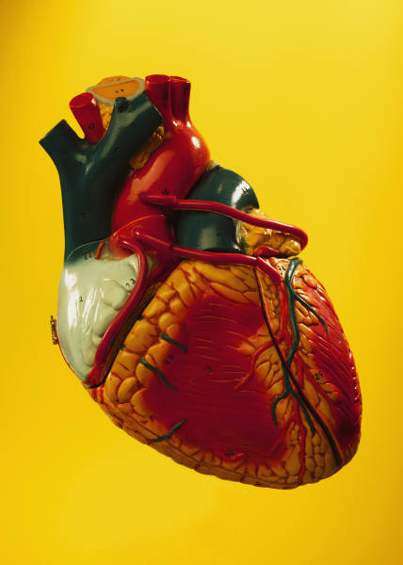
More Models!
Table of Contents
Skeleton
Reproductive
Brain
Skin
Urinary

Slide 42
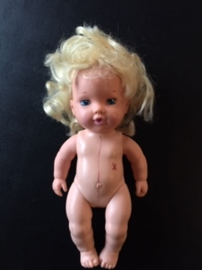
Creepy Baby Doll :)
Table of Contents
Planes
Cavities
Regions
Directional
Quadrants

Slide 43
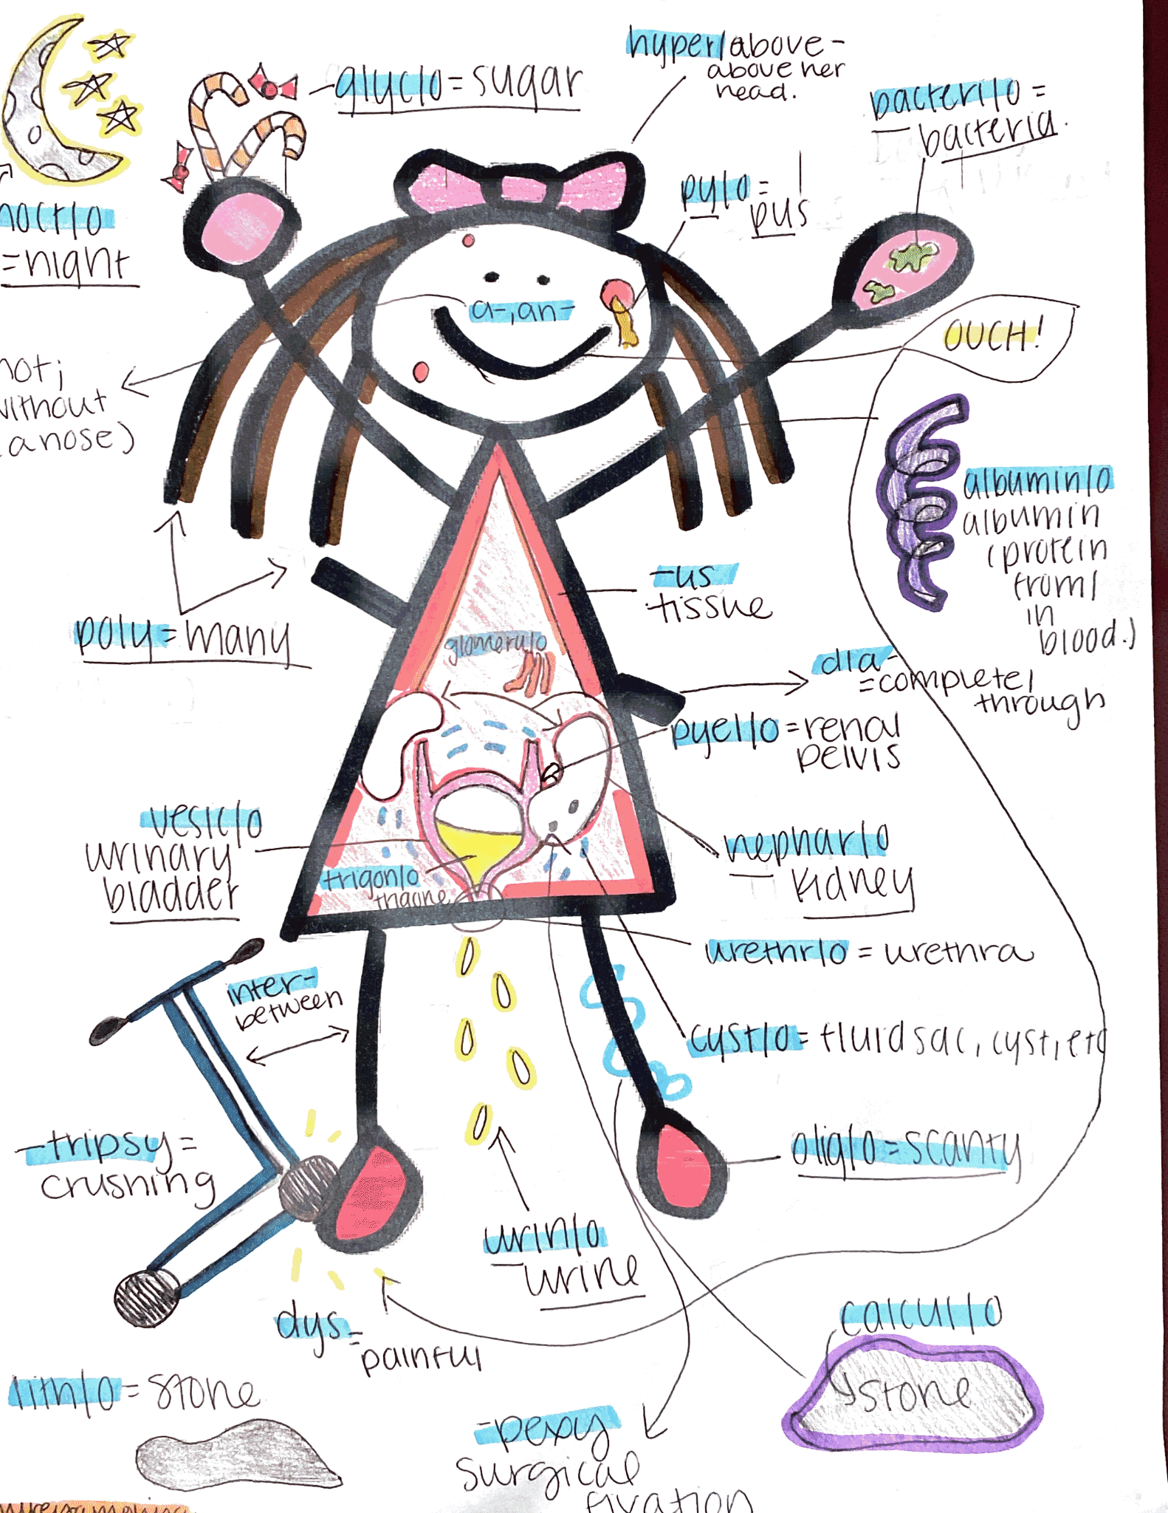
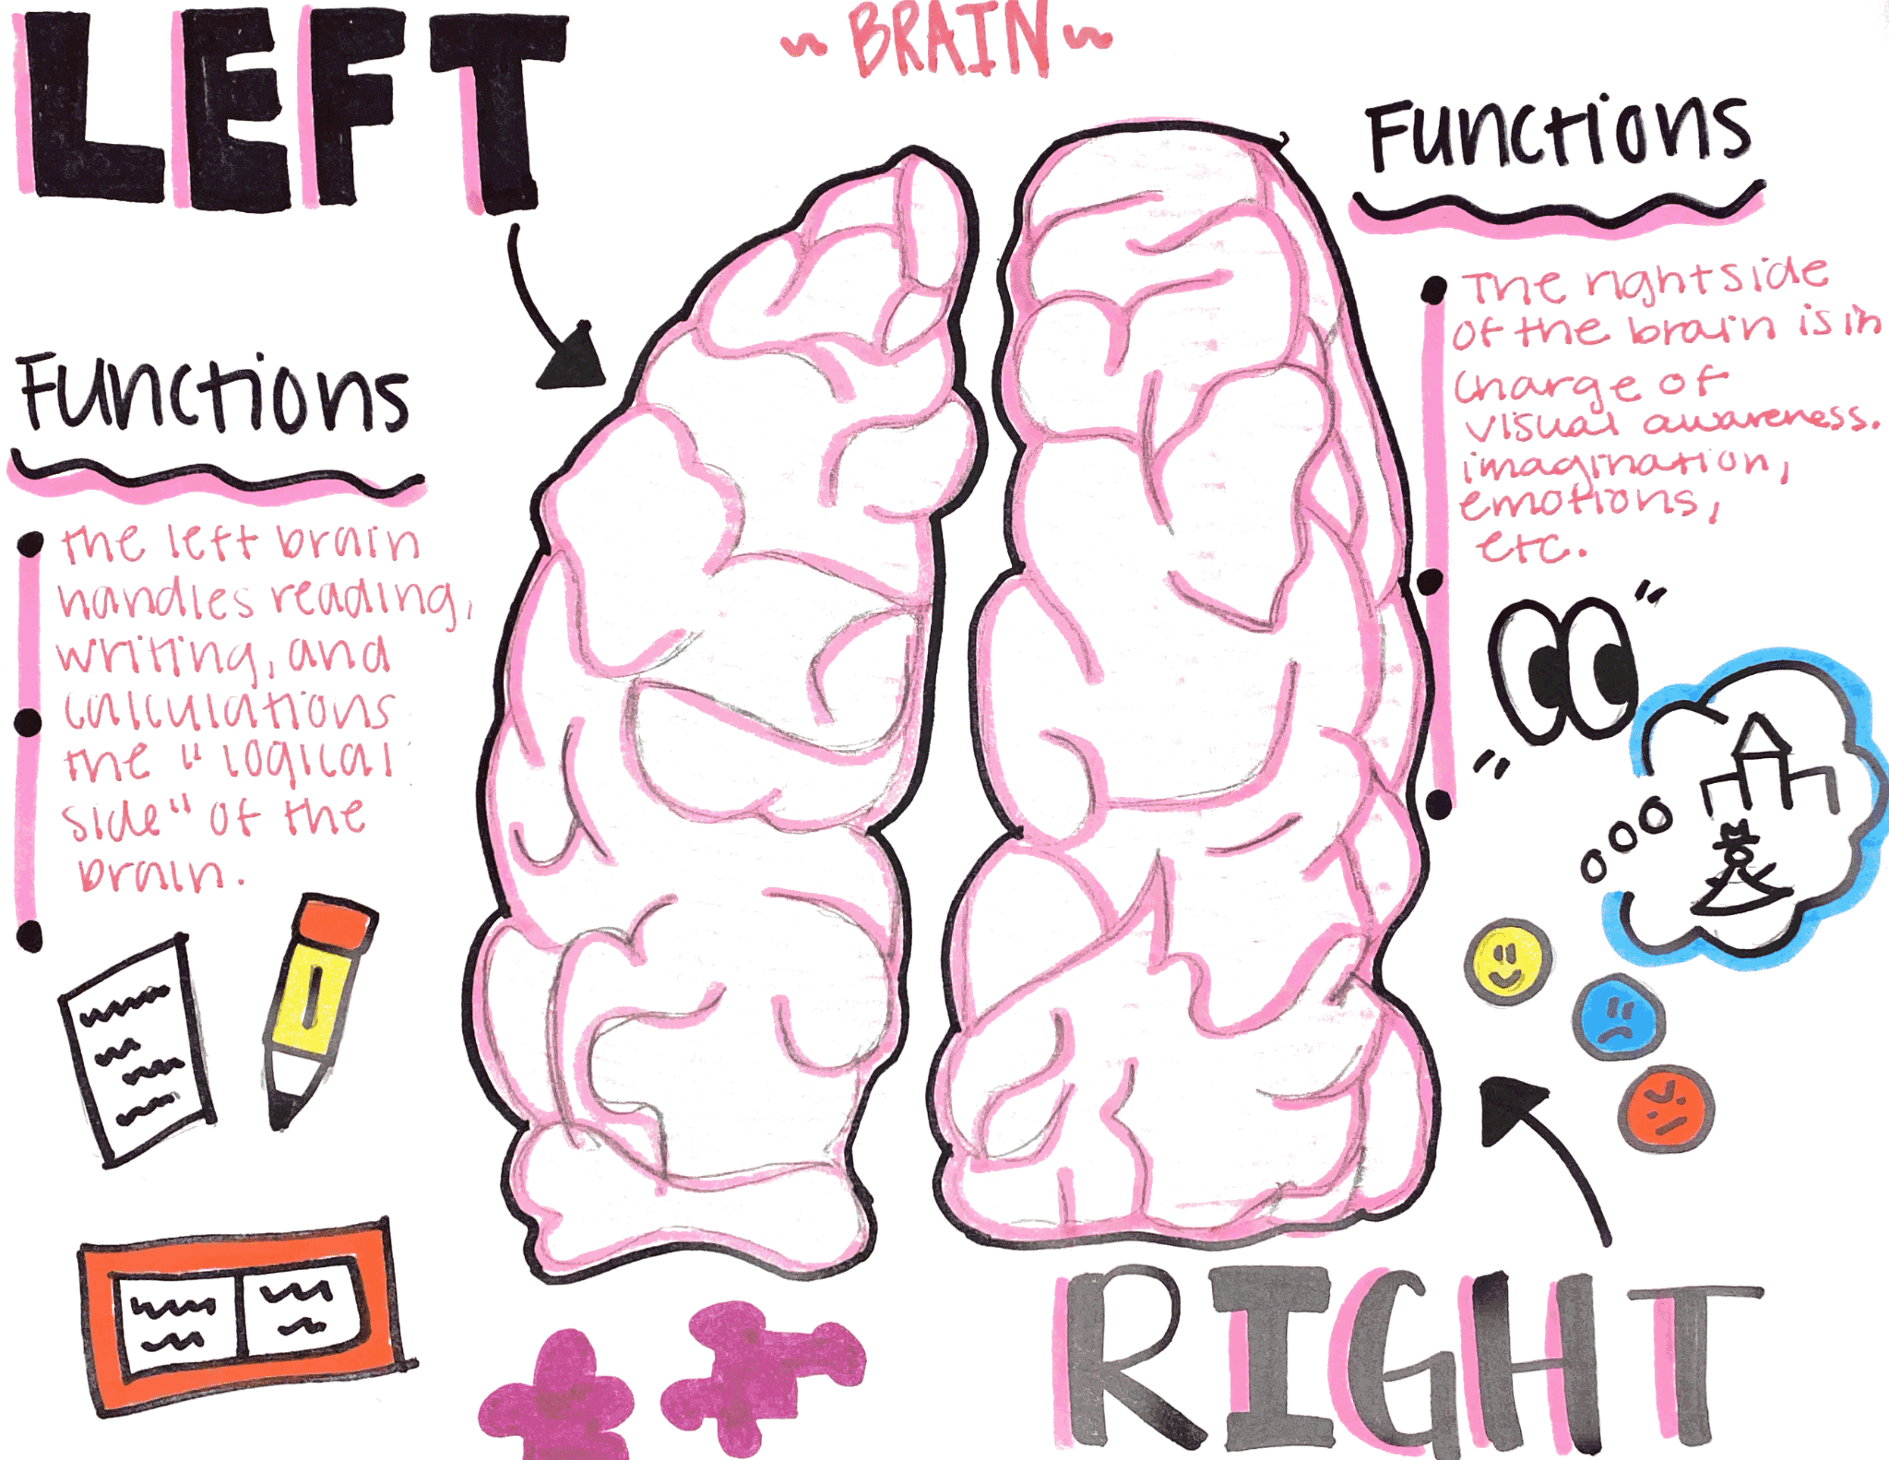
Pinterest Ideas
Table of Contents
Planes
Cavities
Regions
Directional
Quadrants

Slide 44
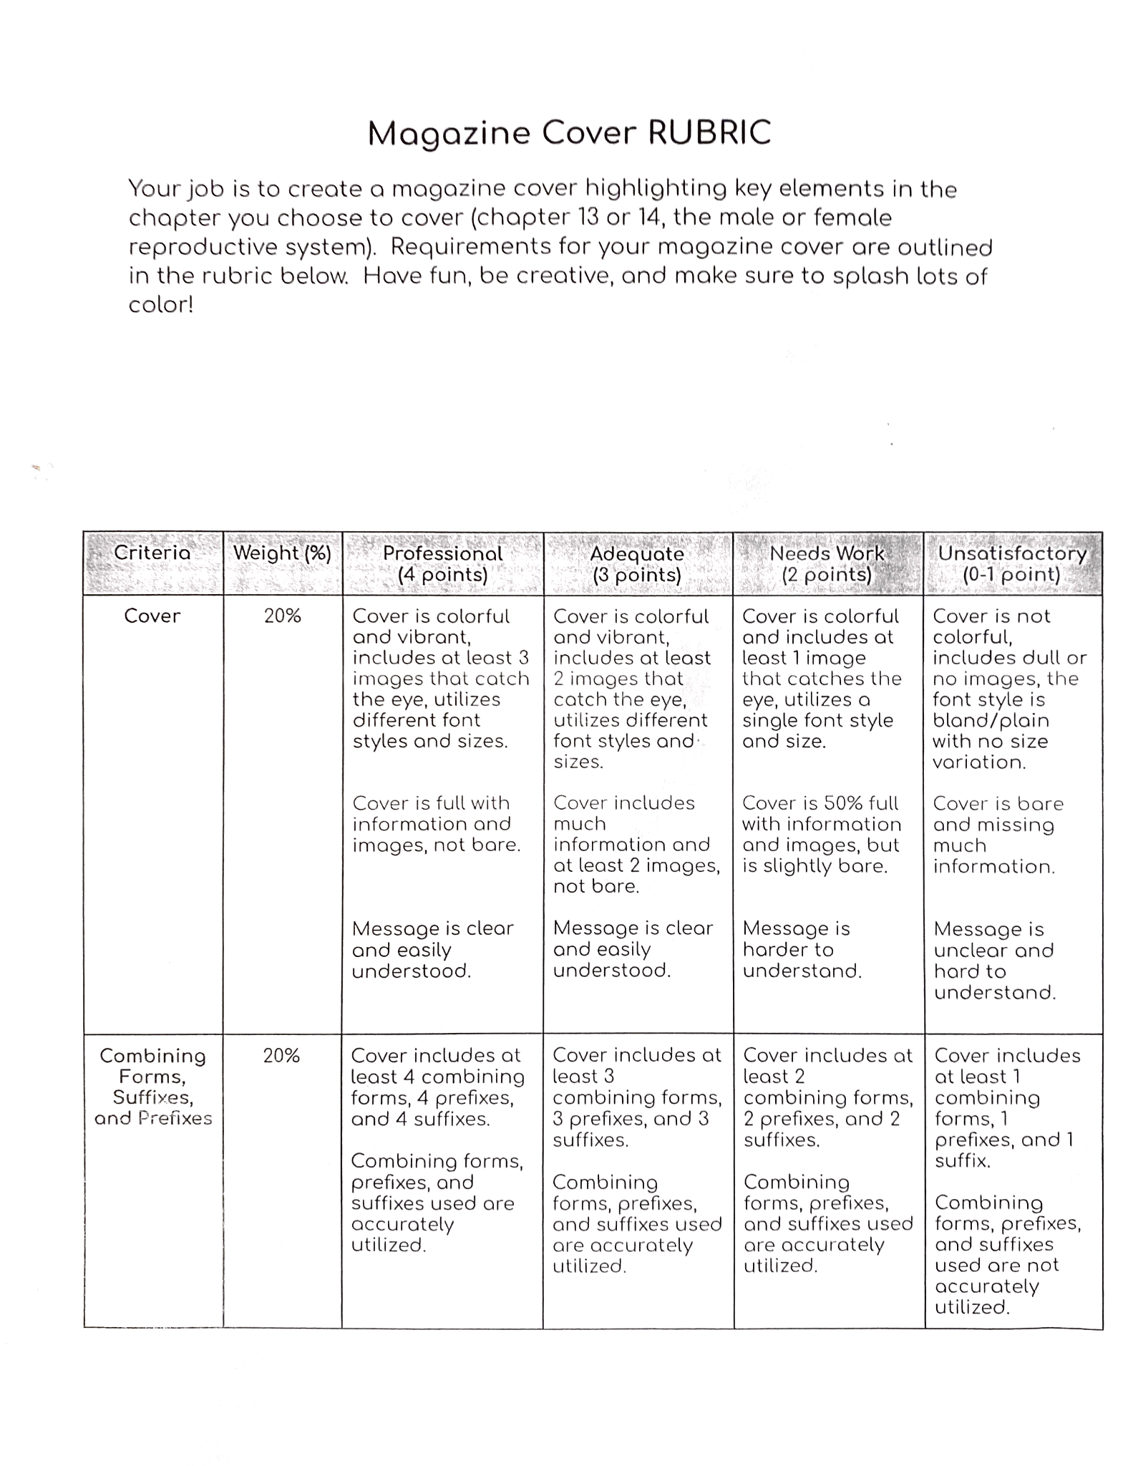
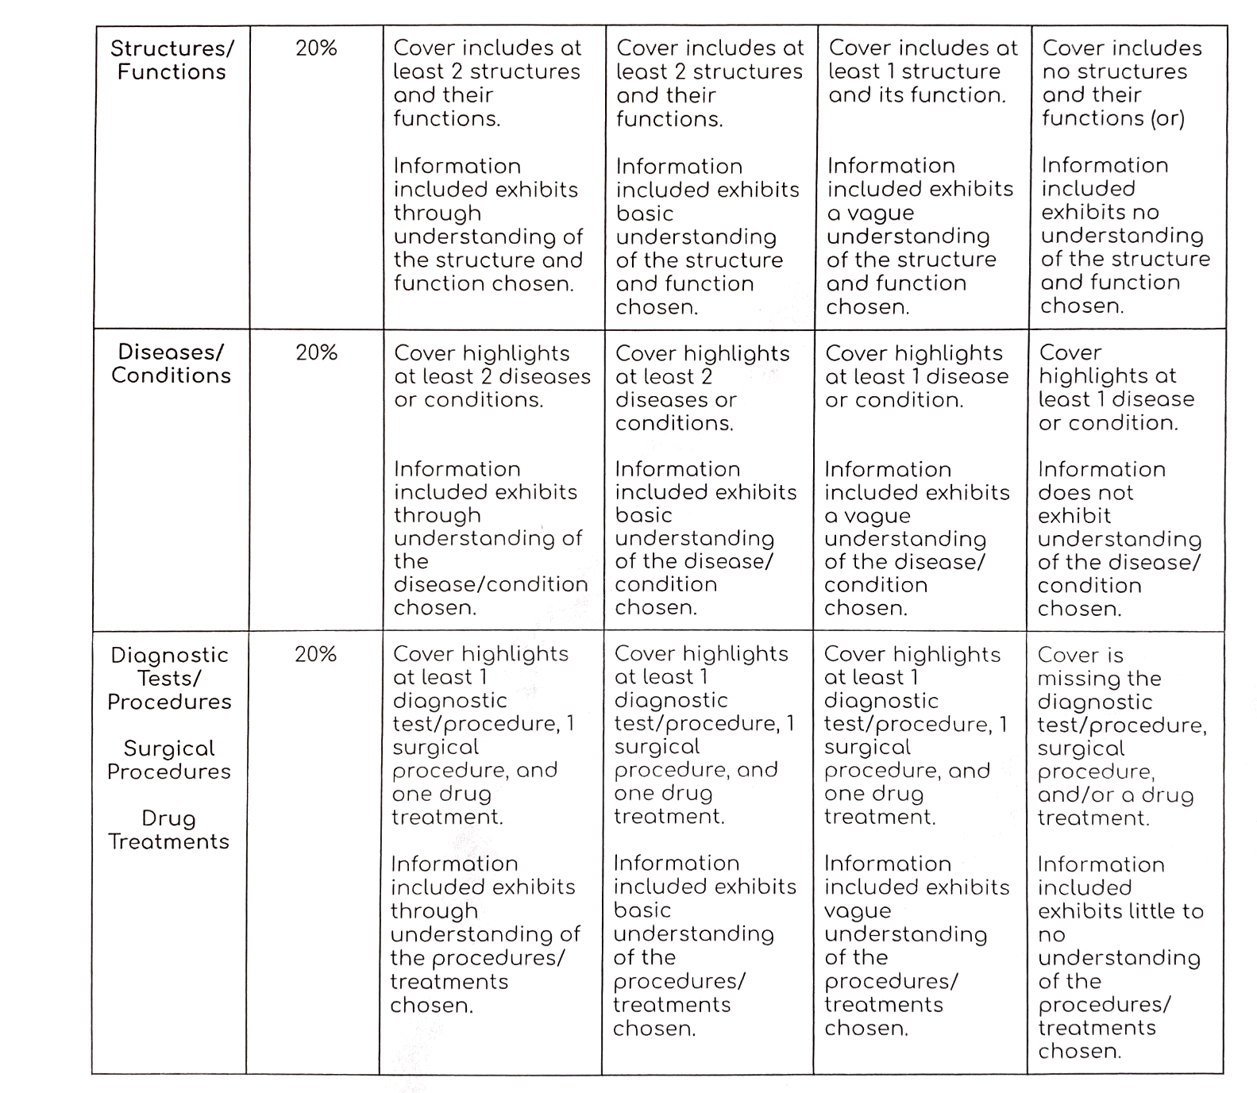
Pinterest Ideas
Table of Contents
Planes
Cavities
Regions
Directional
Quadrants

Slide 45
Pinterest Ideas
Table of Contents
Planes
Cavities
Regions
Directional
Quadrants

Slide 46
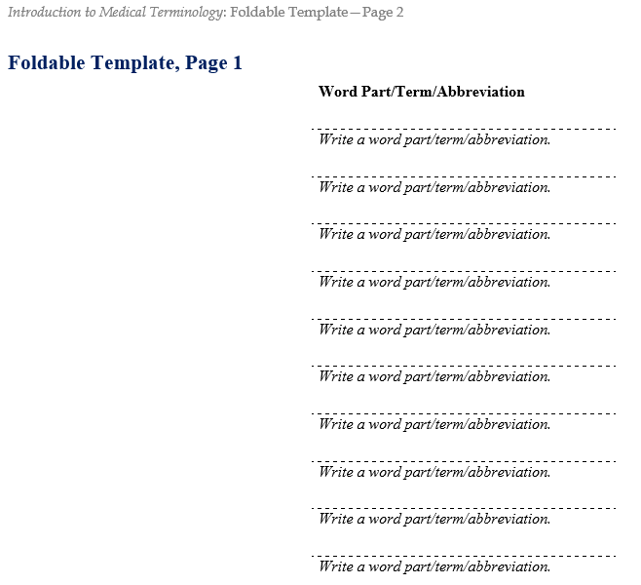
Direction found in Lesson Plans
Foldables
Bell ringers
Exit Tickets
Labs
Flash
cards
White Boards
Review Activities/Foldables Template
Models
Table Groups
Small group Races
Diagram cards
Word Surgery
Word Construction
Diagram Drills

Slide 47
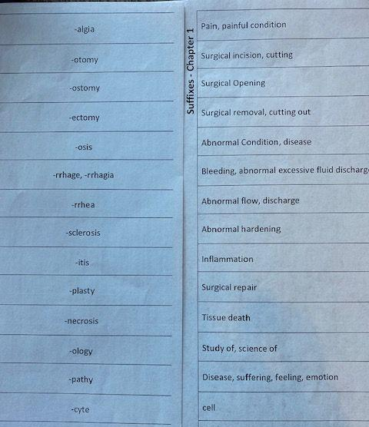
Foldables
Notes:
Have students act out/be visuals for the organs!

Slide 48
Direction found in Lesson Plans
Foldables
Bell ringers
Exit Tickets
Labs
Flash
cards
Games
White Boards
Review Activities/Exit Tickets
Models
Table Groups
Small group Races
Diagram cards
Word Surgery
Word Construction
Diagram Drills
Bingo
Flyswatter
Kahoot
Gimlet
Quizlet

Slide 49
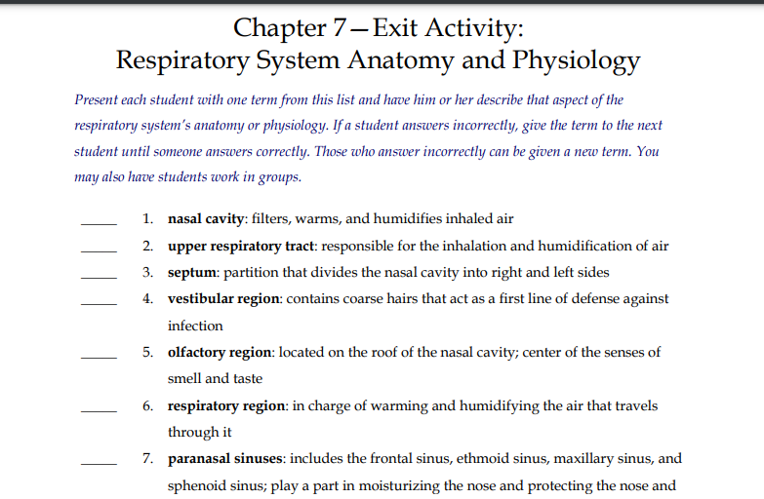
What’s its function?
Exit Ticket

Slide 50
What’s its function?
Bell Ringer
Exit Ticket

Slide 51
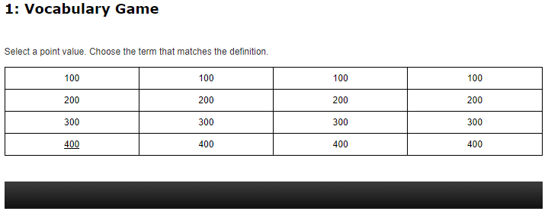
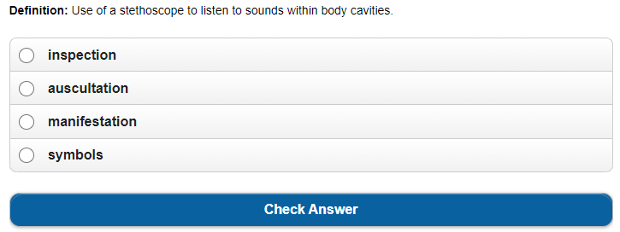
What’s its function?
Exit Ticket

Slide 52
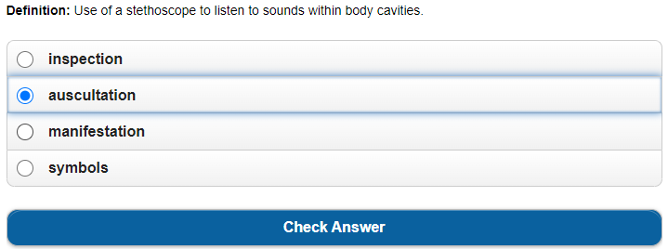
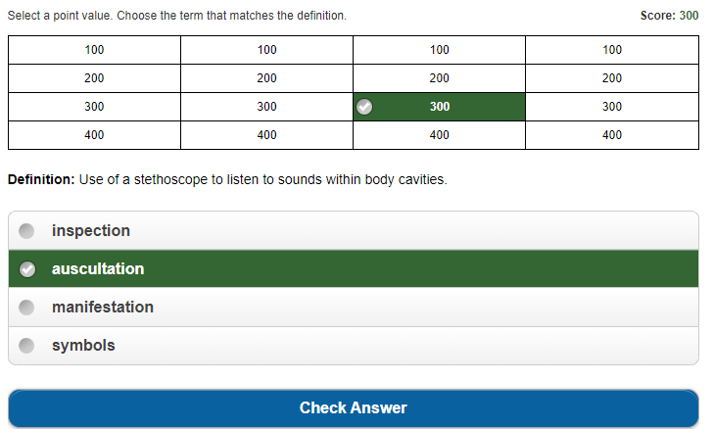
What’s its function?
Exit Ticket

Slide 53
Menu
Lesson Plans
Scope & Sequence
Workbook
Teaching Strategies
Chapter Reviews
Instructor Resources
Cumulative Reviews
!
ExamView
& Games
At your fingertips

Slide 54
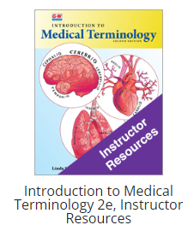
Resources and Autogradeable Options
Notes:
Have students act out/be visuals for the organs!

Slide 55
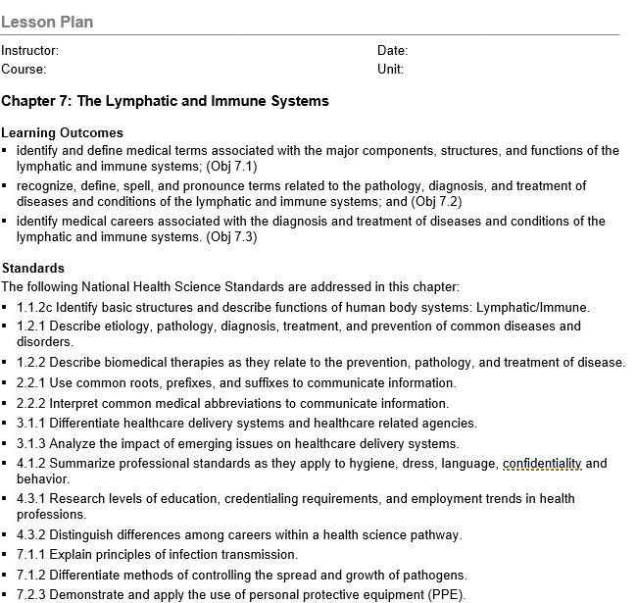
Lesson Plans include Standards
Notes:
Have students act out/be visuals for the organs!

Slide 56
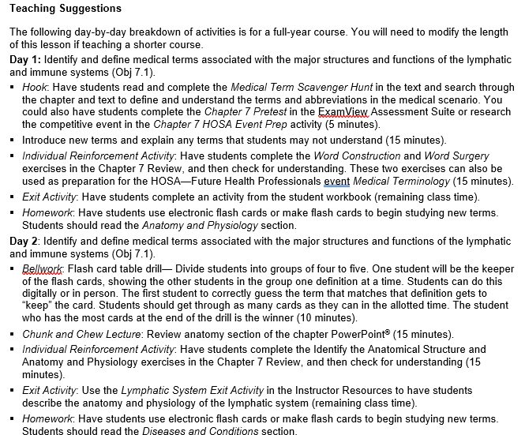
Lesson Plans timeline
Notes:
Have students act out/be visuals for the organs!

Slide 57
Menu
Lesson Plans
Scope & Sequence
Workbook
Teaching Strategies
Chapter Reviews
Instructor Resources
Cumulative Reviews
!
ExamView
& Games
At your fingertips

Slide 58
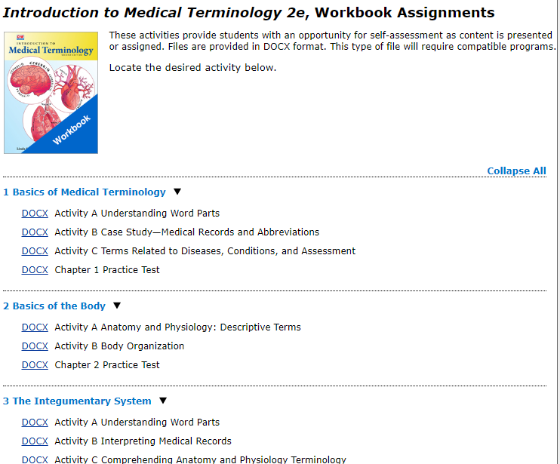
Work book features
Notes:
Have students act out/be visuals for the organs!

Slide 59
Q & A
??????
Questions
Answers

Slide 60
Please Pick up materials and
Put everything except diagrams back into the bag
??????
Questions
Answers

Slide 61
Contact Information
kim.turnbull62@gmail.com
Introduction to Medical Terminology
2nd Edition
linda.stanhope6@gmail.com
www.g-w.com

Slide 62
Thanks!
Table of Contents
Section 1
Section 2
Section 3
Section 4
Credits
Do you have any questions?
Mallory Dufek, Acquisition Editor - mdufek@g-w.com
Abigail Hess, Marketing Manager - ahess@g-w.com
G-W Goodheart-Willcox Publisher
Please keep this slide for attribution.

