Slide 1
Nursing trends, challenges, and updates: How to help your students navigate the changes
Susan McKee, DNP, MEd, RN
Clinical Assistant Professor
Texas A&M University
School of Nursing
Tara Maxa, MSN, RN, RNC-OB, C-EFM, CNE, RNC-IAP, CHSE
Lecturer
Texas A&M University
School of Nursing

Slide 2
https://youtu.be/VlJmRU8EqqY

Slide 3
Abstract
It is challenging to keep up with all of the recent changes in nursing and nursing education. You may feel lost or overwhelmed when trying to advise your students. This presentation will provide updates and trends in admission, progression, graduation, and testing and career information. Topics also include the nursing shortage, changes in licensure exams and nursing curriculum, and nurse mental health. Guidance will be provided so you can help your students navigate the changes and enter and successfully complete nursing school. Time for participant questions and sharing ideas is included.

Slide 4
Objectives
Detail changes in nursing
Discuss predictions of nursing shortages and supply
Explore changes in pre-admit testing, admission, curriculum, NexGen NCLEX, and work opportunities
Generate strategies to increase interest in nursing
Analyze strategies to assist students in admission and progression through nursing school

Slide 5
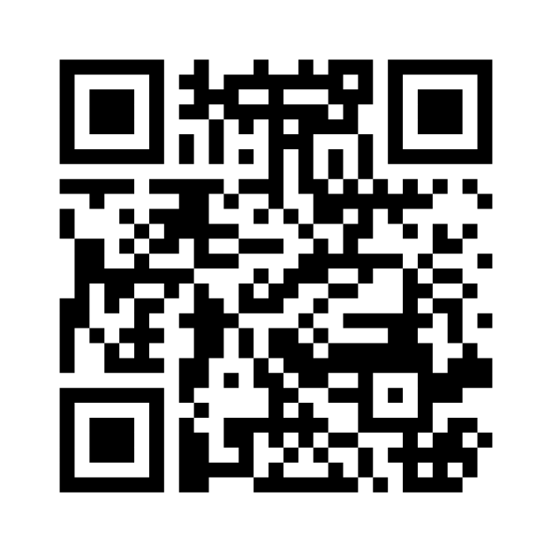

Slide 6
When you think of NURSING, what comes to mind?

Slide 7

What in the world is going on in NURSING?

Slide 8
Statistics from the Workforce Data Center https://www.dshs.texas.gov/health-professions-resource-center-hprc/texas-center-nursing-workforce-studies
About 13% male
47% are over age 45 (6.2% over age 66)
57% white, 42 % other races/ethnicity
49% are RN, 36% LVN, 13% masters, 1% doctorally prepared
57% provide in-patient care, 8% outpatient care
511 hours of hands on clinical, 128 hours in skills lab, 93 hours in simulation, 80 hours of computer activity and 542 classroom instruction hours = total 1354 hours
14,096 graduates in 2021
RN faculty shortage was about 7%

Slide 9
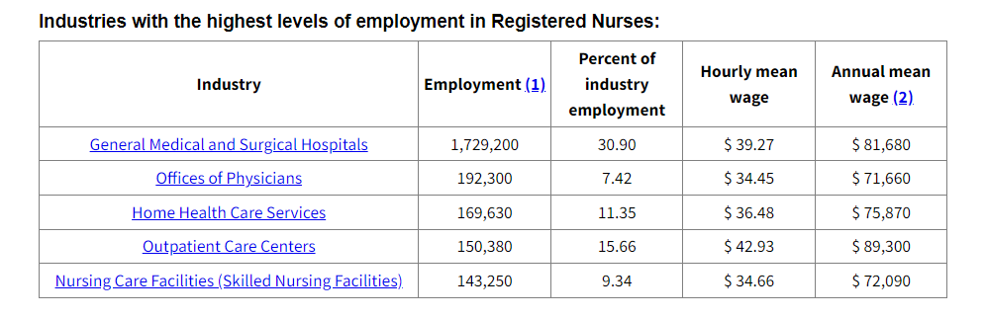
National Nursing Trends

Slide 10
Nursing by the numbers https://www.dshs.texas.gov/sites/default/files/chs/cnws/WorkforceReports/2020-Updated-Nurse-Supply-and-Demand-Projections.pdf
Year | LVN demand | LVN supply | RN demand | RN supply | NP demand | NP supply | CRNA demand | CRNA supply | CNM demand | CNM supply
2018 | 63,078 | 69,577 (+6499) | 251,367 | 223,581 (-27,786) | 19,317 | 20,922 (+1605) | 2,075 | 4,074 (+ 1,999) | 798 | 432 (-366)
2025 | Approximately even supply and demand |  | +/-300,000 | +/- 260,000 (- 36,965) |  | (+11477) |  | (+2713) |  | (-367)
2032 | 91,750 | 79,179 (-12,572) | 348,883 | 291,872 (-57,012) | 26,191 | 45,462 (+19,271) |  | (+3221) |  | (-361)

Slide 11
National Nursing Trends
4.2 million nurses in the US – 84% currently working
More than 200,000 openings each year through 2031
https://www.aacnnursing.org/news-data/fact-sheets/nursing-fact-sheet#:~:text=Nursing%20is%20the%20nation's%20largest,84.1%25%20are%20employed%20in%20nursing.&text=The%20federal%20government%20projects%20that,each%20year%20from%202021%2D2031
The retirement of one million RNs from the nursing workforce between now and 2030
https://www.healthaffairs.org/content/forefront/should-we-prepare-wave-retiring-baby-boomer-nurses

Slide 12
What is making nurses leave the profession?

Slide 13
Internal and external factors impacting nursing
Covid
Retirements
Impact on nurse mental health
Public awareness of dangers in nursing
Inspiration to become a nurse
Hiring and staffing changes
Travel & Agency nursing
Limits on the personal toll nurses are willing to take – moral injury, personal illness, costs to family

Slide 14
For the 1st time in 20 years, nursing school applications are down

Slide 15
Changes in education
Curriculum – AACN Essentials adopted in 2022. All nursing schools moving to competency-based education (ADN, BSN, MSN, DNP).
Faculty shortage – “According to AACN’s report on 2021-2022 Enrollment and Graduations in Baccalaureate and Graduate Programs in Nursing, U.S. nursing schools turned away 91,938 qualified applications from baccalaureate and graduate nursing programs in 2021 due to an insufficient number of faculty, clinical sites, classroom space, clinical preceptors, and budget constraints.” Affected by retirements, salaries, advanced degrees
https://www.aacnnursing.org/Portals/0/PDFs/Fact-Sheets/Faculty-Shortage-Factsheet.pdf
Clinical locations – Expanding across the state. Students may be required to travel for enhanced clinical locations.

Slide 16
Changes in admissions
Admission procedures:
Holistic admissions
Health care experiences
Leadership
Judgement
Nursing values

Slide 17
Changes in admissions
Pre-admit preparation and testing
Understanding of the knowledge, skills, and attitudes needed for nursing
HESI A2, TEAS, or no entrance exam
Application in Nursing CAS
Application to college/university
Essays or interviews

Slide 18
Changes in nursing education
NexGen NCLEX (Began April 1, 2023)
Questions - 85 minimum and 150 maximum
Application level and above
Clinical judgment case studies – based on the NCSBN Clinical Judgment Measurement Model (NCJMM) which includes recognizing cues, analyzing cues, prioritizing hypotheses, generating solutions, taking action, and evaluating outcomes. https://www.nclex.com/files/2023_RN_Test%20Plan_English_FINAL.pdf (p. 15) We cannot show the model.

Slide 19
Changes in nursing education
Graduation – Career and interview preparation, resume building, certifications, specialty areas, student organizations, leadership opportunities, nurse tech positions, residencies, socials, acceptance of positions
Work opportunities - Wide and increasing variety, technology based, public health, traditional hospital based in critical care areas with nurse residency, and more

Slide 20
The GOOD News

Slide 21
The GOOD News! - Legislative changes in Texas related to Nursing
Workplace violence (SB 240 – passed)
Increasing acceptances in nursing (Nursing Innovation Grant Program will extend to 2027)
Nursing scholarships (SB 25 – passed)
Faculty repayment for loans – possible for part time faculty too (SB 25 – passed)
Texas Nurses Association Legislative Update: What you need to know (June 27, 2023)

Slide 22
The GOOD News!
Most TRUSTED profession for 22 years in a row
Meaningful work
Career growth opportunities
Diverse specialty options
Job security
Post-baccalaureate nurse residency programs to aid in nurse retention
Development of fast-track programs (second-degree BSN and MSN programs; baccalaureate to doctoral)

Slide 23
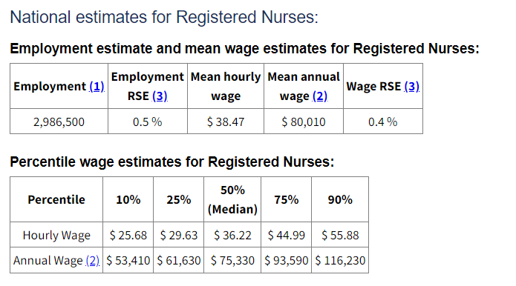
The GOOD News!
Salaries – UP more than 8.5% from 2021-2022 and up since then (Nursing, other health staff pay on the rise, Health Leaders Media (July 7, 2023)
National average RN salary $75,330 ($36+ per hour) https://www.bls.gov/ooh/healthcare/registered-nurses.htm#tab-1

Slide 24
How do we generate interest in nursing?

Slide 25
Strategies for teachers
CNA/PCT/Shadowing experience or skills
Communication skills
Higher order thinking – application of ideas
Focus on the “WHY”
Emphasize the art of caring
Highlight variety in nursing opportunities

Slide 26
Strategies for nursing student success
Early experiences in caring
Meeting the metrics (grades, scores)
Demonstrating the Aggie Core Values – something that sets an Aggie nurse apart
Leadership opportunities
Teaching and communication skills
Personal management – study and time management skills, focus, support system, persistence, resilience

Slide 27
How will you prepare your students for success?

Slide 28
https://youtu.be/gTMuh6AF3A0

Slide 29
Nursing: there’s nothing that compares to the impact of a nurse in the world

Slide 30

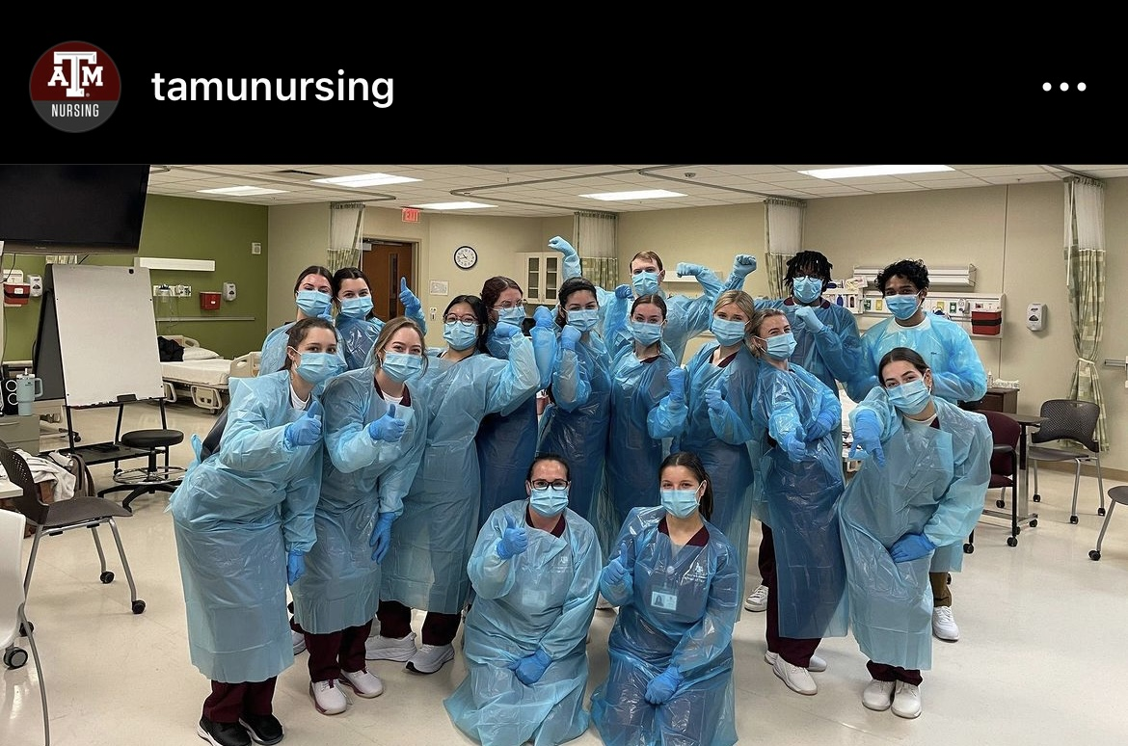
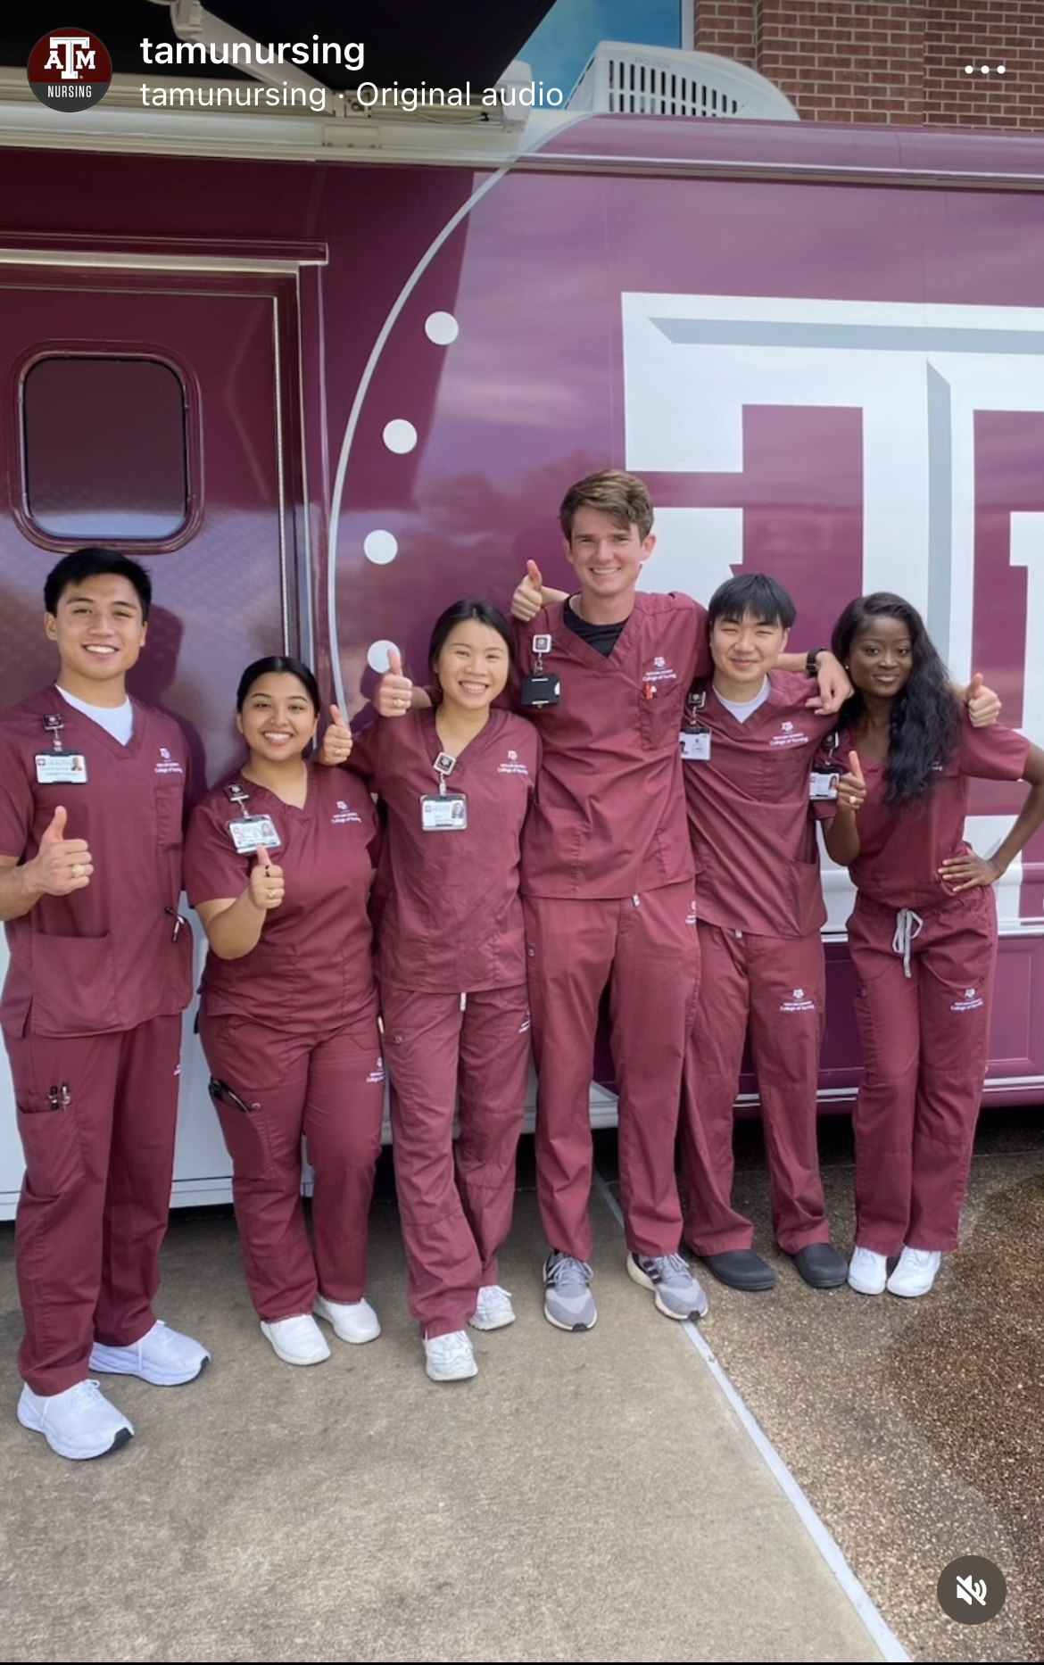
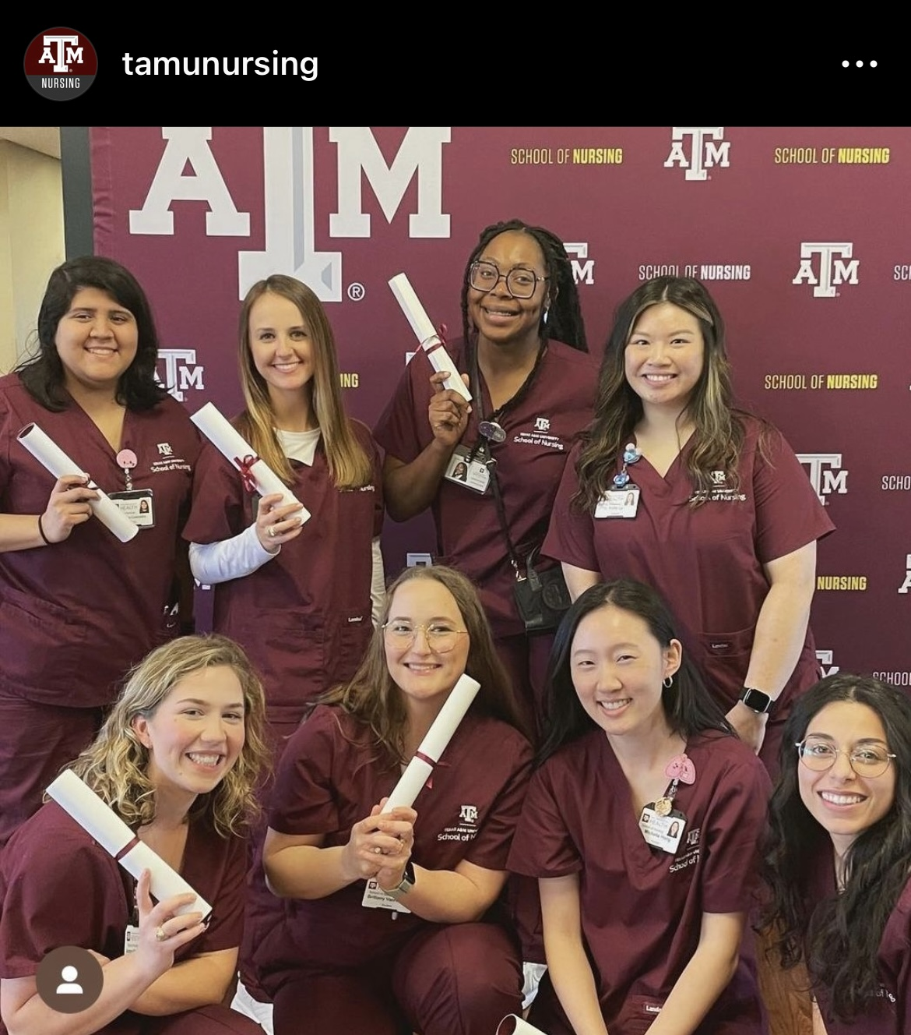
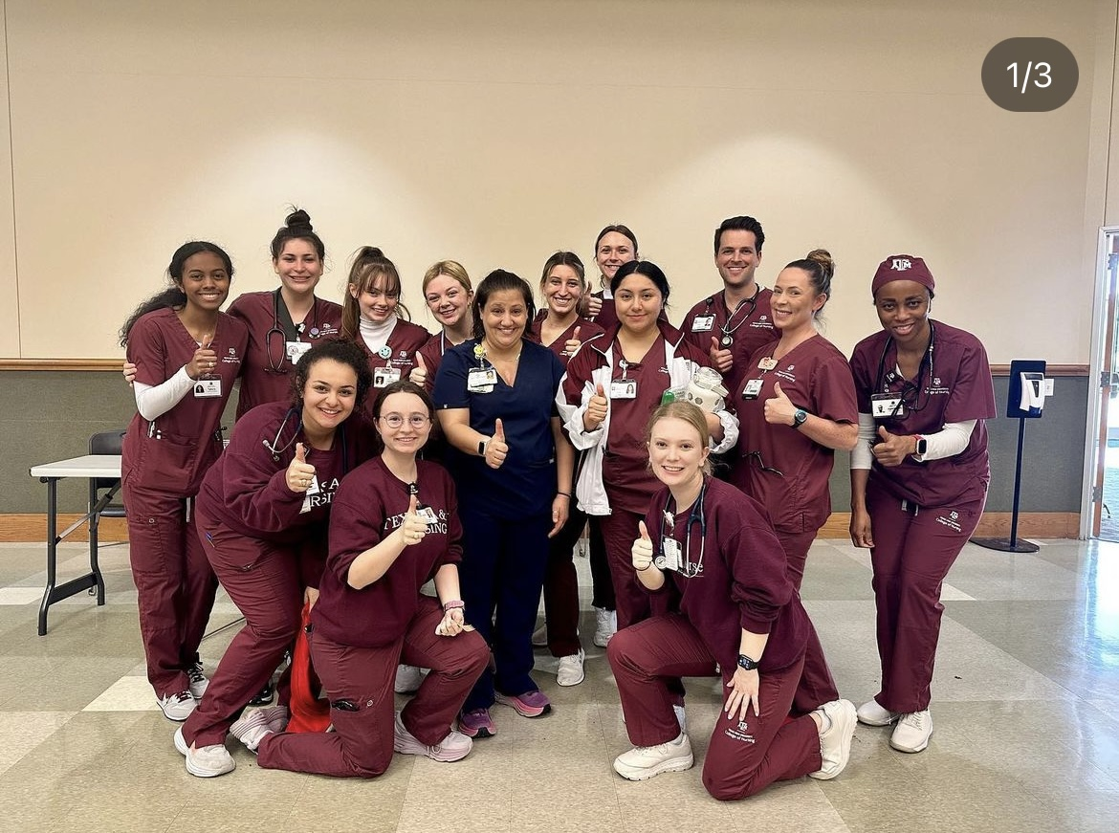
Thanks
& Gig’em!

Slide 31
References
References and sources are embedded in slides

