Slide 1
What can we do as health science teachers in the event of a school shooting? Triage and first aid?
Misty Overfelt, MHS, LAT, ATC, NREMT

Slide 2
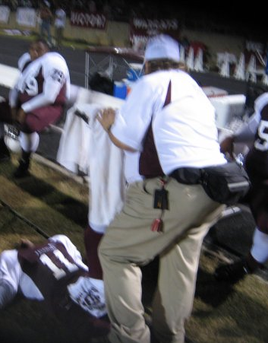
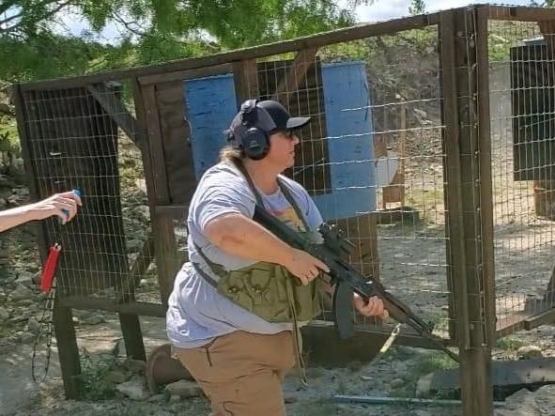
A snap shot about me
LAT, ATC
Certified Health Science Technology teacher
EMT
Competitive Shooter

Slide 3
People who helped me out (much needed feedback)
Officer Wyatt Odom, Florence PD/FISD SRO
Chantel McDonald, District nurse at FISD
Emma Gonzalez, CCMA, Florence High School nurse
Dr. Russell Porterfield, Florence High School principal
Disclaimer: Although these people helped me with this topic, the opinions are my own and may not
reflect the options of the above mentioned people.

Slide 4
The purpose of presentation
Prepare you
Give you the information that I wanted to know more about
Help you have a conversation starter to go back to your school with.
Arm you with the information to make it happen
Ammo to take back and give to your school to make it a safer place
Prepare my school
Possible threat in October
Peaked my interest even more
I think it went bad
I wanted to be able to do more
When shooting happens
I wanted to know way more
I want to help when it happens, I'm a helper
As I began this, I was stoked and wanted to see what my school would do!

Slide 5
Why did I think of such topic
#1 Reason: I want to help
I have been working with my district to produce a plan for our school
Athletic training symposium
Discussed about when accidents happen
This was the biggest part of presentation
Great info about accidents
He skimmed school shootings and that pique my interest
I wanted to know what my school would do in the event of a shooting
What is the plan
I’m merely here to inspire others to want to help in the face of tragedy
I think we can help as health science teachers
We have a closet full of stuff
Please talk with your SRO and administration to see what you can offer

Slide 6
So why are we here?
Sadly, because of school shootings
Since 1999 there have been 380
In 2022, there were 46 alone
More than in any year since at least 1999.
Continuing issues beyond the headlines:
Students who witness school shooting
Noncausality traumatized individuals
Students
Friends
Faculty/Staff
Spouses/partners
Family
Victims and survivors

Slide 7
School shootings quick facts
They are going to happen!
Gun safety laws and preventative action plans are not going to stop someone who wants to cause death
First school shooting
April 9, 1891
James Foster (70 y/o)
St. Mary's Parochial School, Newburgh, New York,
Fired a shotgun at a group of students in the playground
Caused minor injuries to several of the students.
Most deadly shooting
April 16, 2007
Seung-Hui Cho (23 y/o) (suicide)
Virginia Tech
Started in dorm room, then went to a building with large amounts of people
32 students and staff, wounded 17 others
Was the deadliest, now it's the 3rd deadliest
Sandy Hook and Uvalde – over 20 deaths in each

Slide 8
Top 7 plus most recent
2 – Sandy Hook Elementary - December 14, 2012 - 28 deaths, 2 injured (suicide as police arrived)
3- Robb School Elementary (Uvalde) - May 22, 2022 - 22 deaths, 18 injured (taken out by a tactical officer of the US border patrol)
4 – University of Texas Tower shooting– August 1, 1966 – 18 deaths, 31 injured – lasted 96 minutes- deadliest college shooting until Virginia tech – deadliest mass shooting in America for 18 years (Police shot and killed him)
5- Parkland High school – February 14, 2018 – 17 deaths, 17 injured – pulled fire alarm and began shooting as student came out of classroom (blended in with students leaving the school, later caught)
6 - Columbine High School massacre: - April 20, 1999 – 15 deaths, 21 injured (suicide of both)
7 – Santa Fe High School - May 18, 2018 – 10 deaths, 14 injured (remain committed to a state-run mental health institution for up to 12 more months, further delaying a trial as the mass shooting)
13 - Covenant School in Greenhill (Nashville, Tennessee) – March 27, 2023, 7 deaths, 1 injured (person killed)

Slide 9
OVERVIEW OF THE ATTACKS
Where?
73% high school
22% middle school
2% elementary
2% other
Numbers include Overland park and Santé Fe
Uvalde not included
Duration of attack
Most last 5 minutes or less
Nearly half end within 1 minute
6 have lasted longer than 5 minutes
None lasted longer than 15 minutes

Slide 10
OVERVIEW OF THE ATTACKS
Timing & Location
Every day and every month
Except Sunday and July
September and January highest
October is right there
Before school 10 (24%)
Morning classroom hours 20 (51%)
During lunch 3 (7%)
Afternoon classroom hours 6 (15%)
Outside school hours (2%)
Location
Usually start and conclude in the same location
Most common location is the classroom or right outside the school
Weapons used
Firearm 61%
Knife 39%
U.S. Department of Homeland Security. (2019). Protecting America’s schools; a U.S. Secret Service analysis of targeted school violence.

Slide 11
Long term mental health post shooting
More than 100,000 attended a school at which a shooting took place in 2018 and 2019.
Higher rate of antidepressant use among those exposed
For years following the shooting
Drops in student enrollment
Decline in average test scores.
Increase in student absenteeism
Likelihood of needing to repeat a grade
Less likely to graduate high school, go to college, and graduate college,
Less likely to be employed and have lower earnings in their mid-20s.

Slide 12
Preparedness & prevention

Slide 13
School Security & Prevention Measures
Physical Security measures
Review lock down plan and practice it
Security cameras
Inside and outside of school
Alarms
Check locked doors often
Texas schools had safety audits this year
Private security
SRO's – School Resource Officer
Most schools had at least 1 full time on duty
Most of the shootings had part time SRO's that traveled to other campuses.
Reporting tools
Anonymous reporting tool, which accepts tips 24/7 regarding any concern of safety to self or others.
Assessment and intervention protocols
Some type of program involving employees who are assigned to assess unwanted or potentially harmful student behavior
Talk to your students!
You will notice a student's behavior, or their friends will report to you a friend acting different.
You are their safe person
If you suspect an issue, tell someone

Slide 14
Response time
SRO on scene
Less than a minute response time
Outside law enforcement
Once they are contacted, 1 – 5 minutes
First responders, once contacted
5-10 minutes
These times might be different at your school
At Florence, the DPS range training center is with in 3 miles of my school

Slide 15
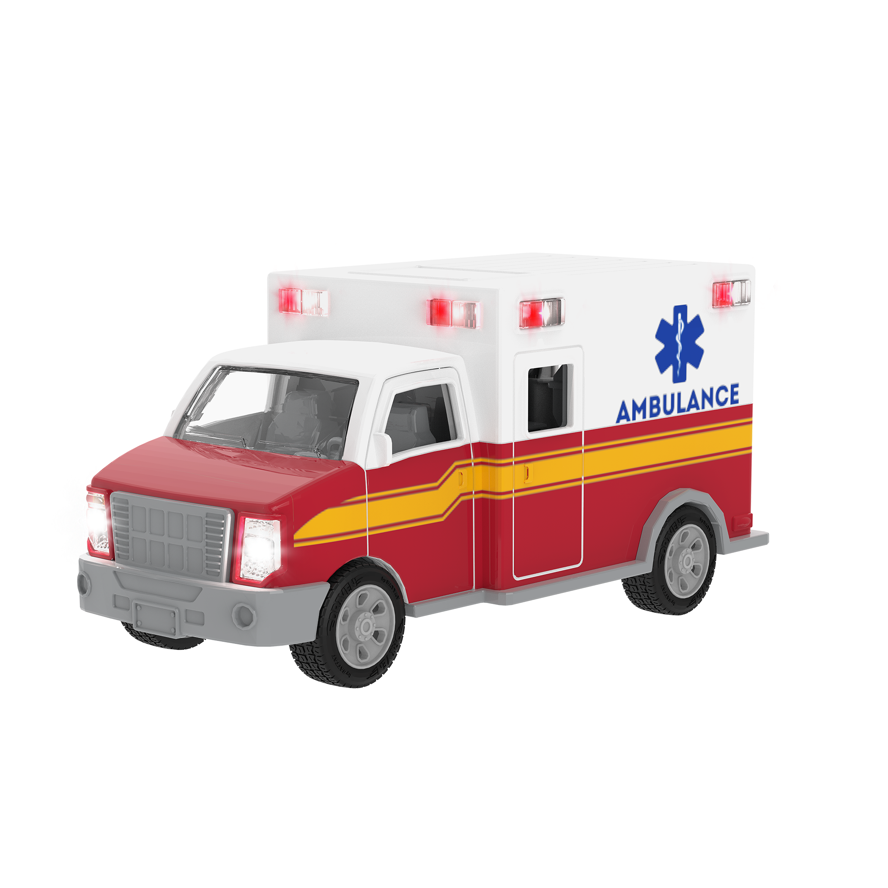
I’m here to give you the tools
Think of an EMT call
Hear tones
Get info about call
You are running differentials in your brain of what the Chief complaint of chest pain could be ….
That’s my way of thinking for a possible shooter.
So if it were to happen, I want a plan
I want to know what needs to happen

Slide 16
Talk with your district SRO and your administration
Check schools plan
Is there one?
YES
Are you practicing it?
Lock down drills - twice a year, once each semester
Should be announced to staff and students
Parents should have advanced notice
Should be clear
Varied in the time and day you do them
Secure – once a year
NO
Ask why not, what are we going to do if?
Have a table talk with administration, school nurse(s), and administration to know everyone's role.
If you are wanting/willing to be involved

Slide 17
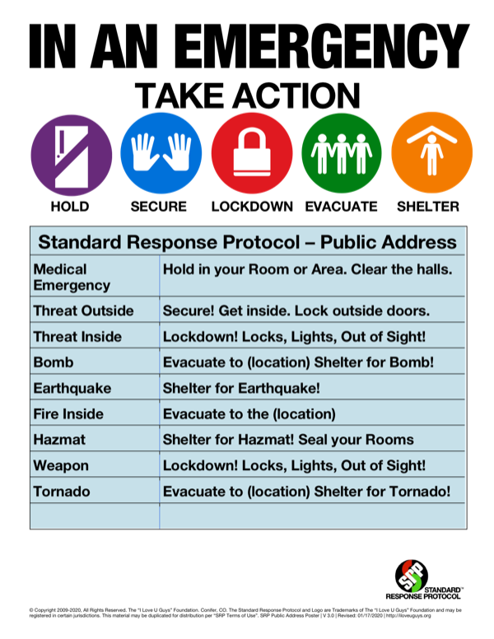
you are here because you want to be involved!
The worst thing has happened, and shots have been fired
"Lockdown! Locks, Lights, Out of Sight!"
This is supposed to be said
Just like the lock down drill:
Secure your room and students
Get away from the door
Now what can we do?
Here is where you need to have a plan with your SRO and administration!!!
This will look different at every school
Know that if law enforcement sees you as the shooter, they are trained to neutralize the threat!
It absolutely necessary to have this conversations ASAP .

Slide 18
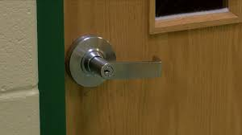
Make sure your room is always locked
Yes it is a pain
Yes it sucks
It can be your life saver!
Studies show that school shooters are not going to try and access locked doors
Uvalde the shooter gained access through an open door
They are looking to get the highest body count with less effort

Slide 19
We did all we could, but ….

Slide 20
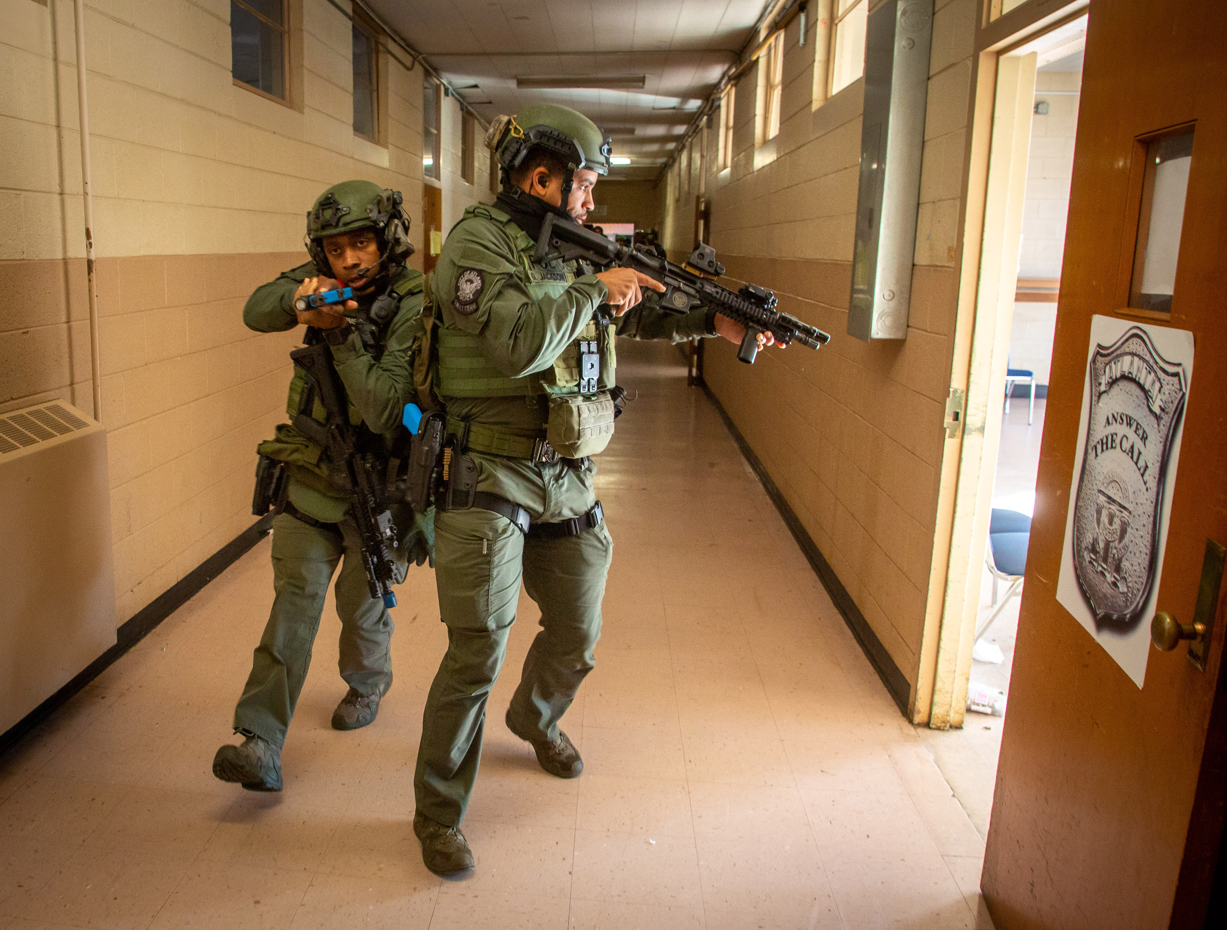
You heard the shots Where are they coming from?
A different floor
Make sure door is locked and stay in lock down mode
Try and keep students calm and off of their phones
Have students arm themselves with something to throw at shooter
Gather first aid gear
You can be of help when shooter is neutralized and law enforcement opens your door

Slide 21
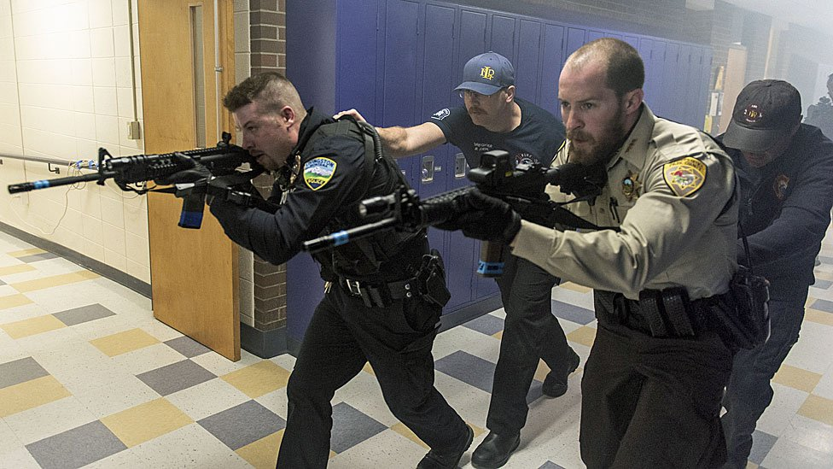
You heard the shots Where are they coming from?
Down the hall
Stay in lock down mode, try and calm students
Have them armed with something to throw at the shooter
Remind them to stay off phones
Gather your first aid gear as quietly and quickly as possible
You should already have this ready to grab and go
Do not open the door for any reason
I would be standing by door to try and take down the shooter if they gained entry, but that's just me
I carry a knife and would be willing to use it.
Wait on law enforcement to gain entry
Leave with students
This may be with their hands above their head so other law enforcement knows they are not the shooter

Slide 22
You heard the shots Where are they coming from?
Your room
Two options:
Have students throw books or whatever they can to throw at the shooter! (Talk to your school district about this!!)
This is a distraction
Have them run at the shooter too, over whelm them and take them over
Take cover and make yourself as small as possible and cover your vital organs as much as possible
Either option, you need to practice this with all your classes
Drill it
Have them throw like paper wads at the “shooter”
If shooter leaves your room, you can try to render aid if able too.
If they do not, stay small as you can till help arrives
Remember most shootings are over in less than 5 minutes

Slide 23
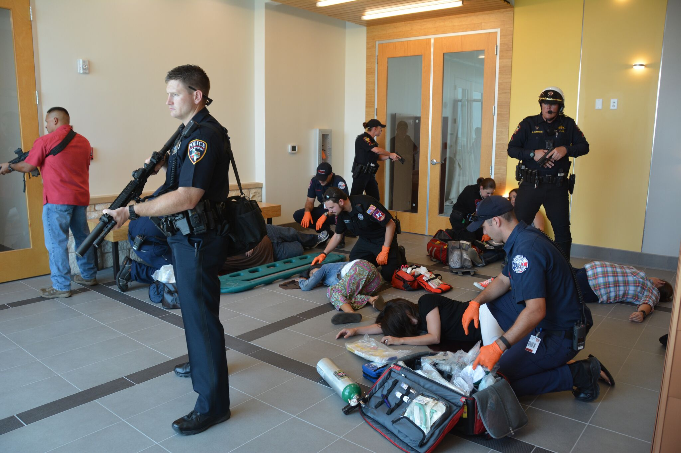
Law enforcement opens your door
Law enforcement gains entry to your room and says to exit the building
They should point you in a direction to go
Be aware that once you leave your room, things are going to be chaotic
Attempt to shield students from what they might see on the way out
Heads down facing the ground
They may have to hold their hands up in the air
Make sure you stay calm as you can to get the students out

Slide 24
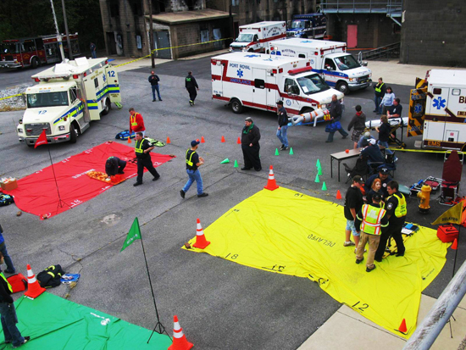
Staying involved You are not done just yet
The threat has passed
Escort your class outside to the staging area.
Account for all your students.
Your school should have a plan for this
Know that once outside, it is going to be crazy!
First aid/triage to those outside of building
Especially if EMS is not there yet
Again, go over this with school prior to anything ever happening
The following slide will review what the MCI staging area will look like

Slide 25
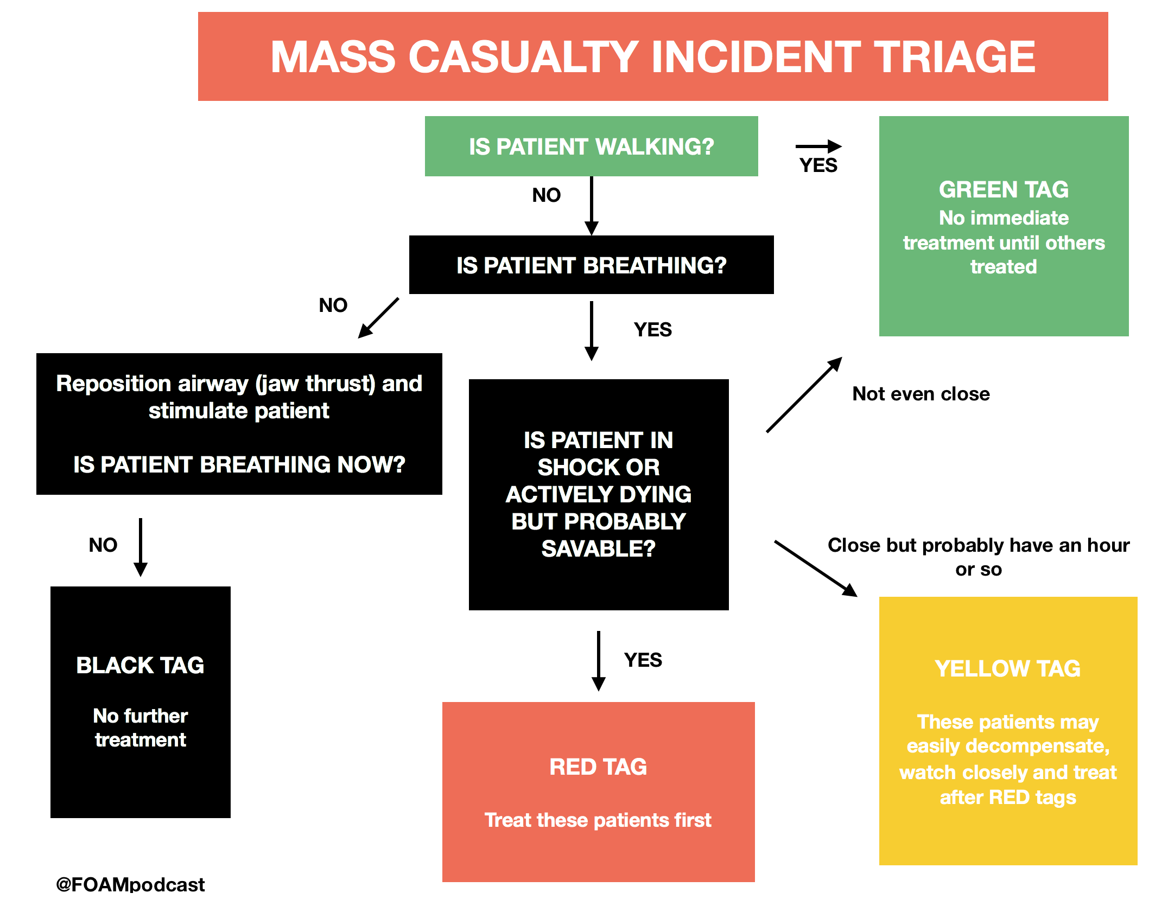
Mass Causality incident - mci
Remember that these are disasters, either man-made or natural, in which local management agencies and the healthcare system are overwhelmed.
Triage - check for immediate life-threatening concerns, usually lasting no more than one minute per patient
Triage personnel do not conduct treatment, with the exception of:
Airway maneuvers;
Tourniquets for life-threatening hemorrhage; and
Where allowed by local protocols, needle decompressions for tension pneumothoraxes
Red - immediate
Patients who have major life-threatening injuries, but are salvageable given the resources available
Yellow - delayed
Patients who have non-life-threatening injuries, but are unable to walk or exhibit an altered mental status
Green – “walking wounded”
Patients who are able to ambulate out of the incident area to a treatment area
Black - deceased or expectant
Used for victims who are dead, or whose injuries make survival unlikely

Slide 26
Staying involved
Try to stop life threats!!!
Use you trauma kit and 4x4’s to stop bleeding
If it spurts, cover it with direct pressure!
Have tourniquets ready to go
Remember high and tight and write the time applied on the patients forehead
Have EMT student help triage
Check with your school first about this
Let them do the things you have trained them for!
Be there for your students
Ya'll endured a horrific ordeal together!
They will be emotional and need mental help

Slide 27
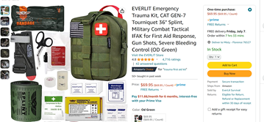
What does being prepared look like
What do you have for first aid?
Stop the bleed kit
My school has them all over the buildings
Trauma kit
I have one always ready to go
Is it packed and ready to go?
Take a brick of 4x4's with you
There will be bleeding
Does your school have an emergency bag?
Containing a class roster for all classes
Do you keep it updated?

Slide 29
Find out your school’s plan
Have a conversation with:
Your Principal
Do we have a plan?
Who can up with the plan?
Did the plan involve the SRO, nurse and counselor?
Does the superintendent know what the plan is for each campus?
What is the community involvement?
The mayor know what the plan is?
Do we have a safety team?
Can I be on it?
Don’t be afraid to talk to him and ask questions

Slide 30
School resource officer - sro
Your SRO
May be your school PD
This is your go to person about what you can and can’t do on campus
They will be honest with you about what you can and can’t do
They will know if you have the Texas school safety certification and the Texas Gaudian program in place
Don’t be afraid of them
Have them come talk to your classes
Many topics they can discuss as well as shootings

Slide 31
School nurse and counselors
Your school nurse
What is their job, how can we work together when it happens?
Do we have a trauma bag?
If not, maybe your HOSA club can create this with them for all classrooms
Your school counselors
How can students find them?
Invite them to your classroom to speak so the students know who they are
Remember prevention is half the battle!!!
They make great guest speakers!
Cover those TEKS

Slide 32
Staff meeting/pd
Have a staff meeting where you talk about the what ifs and how they will be handled on your campus
Who does what
Who is responsible for what
On a professional development day
Run a drill as if a shooting has occurred
Get students and community involved so they know what it looks like and what happens
We practice sports to get better in games, we need to practice this!!!
Have a debrief about what worked and didn't work
Many schools use PD days to practice active shooters!!!!
This would beat doing icebreakers we don’t want to do in the first place
PD available that you can suggest to your administration:
https://iloveuguys.org/standard-response-protocol/
provides consistent, clear, shared language and actions among all students, staff and first responders for all hazards.
https://txssc.txstate.edu/tools/at-toolkit/
planning templates to help districts complete their own Active Threat Annex and underlying incident appendices (shooter, stabber, bomber, rammer), as needed.

Slide 33
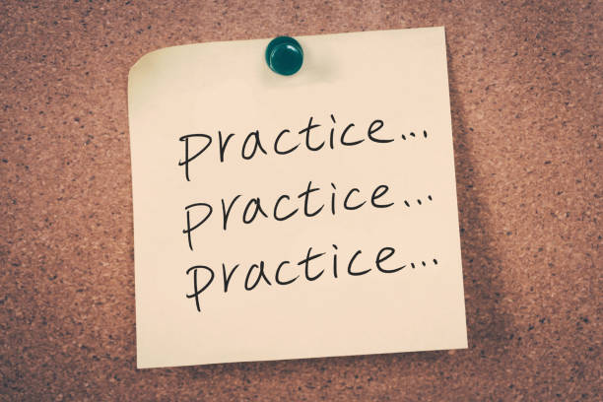
Plan/practice
Talk with your students about the what if and what it looks like in your room
Do this every 3 weeks
Practice makes perfect!
Know that when it happens
It will be crazy, that's why you want to practice
Let someone know if you have a student that is not acting like themselves
You know your students
Your students know when a friend of theirs is not doing good
Be a teacher your students can come talk to
Let your students know you care

Slide 34
references
Rossin-Slater, M. (2022, June). Surviving a school shooting: Impacts on the mental health, education, and earnings of American youth. Sanford - Institute for Economic Research (SIEPR). https://siepr.stanford.edu/publications/health/surviving-school-shooting-impacts-mental-health-education-and-earnings-american
Mistovich, J. J., & Karren, K. J. (2017). Prehospital Emergency Care (11th ed.). Pearson.
U.S. Department of Homeland Security. (2019). Protecting America’s schools; a U.S. Secret Service analysis of targeted school violence.

Slide 36
Questions?
My contact:
mhoodatc@gmail.com

