Slide 1
Welcome to Kinesiology 101
By: Michelle Derr

Slide 2
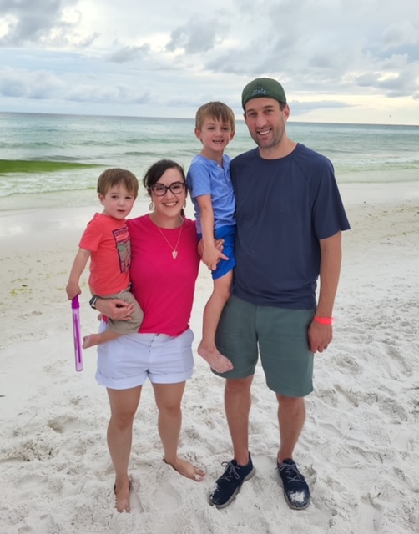
A little bit about myself…
My name is Michelle Derr
Born and raised in Michigan
Graduated from Central Michigan University with a B.S. in Athletic Training
Worked for Oakwood Hospital assigned to John F. Kennedy High School, Plymouth Physical Therapy Specialist assigned to Walled Lake Central, La Grange ISD Head Athletic Trainer, and Westlake High School Women’s Head Athletic Trainer.
Currently one of three Health Science Teachers at Westlake High School.
In field for 10 years, had my first son and was blessed to transition into teaching.
In the Teaching Sector for 6 years at Westlake High School.

Slide 3
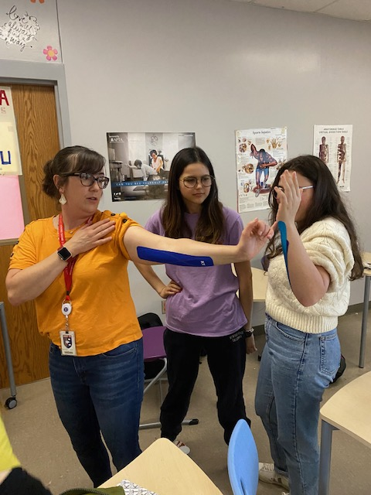
Courses currently taught:
Principles of Health Science
Kinesiology I
New…Kinesiology II (2023-2024 school year)
Using National Academy of Sports Medicine (NASM) curriculum in addition
Seniors eligible to sit for Personal Trainer Certification once curriculum is completed

Slide 4
What is Kinesiology I?
Kinesiology I is designed to develop the understanding of human movement and how the body reacts to exercise. Students will learn in depth about muscular, skeletal and neural movements. Students will gain knowledge about common injuries, and treatment, health and wellness, sports nutrition, developing physical fitness, sports psychology, and careers in Kinesiology. Kinesiology I will provide hands-on activities for students to learn during specific units. Students will also receive their Basic Life Support (BLS) Certification. In addition, Kinesiology I will prepare the student who is interested in choosing a career in the Medical and Health Science Fields. Kinesiology I is a pre-req as well as Principles of Health Science for Kinesiology II.

Slide 5
Lesson Break Down:
I use power points, videos, movies, Kinesiology (KT) taping, my personal experiences and activities for my units.
Available by print is a small example of the Lower Leg, Foot and Ankle Unit:
KT Taping Labs: Medial Tibial Stress Syndrome, Peroneal Tendinitis

Slide 6
Resources for Kinesiology Curriculum
https://kinesiology101.com/product/foundations-of-kinesiology-studying-human-movement-and-health-3rd-edition-4/
I use Foundations of Kinesiology I by Peter Klavora as well as his Teacher Wraparound Edition available via https://kinesiology101.com
Kinesiology II Curriculum
-Foundations of Kinesiology I, Scientific Foundations of Kinesiology and National Academy of Sports Medicine (NASM)
-Seniors eligible to sit for Personal Trainer Board of Certification Exam

Slide 7
Today…we KT Tape!!!
1st Tape: Medial Tibial Stress Syndrome
2nd Tape: Peroneal Tendinitis

