Slide 1


R 244
G 116
B 52
R 32
G 134
B 198
R 176
G 214
B 235
SINCE 1989 NHA
HAS AWARDED OVER
1M CERTIFICATIONS
R 53
G 189
B 178
R 159
G 80
B 159
Helping people access a better future in healthcare

Slide 2

Partnering to Solve Healthcare Challenges
Demand for frontline healthcare roles continues to increase
Healthcare workers are doing more to help patients & improve outcomes
The patient population is growing, faced with more complex, chronic needs
13% average projected growth rate, 2018 – 2028 across seven allied health professions*
34% percent of employers
reported their allied health
employees have more responsibility this year vs. last year*
80% of Americans age 65 and older have at least one chronic disease requiring ongoing care and management
*Source: Bureau of Labor Statistics (2019). Occupational Outlook Handbook
*Source: NHA 2020 Industry Outlook research
*Source: National Council of Aging
Notes:
As you know, our healthcare industry today is more complex and faces greater challenges than ever before. The need for frontline healthcare workers continues to increase, but hiring and retaining qualified candidates for in-demand roles, especially in healthcare support roles, can be difficult. Physicians and their care teams may be burned out from being challenged to do more with less. Employers are turning to allied health employees to take on more responsibility that is easing the burden on other members of the care team – and it’s critical that they are able to perform at the top of their credential. Finally, the patient population is growing older and sicker with more chronic conditions to manage. Quality care, communication and patient engagement are more important than ever before. These challenges can cause weaknesses in the care team. It’s clear there’s a need for more, and more qualified, frontline healthcare workers.

Slide 3
Ensuring Success Before, During & After Credentialing
Learning &
Assessment
Certification Exam
Professional Development
Flexible, interactive & assessment-rich solutions​
Facilitator tools & performance reporting
Eight nationally accredited, industry-leading certifications ​
An accessible platform ​
for real-time results​
Resources beyond certification ​
Inspiring new skill development
& fueling career growth​
Certification
Preparation Tools
Continuing Education
& Recertification
Engaging online study and practice assessment tools​
Focused remediation and
robust reporting for administrators & students​
CE that allows certification holders to stay relevant in their jobs & industry​
Expanding skills & keeping
credentials current​

Slide 4

In the 2021-2022 school year, more than 10,000 NHA certifications were earned
by CTE students in Texas
Since 2013, over 32,000 Texas
CTE students have earned
NHA industry
recognized credentials.

Slide 5





Solutions For Every Step of the Way
Learning &
Assessment
Certification
Preparation Tools
Certification Exam
Continuing Education
& Recertification
Professional Development
CERTIFICATIONS & PROFESSIONS WE SERVE
Medical
Assistant
Phlebotomy
Technician
Pharmacy Technician
Medical Admin.
Assistant
Patient Care Technician
Billing & Coding
EKG
Technician
Electronic Health Records
TRAINING SOLUTIONS
PharmaSeerTM PharmaSeer MathTM
PersonAbilityTM
NHA P360 VitalsTM
TEAM Based
CareTM
Principles of
Health CoachingTM
Medical
Terminology
Anatomy &
Physiology
Notes:
In fact, our latest innovations come directly from conversations we’ve had with customers. Since 2017, we’ve developed five new products to solve industry challenges in a way that supports the ambitions of the professions we serve. All of our solutions provide leaders like you with flexibility to scale to the needs of your program. With multiple nationally recognized certification options, we provide a trusted path to skills growth and career advancement.

Slide 6
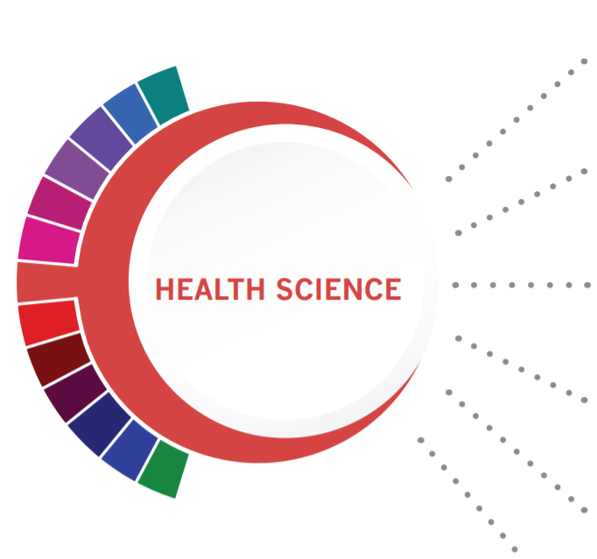




Healthcare Therapeutics
ExCPT Pharmacy Technician
Healthcare Informatics
Coding and Billing Specialist
Healthcare Diagnostics
EKG Technician
Phlebotomy Technician
Nursing Science
Clinical Medical Assistant
Patient Care Technician
Patient Care Technician

Slide 7

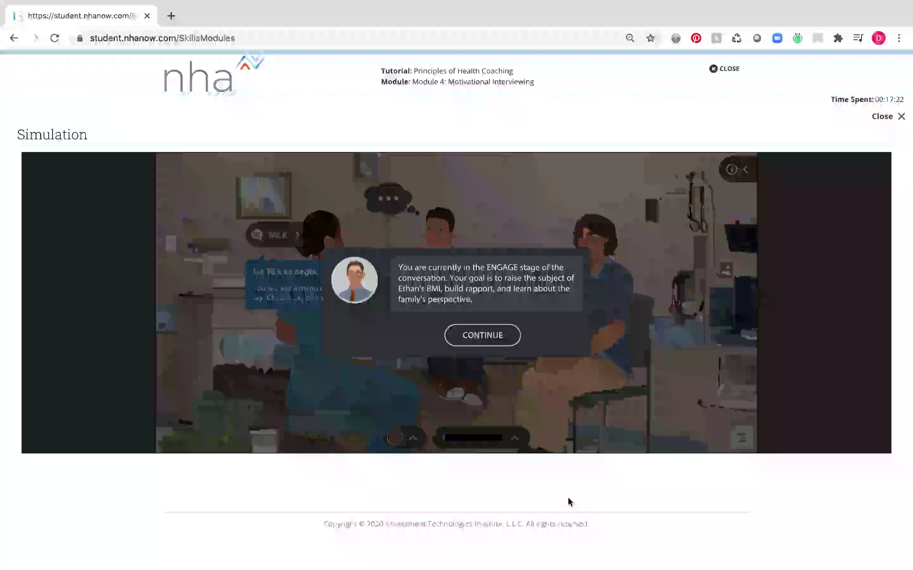

Accessible Online, Engaging &
Interactive Tools for Distance Learning
Secure live remote proctoring | Safe, self-paced practice | Applied learning assessments
Study guide and practice tests | Interactive gaming, flashcards and simulation
Notes:
We provide a secured online learning platform perfect for the classroom or distance learning that can also be self-paced
Our platform encourages safe practice through online prep and practice tests to measure improvement through applied learning assessments delivered in a variety of methods including, quizzing, gaming, flashcards and simulation
Secure Live Remote Proctoring | Safe, self-paced practice | Applied learning assessments |
Online Study guide and practice tests | Interactive gaming, flashcards, simulation

Slide 8
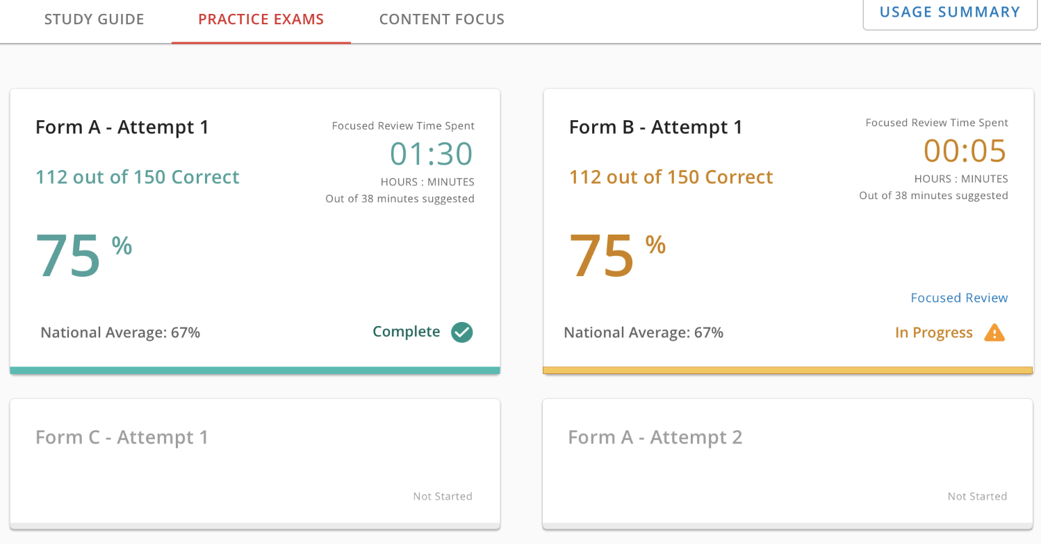

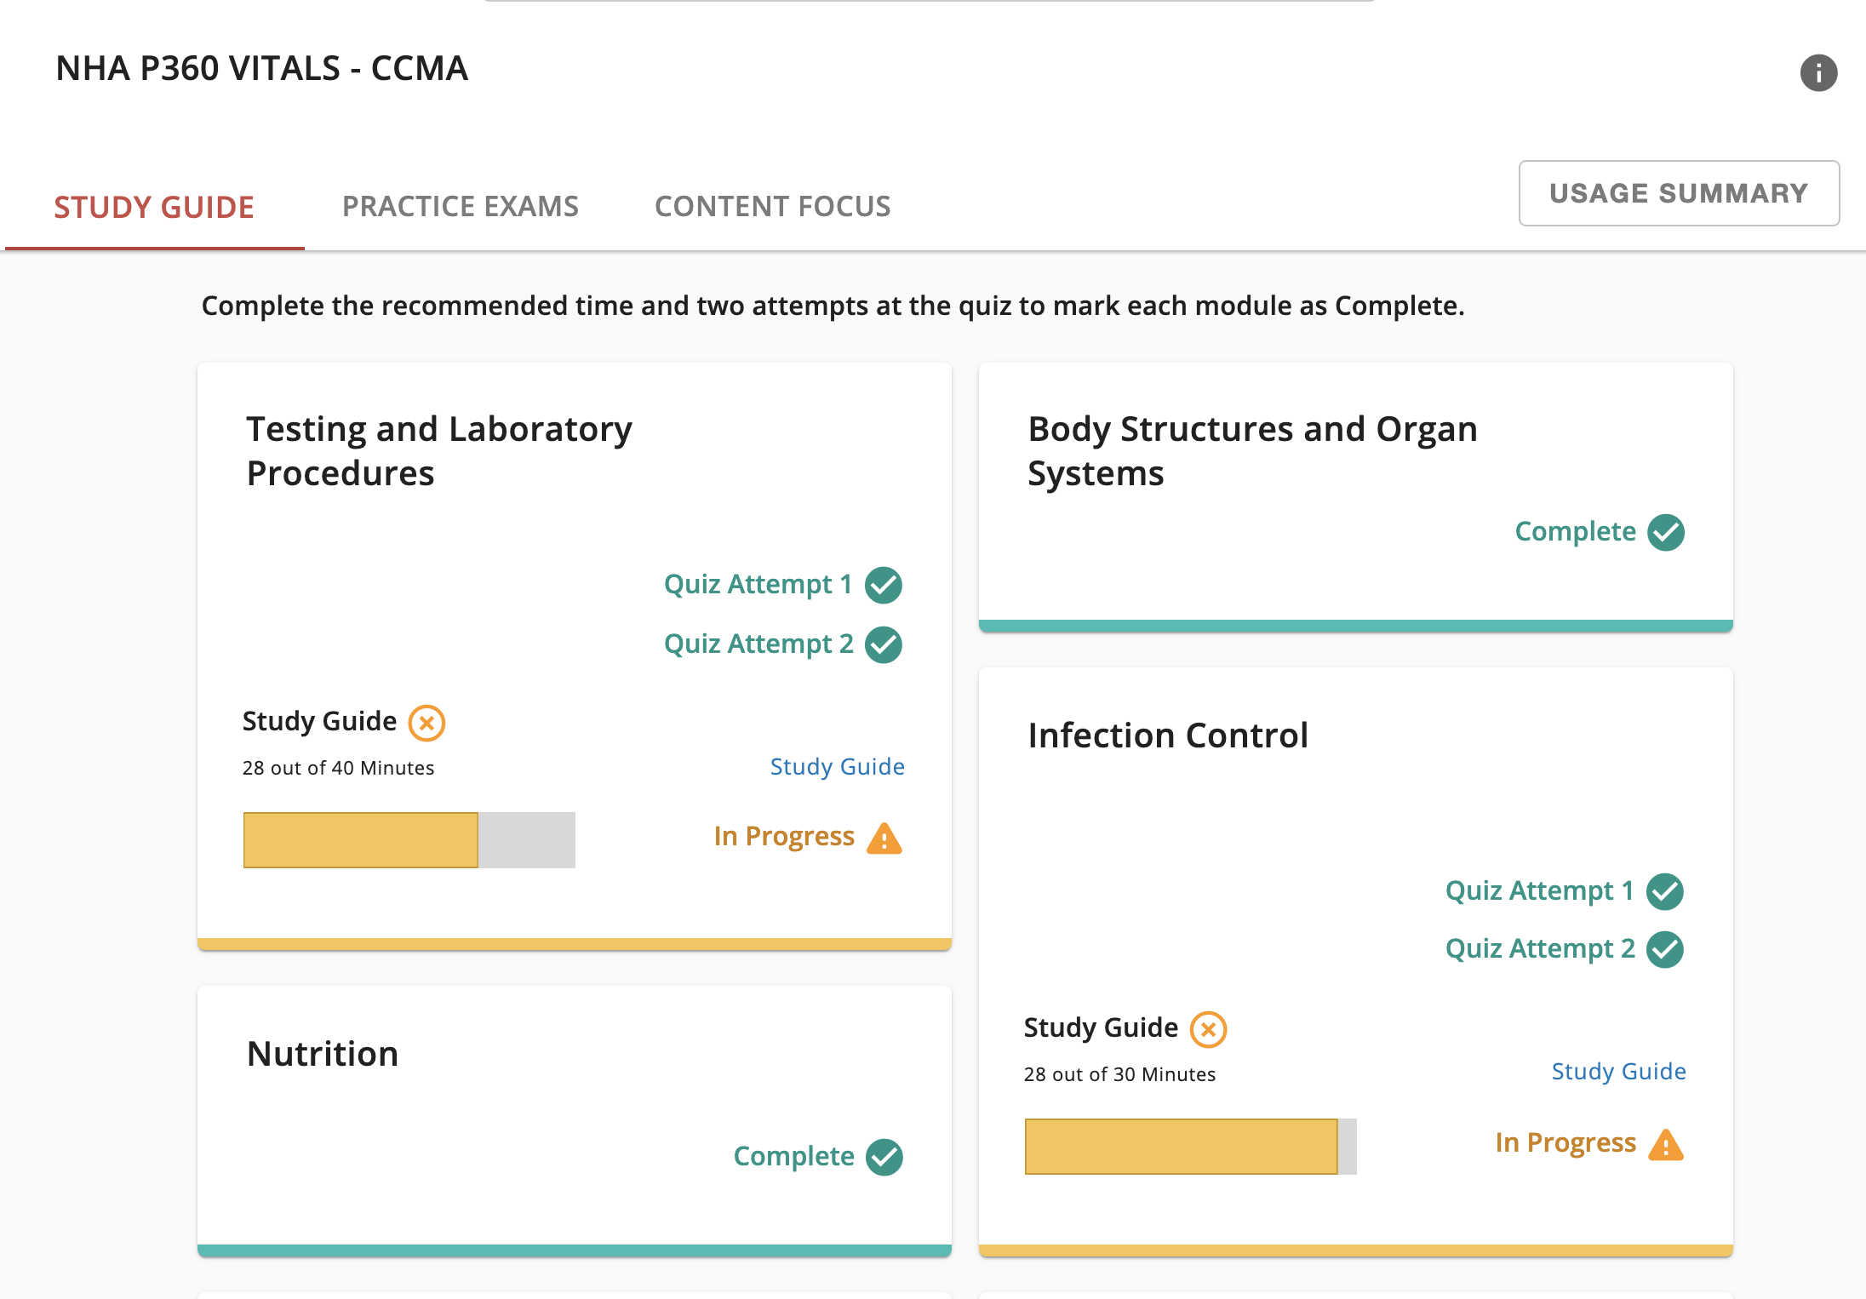
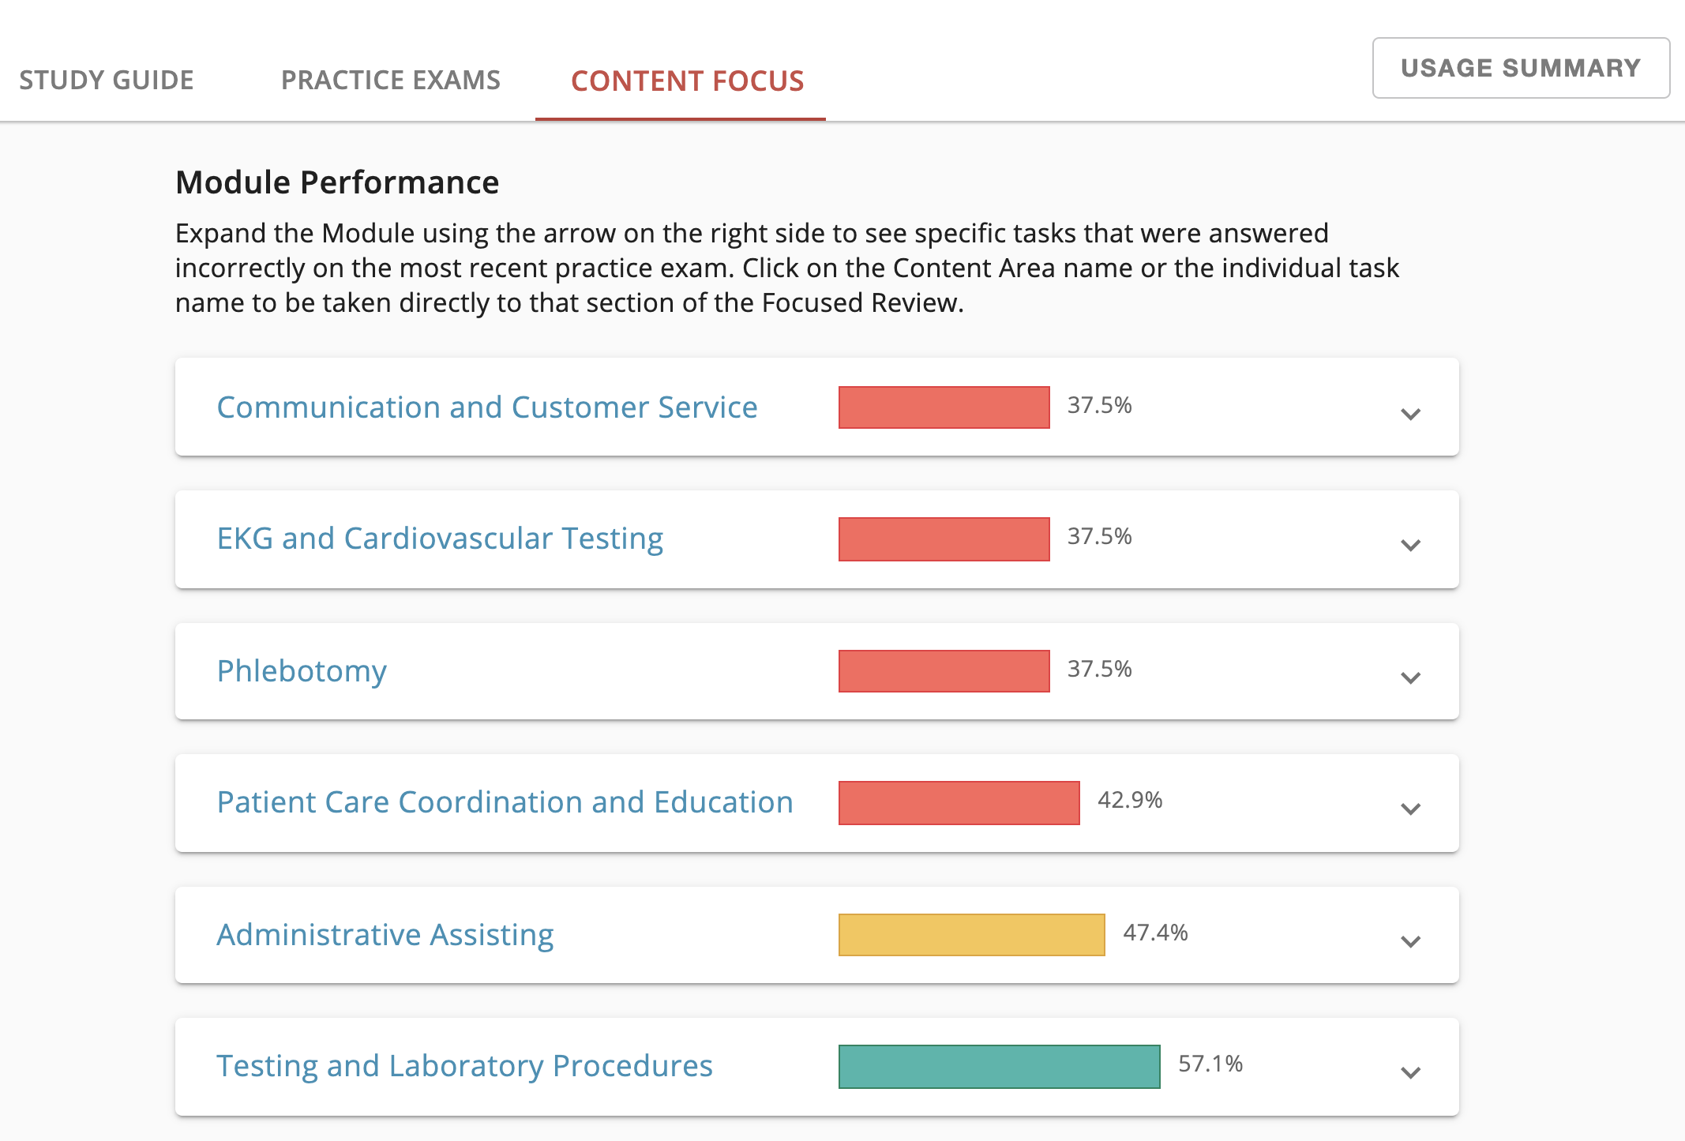
Powered by Reporting and Actionable Data
Notes:
Because we strongly believe information leads to positive change, we power our solutions with action-oriented data analytics and reporting. We make it easy for you to identify areas of weakness in your program and for your individual learners so you can help coach them to achieve success.

Slide 9

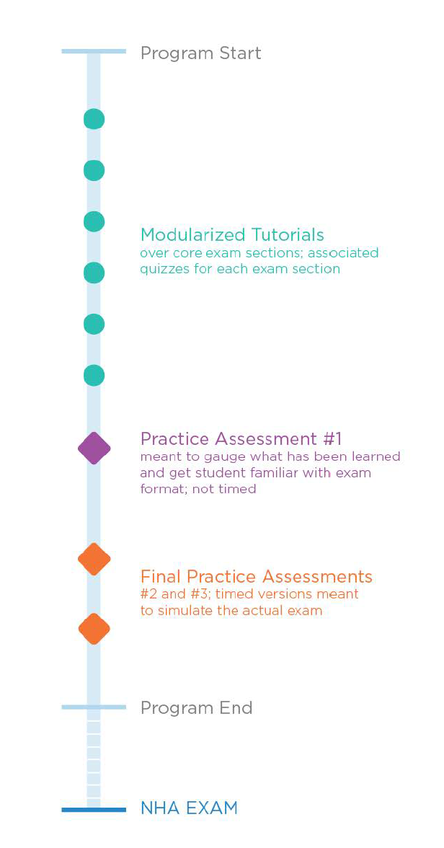
Implementation Planning
Plan timeline for test dates
Crosswalk to test plan
Identify and align resources
Exam Preparation + Remediation
Certify
Notes:
Your time is precious, so we have done some of the heavy lifting for you. Instead of digging to find additional resources to help you teach, we have loaded our new study materials with additional features to go along with each module
Definitions of terms
Case studies with real world examples
Scored Quizzes
Professionalism videos from the field
Enhanced graphics, diagrams, charts, tables, etc. for visual learners
Simple association games like matching, click and drag elements, and more

Slide 10
Provisional Certification
A candidate who is scheduled to graduate from an accredited high school or GED program (or other equivalency test recognized by the candidate’s state or residency) may take the certification exam and receive a Provisional Certification up to twelve (12) months before graduation as long as all certification eligibility requirements are met.
Is a placeholder and is intended to allow candidates to take certification exams as near to the time they complete their training even though they have not yet met the eligibility requirement of holding a high school diploma or its equivalency needed to receive a standard (full) certification.
(Provisional Certifications are not available to candidates sitting for the ExCPT Pharmacy Technician Certification.)
Source: NHA Candidate Handbook
Notes:
IN the high school space we have a special status that allow students to sit for their certification prior to the completion of their program.
Explain Provisional cert…

Slide 11



Partner Centered Support
Certification
Specialists
Your personal consultant, helping you solve business challenges for your frontline teams
Your implementation and training partners will ensure you are getting the most out of NHA products and resources
Your world-class service organization ready to offer support and guidance when you need it
Client Care Specialists
Customer
Experience Team
Notes:
(Optional Slide)
When you work with us, you gain a team from NHA who can help you strategize, execute and measure, all while optimizing your use of our products to help you achieve your goals. Our certification specialists, customer experience and customer service teams work hand-in-hand to ensure you have the support you need at every step of the way.

Slide 12

Notes:
Created with specific objectives in mind, NHA’s new MA SkillsBuilder: Clinical helps students successfully complete trainings and certifications to become attractive and capable candidates able to confidently handle a range of real-world scenarios.
For educators, the program focuses on:
Solving the problem of student retention through enhanced engagement.
Preparing students for externships and subsequent employment through proven skills competency.
Ensuring students graduate with a unique blend of skills perfect for work in a doctors offices, hospitals and outpatient centers.

Slide 13

Notes:
The program is broken into 12 different modules to help learners master those clinical competencies that employers are most focused on. Throughout the modules, they’ll be introduced to the top 39 skills identified and desired by employers.

Slide 14
Your Texas NHA team
Regional Partnerships Manger:
Jen Dehn: jennifer.dehn@nhanow.com
Client executives:
Ashley Guy: ashley.guy@nhanow.com
Nigora McGill: Nigora.mcgill@nhanow.com
Beth Pintner: beth.pintner@nhanow.com

Slide 15

TOGETHER
we can empower people
to access a better future
Notes:
We are fully invested in your success. We take pride in doing what is right and are not afraid to use our voice if it moves the industry forward. So what do you say? Let’s form a team and instead of cheering each other on from the sidelines, let’s cheer each other on from the front lines.

Slide 16

APPENDIX
Notes:
We are fully invested in your success because we care about the professions and the professionals we serve. We take pride in doing what is right and are not afraid to use our voice if it moves the industry forward. So what do you say? Let’s form a team and instead of cheering each other on from the sidelines, let’s cheer each other on from the front lines.

Slide 17



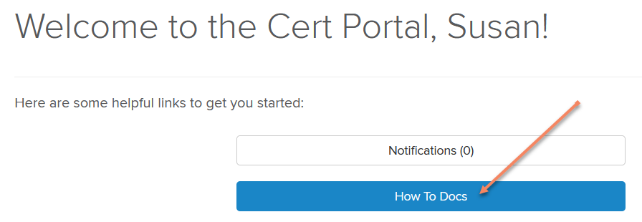
Your NHA Support Resources
SELF GUIDED RESOURCES
“How to Documents”
CLIENT CARE
nhanow.com “Contact Us”
CLIENT EXECUTIVE
Find easy to use reference documents and videos in your NHA Account by clicking on “How To Docs
Candidate support
Registration
Technology
Live Remote Proctor Support
Continuing Education
Recertification
Partner Support
Proctors
Exam date help
Invoice payments
Third Party Testing Support
New Partner Guidance
Program Alignment with NHA Resources
Account Planning
Introduction of New Tools and Resources
Industry Collaboration
Initiate Training Offered Through NHA Client Experience Team
Notes:
As a reminder - NHA wants you to be able to address your questions WHEN they happen so – we’ve already reviewed the how-to space,
but please know these self guided resources are your first line of defense for both you and your students on what to do and the mechanics of how our resources and website work. There’s TONS of great stuff in here to use throughout the program including a best practices video to share with students using their prep materials.
If the answer you need isn’t found here, then please use our Client Care team, they are the live chat and help center phone line and are available extended hours but not 24 hours. This means that you and your students’ don’t have to wait until Kim is free to answer any questions that are urgent! This group of people are INCREDBILE and all located here in the US. They will respond as quickly as they can and the typical wait time is around 30 seconds to connect.
In addition, you have your NHA Certification Specialist, Jennifer Dehn. She’s here to help with all other tools and resources and to ensure you have everything you need to be successful and empower your students to earn their certifications. Her number is for YOU as an administrator. Please refer your students to the Client Care Team for immediate assistance. If you or your campus would like any additional training – either as a group or individually, she can connect with my team to get something scheduled for you!

Slide 18
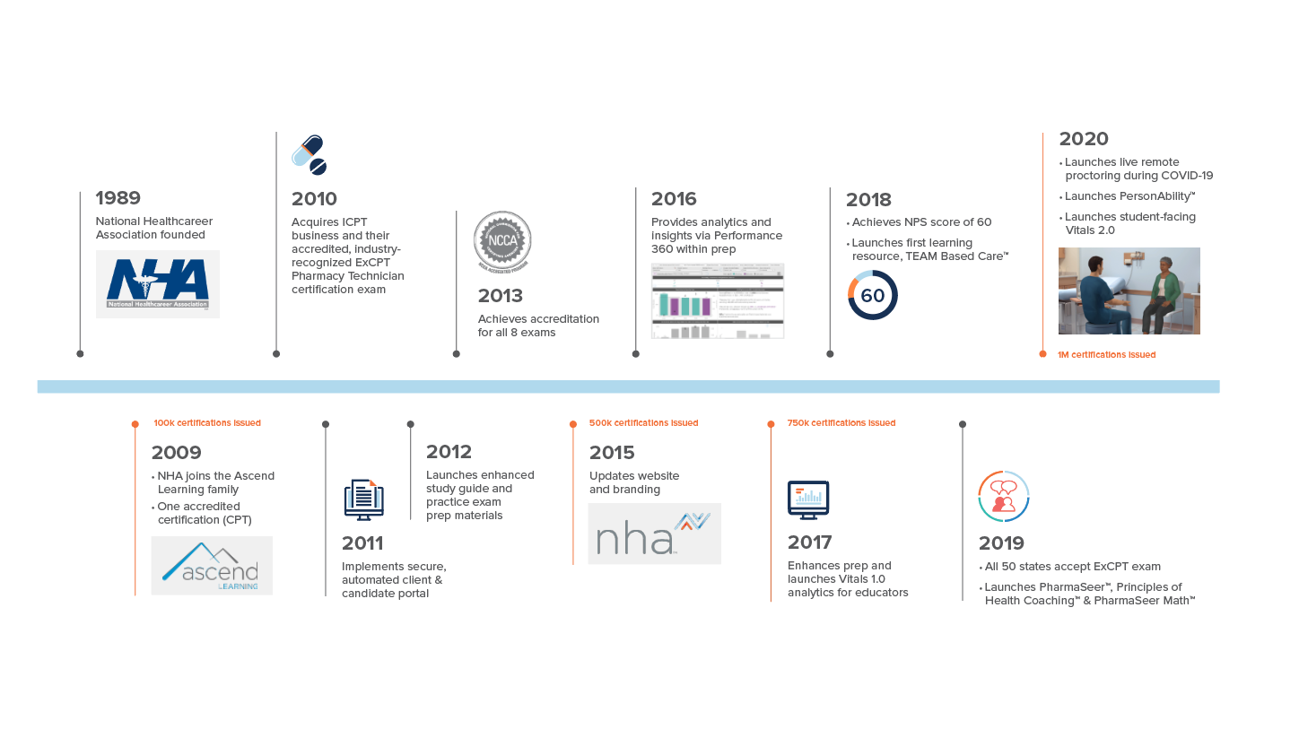

Since 1989 NHA Has Awarded Over 1M Certifications
Notes:
- No changes from Marketing

Slide 19


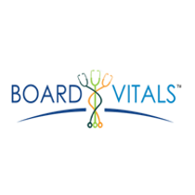















Notes:
- No changes from Marketing

Slide 20
We Change Lives Through Clinical Healthcare, Fitness & Wellness and Professional Education
Notes:
If you’ve been to the doctor’s office, picked up a prescription, worked out with a trainer, or had construction done on your roadways or office, chances are many of those people were helped by Ascend.
Our businesses help test, assess and certify: physicians, nurses, medical assistants, pharmacy technicians, EMTs, fitness trainers, insurance professionals and many more professional careers

Slide 21
Voice of Our Clients
Employer
Educator
Certification Holder
Marlene Lee
Manager, Employment Services, Mercy Hospital & Medical Center
“We can see that NHA certification makes our medical assistants better caregivers. They are more comfortable
and confident around patients, doctors, and nurses, and they gain a greater understanding
of what it takes to deliver quality care in a hospital setting.”
Tracy Huneke
CP, NPA, CHI, phlebotomy and patient care technician educator at Griffin Hospital School of Allied Health Careers
“After we improved training and implemented NHA certifications, patient satisfaction with blood draws increased dramatically.
We saw big improvements in
skills and confidence levels. Patients were happier and so
were our employees.”
Sonya Davis
CPCT
“I love caring for people from
all walks of life. In my career
I have worked for the jail system as a CPT/A and I am now working at a hospital as
a CPCT/A. This has inspired
me to continue my career in nursing and I am currently in school to obtain my RN degree. Very excited for my future."
”
”
”

