Slide 1
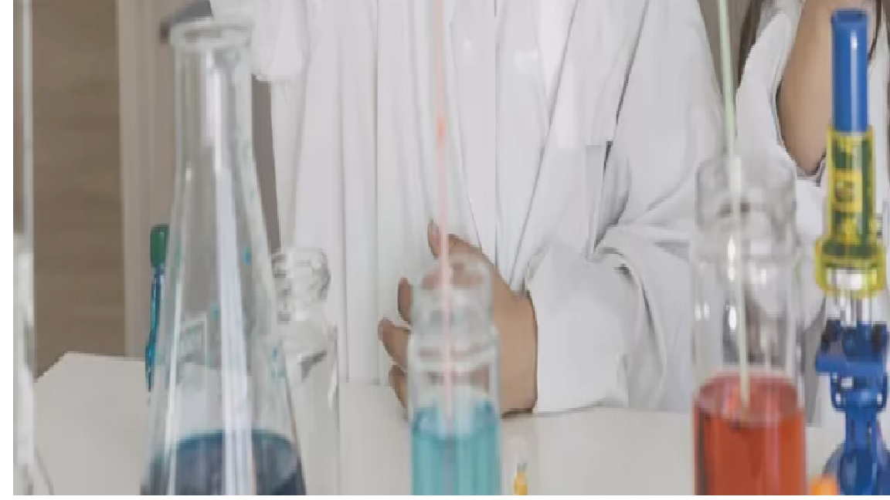
Patho Party!
Ramping up Old Material for a Kinesthetic Learner!
Sandi Cravens-Bristow
Sbristow@Palestineschools.org
903-731-8005

Slide 2
A Little About My Background
I started teaching in 1989 before Health Science was an idea in TEA’s mind.

Slide 3
Education Journeys Highlighted:
Early Childhood Certification San Jacinto College 1985
Montessori Certification 1986
Misc others……..
Bachelors of Life & Earth Science UofH Clear Lake 1989
Bachelors of Nursing TWU 1999

Slide 4
Employment Journeys Highlighted That Apply to This Session:
Santa Fe Tx Math, Art , Science Integrated
National Wildlife Estes Park Colorado
HISD Deady Middle School ESL Physics/Chemistry
PMS @ PISD Life Science
FBISD Career Technology Center Vet,Pharm,CNA
PHS PISD Patho,MA,Phleb,CNA, Pharm,RDA

Slide 5
What is This Session About

Slide 6
This session addresses short & easy kitchen labs with everyday materials to integrate into your current curriculum to add more meaning for those kinesthetic learners. Lesson plans & labs supply lists will be provided to work with.
Why I did this Session

Slide 7
I Keep It Simple!
My Math Grid Experience

Slide 8
The School District Walmart Card is My Friend!

Slide 9
“There is Nothing New Under The Sun”
Teachers:Please Steal with GRACE!
Cheryl WLF Story

Slide 10
So! Onto the Topics in Some of My Units!

Slide 11
Cancer Unit:
Cellular Degeneration Through Radiation
Supplies: Cardboard (for egg stands), Raw Eggs, Graph Paper, Lab Report H.O.
Prep: Review Lab Reports & Rules of the x/y axis griding, MD Anderson Report on increase on thigh and brain cancer R/T cell phones

Slide 12
Cellular Morphology:
Foundation of Blood PH to Prevent/Stop Cancer Growth
Supplies: OTC PH paper with 0-14, becareful! Lab Report, paper plates, gloves
Prep: Review Acid/Base, Blood PH, documentation, Self Report of foods, before a coke, after a coke Advance: schools of thought

Slide 13
Endocrine System
Blood Glucose Explained
2 Hour Lab
Supplies: W/sh, set-up clear cups, red food coloring, sugar, paper plates, titration instrument,pretest, post test
Prep: set up stations ahead of time
Advanced: Hyperglycemia associated blood viscosity can be a nexus stimuli

Slide 14
Kidney and Gallbladder Stones
How They Develop
Supplies: Rock Candy Recipe but don’t call it that!See HO, mason jars, candy making isle sticks, bags, twisties, table coverings, string, food coloring and flavoring
ADV: compare what “grows better”
Prep: HOs, Dead Drs, Drs,

Slide 15
Cellular Membrane Destruction
Supplies: homemade agar , see that list, lemon essential oils, misting device-FREE melaleuka get it going
Prep: make agar, half agars after inoculated in one room and other half in another area-

Slide 16
Same with Tea Tree Oil
Supplies: same as previous slide BUT use tea tree oil
Prep: advance same as previous slide BUT place tea tree oil on the agar
Advance: Double Blide Study, Who Has It

Slide 17
Comments ?
Questions?

