Slide 1
THOA CONFERENCE 2022

Slide 2
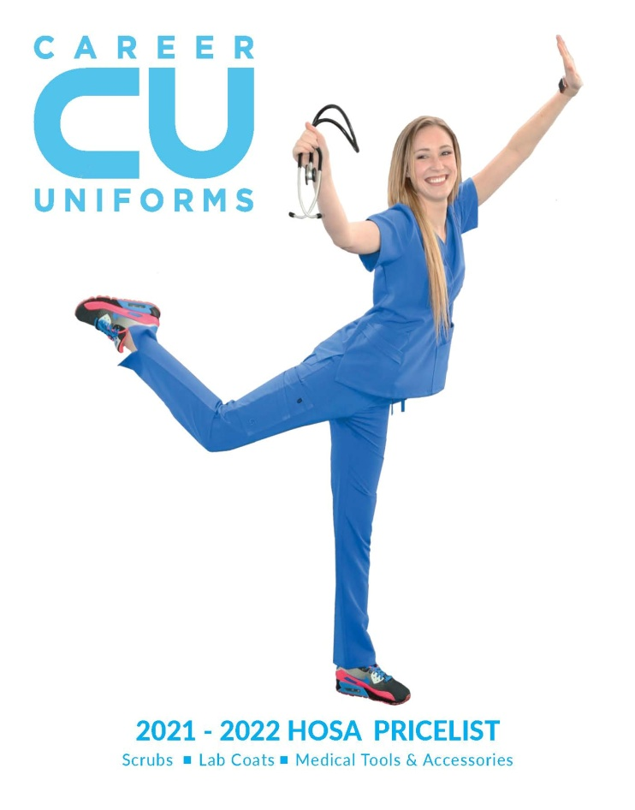
Inclusion, Professionalism & Identity:
Creating an A+ Uniform Program

Slide 3
Who we are:
Medical Scrubs and Accessories Supplier
Founded by a former nurse
In business for over 30 years
Located in Houston, TX

Slide 4
Who we work with:

Slide 5
Why are uniforms important to students?

Slide 6
INCLUSION
A sense of belonging.
A feeling of being part of something bigger than themselves.

Slide 7
PROFESSIONAL & PREPARED
Makes them feel the part and ready to assume the role.

Slide 8
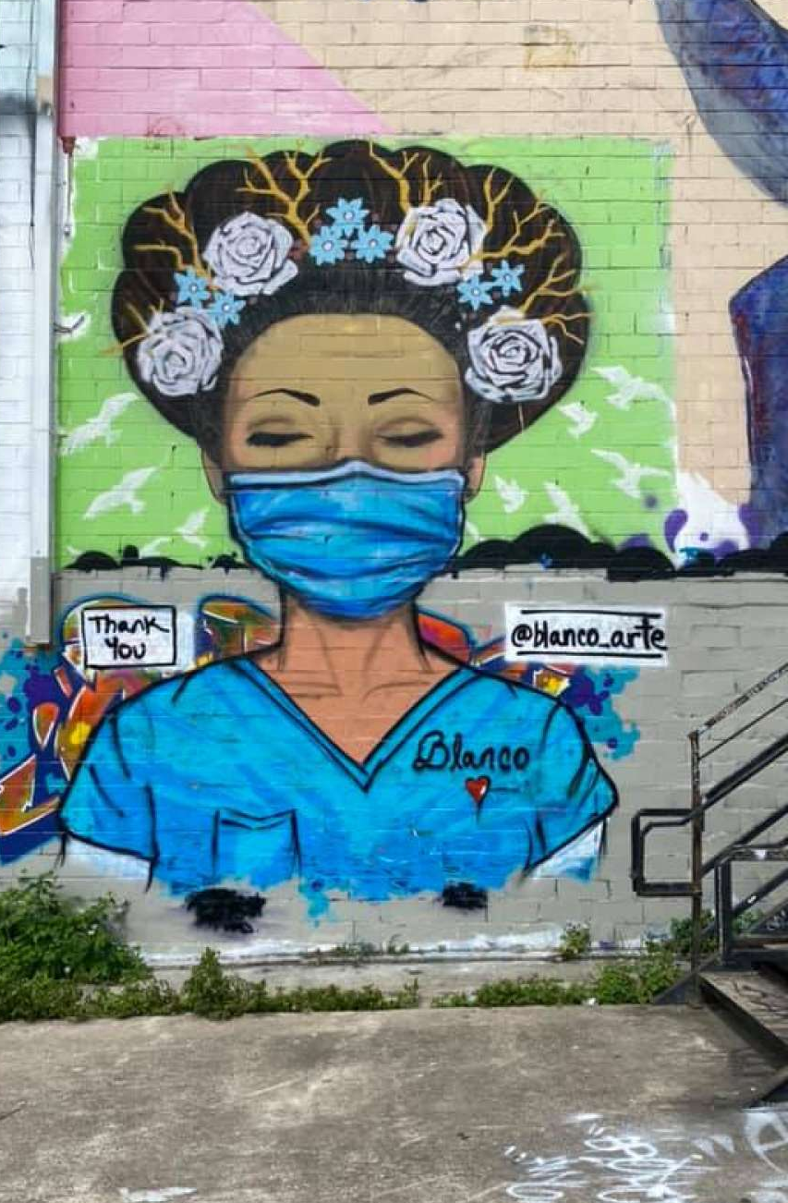
IDENTITY
They can express a big part of who they are…who they dream to become.

Slide 9
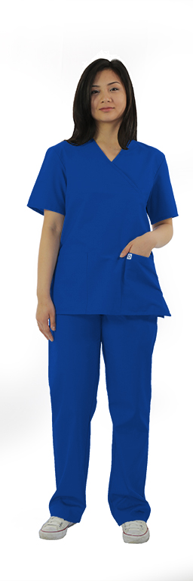
We can help you create a program!

Slide 10
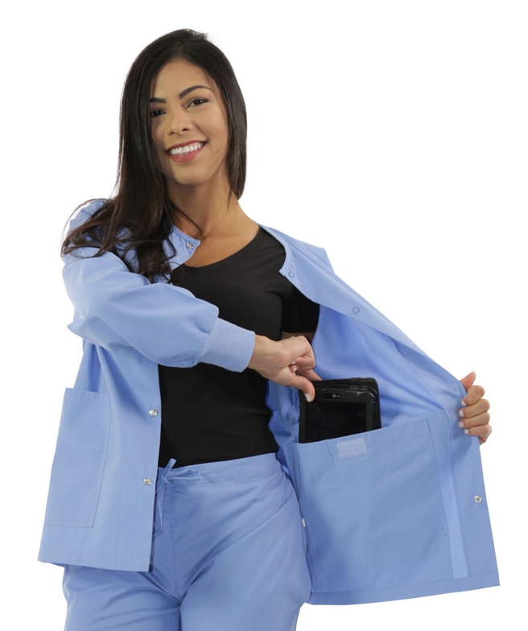
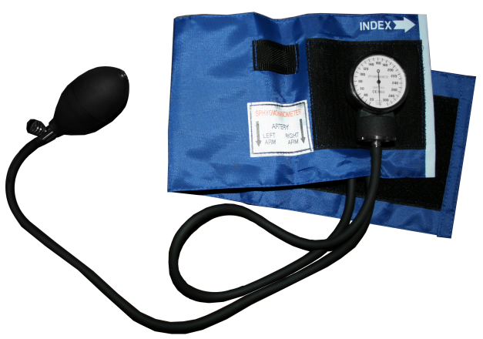
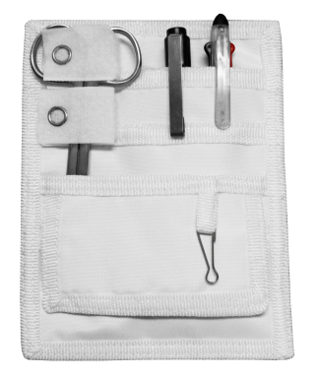
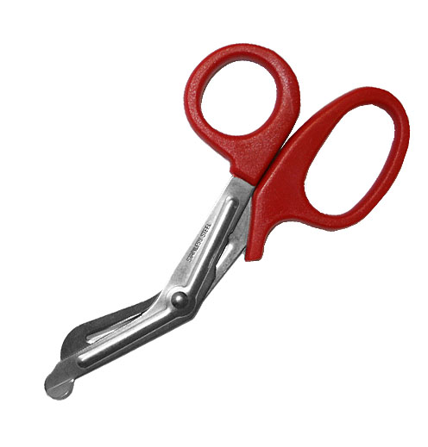
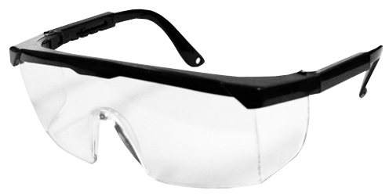
We offer a wide range of products in-house
And can source anything not in our catalog

Slide 11
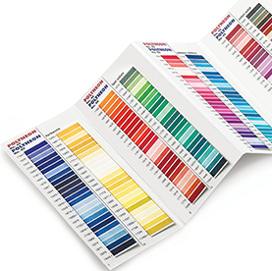
We offer different ways to customize your program

Slide 12
We have options to fit any budget
We offer special HOSA pricing!

Slide 13
We created a…
Step-By-Step Process
Make Selection
Sizing Box
Online Portal
Fulfill and Ship

Slide 14
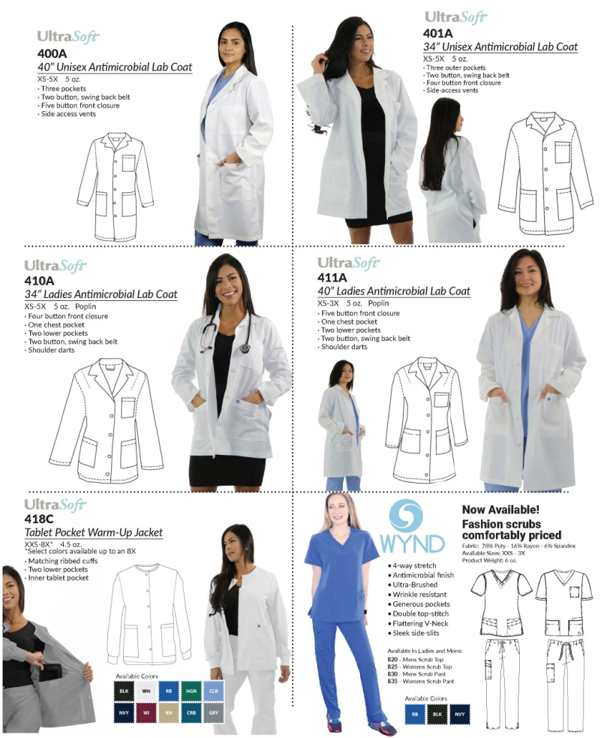
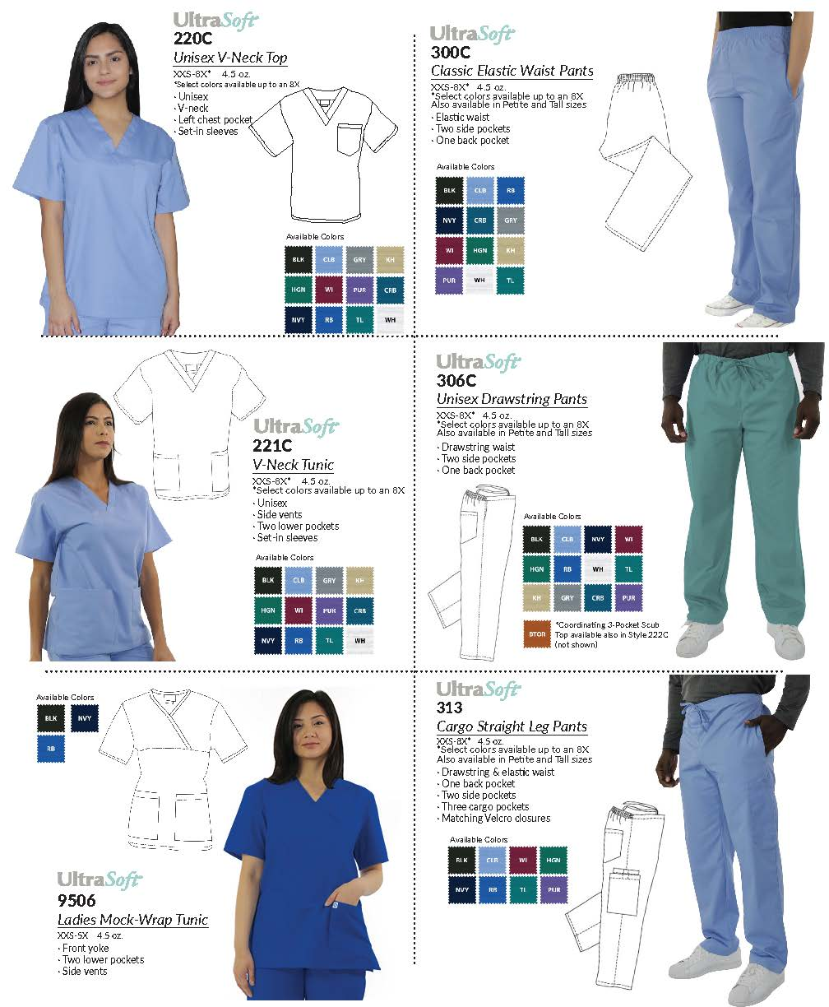
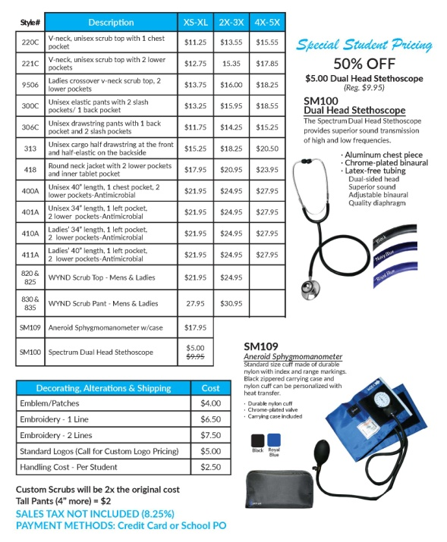
We help you…
Select what you want

Slide 15
We send to you a
….Sizing Box
We offer sizes from XXS to 5X

Slide 16
We create for you….
an online portal…just for your school

Slide 17
Then we…
Fulfill order & ship to school or directly to students!

Slide 18
We adapt the process to work best for you

Slide 19
Free set of Teacher Scrubs!

Slide 20
Michael Miller
National Sales Manager
michael@careeruniforms.com
Isa Jones
Sales
sales@careeruniforms.com
Direct: 713-645-6383
3800 Juniper Street – Houston, TX 77087
careeruniforms.com

