Slide 1
Been there, Done that, taught the EKG Certification
Cherie R. Watts MSN, RN
Former Program Director/Insructor

Slide 2
EKG Tech Program Training
Requirements to test
NHA:
You must be a United States high school student, graduate or hold equivalent credentials (e.g., GED).
You must submit a copy of your ECG Technician diploma, certificate of completion, or official (signed) transcript with graduation date to obtain full accreditation.
All required documents must be submitted within two years after successful program completion in order for your certification to be released.
https://www.nhanow.com/get-certified
NCCT
You must be a United States high school student, graduate or hold equivalent credentials (e.g., GED).
You must submit a copy of your ECG Technician diploma, certificate of completion, or official (signed) transcript with graduation date to obtain full accreditation.
All required documents must be submitted within two years after successful program completion in order for your certification to be released. https://www.ncctinc.com/certifications/ecg

Slide 3
EKG Tech Program Training
Documentation of skills competency is not required to test.
Skills lab and clinical required for a clinical or practicum course.
Skills lab included the following concepts:
Infection control Medical equipment operation
Occupational safety Obtaining a medical history
Patient comfort and safety Med proc justifications/explanations
Medical equipment maintenance
Human Anatomy & Physiology Testing options
Rhythm recognition Drug properties and interactions
Calculating heart rate Patient education
EMR/EHR software HIPAA
Documentation

Slide 4
EKG Tech Program Training
Skills lab included the following:
arts and crafts projects for A/P review of heart
arts and crafts projects for major EKG rhythm
Practice Code for CPR review
Virtual Reality electrode placement
EKG placement on mannequin
Videos of EKG lead placement on family or friend with paper dots or sticky notes
Infection control - gowning, hand hygiene, environmental cleanliness
History taking
Identifying parts of the EKG machine
Practice lead placement on each other

Slide 5
EKG Tech Program Training
Campus Based clinical 6 week clinical
10 EKGs per student. Only 1 classmate can be among the 10.
A clinical waiver of responsibility and information about the clinical is given to each student.
Volunteer consent and disclaimer.
Students set up the clinic schedule, set appointments for their family and friends, classmates and teachers
Students clean the beds and lead cables and monitor after each patient.
EKG is interpreted by student and teacher
Teacher signs off on EKG sheet and staples to clinical skill sheet.
Student take inventory

Slide 6
CONSIDERATIONS
District calendar – clinical dates, testing dates
Absence policy, program rules – such as dismissal
All students must have a valid picture ID before they can sit for the certification exam.
Fee’s – scrubs, patch, certification test, books, computer modules, optional learning resources
Student Folders
Training supplies, clinical and lab set - up, consumables
Recruitment, Pinning Ceremony

Slide 7
TRAINING SITE (clinical rotations)
2 beds
2 EKG machines
EKG supplies
Gowns
Volunteers
Alot time for full clinic: set up, schedule review, assignment of duties, break down, clean up

Slide 8
Offer the Program to match your district needs
What grade level: Who will take the class? Juniors, seniors or combination. Program is flexible as long as rules are followed.
Consider creating a student application or interest survey.
Consider discipline record and absence records.
Consider mandatory parent / student Information Session.
Prerequisites – up to your district. Consider At Risk, Special Education Students, and students with disabilities.
Class size – clinical/lab equipment and supplies influences class size. Classroom can hold more, but clinical lab should be the same as clinical, but no state requirements for lab.
Student schedules - consider double or triple blocking classes.

Slide 9
certification
Certification Process: Successful completion of EKG course
Certification exam can be paid by vouchers, or credit card.
Plan a district Pinning Ceremony; schedule it and order Pins and supplies early in year.

Slide 10
certification
Exam is 75-125 questions depending on the test provider
Each vendor has their own review or practice exams available for a fee.

Slide 11
Classroom Conduct Management
Cell phone pockets with charger station
Keep pocket close to teacher desk
Lab days and clinical days are professional dress days.
Professional and customer service attitude

Slide 12
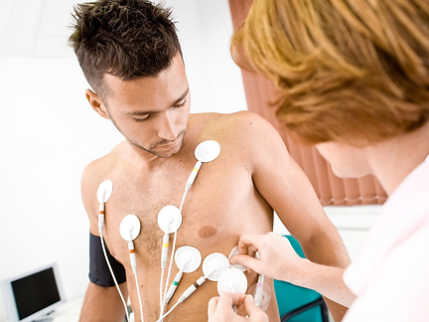
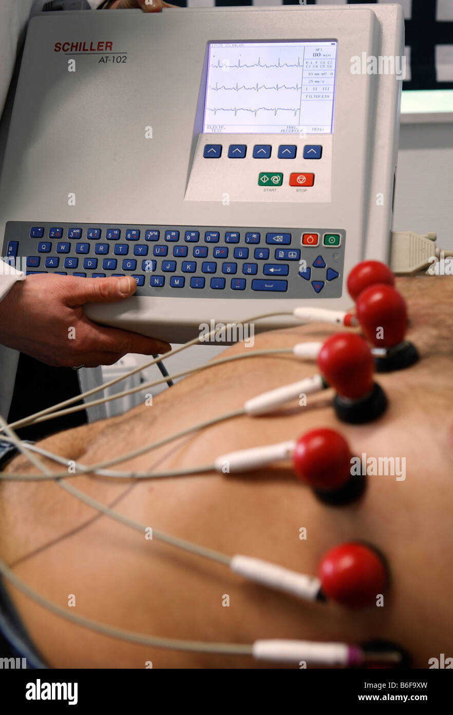
Clinical Skills Lab
Clinical skills labs are interwoven between lectures, coinciding with the related lecture topic. Students will collaborate in small groups to practice applying and aligning electrodes to anatomical dummies. Then, instructors will lead live EKG demonstrations, applying and analyzing the 12 Lead EKG's of student and/or instructor volunteers. Students will have the opportunity to interpret and discuss findings in class, and eventually complete an entire EKG procedure on their own for their practical exams.
Clinical Lab is a controlled environment. Mistakes can be made and corrected.
Students must learn to accept constructive criticism, it is an important part of learning in this lab setting. “Hot Seat”
Students practice clinical skills on each other or on manikins.
Students must practice skills until proficient and must be checked as such by instructor.

Slide 13
Performance Record
Record include EKG reading, interpretation, and signed waiver of volunteer.
Signature needed by instructor
Student needs perform 10 ECG successfully in order to advance to the certification test.

Slide 14
Clinical Lab and Real World Variables
The clinical lab is a controlled real world setting. In the real world there are variables which can alter application of skills such as pain, cognitive or sensory impairment, illness or disease processes. These variables are not present in the clinical lab unless purposefully set up. Unplanned variables occur at unpredictable times in the real world and students and instructors need to be prepared to handle these situations.
The clinical lab teaches students the right way to respond to these variables, but nurses need to learn how to “think on their feet” and be ready to adapt to the real world by implementing critical thinking skills.

Slide 15
Clinical Skills Lab – Set up
This lab should always be a PHONE FREE ZONE
No video taping allowed, unless instructor lead.
Prepares students for real world skills, set it up to resemble the Real World (clinical)
Students should only perform skills in the Real World that they have demonstrated proficiency in the clinical lab – been checked off.
Consider a “Skills Blitz” prior to clinical rotation.
Supplies and set up should be based on number of students in class.
https://www.pocketnurse.com/
https://www.enasco.com/healthcare/
https://www.mooremedical.com/
Local medical supplies

Slide 16
Real World – Clinical Rotation
Observation is an important part of the Real World. Students learn how to respond by observing skills in action. Professionalism and attire is very important and must be emphasized at all times. Should be a big part of pre – clinical discussions.
Real World has variables – not a controlled environment.
Ex: Resident has dementia, family present, patient experiencing chest pain; anatomy differences etc….
The application of critical thinking skills plays a major role in real world setting.
Review and question the readings. Allow them to provide you insight on their interpretation of the reading.
Sign off on the ECG performance sheet.

Slide 17
In Facility Testing
VALUE
Director schedules the exam before the end of the school year directly with the examiner. All students tested before the end of school year.
Students will test with their peer group and it will be less stressful for everyone.
Districts do not have to transport students to other testing site. (which may be quite a distance away)
Retesting is easier – may be able to scheduled as in – facility if 5 or more students. Districts can combine schools.
Get results faster. (most likely the same day)

Slide 18
Student Created Video’s
“Student Created Video’s”
Use caution with student created videos in your lab. Monitor and Preview.
Be prepared for any video created in your lab to be uploaded to “you tube”.

Slide 19
End Of Course
Schedule Test
Make Certificate of Completion
Send out invitations to Pinning Ceremony (invite administration and nursing home staff and residents)
Field trips – nursing schools, hospitals, potential jobs, speakers (Human Resources)

