Slide 1
Been there, Done that, taught the C.N.A Certification
Cherie R. Watts MSN, RN
Curriculum Consultant for Cleveland ISD

Slide 2
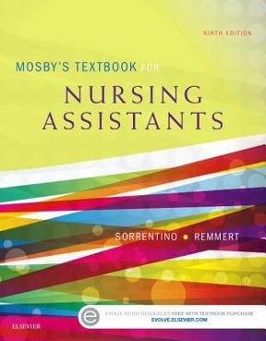
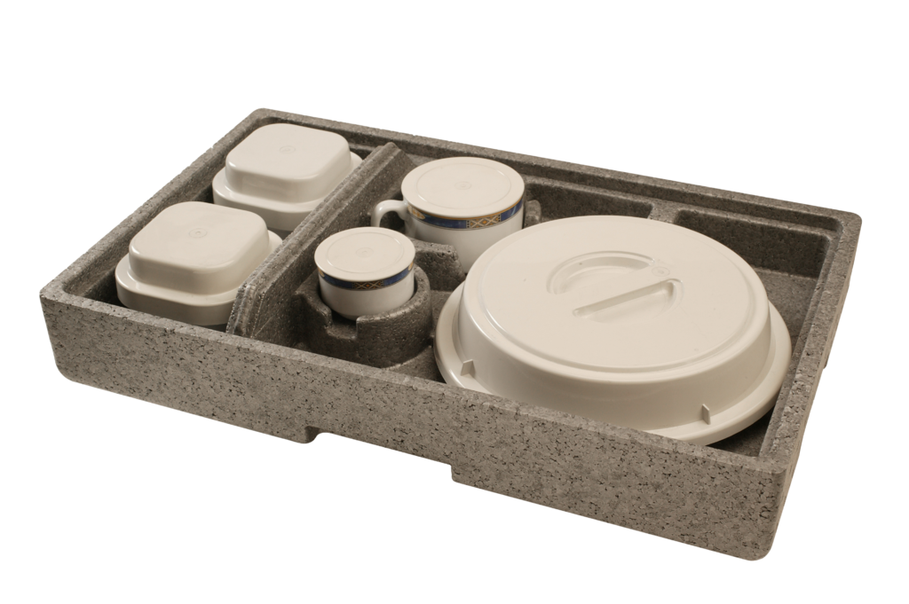
Welcome to Health Science Theory and Clinical: Certified Nurse Aide
Patient Care Assist Level 1
Nurse Watts reporting for duty! Now, where are my CNAs?! We have sooo much to do!
Nurse….I need a bath!
Nurse ...I’m hungry!

Slide 3
C.N.A. Program Training
Texas Health And Human Services https://www.hhs.texas.gov/
NATCEP
Certified Nurse Aide, Certified Nursing Assistants or Aides
The Texas C.N.A program prepares students to become certified nursing assistants, also called nursing assistants. Certified students are able to work as a certified nursing assistant in nursing homes, home health settings, hospitals, clinics.
May be prerequisite for some nursing schools.
Programs must follow the Texas Curriculum for Nurse Aides in Long – Term Care Facilities 6th Edition January 2022
https://hhs.texas.gov/sites/default/files//documents/doing-business-with-hhs/licensing-credentialing-regulation/nurse-aide/cna.pdf

Slide 4
OBRA Law and Texas Regulations
The Federal OBRA Law of 1987 requires that each State ensure that the nurse aide training programs they approve meet Federal requirements pertaining to basic nursing skills, personal care skills, restorative skills, mental health, and social service skills
http://www.aarp.org/home-garden/livable-communities/info-2001/the_1987_nursing_home_reform_act.html
https://oig.hhs.gov/oei/reports/oei-05-01-00031.pdf
https://phinational.org/policy/nurse-aide-training-requirements-state

Slide 5
Texas Nurse Aide Training Regulations
Texas Health and Human Services Website
https://hhs.texas.gov/
Texas Standards for Nurse Aide Registry and Training
http://texreg.sos.state.tx.us/public/readtac$ext.ViewTAC?tac_view=4&ti=40&pt=1&ch=94&rl=Y

Slide 6
NATCEP
NURSE AIDE TRAINING COMPETENCY EVALUATION PROGRAM
NATCEP Regulations
https://hhs.texas.gov/doing-business-hhs/licensing-credentialing-regulation/nurse-aide-training-competency-evaluation-program-natcep
NATCEP Curriculum January 2022 (updated)
https://www.hhs.texas.gov/sites/default/files/documents/doing-business-with-hhs/licensing-credentialing-regulation/nurse-aide/cna.pdf
NATCEP Program Application
https://hhs.texas.gov/sites/default/files//documents/laws-regulations/forms/5514-NATCEP/5514-NATCEP.pdf

Slide 7
your options
Look at the application and approval process. Review the state and federal rules and regulations.
Determine if your school can realistically become an approved training facility. Look at all options and consider creative ways such as, outsourcing director or instructor, combining schools to attend one campus.
Secure qualified director and instructors, and clinical sites.
Determine the costs for classroom, lab and clinical rotation.
Consider becoming an in – facility testing site.

Slide 8
CONSIDERATIONS
Student and instructor schedules, student transportation, parking.
District calendar – clinical dates, testing dates
Absence policy, program rules – such as dismissal
All students must have a valid social security card and picture ID before they can sit for the certification exam.
Fee’s – scrubs, patch, TB Testing, criminal background checks, certification test, books, computer modules
Student Folders, audit process (every 2 years)
Training supplies, clinical and testing lab set - up, consumables
Recruitment, Pinning Ceremony, field trips

Slide 9
TRAINING SITE (clinical rotations)
Locate all available THHS approved training facilities within reasonable distance. Call if necessary. https://www.hhs.texas.gov/business/licensing-credentialing-regulation/long-term-care-credentialing/nurse-aide-training-competency-evaluation-program-natcep
Will have a list of LTC facilities interested in being a clinical site
Facility--A nursing facility that participates in Medicaid, a skilled nursing facility that participates in Medicare, or a nursing facility that participates in both Medicaid and Medicare.
Visit all potential clinical sites and determine possible inclusion into your program. Make appointment with administrator and talk to director of nurses.

Slide 10
TRAINING SITE (clinical rotations)
Develop an affiliation agreement for all sites and get the process started. (could possibly take months for signatures) This can be started before the application process. Put at least 3- 4 years on agreement if possible to cover audit and re -approval process.
Add as many clinical sites to your approval application as possible. Check with THHS prior to completing application.
Discuss potential clinical dates, times, parking, meals, transportation with administration. Consider conflicts with other training programs. Ask for a tour of the facility.

Slide 11
INITIATE the approval process
Complete and mail the application for program to THHS, include resumes for all instructors and director. Add as many instructors as possible. Consider possibility of long term substitute. Make copies and keep a filing system.
Affiliation Agreements. Make them last through next audit. At least three years if possible. Program will be audited every 2 years.
Set up classroom, and clinical laboratory. Order all supplies, books, copy newest curriculum, procedural guidelines, testing skills lab check – off’s.

Slide 12
Offer the Program to match your district needs
What grade level: Who will take the class? Juniors, seniors or combination. Program is flexible as long as rugs are followed.
Consider creating a student application or interest survey.
Consider discipline record and absence records.
Consider mandatory parent / student Information Session.
Prerequisites – up to your district. Consider At Risk, Special Education Students, and students with disabilities.
Class size – THHS: clinical 1 instructor / 10 students. Classroom can hold more, but clinical lab should be the same as clinical, but no state requirements for lab.
Student schedules - consider double or triple blocking classes. If transporting to another campus, consider travel time and lunch needs.
Build in clinical rotation – at least a few 8 hour clinical dates, if possible. (minimum of 40 hours – in any combination)

Slide 13
certification
Certification Process: Requires course completion of all classroom, laboratory practice and clinical hours. Mandatory sign – in sheets.
Students create a profile on Prometric website. The program Director approves each student to sit for the certification exam.
Students then schedule the exam through Prometric on line system.
Certification exam can be paid by vouchers, or credit card. (price increase noted)
Plan a district Pinning Ceremony; schedule it and order Pins and supplies early in year.

Slide 14
certification
Exam is 2 parts. Theory and skills. Students must pass both parts for certification and can attempt 3 times. The exam is administered by a state examiner in an approved testing site that has a testing lab for the skills test and a place to take the written exam. The written exam is currently taken on computer.
The theory exam is 70 multiple choice questions. Skills exam will be discussed in detail later, but students must perform 5-7 random skills within 30-45 minutes.

Slide 15
Program Audit Preparation
§94.7 Approval, Reapproval, and Inspection of a Nurse Aide Training and Competency Evaluation Program (NATCEP)
(a) Initial approval of a NATCEP is made on the basis of the application submitted to DHS.
(b) Approval of a NATCEP is granted for a period of two years.
(c) DHS sends a notice of renewal and a renewal application form to a NATCEP at least 60 days before the expiration date of the approval.
(d) A NATCEP must file the renewal application 30 days before the expiration date of the approval. An application filed after the 30 days, or failure to file an application, will result in the expiration of approval.
(e) The results of an on-site visit to determine NATCEP compliance with the Act and this chapter will be used in the decision to renew the approval of a NATCEP.
(f) DHS may conduct an on-site review of a NATCEP at any reasonable time.
(g) DHS will provide written notification to a NATCEP of any deficiencies found as the result of any on-site review.
(1) The NATCEP must submit a written response to DHS, which includes a plan of correction (POC) to correct all deficiencies.
(2) DHS may direct a NATCEP to comply with the requirements of the Act and this chapter.
(3) A NATCEP that does not meet the requirements of the Act and this chapter by failing to provide an adequate POC will be subject to withdrawal of approval.

Slide 16
PROGRAM AUDIT PREP – Program Records
Keep an accessible organized filing system.
Teacher file – can be in school office or teacher office
District file – CTE Director Office

Slide 17
Files – Program Audit
All Applications – new, old keep them all. Save the entire application including resumes, affiliation agreements
Every two years the program will have to send in a renewal program application that must be notarized.
Keep all correspondence from THHS and Prometric including approval letters, deficiencies, plan of correction (POC),emails, reports

Slide 18
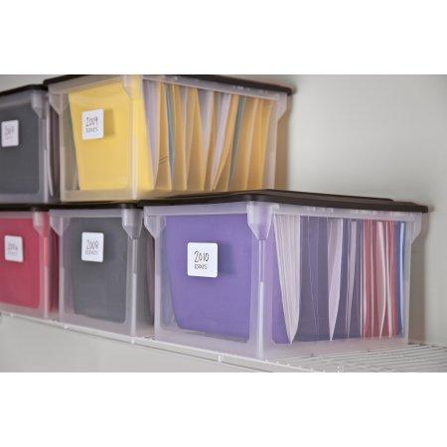
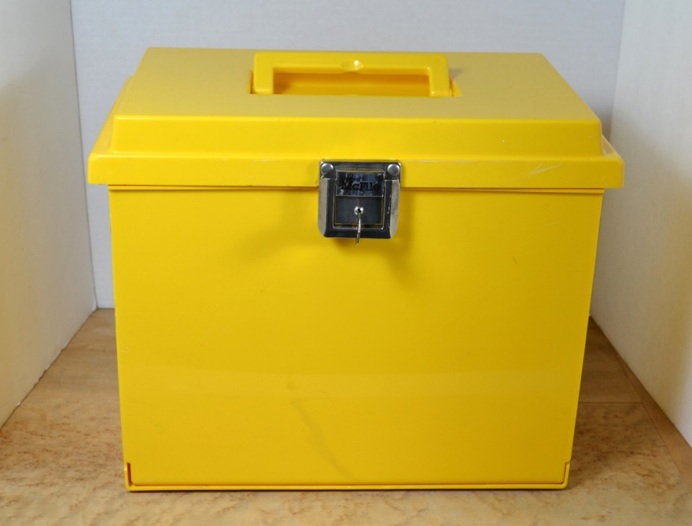
Files – Program Audit
Have everything ready and orderly for the auditor who will conduct the on – site review.
Can keep in file cabinet then move to portable file or keep in portable file.

Slide 19
Program Audit File
Program Applications – most recent( keep all)
All resumes – Director and all instructors, not supplemental instructors
Affiliation Agreements
Approval letters
Other correspondence from DADS, Pearson Vue, Credentia
Copy of clinical rotation dates.
Sign in sheets (daily is too big – keep in binder)
Picture or example of ID.
Certificate of Completion
All original Performance Records – indicate students received a copy with signature.
Keep record of exam results in a file but auditor doesn’t need that information

Slide 20
Student Folder (File)
Use as a class activity or can be done in summer parent meeting. Depends on management style.
Color code the classes.
Have students bring in a copy of social security card and ID – match the names and tell them they must have both to test.
TIP: Never let the students take the file home – vital info in the files and difficult to recreate if lost.
Keep all audit papers together in file. Auditor will ask to see student files
Pull each file by end of year and staple the papers needed for audit and place in the front. You could pull them and copy them and keep in separate file. Your choice, but have access for auditor.

Slide 21
2017 TEKS
http://tea.texas.gov/Academics/College,_Career,_and_Military_Prep/Career_and_Technical_Education/CTE_Texas_Essential_Knowledge_and_Skills_for_2017-2018/

Slide 22
Feeding Assistant
Could be taught as local certification (not state) in HST, clinical rotation or as supplemental for C.N.A. Program.
https://www.hhs.texas.gov/business/licensing-credentialing-regulation/long-term-care-credentialing/nurse-aide-training-competency-evaluation-program-natcep/natcep-curriculum-forms
https://hhs.texas.gov/sites/default/files//documents/doing-business-with-hhs/providers/long-term-care/nf/feedingassistant.pdf

Slide 23
C.N.A Program “Worlds”
Real World: Nursing Home
Clinical Skills Lab
Testing Skills Lab
Classroom: Lecture, discussion, videos, quizzes, exams
Clinical Skills Lab
Classroom
Testing Skills Lab
Real World

Slide 24
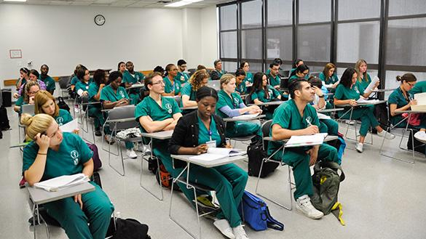
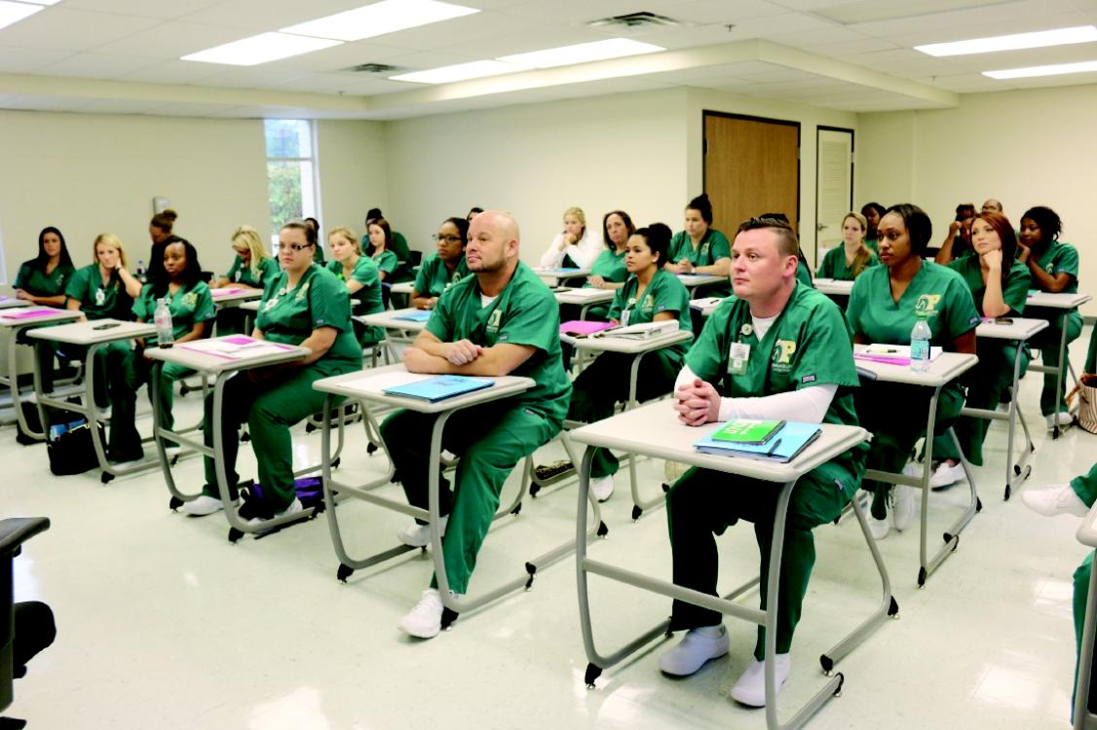
Classroom Structure
Structured Environment / Daily, weekly, monthly planning
Lesson Plans - follow THHS Curriculum
Discipline / Tardies/ Absences
Cell Phone / electronic devices and computer access
Lecture / Power point/ Guest Speakers /Worksheets / Assignments
Jumpstarts, bell ringers
Class Chat / colored tongue blades / unbiased and fair
Projects
Quizzes
Exams
College Classroom

Slide 25
Classroom Conduct Management
Cell phone pockets with charger station
Keep pocket close to teacher desk
Absences should be reconciled for curriculum days
Develop a tutorial make up day policy
Reconcile absences at least every three weeks
Limit clinical until absences made up all skills made up

Slide 26
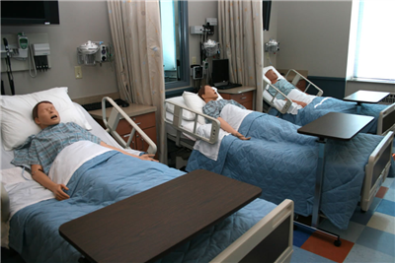
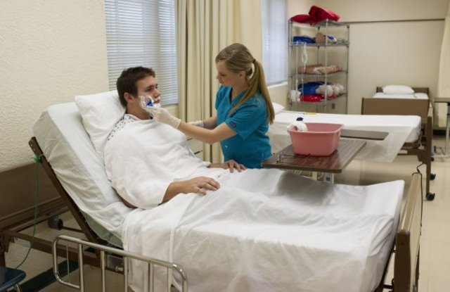
Clinical Skills Lab
Should be set up to closely resemble a real world setting.
Clinical Lab is a controlled environment. Mistakes can be made and corrected.
Students must learn to accept constructive criticism, it is an important part of learning in this lab setting. “Hot Seat”
Students practice clinical skills on each other or on manikins.
Some skills must be practiced in the Real World setting. Ex: Giving a shower
Students must practice skills until proficient and must be checked as such by instructor. (see Performance Record)

Slide 27
Performance Record – THHS
Students must use the DADS Procedural Guidelines and the THHS Performance Record when learning clinical lab skills.
This performance record includes classroom, clinical lab, and clinical rotation check – off’s. (see handout)
Develop a system that works for your program. (Examples: Handouts)

Slide 28
Clinical Lab and Real World Variables
The clinical lab is a controlled real world setting. In the real world there are variables which can alter application of skills such as pain, cognitive or sensory impairment, illness or disease processes. These variables are not present in the clinical lab unless purposefully set up. Unplanned variables occur at unpredictable times in the real world and students and instructors need to be prepared to handle these situations.
The clinical lab teaches students the right way to respond to these variables, but nurses need to learn how to “think on their feet” and be ready to adapt to the real world by implementing critical thinking skills.

Slide 29
Clinical Skills Lab – Set up
This lab should always be a PHONE FREE ZONE
No video taping allowed, unless instructor lead.
Prepares students for real world skills, set it up to resemble the Real World (clinical)
Students should only perform skills in the Real World that they have demonstrated proficiency in the clinical lab – been checked off.
Consider a “Skills Blitz” prior to clinical rotation.
Supplies and set up should be based on number of students in class.
https://www.pocketnurse.com/
https://www.enasco.com/healthcare/
https://www.mooremedical.com/
Local medical supplies

Slide 30
Clinical Lab Set - up
Sink with soap and water, soap, beds, linen, incontinent pads, pillows, towels, basins, bedpans, manikin, foley catheters, graduated cylinders etc……
Plan on consumables – toothbrushes, gloves, etc…..
Washer and dryer very helpful.
Options could include to shared lab time for multiple classes.
Students need built in practice time and also additional check – off time. Check – off’s need to be done by instructor or Director.
Allow time to set – up lab, clean – up lab and wash, dry and fold linen. (teach students how to fold linen)

Slide 31
Real World – Clinical Rotation
The nursing home is a real health care setting and students will apply what they have learned in the classroom and clinical lab while providing direct patient care.
Observation is an important part of the Real World. Students learn how to respond by observing skills in action. Not all observed skills can be performed by the student, only those approved by the program and allowed as a check – off but they are still observed. Ex: Hoyer Lift, medication administration.
Professionalism and attire is very important and must be emphasized at all times. Should be a big part of pre – clinical discussions.
Real World has variables – not a controlled environment.
Ex: Resident has dementia, family present, resident is in pain
etc….
The application of critical thinking skills plays a major role in real world setting.

Slide 32
Testing Lab (Cert Lab)
Should be concentrated at the end of program – after clinical rotation. Can be incorporated throughout if presented correctly. Plan at least 3 weeks of only testing preparation. Include additional dates if possible. Saturday or after school.
Students should not confuse testing skills with clinical skills. Testing skills are controlled without any variables.
Follow sequential steps exactly as written.
Instructor demonstrates skill, then watch videos.

Slide 33
Testing Lab
Testing skills are abbreviated, minimal competencies. Ex: Infection control – do they know when to wear gloves.
Minimal competencies are not the standard in clinical rotation they are only the basic required knowledge needed to show competency.
Plan for students to take multiple end of course exams with pen and paper to prepare for exam at this time also.

Slide 34
Certification Skills Test
This part of the certification exam tests a student’s (candidate’s) competency when performing 5-7 nursing skills in a controlled testing lab environment.
This exam will test the candidate for minimal competency only. Do not confuse it with the Performance Record which is completed in the clinical laboratory and in the nursing home.
The C.N.A. skill exam is a timed skills exam – 45 minutes maximum.
Students are required to complete all 5-7 skills. The first skill is always hand washing.

Slide 35
Measurement Skill
One of the 5-7 skills will be a measurement skill. The student is required to measure and record accurately. Before recording they must state “I would wash my hands and then use hand sanitizer.” There is a copy of how to record the measurement in the handbook, teachers should make copies of this form and use it.
These are the possible measurement skills:
Pulse (client)
Respiratory rate (client)
Blood pressure (client)
Weight (client)
Measure Urine Output (bedpan)

Slide 36
Certification Skills Test
The candidate will be observed by a Test Examiner who will mark if the candidate performs the skill accurately or if they do not perform the skill accurately or they do not perform the skill at all. (skips a step) It is a yes or no.
Candidates also must perform the skills in a certain order (ex: gloves) and the skills have a critical element component that is mandatory for the candidate to perform to obtain credit for the skill.
Candidates should pass all 5 skills to pass the skills certification (students need to prepare to pass all 5 because this could different from last year – students could fail one skill last year)
Steps of the skill are weighted so that the candidate may be able to miss one step, but perhaps not two or not certain combinations of steps. Mystery??

Slide 37
In - Facility Testing
When a high school program is approved as an in – facility testing site the students enrolled in their program can be testing in the high school’s approved skills lab.
Students do need to be prepared to test in any testing facility. Some students need to reschedule or re-test. They should be able to test at any lab. All labs are structured the same, supplies will be different and will test with trainee’s from other schools (adults)

Slide 38
In Facility Testing
VALUE
Director schedules the exam before the end of the school year directly with the examiner. All students tested before the end of school year.
Students will test with their peer group in their training lab and it will be less stressful for everyone.
Districts do not have to transport students to other testing site. (which may be quite a distance away)
Retesting is easier – may be able to scheduled as in – facility if 5 or more students. Districts can combine schools.

Slide 39
In Facility Test Site Application Process
Testing Lab Set Up
Room for computerized exam and lab that can be locked
Prepare to hold bells during testing (very helpful for those testing)

Slide 40
In – Facility Testing Application Site
Prometric Website

Slide 41
Written Certification Exam
Find the most recent NNAAP Practice Exam Print copies and review each questions with students. You can have them take as a pre – test but make sure you review for correct answers.
There are 70 questions https://www.prometric.com/test-takers/search/nurse-aide/nurse-aide-practice-exams
Create your own comprehensive questions. Questions need to be nursing application mostly.
Use the questions in the books, they are good.

Slide 42
Using the Testing Skills Laboratory
Remember a Testing Lab is different than a Clinical Skills Lab.
You teach more thorough skills in the Clinical Skills Lab so you need more supplies in your clinical lab.
Clinical lab skills must be taught before clinical rotation. Our students must be taught how to care for real people, not just pretend clients and manikins.
Concentrate on the testing skills lab after clinical rotations, but the students can be introduced to the testing lab skills. They need to know the differences. These are critical thinking skills!!!

Slide 43
Testing Skill Video’s
Value of “You Tube Video’s” in nursing programs
Essential to preview them for appropriate material
Discuss differences in Peri Care, catheter care
C.N.A. essential skills
https://youtu.be/MN8Xb59Q5vw?list=PL82C9BF2851A5AB51
Hartman Video’s
Sterling King
https://youtu.be/UavDrFB0RBo?list=PLW8QEU8eV1cm4DTpp_UvgroQZnOJObxyw
4Your C.N.A
https://youtu.be/3KSXBIbatRk

Slide 44
Student Created Video’s
“Student Created Video’s”
Use caution with student created videos in your lab. Monitor and Preview.
Be prepared for any video created in your lab to be uploaded to “you tube”.

Slide 45
End Of Year
Schedule Test
Make Certificate of Completion
Send out invitations to Pinning Ceremony (invite administration and nursing home staff and residents)
Certify in CPR – AHA BLS is best
Field trips – nursing schools, hospitals, potential jobs, speakers (Human Resources)

