Slide 1
Texas HOSA Competitive Events Road Trip
Leading to Student and Advisor Success in HOSA

Slide 2
SUCCESS!!!
Big HOSA Guidelines vs Texas HOSA Competitor Orientation Sheets
Useful Tools
Dissecting Guidelines
Comparing Big HOSA and Texas HOSA

Slide 3
Comparing Big HOSA with Texas HOSA
www.hosa.org
All things about BIG HOSA
www.texashosa.org
All things about Texas HOSA

Slide 4
 | Big HOSA | Texas HOSA
General Rules & Regs | For ILC | Texas version
Event Guidelines | For ILC | Same with any differences noted in Competitor Orientation and Event Team Orientation Sheets
Dress Code Policy | For ILC | Same
Photo ID Policy | For ILC | Same

Slide 5
Dissecting the Guidelines
CE guidelines are written by Big HOSA for the ILC
Texas HOSA does not write these guidelines, but we follow them as closely as we can
Event guidelines share common formatting
Understanding this formatting can give you a lot of information

Slide 6
Changes since last year
Dress Code Information
Photo ID Information

Slide 7
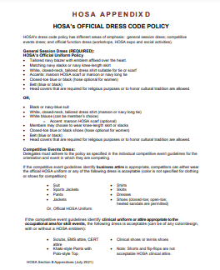
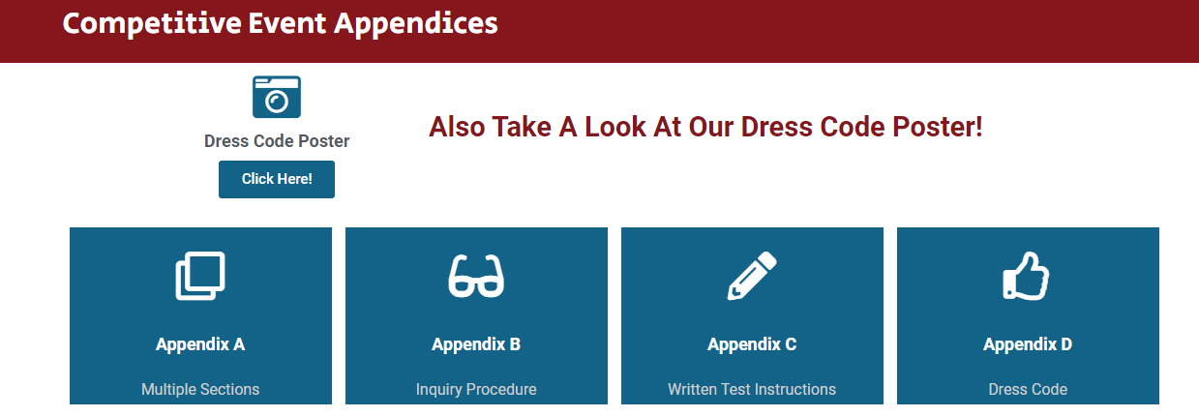
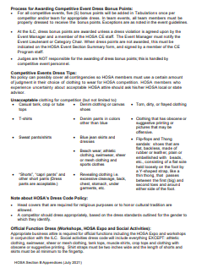

Slide 8
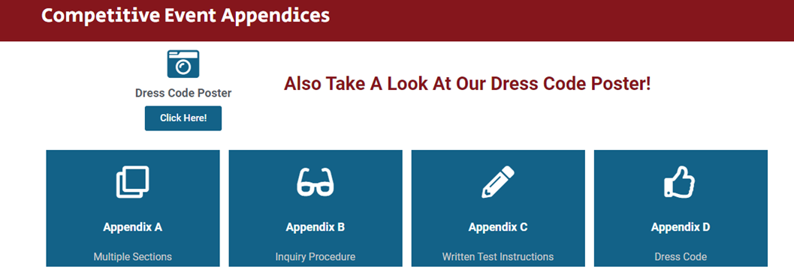
Click here and get a print-ready poster!
Make many copies and put them around your classroom.

Slide 9
Changes since last year
Dress Code Information
Photo ID Information

Slide 10
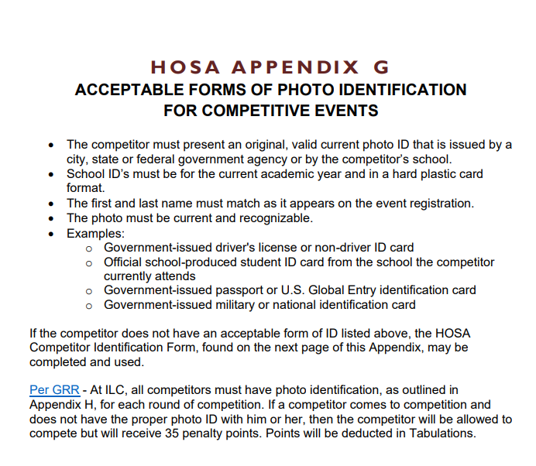
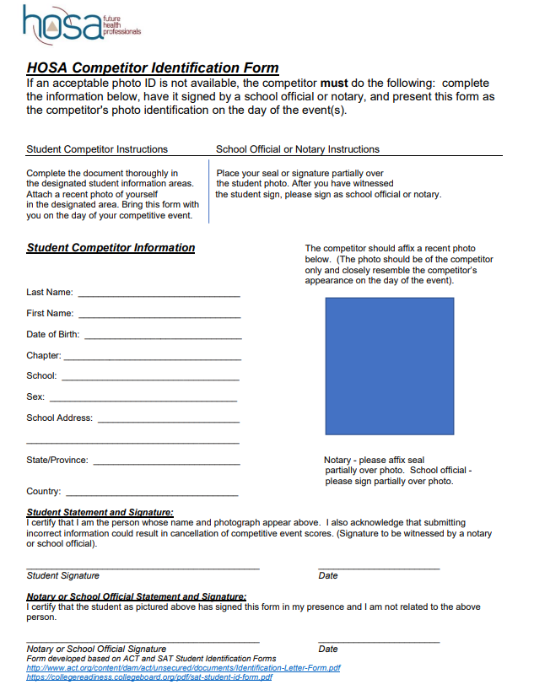

Slide 11
If student does not have a Photo ID
Print and complete page two
Attach a picture in the blue square

Slide 12
Body of the Guidelines will give instructions specific to that event. For example:
Portfolio requirements
If there is more than one round
If there is a digital upload required
Scoring information

Slide 13
Very Important
Competitor Must Provide box
This box tells competitors any supplies/equipment they must bring to the event.

Slide 14
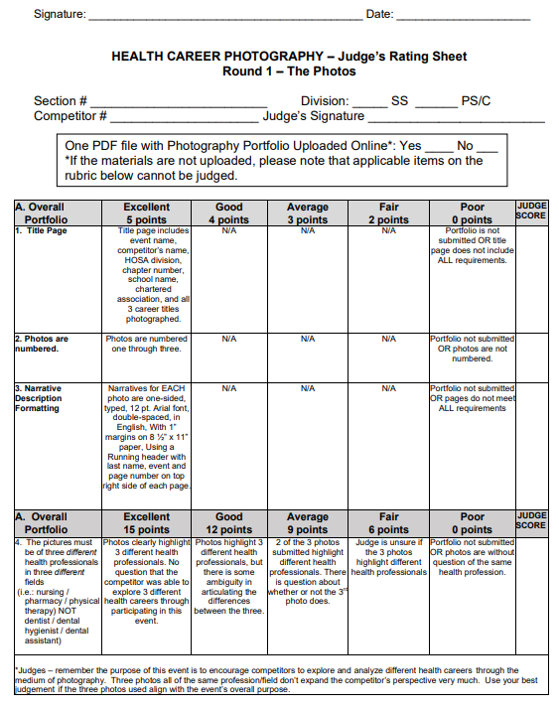
Rating Sheets
At the end of the guidelines
Tells competitors exactly for what judge are looking
Very useful when preparing for the event

Slide 15
Where and What Are Useful Tools?
Under the “Competition” Tab

Slide 16
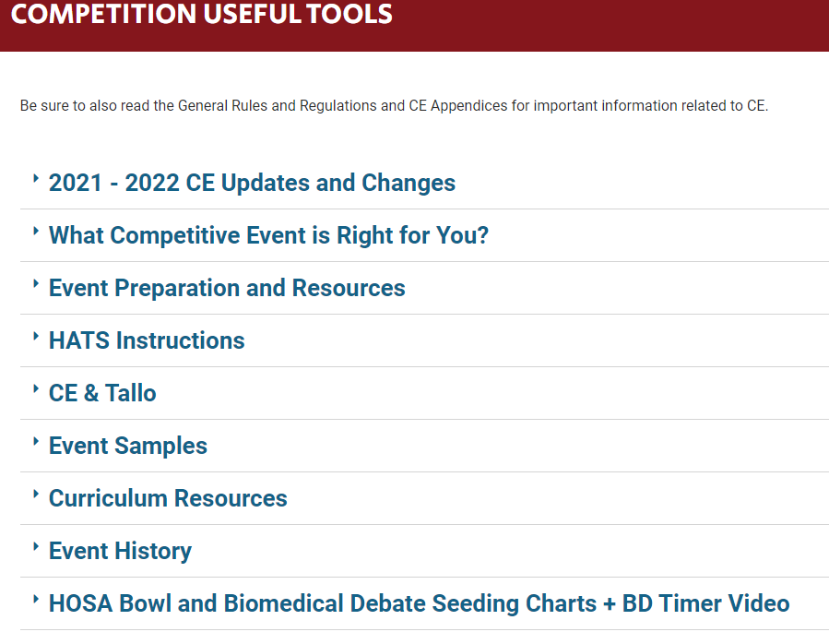

Slide 17
Help your students to decide which event to enter.
Flow chart poster for both Middle School
Flow chart poster for Secondary and Post-Secondary/Collegiate

Slide 18
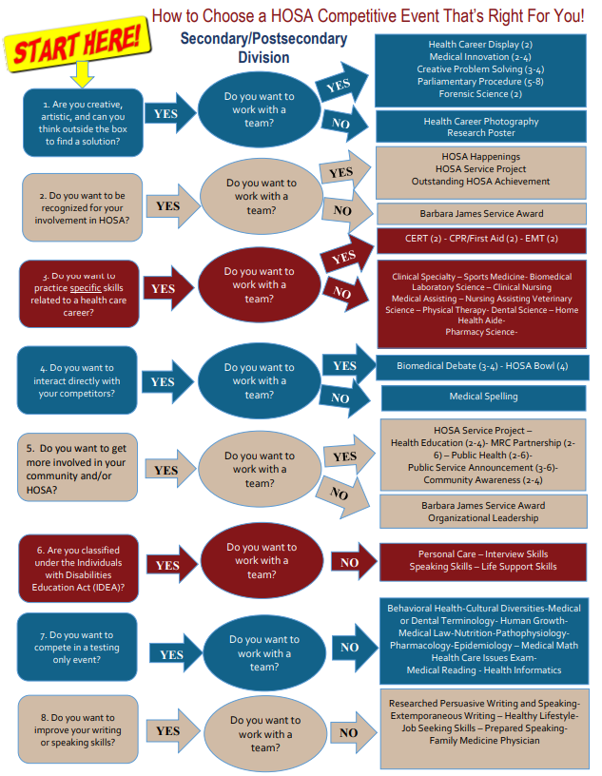
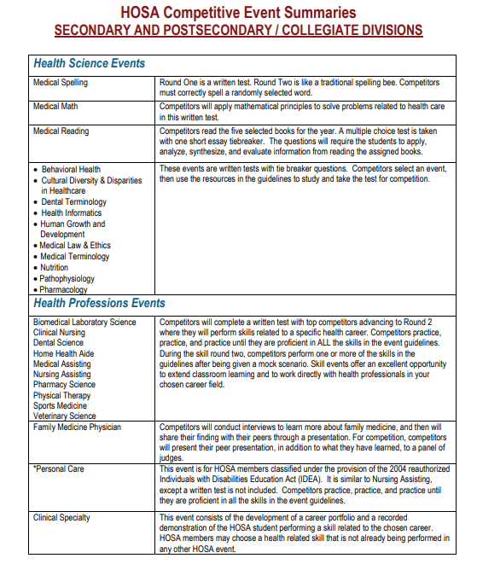
SS and PS/C Event Poster and Summary of Competitive Events
Helps students decide which event to choose in which to compete

Slide 20
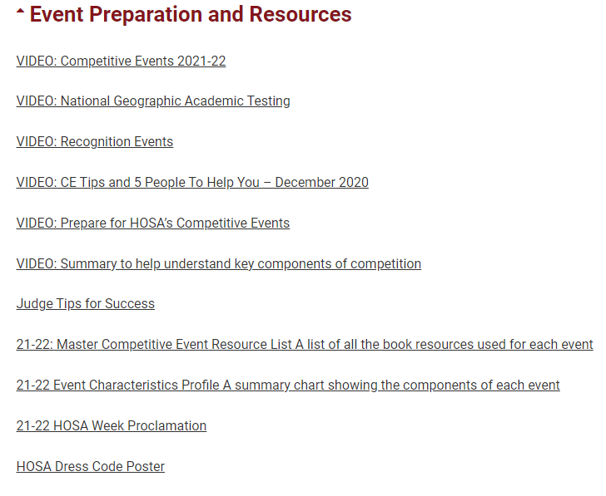
Tips for helping students to prepare for their chosen event.

Slide 21
Instructions for advisors and students uploading to the
HOSA Activity Tracking System (HATS)

Slide 22
Link to instructions for Tallo uploads

Slide 23
Links to Competitive Event,
Forensic Science,
and
Parli Pro Samples

Slide 24
ILC Guidelines vs Texas HOSA Competitor Orientation Sheet
ILC Guidelines (Big HOSA)
Texas HOSA Competitor Orientation Sheet

Slide 25
Big HOSA www.hosa.org
Written by Big HOSA for ILC (International Leadership Conference)
Held in June

Slide 26
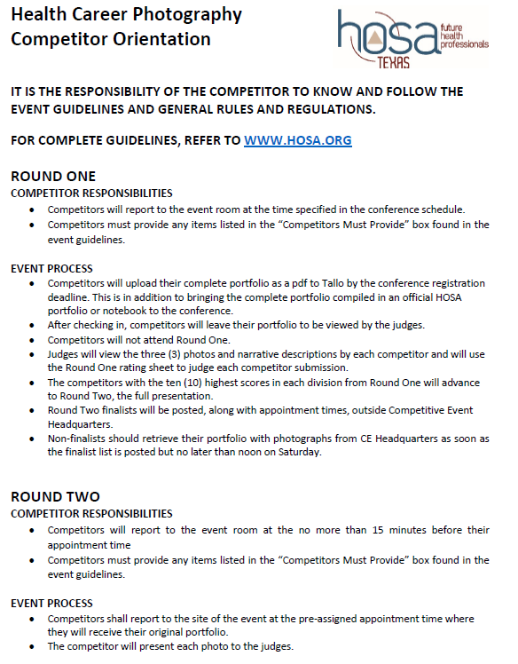
Texas HOSA www.texashosa.org
Written by Texas HOSA for the Area Spring Leadership Conferences and the State Leadership Conference
Area Spring Leadership Conferences are held in Jan-Feb
State Leadership Conference held in March or April

Slide 27
All Texas HOSA Competitor Orientation Sheets (COS) will have the same format.
All COS will inform competitors that they should know the event guidelines and the Tx GRRs and links are provided for each one.

Slide 28
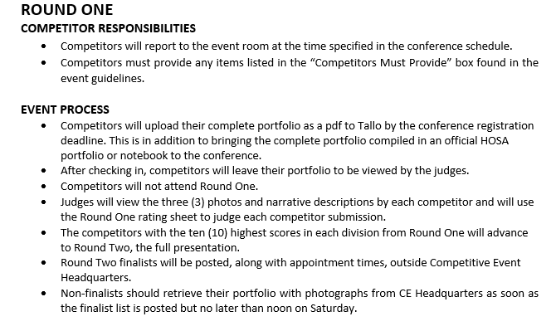
Responsibilities for competitors in round one
Tells how the event will be run in Texas.
Note: tells when and where round two finalists will be posted along with appointment times AND where and when non-finalists should pick-up their portfolio.

Slide 29
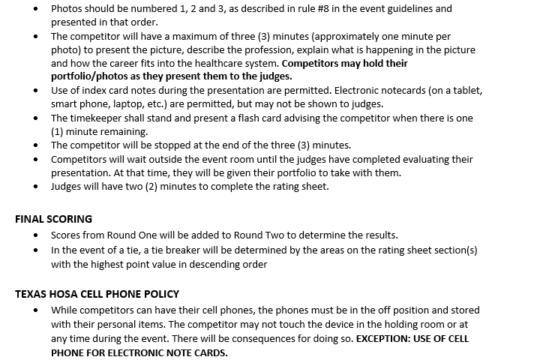
Round two competitor responsibilities
How Texas will run round two of the event
How Texas will score the event
Reiterate the Texas HOSA Cell Phone Policy

Slide 30
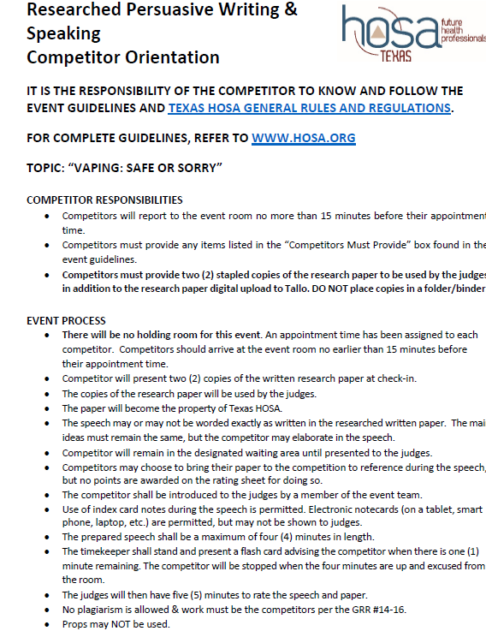

Slide 31
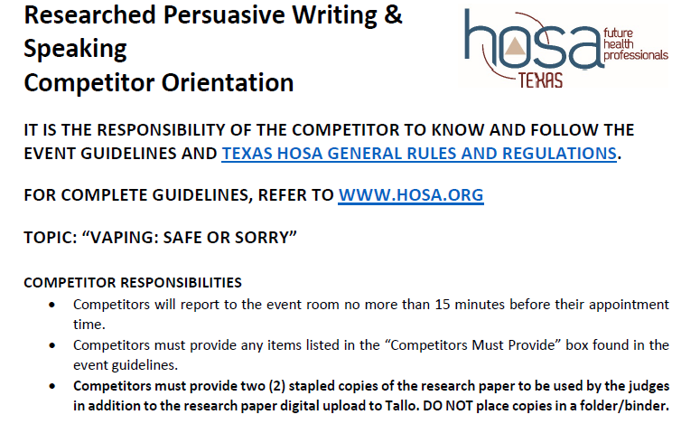
Different from Big HOSA ILC guidelines

Slide 32
IMPORTANT STEPS TO CE SUCCESS IN TEXAS
For the Texas HOSA Area and State Leadership Conferences…
Read Big HOSA guidelines and Texas HOSA COS carefully and compare the two for differences.
Read and understand the Tx GRRs.
Email any questions to anne.regier@texashosa.org for clarification.

Slide 33
IMPORTANT STEPS TO SUCCESS AT ILC
For the International Leadership Conference
Read the Big HOSA guidelines carefully paying attention to digital upload deadlines.
Read and understand the Big HOSA GRRs.
Email either Big HOSA or Anne Regier with questions.

Slide 34
HERE’S HOPING YOU HAVE A FUN AND SUCCESSFUL
2022-2023 HOSA ROAD TRIP!
STAY SAFE AND ENJOY THE RIDE!

