Slide 1
Texas Health Occupations Associations (THOA) and Nurse Family Partnership at the TAMU College of Nursing: Uniquely powerful support for new 1st time mothers

Slide 2
Health Disparities & Risks in Pregnancy of Adolescent Populations and The Role of Nurse-Family Partnership

Slide 3
“We educate, not only for the interest in health science and the workforce needs, but also for the general wellness of Texas.”
THOA’s mission: “To empower Health Science Teachers to achieve maximum self-fulfillment in order to provide the best education for students”.
Nurse Watts
Board President of THOA Inc.

Slide 4
Teen Pregnancy in the United States
Despite the United State’s teen birth rate, 15.4 (births per 1,000 females aged 15-19 years) steadily declining over time, there remains a concern for women of vulnerable populations.
Teen pregnancies account for only a small proportion of all pregnancies in developed countries, but they receive disproportionate attention.
AK;, M. J. A. H. B. E. O. M. J. K. D. (n.d.). Births: Final data for 2019. National vital statistics reports : from the Centers for Disease Control and Prevention, National Center for Health Statistics, National Vital Statistics System. Retrieved June 1, 2022, from https://pubmed.ncbi.nlm.nih.gov/33814033/
National Vital Statistics Reports. (n.d.). Retrieved June 1, 2022, from https://www.cdc.gov/nchs/data/nvsr/nvsr70/NVSR70-17.pdf
Notes:
Hispanic teen and non-Hispanic Black teen birth rates were more than two times higher than the rate for non-Hispanic White teens.
American Indian/Alaska Native teens had the highest teen birth rate among all race/ethnicities.

Slide 5
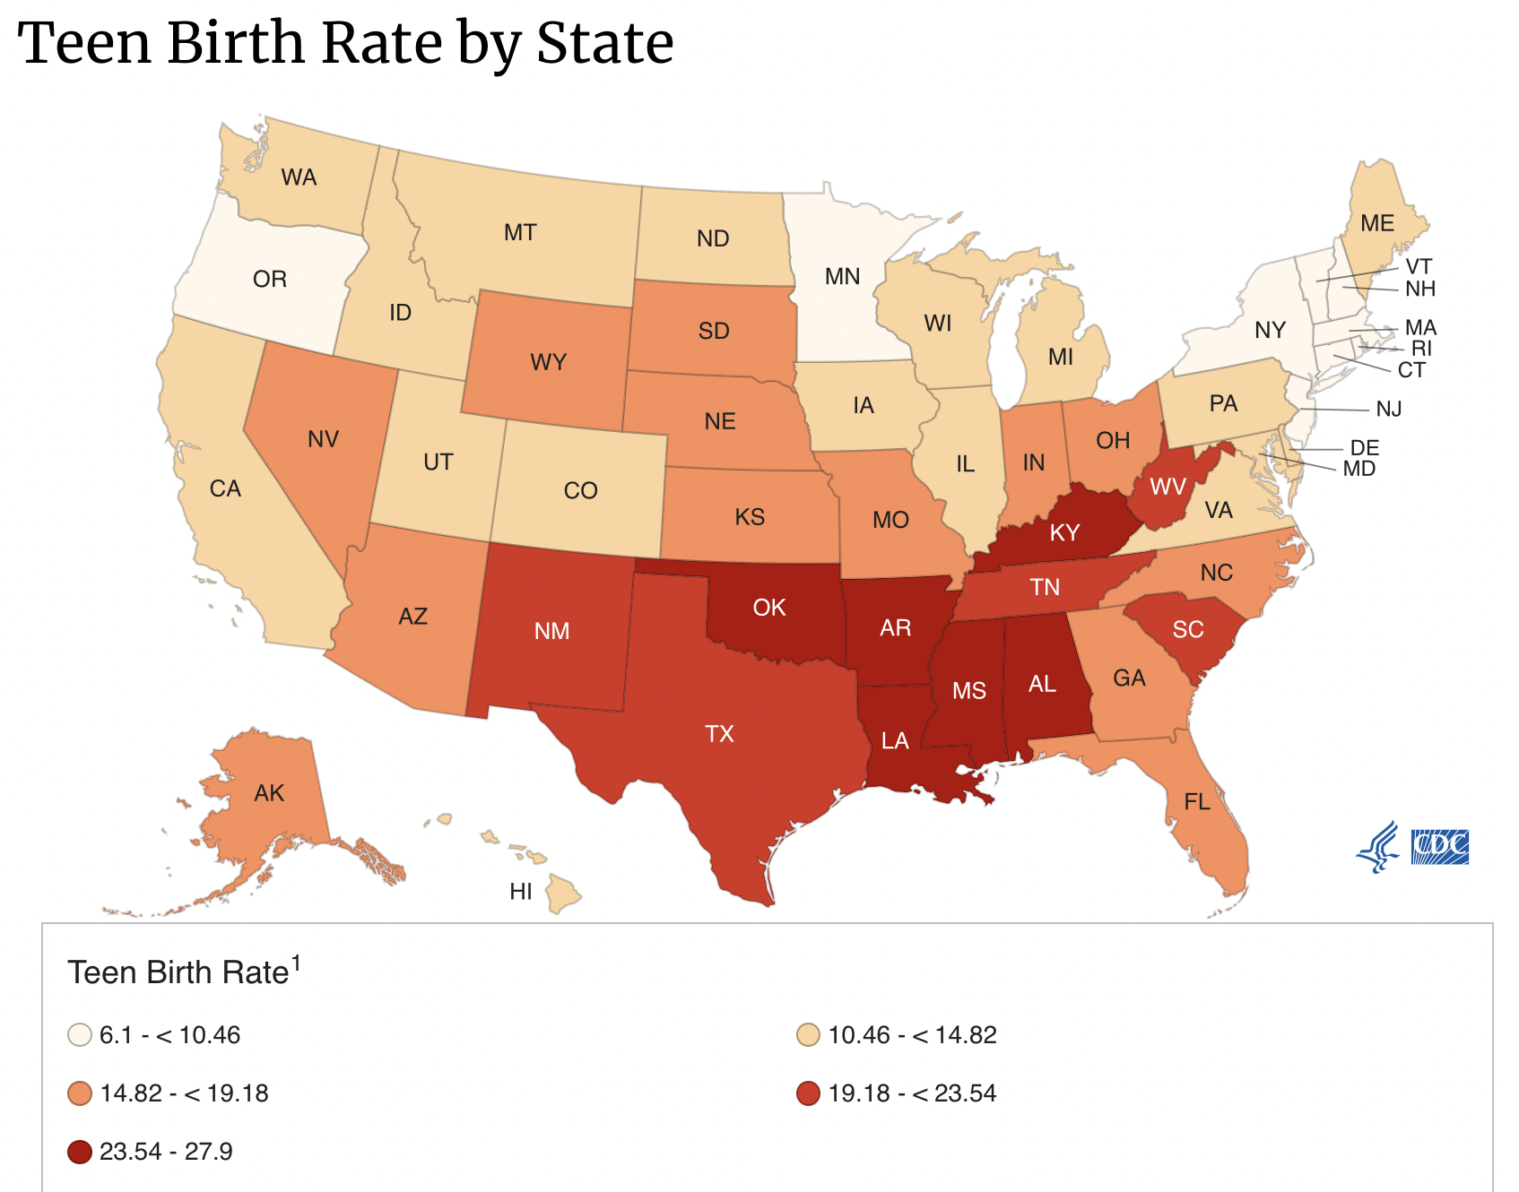
Teen Pregnancy in Texas
Texas is among the Top 10 states with the highest rates for teen pregnancy
22.4 (births per 1,000 females 15-19 years of age)
Centers for Disease Control and Prevention. (2022, February 25). Stats of the state - teen birth rates. Centers for Disease Control and Prevention. Retrieved June 1, 2022, from https://www.cdc.gov/nchs/pressroom/sosmap/teen-births/teenbirths.htm

Slide 6
Hispanic Women
Latina women less likely to receive screening for breast and ovarian cancers
Higher mortality from breast/ovarian cancer
Many cited barriers of embarrassment, language barriers, fear of results
Study found that about half of Latino respondents reported speaking English less than “very well”
Less likely to have health insurance
Hispanic communities had a 33% increased severe maternal morbidity when compared to white communities
Largest increase in maternal morbidity from 2018-2020 (19%)
Same report showed only 71% of Hispanic women completed all of their prenatal care visits
Paz, K., & Massey, K. P. (2016). Health Disparity among Latina Women: Comparison with Non-Latina Women. Clinical medicine insights. Women's health, 9(Suppl 1), 71–74. https://doi.org/10.4137/CMWH.S38488
Notes:
Paz, K., & Massey, K. P. (2016). Health Disparity among Latina Women: Comparison with Non-Latina Women. Clinical medicine insights. Women's health, 9(Suppl 1), 71–74. https://doi.org/10.4137/CMWH.S38488

Slide 7
African American Women
Non-Hispanic Black women are three to almost four times more likely to die while pregnant or within 1 year postpartum than their non-Hispanic White and Latina counterparts
Non-Hispanic Black women are twice as likely to have a low-birth weight infant than non-Hispanic White women
Non-Hispanic Black women are at a disadvantage regarding the protective factor of the early initiation of prenatal care, with 67% participating in prenatal care in the first trimester compared with 77% of non-Hispanic White women and 81% of Asian women.
It is estimated that up to 28% of non-Hispanic Black women experience perinatal depression. Perinatal depression has been linked to risks for adverse maternal and birth outcomes, including preeclampsia, gestational diabetes, preterm birth, and low birth weight.
Chinn, J. J., Martin, I. K., & Redmond, N. (2021). Health Equity Among Black Women in the United States. Journal of women's health (2002), 30(2), 212–219. https://doi.org/10.1089/jwh.2020.8868
Notes:
Chinn, J. J., Martin, I. K., & Redmond, N. (2021). Health Equity Among Black Women in the United States. Journal of women's health (2002), 30(2), 212–219. https://doi.org/10.1089/jwh.2020.8868

Slide 8
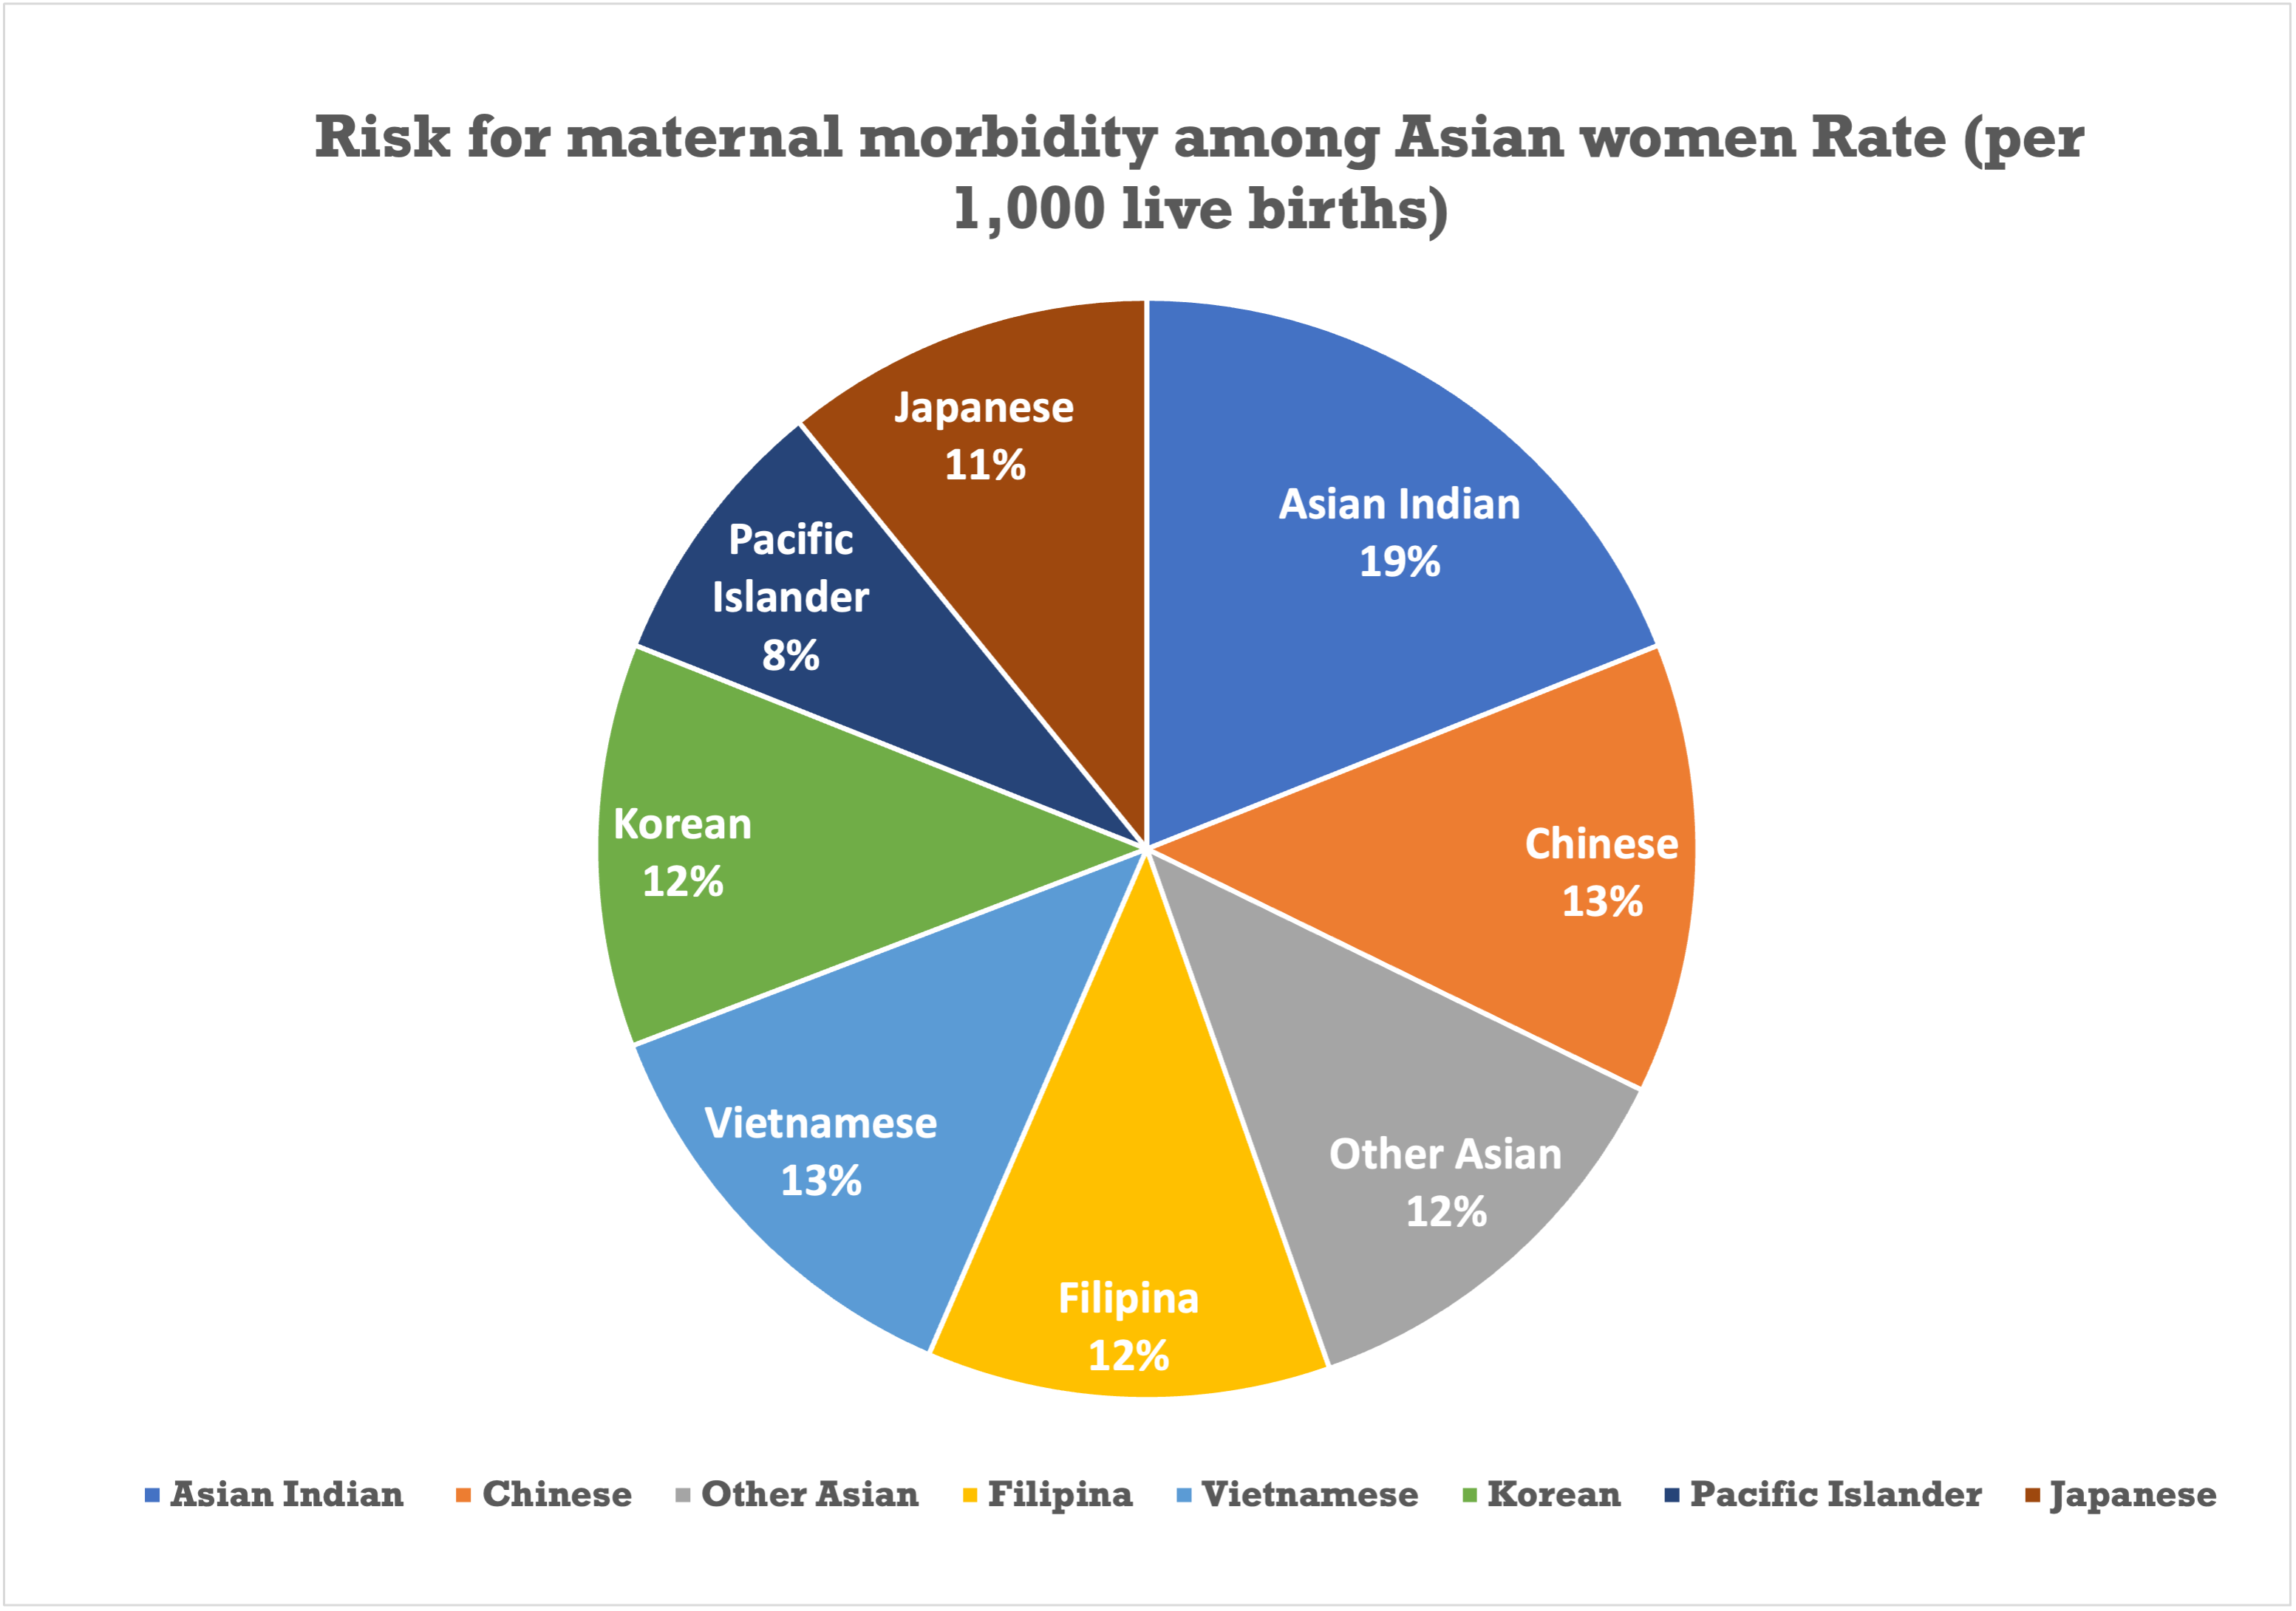
Asian American Women
Women of all Asian ethnic groups have higher rates of gestational diabetes, but generally lower rates of neonates large for gestational age
The risk for maternal morbidity among Asian women varies by ethnic group with all but Pacific Islanders being greater than that of white women (Rate per 1000 live births - 13.7)
Wagner SM, Bicocca MJ, Gupta M, Chauhan SP, Mendez-Figueroa H, Parchem JG. Disparities in Adverse Maternal Outcomes Among Asian Women in the US Delivering at Term. JAMA Netw Open. 2020;3(10):e2020180. doi:10.1001/jamanetworkopen.2020.20180
Notes:
Wagner SM, Bicocca MJ, Gupta M, Chauhan SP, Mendez-Figueroa H, Parchem JG. Disparities in Adverse Maternal Outcomes Among Asian Women in the US Delivering at Term. JAMA Netw Open. 2020;3(10):e2020180. doi:10.1001/jamanetworkopen.2020.20180

Slide 9
Becoming a Teen Mom
There are unique developmental needs that support the independence and adulthood transition of teens.
Academic achievement
Employment
Community engagement
Peer/familial relationships
There is a negative stigmatic perception that is associated with becoming a teen mom. Research has shown how this can affect the mother’s attitude and behavior leaving them feeling more vulnerable.
Isolation
Lower-self esteem
Fear of abuse from peers and/or family
Notes:
As a teen becomes a new mom, Teachers can still provide support. This includes promoting academic success and self-worth. Having this relationship and dialogue encourages a positive development and environment for the new mother.

Slide 10
Supporting Teen Moms
Support from the community and other external structural factors are especially important.
Teachers can still provide support. This includes promoting academic success and self-worth. Having this relationship and dialogue encourages a positive development and environment for the new mother.
Notes:
As a teen becomes a new mom, Teachers can still provide support. This includes promoting academic success and self-worth. Having this relationship and dialogue encourages a positive development and environment for the new mother.

Slide 11
How Can Communities Help…..

Slide 12
Nurse-Family Partnership® is an evidence-based, community health program with over 40 years of evidence showing significant improvements in the health and lives of first-time moms and their children living in poverty.
Notes:
If you are unable to play the video you can use this slide to introduce NFP. Delete the previous slide.
When possible use the video as it does such a terrific job of telling our story. If you play the video you can delete this slide.

Slide 13
Play video. https://www.youtube.com/watch?v=rn8V784A6tE&ab_channel=Nurse-FamilyPartnership
Notes:
Play Video to introduce program. Tells our story in such a compelling way. 4 min video. The video lives on YouTube and you will play it from there by clicking the image of the play video text. If you’d like the video on your computer, please reach out to marketing@nursefamilypartnership.org and we can send you the file.

Slide 14
"There is a magic window during pregnancy…it’s a time when the desire to be a good mother and raise a healthy, happy child creates motivation to overcome incredible obstacles including poverty, instability or abuse with the help of a well-trained nurse."
David Olds, PhD
Founder of Nurse-Family Partnership
Professor of Pediatrics at University of Colorado
Notes:
Dr. David Olds - Working in an inner city day care with 4 and 5 year old who were already in trouble
Decided to do something about it
“If we provide a supportive program that’s preventative, will it have an impact on these mom and babies?”
This is where we develop the concept of the magic window and the power of early intervention, which NFP capitalizes on

Slide 15
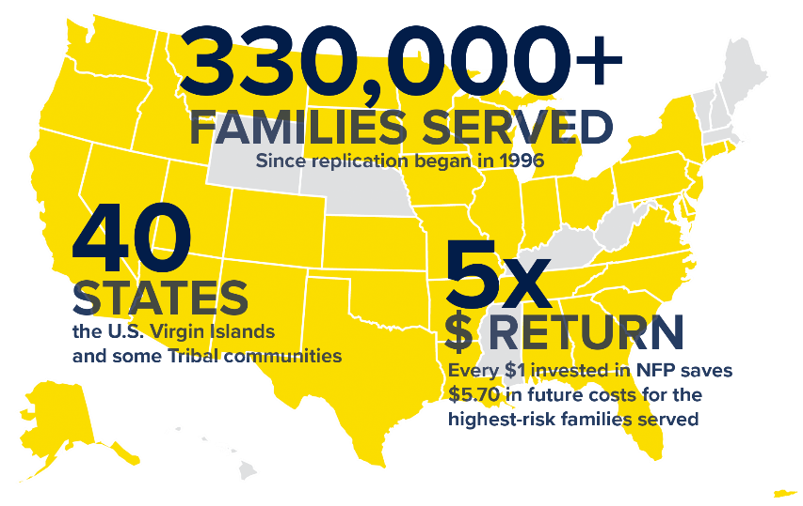
Notes:
This will change occasionally as we update the number of families served. Check for an updated ppt on the community website https://community.nursefamilypartnership.org/Agency-Support/Marketing/Marketing-collateral

Slide 16
OUR VISION
A future where all children are healthy, families thrive, communities prosper and the cycle of poverty is broken.

Slide 17
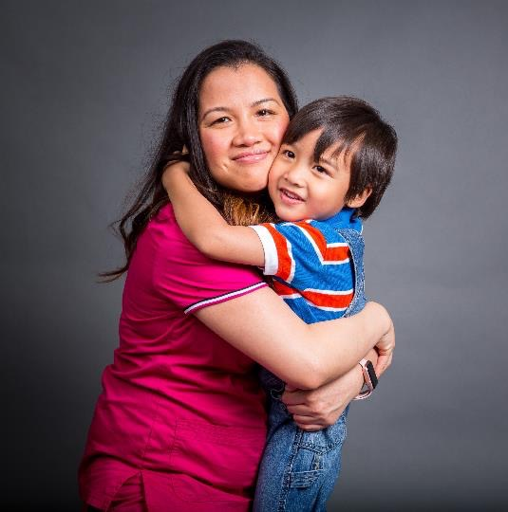
WE KNOW how to positively transform the lives of vulnerable babies and mothers—family by family. Day in and day out.
Changing FAMILIES…
Changes COMMUNITIES…
Changes ZIP CODES…
Changes STATES…
CHANGES THE COUNTRY!
If ONE family can break the cycle,
then so can
100,000 FAMILIES!
nursing.tamu.edu/nfp
Notes:
We change the future for the most vulnerable babies born into poverty by equipping the BEST person for the job, MOM, to become a competent, confident parent. Our intensive and scientifically proven program is delivered at the most critical time for mom and baby, by a specially trained clinical expert. Give us 1000 days from early pregnancy to baby's second birthday and we will deliver a self-assured, capable first-time mother, a thriving baby poised for a bright future, and hundreds of thousands of dollars in societal benefits.

Slide 18
KEY GOALS
Improve Pregnancy Outcomes
Improve Child Health and Development
Improve Economic Self-Sufficiency of the Family

Slide 19
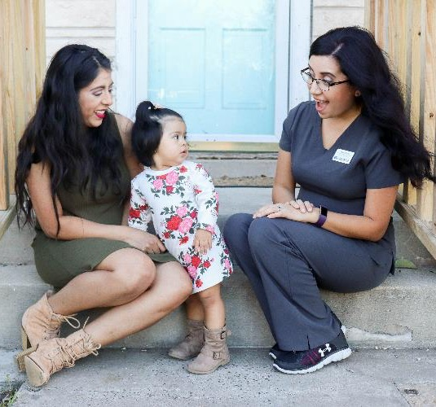
HOW IT HAPPENS
EXPERTS:
Specially-trained nurses
PROVEN:
Extensive and compelling evidence
INTENSIVE:
Pregnancy through age 2
TIMELY:
First 1000 days
Notes:
Expert: NFP moms receive care, information and advice from nurses specially trained in pregnancy, early development, and the very unique NFP proven model of nursing care.
Proven: Our program has the most extensive and compelling evidence and outcomes in the field – 3 randomized controlled trials demonstrate that our work results in healthier pregnancies; reduction in child abuse and neglect improvements in cognitive and language development, fewer childhood injuries, and many more cost-saving outcomes to government and society.
Intensive: Our specially NFP trained expert nurses offer at least regular in-home, high-touch visits to the most vulnerable young mothers, living in the most difficult circumstances.
Timely: In the first few years of life, 700 to 1,000 new neural connections form every second. After this period of rapid proliferation, connections are reduced through a process called pruning, which allows brain circuits to become more efficient. Pregnancy outcomes are heavily influenced by prenatal care and a mother’s actions towards her baby in the first 1000 days from early pregnancy to baby’s second birthday.

Slide 20
Nurse-Family Partnership model elements
Proprietary model that encompasses 19 model elements, such as:
Participation is voluntary
Client is a first-time mom
Client is low-income
Client is enrolled before 28 weeks pregnancy
Nurses are BSNs
Nurses carry a caseload of 25-30 clients

Slide 21
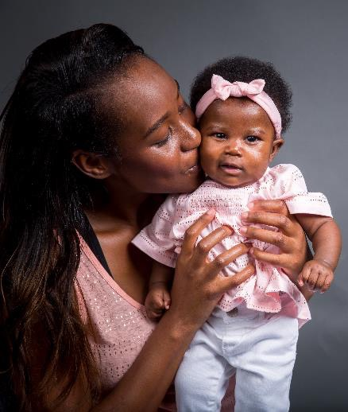
What to expect from the Nurse
Will visit the new mom for about 1 hour every 1 to 2 weeks
Will assess both mom and baby and provide education at visits
Will refer the new mom to the appropriate community resources
nursing.tamu.edu/nfp

Slide 22
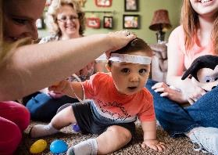
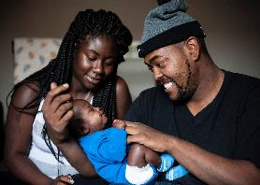
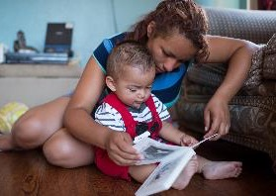
GOLD STANDARD RESEARCH
1977 Elmira, NY 400 Low-income whites Semi-rural area
1990 Memphis, TN 1,138 Low-income blacks Urban area
1994 Denver, CO 735 Large proportion of Hispanics
Nurses and paraprofessionals
nursing.tamu.edu/nfp
Notes:
Nurse-Family Partnership is an evidence-based community health program that helps transform the lives of vulnerable, low-income mothers pregnant with their first child. Built upon the pioneering work of David Olds, Ph.D., Nurse-Family Partnership’s model is based on more than 40 years of evidence from randomized, controlled trials that show it works.
Beginning in the early 1970s, Olds initiated the development of a nurse home visitation program for first-time mothers and their children. Over the next three decades, he and his colleagues continued to test the program in three separate, randomized, controlled trials with three different populations in Elmira, NY, Memphis, TN and Denver, CO. The trials were designed to study the effects of the Nurse-Family Partnership model on maternal and child health and child development, by comparing the short- and long-term outcomes of mothers and children enrolled in the Nurse-Family Partnership program to those of a control group of mothers and children not participating in the program.
For more info you can share RESEARCH TRIALS AND OUTCOMES FACT SHEET – available for download https://www.nursefamilypartnership.org/about/

Slide 23
nursing.tamu.edu/nfp
Notes:
Further research and citations can be found at www.nursefamilypartnership.org/about/proven-results/

Slide 24
The Nurse-Family Partnership program has been independently reviewed and evaluated and is ranked as the Gold Standard of home visiting programs. A report from the Center on the Developing Child at Harvard University shows the extent to which very early childhood experiences influence later learning, behavior and health.
Proven Results

Slide 25
THE FIRST 1,000 DAYS
Early experiences influence the developing brain
Toxic effects of chronic stress
Adversity can lead to lifelong problems
Early intervention can prevent consequences
Stable, caring relationships essential for development
nursing.tamu.edu/nfp
Notes:
Harvard - What happens in early childhood can matter for a lifetime. To successfully manage our society’s future, we must recognize problems and address them before they get worse. In early childhood, research on the biology of stress shows how major adversity, such as extreme poverty, abuse, or neglect can weaken developing brain architecture and permanently set the body’s stress response system on high alert. Science also shows that providing stable, responsive, nurturing relationships in the earliest years of life can prevent or even reverse the damaging effects of early life stress, with lifelong benefits for learning, behavior, and health.

Slide 26
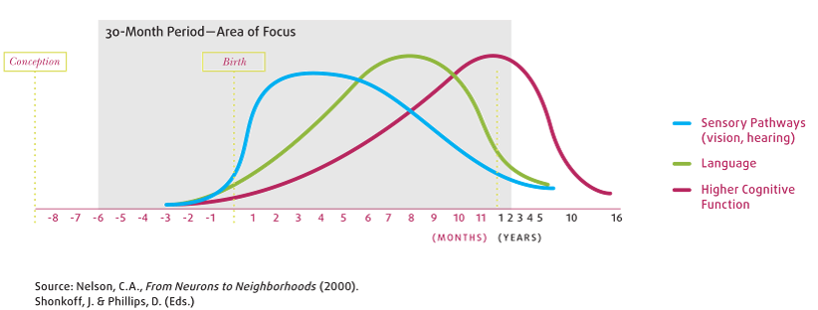
BRAIN DEVELOPMENT
Synapse formation dependent on early experiences
nursing.tamu.edu/nfp
Notes:
First 1000 days, if we can have the nurse intervene, we can increase the sensory pathways, language and cognitive function.
Great visual
You can see the spikes
The grey area is NFP’s service period
So it couldn’t be any clearer – we’re there when it matters most, making sure vulnerable moms get the support they need to be competent parents by virtue of a trusting relationship with a trained professional

Slide 27
Nurse Family Partnership in Texas

Slide 28
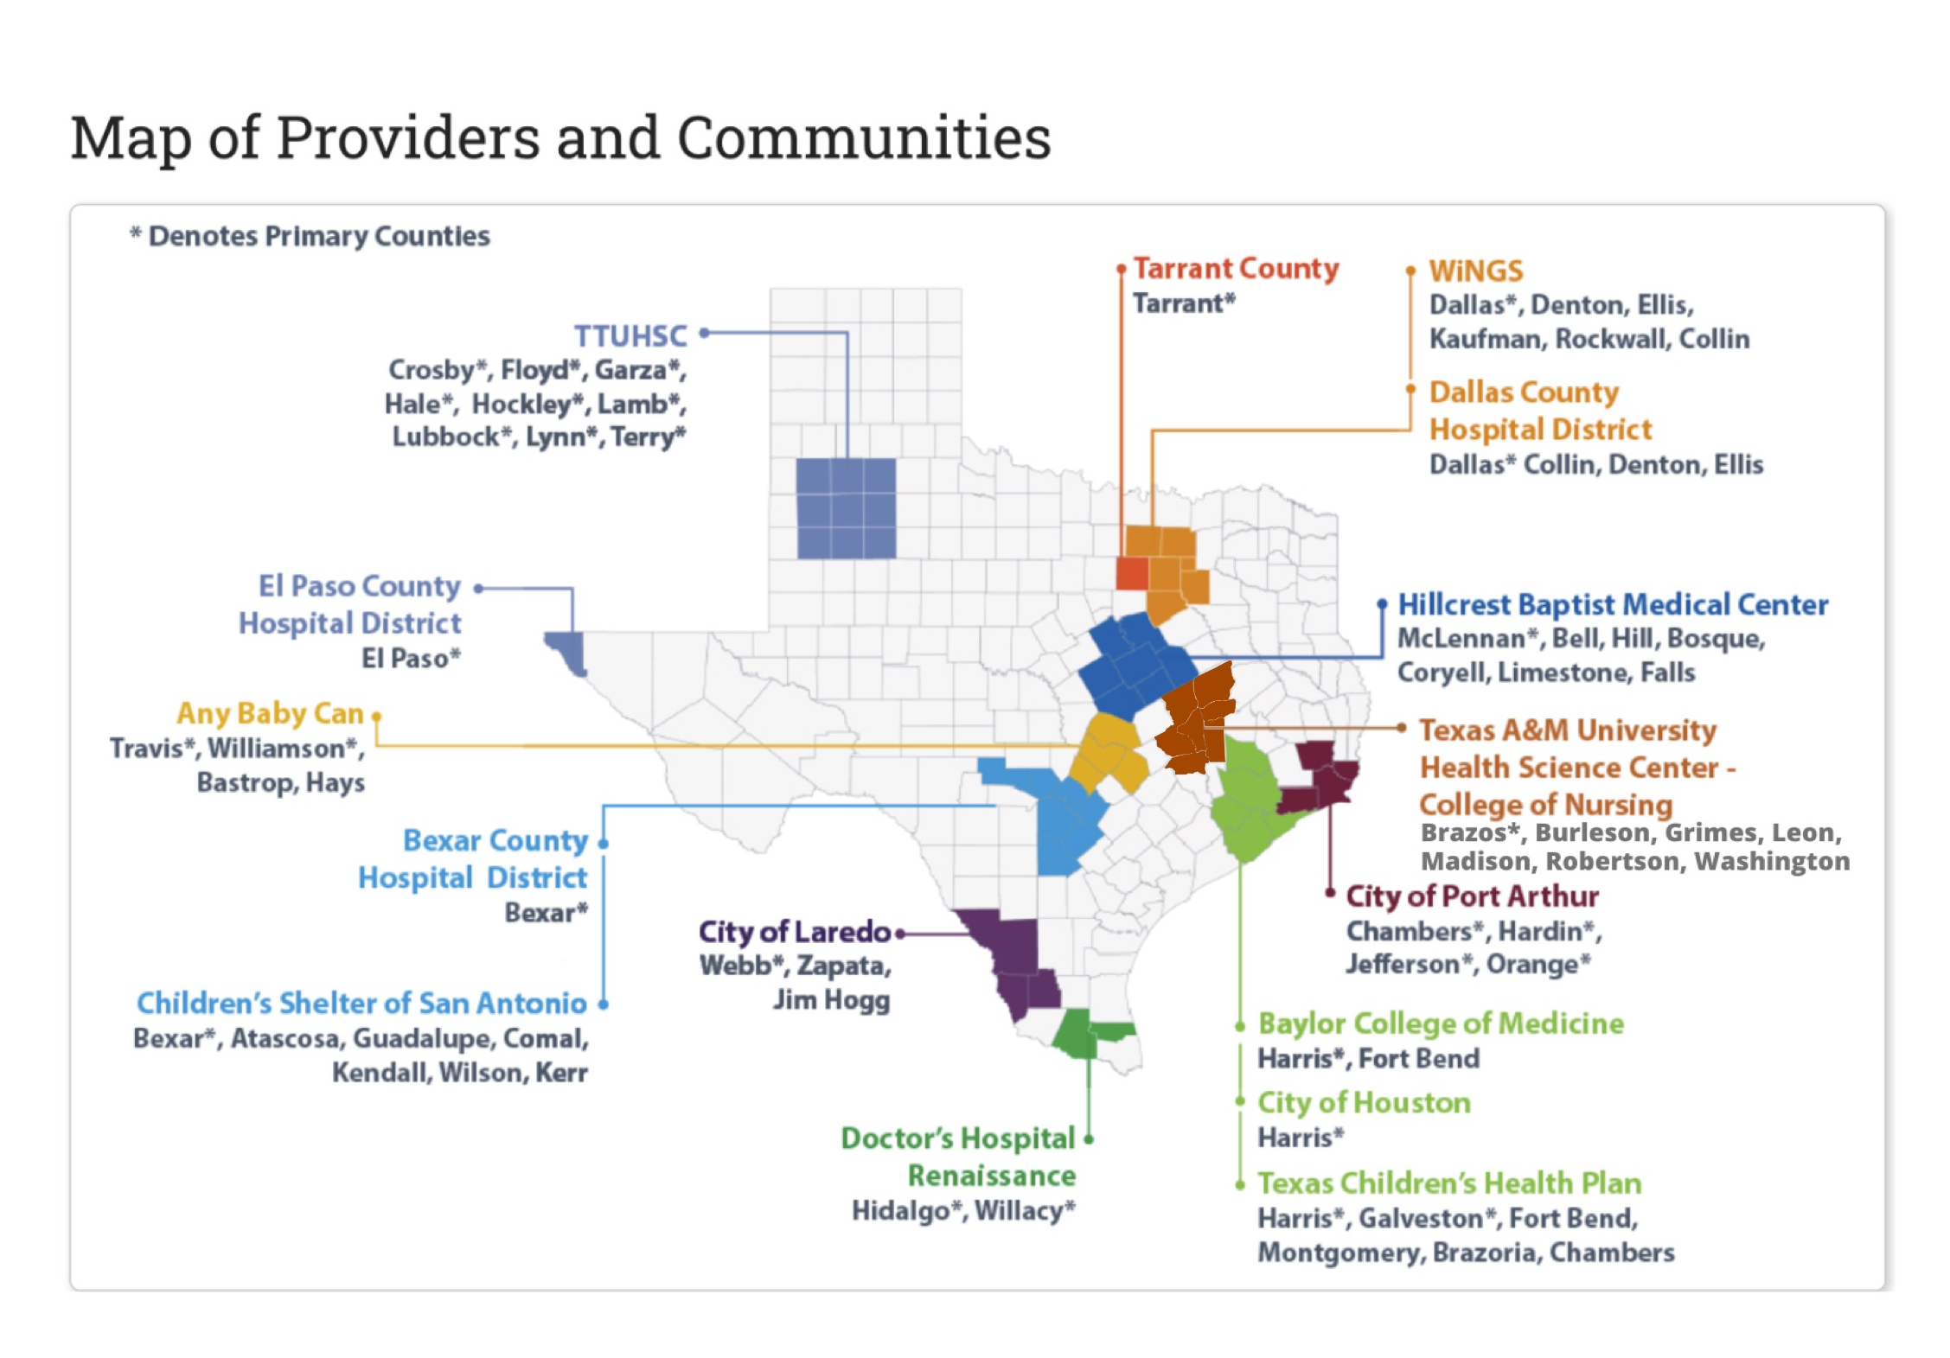
Notes:
https://www.dfps.state.tx.us/Prevention_and_Early_Intervention/About_Prevention_and_Early_Intervention/tnfp.asp
Brazos County is our current ‘primary’ county but we can serve the surrounding counties that make up the Brazos Valley.

Slide 29
TEXAS
89% Babies Born Full Term
92% Mothers Initiated Breastfeeding
90% Babies Received all Immunizations by 24 Months
54% of clients 18+ were Employed at 24 Months
nursing.tamu.edu/nfp
Notes:
Example of slide. Use for your state specific outcomes and move up in presentation. Several slide options provided to help best represent your families.

Slide 30
Nurse Family Partnership in Brazos Valley

Slide 31
Brazos Valley Needs
Many families report barriers to accessing health care
Socioeconomic status, cultural norms, and transportation issues contribute to poor access
5 out of 7 counties in the Brazos Valley with above average teen pregnancy
nursing.tamu.edu/nfp

Slide 32
Our GOAL is simple:
We want to provide Nurse-Family Partnership® to Texas A&M University (NFP@TAMU) to every eligible new Mother in the Brazos Valley.
nursing.tamu.edu/nfp
Notes:
If you are unable to play the video you can use this slide to introduce NFP. Delete the previous slide.
When possible use the video as it does such a terrific job of telling our story. If you play the video you can delete this slide.

Slide 33
Notes:
This presentation is great for introducing NFP to potential supporters (donors, advocates, stakeholders, policy makers, etc.)

Slide 34
What is Nurse-Family Partnership @ TAMU (NFP@TAMU)?
It is a free service for women who are pregnant with their first baby
A Registered Nurse provides families with coaching, support, advice, and information needed to have a healthy pregnancy, healthy baby, and become a great mother
Notes:
We believe that if we can empower a new mother, we can change a family … and if we can change a family, we can change our community.

Slide 35
Who Can Enroll?
Any women who is:
Pregnant with her first child
Pregnant 28 weeks or less
Meets income requirements
Lives in an area where Nurse-Family Partnership is available

Slide 36
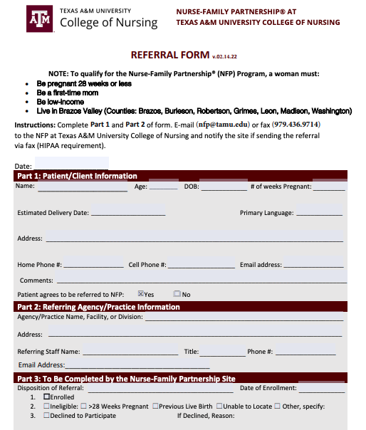
How to Refer
Identify a woman who meets criteria
Lives in proximity to an NFP site
First time mom
Low income
28 weeks gestation or less
Fill out referral form
Fax or email completed form
Nurse Family Partnership:
Call/Text: (346) 201-3730
Email: Texas@nursefamilypartnership.org
NFP @ TAMU:
Call: 877-NFP-TAMU
877-637-8268
Email: NFP@TAMU.EDU
Website: nursing.tamu.edu/nfp
nursing.tamu.edu/nfp

Slide 37
PARTNERS &
FUNDING SOURCES
State of Texas (PEI)
Schools
Pregnancy Centers
MIECHV
Medicaid/Managed Care Reimbursement
Title V/Maternal and Child Health
TANF/Public Welfare
Child Abuse Prevention
Juvenile Justice/Delinquency Prevention
Substance Abuse and Mental Health
State, City and County General Funds
Private Philanthropy
School Readiness Programs
Pay for Success/Social Impact Bonds
Local & Regional Health Systems
nursing.tamu.edu/nfp

Slide 38
Community Partnerships

Slide 39
Texas TIPS | Texas Teratogen Information in Pregnancy
WIC (Women, Infants, and Children)
Texas Health Steps
Local Pregnancy Clinics
Texas Solutions
Childbirth Connection
Before, Between, and Beyond Pregnancy Website
March of Dimes
Medicaid & CHIP Perinatal
Notes:
Community/State Solutions
WIC (Women, Infants and Children) (http://www.capbv.org/programs/women-infants-and-children/)
WIC provides nutrition education for nourishment during critical human growth cycles, USDA regulated and approved food vouchers, referrals to other community services and breastfeeding promotion and support.
March of Dimes (https://www.marchofdimes.org/)
March of Dimes leads the fight for the health of all moms and babies. We support research, lead programs and provide education and advocacy so that every family can have the best possible start.
Medicaid & CHIP Perinatal (https://www.yourtexasbenefits.com/Learn/Home)
Pregnant women might be able to get free health coverage during their pregnancy through Medicaid for Pregnant Women or the CHIP Perinatal program.
Medicaid provides health coverage to low-income pregnant women during pregnancy and up to two months after the birth of the baby.
CHIP Perinatal provides similar coverage for women who can't get Medicaid and don't have health insurance.
To get Medicaid for Pregnant Women or CHIP Perinatal, you must be a Texas resident. You must be a U.S. citizen or qualified non-citizen to get Medicaid for Pregnant Women.
Childbirth Connection ( http://www.childbirthconnection.org/)
ChildbirthConnection.org is a source for trustworthy up-to-date evidence-based information and resources on planning for pregnancy, labor and birth, and the postpartum period. Founded in 1918, Childbirth Connection is a national not-for-profit organization dedicated to improving the quality of maternity care. Childbirth Connection promotes safe, effective and satisfying evidence-based maternity care for all women and families.
Texas Health Steps (http://txhealthsteps.com/)
Texas Health Steps provides regular medical and dental checkups and case management services to babies, children, teens, and young adults at no cost to you. If your child's doctor finds a health problem during a checkup, he or she can make sure your child gets the medical care that is necessary to help prevent problems that could make it hard for your child to learn and grow.
Texas TIPS (https://med.uth.edu/texastips/)
MotherToBaby Texas TIPS is a free and confidential telephone counseling service that provides information about exposures related to pregnancy and breastfeeding.
Before, Between, and Beyond Pregnancy Website (http://www.beforeandbeyond.org/)
The Before, Between and Beyond Pregnancy Website offers guidance and resources for patients and practitioners on integration of preconception care into practice.

Slide 40
Community Contact Information
WIC (Women, Infants, & Children)
phone: (979) 260-2942
website: http://www.capbv.org/programs/women-infants-and-children/
Before, Between and Beyond Pregnancy Website
website: http://www.beforeandbeyond.org/
Texas Health Steps
website: http://txhealthsteps.com/
Childbirth Connection
website: http://www.childbirthconnection.org/
Medicaid & CHIP Perinatal
website: https://www.yourtexasbenefits.com/Learn/Home
Texas TIPS - Texas Teratogen Information in Pregnancy
website: https://med.uth.edu/texastips/
March of Dimes
website: https://www.marchofdimes.org/
https://www.dshs.state.tx.us/healthytexasbabies/resources-moms.aspx
Notes:
State resources from Texas Health & Human Services: https://www.dshs.state.tx.us/healthytexasbabies/resources-moms.aspx
WIC:

Slide 41
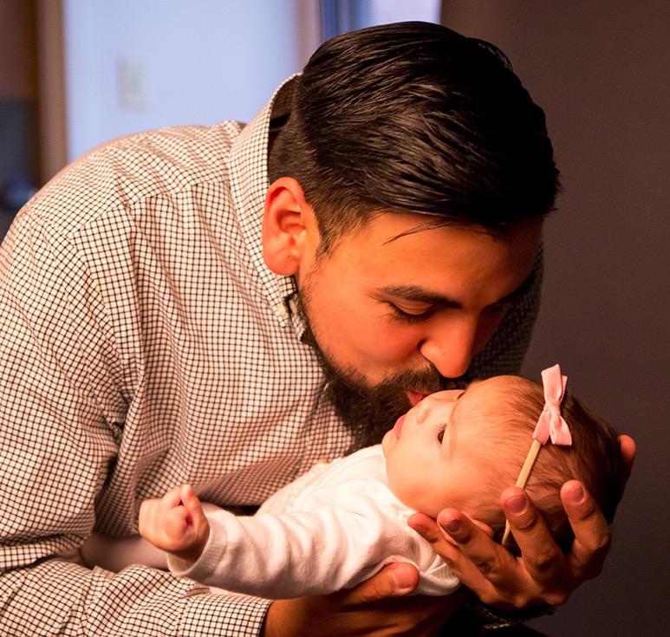
QUESTIONS?
nursing.tamu.edu/nfp

Slide 42
QUESTIONS?
nursing.tamu.edu/nfp

Slide 43
QUESTIONS?
nursing.tamu.edu/nfp

