Slide 1
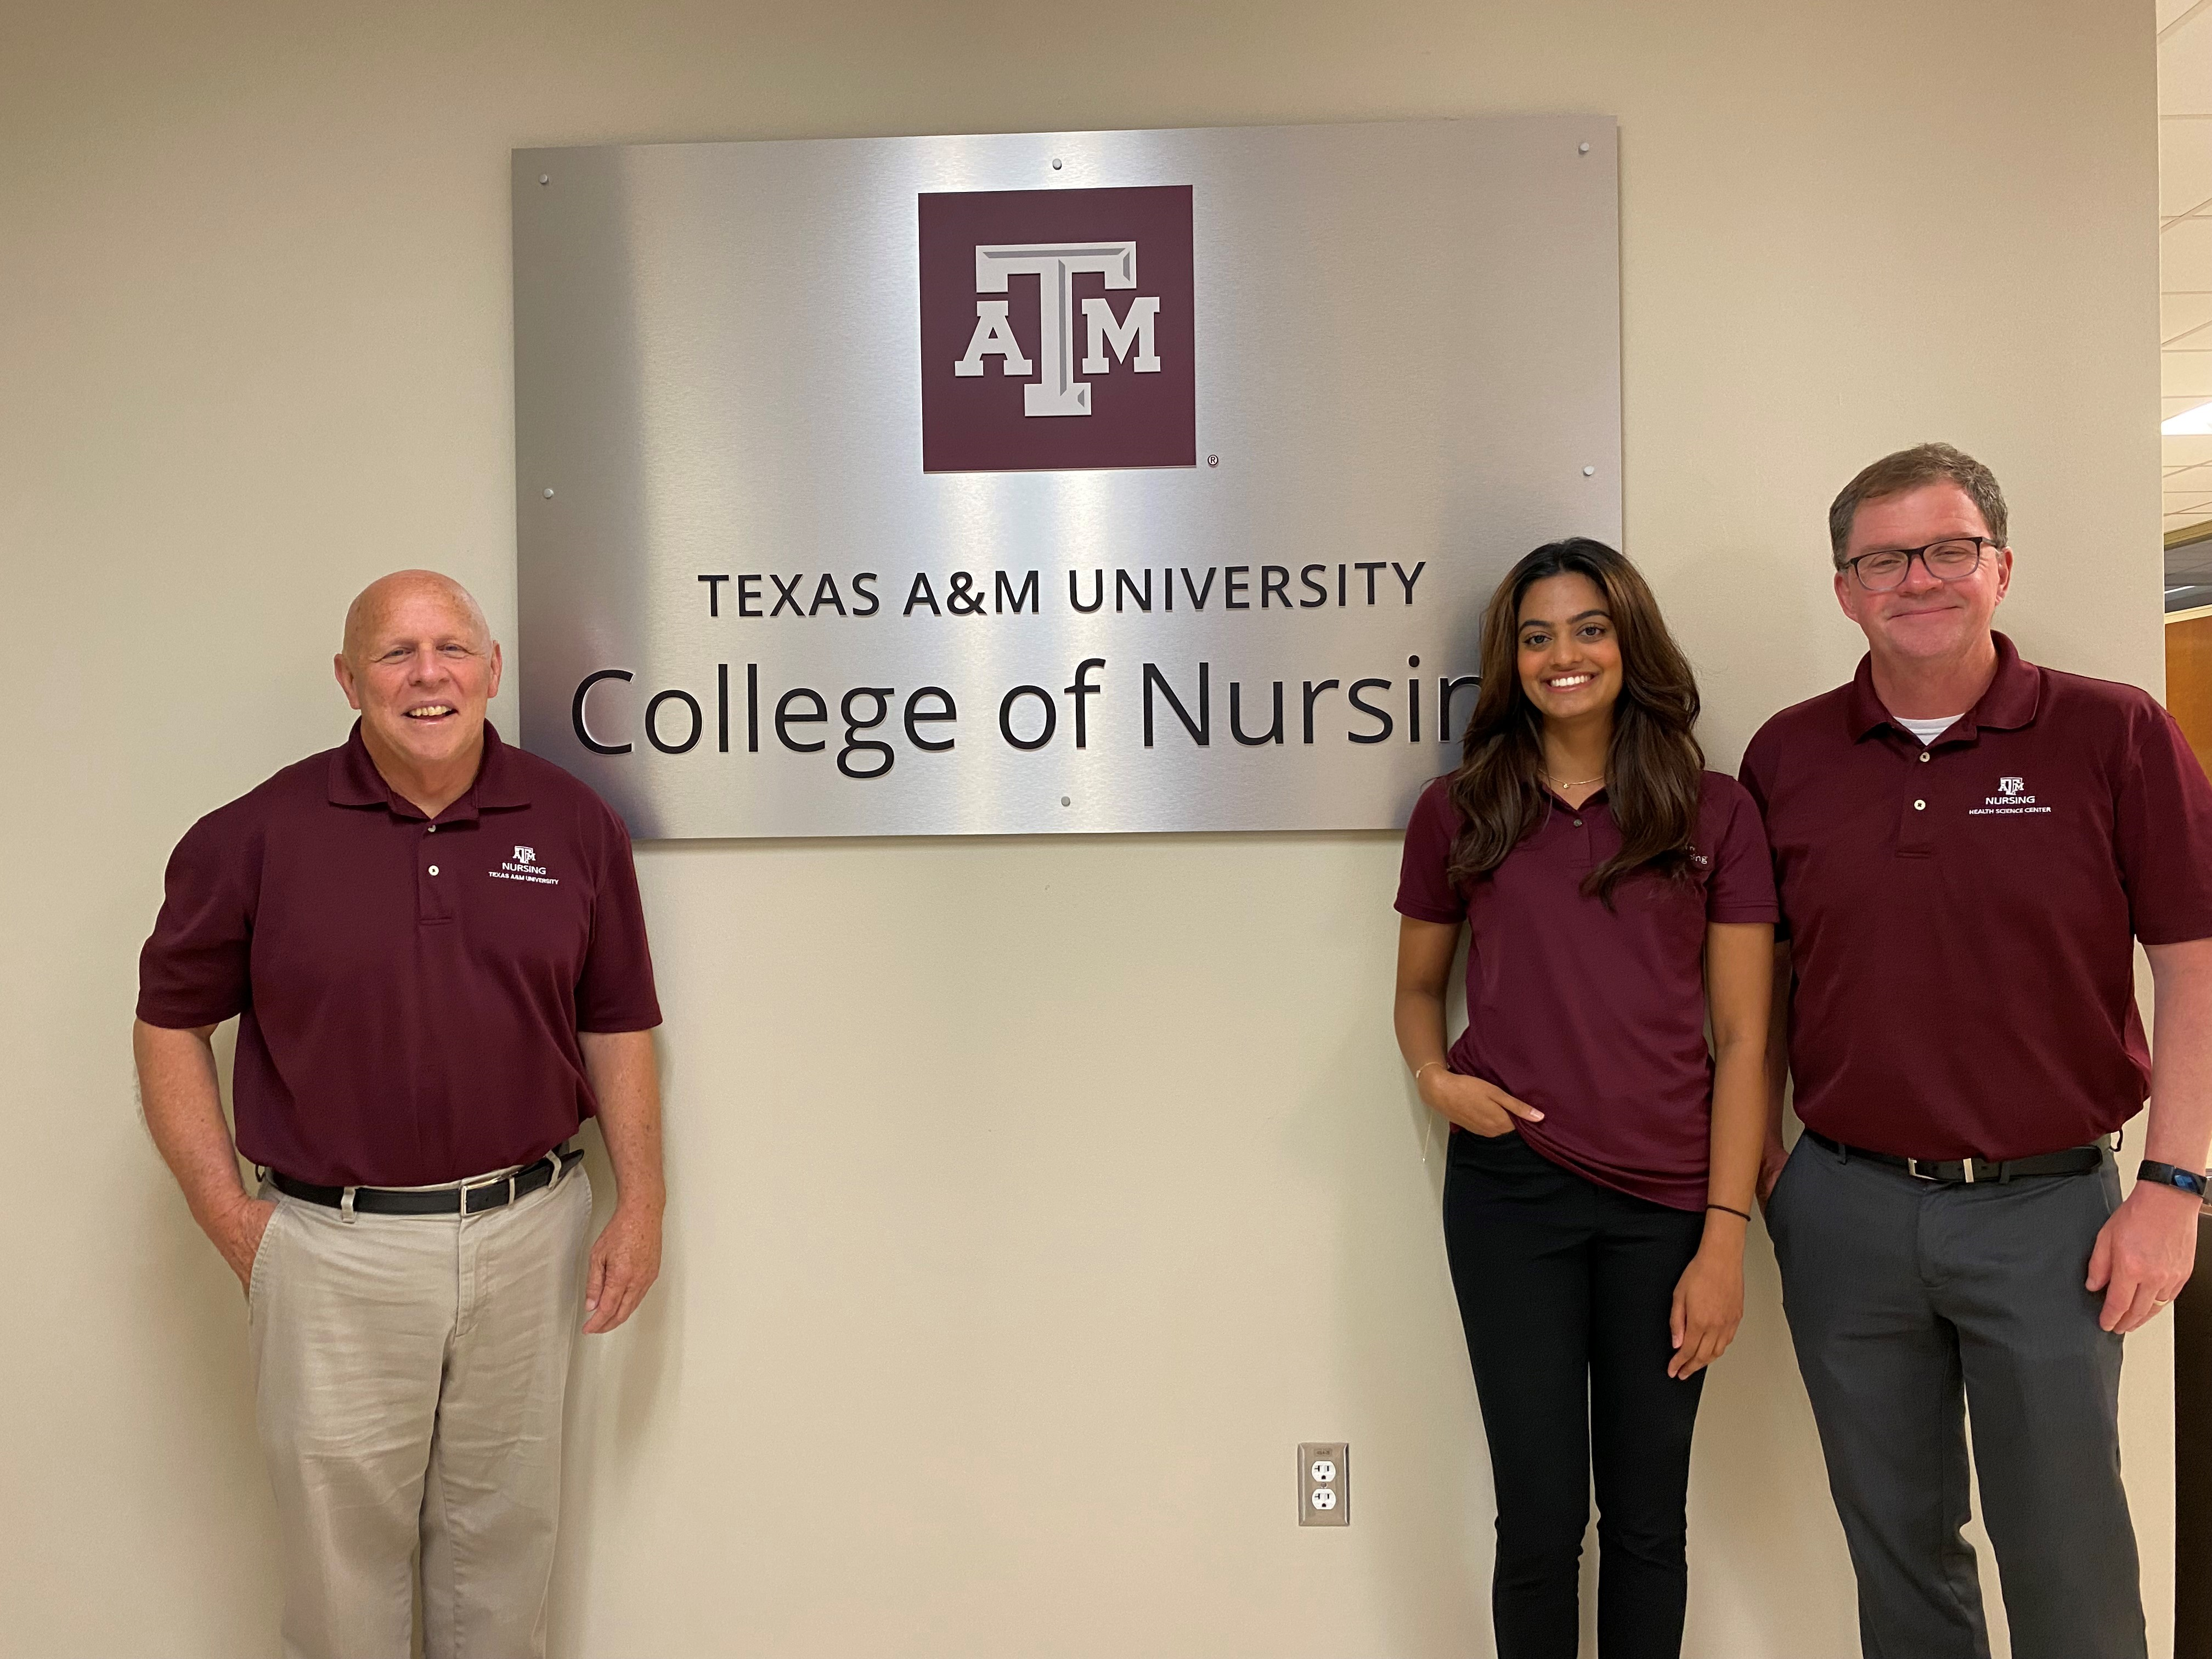
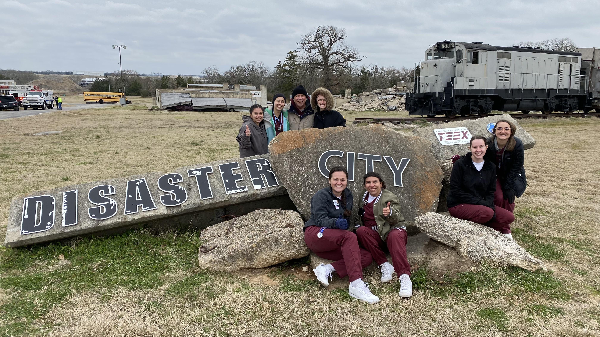
Aggie Nurses Exemplify Preparedness and Readiness for 2022 Disaster Day
February 25, 2022
SKILLS PERFORMED
PRESENTERS
Triage of Injured Casualties
Interprofessional Team Building
Effective Closed Loop Communication to Facilitate Patient Safety
Basic First Aid
LeRoy Marklund marklund@tamu.edu
Martin Mufich mufich@tamu.edu
Asma Qureshi asma_qureshi1@tamu.edu
PARTICIPANTS
College of Nursing
College of Medicine
College of Pharmacology
College of Veterinary Medicine and Biomedical Sciences
School of Public Health
TAMU Athletic Trainers
AUXILIARY SUPPORT
TAMU Corps of Cadets
Texas A&M Engineering Extension Service (TEEX)
Texas State Guard
Rudder High School
H-E-B
CONTACT US
(979) 436-0110
health.tamu.edu

