Slide 1
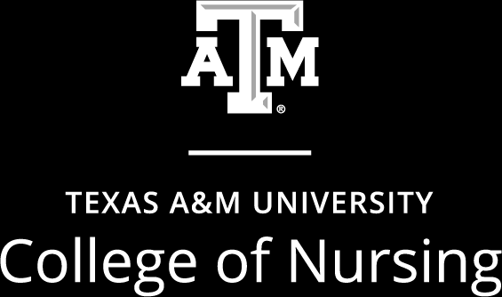
Aggie Nurses Exemplify Preparedness and Readiness for 2022 Disaster Day
LeRoy A. Marklund, DNP, MPH, RN
Martin W. Mufich, PhD(c), RN, FAWM
Asma Qureshi, Aggie Nursing Student
July 19, 2022
LM MM AQ

Slide 2
Abstract
On February 25, 2022, around 200 Texas A&M College of Nursing undergraduate students participated in Disaster Day. Skills included: Triage of injured casualties, verbal handoffs between team members, closed looped communication, and first aid. Prior to this event, students participated in Simple Triage and Rapid Treatment, Team Strategies and Tools to Enhance Performance and Patient Safety along with Stop the Bleed. These activities allowed nursing students to become skillful, competent, and collaborate as effective interprofessional team members. After taking a role in 2022 Disaster Day, students believe they are more prepared and ready to respond to all hazard disaster scenarios.
LM

Slide 3
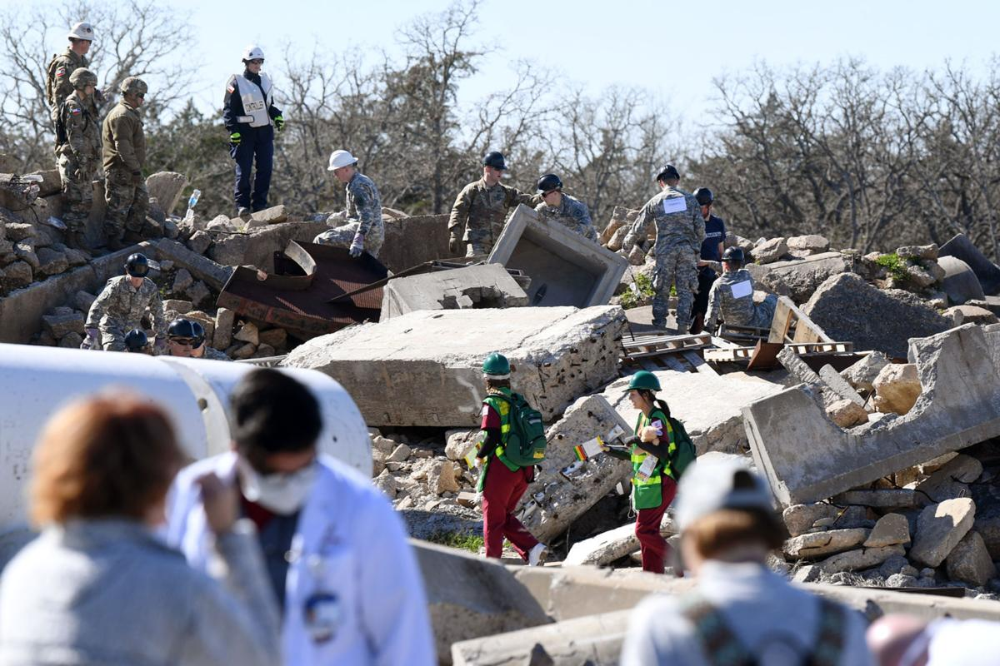
Outline
Background Information
Planning
Preparation
2022 Disaster Day Event
Faculty’s Perspective
Student’s Perspective
In The Face of Danger
LM

Slide 4
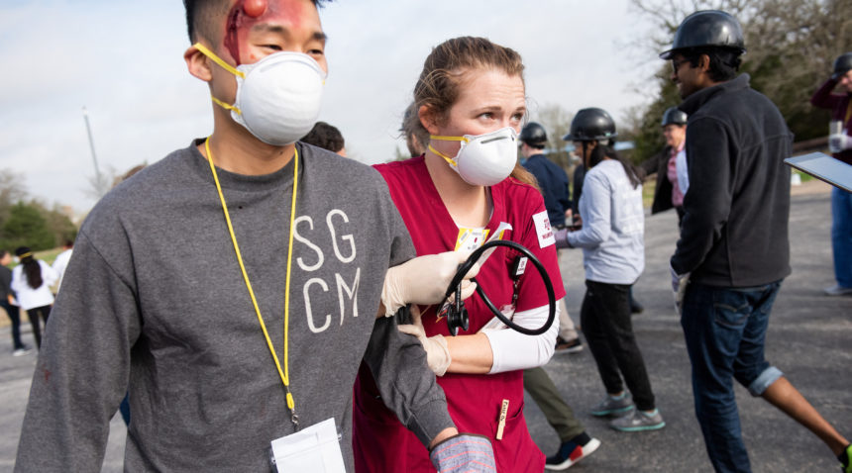
Background Information
Disaster Day Was Started in 2008 By TAMU College of Nursing
35 Participants during inaugural event
Utilized Community Assets
Facilitator is Interprofessional Education & Research Since 2018
Held at Disaster City
2021 Virtual Disaster Day
LM

Slide 5
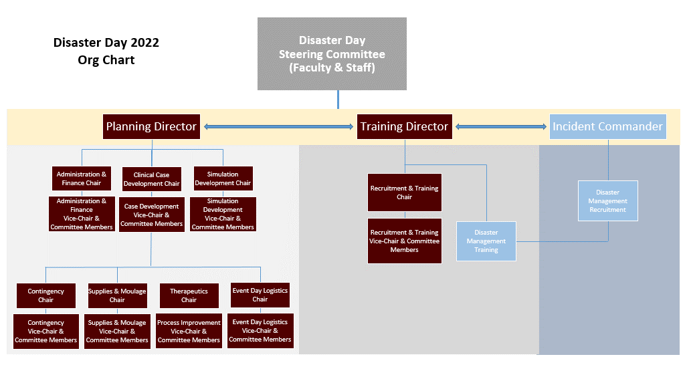
Background Information
Dr. LeRoy A. Marklund
marklund@tamu.edu
Professor Martin W. Mufich
mufich@tamu.edu
Asma Qureshi
asma_qureshi1@tamu.edu
LM

Slide 6
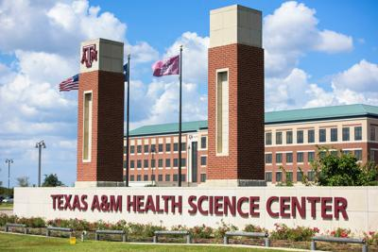
Planning – Executive Steering Committee
Interprofessional Education & Research
College of Nursing
College of Medicine
College of Pharmacy
College of Veterinary & Biomedical Sciences
School of Public Health
TAMU Athletic Trainers
LM

Slide 7
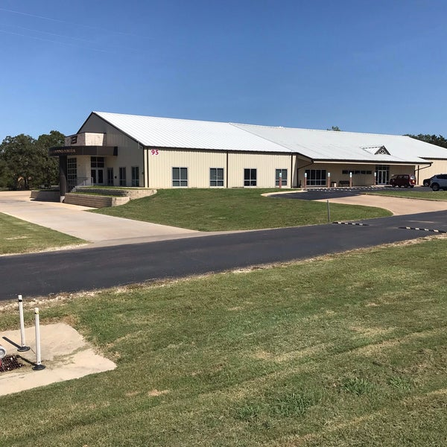
Planning – Auxiliary Support
TAMU Corps of Cadets
Texas A&M Engineering Extension Service (TEEX)
Texas State Guard
Rudder High School
H-E-B
LM

Slide 8
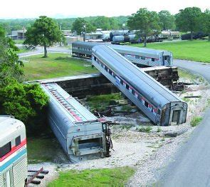
Preparation – Executive Steering Committee
Weekly Interprofessional Meetings
Crosswalk Communication
Supply Chain Management
Student Leader Development
Ensure Teamwork
LM

Slide 9
Planning – Student Steering Committee
This Event is “Student Led”... to a Point
Established Format (Timeline, Committees, Responsibilities, etc.)
Majority of Students New to Steering Committee
“Reinventing the Wheel”
Students Perception of What Can be Done During a Disaster
MM

Slide 10
Preparation – Student Steering Committee
Biweekly Interprofessional Meetings
Organized Over 800 Total Student Participants
Interprofessional Team Assignments - Scheduling
Moulage Training
Federal Emergency Management Agency (FEMA) Training
MM

Slide 11
Preparation – College of Nursing
Community Emergency Response Team (CERT)
Simple Triage & Rapid Treatment (START)
Stop The Bleed
American College of Surgeons
Federal Emergency Response Agency (FEMA) Training
MM

Slide 12
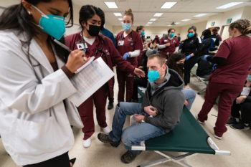
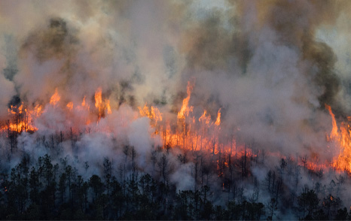
2022 Disaster Day - Event Day
Forest Fire Scenario
Team Huddle
Search & Rescue
Triage/First Aid
Field Hospital(s)
Repatriation Center
Displaced People & Pets
MM

Slide 13
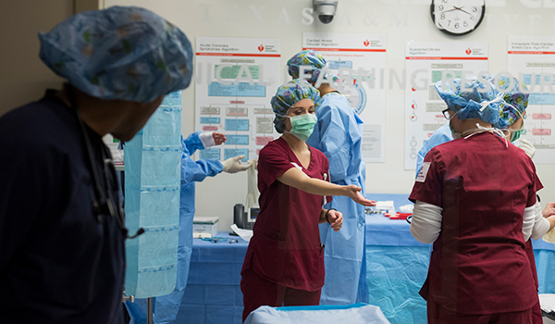
Evaluation - IPE Competencies
Roles & Responsibilities
Team Dynamics
Interprofessional Communication
Resource Management
Values/Ethics
Clinical Skills
MM

Slide 14
Faculty Perspective
Student Leadership Positions are Valuable
Student Participation is Essential for Professional Growth
Disaster Day Encourages Creativity and Innovation
Takes Students Out of Their “Silo”
MM LM

Slide 15
Faculty Perspective
Supports the TAMU College of Nursing Mission and Vision
Encourages Non-Traditional Nursing Concepts
Teamwork Strengthens Soft Skills
Interprofessional Collaboration is Imperative for Team Building
LM & MM

Slide 16
Student Perspective
Interdisciplinary Teamwork
College of Medicine & College of Pharmacy
Conservation of Resources and Improvisation
Application of Clinical Skills
AQ

Slide 17
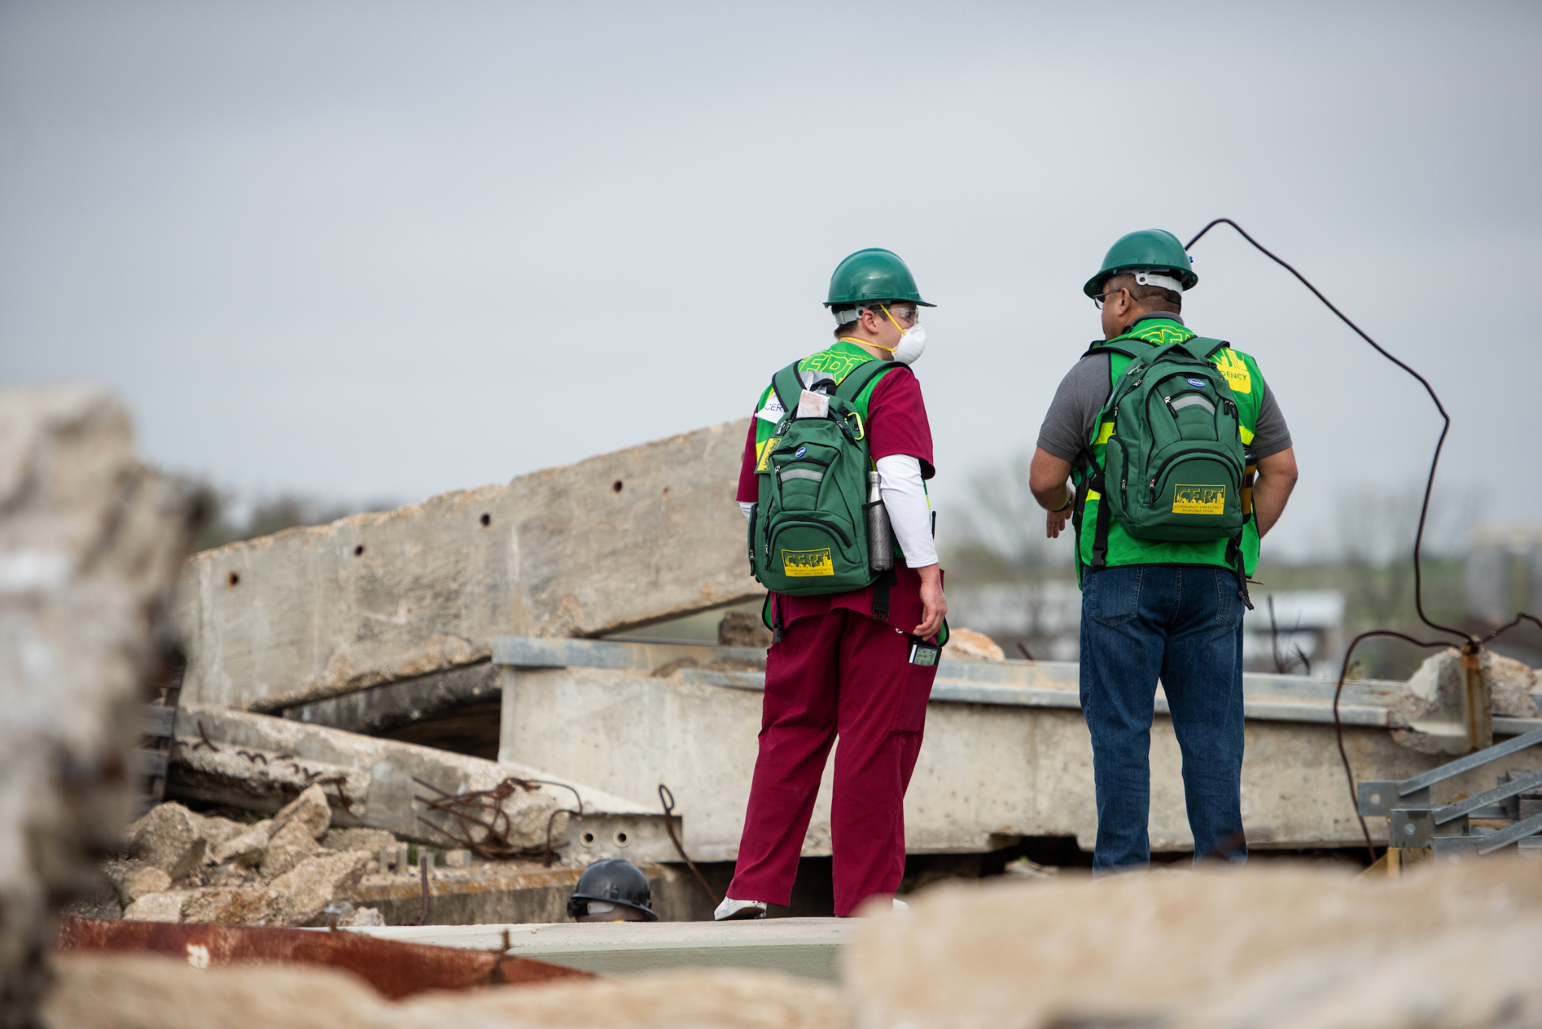
Student Perspective
Importance of Expedited Care
Teamwork & Role Assignments
Debriefing in Mass-Casualty Incident
AQ

Slide 18
In The Face Of Danger - Nicole Mancuso
We currently live in a world with unknown tomorrows
Disasters can strike as contagious diseases or deadly shootings
Preparedness is always the key
https://youtu.be/TLSrZDq2G6s
AQ
Notes:
In the Face of Danger - Nicole Mancuso (Video 4:05 minutes)

Slide 19
We cannot stop natural disasters, but we can arm ourselves with knowledge: So many lives wouldn’t have to be lost if there was enough disaster preparedness
AQ

Slide 20
Thank You & Gig’em!
Dr. LeRoy A. Marklund
marklund@tamu.edu
Professor Martin W. Mufich
mufich@tamu.edu
Asma Qureshi
asma_qureshi1@tamu.edu
LM MM AQ

