Slide 1
Been There, Done That! Phlebotomy 101
Michele Knorpp, LVN
Elkhart ISD
mknorpp@elkhartisd.org

Slide 2
How I Started

Slide 3
Intro
Career Nurse 28 yrs
Angelina College 2013 CNA on campus & near by high schools, etc
EHS 2016 Phlebotomy, CNA, Med Term, Law & Ethics and First Aid
Intro into THOA 2017
Now: Phleb, PCT, CMA,Med Term & Principles

Slide 4
1st Hard Lesson!
The Phlebotomy that I knew as an LVN is NOT the phlebotomy for phlebotomists!!!!
It’s not easy to unlearn, but you can do it!

Slide 5
Textbook & Testing Agency
Your textbook is important but FIRST what testing agency will you use?

Slide 6
My Pathway
We tested through Angelina College for 3 years, then through NHA for 2 years & now, AMCA 1 year

Slide 7
My Reasons?
Angelina charged separately : Student, then Course then Test
NHA charges for their study guides & practice tests & separately for the certification test
AMCA- only charges for the exam-only bills after the exam has been taken

Slide 8
AMCA 1-888-960-2622
NHA 1-800-499-9092

Slide 9
Now you’ve Chosen you’ve Testing Agency so on to the Textbook(s) ……

Slide 10
I started with a Phlebotomy
Textbook-Phlebotomy Essentials 6th ed. By McCall & Tankersley
& now
Hartman’s Complete Guide for the Phlebotomy Technician

Slide 11
HARTMAN’S -1-800-999-9534

Slide 12
SETTING UP YOUR TEXTBOOK FOR SUCCESS!

Slide 13
Pull Apart That Textbook !

Slide 14
Huge Binder
Textbook Pages
Insert Worksheet/Online Information from your testing center, etc
Dividers for Semesters & Topics-this will set your course foundation for your lesson sequencing and lesson plans
Sheet Protectors

Slide 15
NOW, Print out Your Testing Agencies Information!
This is a MUST for Students Passing the Exam!:
READ ALL Information
Study Materials
Blue Print
Practice Tests
& THEN compare them to your Textbook Format and add to your binder as you need to accent the textbook. This process is aligning your testing agency material to your textbook.

Slide 16
You will add to YOUR BINDER through the Year & Change as you Discover the Certification Criteria Changes. How will you know what Criteria Changes? You can read, get alerts from your testing agency and/or Attend these THOA Conferences.

Slide 17
Now, How To Teach the Students the Material in the Binder

Slide 18
Handouts, Packets, DAILY Quizzes, Tests
LOTS!!!!!!!
A MUST!!!!!!!

Slide 19
TUBES, TUBES, TUBES!!!

Slide 20
Order of Draw!
Why We Have OOD?
Top Tests for Each Tube
Additives in Each Tube
Pre & Post Analytical Errors
POC Testing
Syringe Size Needed
Parts of the Syringe & Needles
Infection Control & the lab’s governing bodies: OSHA, HIPAA, CLIA

Slide 21
NOW, ADJUST How You Present to Each Class According to Their Individual Needs

Slide 22
Games? Flashcards? Individual Online Study Quizzes?
Group Competition? Quizlet, Kahoot, Fly Swatter Game & the List Goes On
BUT YOU HAVE TO DO DAILY QUIZZES PEN & PAPER

Slide 23
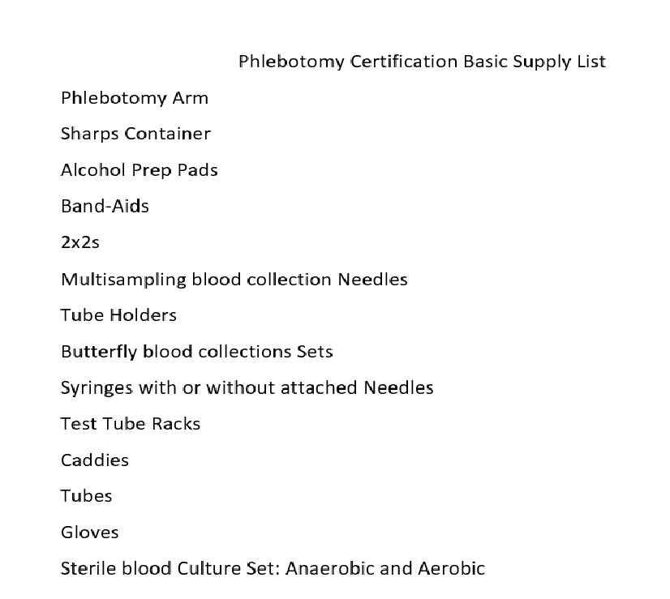
BASIC
SUPPLY
LIST

Slide 24
Where I Purchase From
POCKET NURSE!
1-800-225-1600

Slide 25
QUESTIONS?
COMMENTS?
ASK AWAY!

