Slide 1
STUDENT-
CENTERED
HEALTH FAIR
HOW TO SUPPORT THE STUDENT BODY
AND THE HEALTH SCIENCE CURRICULUM

Slide 2
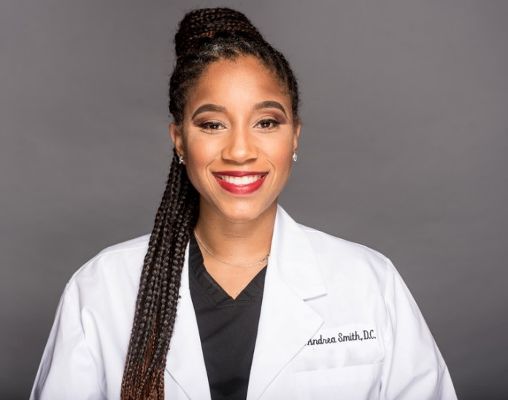
PRESENTER
Andrea Smith, D.C.
10th year at Nimitz Sr. High School in Aldine ISD
Courses
  Health Science Theory / Clinical Rotations
  Medical Billing and Coding
Owner of the Art of Healing Chiropractic Clinic in Houston, Texas

Slide 3
INCEPTION
Ms. Marlene Jones, an intervention specialist
  “The district hosts a health fair every year for us to monitor our health, but what about the kids?
Parents – First line of defense or not ?

Slide 4
PROFESSIONALISM
Student ambassadors
Planning
Set-up

Slide 5
COMMUNICATION
Professionalism with health science students
Open dialogue with the student body

Slide 6
BUSINESS PARTNERSHIPS
CTE Students
Clinical Sites
Community Service
Classroom Speakers

Slide 7
WHERE TO START?
ACTIVITY: YOU WILL NEED A SHEET OF PAPER
MAKE YOUR LIST! WRITE DOWN ANY VENDOR, PRESENTER OR SERVICE PROVIDER THAT YOU CAN THINK OF

Slide 8
STIPULATIONS
Topics
Handouts
Procedures
Don’t forget background checks!

Slide 9
TIMELINE
Reserve your date on the campus calendar at the beginning of the school year
Start contacting vendors at least two months in advance if not sooner.
Set your deadline two weeks before your event due to late comers
If you plan to provide a meal also add this onto your timeline

Slide 10
BUDGET
Food (Water, Snacks, Lunch)
Vendors that charge

Slide 11
SAMPLES
Vendor Letter
Flyer
Map
Vendor response form
Vendor List

Slide 12
Vendor Letter
Good afternoon,
We would like to invite your organization to participate at the Nimitz Health Fair, which will be held on Wednesday, February 6, 2019. Our focus will be to our students and faculty members. Please find attached a flyer with the time and location.
If you or a member from your organization is able to assist us, please complete the registration form here or the hard copy attached.
Thank you and I look forward to hearing from you!

Slide 13

SUGGESTED APPS
Poster My Wall
Canva

Slide 14
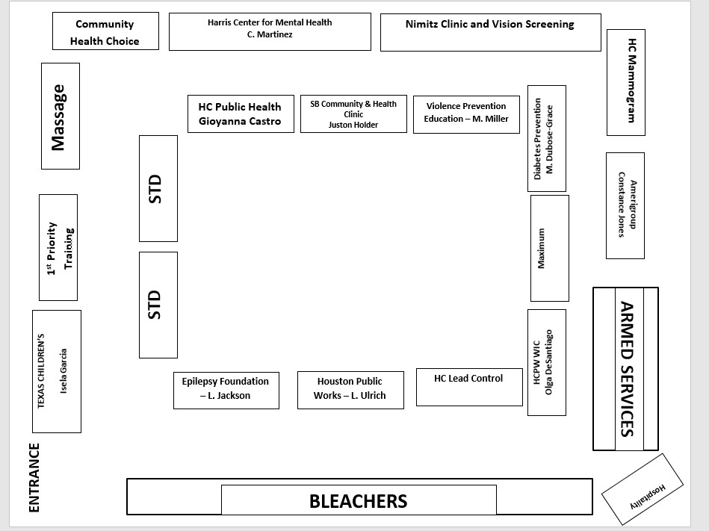
MAP

Slide 15
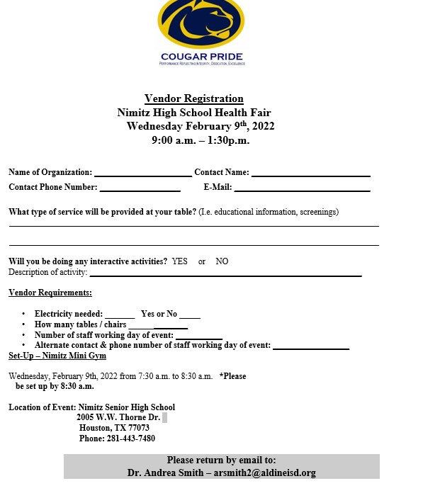
VENDOR RESPONSE FORM

Slide 16
QUESTIONS?
Feel free to contact me
arsmith2@aldineisd.org

