Slide 1
Teaching EKG like A BOSS
Increasing student success on EKG Certification

Slide 2
Objectives
This class will:
Teach the basics of EKG’s
Outline the sections of the NHA EKG exam
Interpret EKG’s and give tools to help teach interpretation
Provide practice
Increase confidence in preparing students for EKG certification
Provide toolkit for teachers to utilize

Slide 3
TEA approved EKG certification Vendors
American Allied health: https://www.americanalliedhealth.com/
NHA: National Healthcare careers Association: https://www.nhanow.com/
AMCA: American Medical Certification Association: https://www.amcaexams.com/
National Center for Competency testing: https://www.ncctinc.com/certifications

Slide 4
Clinical Component of the EKG exam
Students who are testing for the EKG have to perform 10 EKG on real people.
HOW?
Notes:
Show letters take about family clinics and assisting with athlete physicals

Slide 5
Sections of The NHA EKG exam
Part 1: Safety, Compliance, and coordinated patient care
Part 2: EKG Acquisition
Part 3: EKG Analysis and Interpretation
Notes:
If also teaching PCT some will overlap.

Slide 6
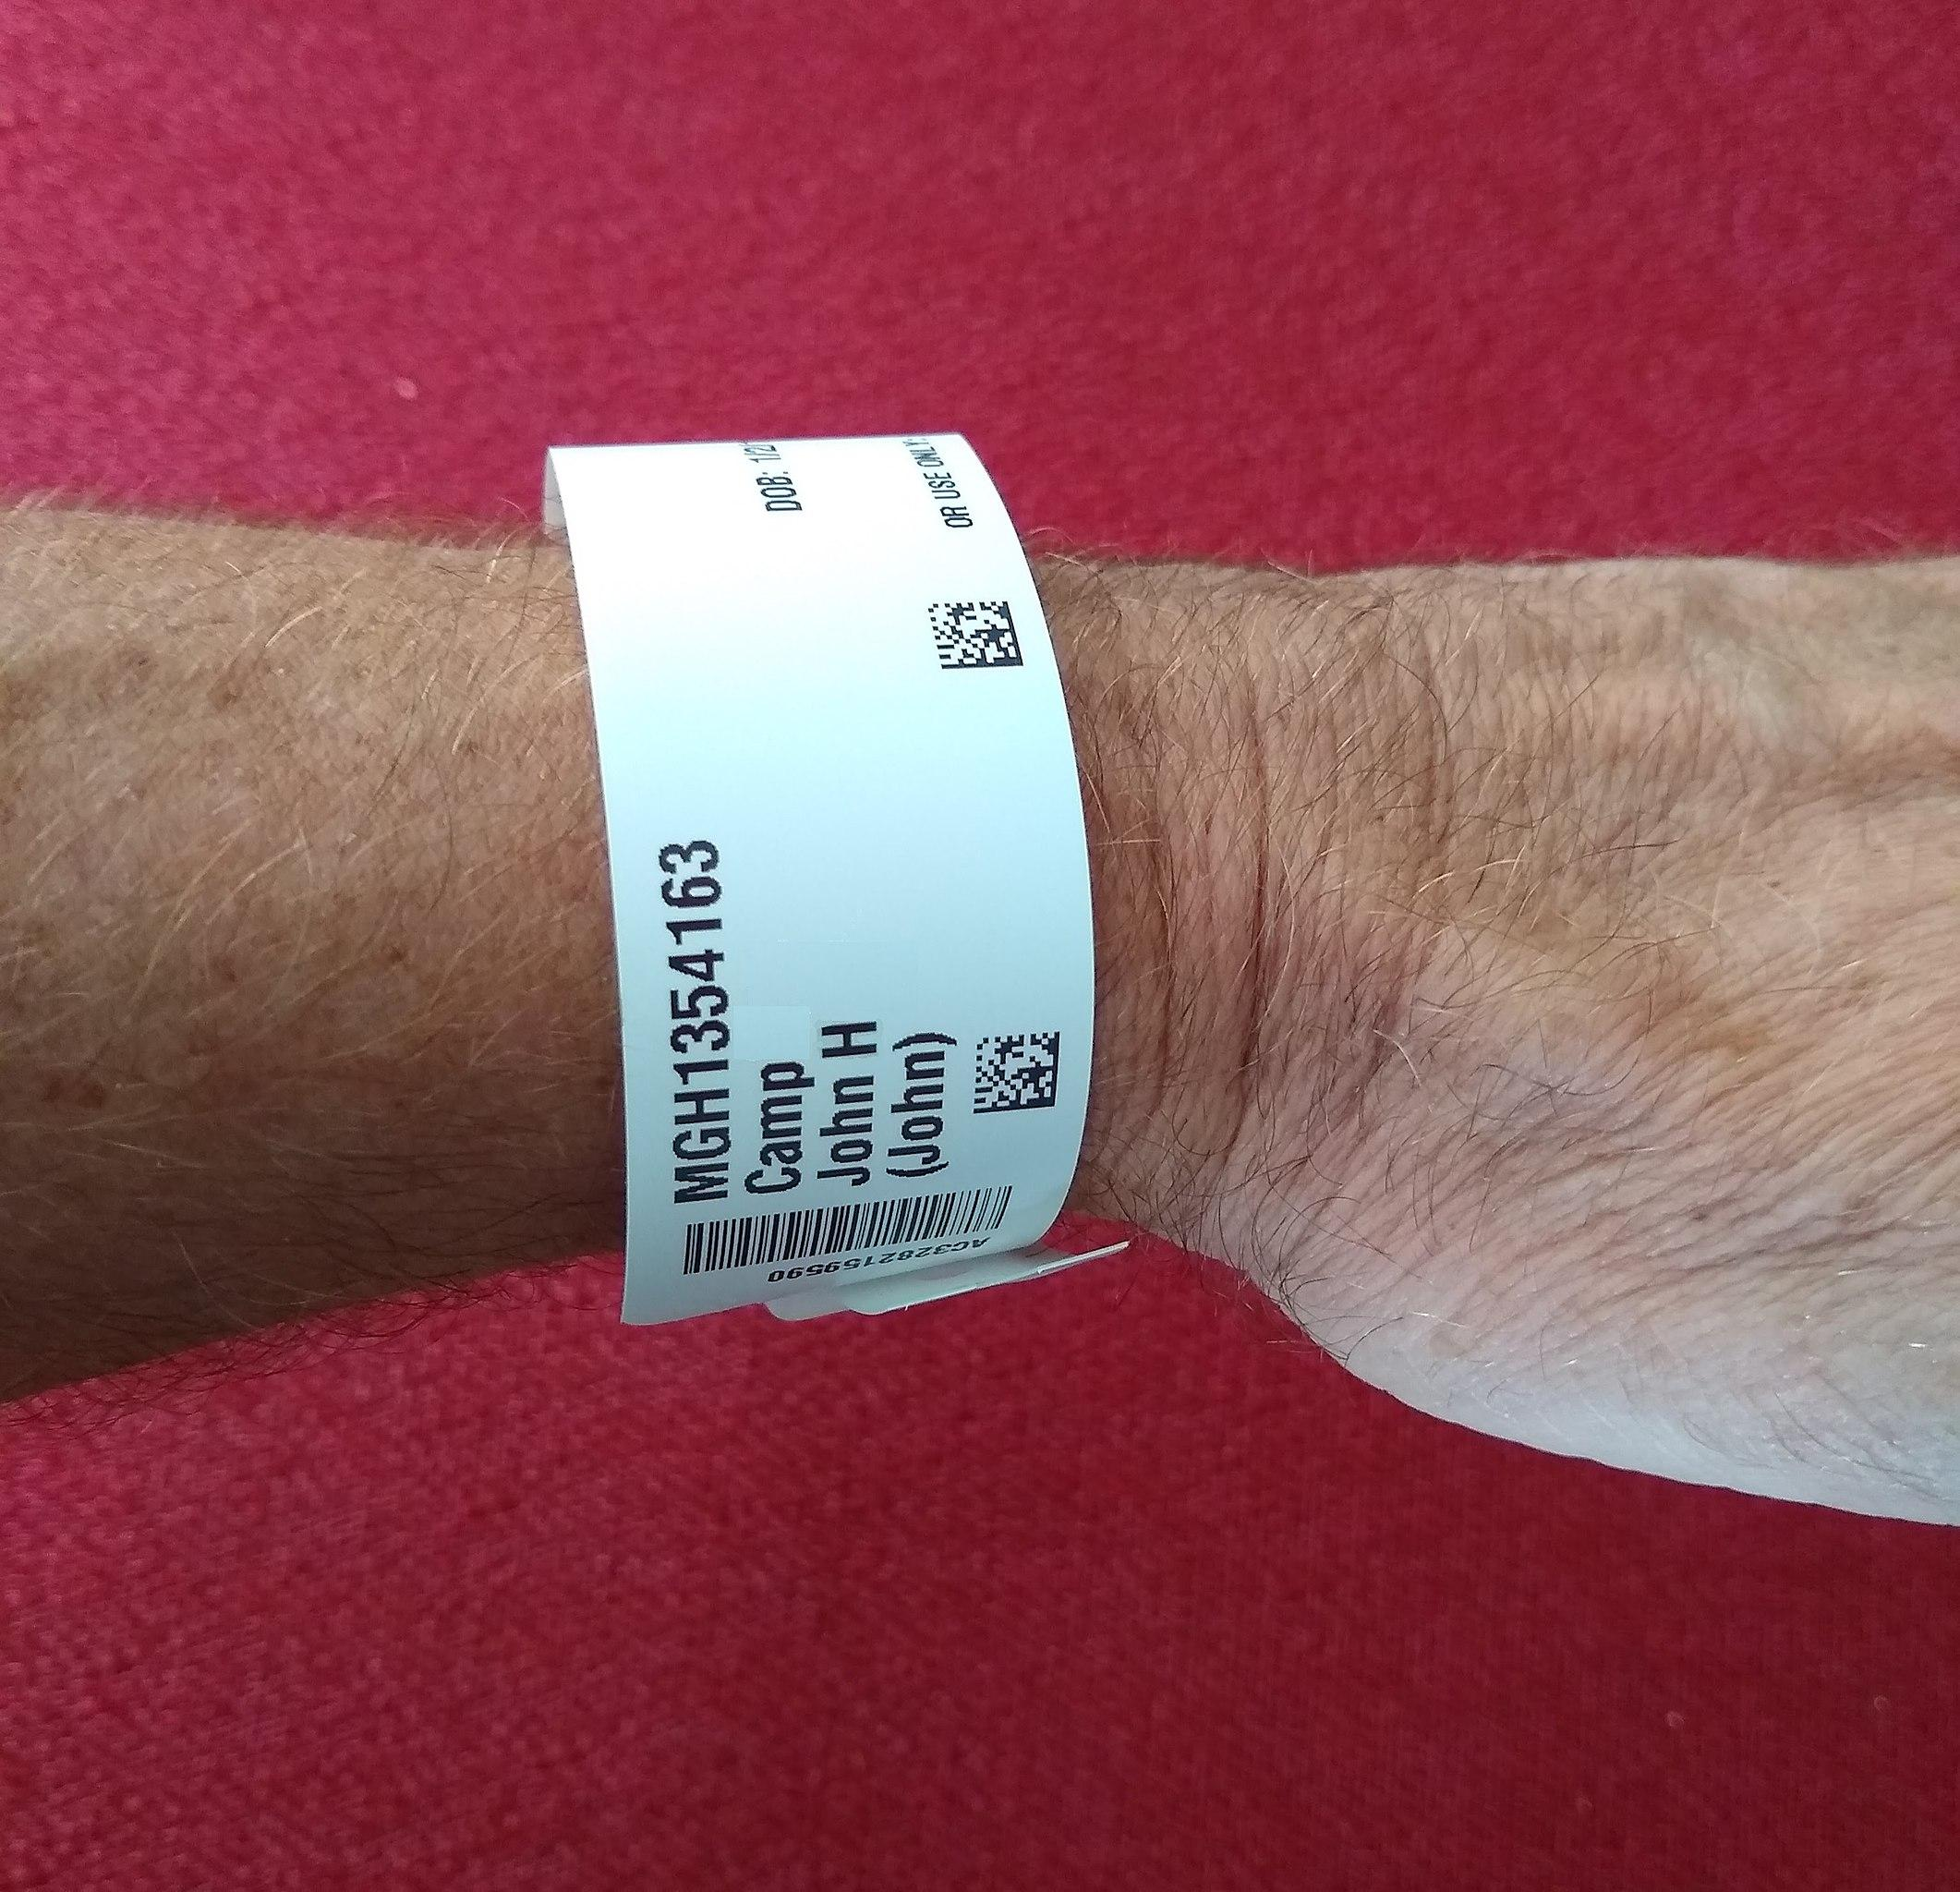
Part 1: Safety, Compliance, and Coordinated patient care

Slide 7
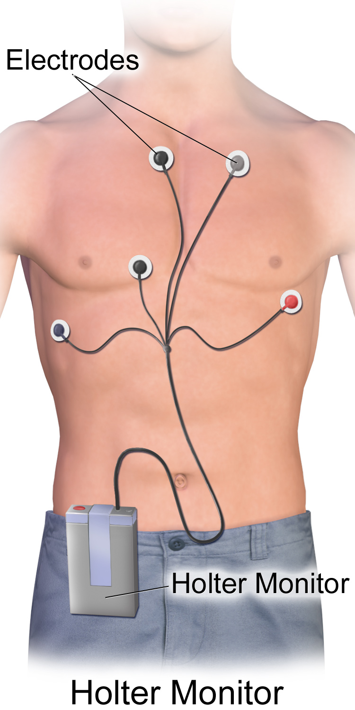
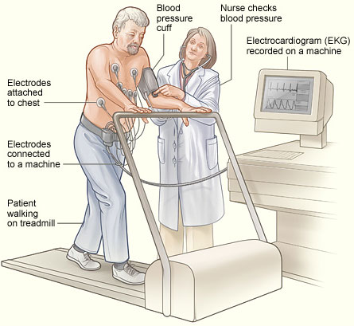
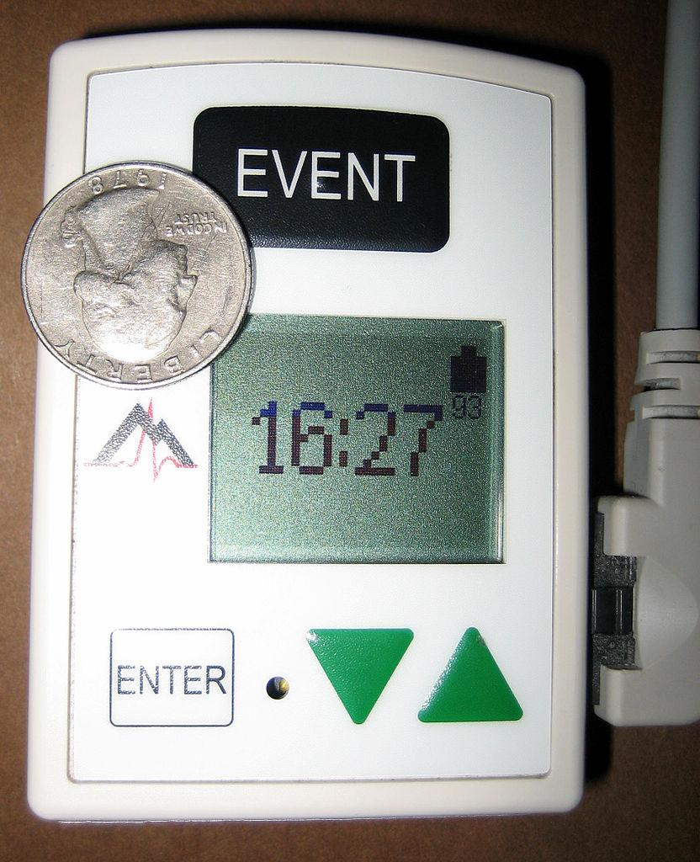
What is the difference?

Slide 8
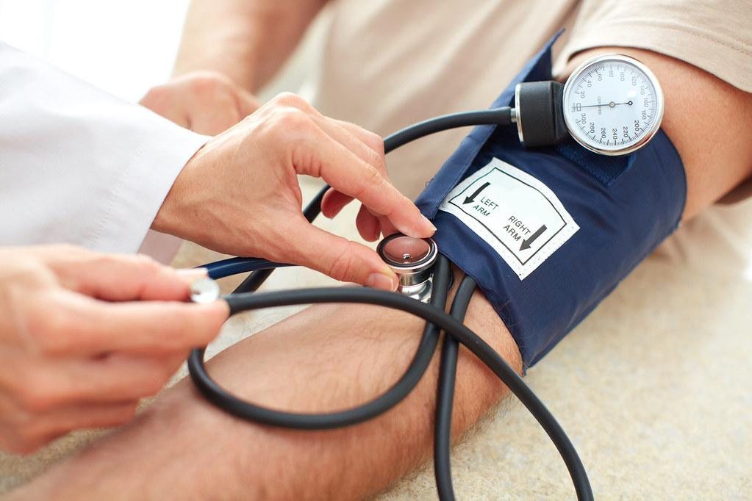
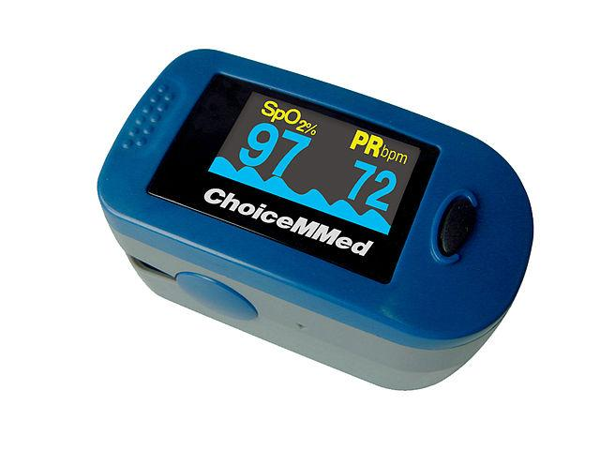
What is Normal?

Slide 9
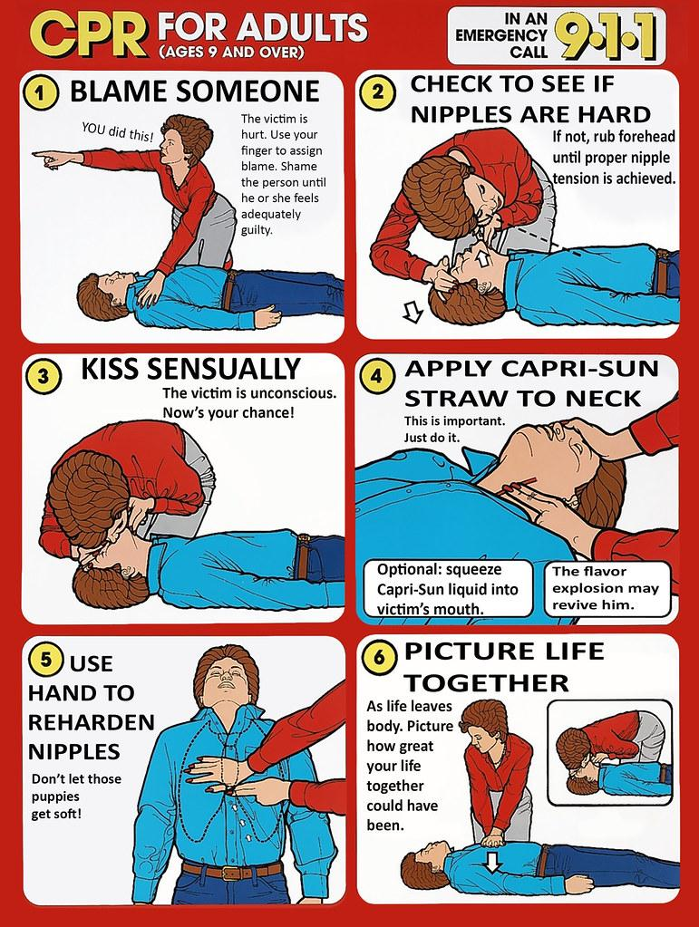
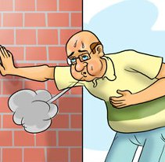
Medical Emergencies

Slide 10
Sample questions from Part 1
Which of the following is an important factor in preparing a patient for an EKG stress test?
Instruct patients to stop taking any medication 24 hours prior
Ask a patient to keep a journal during of cardiac events during the test
Inform the student the exam only takes about 10 seconds
Have patients wear loose comfortable clothing and sturdy non skid walking shoes
Answer: D

Slide 11
Sample questions from Part 1
2. Which is an expected heart rate for an adolescent?
15 bpm
80 bpm
120 bpm
180 bpm
Answer: B

Slide 12
Sample questions from Part 1
3. When performing a standard EKG on a 9 year old what action can reduce the child’s anxiety?
Give the child the option to allow their parent to leave the room
Wait 15 min before entering the room
Explain the procedure to the child using correct medical terminology
Allow the child to touch the equipment and ask questions prior to performing the exam
Answer: D

Slide 13
Sample questions from Part 1
4. The EKG tech should recognize which of the following statement is in compliance with HIPPA regulations.
The patient’s diagnosis is considered protected health information
The patient’s vital signs should be disclosed to the provider
The patient’s treatment plan should be shared with the family
The patient’s ID number cannot be disclosed as a part of providing facility healthcare statistics
Answer: A

Slide 14
Sample questions from Part 1
5. What are two way Joint commission states should be used to verify a patient’s identification?
Ask the patient to provide their account number and provider’s name
Ask a patient their room number and name
Ask patient to spell out their name and their birthdate
Ask patient to provide their name and provider’s name
The patient’s ID number cannot be disclosed as a part of providing facility healthcare statistics
Answer: C

Slide 15
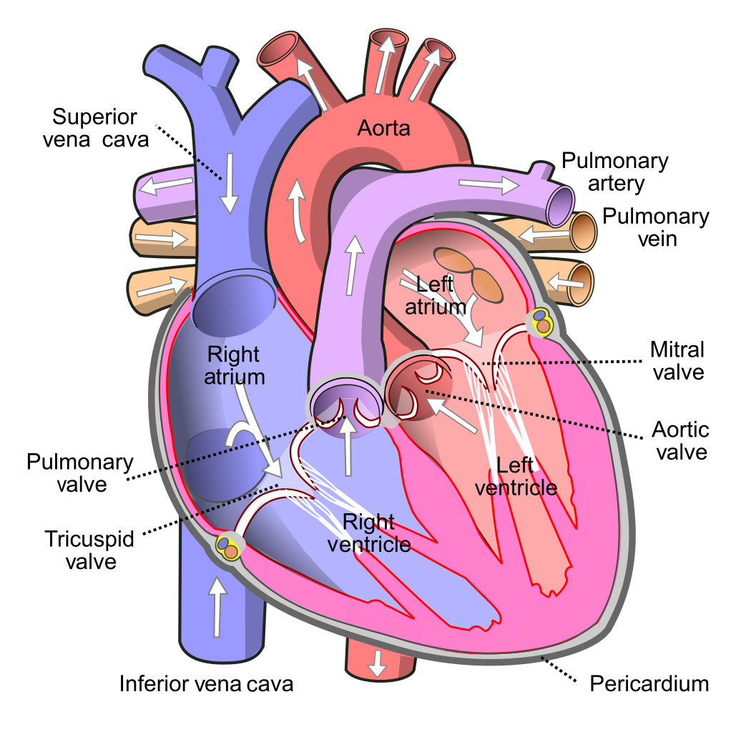
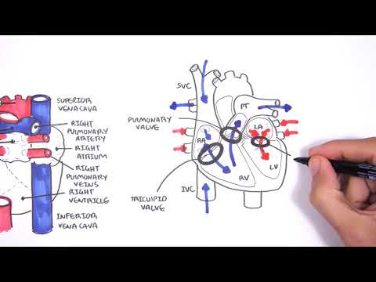
Basic heart anatomy

Slide 16
Part II: EKG Acquisition
Standard grid: EKG paper Time and voltage
Standard speed: 25mm/sec
Standard amplitude (gain): 10mm/ 1mv
Standard calibration: small boxes 10mm x 5mm
Lead Placement

Slide 17
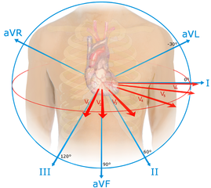
Lead Placement
Wilson’s Central Terminal
Precordial leads: 6 chest leads / unipolar
Augmented leads: limb leads / positive
Bipolar leads: + and - lead
Einthoven’s Triangle

Slide 18
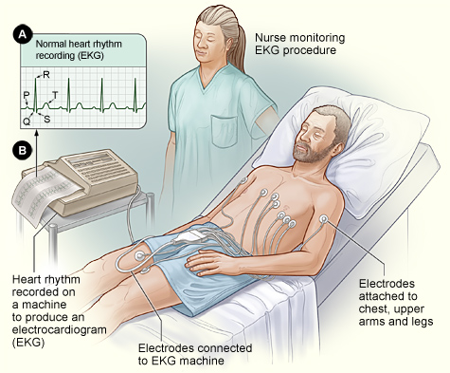
EKG Equipment
Electrodes
Three channel
Single channel
EKG paper
Artifact
Troubleshooting

Slide 19
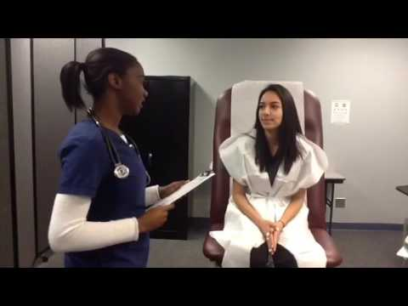
Performing An EKG

Slide 20
Part II: Sample questions
An EKG tech is preparing a patient for a Stress Test. Which of the following actions should they take?
Administer oxygen to the patient prior to performing the test
Administer lotion prior to lead placement
Allow the patient to wear jewelry during the test
Shave the areas with excessive hair prior to placing the electrodes
Answer: D

Slide 21
Part II: Sample questions
2. An EKG tech should recognize that which of the following can result in an interrupted baseline on the Patient’s EKG tracing?
Crossed Lead wires
Hair on the skin under the electrodes
Involuntary muscle movements
Corroded lead wires
Answer: D

Slide 22
Part II: Sample questions
3. An EKG tech is preparing to apply electrodes and leads for a patient who has a prescription for a Holter monitor. Which of the following actions should the EKG take?
Apply tape to lead wires
Ensure that lead wires are held in tension
Apply electrode gel to lead site
Place monitor in patients pocket
Answer: A

Slide 23
Part II: Sample questions
4. Which of the following is the recommended to remove oil from skin prior to placing electrodes?
Use alcohol wipes
Perform a dry rub with clean guaze
Apply an acetone base solution to the skin
Swab the skin with povidone- iodine solution.
Answer: A

Slide 24
Part II: Sample questions
5. The EKG tech notes a positive deflection of the waveform on lead aVR on a patient’s standard 12-lead EKG. Which of the following steps should the EKG tech take?
Remove tension from lead wires
Immediately print the EKG results
Verify lead and electrode placement
Reposition the patient on the exam table
Answer: C

Slide 25
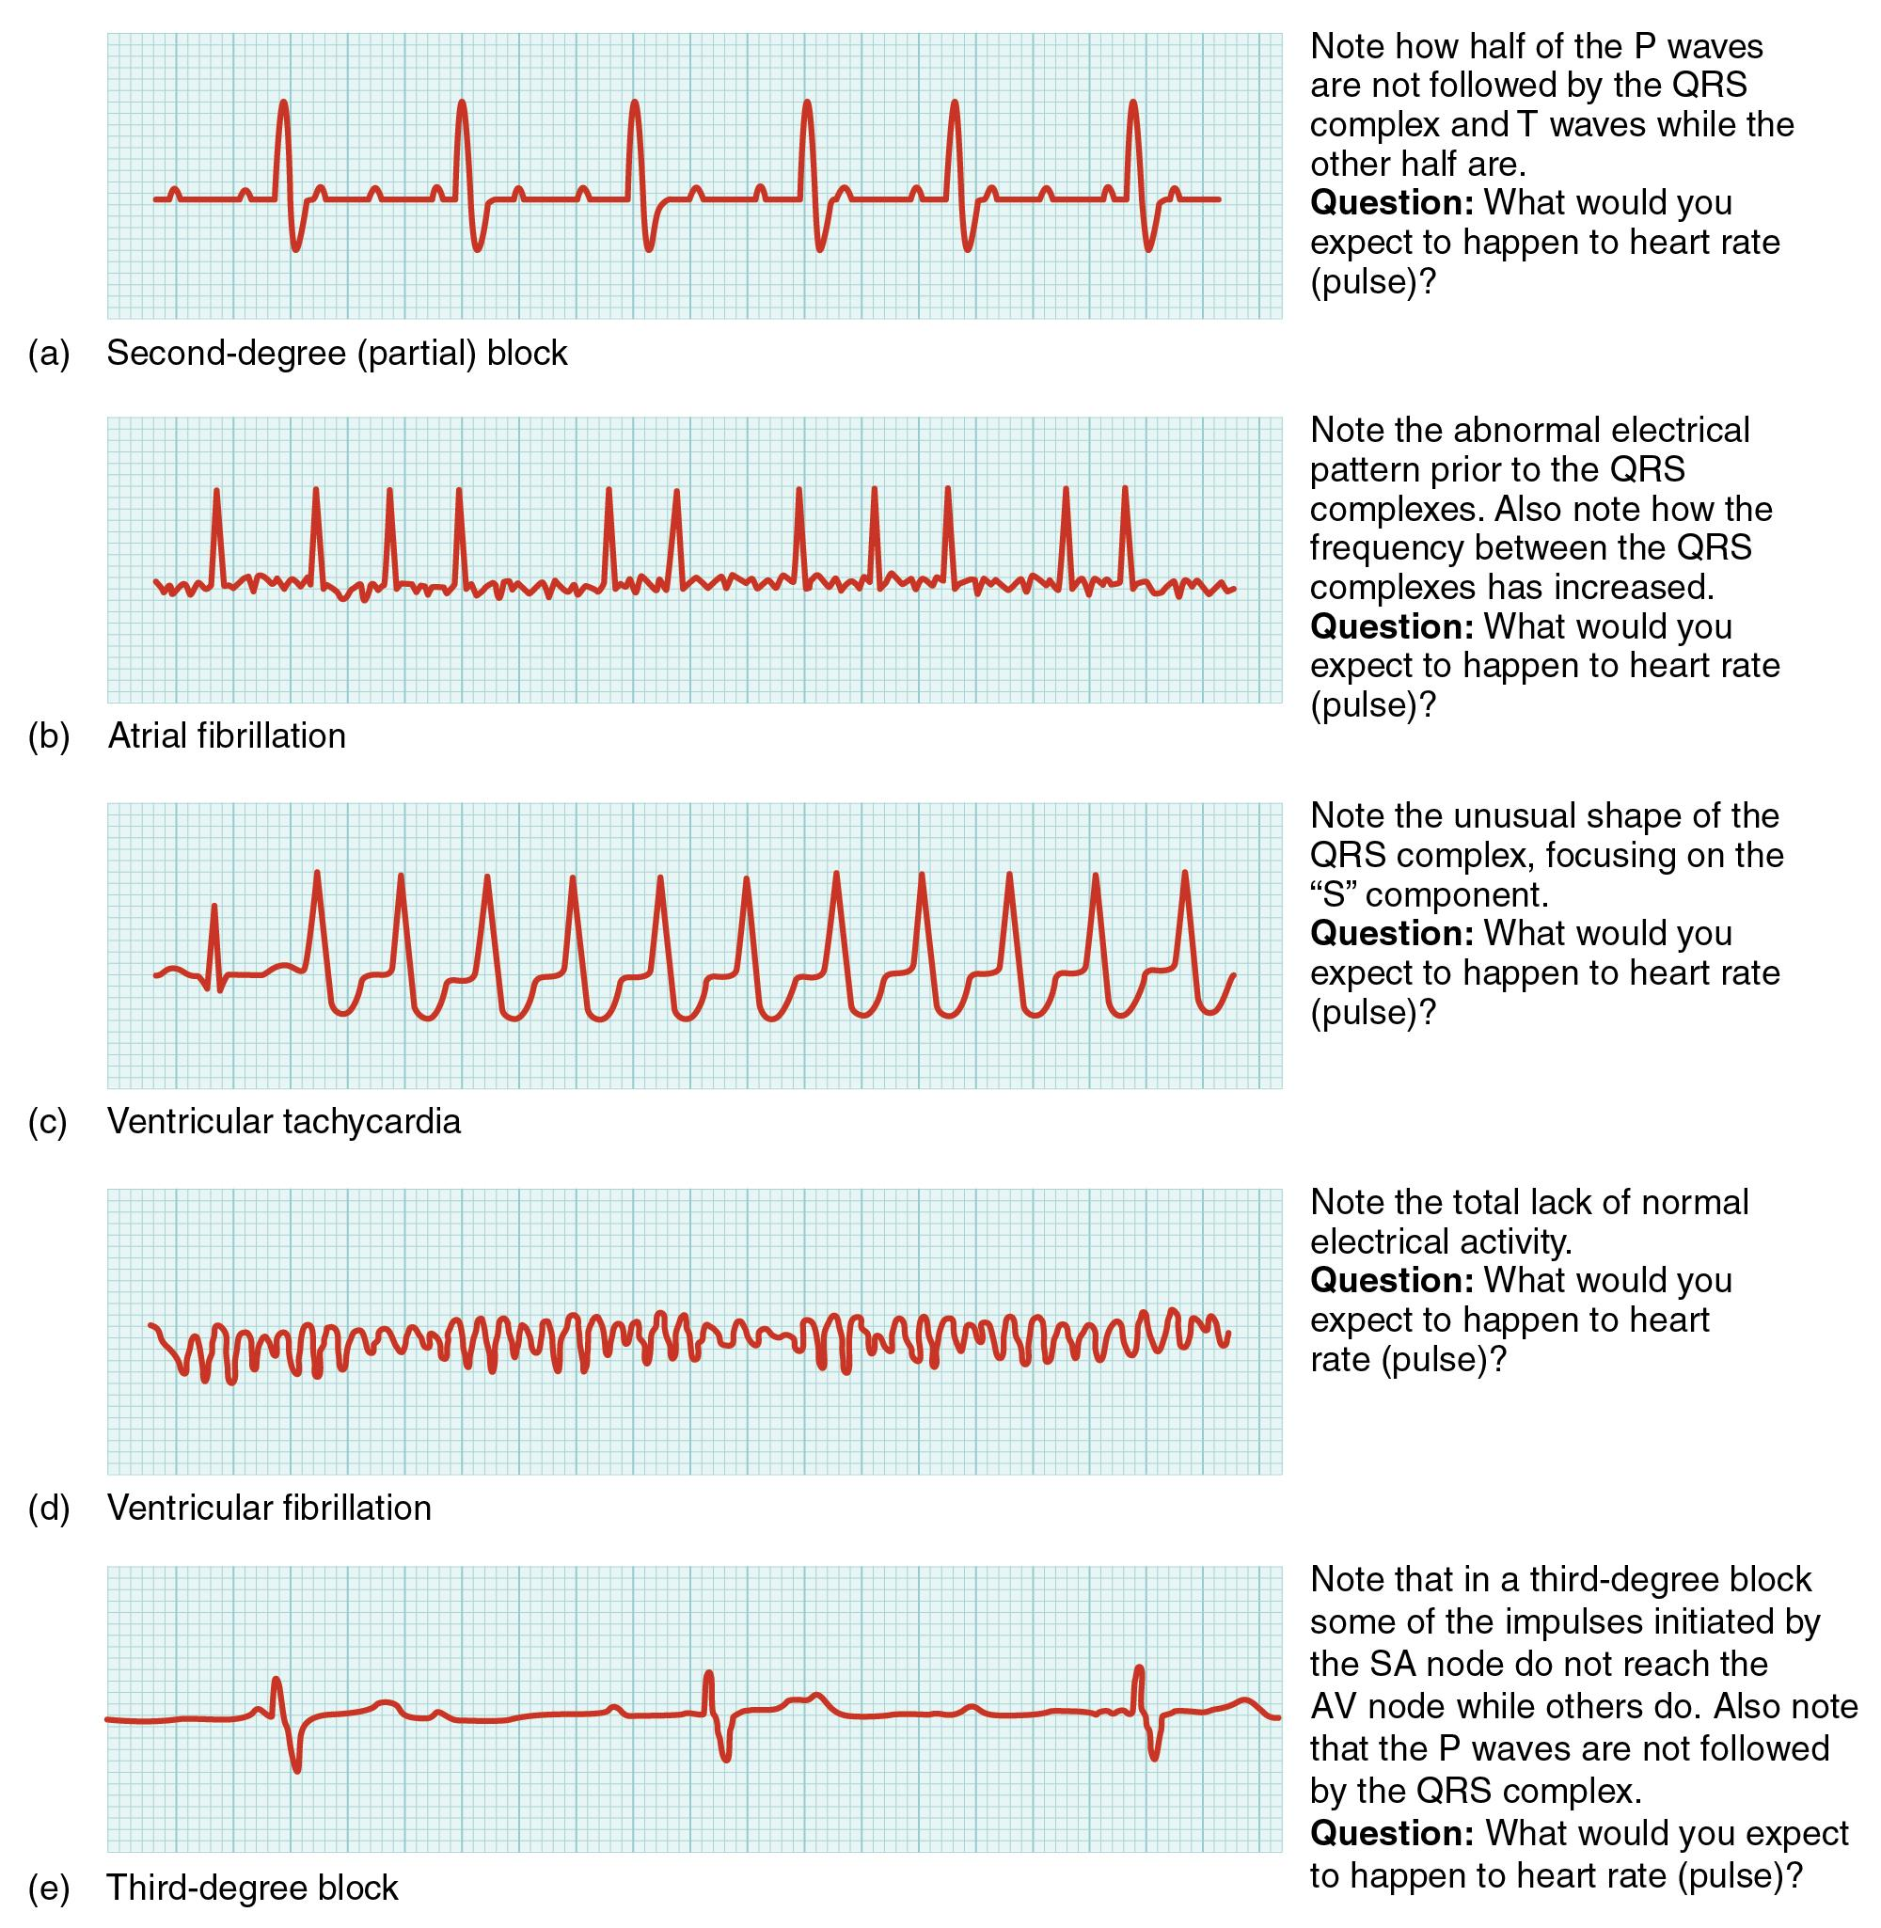
Part III: EKG Analysis and Interpretation

Slide 26
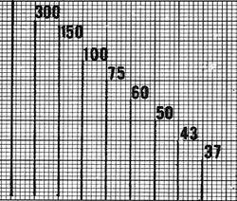
Calculating heart rate on the EKG strip

Slide 27
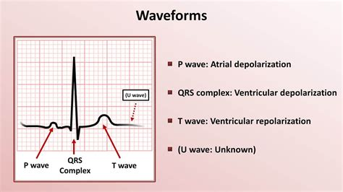
Intervals and waveforms

Slide 28
Resources for EKG interpretation
EKG made simple: https://www.ecgmadesimple.com/tutorials2
EKG flashcard review: https://quizlet.com/88091371/ekg-review-flash-cards/
EKG like a BOSS Part 1 Interpretation: https://www.youtube.com/watch?v=ocWk8zD8ZPk
EKG like BOSS part 2: https://www.youtube.com/watch?v=nfVtAtJpjkQ&t=6s
EKG like a BOSS part 3 abnormal: https://www.youtube.com/watch?v=kVhnNGlgIOU&t=41s
EKG interpretation sheet: https://nurseslabs.com/ekg-interpretation-cheat-sheet/

Slide 29
Arrythmias
Atrial arrhythmias: P wave is visible and upright. In a normal sinus rhythm
SInus brady, Sinus tach, Sinus arrhythmia, and sinus arrest
Atrial arrhythmias: Atrial fibrillation and Atrial Flutter
Junctional rhythms:occurs at the atrial node, p waves will be inverted,
PJC, Junctional escape rhythm, Junctional accelerated rhythm, SVT
Ventricular rhythms: can be urgent and life threatening
PVC, V-tach, V-Fib, Idioventricular rhythm, Agonal, Heart blocks, Bundle Branch Blocks

Slide 30
Heart Blocks:
1st degree: PR interval is >20 sec. Asymptomatic
2nd Degree Type 1: Mobitz I or Wenckebach P wave gets longer until it is absent
2nd degree Type II: Classic heart block or Mobitz II PR interval constant but there will be a P wave by itself
3rd Degree: Complete heart block. No pattern in cardiac cycle as atria and ventricles do not work together.
https://youtu.be/GoN8RyFE3jI

Slide 31
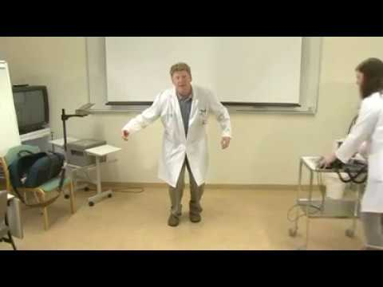
EKG Rhythm Dance

Slide 32
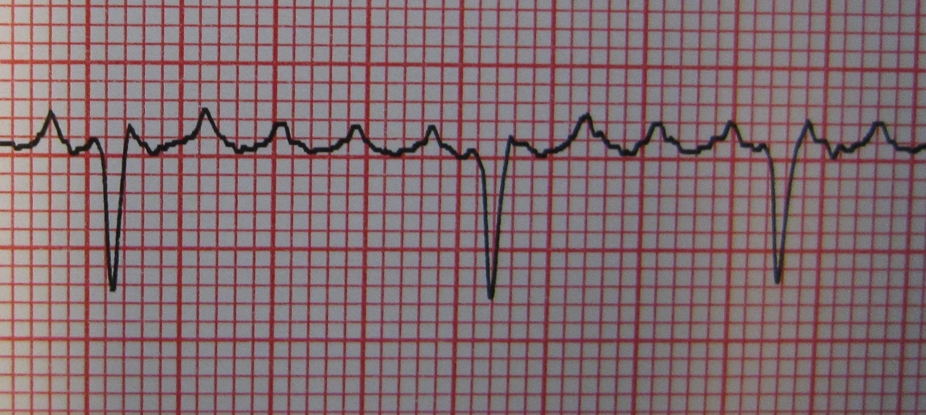
Part III: sample questions
What is this rhythm?
Atrial Flutter

Slide 33
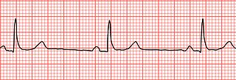
What is this Rhythm?
Sinus Bradycardia

Slide 34
What is this Rhythm?
PVC Bigeminy

Slide 35
What Rhythm is This?
Ventricular Tachycardia

Slide 36
What is this Rhythm?
Second Degree AV block Type II (Mobitz)

Slide 37
Giving students additional certification opportunities
EKG is a part of PCT certification
So why not allow students to test for an EKG certification too?

Slide 38
EKG Certification For Teachers

