Slide 1
Medical Assisting 101
Ensuring your program is successful…

Slide 2
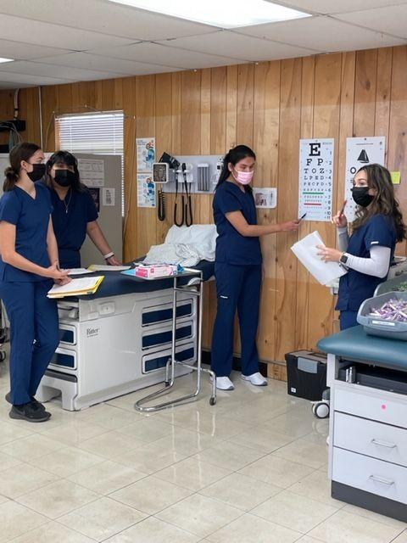
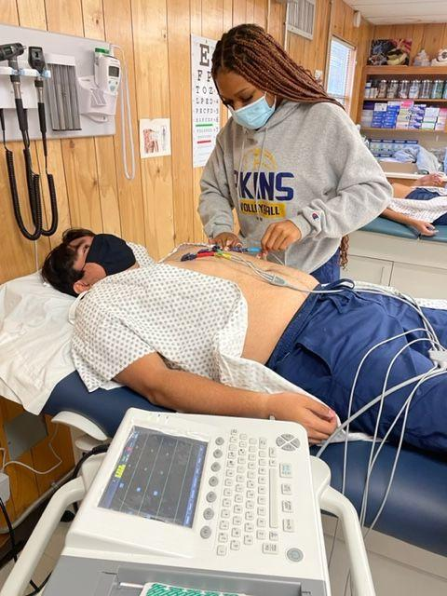
HELLO! I’m…
Jennifer Pittaway
I have been teaching Medical Assisting for the last 16 years (13 post secondary and 3 high school Title 1 school). The last 15 years with 100% pass rate. Prior to teaching I worked as a EMT and medical assistant primarily the in ER and OBGyn. My bachelors is in communications.

Slide 3
TABLE OF CONTENTS.
REMEMBER YOUR WHY
SET CLASS CULTURE
CERT CHOICES
PREPPING FROM DAY 1
CURRICULUM MUST HAVES
COMMUNITY PARTNERS
Let’s be real, it’s not all rainbows and unicorns…
THE MOST IMPORTANT THING YOU DO EVERY YEAR!!
Understand your options and choose what’s best for your STUDENTS.
Study guides,quizlets, kahoots, ect… students should have access from day 1.
The book is thick, what do your students HAVE to know… clinical and theory.
Marketing your program
ILC meetings
Internships

Slide 4
Remember your WHY…
Why are you teaching? Hopefully it wasn’t to become rich and famous… Are you COMMITTED and INVESTED? If you aren’t do not expect your students to be.
Write yourself a letter at the beginning of each year, read at the end. (great activity for students as well)
Set personal goals.
Set goals for your students. SHARE WITH YOUR STUDENTS!

Slide 5
SET CLASS CULTURE
THIS IS EVERYTHING
First week getting to know you activities… DON’T BE BASIC! Find fun activities that other teachers aren’t doing.
Second week GET REAL
Lead4Change.org
https://www.lead4change.org/mydashboard/lessons/12-lesson-track/lesson-1/

Slide 6
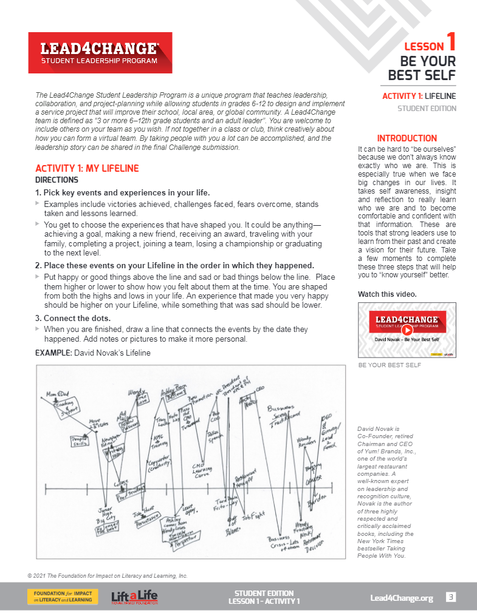
MY LIFELINE ACTIVITY
Students will create a timeline from the time they were born to current. Mapping out significant times highs and lows. They will then answer self reflection questions.
Have your students share with the class. DO NOT RUSH THIS ASSIGNMENT. You need to participate as well and present first. Build trust with your students.

Slide 7
CERT CHOICES
https://tea.texas.gov/sites/default/files/Certified%20Medical%20Assistant%20final%201.pdf
CHOOSE WHAT IS BEST FOR YOUR STUDENTS!

Slide 8
PREP from DAY 1
Give students a study guide or overview of the certification test. They need to have a visual of EVERYTHING they need to know and by when.
Use their cell phones as an advantage utilize apps to have the students engage in learning.
Give a practice test after your getting to know you period to gage your students.
If your program is a full school year, have a practice test before Christmas break. At that point I tell my students they should be able to pass they test, not master but pass.
A month before their certification test, take another practice.
Make sure you are showing the students their progression. Let the students identify what they are struggling with.
Incorporate study time and activities throughout the entire year.

Slide 9
Curriculum MUST HAVES
This is where you section ends. Duplicate this set of slides as many times you need to go over all your sections.

Slide 10
Soft Skills
Professional communication
Patient education
Difficult patients / coworkers
Proper phone and email etiquette
Cultural differences
Medical Concepts
Med Term
Anatomy & Physiology
Medical Specialties for Clinical Setting
Pharmacology
Law & Ethics

Slide 11
Clinical Skills
Vitals
Phlebotomy
Injections
Urinalysis
EKG
Visual Acuity
Sterilization
Finger sticks
Administrative Skills
Scheduling
Coding
Reconciling Statements
Insurance
CMS 1500

Slide 12
COMMUNITY PARTNERS
Market your program to health care entities. Invite them to school events and to your classroom to engage with your students.
Set up and advisory board for your ILC meetings. Great way to have employer input on making your program and students more employable.
GET INTERNSHIPS FOR STUDENTS!!

Slide 13
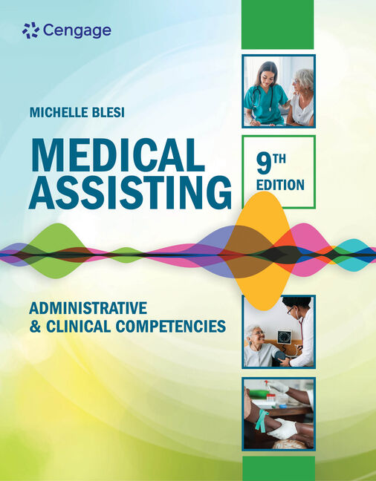
Resource Page
https://quizlet.com/528237706/medical-assistant-pre-assessment-exam-part-1-flash-cards/
https://quizlet.com/581296926/medical-assistant-pre-assessment-part-2-flash-cards/

Slide 14
THANK YOU!
DO YOU HAVE ANY QUESTIONS?
jennifer.pittaway@austinisd.org
(512)653-6281 cell
(512) 841-9868 classroom
https://www.akinseagles.org/apps/pages/index.jsp?uREC_ID=296578&type=d&pREC_ID=684975

