Slide 1
Multiple Certifications in One Year: The Plan, Process and Implementation
https://www.facebook.com/groups/1106562293071566
Bonnie Heinrich, RN, COHN-S/CM
Hutto ISD
Hutto, Texas
Bonnie.heinrich@huttoisd.net

Slide 2
Objectives:
Attendees of this conference will be able to:
Understand the steps needed to create a plan for offering 3 certifications in one school year
Gain knowledge of how to develop the process in order to implement the program
Obtain Year at a Glance with steps of implementation of this program
Learn about obstacles and pitfalls to avoid and how to overcome them
Walk away with activities for the classroom, ready to implement

Slide 3
About Me:
High school: Work-study program as x-ray technician assistant/EKG Technician
After high school: Worked at md office (radiologist) performing billing services then worked as an EKG technician in hospital
In 1989, became Registered Nurse (that is 33 years ago)
Neonatal ICU, Newborn nursery, Med-Surg, ICU, Post-Anesthesia Care, Home Health, Occupational Health, Med-surg Nurse manager, House/Nursing supervisor, Asst DON, Infection Control Nurse, School nurse (sub), Currently: Telephonic Triage Nurse and Health Science Teacher.
Claim to Fame: Traveled to Iraq, Kuwait, Dubai and Afghanistan (along with most of the 50 states) as an occupational health nurse; Hutto High School Teacher of the month December 2018; HISD High School Teacher of the Year 20-21 and HISD District Teacher of the Year 2020-2021

Slide 4
What about You
Turn to your shoulder partner and share for 1 minute each, what you background is and one (or 2) of your “Claims to Fame”

Slide 5
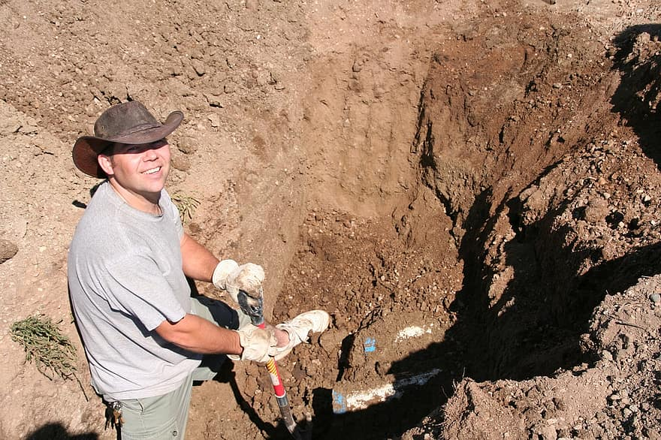
Let’s Dig In!

Slide 6
Why?
Why do more than one certification?
Why do more than two certifications?
You must find out your own “Why?”
But… here is my “Why?”
Notes:
When I first came to Hutto High School, I was hired to teach a CNA program. During the interview, the principal asked me if I could do it. Sure, I said confidently. I used to train the CNA’s at our home health agency and worked with the local nursing homes in providing refresher trainings, etc. He hired me. As we got ready to start the school year, I started researching the CNA program information. Little did I know that I was not qualified to teach the CNA program since I was not directly hired by a nursing home for one year, I even called the CNA certification board to make sure……Plan B (quick, since school starts in a few days)....I found out about CMA and got the information I needed on qualifications and what I needed to teach. I met with parents the week school started and advised them that we would be teaching CMA, not CNA…..shew, they didn’t care. :) Okay, now to get busy preparing. As the school year starts, I see that EKG is part of it. I was an EKG technician for several years before going into nursing. It is part of CMA and there is only a little more detail needed to get the certification, so why not? Same thing with phlebotomy. It’s covered, they need more details, but we can do this….right?? Remember, this is my first year teaching. I also teach multiple classes of Principles of health science. I also have no clinical contracts, we had no equipment or supplies for any of this. Sometimes when I look back, I think….why did I think I could do this?

Slide 7
Create The Plan
Identify your school year, dates, weeks, off times (holidays, teacher inservice dates, mandatory school testing dates, for seniors: senior skip day, senior finals, senior picture day, senior trip, grading periods, etc.
Look at the number of weeks/days of instruction.
Where are the optimal cut-off dates between certifications for each test?
Notes:
You need to set aside a couple of hours to look at your overall school year. Get a blank calendar or put it on a list like I will show you how I did it. But it is not only the holidays, teachers inservice days, you must also put the various days that they will not be in your class for instruction as each and every day is important. The timeline is fast and furious. I initially start by listing the monday of each week of the year from the first week of school until the last week of school. By each week I then look at where are my dates that offer large breaks as I know the students will need to get re-acclimated when they return to school. I know (now) that they rarely use that time to study although I preach it to them to use that time and I have that expectation given to them but I don’t count on it to myself.
So let’s take a look at how I initially set this up.

Slide 8
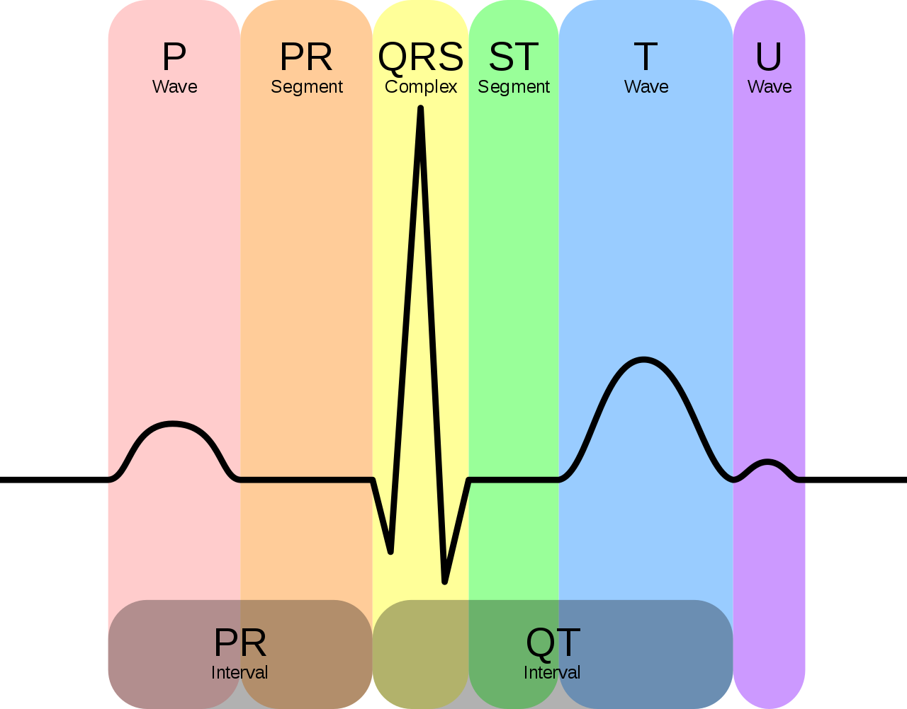
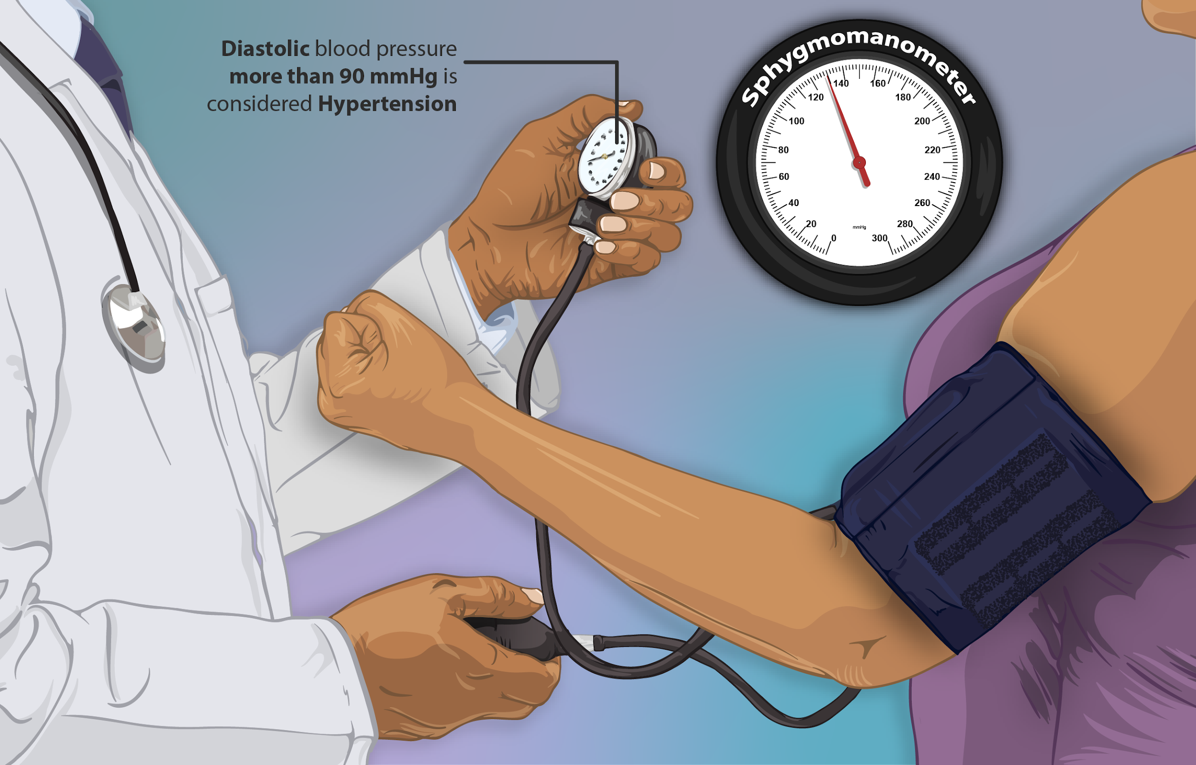
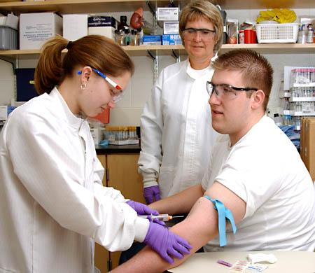
We Offer 3 Certifications
Clinical Medical Assistant
EKG Technician
Phlebotomy Technician
Notes:
We, at Hutto ISD for our CMA class, offer 3 certifications within that course. We also offer other Health Science certifications at the High school (Pharmacy and EMT), but these 3 are embedded in the CMA program. You can offer just CCMA, or combine CMA with one of the others (EKG or Phlebotomy) or do all 3. Today, I will show you how we do all 3.

Slide 9
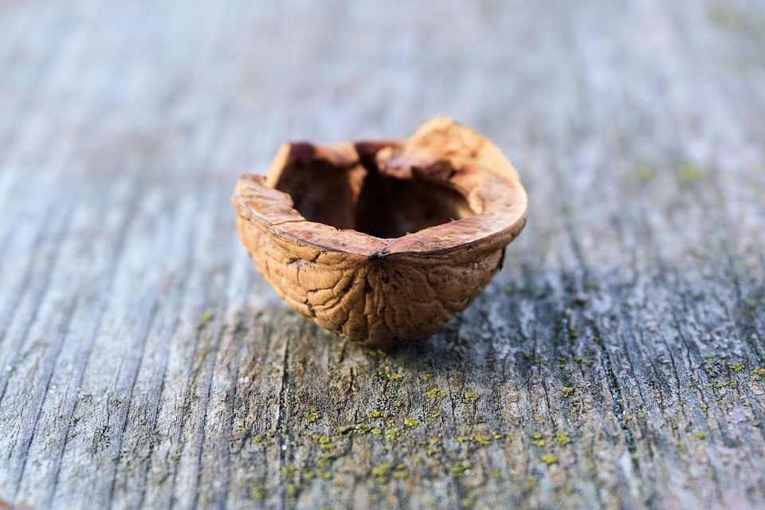
Our Timeline in a Nutshell
CMA- One module a week for 17 weeks; 3 weeks of review
National Exam taken last week of January
EKG- One module a week for 3 weeks; 1 week of review
National Exam taken week before spring break (March)
Phlebotomy- One module/week for 7 wks; 1 wk of review
National Exam taken 1st week of May
Notes:
This is the way that we have set up our timeline. Each school/program should set it up with what is best for the students and their success in coordination with the other education requirements the students must meet ie: testing, holidays, senior requirements, etc.

Slide 10
Step 1 - Year at a Glance
Please make a copy for your own use:
https://docs.google.com/spreadsheets/d/1A-HvO5a459P7qctlamgqdJg4dWc-86zsNEb49pZtfWU/edit?usp=sharing

Slide 11
Step 2- Year at a glance
Please make a copy for your own use:
https://docs.google.com/spreadsheets/d/1-z_wGvZCFo-IgINHuJ8kUZ2qvUJ1xAJ2iKu_nhRAVCg/edit?usp=sharing

Slide 12
Student Expectations
Minimum of 3 hours of NHA time EVERY week (even when we are off for long breaks) outside of class time. Optimally prior to start of next module
Grades are taken on the 3 hours required (usually do an average)
Highly recommend that students NOT work a job outside of school and athletics. If they MUST work to help the family, they need to schedule their NHA time accordingly
Must Pass Pre-test with a 75. If 75 is not obtained, they are required to attend tutorials on the weekend before the exam (they know this date ahead of time).
Let student know that if they are not meeting expectations, parents are notified!

Slide 13
Student Expectations (continued)
This is a college class. They do get college credit through the NHA program
Treated as a colleague or peer as long as they continue to learn and stay engaged. When they stop doing that, they become students again.
They are medical professionals and they need to start thinking of themselves as such, acting as such all of the time
If commit to a clinic assignment, they are required to attend
Must invite friends and family for their 30 venipunctures

Slide 14
Obstacles

Slide 15
Obstacles Encountered
Parent communications
Students not preparing ahead of time
Keeping students engaged during class
Senioritis
Obtaining required venipunctures
Clinical rotations

Slide 16
Parent Meetings/Letters
If possible, a meeting in person is optimal during first couple of weeks of school
Send out minutes of meeting to all parents (I have this typed ahead of time so that I go over everything in the letter that I will be sending out).
Parents are advised of:
Professionalism (HIPAA, phones in class/clinicals, reasons for dismissal)
Hygiene (nail care and hair)
Scrubs (provided), shoes (closed-toe, rubber soled, must have a back, student provides)
Supplies (stethoscope-optional to purchase for a group price of approx. $10)
Optional student book from NHA, encouraged for all but especially helpful for those needing extra help
Transportation is required by parent/student for clinical rotations
Students need support during “Friends and Family Night”

Slide 17
Students not preparing ahead of time
Students might start off okay, but this quickly fades. :)
Students are required to have 3 hours of NHA time each week
This breaks down to 30 minutes a day!!
Initially I take it as a grade each week
Then, as I have more grades to take and they are accustomed to doing the work, I take a grade every other week and look to see if, on average, they have 3 hours
Students must complete the Digital Interactive Notebook prior to the exam
Students will complain that the 3 hours and digital notebook are too much….however, if they complete the interactive notebook they’ll almost have their 3 hours of NHA time
Students must take the quiz at the end of the NHA modules
Again, by doing this, it helps them get the 3 NHA hours each week

Slide 18
How to Keep Students Focused?
First: It is tough, it is stringent, and the students have to want it or want to please you or their parents
Second: Expectations have to be set at the beginning of the year not only with the students but with a parent meeting
Third: Send frequent updates to parents, the good news and the “I need help”

Slide 19
A Week at a Glance prior to start of clinicals…
Monday- Introduction to the assigned module: Discussion/powerpoint/videos
Tuesday- Continue with discussion/powerpoint/videos. Create flashcards
Wednesday- Activity related to topic (ie: Nearpod, stations, patient scenarios, matching game, Simon Says, etc.)
Thursday- Speed drill (students use their flashcards to drill each other) Blooket/Quizlet
Friday- Exam (or if no exam, they use this time for “NHA time”). Quiz at the end of each NHA module is required to be completed.

Slide 20
A Week at a Glance after start of clinicals…
Monday- Discussion of the assigned module: Discussion/powerpoint/videos
Tuesday- Clinical/NHA and Interactive Notebook time
Wednesday- Clinical/NHA and Interactive Notebook time
Thursday- Speed drill (students use their flashcards to drill each other)
Discussion and then activity
Friday- Exam (or if no exam, Blooket or Quizlet over content). Quiz at the end of each NHA module is required to be completed.

Slide 21
How Do We Do Clinicals?
Students go to clinicals every other week on Tuesdays and Wednesdays
There are 2 “shifts”; 8 am-11:30 or 1:00-4:30
Allowed 1.5 hours to drive to/from clinical and have lunch
Clinicals start in January and end first of May
Students must be passing all other classes
Students miss 2 of their classes 4 x month for 4 months

Slide 22
Activities

Slide 23
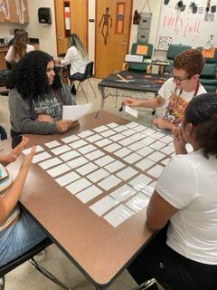
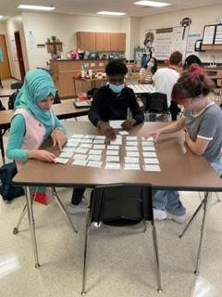
Matching game

Slide 24
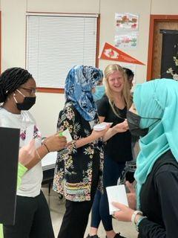
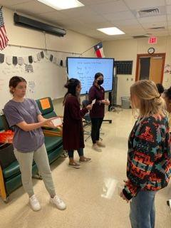
Speed Drill: 30 seconds or 1 minute- Rotate

Slide 25
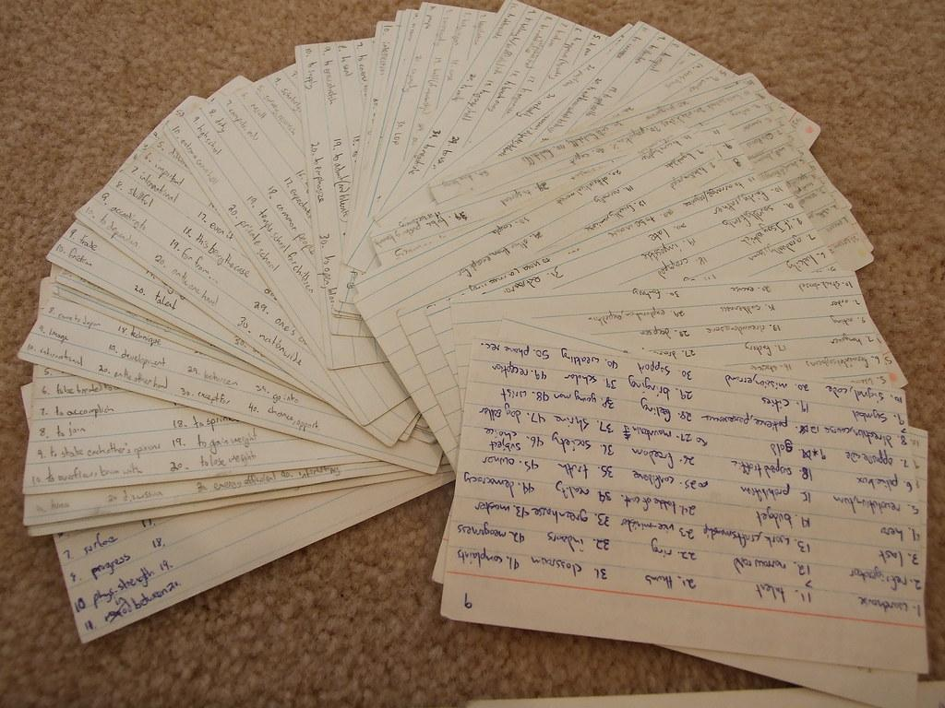
Speed Drill Activity: 15 minutes

Slide 26
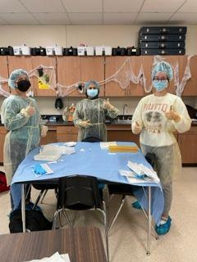
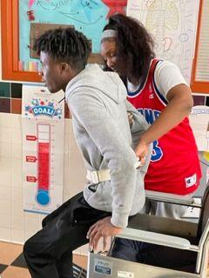
Donning/Doffing and Gait Belt Training

Slide 27
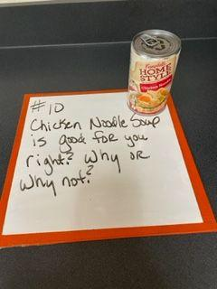
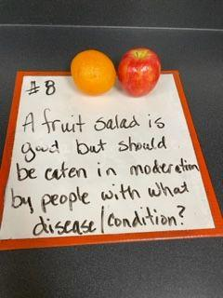
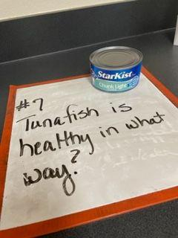
Nutrition Station
Notes:
We had nutrition stations but then they also had to put that to use on their own.
Each table was given various foods (about 3-5 items). They had to create a menu out of it and then tell the class the nutritional value of that meal.

Slide 28
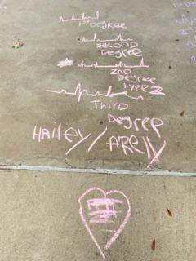
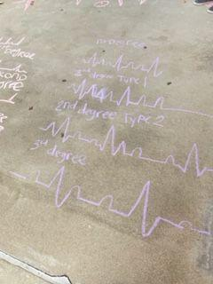
Heart Block Chalk

Slide 29
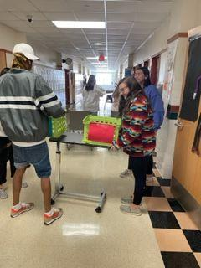
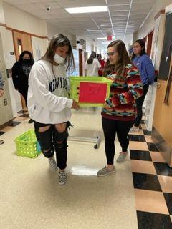
Proper Lifting

Slide 30
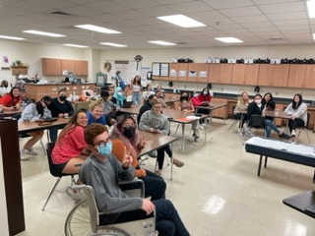
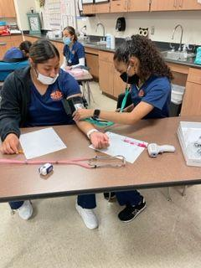
Tutorials and Vital Sign Assessments

Slide 31
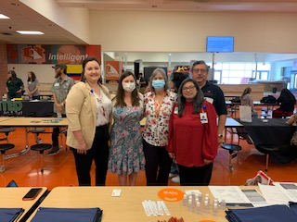
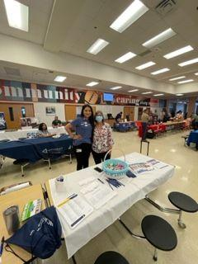
Job Fair

Slide 32
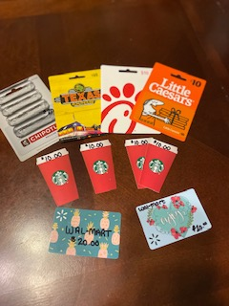
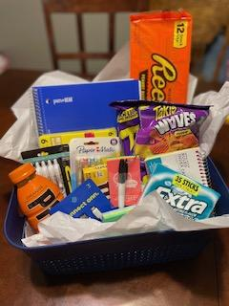
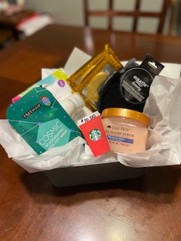
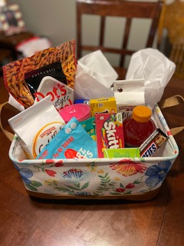
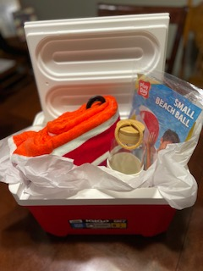
Phlebotomy Prizes

Slide 33
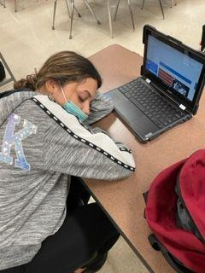
Sleep Deprivation: Occasionally Grace is needed

Slide 34
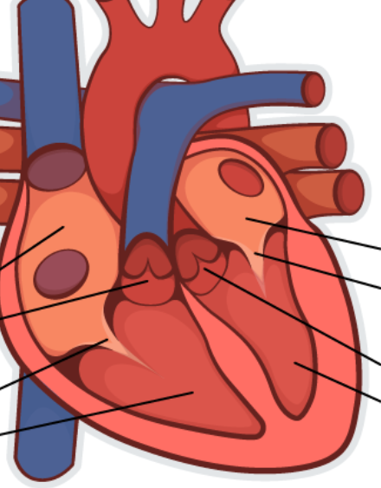
Digital Interactive Notebook
One for each certification
Forces students to look at the objectives, find it in the material read it and then write it down.
Grades are taken on completion of notebook for the assigned modules prior to exam.
https://docs.google.com/presentation/d/1JRKTaAyhhG_lEJnr0Xv6ccFbru_XwhJuDMgFHW3CaVM/edit?usp=sharing

Slide 35
EKG Interpretation
Please make a copy for your own use:
https://docs.google.com/presentation/d/1pfrW4rSp4XR5ZhpJ8Q4Iue9HLRakwLfnlZjKqMP_OZk/edit?usp=sharing

Slide 36
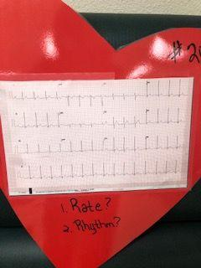
EKG Activity

Slide 37
EKG Class Notes
Please make a copy for your own use:
https://docs.google.com/document/d/1QetRJBChMUkvFFK6URELuJ6-W8lSHoV368bjJV_ucQI/edit?usp=sharing

Slide 38
EKG Pitfalls
This is usually my highest successful certification exam!
Each student must perform 10 EKG’s
Students are initially shy and hesitant to touch the patient's chest
Students must provide privacy for their patient; however, that means that you must be in the room with them or in your classroom with the other students

Slide 39
Phlebotomy Digital Interactive Notebook
Please make a copy for your own use:
https://docs.google.com/presentation/d/1I5P6GFnCLEsTXC1w120kCqDhdFY1qkohrxDILBdEIhQ/edit?usp=sharing

Slide 40
Stations Activity: 30 minutes
Examples of stations set around the room:
CMA
EKG
Phlebotomy

Slide 41
Pitfalls of Phlebotomy
Each student must perform 30 successful venipunctures and 10 capillary sticks
MAKE SURE:
Blood and body fluid exposure policy is reviewed and up-to-date
All students and visitors sign in
Release form is signed
Students understand the significance of blood leaving the room

Slide 43
THANK YOU
https://www.facebook.com/groups/1106562293071566
Bonnie Heinrich, RN, COHN-S/CM
Hutto ISD
Hutto, Texas
Bonnie.heinrich@huttoisd.net

