Slide 1
Effective Praise
Lori Powell RN, MSN Educator
THOA Conference 2022

Slide 2
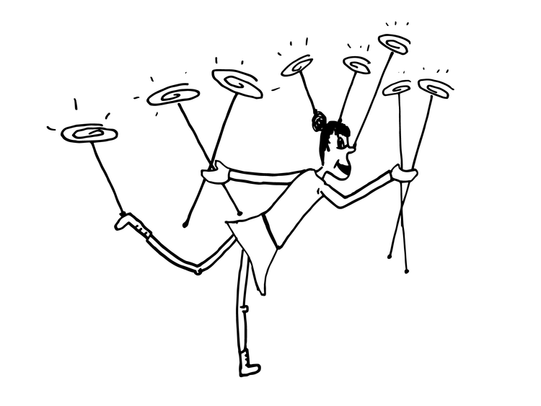
Adding one more…
Doing a million things all at once well is hard…
We call it our passion
Others call it education
Motivation of students is but one SLIVER of a spinning plate
Effective praise of students is contained within that SLIVER

Slide 3
Praise is broadly endorsed as a strengthening technique because it is without cost and can offer inspiration and improved confidence. (Durwin-Reese-Weber, 2021)

Slide 4
Age Matters
< 7 yoa Praise =
Satisfying Authority
Value praise with awareness of correlation with obedience/scholarly accomplishment

Slide 5
Age Matters 2
HS-Praise = signal of minimal ability
Effective praise in JH/HS requires
Genuine
Detailed
Required to be on level with student’s competency
REFRAIN from praising
Effort
Labor
Simple assignments

Slide 6
Special Student Populations
Students with outside point of control are more amenable to praise
These students GAIN in the classroom from praise
Lower achieving students
Low socioeconomic backgrounds

Slide 7
The Unexpected
Unexpected feedback truly have accomplished something worthwhile
Praise can enrich OR destabilize internal motivation of students
Positive or Negative Impact depends on:
Kind
Method of delivers
How it is perceived

Slide 8
Sub-Categories
Process praise
Method used to complete something
Applies to all ages
Cultivates intrinsic motivation
Cultivates intrinsic sentiments of competence
Adolescents require process praise to be specific

Slide 9
Sub-Categories2
Person Praise
Affirmations of one’s traits or actions
Not specific
Considered to be controlling
May be detrimental to intrinsic motivation
Evade difficult assignments
Learned helplessness associated with repeated failures
Feelings of shame, poor self-worth and lack of control for failing

Slide 10
Sub-Categories 3
Outcome or Performance Praise
Prevue of a result
Informational feedback
Gives direction for what to repeat
Details what to modify in future assignments
Intrinsic motivation enhances constructive feedback
Specific
Supportively articulate

Slide 11
Positive for Most
Understanding students helps to implement effective praise techniques and approaches
Lower achieving students and low socioeconomic backgrounds are apt to gain in classroom
Students who are more likely to be disappointed educationally may decipher teacher praise as more significant

Slide 12
Conditioned reinforcer
Multiple reinforcers > singular approaches
Behavior specific praise is effective
For student motivation
For classroom management
Adding gestures synergistic
Greatest impact diverse, unique
for self-esteem and classwork

Slide 13
Diverse Approaches
Electronic prompting
Tactile responses
Use of technology
Whether face to face or remote, benefits of praise more positive impact than rewards

Slide 14
Giving is Receiving
Increasing student motivation has impact on teachers
Negative impact occurs on praise-r & praise-ee when praise is policy and response along with circumstances is mandated
Genuine, detailed and innately personal praise is critical for both students and those offering the praise

Slide 15
Do this…
1. Ensure praise is sincere and bears credibility with students
2. Ensure there is careful application considering
timing
Circumstances
student dynamics
setting
3. Rather than applaud completion generically, consider saying something like the task is too easy and offer a more challenging one…which means the teacher values challenging tasks that require effort

Slide 16
& do this…
4. Give praise that is condition on behavior to be reinforced
5. Be better than average (10%)
6. Be consistent
7. Jointly creating short- and long-term goals breeds positive results
8. Provide opportunity for peer recognition

Slide 17
& this…
9. Value in setting an environment that exudes
Enthusiasm
Motivations
Competency
Flexibility
Creativity
Light-hearted
Empathy

Slide 18
Don’t do this…
Don’t praise easy tasks
Breeds negative impact
Opposes intrinsic motivation
Don’t praise speed and ease of completing tasks/assignments
Don’t praise incorrect responses equally to correct responses
Discredits genuine praise
Abstain from using personal praise
Damaging to intrinsic motivation
Withhold praise of talent rather than effort

Slide 19
Final thoughts…
Praise has benefits…for everyone
Types of praise to be used varies
Effective praise requires a savvy praise provider
Timing is important
Best Synergy: Verbal + Tactile + Other Forms
Praise specific and unique to each student individually
We can develop this knowledge and skill…a most worthwhile GOAL

Slide 20
Finally...& Thanks
Presentation found in Conference Portal

Slide 21
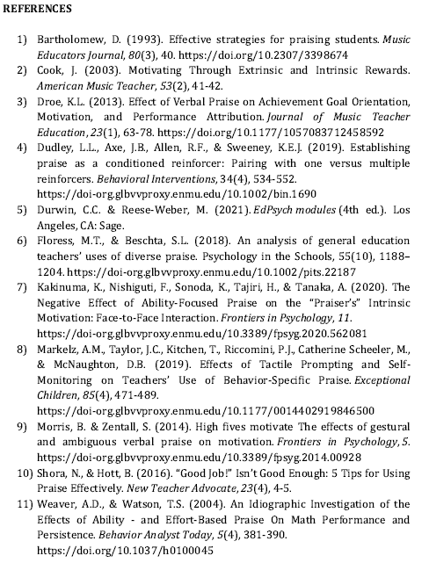
In case you are interested…

