Slide 1
Disruptive Teaching Methods Mass Casualty simulations and disaster drills
Presented by: Kristen Tamez, MSN, RN, DNP-October 2024
Senior Director Nursing Services

Slide 2
Disruptive Innovation
What is disruptive innovation?
Notes:
What is disruptive innovation?
Nurses are trained throughout nursing school to develop their critical thinking and clinical judgement skills.
It’s imperative for nursing leaders to thoughtfully consider how we deliver care. Innovations can foster efficiencies in the day-to-day work of clinical nurses and promote effectiveness in meeting patient outcomes. What does that mean for education? How can we expand our students’ critical thinking and judgement skills. We must develop new ways, thinking outside the box.
Ask: What have you done?
What did you learn?
How was it received by your partner or University?
What was the student feedback?

Slide 3
Why include disaster drills
Improve preparedness
Hone and refine responses
Validate plans
Develop responses
Unlock critical thinking and clinical judgment skills
Notes:
"I've been through two bad hurricanes on Team A (Tampa). The hospital is a ghost town during the storm. Be prepared for chaos once it passes. You will get a lot of clean up injuries, people who need dialysis, oxygen dependent pts who don't have electricity or back up tanks, plus people who don't have AC and no place to go. Nursing homes will start sending you residents if they don't have electricity.
Why should we do these drills? Think about the first time you do something. How does your response look? Is there room for improvement?
Simulated emergency drills are essential components of any robust emergency preparedness framework (7). They aim to be part of a continuous cycle that includes planning, training, practicing, identifying weaknesses, improving areas, and implementing corrective actions. emergency drills are by no means a simple repetition of past emergency practices. They emphasize the exploration of standardized emergency response or the simulation of “worst-case scenarios” (9). Furthermore, drills are training, which emphasizes “scenario-driven, role-playing, teaching interaction, and joint evaluation (10).” Zhuge et at., 2024.
“Health care personnel training and education are essential for successful disaster responses.” (Winters et al. 2022) In a study by Currie & Heslop (2022) 140 nursing students were surveyed after participating in a mass casualty simulation. 94% of the students surveyed indicated they learned something from the simulation, and an amazing 85.5% reported that their participation in the simulation changed the way they would approach future practice (Currie & Heslop, 2022). This presentation will suggest how to successfully leverage community resources and providers to plan and implement a mass casualty simulation to offer a real-world simulation for tragic and unplanned situations, as well as large scale disasters.

Slide 4
Mapping to BSN essentials
Domain 2:
2.3 b, c, e, f
2.4 a, b, c, e
2.5a
2.9 a, b, c, e
Domain 3:
3.2 a, b
3.6 a, c
Domain 6:
6.2 a, b, c, d
6.3 a, b, c
6.4d
Notes:
While there is no substitute for real-life events to develop the ability to respond in an expedited and accurate manner to high-stress situations, simulation comes very close. Nursing programs have utilized high-fidelity simulations to address the need for highly trained nurses. Our world is constantly changing and the ability to respond to high-stress situations is crucial.
On October 26, 2023, the University of St. Thomas’s ABSN program partnered with multiple local, state, and federal agencies in a large-scale, no-notice drill. The agencies included local EMS, hospital systems, fire departments, police departments, Homeland Security, Texas Rangers, Texas Department of Public Safety, and the FBI.
More than 100 students portrayed victims and nurses in a terroristic attack, spanning the entire state of Texas. 4 drills were held simultaneously across the state. Not only was there an active shooter, but also suspicious bags were left, requiring bomb squads and SWAT.
The students reported the simulated experience was eye-opening on what happens in a real-world situation and how to successfully leverage community resources and providers to plan and implement a mass casualty simulation to offer a real-world simulation for tragic and unplanned situations, as well as large-scale disasters.
In April 2024 we performed a hurricane response drill, while in August, we again partnered in a large venue fire scenario.

Slide 5
Planning your simulation
Determine the scenario
Identify roles and ratios of participants
Research injuries and treatments
Resources/ requirements/supplies
Notes:
So how do you plan your simulation?
Just as in a traditional high-fidelity simulation, you’ll gather the information and tools necessary to facilitate the simulation, roles, tools, care plan, and determine the objectives, goals, and structure of the simulation.
Factors, such as how many students, faculty, and support staff you’ll have will help determine how many “nurses” will be assigned, as well as how many of the various acuity levels of patients you utilize.

Slide 6
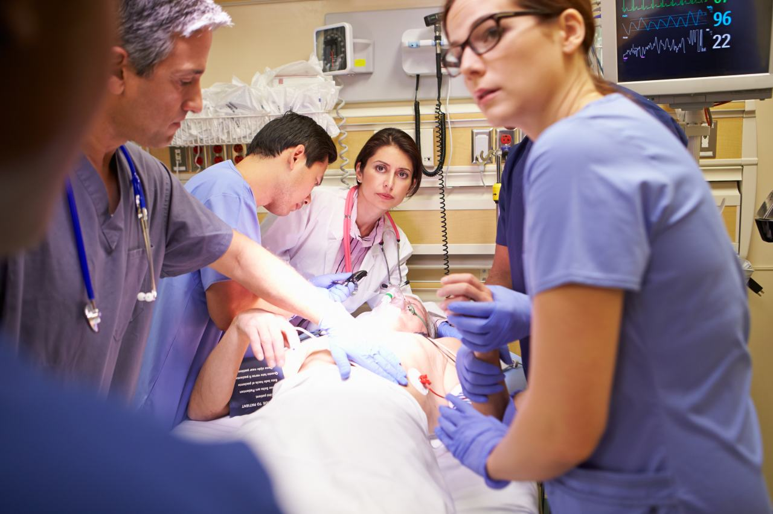
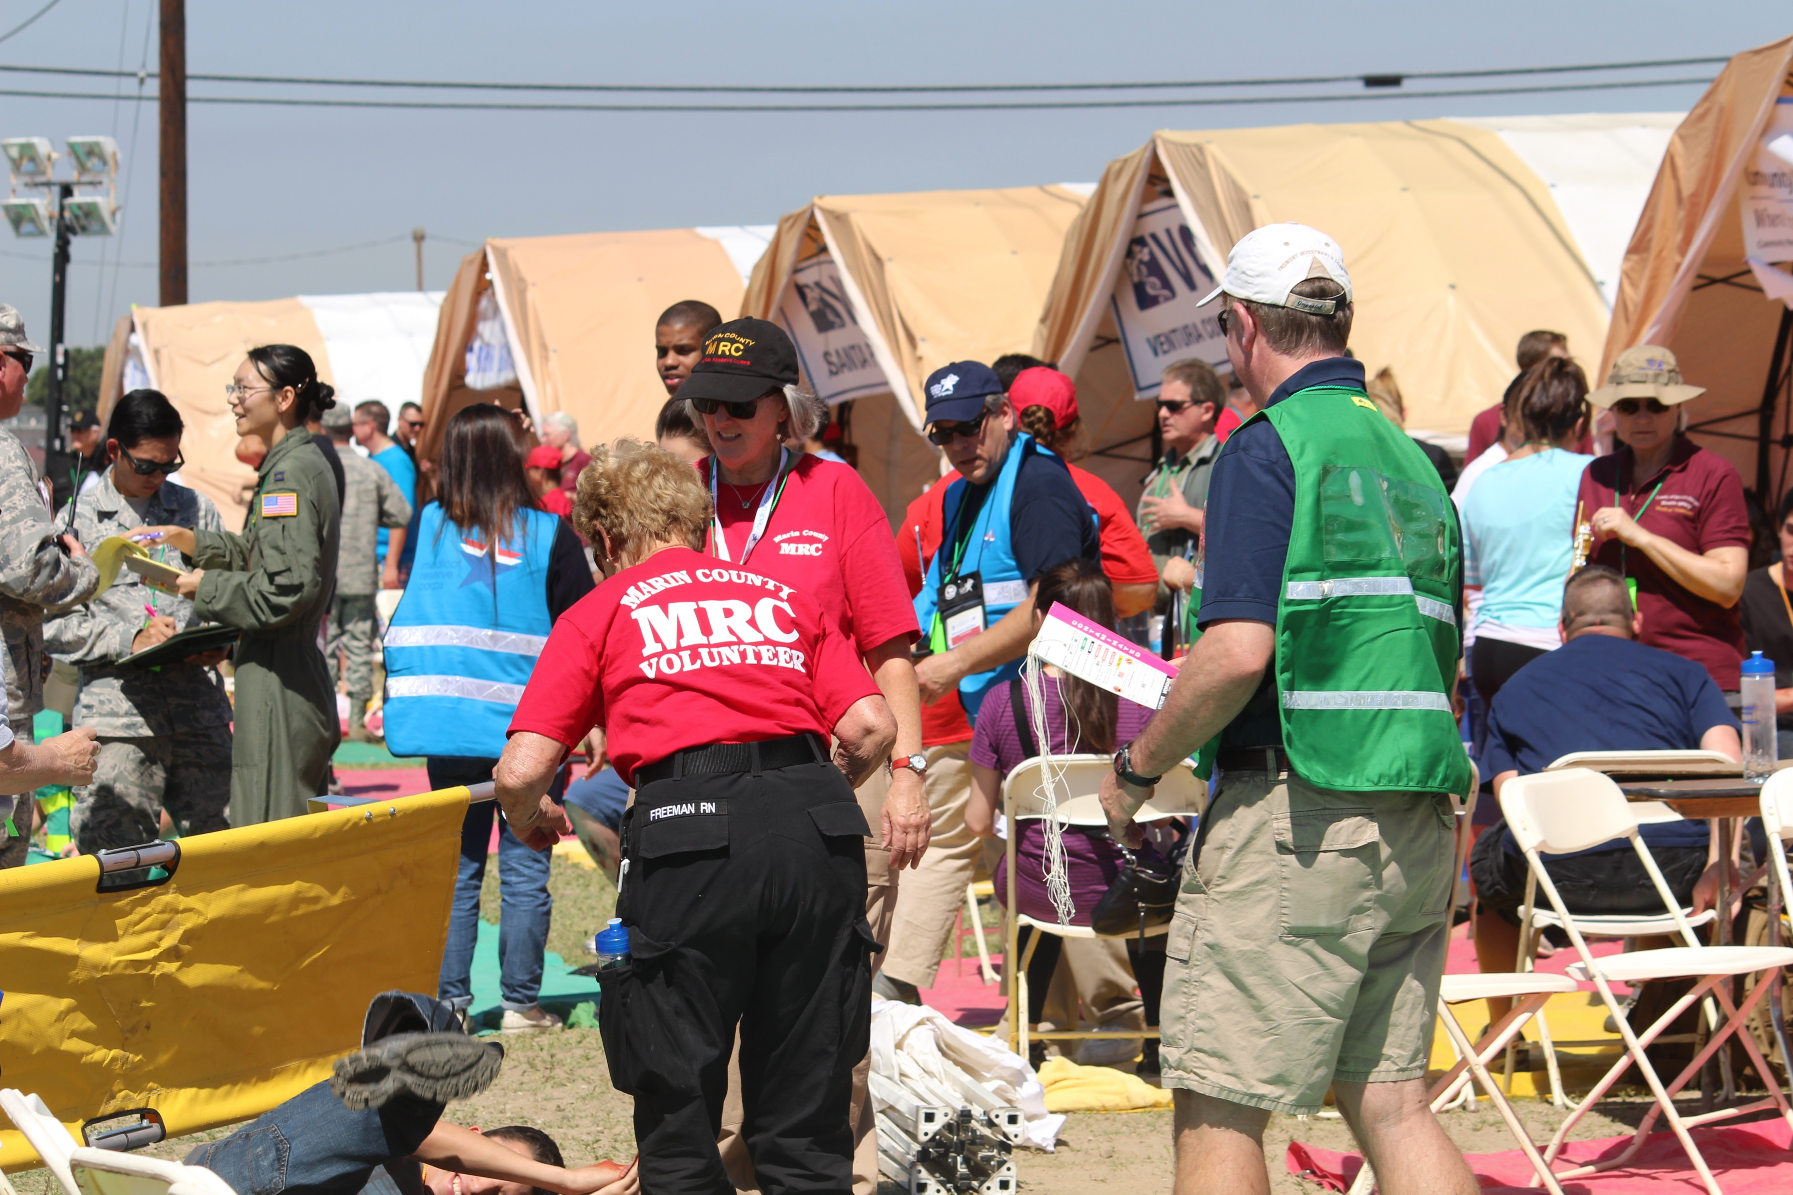
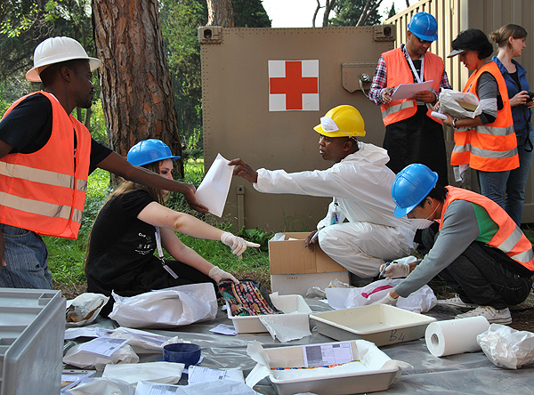
Scenarios
What’s your disaster?
Natural
Man-made
Notes:
There are many options to choose from. You can rotate between the various types of scenarios, such as a natural disaster or a man-made situation. In the three years we’ve been offering the simulation, we’ve varied the scenario each time. We’ve participated in: gas explosion, multi-vehicle bus crash, tornado, chemical spill at water park, active shooter, high-school wide drug overdose, and hurricane is in two weeks. In the early planning stages are: train wreck, plane crash, riot, structure collapse, and earthquake. Although we don’t typically have earthquakes in Houston, our students are from all over the country and may return to places such a California where it is more frequent. Ironically, or maybe providentially, when we held our active shooter drill, the literal night before there was an active shooter in Maine who killed several people and injured many others. We did our hurricane scenario in April, and in May we dealt with the Derecho and July was our first hurricane of the season. You just never know when these will be needed.

Slide 7
Natural Disasters
Hurricane
Tornado
Earthquake
Flooding
Blizzard/Freeze
Fire
Notes:
Some options to consider for natural disasters would include the above topics. Take hurricane for example. Think about what happens during a hurricane. You have high winds, storm surge, rivers run out of their banks due to excessive rain. If the rivers run out of their banks, it brings not only water, but everything IN that water up into areas it doesn’t belong. Things like snakes, chemicals, insects, fallen trees, trash, alligators.

Slide 8
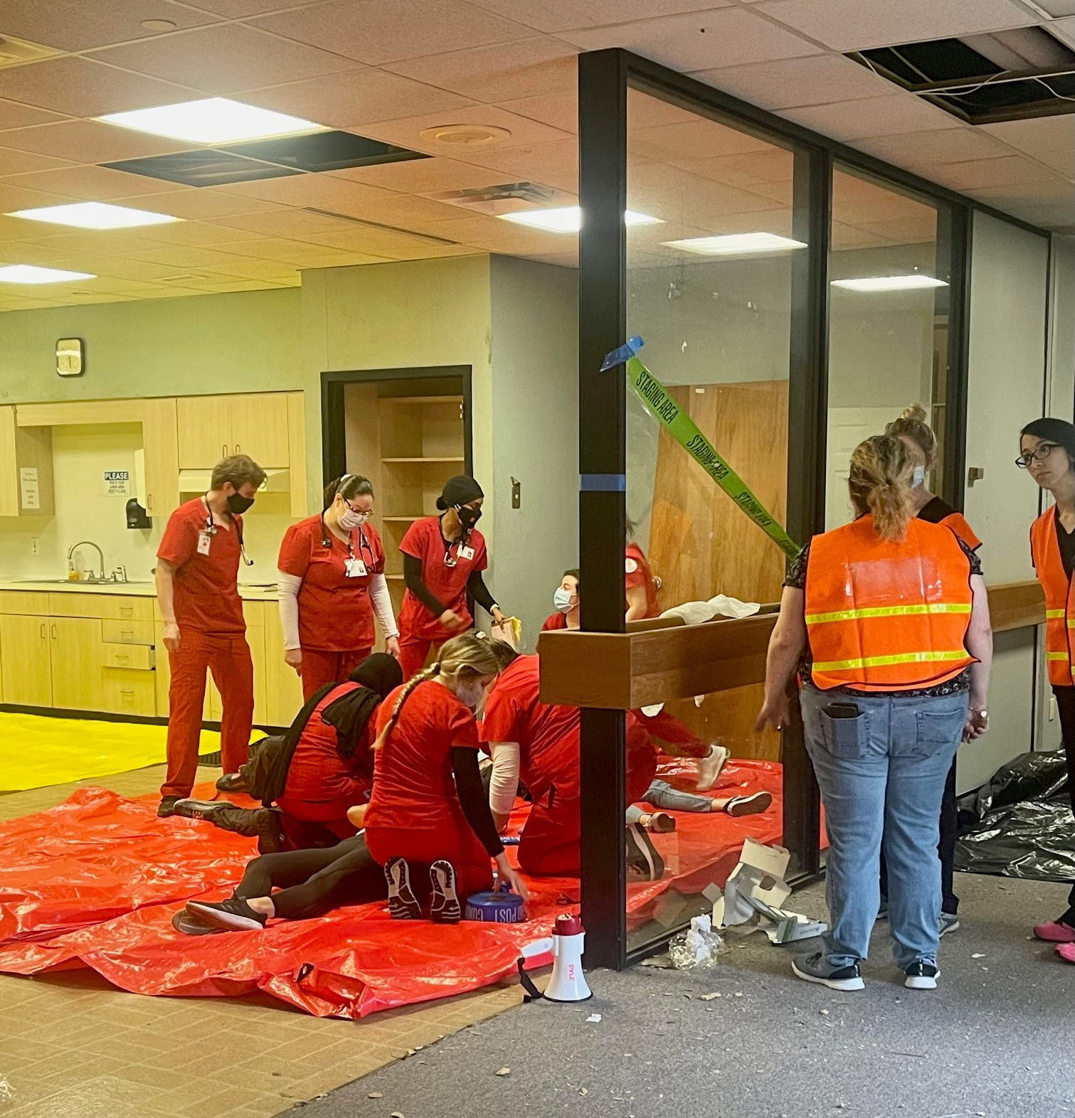
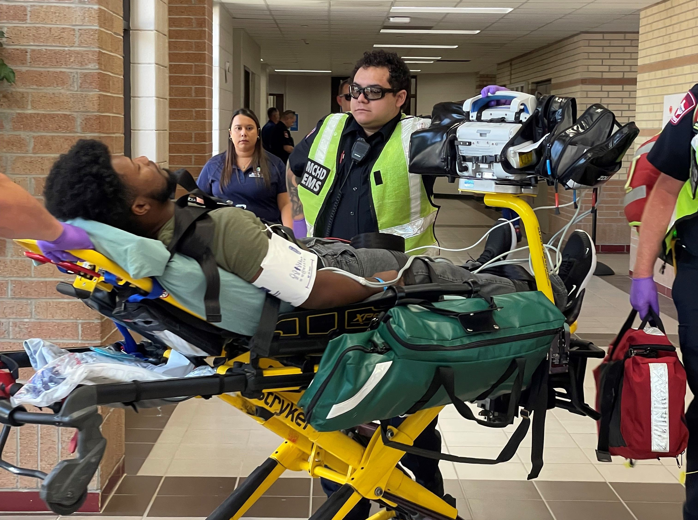
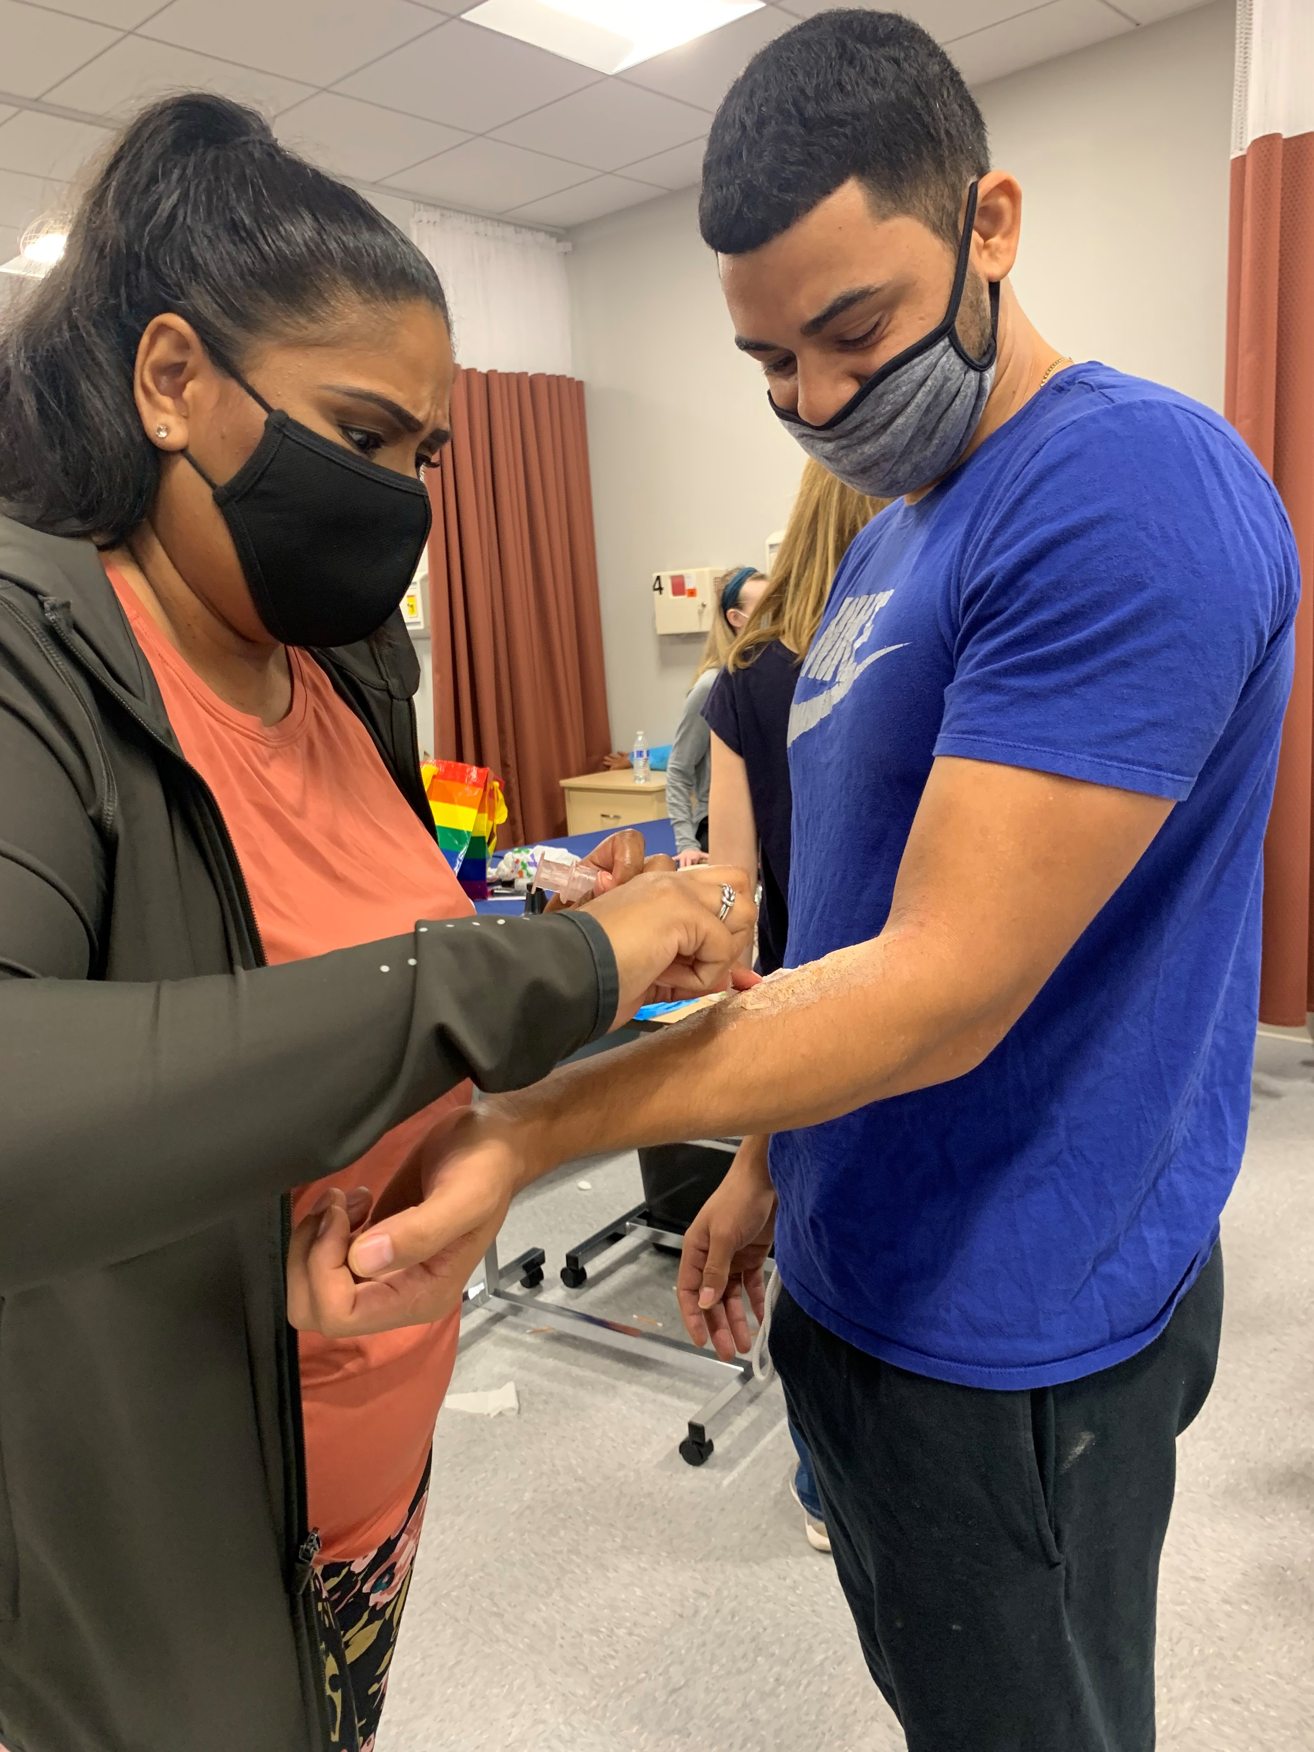
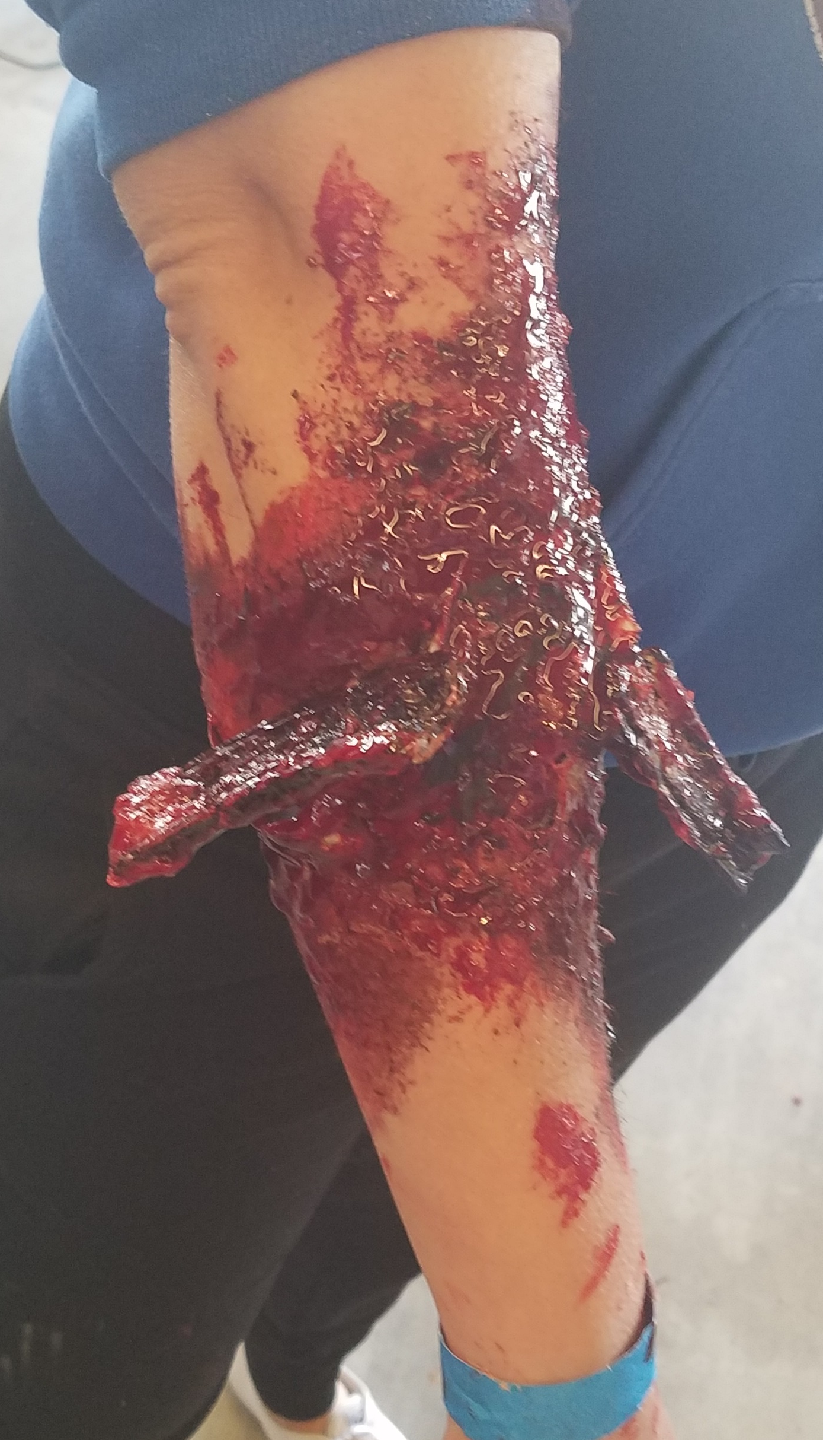
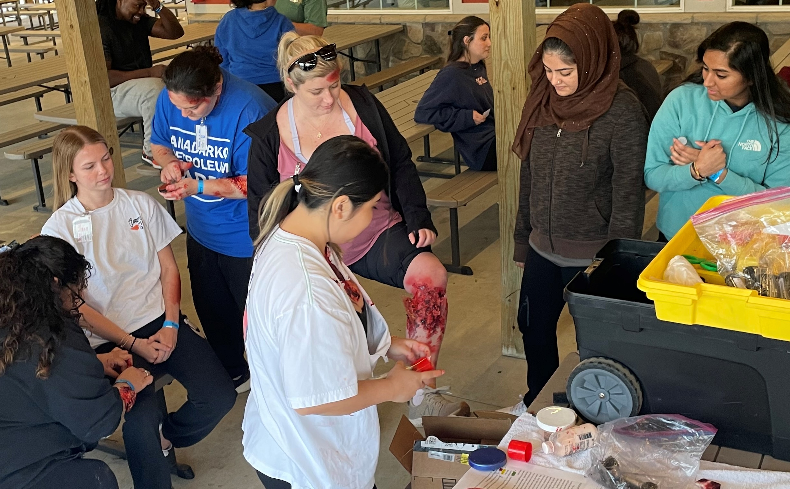
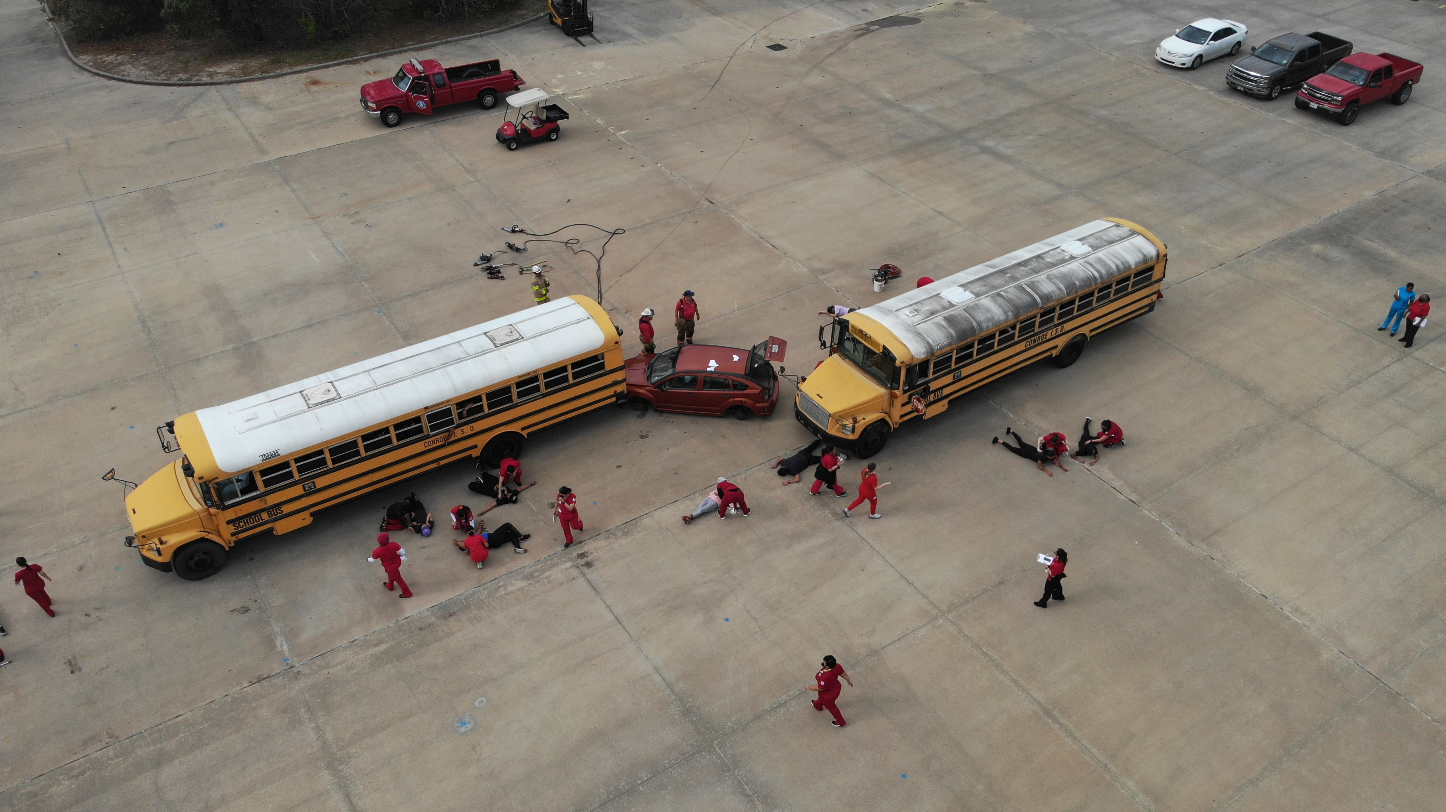

Slide 9
Man-Made
Riots
Active shooting
Bomb
Explosion
Multi-vehicle car crash
Train wreck
Airplane crash

Slide 10
Personnel
Nurses: 6 units
Patients: variety of injuries, superficial to life-threatening
Support staff: moulage, facilitation, set up, clean up
Instructors: healthcare providers, doctors, nurse practitioners
Notes:
So how do we make these simulations work for us? My university partner is facilitating a train derailment with hazmat spill simulation coming up.
We began by establishing the desired objectives from each course because all participating students are in different courses based on level. This also ensures that we assign the students based on their level of knowledge task within the simulation
Then we determine how many participants we will have and how many are patients or nurses.
For our program, we used our senior students as the nurses. We have around 50 seniors, which we broke into a triage area, emergency department, med/surg unit, OR, ICU, and OB.
Each “unit” was assigned 1-2 charge nurses to facilitate patient flow and ensure situational awareness. We also designated a code team to respond to patient deterioration.
The lower-level students, around 210 of them, were assigned injuries ranging from abrasions and dehydration to impalement, shark bite, and chronic disease exacerbations escalating the patients to ICU.
The faculty were assigned as providers to give orders to the nurses when asked.

Slide 11
Injuries and treatments
Chronic health exacerbations
Superficial injuries, such as abrasions
Serious injuries
Care plans
Treatment protocols
Units and patient flow
Notes:
We developed treatment plans for each injury, which were provided to the “physicians” during the simulation. The “nurses” were given the injuries they could anticipate to prepare for the simulation. The patients were given their injuries and, in the weeks leading up the simulation, practiced moulage and developed their “story” for their nurse. Some were assigned injuries which would escalate, and they worked with faculty to know when and how to change their patient status.
The “charge nurses” also ensured they knew what was happening on their unit and maintained situational awareness.

Slide 12
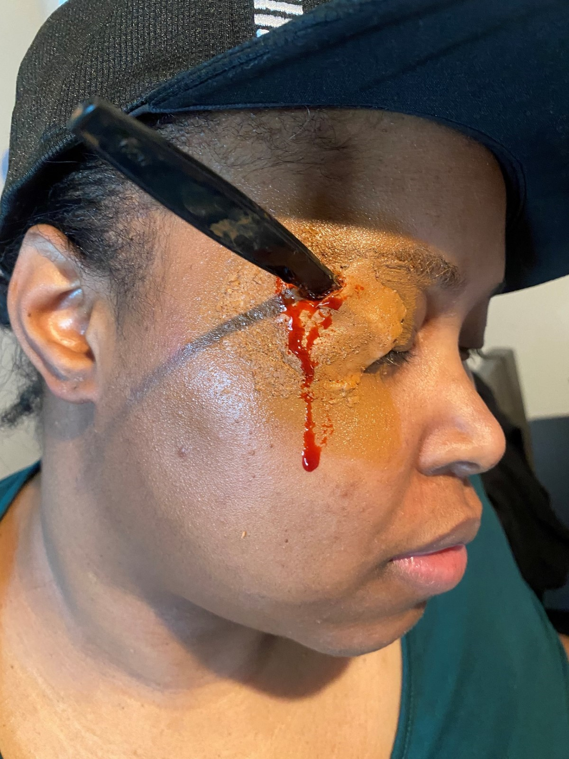
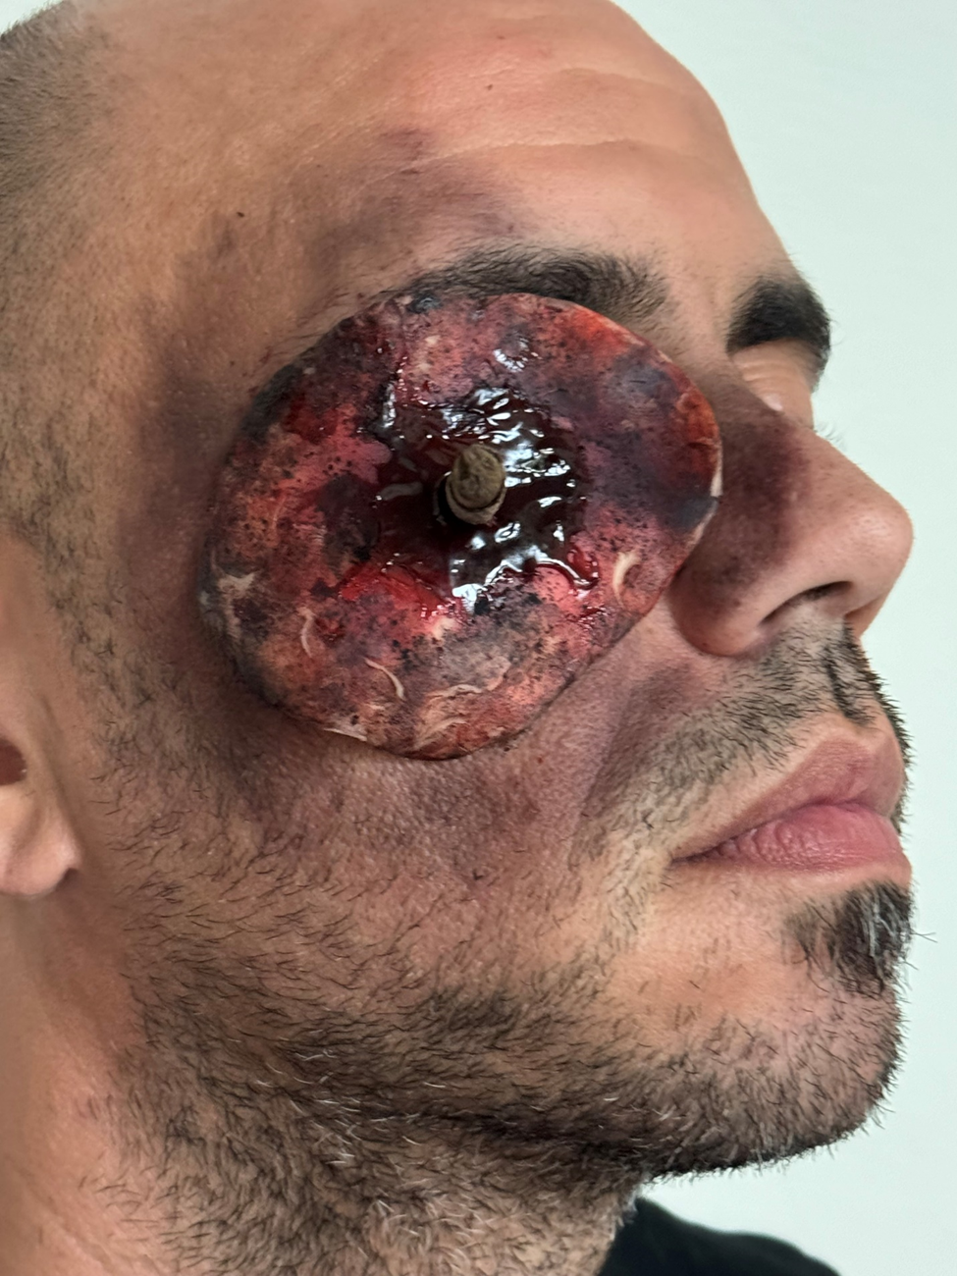
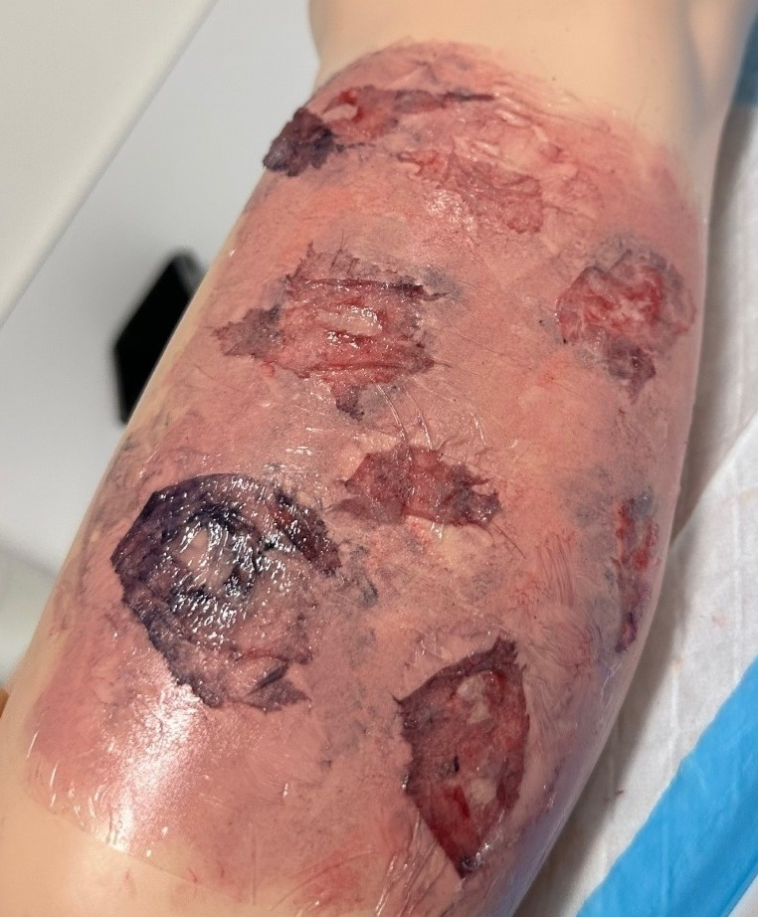
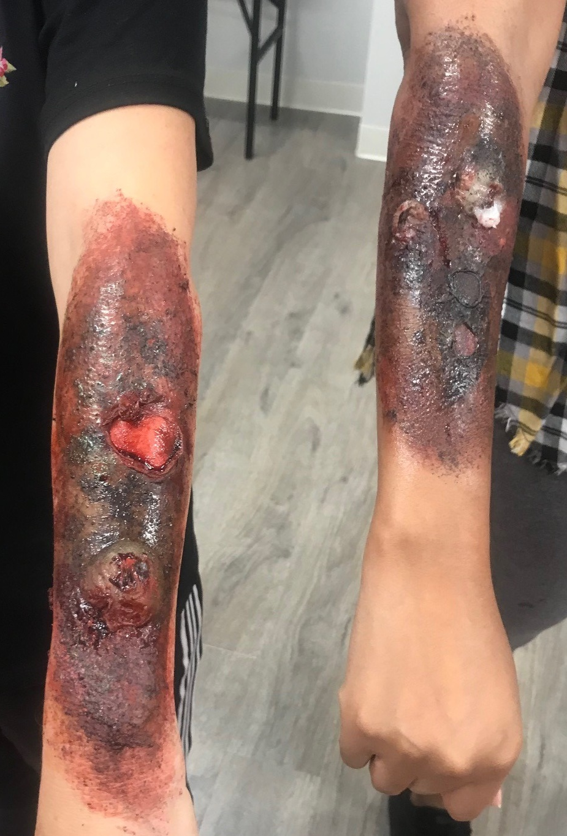
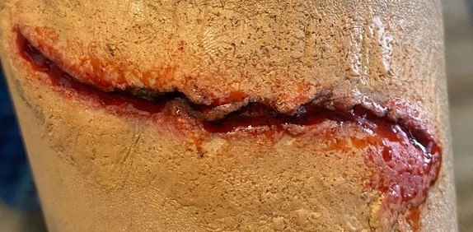
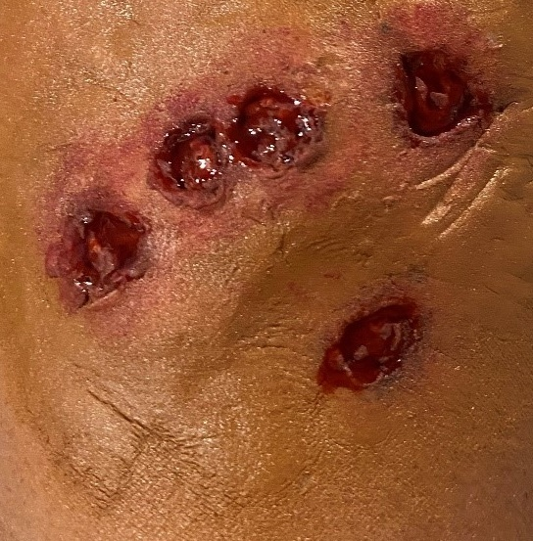
Moulage
Notes:
Those things can create injury to patients, bringing them to the hospital for treatment. What happens when the sewers overflow? Now you have chemicals, sewage, and other toxic materials potentially compromising drinking water integrity, poisoning individuals, etc. You get the picture. Think about what nurses at the hospitals will see. How many times do nurse have patients suffering from toxic sewage poisoning? What happens when it’s the entire street or neighborhood? It’s crucial for the nurses to understand how to respond in these situations and determine patient priority and treatability.

Slide 13
Requirements and supplies
Moulage
Consumables
Location
Insurance
Community Partners
Notes:
A major step in the planning is determining where you will have the simulation.
Another big part of planning is knowing what tools to make the simulation work. It would be best if you planned for the moulage make-up, and pre-make injuries to speed up the moulage process on the simulation day. What medical supplies will you use in the sim? We won’t start an IV or insert a foley catheter, but bandages, braces, crutches, etc. are utilized and planned for in our budgeting.
You’ll need to obtain a Certificate of Insurance in case of a real-world injury. Establish a “safe word” and ensure all participants know it. It is used if a real injury occurs. Our success coaches are present as well to provide support. We often include our partner’s wellness center for counsellors, depending on the situation, such as an active shooter
We also invite our EMS, PD, and FD to serve as front-line experts and participate in the debrief. They also participate by bringing patients. Many of our hospital partners have participated as well, testing their responses in these crises

Slide 14
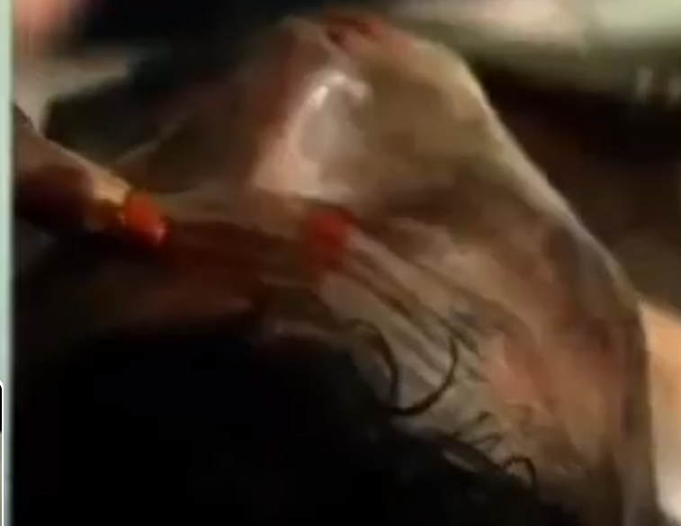
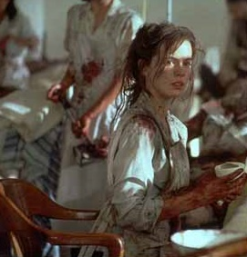
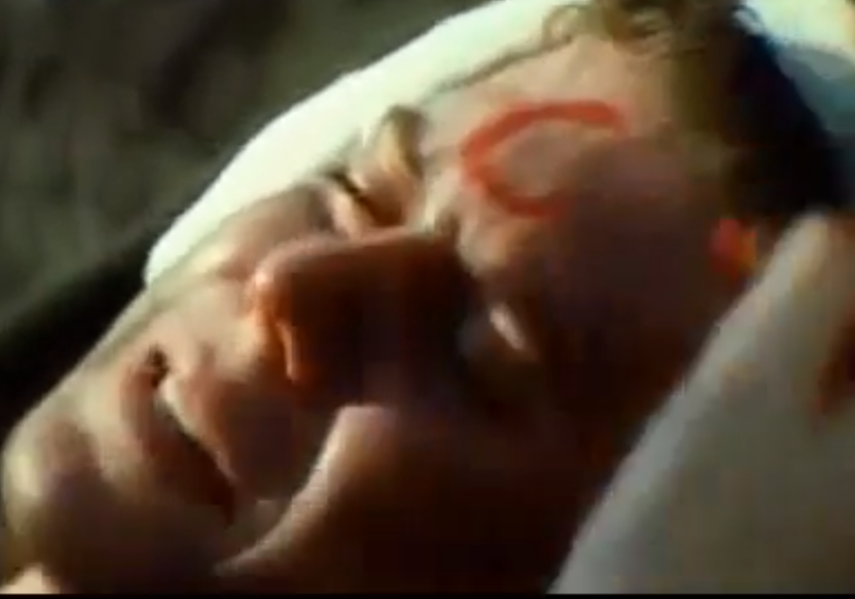
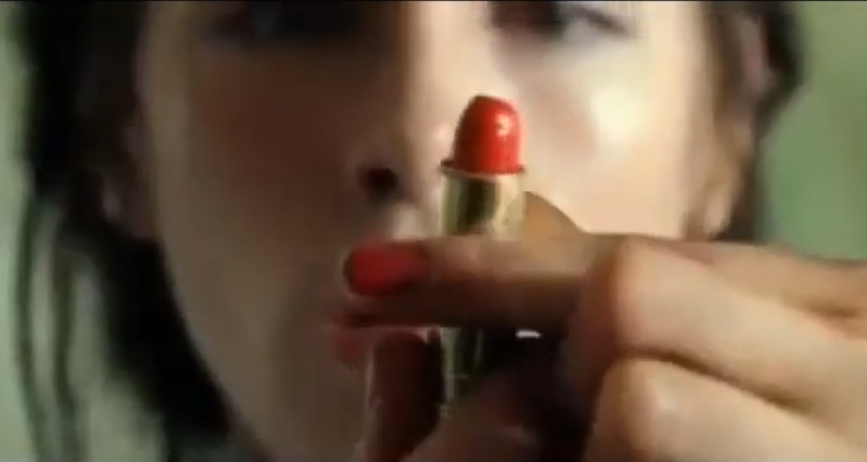
Notes:
It’s crucial for the nurses to understand how to respond in these situations and determine patient priority and treatability. Think of the scene in Pearl Harbor. Remember the lipstick? These nurses had to decide in seconds who they couldn’t save, make tough decisions, and prioritize the patients. Save who you can!

Slide 15
Patient Prioritization
Image retrieved from www.disabled-world.com/calculators-charts/triage.php
Notes:
We prepare our students to triage their patients using the above chart. It provides a high level, basic blueprint for who is highest treatment priority. We also have triage tags, printed and laminated which are provided to the patients at the triage area.

Slide 16
Debrief / hotwash
What did they learn?
How did it make them feel?
How would it change their response?

Slide 17
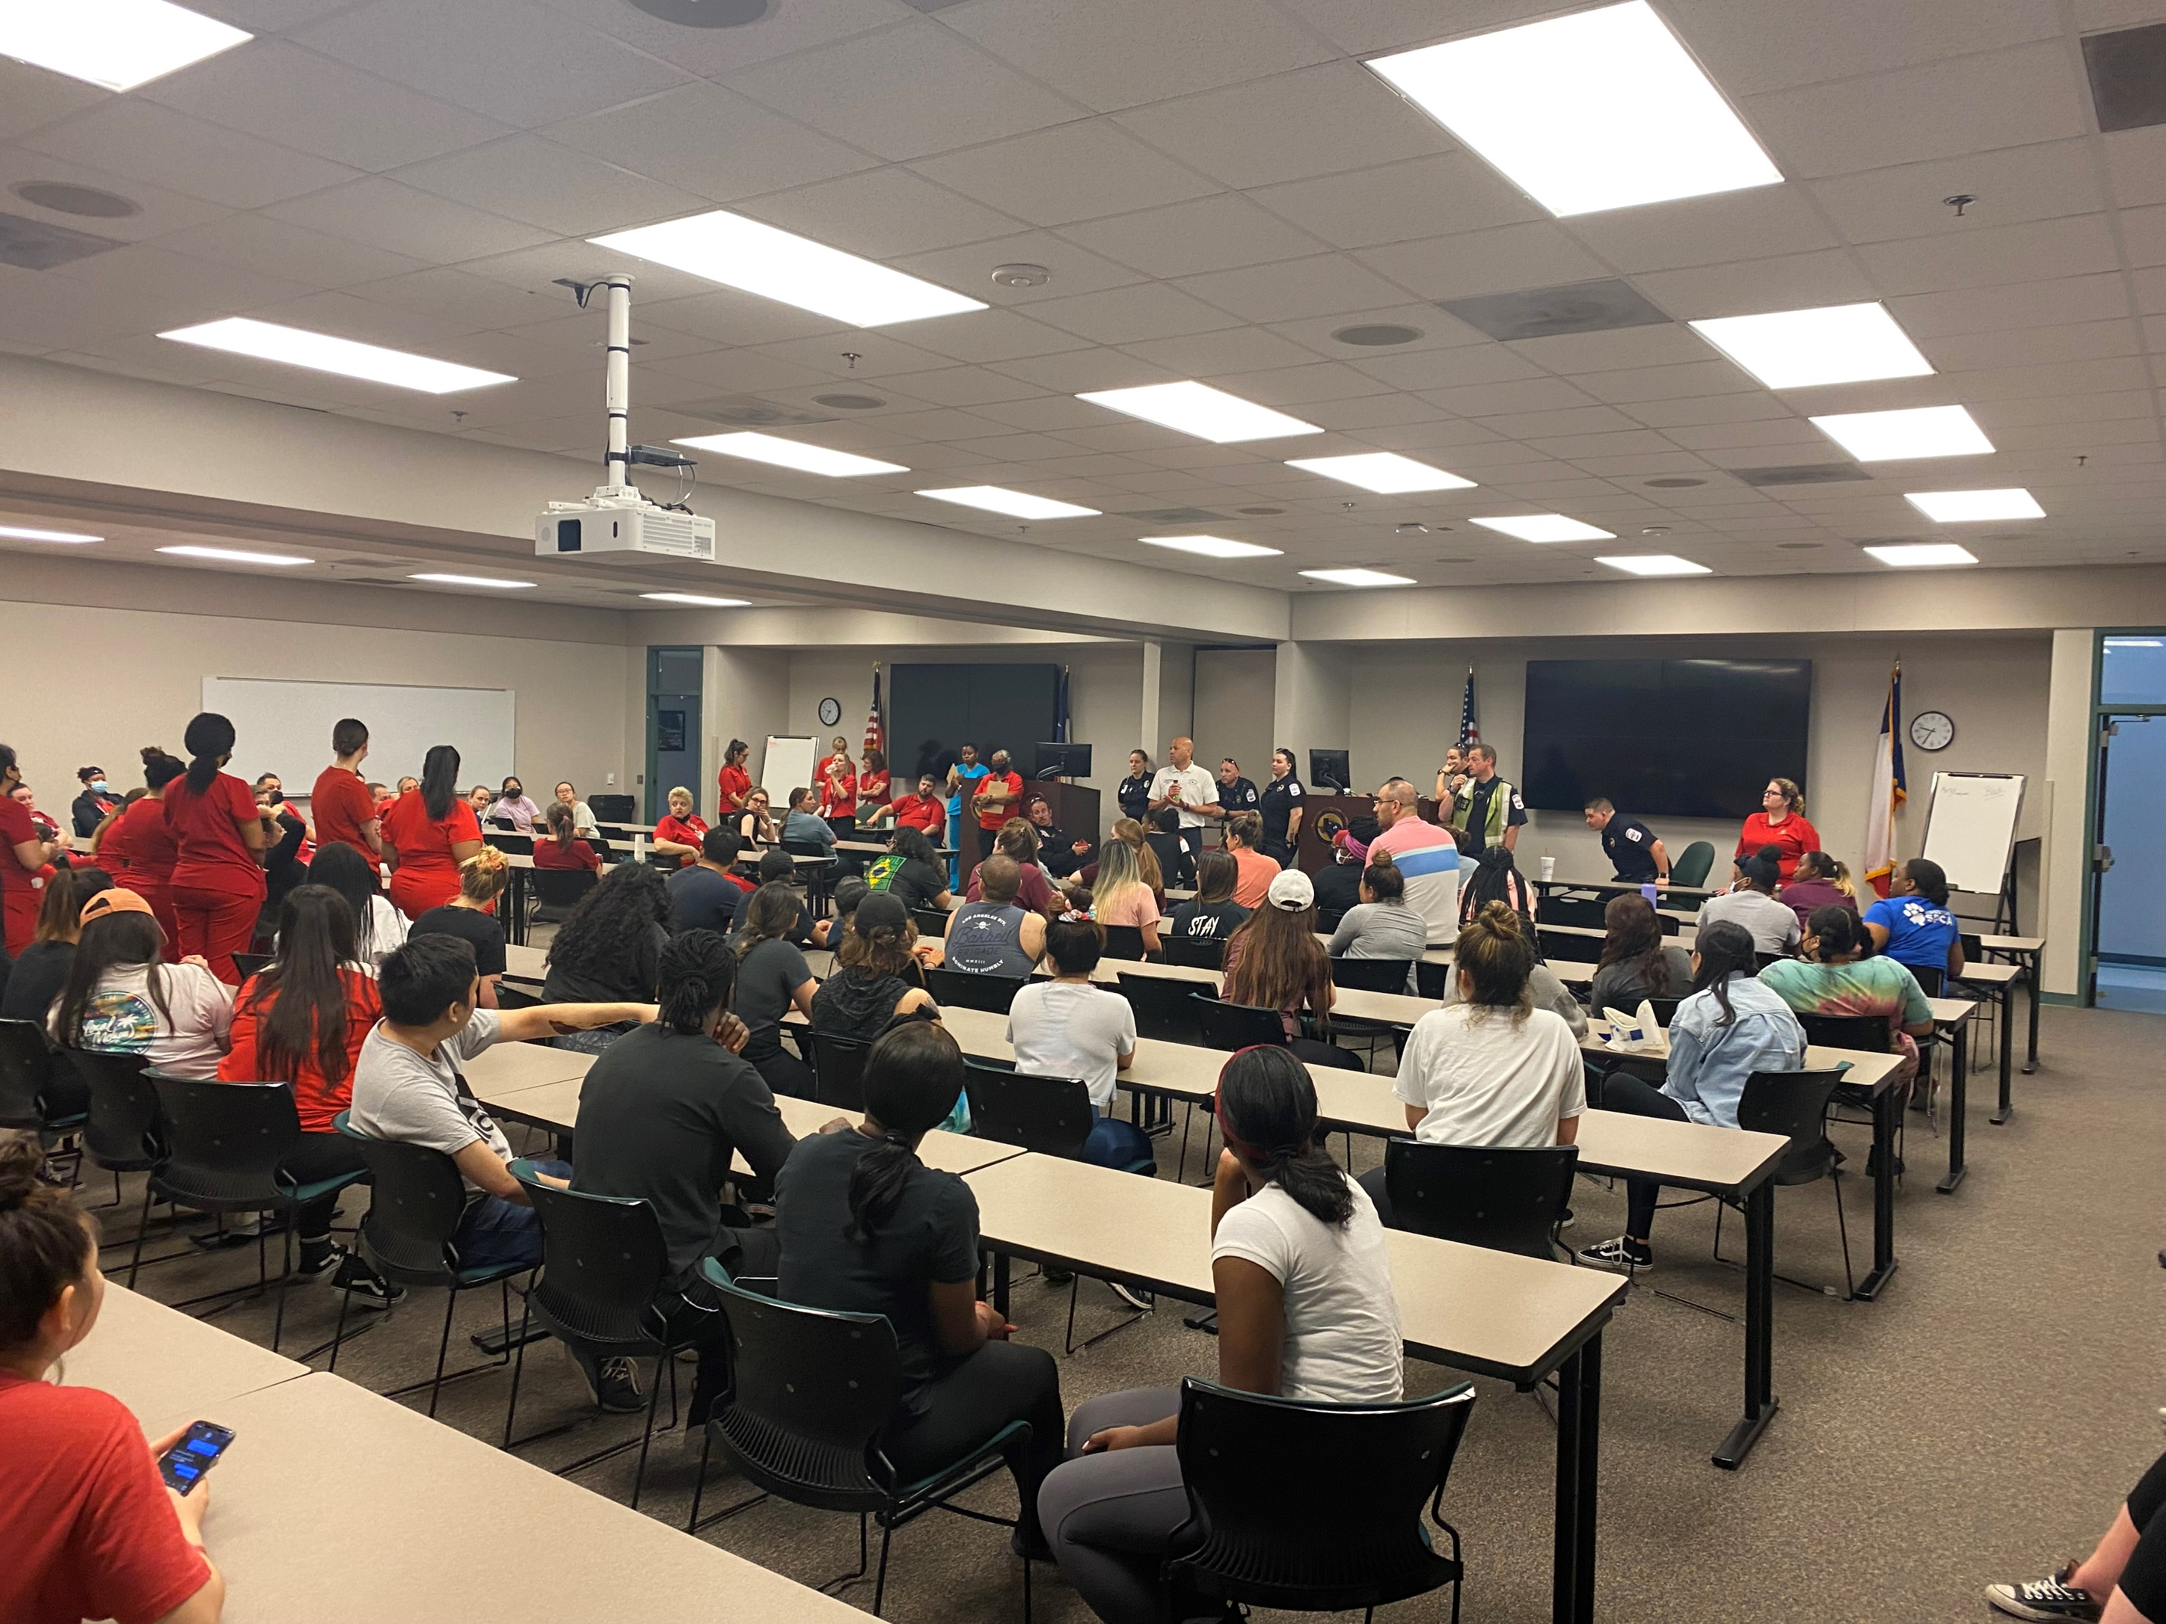
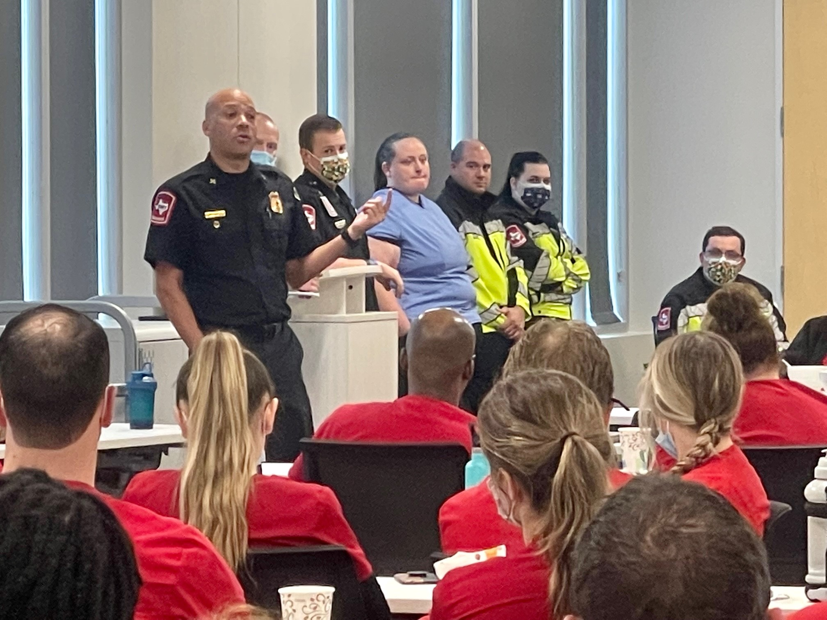

Slide 18
Gas explosion inaugural drill

Slide 19
Questions

Slide 20
References
Currie, & Heslop, D. (2022). Playing Sick and Injured: The Experiences of Undergraduate Nurses as Casualty Actors in a Mass Casualty Simulation Exercise. Clinical Simulation in Nursing, 62, 73–82. https://doi.org/10.1016/j.ecns.2021.08.005
Langtree, I. C. (2021, April 6). Medical Triage Explanation and Tag Color Chart. Disabled World. Retrieved April 5, 2024, from www.disabled-world.com/calculators-charts/triage.php
Winters, Lund, E., Sylvester, K., & Price, L. (2022). Lessons Learned in a Large-Scale Mass Casualty Simulation. The Journal of Nursing Education, 61(1), 50–52. https://doi.org/10.3928/01484834-20211129-01
Zhuge, R., Ruzieva, A., Chang, N., Wang, X., Qi, X., Wang, Q., Wang, Y., Kang, Z., Liu, J., & Wu, Q. (2024). Evaluation of emergency drills effectiveness by center of disease prevention and control staff in Heilongjiang Province, China: an empirical study using the logistic-ISM model. Frontiers in public health, 12, 1305426. https://doi.org/10.3389/fpubh.2024.1305426

