Slide 1

ESTABLISHING SUCCESS FROM DAY ONE
Essential First Week Practices
Lara Climer, EdD, MSN, RN
Health Science Technology Teacher
Nursing Academic Readiness Educator
Owner, Nursing & Health Science Central
© 2024 Lara Climer

Slide 2


OBJECTIVE
Explore strategies for establishing a structured, supportive classroom learning environment
© 2024 Lara Climer

Slide 3
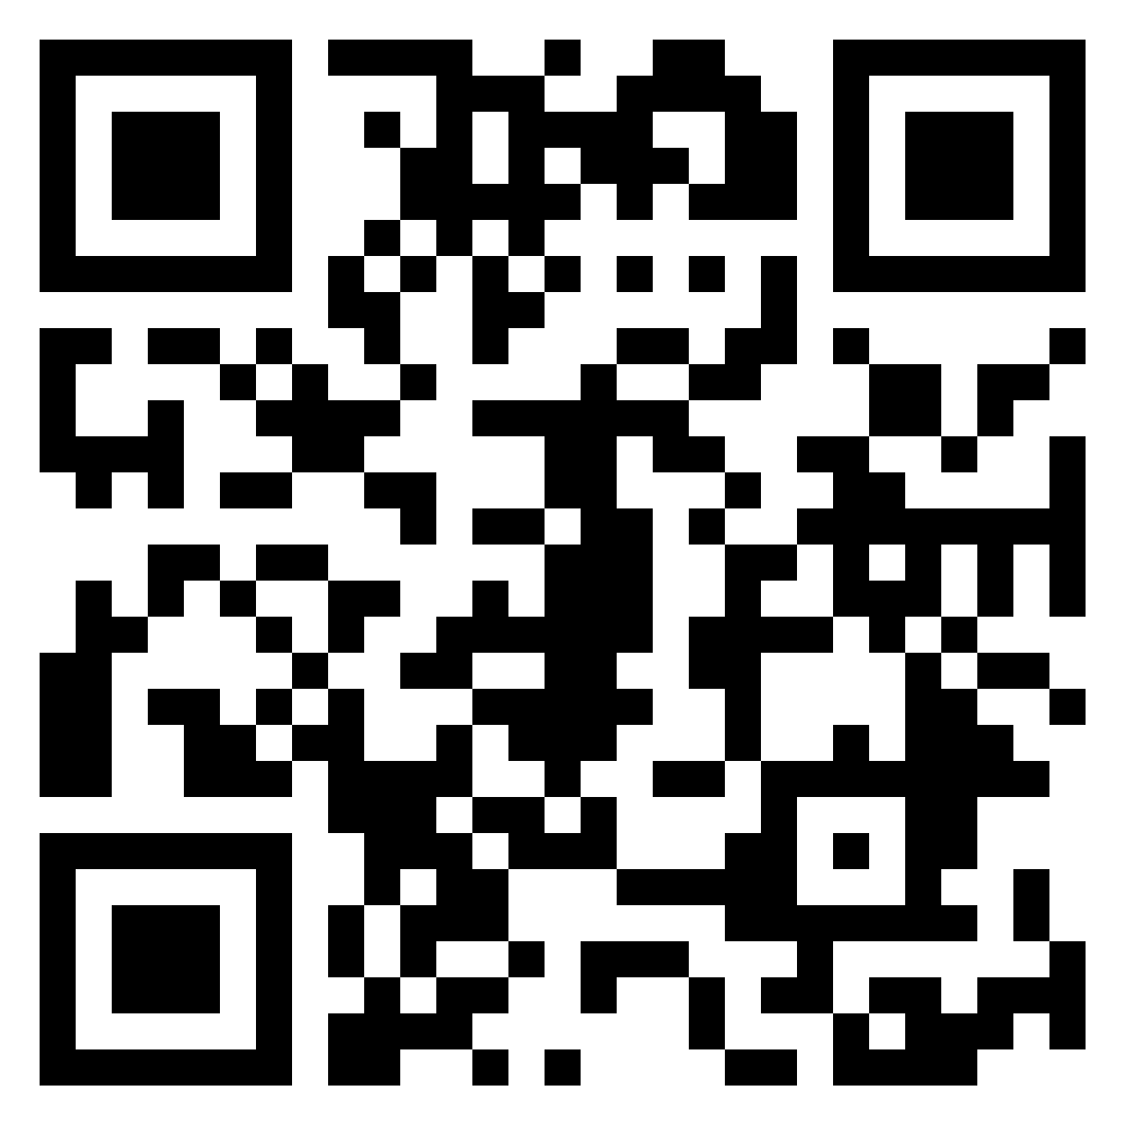
What is the most significant factor supporting student learning and engagement?
© 2024 Lara Climer

Slide 4

Trust Belonging and Engagement
Caring, respectful relationships
      with and among students
Sense of value
Structure and routines
Support
© 2024 Lara Climer

Slide 5
Be Vulnerable
Never ask kids to do something you aren’t willing to do
Let them know who you are
Let them know you care
Maintain professional boundaries
© 2024 Lara Climer

Slide 6


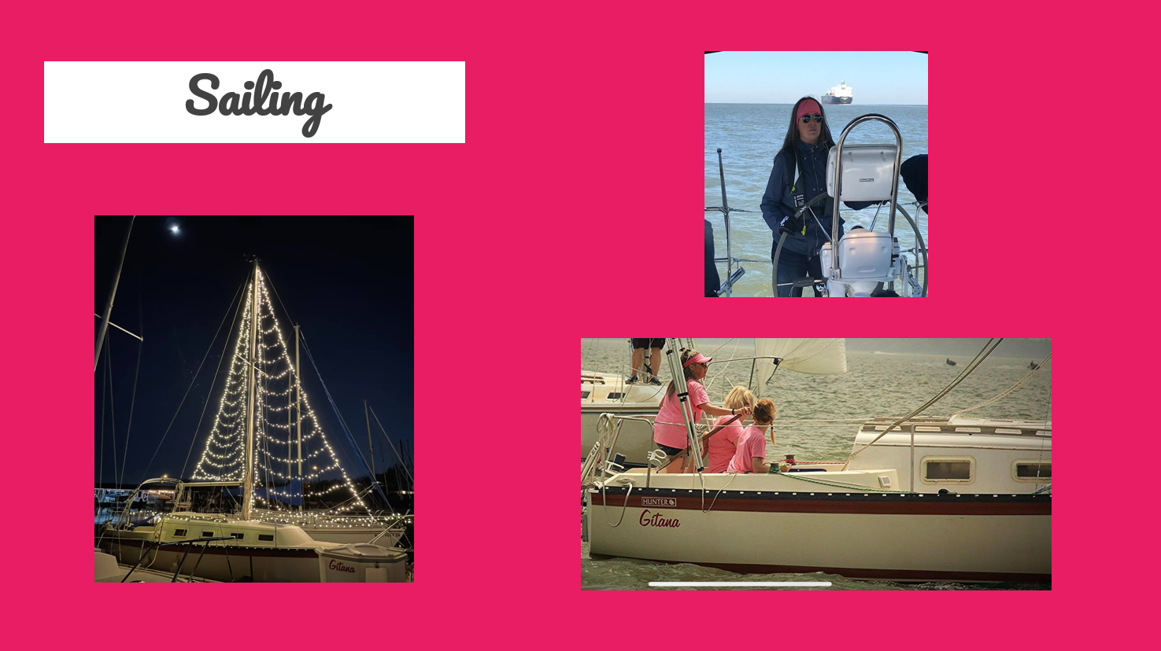
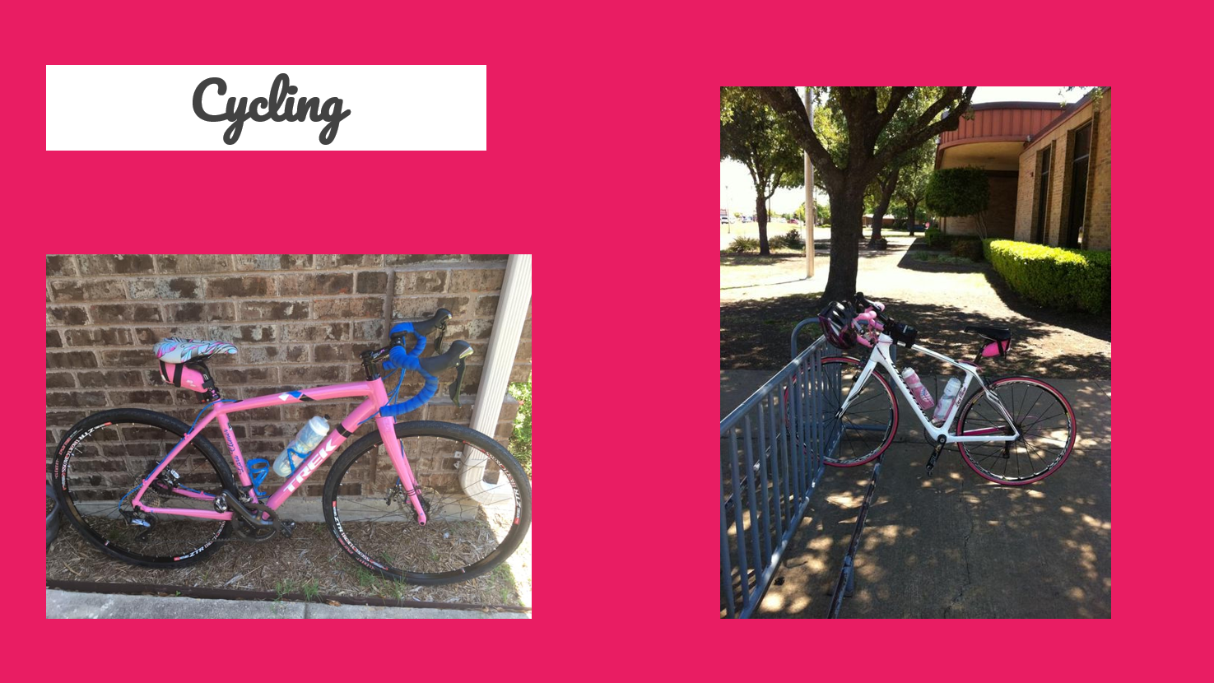
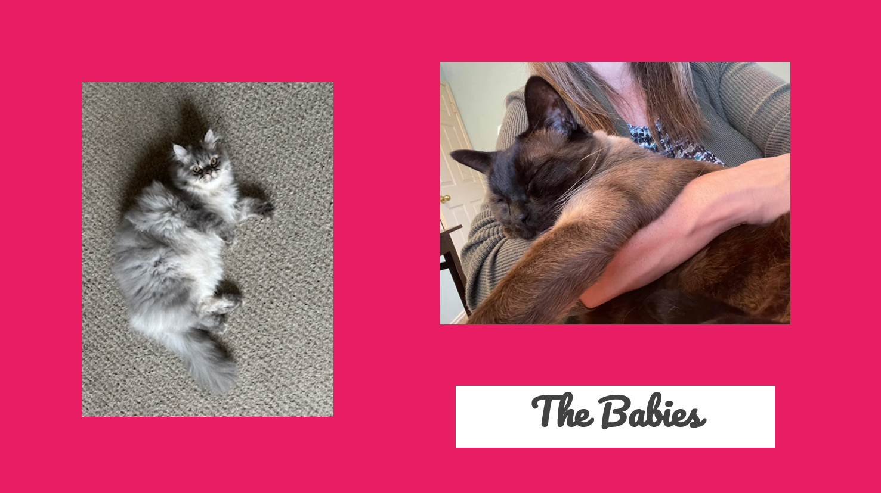
Be Approachable – Who Are You?
© 2024 Lara Climer

Slide 7





Know Your Students as People
Know Students By Name
Understand Their Lives and
What Matters to Them
Seating charts
Name tags
Greeting at the door
Student surveys
Ice breakers
Check-ins
© 2024 Lara Climer

Slide 8

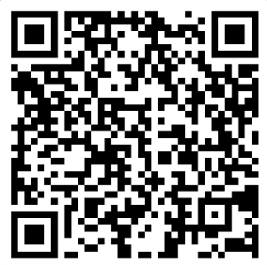
Student Survey
Demonstrate you care
Incorporate their interests and cultures into your lessons
Let them have a say – consider their learning preferences
© 2024 Lara Climer

Slide 9
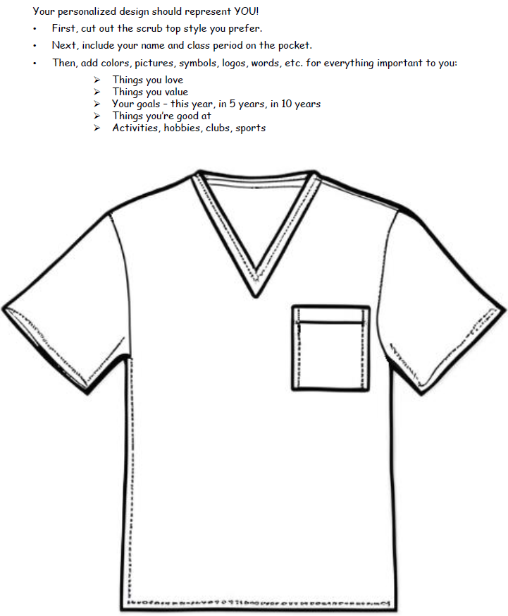
Visual Presence
Student interests, values, goals
Foster belongingness
    Display
    Gallery walks
© 2024 Lara Climer

Slide 10
Engagement Among Students
Facilitate opportunities for students to engage with one another
    Collaborative seating arrangements
    Ice breaker activities
    Random grouping and jigsaw activities
© 2024 Lara Climer

Slide 11
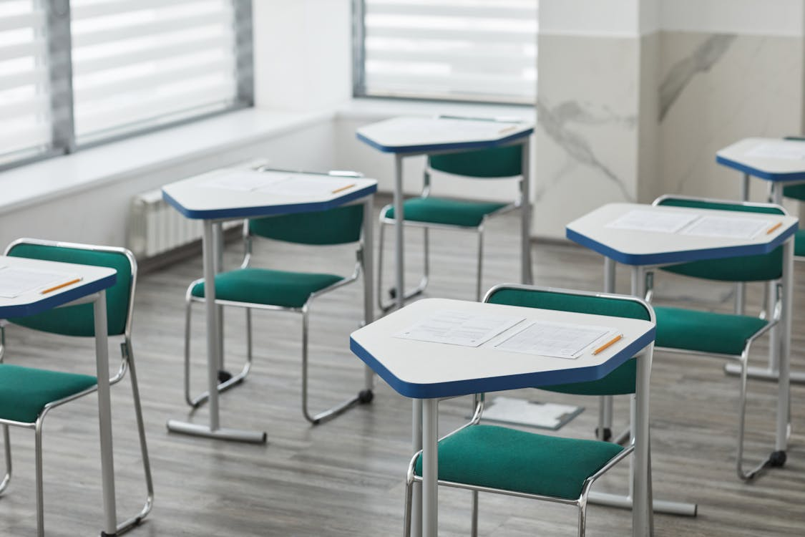
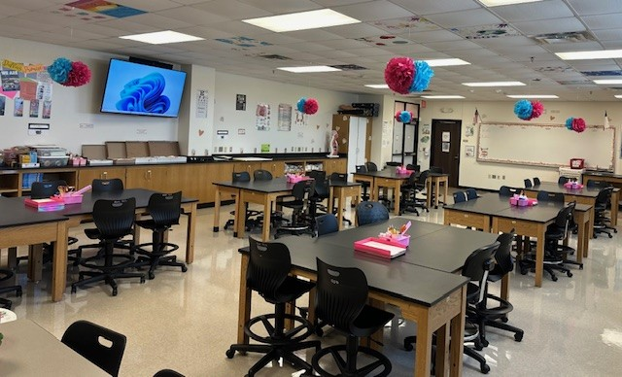
Collaborative Seating
© 2024 Lara Climer

Slide 12







This or That
Health Science Edition
© 2024 Lara Climer

Slide 13





day shift
night shift
© 2024 Lara Climer

Slide 14



emergency room
newborn nursery
© 2024 Lara Climer

Slide 15



pediatrics
geriatrics
© 2024 Lara Climer

Slide 16
Be Predictable
Clearly communicate classroom and school norms
    Environmental organization and routines
    Behavior expectations
    Academic expectations and grading criteria
© 2024 Lara Climer

Slide 17
Environmental Organization
Classroom
School
    Supplies
    Bulletin Boards
    Homework baskets
    Hall passes
    Restroom
    Water
    Library
    Nurse
    Counselor
© 2024 Lara Climer

Slide 18
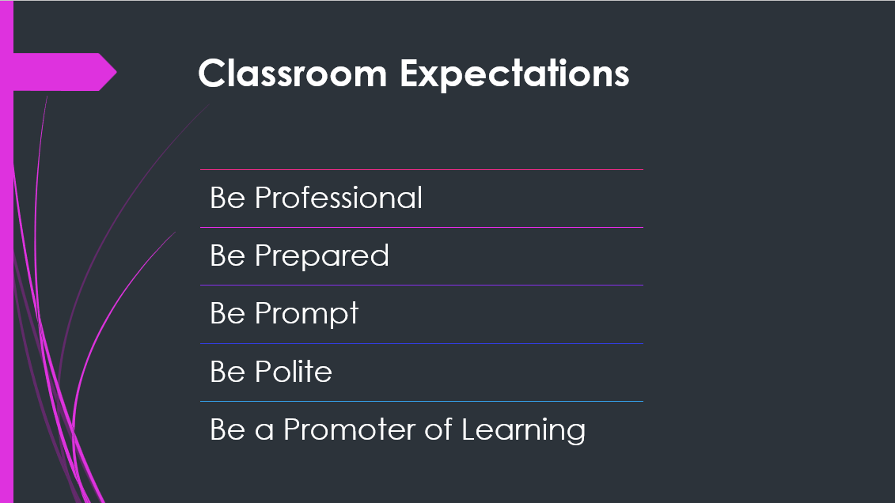
Classroom Expectations
© 2024 Lara Climer

Slide 19
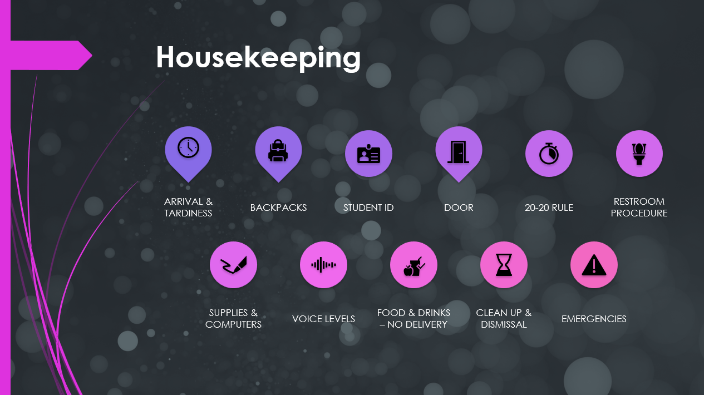
Classroom Expectations
© 2024 Lara Climer

Slide 20
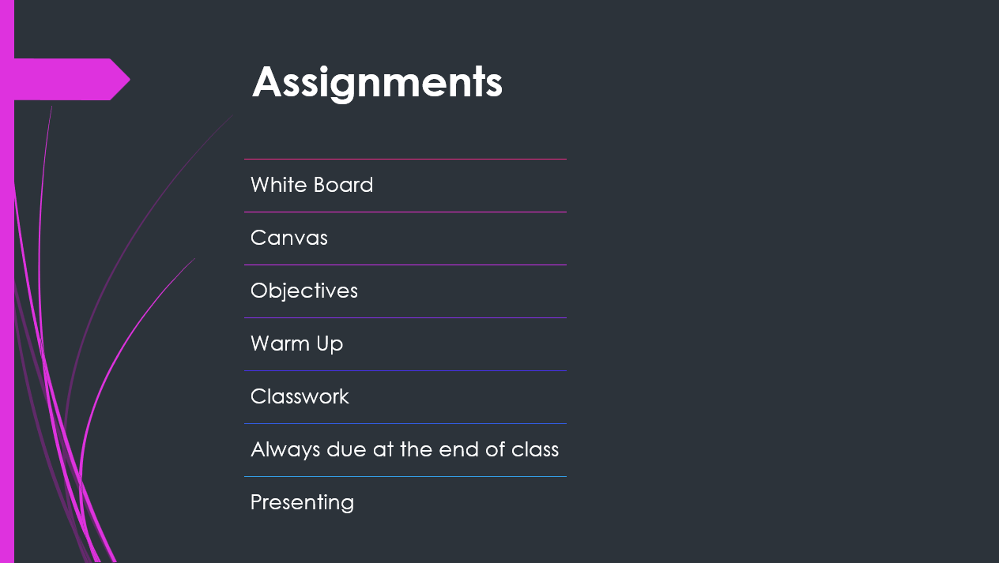
Classroom Expectations
© 2024 Lara Climer

Slide 21
References
Brake, A. (2020). Right from the Start: Critical Classroom Practices for Building Teacher–Student Trust in the First 10 Weeks of Ninth Grade. The Urban
Review, 52(2), 277–298. https://doi.org/10.1007/s11256-019-00528-z
Demerath, P., Kemper, S., Yousuf, E., & Banwo, B. (2022). A Grounded Model of How Educators Earn Students’ Trust in a High Performing U.S. Urban High
School. The Urban Review, 54(5), 703–732. https://doi.org/10.1007/s11256-022-00635-4
Keyes, T. S. (2019). A Qualitative Inquiry: Factors That Promote Classroom Belonging and Engagement among High School Students. School Community
Journal, 29(1), 171–200.
Thornberg, R., Forsberg, C., Hammar Chiriac, E., & Bjereld, Y. (2022). Teacher–Student Relationship Quality and Student Engagement: A Sequential
Explanatory Mixed-Methods Study. Research Papers in Education, 37(6), 840–859. https://doi.org/10.1080/02671522.2020.1864772
© 2024 Lara Climer

Slide 22

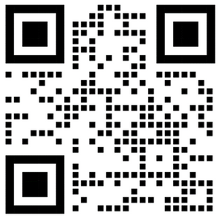
Lara Climer, EdD, MSN, RN
© 2024 Lara Climer

