Slide 1
Comfort Keepers® A Partner in Wellbeing and Quality of Life
July, 2024

Slide 2
What Makes Us Different
Consumer research illuminated the principle that seniors desire in their lives the same things that we all do – connectedness, love, purpose, hope and joy. This doesn’t change from what we wanted throughout our younger years. It’s fundamental to how we define quality of life, going beyond keeping them safe and secure at home.

Slide 3
Comfort Keepers: A Like-Minded Partner
Brand Promise
Comfort Keepers elevates the human spirit for today’s seniors and their families through a unique, individualized approach to care that helps seniors thrive and achieve greater wellbeing by fostering everyday positive moments, connection and a more purposeful life no matter their age or acuity.

Slide 4
Our Approach
We help our clients reclaim all that life has to offer, and go beyond daily care needs to bring about a sense of hope, connectedness, purpose and joy
Individualized care plans based on a whole person assessment
Our Interactive Caregiving™ focuses on engaging body, mind, and spirit
Technology plays an integral role in care delivery, enabling connection and enhancing care coordination
Our difference is our caregivers, selected for empathy and trained in senior care and bringing clients a daily dose of joy

Slide 5
We focus on social determinants of health
Social isolation and loneliness is health equivalent of 15 cigarettes a day
Volunteering lowers depression, improves wellbeing
Elderly people who feel younger than their age show less brain aging, better memory and less depression
Socially isolated seniors have a much greater risk of mental and physical decline
Lower depression is correlated with less falls
Socialization and interaction slow Alzheimer’s and Dementia patients’ decline
Our approach to caring for our elders is rooted in science and medicine
Seniors who feel better can live healthier and longer

Slide 6
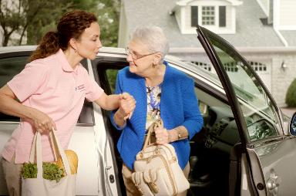
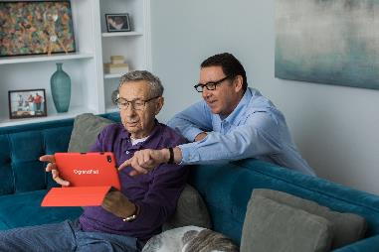
Customized Care Plans
Companion Care
Companionship
Light Housekeeping
Laundry
Meal Preparation
Incidental Transport
Errands
Personal Care
Grooming
Bathing Hygiene
Med Reminders
Transferring
Toileting
Feeding
Dementia Care
Technology
PERS
Monitoring Technology
Home Sensors
Medication Management
Family Communication

Slide 7
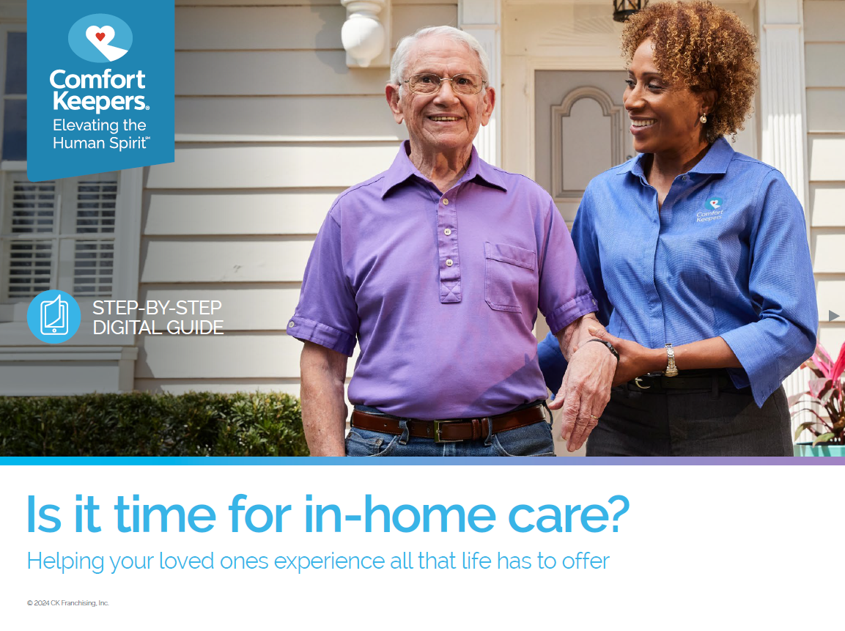
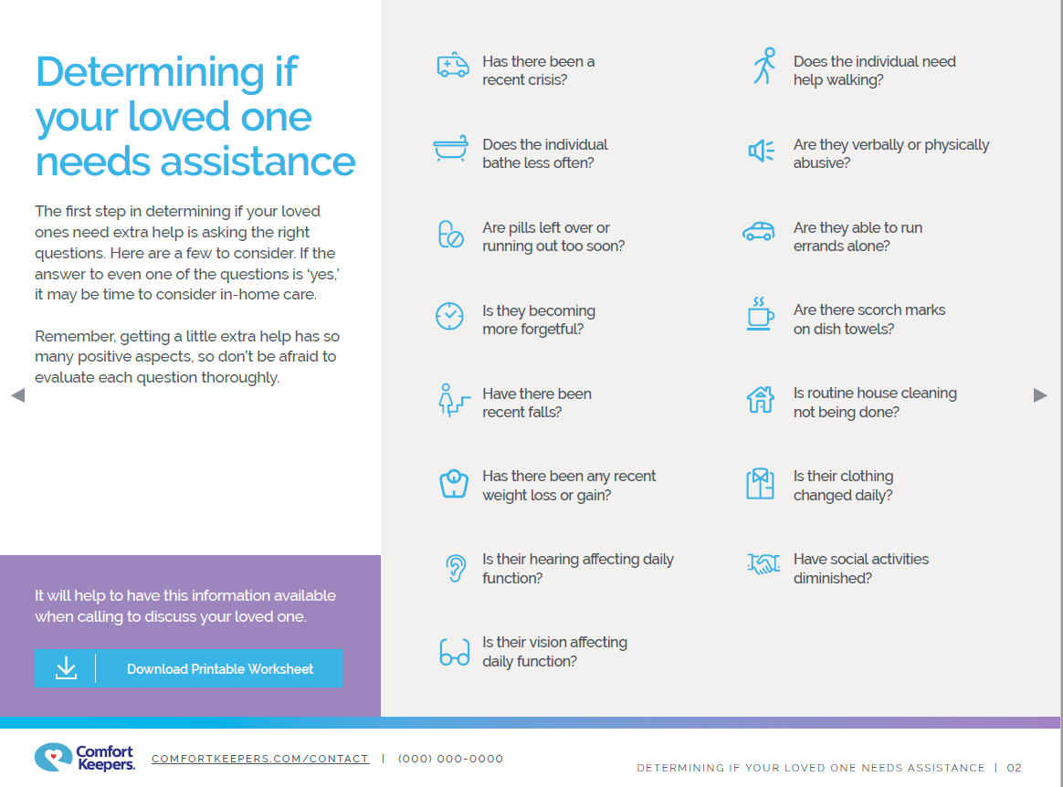
A trusted family resource
We’ve partnered with outside organizations to be a resource to families, educating on issues like compassion fatigue and the emotional toll of caregivers

Slide 8
About Comfort Keepers®
For over 25 years, Comfort Keepers® has been Elevating the Human SpiritSM through its in-home care network for seniors and other adults by empowering them to maintain their independence and realize joy in the everyday moments. Comfort Keepers operates a franchise network that has grown to more than 600 locations in the U.S. and Canada, serving hundreds of thousands of clients since 1998.

Slide 9
Questions
And in the end it's not the years in your life that count; it's the life in your years.
- Abraham Lincoln

