Slide 1
Canines Against Dementia
Bailey Bishop
Dallas Salazar
Allyson Rioux
Isabella Farmer
Riley Bridgford
Dr. LeRoy Marklund (Faculty Advisor)

Slide 2
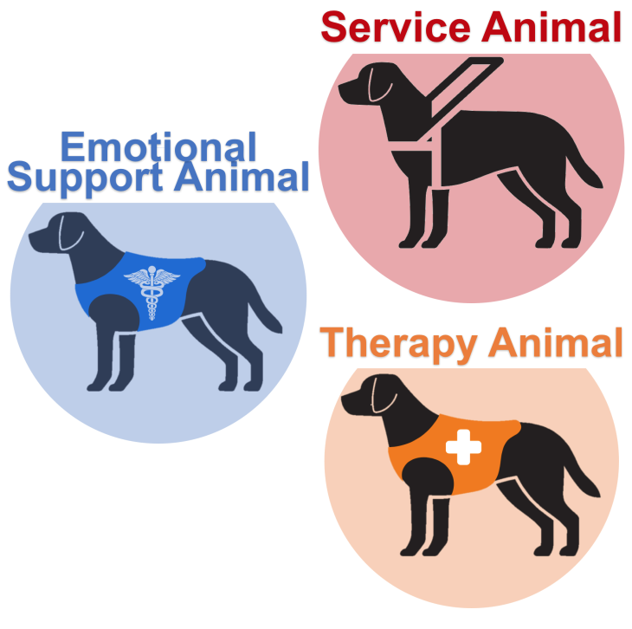
Know the Difference
There are important differences between a service animal, therapy animal, and an emotional support animal
There's a common tendency among many individuals to confuse or mistakenly interchange the terms service animal, emotional support animal, & therapy or psychiatric animals¹
Image sourced: https://certifytherapydog.org/hello-world/
[1] Service, emotional support, and therapy animals. American Veterinary Medical Association. (2024). https://www.avma.org/resources-tools/animal-health-and-welfare/service-emotional-support-and-therapy-animals

Slide 3
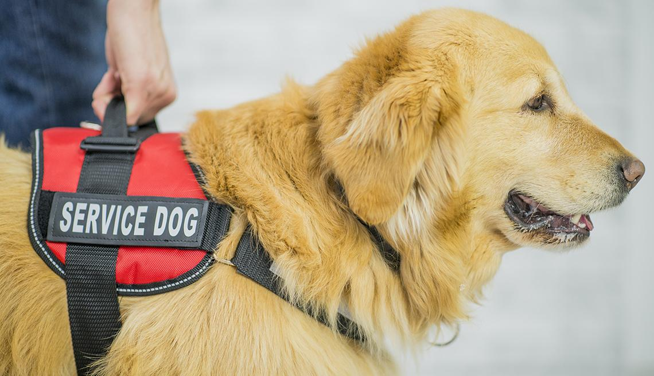
What is a Service Animal?
The American with Disabilities Act defines a service animal as a dog that has been trained to work and perform tasks for an individual with a disability²
Image Sourced: https://www.aarp.org/travel/travel-tips/transportation/info-2019/how-to-fly-with-service-animals.html
[2] Frequently asked questions about service animals and the ada. ADA.gov. (2024, May 2). https://www.ada.gov/resources/service-animals-faqs/#https://www.ada.gov/resources/service-animals-faqs/#definition-of-a-service-animaldefinition-of-a-service-animal

Slide 4
What is an Emotional Support Animal?
The main difference between a support animal and a service animal is that support animals provide therapeutic benefit such as comfort and companionship and is not restricted to one type of animal such as that of a dog.³
Image Sourced: https://www.akc.org/expert-advice/news/everything-about-emotional-support-animals/
[3] Emotional support animals: The basics. UMass Chan Medical School. (2024, April 18). https://www.umassmed.edu/TransitionsACR/resources/emotional-support-animals-101/

Slide 5
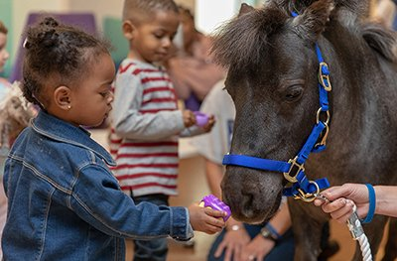
What is a Therapy Animal
Therapy Animals can be any species.
Usually, these animals undergo successful training, behavioral assessment, and veterinary evaluation before being registered or certified by an animal-assisted intervention organization¹
There is no federal mandate for identification and these animals are not recognized under federal law. Typically, these animals wear a bandana, harness, or ID tag for recognition
Image Sourced: https://www.aamc.org/news/paging-dr-spot
[1] Service, emotional support, and therapy animals. American Veterinary Medical Association. (2024). https://www.avma.org/resources-tools/animal-health-and-welfare/service-emotional-support-and-therapy-animals

Slide 6
The Benefits of Service Animals

Slide 7
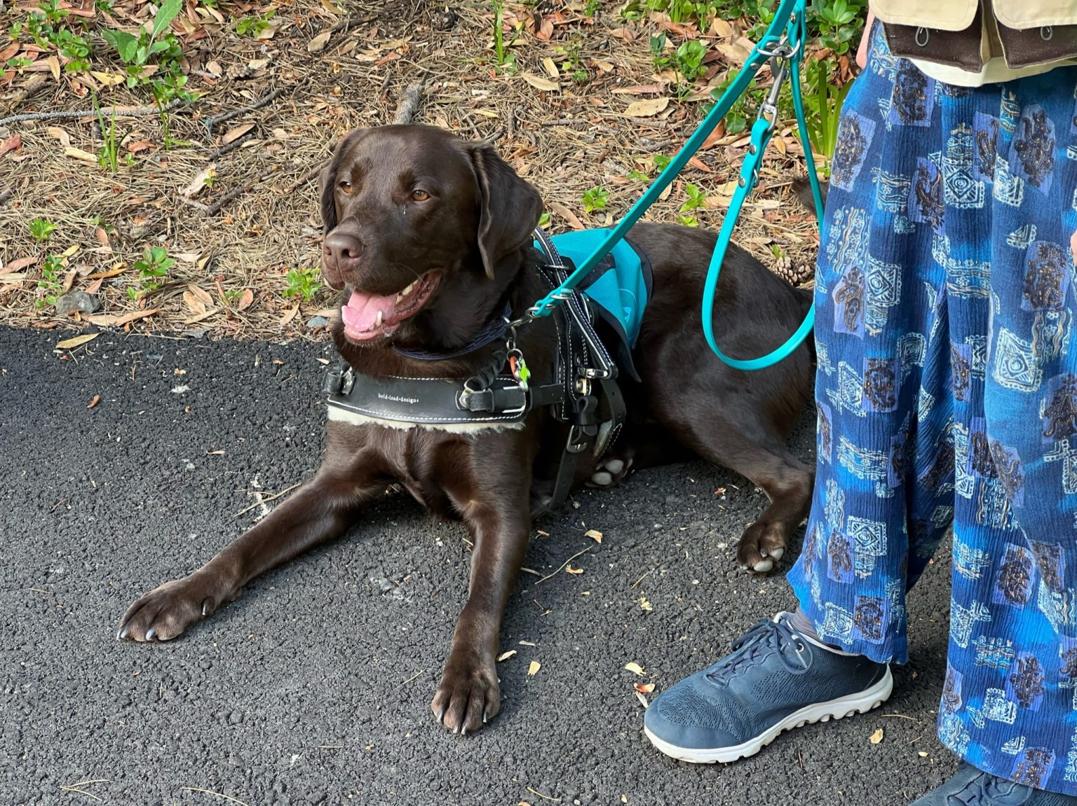
The Relevance of Man’s Best Friend
As Technology increases why are service dogs still relevant?
Studies indicate that Service Dogs support the psychosocial wellbeing of their users
Furthermore, service dogs can enhance life satisfaction, physical health, psychosocial well-being, & overall quality of life⁴
.
Image Sourced: https://www.atlasdog.org/2022/09/why-service-dogs-matter/
[4] Rodriguez, K. E., Bibbo, J., Verdon, S., & O’Haire, M. E. (2020, July). Mobility and Medical Service Dogs: A qualitative analysis of expectations and experiences. Disability and rehabilitation. Assistive technology. https://www.ncbi.nlm.nih.gov/pmc/articles/PMC8450924/

Slide 8
Service Dogs & Traditional Western Medicine
Service animals enable individuals with disabilities to better engage in daily activities, effectively by removing barriers and greatly enhancing their quality of life
This contributes to holistic care by addressing the specific needs of these patients⁵
Image Sourced: https://tembusu3.nus.edu.sg/treehouse/2017/04/medicine-of-my-mothers-mother-the-issues-with-tcm/
[5] Krawczyk, M. (2016). Caring for patients with service dogs: Information for Healthcare Providers. OJIN: The Online Journal of Issues in Nursing, 22(1). https://doi.org/10.3912/ojin.vol22no01ppt45

Slide 9
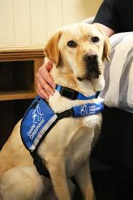
How Can Technology Better the Role of a Service Dog
As time goes on, technology will continue to advance. The Canine Alert device represents just one of those small advancements that can make a big difference
This device sends alerts to the canine via vibrations which prompt them to take corrective actions⁶
Image Sourced: https://canine.org/news/canine-companions-launches-the-caninealert-device/
[6] CanineAlertTM device. Canine Companions. (2024, April 3). https://canine.org/service-dogs/our-dogs/caninealert-device/

Slide 10
How Can Technology Better the Role of a Service Dog
These technological advancements contribute to the ongoing improvement and optimization of service dog training and performance, ultimately benefiting individuals with disabilities who rely on these remarkable animals for assistance & support⁶
Image Sourced: https://canine.org/news/canine-companions-launches-the-caninealert-device/
[6] CanineAlertTM device. Canine Companions. (2024, April 3). https://canine.org/service-dogs/our-dogs/caninealert-device/

Slide 11
Patriot Paws of Aggieland
A student organization at Texas A&M University is dedicated to training and raising service dogs for veterans in need​​.
Veterans suffering from PTSD or physical disabilities may face challenges in their everyday lives that a service dog can help manage
The dogs can serve as a companion while also enhancing the veteran’s safety

Slide 12
Neurological Diseases & Service Dogs

Slide 13
By The Numbers - Dementia
Worldwide there are 55 Million People living with dementia and alzheimers.⁷
The current guidelines for managing dementia are limited, which prompts a need for further research into more effective treatment approaches
While Alzheimer's disease currently lacks a cure, there exist treatments that could potentially alter its progression, alongside both pharmaceutical and non-pharmaceutical interventions that might alleviate symptoms
Image Sourced: https://www.alz.org/
[7] Alzheimer’s and dementia. Alzheimer’s Association . (2024). https://www.alz.org/alzheimer_s_dementia

Slide 14
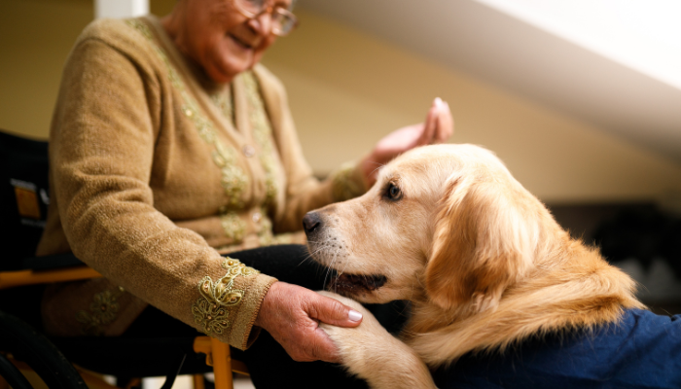
Service Dogs + Dementia/Alzheimer’s Patients
Service dogs can be trained to remind their owner to take medications, keep them from walking out the door, or remind them if they left a cooking pot on the stove
The dogs can make their owner and the people around them overall happier, which is something I have experienced firsthand

Slide 15
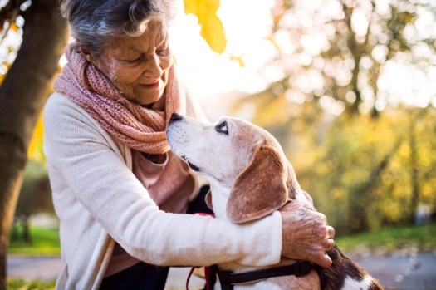
Alzheimer’s Disease & Emotional Support
Patients with Alzheimer’s disease have shown an overall improvement in wellbeing when interacting with dogs on a consistent basis (Quintavalla et al., 2021).
When Alzheimer’s patients interact with dogs, feelings of loneliness and social isolation decrease
Dogs have shown to produce greater therapeutic effects when compared to other therapy animals due to their ability to create a deeper bond with their companion

Slide 16
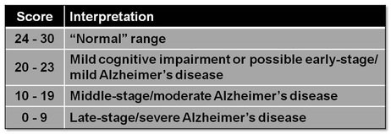
Cognitive Improvement in Alzheimer’s Patients
Quintavalla et al. (2021) suggests that interacting with animals, especially dogs, causes Alzheimer’s patients to recall and share memories.
Participants in this study recalled previous experiences with pets and their living habits with pets over the years
This study demonstrates improvements have been seen in comprehension, orientation, memory, and attention when working with a therapy dog. Shown by an increase in Mini-Mental State Examination score that evaluates cognitive function in Alzheimer’s disease patients

Slide 17
Alzheimer’s Disease & Motor Skills
Therapy dogs can assist Alzheimer’s patients in working on fine motor skills and mobility exercises (Quintavalla et al., 2021).
Activities include brushing the dog’s coat and throwing a ball to play fetch with the dog

Slide 18
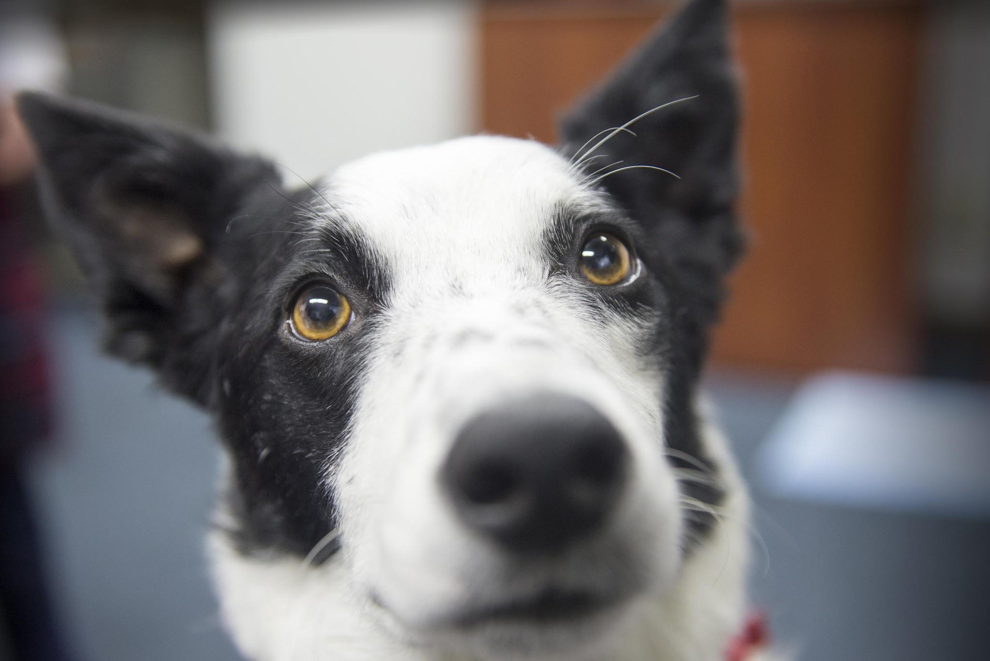
Emotional Support Animals & Parkinson Disease
Parkinson’s is isolating, and these patients feel anxiety, fear, and fatigue (Cong et al., 2022)
Pain and mental health are two of the only symptoms of Parkinson’s Disease that can be treated by their healthcare team
Emotional support animals offer a simple and low side effect option to improve these patients’ quality of life

Slide 19
Integrating Service Animals into Care Plans

Slide 20
What qualifies you for a service dog?
To qualify for a service dog your ailment or disease must fall under the Americans with Disabilities Act (ADA) definition of a physical or mental disability.
These individuals must provide legal documentation from a medical professional that their illness or impairment could be improved in some way by the animal.

Slide 21
Conclusion
Service animals offer support and companionship that has proven to be an effective approach for individuals living with dementia
Once qualified, through their trained abilities and innate empathy, these dogs help enhance the quality of life for both the individuals & their caregivers
This is an extremely important palliative approach for individuals living with a disease that has been proclaimed incurable. As we continue to explore the benefits of integrating service animals into dementia care, let us also recognize the importance in further research, advocacy, & support!
Thank you for your time & consideration!

Slide 22
References
Alzheimer’s and dementia. Alzheimer’s Association . (2024). https://www.alz.org/alzheimer_s_dementia
Cong, S., Xiang, C., Zhang, S., Zhang, T., Wang, H., & Cong, S. (2022, October). Prevalence and clinical aspects of depression in Parkinson’s disease: A systematic review and meta-analysis of 129 studies. Neuroscience & Biobehavioral Reviews, 141. ScienceDirect. https://doi.org/10.1016/j.neubiorev.2022.104749 l
Emotional support animals: The basics. UMass Chan Medical School. (2024, April 18). https://www.umassmed.edu/TransitionsACR/resources/emotional-support-animals-101/
Frequently asked questions about service animals and the ada. ADA.gov. (2024, May 2). https://www.ada.gov/resources/service-animals-faqs/#https://www.ada.gov/resources/service-animals-faqs/#definition-of-a-service-animaldefinition-of-a-service-animal
Krawczyk, M. (2016). Caring for patients with service dogs: Information for Healthcare Providers. OJIN: The Online Journal of Issues in Nursing, 22(1). https://doi.org/10.3912/ojin.vol22no01ppt45
Patriot Paws of Aggieland. (2013). https://patriotpawsaggieland.weebly.com/

Slide 23
References
Quintavalla, F., Cao, S., Spinelli, D., Caffarra, P., Rossi, F.M., Basini, G., & Sabbioni, A. (2021). Effects of dog-assisted therapies on cognitive mnemonic capabilities in people affected by Alzheimer’s disease. Animals, 11(5), 1366. https://doi.org/10.3390/ani11051366
Service, emotional support, and therapy animals. American Veterinary Medical Association. (2024). https://www.avma.org/resources-tools/animal-health-and-welfare/service-emotional-support-and-therapy-animals
What disabilities qualify for a service dog?. US Service Animals Blog. (2023, January 4). https://usserviceanimals.org/blog/what-disabilities-qualify-for-a-service-dog/#:~:text=%E2%80%9CAny%20physiological%20disorder%20or%20condition,hemic%20and%20lymphatic%2C%20skin%2C%20and
Why service dogs matter. Atlas Assistance Dogs. (2022, September 26). https://www.atlasdog.org/2022/09/why-service-dogs-matter/

Slide 24
Bibliographies

Slide 25
Bailey Bishop
Hello! My name is Bailey Bishop and I am so excited to be here! I was born and raised in Houston, Texas. I am currently a second semester nursing student at Texas A&M School of Nursing. I have a passion for helping others and I can’t wait to see where the nursing profession takes me!

Slide 26
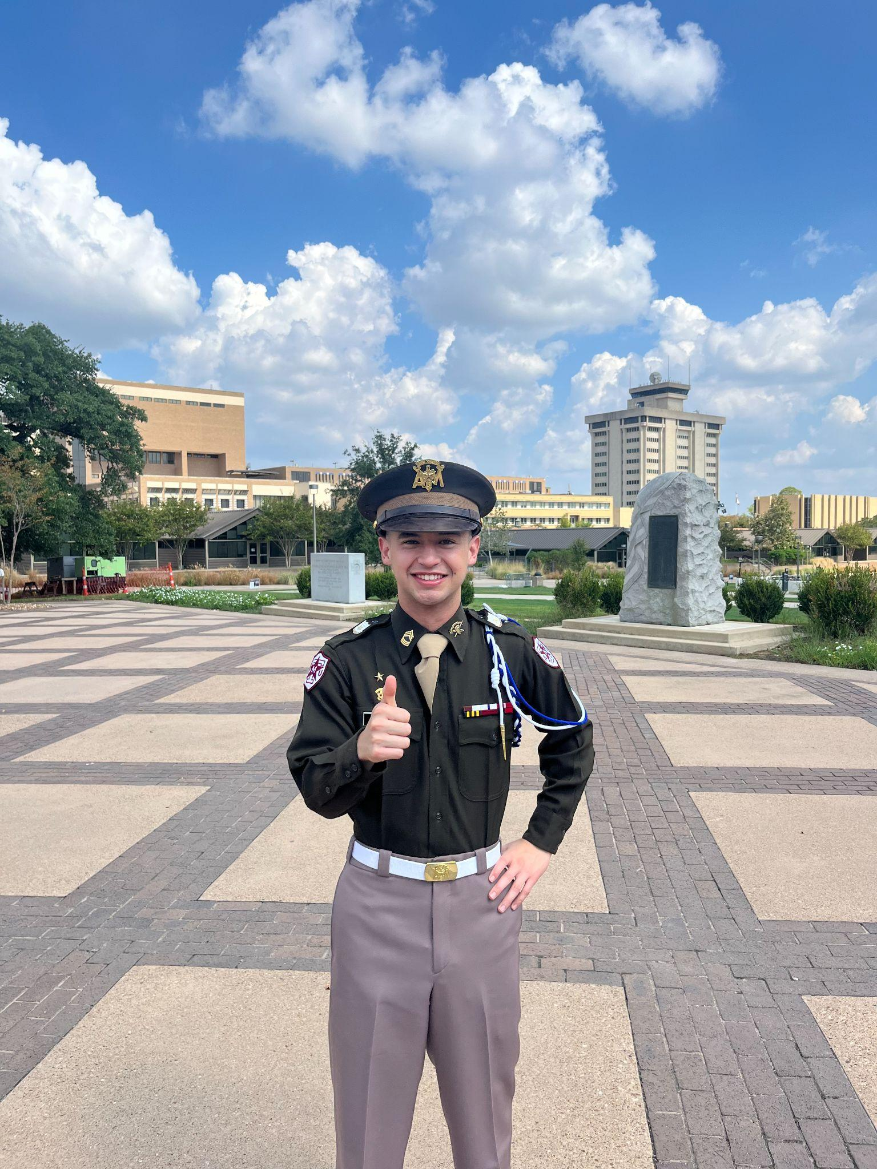
Dallas Salazar
Howdy, My name is Dallas Salazar, I am from Hondo Texas. Currently I am a second semester nursing student. I enjoy spending time outdoors. I am also a member of the Corps of Cadets. And upon graduation I would like to enter the ED to serve those around me to the best of my ability.

Slide 27
Allyson Rioux
Howdy! My name is Allyson Rioux. I am a senior at Texas A&M University. I am currently in my second semester of nursing school. I grew up in El Campo, Texas. I am an active member of The Student Nurses Association which is a student organization at Texas A&M health science center.

Slide 28
Isabella Farmer
Hi! My name is Isabella Farmer! I am currently a second semester nursing student at Texas A&M School of Nursing! I grew up in McAllen, Texas and have been so blessed with the opportunity to pursue my passion for serving others at this school and with this community! I am involved in a sorority here at A&M and have a small baking business that I run outside of school! Thank you for this opportunity to share our research with you!

Slide 29
Rylie Bridgford
Hello! My name is Rylie Bridgford and I am a second semester nursing student at Texas A&M University! I was born in Oklahoma, but have spent most of my life in West Texas in a small town called Wall. I am an active member in the Student Nurses Association on campus, and Class council! I could not be more excited for the next 4 semesters!

