Slide 1
Women’s Health
Empowering Wellness & Navigating Disorders
Avery Davis
Tiana Albino
Kylie Nance
Bailey Boullion
Ana Gomez
Dr. LeRoy Maklund (Faculty Advisor)

Slide 2
Table of Contents
01
02
03
04
05
06
Purpose Statement
Endometriosis
Polycystic Ovary Syndrome
Gestational Diabetes
Fetal Alcohol Syndrome
Postpartum Depression

Slide 3
Our Purpose Statement

Slide 4
Howdy! We are all second semester nursing students here at Texas A&M University’s School of Nursing. During our first semester, we were each asked to write a paper discussing a healthcare issue of our choice, and each one of us chose a different topic related to women’s health. In this presentation, we combined our research about these different topics in hopes of bringing awareness to relevant issues faced by women all over the world every single day. Women’s health is something we each feel drawn to and passionate about, and we are excited to share this presentation with you all today!

Slide 5
Endometriosis

Slide 6
Endometriosis
A disorder characterized by the abnormal growth of endometrial tissue outside of the uterus (Chauhan & Kathane, 2022).

Slide 7
Pathophysiology of Endometriosis
Causes
Signs & Symptoms
Genetic factors
Environmental factors
Hormonal factors
Pain, especially menstrual cramps
Infertility *
Long and heavy menstrual bleeding
Fatigue
Pain during intercourse

Slide 8
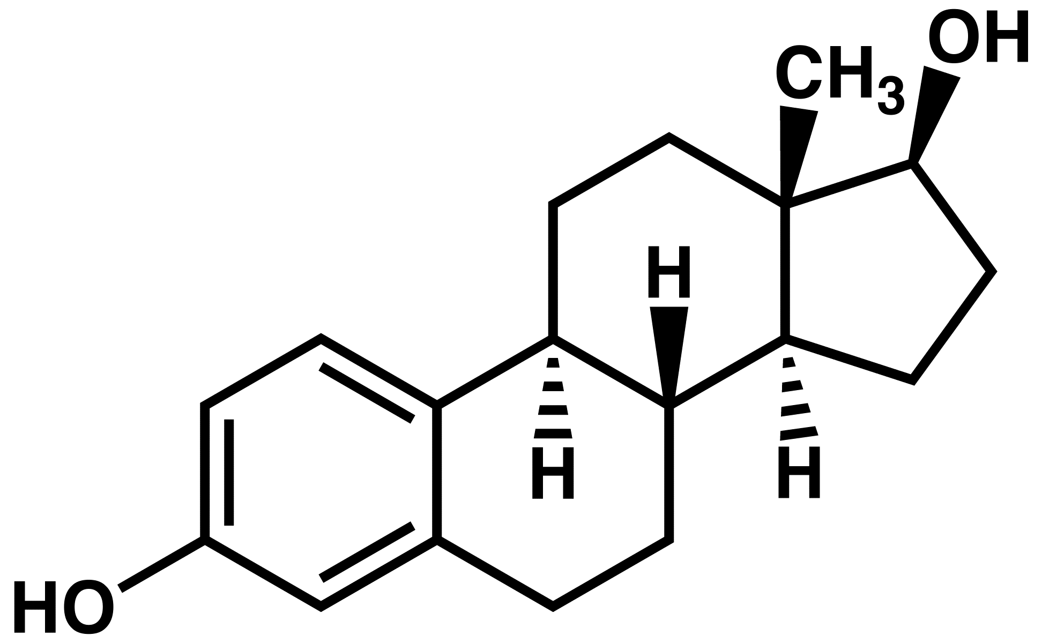
Innovative Treatments for Endometriosis & Its Associated Infertility
Diet
Hormone Therapy
Plant-based
Limit caffeine
Take vitamins
GnRH
Oral Contraceptives
Non-estrogen based contraceptives
Danazol
Laparoscopic Surgery
In Vitro Fertilization
Using a thin tube with a camera on the end
To find & remove excess endometrial tissue
An egg & sperm are fertilized in a petri dish
Then implanted into the uterus

Slide 9
Polycystic Ovary Disease

Slide 10
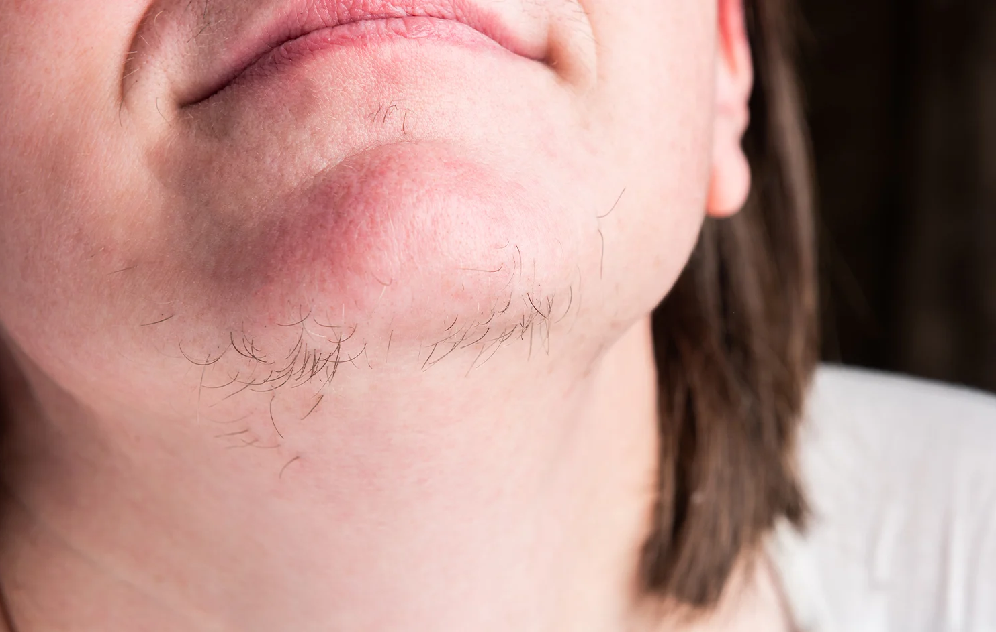
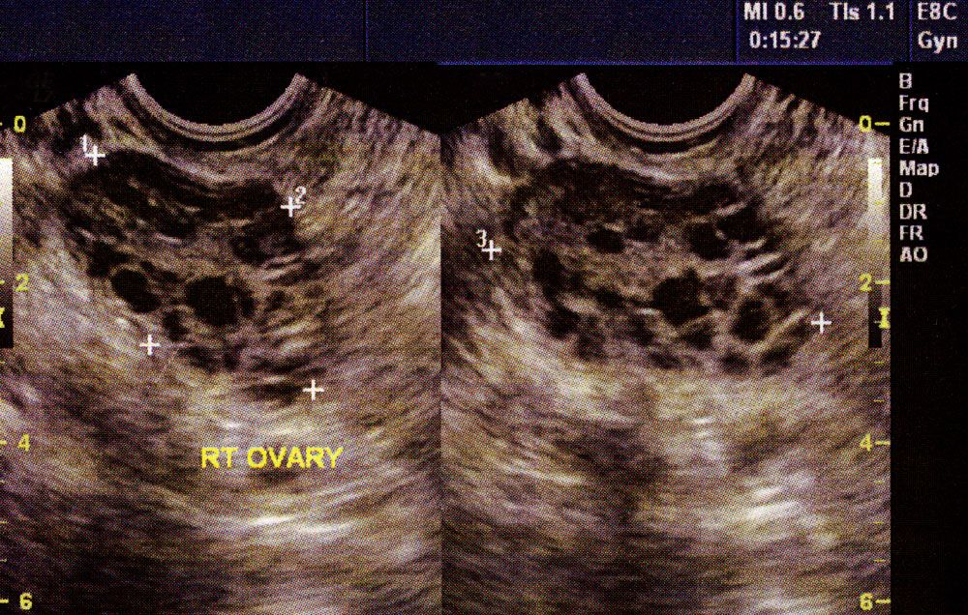
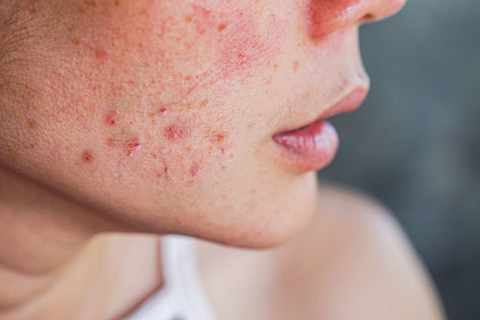
Polycystic Ovary Disease
Polycystic Ovary Disease (PCOS) is an endocrine disorder that affects the hormones of many women of reproductive age (Norris & Tuan, 2020; Mayo Clinic, 2022).
It is a relatively misunderstood disorder that presents itself not only as ovarian cysts, but with oligomenorrhea, hirsutism, acne, anovulation, & infertility.

Slide 11
PCOS & Our Microbiota
Although it is not thoroughly understood, studies have shown a significant difference in the microbiota of women with PCOS compared to healthy individuals (Mukherjee et al., 2023).
PCOS is thought to be closely related to disruption of one’s microbiota
PCOS is thought to be closely related to dysbiosis.

Slide 12
PCOS & Our Microbiota
Increased presence of harmful bacteria & a decreased presence of beneficial bacteria
Altered production of short-chain fatty acids (SCFAs)
Compromisation of the integrity of the intestinal lining
Decreased immunity
Increased inflammation
Altered metabolic processes
Improper production & regulation of reproductive hormones such as androgens
Leakage of lipopolysaccharides from the intestinal tract into the blood stream
Inflammatory response
Insulin resistance

Slide 13
Lifestyle Habits to Increase Microbiota Diversity & Decrease the Manifestations of PCOS
Exercise & healthy lifestyle habits are known to increase the diversity of bacteria in the microbiome and assist in regulating hormonal imbalances (Ibrahim et al., 2023)
When treating a patient with PCOS, the education of healthy lifestyle choices & modifications should be the priority
A diet consisting of a low glycemic index, healthy fats, good quality protein, high fiber, & low refined carbohydrates
Efficient stress-management strategies, such as mindful meditation, deep breathing, or music therapy
Low impact workouts, such as walking at least 5 out of the 7 days a week

Slide 14
Gestational Diabetes

Slide 15
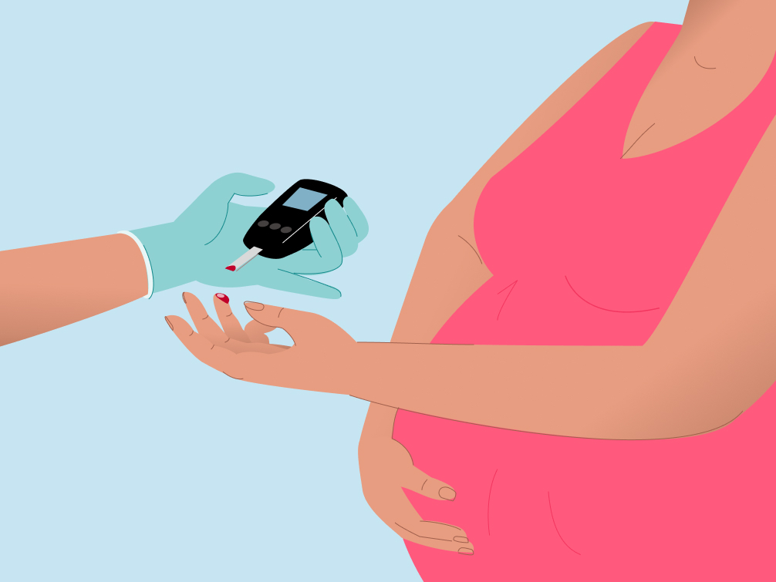
Gestational Diabetes
What is it?
Gestational diabetes is a state of hyperglycemia (high blood sugar) that women experience during pregnancy that can impact their health and the health of their baby (Mayo Clinic, 2022).
Signs and Symptoms of Gestational Diabetes:
Many women diagnosed with gestational diabetes experience increased thirst and increased urination frequency (Mayo Clinic, 2022).

Slide 16
Risk Factors of Gestational Diabetes
Risk Factors: (Mayo Clinic, 2022)
Being overweight or obese
Sedentary Lifestyle
Prediabetes
Gestational Diabetes during a previous pregnancy
Polycystic Ovary Syndrome
Family history of diabetes
Having previously delivered a baby weighing more than 9 pounds

Slide 17
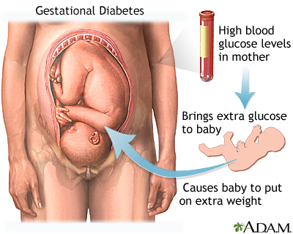
Complications of Gestational Diabetes
Possible complications for the baby:
Excessive birth weight (9 lbs or greater)
Preterm birth
Respiratory distress syndrome
Hypoglycemia after delivery
Obesity and Type 2 diabetes later in life
Stillbirth
Possible complications for the mother:
High blood pressure and preeclampsia
C-section delivery
Developing diabetes with future pregnancies
Develop type 2 diabetes after pregnancy

Slide 18
Diagnosing Gestational Diabetes
The oral glucose tolerance test is used to test pregnant women for gestational diabetes typically between 24 and 28 weeks into their pregnancy (Mayo Clinic, 2024)
1 Hour Oral Glucose Test:
Passing the test = blood glucose of 140 or lower
A blood glucose of 190 or higher after 1 hour
Means the mother needs to be retested using the 3 hour test
3 Hour Oral Glucose Test:
A healthy fasting glucose is 95 or less
1 hour after = 180 or less
2 hours after = 155 or less
3 hours after = 140 or lower

Slide 19
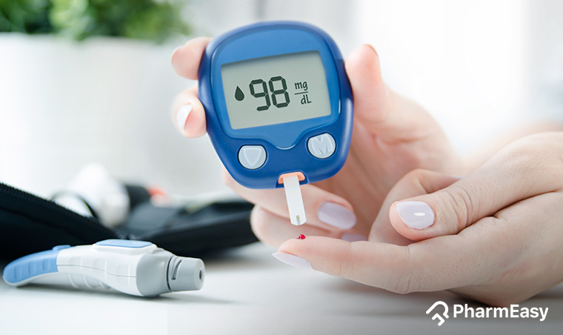
Managing Gestational Diabetes
Low-carbohydrate diet
Increasing physical activity
Staying adequately hydrated
Medication (Metformin)
Insulin injections
Recommended daily blood sugar target ranges for a woman with gestational diabetes (Mayo Clinic, 2024)
Before meals, at bedtime & overnight = 95 mg/dL or less
1 hour after eating = 140 mg/dL or less
2 hours after eating = 120 mg/dL or less
Low-Carbohydrate Diet: (MedlinePlus, 2023)
Plenty of fruits & vegetables
Lean Meat
Moderate amounts of whole grains
Limit foods high in sugar such as soda (not diet) fruit juices, & pastries

Slide 20
Fetal Alcohol Syndrome

Slide 21
Fetal Alcohol Syndrome
What is Fetal Alcohol Syndrome (FAS)?
The consumption of alcohol during pregnancy is linked to various neurological and physical abnormalities in a fetus, specifically fetal alcohol syndrome disorders (FASDs)
FASDs are disorders that occur in a fetus when they have been exposed to alcohol during gestation (CDC, 2023)
This is a prevalent public health issue in America in which there have been abundant efforts to promote the importance of alcohol abstinence during pregnancy (Oh et al., 2022)
Causes
The consumption of alcohol crosses the placenta and umbilical cord
There is no known safe alcohol consumption during pregancy nor safe time

Slide 22
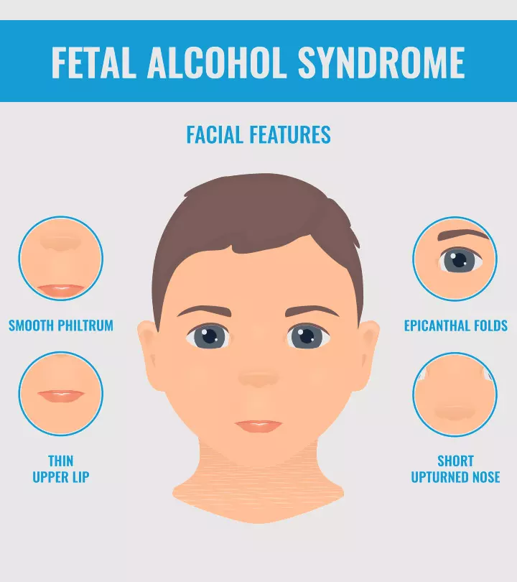
Fetal Alcohol Syndrome
Risk Factors
Signs & Symptoms of FAS
Consuming alcohol during gestation
Low socioeconomic status
Poor maternal nutritional status
Genetic susceptibility to FAS
Areas where heavy drinking during pregnancy is common
Mental health problems
Smooth philtrum
Short palperbral fissures
Intellectual impairment
Cognitive impairment
Developmental delay
Flexion contravtures
Cleft palate
Heart defects
Renal anomalies
Infant small for gestational age

Slide 23
Fetal Alcohol Syndrome
Patient Education
The most common types of preventive services used are alcohol screening and brief interventions and educational campaigns (CDC, 2020)
Despite multiple efforts to prevent alcohol consumption among pregnant women there a several barriers, such as lack of healthcare access and the stigma surrounding substance use during pregnancy
Interventions
Seeking therapy and mental health resources
Screenings
Use of digital interventions
Alcohol cessation during pregnancy
Educational resources

Slide 24
Fetal Alcohol Syndrome
Patient Education
With emerging new technologies there have been developments in digital interventions to deliver healthcare to a patient at a low cost & easily accessible (Oh et al., 2022)
Digital Interventions
Flo Pregnancy Tracker
Pregnancy & Baby Tracker: What to Expect
The Bump Baby Tracker & Pregnancy App
Glow Nurture AI Pregnancy App
Pregnancy+

Slide 25
Postpartum Depression

Slide 26
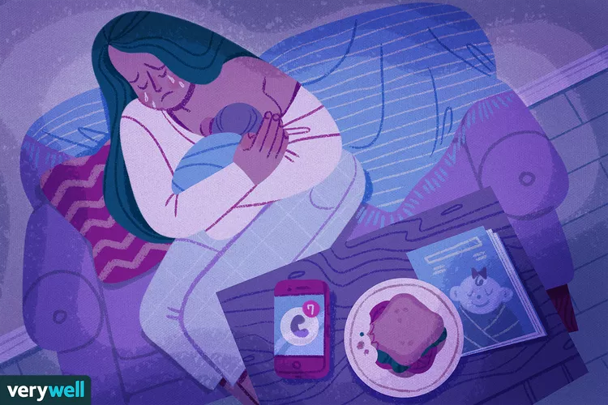
Postpartum Depression (PPD) According to research by the Mayo Foundation
Baby Blues
Postpartum Depression
Few days - Two weeks
Irritability/Anxiety/Mood swings
Overwhelmed feeling
Trouble sleeping
Three weeks - Up to a year
Severe mood swings
Difficult time bonding with baby
Social withdrawal
Sleep irregularities
Hopelessness, worthlessness
Thoughts of harm to self/baby
Maternal Mental Health Hotline at TLC-MAMA (852-6262)
(Amy Morin, 2023)
(Mayo Foundation, 2022)
Notes:
Debilitating fear that you are not being a “good mother” or living up to your expectations

Slide 27
The Role of Holistic Healthcare During & After Pregnancy
The overarching goal of educational interventions for the mother
(Williamson, 2023).
Amelioration of health inequities that drive disparities
Bridging the gap!
Diverse healthcare with cultural & generational considerations
Considerations and ways to promote maternal well-being
(Pouryousef et al., 2022).
Support groups (i.e. New/first-time moms, etc.)
Maternal mental health hotlines
Social media campaigns
Informational programs
Notes:
First and foremost, it is critical for the healthcare team to remain cognizant of their pregnant client’s health from a holistic standpoint (Williamson, 2023). In general, inadequate mental health promotion results in women lacking congruous support when it comes to potential psychological changes. Therefore, patient education is the key to approaching the stigma on mental health and elucidating the matter of self-care.
Moreover, the aim of educational interventions must tie back to the amelioration of health inequities that drive disparities amongst less informed expectant mothers (Pouryousef et al., 2022). With the goal of building upon diverse healthcare with cultural and generational considerations, healthcare professionals can aid in bridging the gap. All in all, ways to promote maternal well-being through all-encompassing healthcare interventions involve a blend of support groups, maternal mental health hotlines, social media campaigns, and informational programs.

Slide 28
The Support System
The overarching goal of educational interventions for the support system (Doaltabadi et al., 2021).
Shed light on expectations & norms
Set the foundation for roles
Fill in the blanks of any misconceptions, myths, & questions
Further educational interventions (Bedaso et al., 2021).
In-person support groups (ie. For new dads)
Online programs
Notes:
Shed light on expectations and norms throughout the transitional period before childbirth and once the baby is born

Slide 29
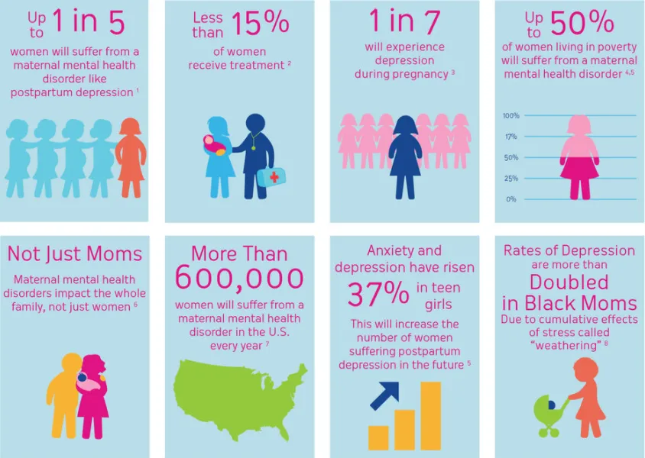
Summary
(2022)
Notes:
In conclusion, healthcare interventions that involve a heavy emphasis on maternity health education and literacy wield the power to enlighten and comfort not only pregnant women but also their support system concerning the ins and outs of maternal and infant care.
Ultimately, by actively cultivating an open space to augment and enhance patient knowledge and welfare, healthcare professionals can uphold and advocate for the comprehensive wellness of expectant mothers.
***Conclude with some demographics from Brown University to drive in the significance holistic care and how PPD often goes untreated and even undetected due to lack of education, accessibility, etcetera (see the “Not Just Moms” square too!!!)

Slide 30
References
Amy Morin, L. (2023, October 17). How to know if you’re experiencing postpartum depression. Verywell Mind. https://www.verywellmind.com/what-is-postpartum-depression-4847104
Bedaso, A., Adams, J., Peng, W., & Sibbritt, D. (2021). The relationship between social support and mental health problems during pregnancy: A systematic review and meta-analysis. Reproductive Health, 18(1). https://doi.org/10.1186/s12978-021-01209-5
Brown University Med-Peds. (2022, January 21). Postpartum depression: So common, yet so commonly missed: Brown Med. PEDS. https://brownmedpedsresidency.org/postpartum-depression/
Centers for Disease Control and Prevention. (2023, October 3). Fetal Alcohol Spectrum Disorders: Resources for prevention and care. Department of Health and Human Services. https://www.cdc.gov/ncbddd/fasd/features/resources-for-prevention-and-care.html
Doaltabadi, Z., Amiri-Farahani, L., Hasanpoor-Azghady, S.B., & Haghani, S. (2021). The effect of face-to-face and virtual prenatal care training of spouses on the pregnancy experience and fear of childbirth of primiparous women: A controlled quasi-experimental study. Journal of Telemedicine and Telecare, 29(10), 775–784. https://doi.org/10.1177/1357633x211024101
Ibrahim, A. A., Ghoneim, H.M., Elsaid, N. M. A. B., & Shalaby, N. S. (2023). Effectiveness of lifestyle modification on health-related quality of life among women with polycystic ovary syndrome. Iranian Journal of Nursing and Midwifery Research, 28(3), 286-292. https://doi.org/10.4103/ijnmr.ijnmr_380_21
Mayo Clinic. (2022, April 09). Gestational diabetes. https://www.mayoclinic.org/diseases-conditions/gestational-diabetes/symptoms-causes/syc-20355339

Slide 31
References
Mayo Clinic. (2024, May 03). Glucose tolerance test. https://www.mayoclinic.org/tests-procedures/glucose-tolerance-test/about/pac-20394296
Mayo Clinic. (2022, September 8). Polycystic ovary syndrome (PCOS). Retrieved February 6, 2024, from https://www.mayoclinic.org/diseases-conditions/pcos/symptoms-causes/syc-20353439
Mayo Foundation for Medical Education and Research. (2022, November 24). Postpartum depression. Mayo Clinic. https://www.mayoclinic.org/diseases-conditions/postpartum-depression/symptoms-causes/syc-20376617
MedlinePlus. (2023, March 01). Gestational diabetes diet. https://medlineplus.gov/ency/article/007430.htm#:~:text=Plenty%20of%20whole%20fruits%20and,drinks%2C%20fruit%20juices%2C%20and%20pastries
Mukherjee, A. G., Wanjari, U. R., Kannampuzha S., Murali, R., Namachivayam, A., Ganesan, R., Dey, A., Babu, A., Renu, K., Vellingiri, B., Ramanathan, G., Doss, G. P., Elsherbiny, N., Elsherbini, A. M., Alsamman, A. M., Zayed, H., & Gopalakrishnan, A. V. (2023). The implication of mechanistic approaches and the role of the microbiome in polycystic ovary syndrome (PCOS): A review. Metabolites, 13(1), 129. https://doi.org/10.3390/metabo13010129
National Institute of Diabetes and Digestive and Kidney Diseases. (2017, May). Tests & diagnosis for gestational diabetes. https://www.niddk.nih.gov/health-information/diabetes/overview/what-is-diabetes/gestational/tests-diagnosis#:~:text=Oral%20Glucose%20Tolerance%20Test%20(OGTT,doctor%20to%20diagnose%20gestational%20diabetes.
Norris, T., & Tuan, R. (2020). Porth 's essentials of pathophysiology (5th ed.). Wolters Kluwer.

Slide 32
References
Oei J. L. (2020). Alcohol use in pregnancy and its impact on the mother and child. Addiction, 115(11), 2148–2163. https://doi.org/10.1111/add.15036
Popova, S., Dozet, D., Pandya, E. et al. Effectiveness of brief alcohol interventions for pregnant women: a systematic literature review and meta-analysis. BioMed Central Pregnancy Childbirth, 23(61). (2023). https://doi.org/10.1186/s12884-023-05344-8
Pouryousef, S., Jahromi, M. K., Yeganeh, S., Rouhandeh, R., Paki, S., & Jokar, M. (2022). The effect of an educational intervention on anxiety of pregnant women: A quasi-experimental study. Investigación y Educación En Enfermería, 40(2), Article e05 https://doi.org/10.17533/udea.iee.v40n2e05
Williamson, L. (2023). What expectant moms need to know about mental health during and after
pregnancy. American Heart Association. https://www.heart.org/en/news/2022/05/09/what-expectant-moms-need-to-know-about-mental-health-during-and-after-pregnancy
Zou, Y., Liao, R., Cheng, R., Chung, H., Zhu, H., & Huang, Y. (2023). Alterations of gut microbiota biodiversity and relative abundance in women with PCOS: A systematic review and meta-analysis. Microbial Pathogenesis. 184, 106370. https://doi.org/10.1016/j.micpath.2023.106370

