Slide 1
Combating Human Trafficking in the Educational Sector
By Tiffani Price

Slide 2
About Me
Tiffani Price
Human Trafficking Survivor and Consultant (Many of the atrocities we will discuss have happened to me)
Worked in Education for 7 years
The Jenson Project
Website: GloryB.org
Notes:
Many survivors have been trafficked by romantic partners, including spouses, and by family members, including parents.

Slide 3
Trigger Warning

Slide 4
The purpose of this session is to
raise awareness of human trafficking and
provide signs to look for in students in your school
that might indicate they are being trafficked.

Slide 5
The U.S. Department of Education reports that “Many underage victims of human trafficking are students in the American school system.
No community, school, socioeconomic group, or student demographic is immune to the threat of human trafficking. Cases of child trafficking are found in every area of the country—in rural, suburban, and urban settings alike.”
Notes:
https://www.ed.gov/human-trafficking#:~:text=Combatting%20Hum
https://www.ed.gov/human-trafficking
¹Polaris Project. (2020). 2019 data report: The US National Human Trafficking Hotline. Washington, DC: Author. https://polarisproject.org/wp-content/uploads/2019/09/Polaris-2019-US-National-Human-Trafficking-Hotline-Data-Report.pdf

Slide 6
Objectives
Define human trafficking
Describe the types and venues of human trafficking
Differentiate between human trafficking and human smuggling
Discuss communication strategies to assist with identification of a trafficked person
Identify the prevalence of human trafficking in schools and communities
Discuss the global impact and identify preventative measures
Recognize indicators and warning signs of trafficking involvement

Slide 7
Definition
Human Trafficking involves the use of Force, Fraud, Coercion to obtain some type of labor and commercial sex act.
Force: The use of Physical power (example: beating, Physical restraint, rape)
Fraud: The use of false Promises (example: Promising payment or citizenship of work.)
Coercion: Threats of harm( example: blackmail)

Slide 8
An individual under the age of 18
engaged in commercial sex
is considered a victim of sex trafficking
regardless
of the presence of force, fraud or coercion.
Notes:
https://humantraffickinghotline.org/en/sex-trafficking-venuesindustries/street-based

Slide 9
Examples of Use of Force to Control
Physical or sexual abuse, often in the form of repeated rapes by one or more people to create submission;
Confinement to the residence;
Restrictions on movement and communication with family and friends;
Forced abortions;
Lack of medical treatment or reproductive health.
Notes:
https://humantraffickinghotline.org/en/sex-trafficking-venuesindustries/street-based

Slide 10
Examples of Use of Fraud to Control
False promises of a better life through the trafficker presenting as a boyfriend or caretaker figure.
(Watch carefully for this in teenagers!)
Notes:
https://humantraffickinghotline.org/en/sex-trafficking-venuesindustries/street-based

Slide 11
Examples of Use of Coercion to Control – Part 1
Threats of harm to the victim or victim’s family
Threats to shame the victim by revealing the commercial sex to his or her family and others in the community
Confiscation of birth certificates and other identification documents
Forced dependency on the trafficker
Notes:
https://humantraffickinghotline.org/en/sex-trafficking-venuesindustries/street-based

Slide 12
Examples of Use of Coercion to Control – Part 2
Rumors of or witnessed violence at the hands of traffickers used as threats
A cycle of rewards and punishments
Threats of police involvement and arrest
Threats of deportation if the victim is a foreign national
Notes:
https://humantraffickinghotline.org/en/sex-trafficking-venuesindustries/street-based

Slide 13
Important Information to Know
Trafficking of people has gone on for Centuries, another reason why it’s called “Modern Day Slavery”.
Trafficking does not require crossing international or state borders.
Intimate Partners and family members are potential traffickers. (My parents were my traffickers.)

Slide 14
Law
Trafficking Victims Protection Act (2000)- The first comprehensive federal law to address trafficking in persons.
Three-pronged approach: prevention, protection, and prosecution.
Notes:
The Trafficking Victims Protection Act (TVPA) of 2000 is the first comprehensive federal law to address trafficking in persons. The law provides a three-pronged approach that includes prevention, protection, and prosecution. The TVPA was reauthorized through the Trafficking Victims Protection Reauthorization Act (TVPRA) the unlawful act of recruiting, harboring, transporting, provisioning, obtaining, patronizing, or soliciting of a person, through the use of force, fraud, or coercion for the purpose of forced labor or sexual exploitation. Peonage is holding someone against his or her will to pay off a debt.
Prosecution: The Department of State analyzes whether governments criminalize all forms of human trafficking, vigorously investigate and prosecute cases of human trafficking, and convict and sentence those responsible for such acts with prison sentences that are sufficiently stringent to deter the crime and adequately reflect the heinous nature of the offense. The TPVA Adding new criminal provisions prohibiting forced labor, trafficking with respect to peonage, slavery, involuntary servitude, or forced labor, and sex trafficking of children or by force, fraud, or coercion;
Criminalizing attempts to engage in these activities; Mandating that traffickers pay restitution to their victims, and providing for forfeiture;
Strengthening penalties for existing trafficking crime
Protection: key to the victim-centered approach that the international community takes in its efforts to combat modern slavery. TVPA making foreign victims eligible for federally funded or administered health and other benefits and services and by requiring federal agencies to expand the provision of such benefits and services to victims, regardless of their immigration status;
By creating immigration protections for foreign national victims of human trafficking, including protection from removal for victims of trafficking (the T visa) and victims of certain crimes (the U visa)
To effectively protect foreign national trafficking victims, governments should enable them to remain in the country, work, and obtain services without fear of detention or deportation for lack of legal status or because of crimes that their traffickers forced them to commit. In addition, governments should ease the process for victims to secure immigration relief.
Prevention: efforts are an equally important component of the global movement to combat human trafficking. Providing for international initiatives to be established and carried out to improve economic opportunity for potential victims as a means of deterring trafficking.

Slide 15
Crime Statistics Are Limited and Underrepresent the Victim
The crime statistics on human trafficking are only as good as the crime data informing them.
Often survivors do not disclose their victimization for reasons such as fear of their trafficker, arrest, deportation, or being stigmatized.

Slide 16
Crime Statistics
Texas is #2 behind California as the most trafficked victims
800,000-900,000 are trafficked annually across international borders (2003)
Underaged children (<17 years old) involved in sexual exploitation in the US >250,000, and 60% are runaways or homeless youth
1 in 4 victims are minors
Women account for 2/3 of the reported victims
The majority of the traffickers are male
The average age of entry is 12 years old
Notes:
The deficiency of UCR data on trafficking crimes is attributable to three primary factors, the report said:
The relative recency of the incorporation of trafficking data in UCR, with some jurisdictions moving more quickly than others to contribute their data to that central crime data source.
Deficient identification of potential human trafficking incidents by local law enforcement.
Incomplete reporting of identified offenses at the local and state agency levels.
Per state.gov website: Traffickers profit at the expense of their victims by compelling them to perform labor or to engage in commercial sex in every region of the United States and around the world. With an estimated 27.6 million victims worldwide at any given time, human traffickers' prey on people of all ages, backgrounds, and nationalities, exploiting them for their own profit.
Inability to collect data: Researchers discovered a widespread inability of law enforcement officers to identify local trafficking offenses, coupled with inadequate reporting of those offenses that were identified.
Recommendations: Continued training of officers on how to spot a trafficking case, how to record it, and how to refer it to special investigators.
Establishment of nontraditional partnerships between law enforcement, labor regulators, inspection services, youth service providers, and immigration advocates to address labor trafficking.

Slide 17
Facts
According to the International Labour Organization (ILO), 27.6 million people are in forced labor, of which 6.3 million in forced commercial sexual exploitation.
Homeland Security reports that Human Trafficking is a $150 billion industry globally.
Notes:
https://www.dhs.gov/sites/default/files/2022-02/CCHT%20Annual%20Report.pdf
Victims of forced labour include 17.3 million exploited in the private sector; 6.3 million in forced commercial sexual exploitation, and 3.9 million in forced labour imposed by State.
https://www.ilo.org/resource/news/mexico-renews-commitment-against-forced-labour#:~:text=According%20to%20the%20ILO%2C%2027.6,forced%20labour%20imposed%20by%20state.

Slide 18
Considerations
The crime of sex trafficking is also understood through the “acts,” “means,” and “purpose” framework. All three elements are required to establish a sex trafficking crime (except in the case of child sex trafficking where the means are irrelevant).
Notes:
The “acts” element of sex trafficking is met when a trafficker recruits, harbors, transports, provides, obtains, patronizes, or solicits another person to engage in commercial sex.
The “means” element of sex trafficking occurs when a trafficker uses force, fraud, or coercion. Coercion in the case of sex trafficking includes the broad array of means included in the forced labor definition. These can include threats of serious harm, psychological harm, reputational harm, threats to others, and debt manipulation.
The “purpose” element is a commercial sex act. Sex trafficking can take place in private homes, massage parlors, hotels, or brothels, among other locations, as well as on the internet.

Slide 19
Why does trafficking happen?
Operates in the form of supply and demand (i.e. people being used as a commodity)
No boundaries for trafficked victims
Multiple trafficking entry points
Notes:
The “acts” element of sex trafficking is met when a trafficker recruits, harbors, transports, provides, obtains, patronizes, or solicits another person to engage in commercial sex.
The “means” element of sex trafficking occurs when a trafficker uses force, fraud, or coercion. Coercion in the case of sex trafficking includes the broad array of means included in the forced labor definition. These can include threats of serious harm, psychological harm, reputational harm, threats to others, and debt manipulation.
The “purpose” element is a commercial sex act. Sex trafficking can take place in private homes, massage parlors, hotels, or brothels, among other locations, as well as on the internet.

Slide 20
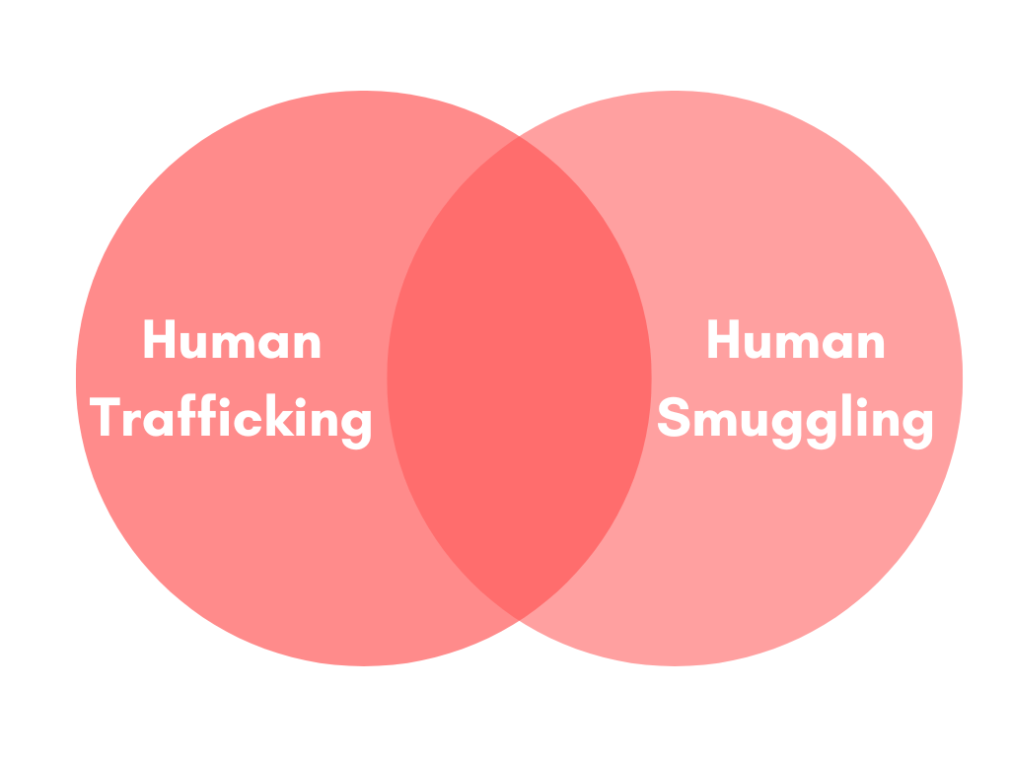
Trafficking | Smuggling
Crime against a person | Crimes against a country
Contains an element of coercion (unless a child is under 18) | No coercion
Exploitation and/or forced labor | Involves entry into the country only
Persons are seen as victims (one cannot consent to be a victim) | Persons are seen as criminals
*Smuggling can become trafficking if exploited after a border crossing
Texas Abuse Hotline 800-252-5400

Slide 21
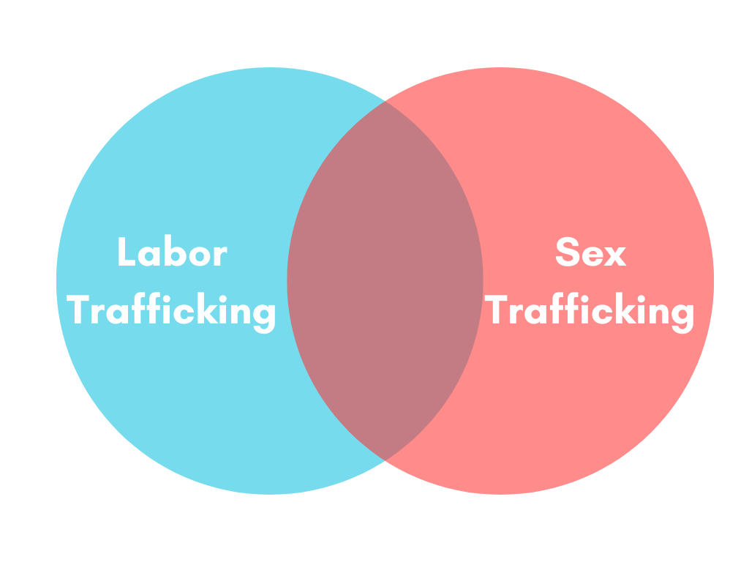
Categories of Human Trafficking
Labor Trafficking
Sex Trafficking
A crossover of both labor and sex trafficking

Slide 22
Human Trafficking…
Can be prosecuted under federal or state law.
Is about exploitation and does not have to involve the movement of a person.
Notes:
TEA
https://tea.texas.gov/about-tea/other-services/educator-ppt-final-w-tea-logo1.pdf

Slide 23
Types of Trafficking
Some forms of sex and labor trafficking are debt bondage, slavery, child soldiering, and involuntary servitude.
Notes:
There are four major types of trafficking:
Adult Sex Trafficking - Trafficking of adults for sex by force, fraud, or coercion in strip clubs, brothels, massage parlors, street prostitution, or internet prostitution.
Adult Labor Trafficking - Trafficking adults for labor by force, fraud, or coercion into industries, such as agriculture, food service, manufacturing, domestic servitude, or hospitality.
Child Sex Trafficking - In cases where an individual engages in any of the specified “acts” with a child (under the age of 18), the means element is irrelevant regardless of whether evidence of force, fraud, or coercion exists. The use of children in commercial sex is prohibited by law in the United States and most countries around the world.
Child Labor Trafficking - Trafficking children, under the age of 18, by force, fraud or coercion into industries such as agriculture, food service, manufacturing, domestic servitude, or hospitality.

Slide 24
Labor Trafficking: Domestic servitude
“Domestic servitude” is a form of forced labor in which the trafficker requires a victim to perform work in a private residence.
Such circumstances create unique vulnerabilities.
Domestic workers are often isolated and may work alone in a house.
Their employer often controls their access to food, transportation, and housing.
Notes:
There are four major types of trafficking:
Adult Sex Trafficking - Trafficking of adults for sex by force, fraud, or coercion in strip clubs, brothels, massage parlors, street prostitution, or internet prostitution.
Adult Labor Trafficking - Trafficking adults for labor by force, fraud, or coercion into industries, such as agriculture, food service, manufacturing, domestic servitude, or hospitality.
Child Sex Trafficking - In cases where an individual engages in any of the specified “acts” with a child (under the age of 18), the means element is irrelevant regardless of whether evidence of force, fraud, or coercion exists. The use of children in commercial sex is prohibited by law in the United States and most countries around the world.
Child Labor Trafficking - Trafficking children, under the age of 18, by force, fraud or coercion into industries such as agriculture, food service, manufacturing, domestic servitude, or hospitality.

Slide 25
Labor Trafficking: Forced Child Labor
The term “forced child labor” describes forced labor schemes in which traffickers compel children to work.
Traffickers often target children because they are more vulnerable.
Although some children may legally engage in certain forms of work, forcing or coercing children to work remains illegal.
Notes:
There are four major types of trafficking:
Adult Sex Trafficking - Trafficking of adults for sex by force, fraud, or coercion in strip clubs, brothels, massage parlors, street prostitution, or internet prostitution.
Adult Labor Trafficking - Trafficking adults for labor by force, fraud, or coercion into industries, such as agriculture, food service, manufacturing, domestic servitude, or hospitality.
Child Sex Trafficking - In cases where an individual engages in any of the specified “acts” with a child (under the age of 18), the means element is irrelevant regardless of whether evidence of force, fraud, or coercion exists. The use of children in commercial sex is prohibited by law in the United States and most countries around the world.
Child Labor Trafficking - Trafficking children, under the age of 18, by force, fraud or coercion into industries such as agriculture, food service, manufacturing, domestic servitude, or hospitality.

Slide 26
Labor and Sex Trafficking: Familial Trafficking – Part 1
Familial trafficking invites the exploitation of minors within their own family for goods, substances, services, or money.
While parents or often the perpetrators, any legal guardian or family member, including aunts, uncles, cousins, grandparents, or siblings, can be involved
Notes:
https://www.inhope.org/EN/articles/what-is-familial-trafficking

Slide 27
Labor and Sex Trafficking: Familial Trafficking – Part 2
This is one of the most common forms of trafficking and is on the rise.
40% of all trafficking cases are familial.
Familial Trafficking goes unreported due to the complexities of the familial power dynamics.
This is the kind of trafficking I’m most familiar with because it happened to me.
Notes:
https://www.inhope.org/EN/articles/what-is-familial-trafficking

Slide 28
Signs That Were Missed With Me
I missed a lot of days of school.
I was extremely fearful of my parents.
I fell asleep often during class time.
I was starving for any attention.
I had behavior issues.
I was socially awkward.
I was not comprehending anything the teacher taught.
I wasn’t on the same grade level as my peers.
I was scared to death of men.
I was very jumpy.
I had advanced knowledge of sexual activities.

Slide 29
Sex Trafficking: Pimp-Controlled/Street-Based
Pimp-controlled trafficking is the most talked about form of trafficking in the U.S. Though the focus of these conversations remains largely on the trafficking of girls, pimps who exploit minors for Commercial Sexual.
Pimp-controlled trafficking is extremely dangerous as it specifically targets vulnerable youth and involves severe levels of manipulation and violence.
Notes:
Pimp Controlled Fact Sheet

Slide 30
How Pimps Groom and Control Youth – Part 1
One common tactic utilized by pimps to exploit youth is to develop a connection or special relationship with the youth, such as a strong friendship, romantic relationship or family-like bond.
Over time the relationship changes to one of power and abuse, much like domestic violence, until, ultimately, the youth is forced to engage in sex work.
Notes:
Pimp Controlled Fact Sheet

Slide 31
How Pimps Groom and Control Youth – Part 2
Conversely, however, many pimps do not go through this process and instead utilize force from the onset. Pimps may use fear, intimidation, and threats of violence to force youth into prostitution, absent of a “special relationship.”
Notes:
Pimp Controlled Fact Sheet

Slide 32
Pimps make deliberate choices to target certain youth based on their vulnerabilities.
Notes:
Pimp Controlled Fact Sheet

Slide 33
Oftentimes, traffickers zero in on youth who demonstrate having unfulfilled physical or emotional needs.
Pimps focus on youth in desperate or unwanted situations.
This includes:
youth who have left home
youth in abusive homes
youth in child welfare.
Notes:
Pimp Controlled Fact Sheet

Slide 34
The pimp can then pose as a:
friend,
mother/father figure
romantic partner
good Samaritan
and offer to provide such needs.
Notes:
Pimp Controlled Fact Sheet

Slide 35
Even teens who may show anger and frustration toward their parents for giving them the freedom they desire can be targets for pimps who can make promises of
Love
Freedom
Independence
Family
Safety
Even commercial goods.
Notes:
Pimp Controlled Fact Sheet

Slide 36
Pimps start by fulfilling these promises, thus manipulating the youth into trusting them.
The youth then believes that the pimp is truly someone who cares for them.
Often youth don’t recognize that what they are experiencing is a form of control or manipulation, because they feel they love and/or depend on
their pimp.
This is similar to the dynamics of domestic violence.
Notes:
Pimp Controlled Fact Sheet

Slide 37
Pimps may utilize control mechanisms such as:
Providing basic needs such as housing and food
Providing gifts, drugs, technology, beauty makeovers
Making false promises of a career in modeling, acting, or dancing
Making false offers of love, marriage, family
Providing a false sense of safety and/or understanding
Normalizing past, current, and/or ongoing abuse.
Notes:
Pimp Controlled Fact Sheet

Slide 38
Extreme Systems Of Behavioral Expectations
Victims are often expected to earn a nightly quota which is all confiscated by the trafficker.
Victims may not allowed to walk on the sidewalks, but instead walk along the street.
They may not be allowed to look other traffickers in the eye or may be required to take on a completely new persona and identity.
Punishments have been reported to be extremely harsh, including physical beatings, sexual assault or torture techniques.
Notes:
https://humantraffickinghotline.org/en/sex-trafficking-venuesindustries/street-based

Slide 39
Names Commonly Used in Pimp Culture
Daddy
Boyfriend
Wifey
Stable
Master
Sister

Slide 40
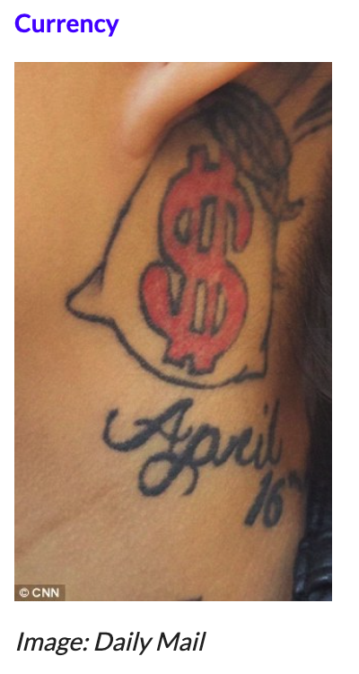
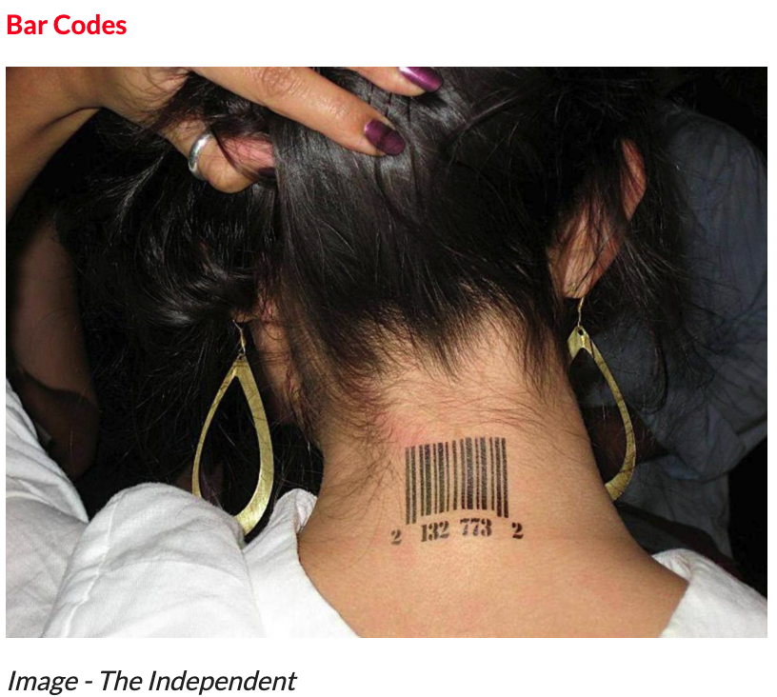
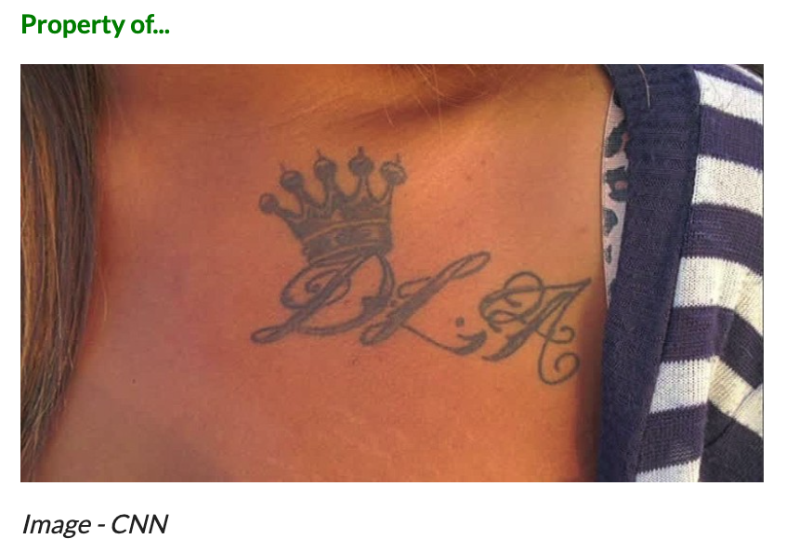
Branding Tattoos
Notes:
https://www.napnappartners.org/tattoos-human-trafficking-victims

Slide 41
Who Are the Traffickers?
Traffickers can be anyone:
Men or Women
Parents or Family Members
Neighbors
Boyfriends/Girlfriends
Peers
Employers
Brothel Owners
Organized Crime Participants/Gang Members
Notes:
TEA
https://tea.texas.gov/about-tea/other-services/educator-ppt-final-w-tea-logo1.pdf

Slide 42
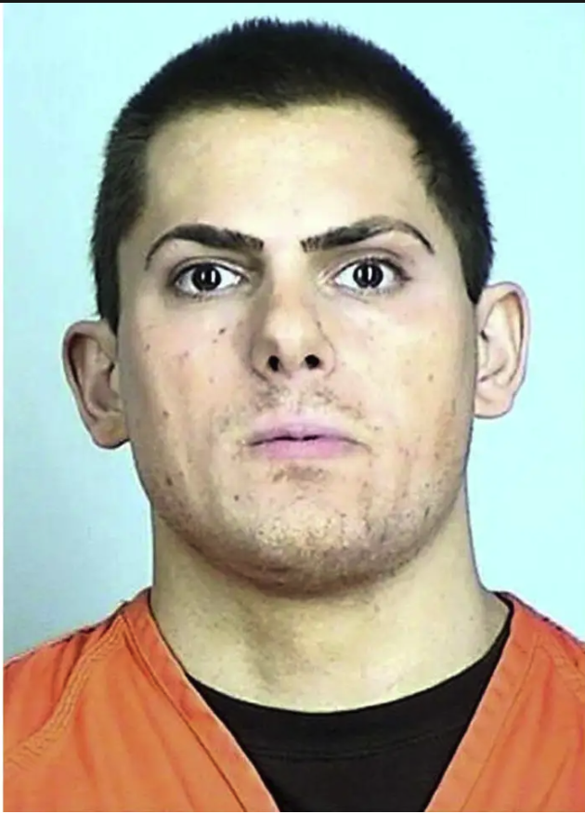
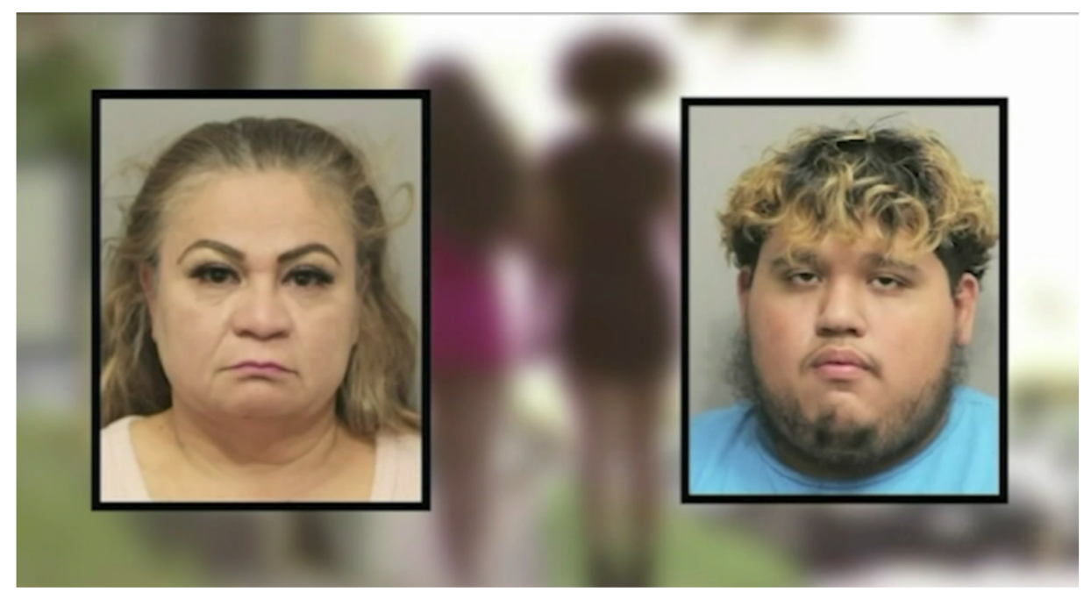
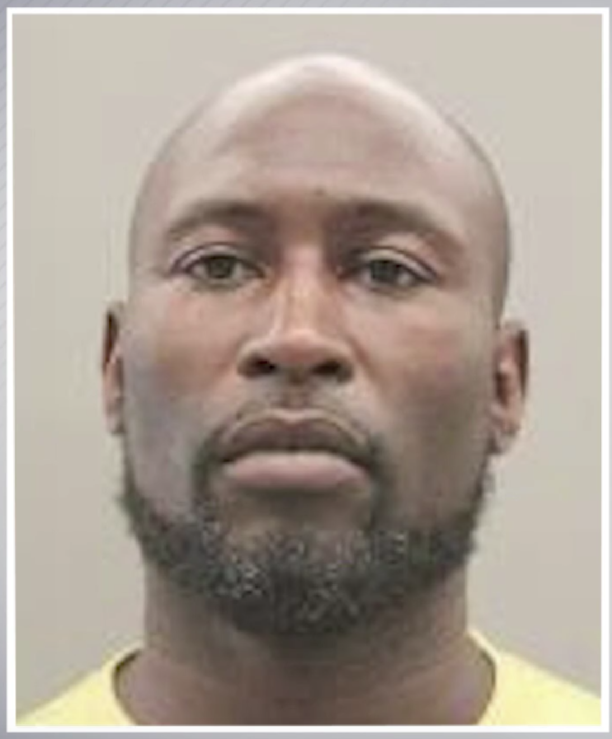
Add pictures of convicted pimps varying in age & gender
Notes:
https://apnews.com/article/sex-trafficking-gop-donor-conviction-lazzaro-c1c3c808036e83006485c321e447d0e9
https://www.khou.com/article/news/crime/king-of-bissonnet-prison-prostitution/285-40d4ad68-1f65-48b1-8262-78f3f3bcaee4
https://www.justice.gov/usao-sdtx/pr/woman-guilty-trafficking-women-cantina-backroom

Slide 43
Media Reports: Anyone Can Be a Trafficker
A Houston trafficking ring forced minors to work in businesses labeled as massage parlors, bikini bars, etc. The victims could not keep their profits, making them financially dependent on their traffickers.
In Fayetteville, NC, a mom pled guilty to sex trafficking her 5-year-old daughter to pay off a $200 debt.
In White Plains, NY, three members of a suburban family were convicted of assault and labor traffic king after they forced a woman into domestic servitude.
Notes:
https://tea.texas.gov/about-tea/other-services/educator-ppt-final-w-tea-logo1.pdf

Slide 44
Trafficker Recruitment Techniques
Proactive targeting of vulnerable individuals and grooming behaviors
Seduction, romance
False job advertisements
Travel opportunities
Sale by family
Recruitment through former victims
Abuse of religious beliefs
Forced pregnancy or sale at birth

Slide 45
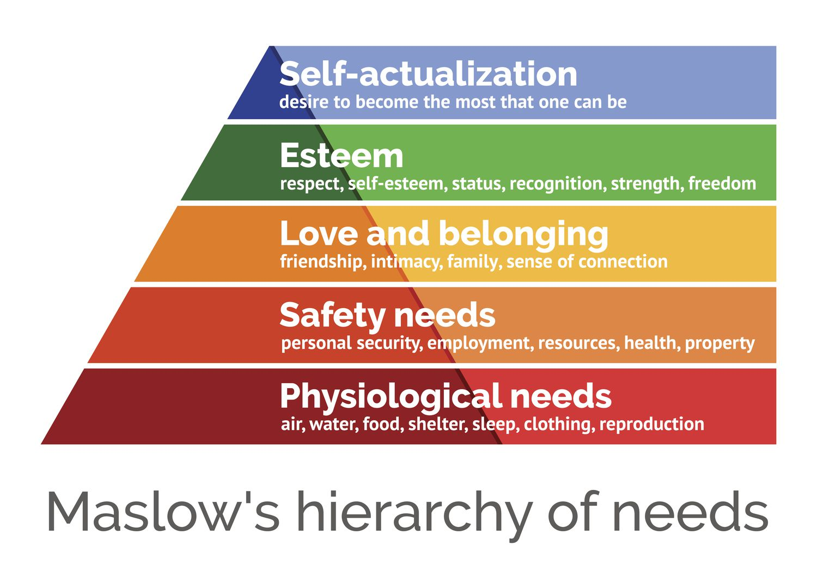
Needs of the Victim
Notes:
The safety needs of victims were identified as the first priority by all of those working with victims. According to law enforcement and providers, screening for safety needs (for both the victims and providers) is part of every assessment they conduct. Safety needs are often met when the next priority need for (safe) emergency housing is addressed. Other emergency needs include food and clothing and, for international victims, translation services to avoid feelings of isolation and to facilitate communication regarding other needs.

Slide 46
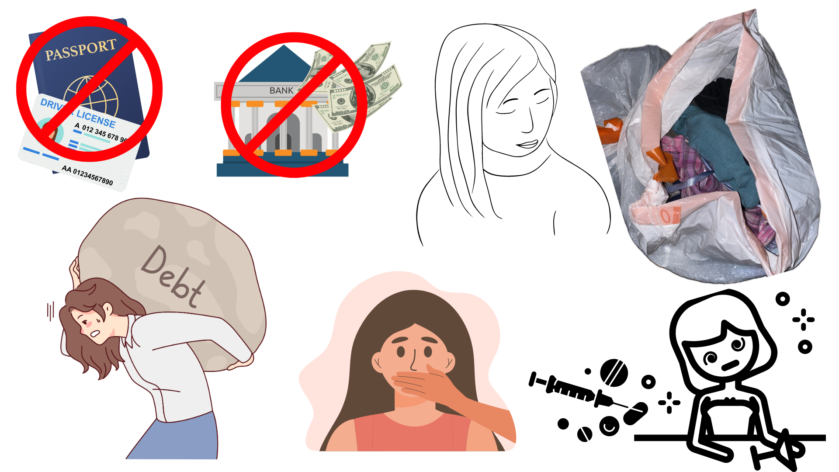
Tactics Used by the Abuser
Notes:
Not in control of their own ID or passport.
Not allowed or able to speak for themselves, refuse to make eye contact
Has little personal property/wears the same clothes over and over again or carries belongings in a trash bag.
Paid mostly in cash, not in control of their money/no financial records or bank account
Appears to be under the influence of drugs or alcohol.
Has a large debt that cannot be paid off.

Slide 47
Vulnerable Characteristics
Fearful
Anxious
Depressed
Submissive
Tense
Nervous
Paranoid
Notes:
Not in control of their own ID or passport.
Not allowed or able to speak for themselves, refuse to make eye contact
Has little personal property/wears the same clothes over and over again or carries belongings in a trash bag.
Paid mostly in cash, not in control of their money/no financial records or bank account
Appears to be under the influence of drugs or alcohol.
Has a large debt that cannot be paid off.

Slide 48
Tactics Used by the Abuser
Overly attached to one person or has one person overly attached to them.
Has a pimp, manager or someone who will not leave their side.
Needs permission or direction to make simple decisions, such as going to the bathroom.
Not free to leave or come and go as they wish.
Notes:
Not in control of their own ID or passport.
Not allowed or able to speak for themselves, refuse to make eye contact
Has little personal property/wears the same clothes over and over again or carries belongings in a trash bag.
Paid mostly in cash, not in control of their money/no financial records or bank account
Recruited with false promises concerning the nature and conditions of their work.
Unpaid or paid very little by cash tips off the record.
Has a pimp, manager or someone who will not leave their side.
Works long and/or unusual hours.
Has a large debt that cannot be paid off.
Is under the age of 18 and performing sex acts in exchange for anything of value.
Exchanging commercial sex acts for needs like shelter, food, or other means of survival.
Fearful, anxious, depressed, submissive, tense, nervous, or paranoid.
Appears to be under the influence of drugs or alcohol.
Overly attached to one person or has one person overly attached to them.
Needs permission or direction to make simple decisions, such as going to the bathroom.
Not free to leave or come and go as they wish.

Slide 49
Who are the victims?
Labor and sex trafficking affect people of all
Ages
Races
Nationalities
Religions
Genders
Sexual orientations
Socioeconomic backgrounds &
Citizenship statuses.
However, some populations are at a higher risk of exploitation.
Evidence suggests that people of color and LGBTQ+ people are more likely to be trafficked than other demographic groups.
Notes:
https://humantraffickinghotline.org/en/sex-trafficking-venuesindustries/street-based

Slide 50
Victim Vulnerabilities – Part 1
Some examples of these include (and are not limited by):
Homelessness: Runaway and homeless youth may be particularly at risk for sex trafficking.
A study by Covenant House found that 48% of interviewed youth that had experienced sex trafficking and had initially engaged in commercial sex because they did not have a place to stay.
Notes:
https://humantraffickinghotline.org/en/sex-trafficking-venuesindustries/street-based

Slide 51
Victim Vulnerabilities – Part 2
In addition, LGBTQ youth are disproportionately overrepresented in the number of minor sex trafficking victims
(20-40% compared 5-7% of the general youth population).
Notes:
https://humantraffickinghotline.org/en/sex-trafficking-venuesindustries/street-based

Slide 52
Victim Vulnerabilities – Part 3
Prior Violence and Assault:
Individuals who have experienced prior sexual assault and violence may have increased risk of sex trafficking, according to a study by the Illinois Criminal Justice Information Authority.
Victims who experience repeated violent acts may unconsciously normalize victimization and/or be unable to see alternative possibilities.
Notes:
https://humantraffickinghotline.org/en/sex-trafficking-venuesindustries/street-based

Slide 53
Victim Vulnerabilities – Part 4
Victims of street-based commercial sex are known to be vulnerable to violence and assault from buyers.
Although victims in street-based commercial sex are commonly monitored by a trafficker, the trafficker is often less visible and, therefore, more difficult for police to investigate.
Notes:
https://humantraffickinghotline.org/en/sex-trafficking-venuesindustries/street-based

Slide 54
Where Does Trafficking Often Take Place?
Social Media (modeling gigs)
Internet Based Commercial Sex Act (CSA) (i.e. back page or craigslist)
Fake Massage or Spa business (strip shopping mall)
Residential based commercial sex act
Truck stop
Hotel
Escort Service Ad (newspaper, magazine)
Prostitution (i.e. gang affiliation, pimps, madams)
Labor Trafficking: Restaurant/ Food Services (i.e. undocumented immigrants)
Traveling Sales Crews (i.e. carnivals, cruises, panhandling w/kids)
Parties
Notes:
Victims of sex trafficking can be found anywhere, but are often found in:
• Bars and Brothels
• Dance clubs and strip clubs
Massage parlors and spas
• Escort services
• Private parties
• Pornography industry
• On the Internet
In the DoD, labor trafficking has occurred in contracts that cover labor intensive industries such as:
• Food services
• Janitorial and disposal services
• Truck and driver services
• Security guards
• Construction work

Slide 55
Entry Points
#1 is a History of Sexual Abuse
25% enter through the Texas-Mexico Border (HHS, 2023)
30% of calls received by the National Human Trafficking Hotline is from Texas
Often occurs amongst people known and trusted (family members, partners, community leaders)
DFW region accounts for 35% of the state’s commercial sexual exploitation cases even though they only make up 25% of the state’s entire population.
Notes:
Generational trauma, historic oppression, discrimination and other societal factors and inequities create community-wide vulnerabilities.
Traffickers recognize and take advantage of people who are vulnerable in certain ways.
#1 History of Sexual Abuse
Have an unstable living situation
Have a history of domestic violence/ sexual abuse
Has a caregiver or family member who has a substance abuse issue
Are runaways or involved in the juvenile justice or foster care system
Are undocumented immigrants
Are facing poverty or economic need
Have a history of sexual abuse
Are addicted to drugs or alcohol
Social media posts for potential victims (i.e.
Foster care (i.e. 60% have experienced sex abuse in foster care)
Intellectual disabilities (i.e. criminal charge if trafficking a disabled person)

Slide 56
Trafficking ads

Slide 58
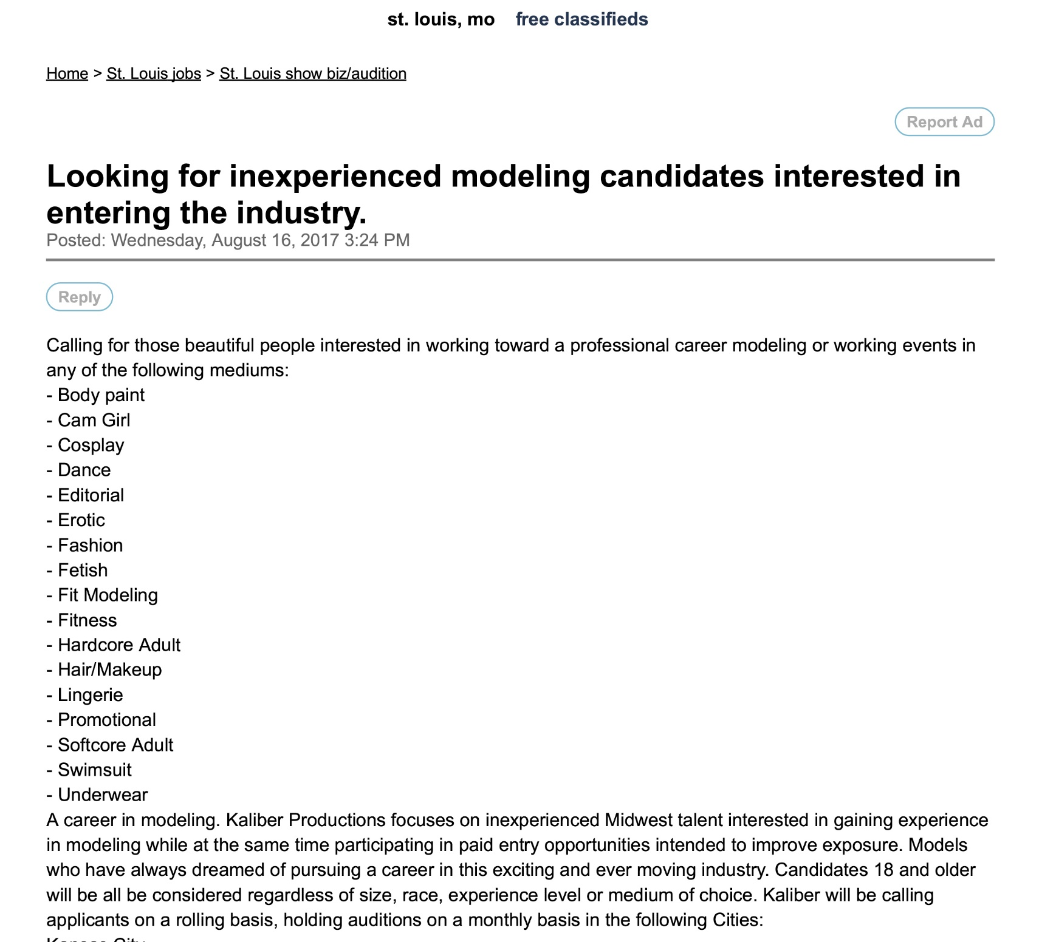

Slide 59
Why Don’t Youth Leave a Pimp-Controlled Trafficking Situation?
Youth are often traumatized and blame themselves for victimization.
Youth may believe that there is no way out of their trafficking situation.
Notes:
Pimp Controlled Fact Sheet

Slide 60
Additional Reasons Why Youth May Stay in a Trafficking Situation:
The youth:
● Are unaware what is being done to them is a crime
● Do not consider themselves victims (abuse is normalized from past experiences)
● Develop positive feelings toward trafficker as coping mechanism
● Distrust of Authorities
● May try to protect trafficker from authorities
● Do not know where they are because traffickers frequently move youth
● Are blackmailed and fear for the safety of family
Notes:
Pimp Controlled Fact Sheet

Slide 61
Combating Human Trafficking in the Field of Education
Know the signs of trafficking
Develop meaningful relationships with students
Make the time to inquire about behavior that is concerning
Have a plan in place
Ask the student, “Is someone asking you to do this behavior?”

Slide 62
Safety 1st
Do not approach the trafficker!
Follow the district protocols.
Notify law enforcement.

Slide 63
Vulnerable Populations in the School System
Foster care youth
Students with low-income parents who need to work more (Kids want items and opportunities their peers have.)
Known sexual abuse victims
LGBTQ (They are looking for a support system.)
Homeless youth

Slide 64
Identifying the Trafficked Victim
Is the victim accompanied by another person who seems to be controlling?
Does the accompanied party insist on providing the information?
Is the victim unsure of their whereabouts or environment (i.e. city, orientation)?
Is the victim in control of their own documents or ID?

Slide 65
Prevention Is Key!
There are not enough resources available to combat all of the physical, psychological, emotional, and financial needs of a survivor for even minimal care,
much less long-term care.

Slide 66
Identifying “Red Flags”
Identifying “red flags” is the first step in determining if a youth may be a victim or survivor of sex trafficking. If you suspect a student is a victim based on these or other observations, follow district protocol to report so professionals can determine if further steps need to be taken.
Notes:
https://iofa.org/wp-content/uploads/2018/09/IOFA-Red-Flags-of-Youth-Sex-Trafficking.pdf
Identifying “red flags” is the first step in determining if a youth may be a victim or survivor of sex trafficking. Based on these observations, professionals can determine if the youth should be assessed for sex trafficking by an agency that specializes in forensic interviewing, such as a local Child Advocacy Center. Youth should be provided with immediate needs, such as shelter, food, and safety. For referral services in your area, call the National Human Trafficking Hotline at 1-888-373- 7888. If a youth is in immediate danger, please call 9-1-1.

Slide 67
Behavioral Red Flags – Part 1
Has contact with strangers on the internet or sexual risk taking on social media or websites
Has a significantly older romantic and/or sexual partner and may refer to this person as “Daddy”
Displays large amounts of money, a cell phone, hotel keys or others items the youth normally does not have resources to afford and cannot account for
Significantly reduces contact with family, friends, or other support networks

Slide 68
Behavioral Red Flags – Part 2
Parent(s) exhibit overt control over older youth’s behaviors by speaking for youth, controlling all communication with youth and blaming the youth, not allowing to have friends.
Wears inappropriate clothing for the weather or venue

Slide 69
Psychological Red Flags – Part 1
Has extreme anxiety surrounding consequences for seemingly minor infractions (for example, being late or not answering a phone call)
Unable to concentrate or provide basic information including age, address or time
Gives confusing or contradicting information
Abuses substances
Has depression or anxiety
Appears nervous or avoids eye contact
Notes:
https://iofa.org/wp-content/uploads/2018/09/IOFA-Red-Flags-of-Youth-Sex-Trafficking.pdf

Slide 70
Psychological Red Flags – Part 2
Has post-traumatic stress disorder
Emotional detachment or flat affect
Lack of eye contact
Physical and emotional abuse
Notes:
https://iofa.org/wp-content/uploads/2018/09/IOFA-Red-Flags-of-Youth-Sex-Trafficking.pdf

Slide 71
Medical Red Flags – Part 1
STDs, HIV, AIDs, pelvic pain, rectal trauma, frequent UTIs
Unwanted pregnancies resulting from rape or prostitution
Infertility from untreated STDs or botched abortions
Infections caused by unsanitary environments and living conditions
Chronic medical conditions due to working environment
Unwilling to answer questions about their health
Reports a high number of sexual encounters

Slide 72
Medical Red Flags – Part 2
Fractures or burns
Bruising
Gastrointestinal problems
Skin or respiratory problems caused by exposure to agricultural or other chemicals
Communicable and non-communicable diseases
Oral health issues, including broken teeth
Chronic pain
Signs of concussions, traumatic brain injuries or unexplained memory loss
Malnutrition or obesity

Slide 73
Physical Red Flags
Poor personal hygiene
Dangerous workplace conditions
Lack of medical care
Inhumane living conditions

Slide 74
Behavioral Red Flags
Unable to provide physical address
Refers to significant other as “Daddy”
References life as “the game” or “the life”
Minimal information about living conditions and whereabouts
Isolation from friends or family members

Slide 75
Assessment Questions for Youth in a Potential Sex Trafficking Situation
Staff working with vulnerable youth may use the following questions to help determine if the youth is or has been in a trafficking situation.
Assessment questions are best to use after building rapport with the youth.
Note:
Use “to leave/to leave home” instead of “running away”.
Notes:
Pimp Controlled Fact Sheet
Often, professionals may use the term “running away” when describing a situation when a youth leaves home or a placement. This terminology may create a sense of blame on the youth, and may also have legal connotations if a youth admits to this. A preferred term is “to leave/to leave home.”

Slide 76
Assessment Questions – Part 1
● Have you ever left home?
● What made you leave home?
● How many times did you leave home?
● What were some of the ways you took care of yourself while you were away from home?
● Did you ever travel while you were gone?
● What places did you go to?
● While traveling, who did you go with?
● How long were you gone?
Notes:
Pimp Controlled Fact Sheet

Slide 77
Assessment Questions – Part 2
● While you were away from home, did anybody keep you from coming back?
● Did anyone introduce you to stripping? If so, where did you strip? (98% of trafficked youth at Courtney House stripped before engaging in prostitution)
● Did you ever go to any shopping malls while you were gone?
(This question could provide proof of trafficking in court if the trafficker made excessive purchases at a mall, which has video footage).
Notes:
Pimp Controlled Fact Sheet

Slide 78
Human trafficking can have a persistent negative effect on a trafficked person or survivor in terms of the following:
Overall feelings of well-being, happiness, and purpose.
Ability to make decisions free from external control or influence.
Self-determination and self-reliance.
Physical Impact, psychological and social, and fear of law enforcement
Simply accessing services can be a major challenge for victims, due to a lack of knowledge about where providers are located, restricted mobility, limited financial resources, and a lack of awareness of free services.
Notes:
For example, international victims often express a greater and more urgent need to obtain employment than domestic victims do. This is reportedly the result of their desire to send money back home to support their families.
Physical:
▪ Unhealthy weight loss due to food deprivation and poor nutrition. ▪ Memory loss. ▪ Chronic pain. ▪ Head and neck trauma. ▪ Loss of consciousness. ▪ Infectious diseases. ▪ Human Immunodeficiency Virus (HIV) & Sexually
Psychological and social:
▪ Anxiety. ▪ Headaches. ▪ Loss of interest in things. ▪ Anger. ▪ Changes in appetite or eating. ▪ Hopelessness. ▪ Sleeplessness, sleep disturbances, nightmares, and/or insomnia. ▪ Isolating behavior.
Once emergency needs are met, other needs that present themselves in the short- and long-term need to be met. These include housing (transitional and permanent for adults, and foster care or permanent placement for minors), legal assistance (e.g., help in understanding legal rights, legal representation and, for international victims, assistance with filing T-visa applications, and immigration petitions), and advocacy (e.g., assistance retrieving identification documents, completing applications, attending appointments, and navigating the different U.S. systems, including criminal justice, child welfare, immigration, human services, transportation, etc.).

Slide 79
Reporting – Part 1
Follow the protocol of your district.
It is MANDATED by law to report abuse of individuals under 18 years old within 48 hours.
If you suspect someone may be in a trafficking situation and in imminent danger, please report it immediately.
Unfortunately, there have been instances where mandated reporters failed to intervene when necessary on my behalf.

Slide 80
Reporting – Part 2
It is essential to document all relevant information, including dates, behavior, and statements made by the individual.
Additionally, it is crucial to inform administrators about the situation.
The safety and well-being of the at-risk individual should be prioritized above all else.

Slide 81
Human Trafficking Contact Number
National Human Trafficking Hotline:
1 (888) 373-7888 1-888-3737-888
Email: help@humantraffickinghotline.org
Text: “HELP” or “INFO” to 233733 (BeFree)
*If a youth is in immediate danger, please call 9-1-1.*

Slide 82
Any youth may be targeted by pimps, who can set themselves up outside of schools, reach out to youth through social media, or other students.
School staff must be vigilant of youth, especially vulnerable populations, to ensure protection from pimps and other traffickers.
Notes:
Pimp Controlled Fact Sheet

Slide 83
Resources for Trafficking Reports & Strategies
Department of State Trafficking in Persons Report
https://www.state.gov/reports/2022-trafficking-in-persons-report/
Attorney General’s Annual Report to Congress on U.S. Government Activities to Combat Trafficking in Persons
https://www.justice.gov/
Department of Labor Lists of Goods Produced by Child Labor or Forced Labor
https://www.dol.gov/agencies/ilab/reports/child-labor/list-of-goods

Slide 84
References
CBS News and Stations (2023). Retrieved from https://www.cbsnews.com/dfw/tag/sex-trafficking/
Center for Family Services (2023). Retrieved from https://www.centerffs.org/sites/default/files/HT%20for%20Healthcare%20Providers%20Slides.pdf
Children for Sale: Texas’ Trafficked Kids. Unreported World. Retrieved from https://youtu.be/oNghKbk_bQM
ICE Human Trafficking versus Human Smuggling (2023). Retrieved from https://www.ice.gov/sites/default/files/documents/Report/2017/CSReport-13-1.pdf
Texas Human Trafficking Resource Center. Retrieved from https://www.hhs.texas.gov/services/safety/texas-human-trafficking-resource-center
U.S. Department of State (2022). Retrieved from https://www.state.gov/humantrafficking-about-human-trafficking/
United Nations. (2023). World Day Against Trafficking in Persons. Retrieved from World Day Against Trafficking in Persons | United Nations

Slide 85
Contact Info:
Tiffani@GloryB.org
972-896-2122

