Slide 1
Texas HOSA Huddle
Janet Villarreal
Linda Stanhope
Wanda Herfarth

Slide 2
You are the driving force on how this Presentation will go!
We will present you with a question, then we would like for you to share your experiences with the group.
There will be 3-minutes discussion time per question.

Slide 3
What are the first steps you take at the start of a new school year for your HOSA Chapter?

Slide 4
What are your chapter advisor duties?

Slide 5
Do you have a yearly program of work?
SEPTEMBER Officer installation Develop plan of work Attend Fall Leadership | OCTOBER Float in Homecoming parade Guest speaker at chapter meeting Begin Contest sign-up | NOVEMBER Sponsor a family at Thanksgiving Blood drive
DECEMBER | JANUARY | FEBRUARY
MARCH | APRIL | MAY

Slide 6
How many Officers does your chapter have? How are your officers elected?

Slide 7
Do you have an officer installation Ceremony?
And when do you have this?

Slide 8
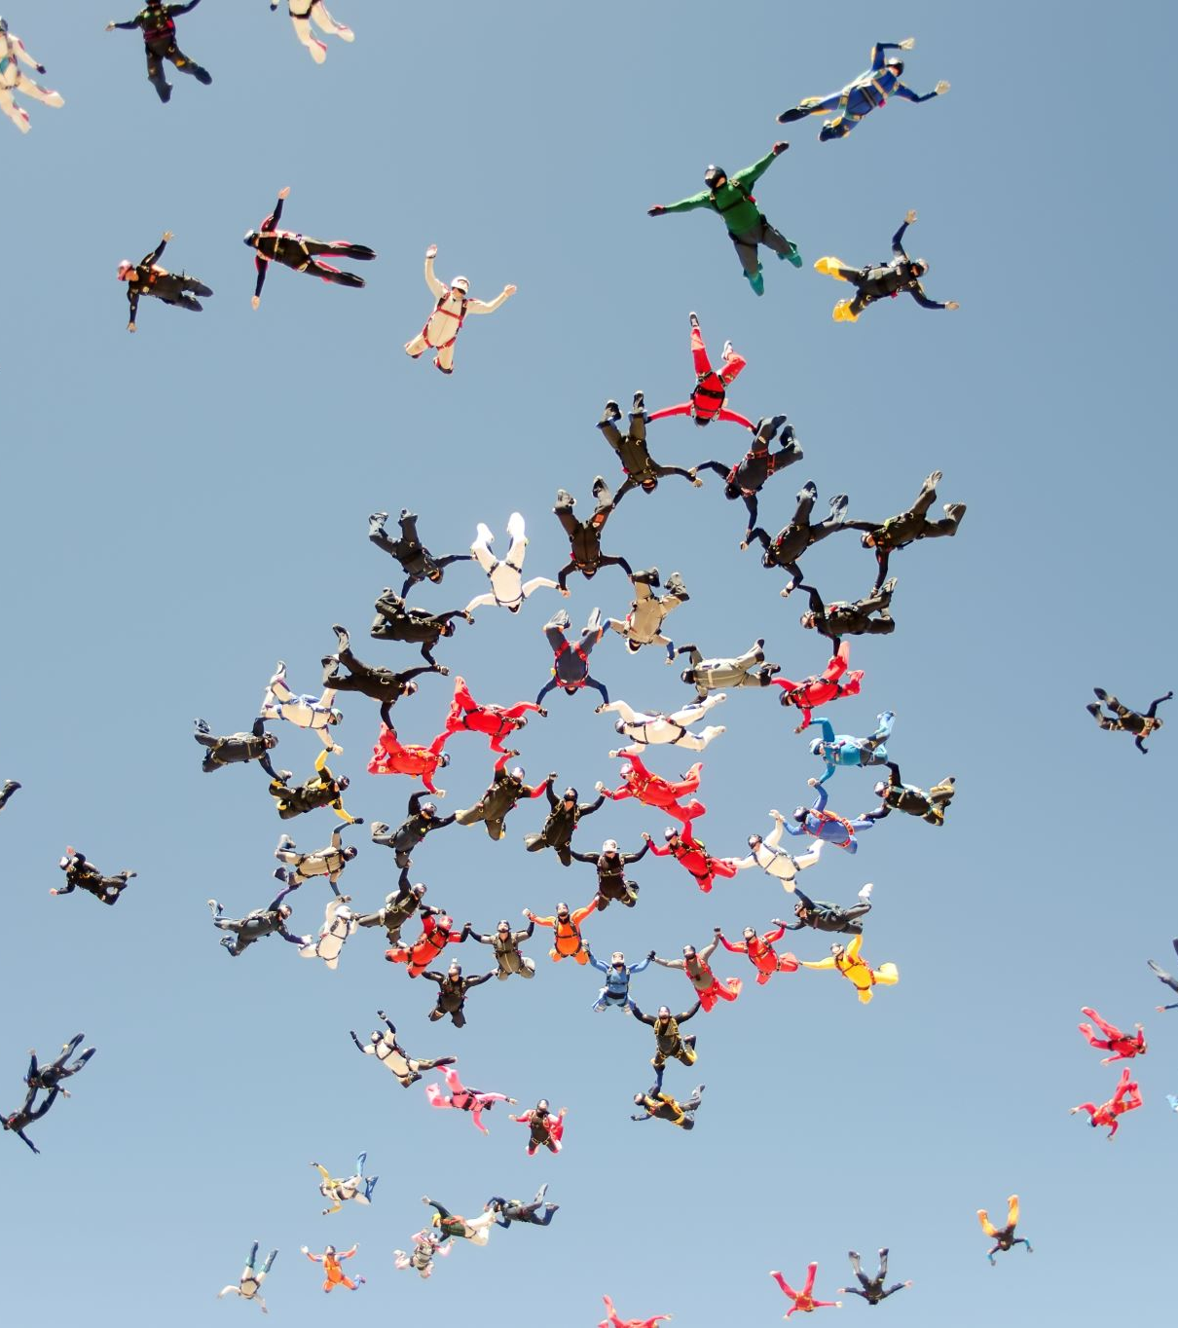
How do you prepare your students for competitive events?

Slide 9
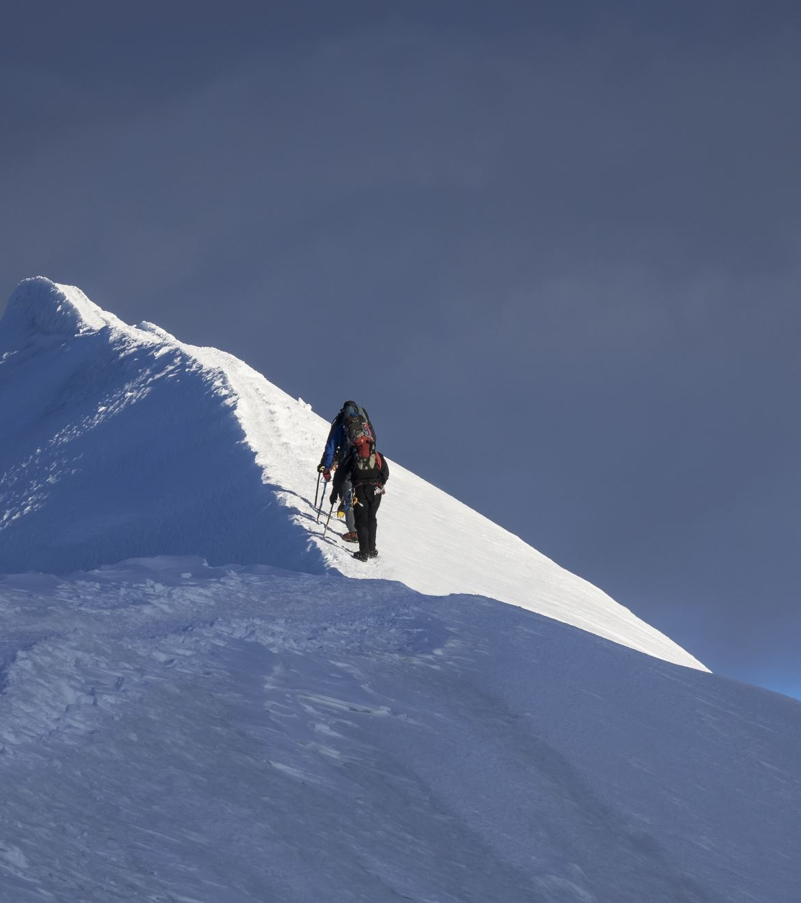
What is the most challenging aspect of Spring Leadership Conference for you as the advisor?

Slide 10
Do you integrate HOSA into your classroom?

Slide 11
How often do you have HOSA Meetings?

Slide 12
Do you have chapter bylaws?

Slide 13
What is your best fundraiser that your chapter has done?

