Slide 1
Building your Health Science program one step at a time
Kristi C. Houchin, RN BSN
Mount Pleasant High School

Slide 2
Introduce your new best friend:
Name
School
Years of Teaching
New or Established program
Courses teaching
Medical Background
What excites you about being in the classroom teaching?

Slide 3
Tea tracts for health science
6 tracts for health science
Pick based off your background
Start with one – two classes your first year
https://tea.texas.gov/

Slide 4
Classroom Management
Must start on first day of school
Be consistent
It’s easier to back off after 6 weeks
Cell Phone Policy
Seating Chart
Know your student’s name
Model Expectations
Questions?????

Slide 5
Principles of Health science
9th or 10th graders
Hold accountable
Start teaching application process to Clinical Classes
Course focuses on:
How Health care functions
Infection Control- Contagion
Careers- Gifted Hands: the Ben Carson Story
Law/Ethics- The Good Nurse
Basic Skills Sets

Slide 6
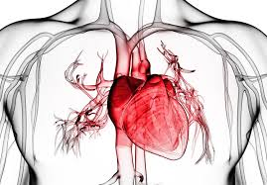
Health Science Theory
Medical Terminology
Body Systems
CPR- must be certified as an instructor to teach own students
Vital Signs
Application for Practicum I
Requirements must be met to be accepted.

Slide 7
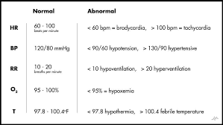
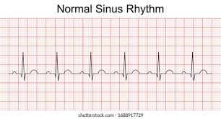
Practicum I
11th and 12th graders
Basic Skills- Bed Making/Vital Signs/Transfer Training
Head to Toe Assessment
More in-depth Body Systems
CET certification through NHA- if pass receive provisional licensure
Apply for Practicum II- must meet requirements

Slide 8
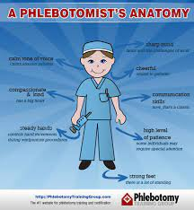
Practicum II
12th only
Must have completed Practicum I
Choose CCMA or PCT/CPT tract
Depending on route determines clinical rotation sites
Dual Credit Medical Terminology (Fall)/ Law and Ethics (Spring)
Recertify in BLS Provider
Certification taken before Graduation through NHA

Slide 9
Student organizations
www.hosa.org
www.texashosa.org
www.skillsusa.org
Great way for students to meet and compete
Work Nights
Overnight Trips
Officers required to compete

Slide 10
Learning Platforms
Kahoot- www.kahoot.com
Remind
Blookit- www.blooket.com
Netflix
YouTube
Hulu

Slide 11
THOA Teacher Conference
www.thoainc.org
New Teacher Only portion
Network with other Teachers

